Slide 1
0
17
Gene Expression: From Gene to Protein
Lecture Presentation by Nicole Tunbridge and
Kathleen Fitzpatrick

Slide 2
The Flow of Genetic Information
The information content of genes is in the specific sequences of nucleotides
The DNA inherited by an organism leads to specific traits by dictating the synthesis of proteins
Proteins are the links between genotype and phenotype
Gene expression, the process by which DNA directs protein synthesis, includes two stages: transcription and translation

Slide 3
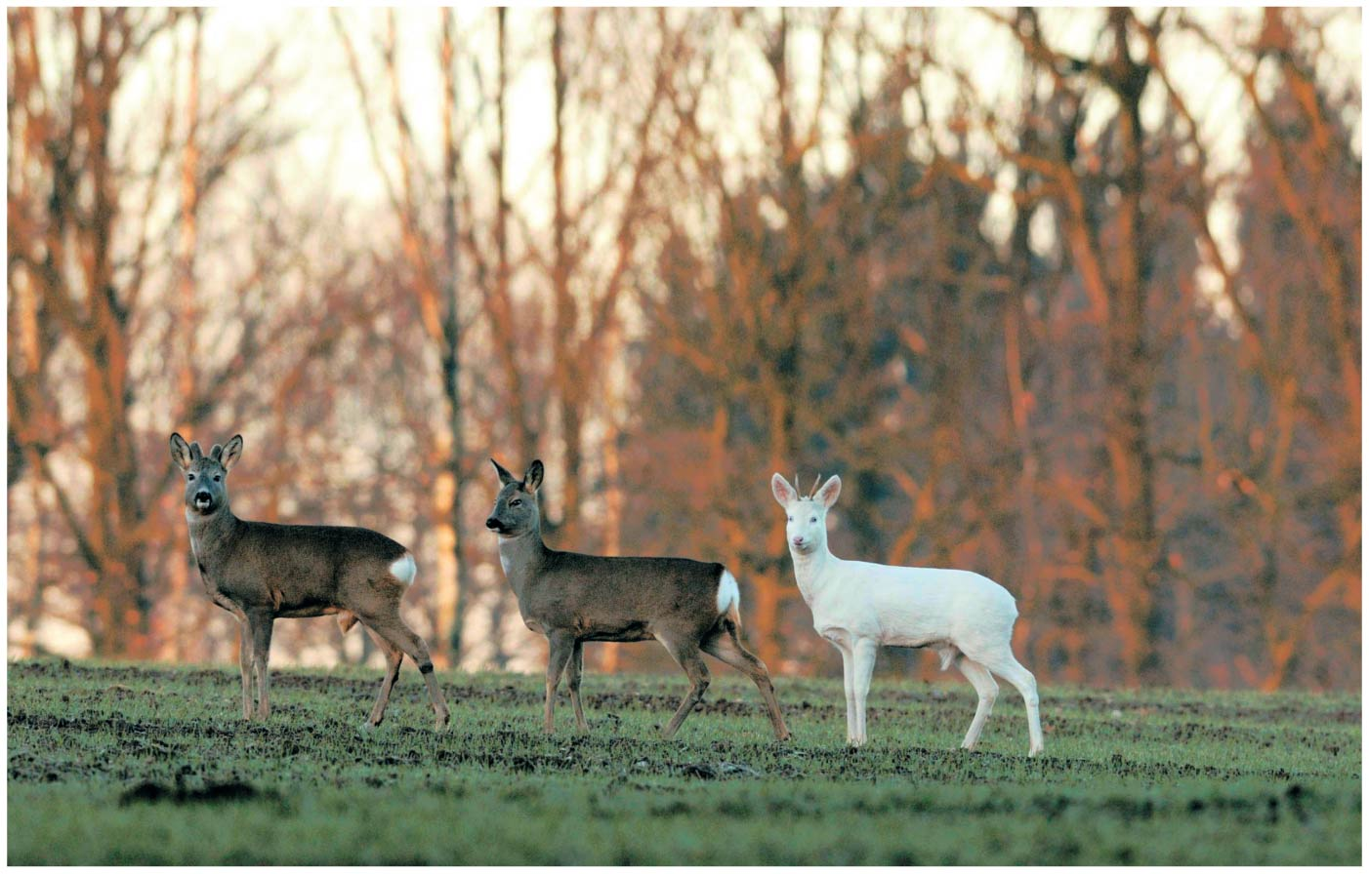
Figure 17.1
Notes:
Figure 17.1 How does a single faulty gene result in the dramatic appearance of an albino deer?

Slide 4
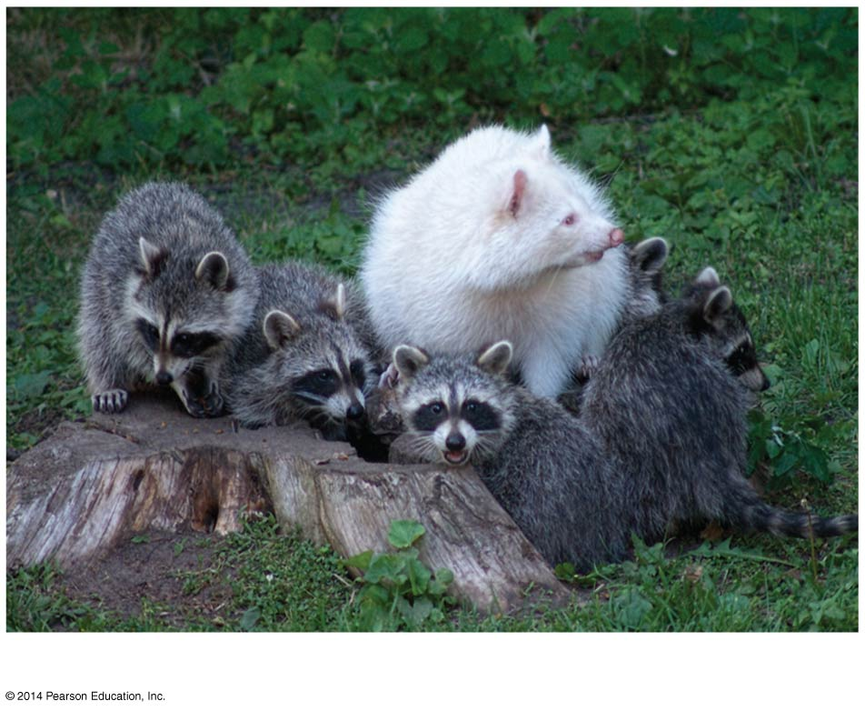
Figure 17.1a
An albino racoon
Notes:
Figure 17.1a How does a single faulty gene result in the dramatic appearance of an albino deer? (part 1: albino raccoon)

Slide 5
The Products of Gene Expression: A Developing Story
Some proteins aren’t enzymes, so researchers later revised the hypothesis: one gene–one protein
Many proteins are composed of several polypeptides, each of which has its own gene
Therefore, Beadle and Tatum’s hypothesis is now restated as the one gene–one polypeptide hypothesis
It is common to refer to gene products as proteins rather than polypeptides

Slide 6
Basic Principles of Transcription and Translation
RNA is the bridge between genes and the proteins for which they code
Transcription is the synthesis of RNA using information in DNA
Transcription produces messenger RNA (mRNA)
Translation is the synthesis of a polypeptide, using information in the mRNA
Ribosomes are the sites of translation

Slide 7
In prokaryotes, translation of mRNA can begin before transcription has finished
In a eukaryotic cell, the nuclear envelope separates transcription from translation
Eukaryotic RNA transcripts are modified through RNA processing to yield the finished mRNA

Slide 8
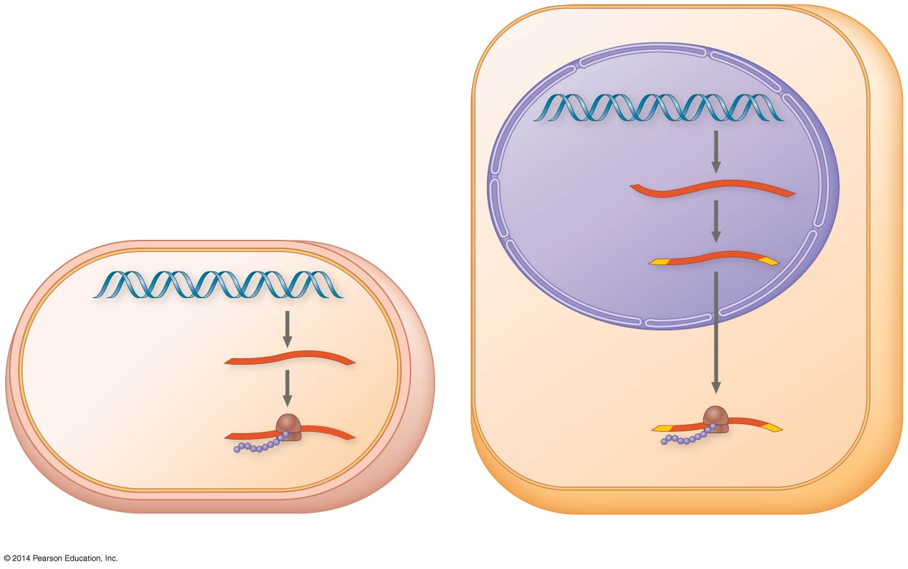
Figure 17.3
Nuclear
envelope
TRANSCRIPTION
DNA
Pre-mRNA
RNA PROCESSING
NUCLEUS
mRNA
TRANSCRIPTION
DNA
CYTOPLASM
CYTOPLASM
mRNA
Ribosome
TRANSLATION
Ribosome
TRANSLATION
Polypeptide
Polypeptide
(a) Bacterial cell
(b) Eukaryotic cell
Notes:
Figure 17.3 Overview: the roles of transcription and translation in the flow of genetic information

Slide 9
A primary transcript is the initial RNA transcript from any gene prior to processing
The central dogma is the concept that cells are governed by a cellular chain of command: DNA → RNA → protein

Slide 10
Figure 17.UN01
DNA
RNA
Protein
Notes:
Figure 17.UN01 In-text figure, central dogma, p. 337

Slide 11
The Genetic Code
How are the instructions for assembling amino acids into proteins encoded into DNA?
There are 20 amino acids, but there are only four nucleotide bases in DNA
How many nucleotides correspond to an amino acid?

Slide 12
Codons: Triplets of Nucleotides
The flow of information from gene to protein is based on a triplet code: a series of nonoverlapping, three-nucleotide words
The words of a gene are transcribed into complementary nonoverlapping three-nucleotide words of mRNA
These words are then translated into a chain of amino acids, forming a polypeptide

Slide 13
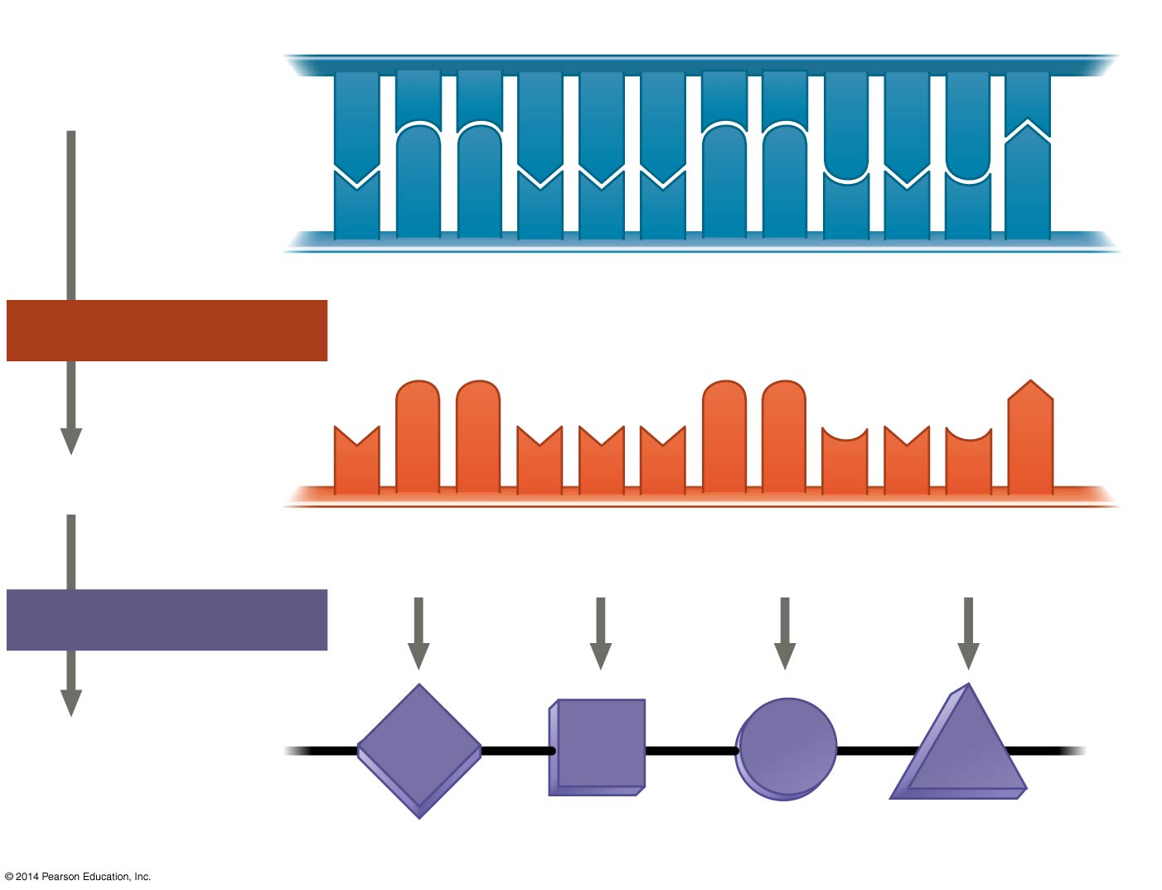
Figure 17.4
DNA
template
strand
3′
5′
A
C
C
A
A
A
C
C
G
A
G
T
T
G
G
T
T
T
G
G
C
T
C
A
5′
3′
TRANSCRIPTION
mRNA
U
G
G
U
U
U
G
G
C
U
C
A
5′
3′
Codon
TRANSLATION
Protein
Trp
Phe
Gly
Ser
Amino acid
Notes:
Figure 17.4 The triplet code

Slide 14
During transcription, one of the two DNA strands, called the template strand, provides a template for ordering the sequence of complementary nucleotides in an RNA transcript
The template strand is always the same strand for a given gene

Slide 15
During translation, the mRNA base triplets, called codons, are read in the 5′ → 3′ direction
Each codon specifies the amino acid (one of 20) to be placed at the corresponding position along a polypeptide

Slide 16
Cracking the Code
All 64 codons were deciphered by the mid-1960s
Of the 64 triplets, 61 code for amino acids; 3 triplets are “stop” signals to end translation
The genetic code is redundant (more than one codon may specify a particular amino acid) but not ambiguous; no codon specifies more than one amino acid
Codons must be read in the correct reading frame (correct groupings) in order for the specified polypeptide to be produced

Slide 17
UUG UUU GGC UCA
THE RED DOG ATE THE BUG
HER EDD OGA TET HEB

Slide 18
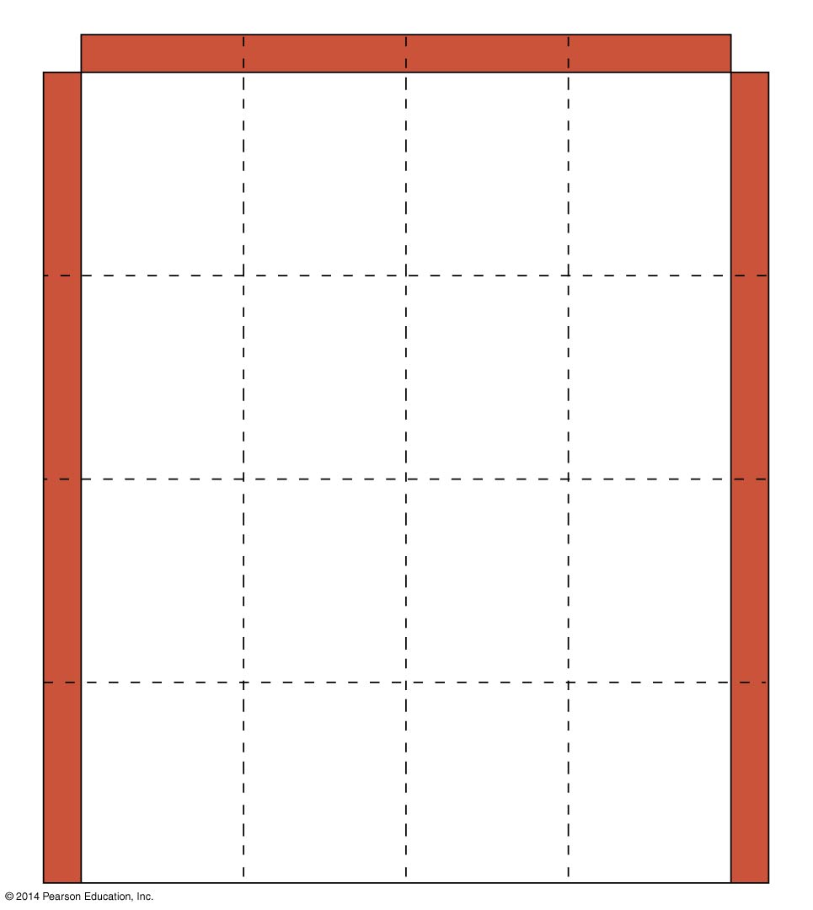
Figure 17.5
Second mRNA base
U
C
A
G
UUU
UCU
UAU
UGU
U
Phe
Tyr
Cys
U
UUC
UCC
UAC
UGC
C
Ser
UUA
UCA
UAA
Stop
UGA
Stop
A
Leu
UUG
UCG
UAG
Stop
UGG
Trp
G
CUU
CCU
CAU
CGU
U
His
C
CUC
CCC
CAC
CGC
C
Leu
Pro
Arg
CUA
CCA
CAA
CGA
A
Gln
CUG
CCG
CAG
CGG
G
First mRNA base (5′ end of codon)
Third mRNA base (3′ end of codon)
AUU
ACU
AAU
AGU
U
Asn
Ser
AUC
Ile
ACC
AAC
AGC
C
A
Thr
AUA
ACA
AAA
AGA
A
Lys
Arg
AUG
Met or
start
ACG
AAG
AGG
G
GUU
GCU
GAU
GGU
U
Asp
G
GUC
GCC
GAC
GGC
C
Val
Ala
Gly
GUA
GCA
GAA
GGA
A
Glu
GUG
GCG
GAG
GGG
G
Notes:
Figure 17.5 The codon table for mRNA

Slide 19
Evolution of the Genetic Code
The genetic code is nearly universal, shared by the simplest bacteria to the most complex animals
Genes can be transcribed and translated after being transplanted from one species to another

Slide 20
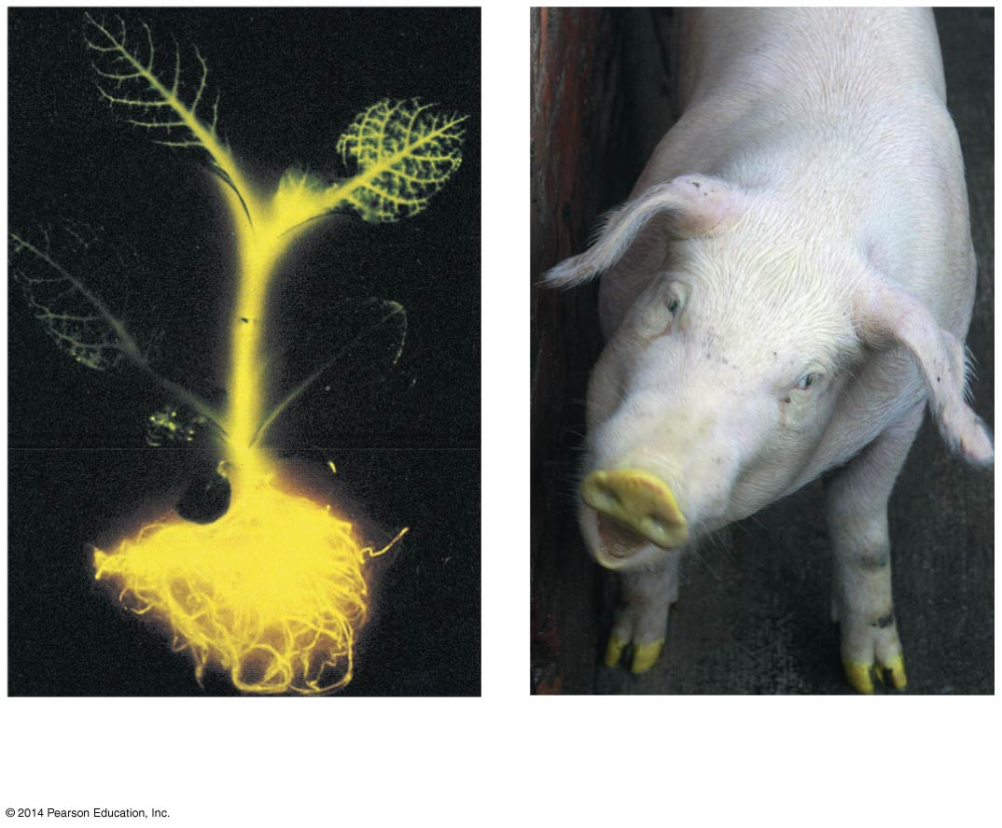
Figure 17.6
(a)
Tobacco plant expressing
a firefly gene
(b)
Pig expressing a jellyfish
gene
Notes:
Figure 17.6 Expression of genes from different species

Slide 21
Concept 17.2: Transcription is the DNA-directed synthesis of RNA: A closer look
Transcription is the first stage of gene expression

Slide 22
Molecular Components of Transcription
RNA synthesis is catalyzed by RNA polymerase, which pries the DNA strands apart and joins together the RNA nucleotides
The RNA is complementary to the DNA template strand
RNA polymerase does not need any primer
RNA synthesis follows the same base-pairing rules as DNA, except that uracil substitutes for thymine

Slide 23
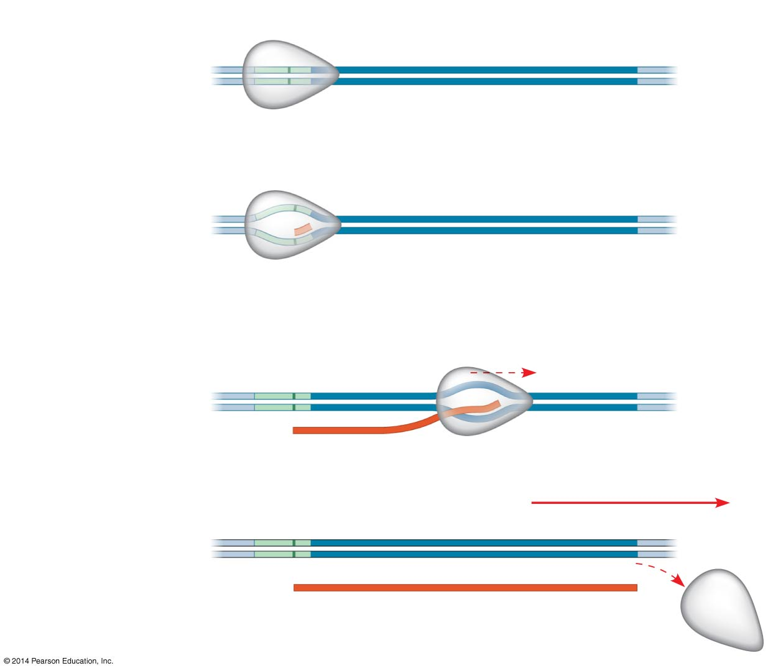
Figure 17.7-3
Promoter
Transcription unit
5′
3′
3′
5′
Start point
RNA polymerase
1
Initiation
5′
3′
3′
5′
Unwound
DNA
RNA
transcript
Template strand of DNA
2
Elongation
Rewound
DNA
5′
3′
3′
3′
5′
5′
Direction of
transcription
(“downstream”)
RNA
transcript
3
Termination
5′
3′
3′
5′
5′
3′
Completed RNA transcript
Notes:
Figure 17.7-3 The stages of transcription: initiation, elongation, and termination (step 3)

Slide 24
Animation: Transcription

Slide 25
The DNA sequence where RNA polymerase attaches is called the promoter; in bacteria, the sequence signaling the end of transcription is called the terminator
The stretch of DNA that is transcribed is called a transcription unit

Slide 26
Synthesis of an RNA Transcript
The three stages of transcription
Initiation
Elongation
Termination

Slide 27
RNA Polymerase Binding and Initiation of Transcription
Promoters signal the transcriptional start point and usually extend several dozen nucleotide pairs upstream of the start point
Transcription factors mediate the binding of RNA polymerase and the initiation of transcription
The completed assembly of transcription factors and RNA polymerase II bound to a promoter is called a transcription initiation complex
A promoter called a TATA box is crucial in forming the initiation complex in eukaryotes

Slide 28
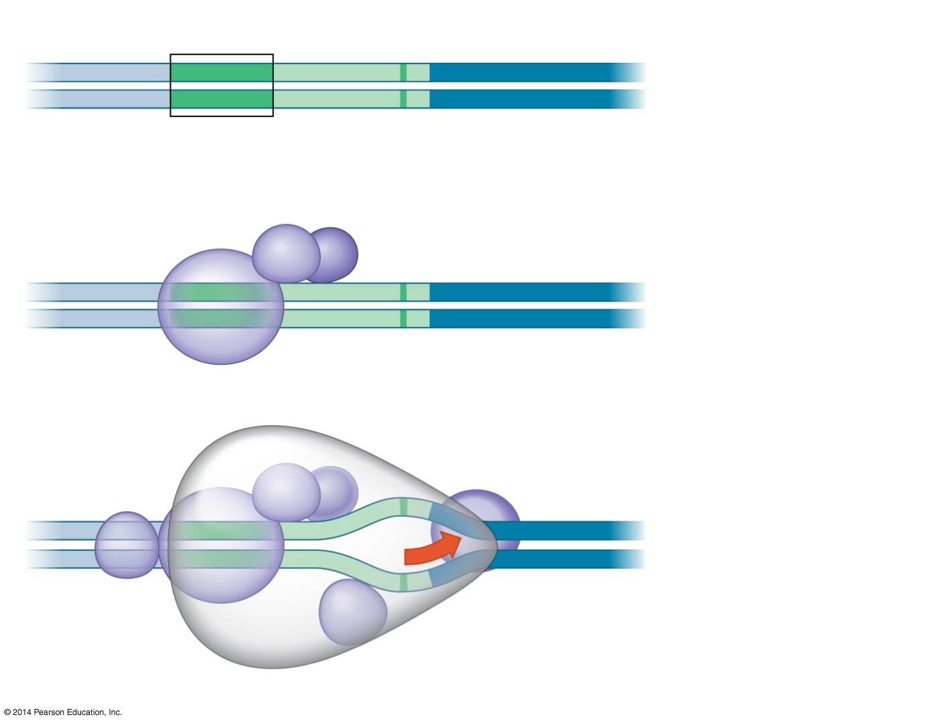
Figure 17.8
Promoter
Nontemplate strand
DNA
5′
T
A
T
A
A
A
A
3′
1
A eukaryotic
promoter
3′
A
T
A
T
T
T
T
5′
TATA box
Start point
Template
strand
Transcription
factors
5′
3′
2
Several
transcription
factors bind
to DNA.
3′
5′
RNA polymerase II
Transcription factors
5′
3′
3′
Transcription
initiation
complex
forms.
3′
5′
5′
3
RNA transcript
Transcription initiation complex
Notes:
Figure 17.8 The initiation of transcription at a eukaryotic promoter

Slide 29
Elongation of the RNA Strand
As RNA polymerase moves along the DNA, it untwists the double helix, 10 to 20 bases at a time
Transcription progresses at a rate of 40 nucleotides per second in eukaryotes
A gene can be transcribed simultaneously by several RNA polymerases
Nucleotides are added to the 3′ end of the growing RNA molecule

Slide 30
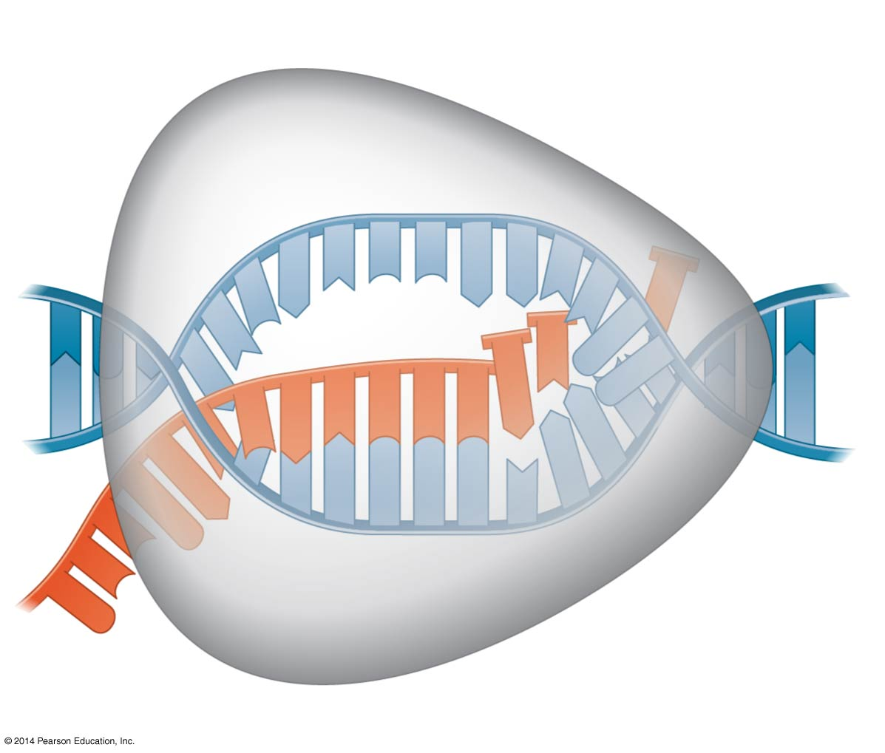
Figure 17.9
Nontemplate
strand of DNA
RNA nucleotides
RNA
polymerase
A
T
C
C
A
A
T
3′
C
T
U
5′
T
3′ end
G
A
U
A
G
A
U
C
C
A
C
C
C
5′
A
3′
T
A
A
G
G
T
T
5′
Direction of transcription
Template
strand of DNA
Newly made
RNA
Notes:
Figure 17.9 Transcription elongation

Slide 31
Termination of Transcription
The mechanisms of termination are different in bacteria and eukaryotes
In bacteria, the polymerase stops transcription at the end of the terminator and the mRNA can be translated without further modification
In eukaryotes, RNA polymerase II transcribes the polyadenylation signal sequence; the RNA transcript is released 10–35 nucleotides past this polyadenylation sequence

Slide 32
Concept 17.3: Eukaryotic cells modify RNA after transcription
Enzymes in the eukaryotic nucleus modify pre-mRNA (RNA processing) before the genetic messages are dispatched to the cytoplasm
During RNA processing, both ends of the primary transcript are usually altered
Also, usually certain interior sections of the molecule are cut out, and the remaining parts spliced together

Slide 33
Alteration of mRNA Ends
Each end of a pre-mRNA molecule is modified in a particular way
The 5′ end receives a modified nucleotide 5′ cap
The 3′ end gets a poly-A tail
These modifications share several functions
They seem to facilitate the export of mRNA to the cytoplasm
They protect mRNA from hydrolytic enzymes
They help ribosomes attach to the 5′ end

Slide 34
Figure 17.10
A modified guanine
nucleotide added to
the 5′ end
50–250 adenine
nucleotides added
to the 3′ end
Region that includes
protein-coding segments
Polyadenylation
signal
5′
3′
G
P
P
P
AAUAAA
AAA
…
AAA
5′ Cap
5′ UTR
Start
codon
Stop
codon
3′ UTR
Poly-A tail
Notes:
Figure 17.10 RNA processing: Addition of the 5' cap and poly-A tail

Slide 35
Split Genes and RNA Splicing
Most eukaryotic genes and their RNA transcripts have long noncoding stretches of nucleotides that lie between coding regions
These noncoding regions are called intervening sequences, or introns
The other regions are called exons because they are eventually expressed, usually translated into amino acid sequences
RNA splicing removes introns and joins exons, creating an mRNA molecule with a continuous coding sequence

Slide 36
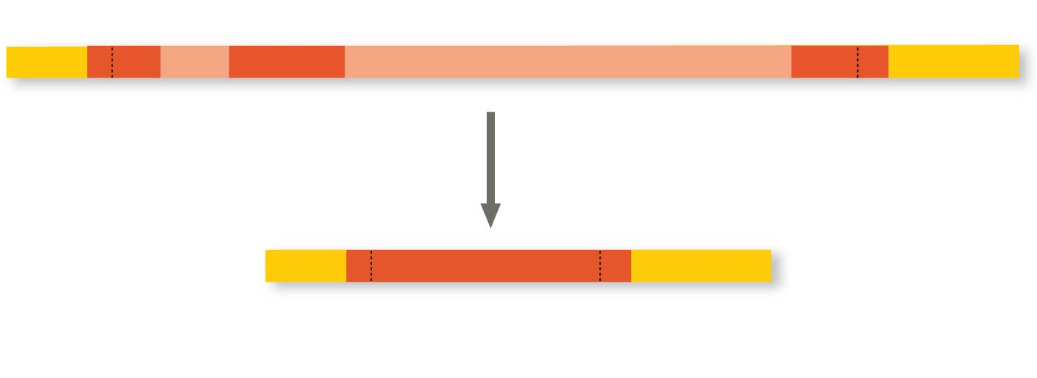
Figure 17.11
Pre-mRNA
Intron
Intron
5′ Cap
Poly-A tail
1–30
31–104
Introns cut out
and exons
spliced together
105–146
mRNA
5′ Cap
Poly-A tail
1–146
5′ UTR
3′ UTR
Coding
segment
Notes:
Figure 17.11 RNA processing: RNA splicing

Slide 37
In some cases, RNA splicing is carried out by spliceosomes
Spliceosomes consist of a variety of proteins and several small nuclear ribonucleoproteins (snRNPs) that recognize the splice sites
The RNAs of the spliceosome also catalyze the splicing reaction

Slide 38
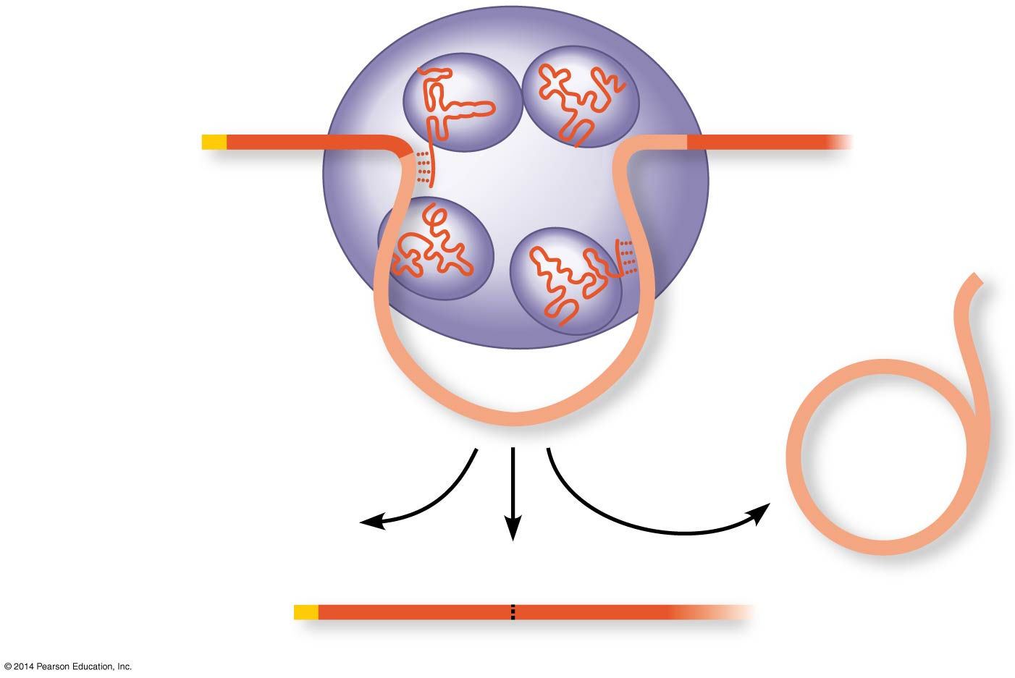
Figure 17.12
Spliceosome
Small RNAs
5′
Pre-mRNA
Exon 1
Exon 2
Intron
Spliceosome
components
mRNA
Cut-out
intron
5′
Exon 1
Exon 2
Notes:
Figure 17.12 A spliceosome splicing a pre-mRNA

Slide 39
Ribozymes
Ribozymes are catalytic RNA molecules that function as enzymes and can splice RNA
The discovery of ribozymes rendered obsolete the belief that all biological catalysts were proteins

Slide 40
Three properties of RNA enable it to function as an enzyme
It can form a three-dimensional structure because of its ability to base-pair with itself
Some bases in RNA contain functional groups that may participate in catalysis
RNA may hydrogen-bond with other nucleic acid molecules

Slide 41
The Functional and Evolutionary Importance of Introns
Some introns contain sequences that may regulate gene expression
Some genes can encode more than one kind of polypeptide, depending on which segments are treated as exons during splicing
This is called alternative RNA splicing
Consequently, the number of different proteins an organism can produce is much greater than its number of genes

Slide 42
Proteins often have a modular architecture consisting of discrete regions called domains
In many cases, different exons code for the different domains in a protein
Exon shuffling may result in the evolution of new proteins

Slide 43
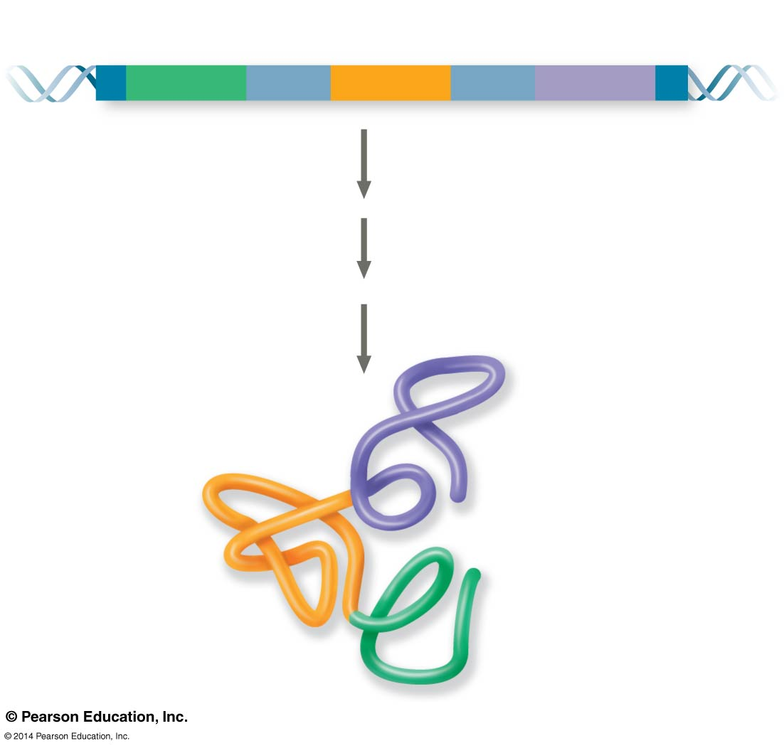
Figure 17.13
Gene
DNA
Exon 1
Intron
Exon 2
Intron
Exon 3
Transcription
RNA processing
Translation
Domain 3
Domain 2
Domain 1
Polypeptide
Notes:
Figure 17.13 Correspondence between exons and protein domains

Slide 44
Concept 17.4: Translation is the RNA-directed synthesis of a polypeptide: A closer look
Genetic information flows from mRNA to protein through the process of translation

Slide 45
Molecular Components of Translation
A cell translates an mRNA message into protein with the help of transfer RNA (tRNA)
tRNAs transfer amino acids to the growing polypeptide in a ribosome
Translation is a complex process in terms of its biochemistry and mechanics

Slide 46
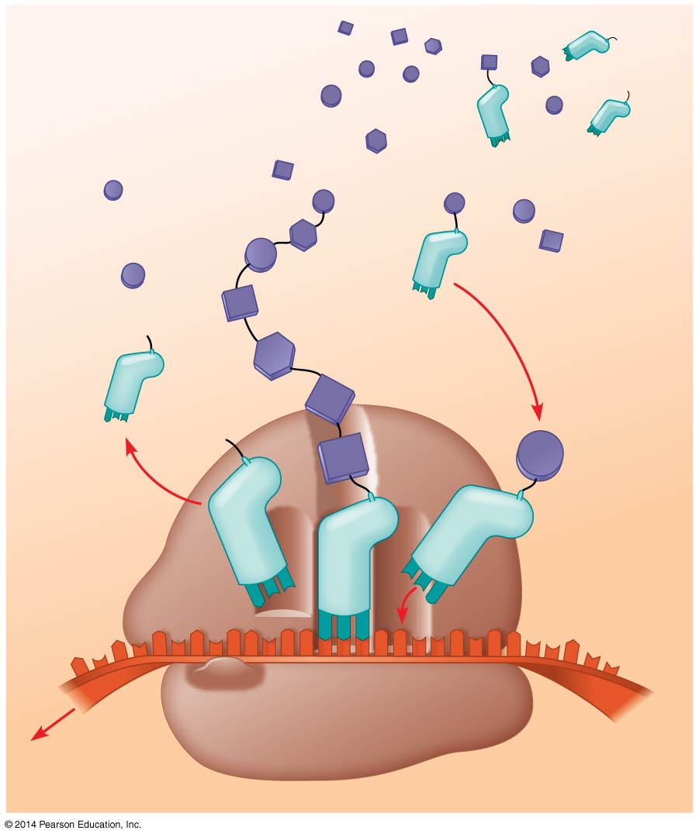
Figure 17.14
Amino
acids
Polypeptide
tRNA with
amino acid
attached
Ribosome
Trp
Phe
Gly
tRNA
C
C
C
Anticodon
A
C
G
A
A
A
U
G
G
U
U
U
G
G
C
5′
Codons
3′
mRNA
Notes:
Figure 17.14 Translation: the basic concept

Slide 47
The Structure and Function of Transfer RNA
Molecules of tRNA are not identical
Each carries a specific amino acid on one end
Each has an anticodon on the other end; the anticodon base-pairs with a complementary codon on mRNA

Slide 48
A tRNA molecule consists of a single RNA strand that is only about 80 nucleotides long
Flattened into one plane to reveal its base pairing, a tRNA molecule looks like a cloverleaf

Slide 49
Because of hydrogen bonds, tRNA actually twists and folds into a three-dimensional molecule
tRNA is roughly L-shaped

Slide 50
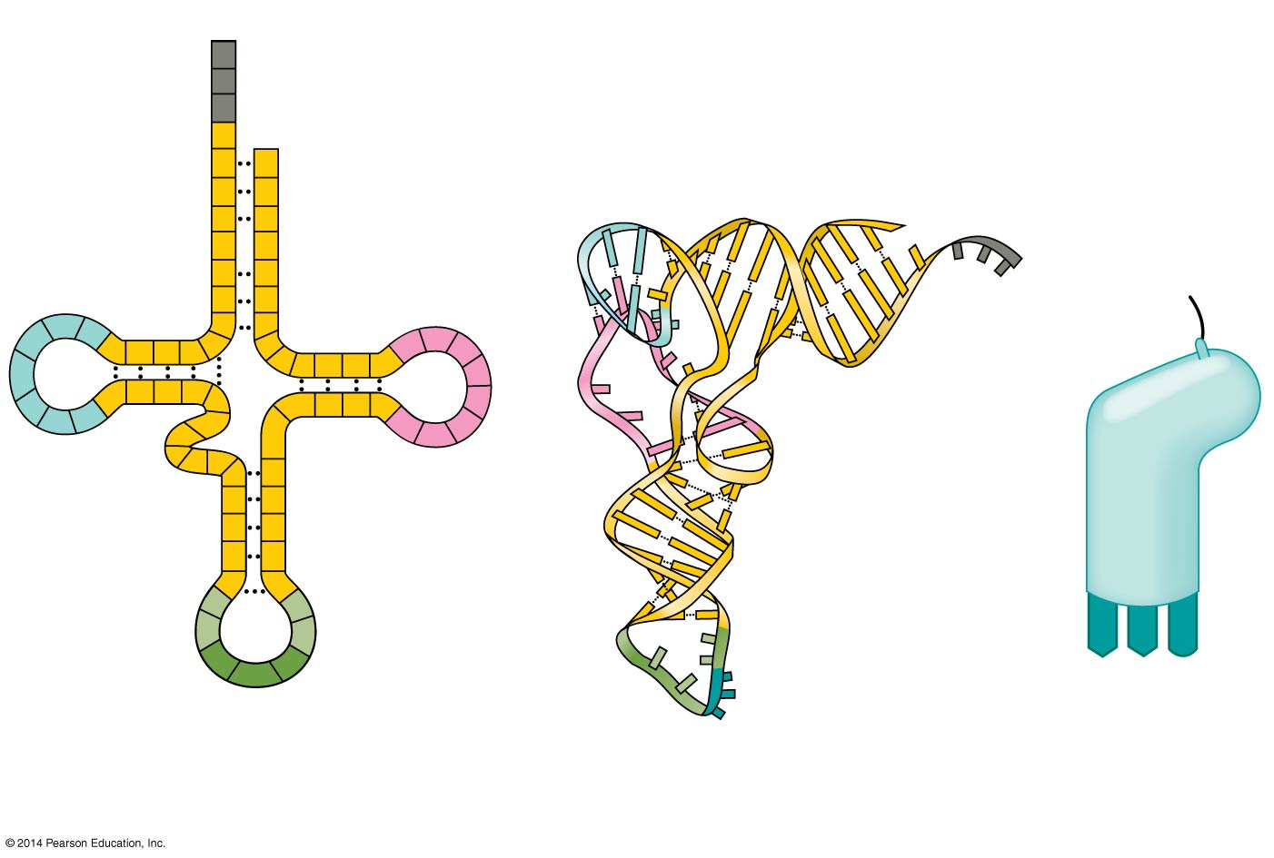
Figure 17.15
3′
Amino acid
attachment
site
A
C
C
5′
A
Amino acid
attachment site
C
G
G
C
C
G
5′
U
G
U
A
3′
A
U
*
U
C
G
A
U
G
C
A
C
A
U
A
C
A
*
G
*
C
U
*
C
G
U
G
U
*
C
G
A
G
G
Hydrogen
bonds
*
*
U
C
*
A
G
G
*
G
A
G
C
G
C
Hydrogen
bonds
U
A
*
G
A
*
A
C
A
A
G
*
U
A
A
G
3′
5′
Anticodon
Anticodon
Anticodon
(a) Two-dimensional structure
(b)
Three-dimensional
structure
(c)
Symbol used
in this book
Notes:
Figure 17.15 The structure of transfer RNA (tRNA)

Slide 51
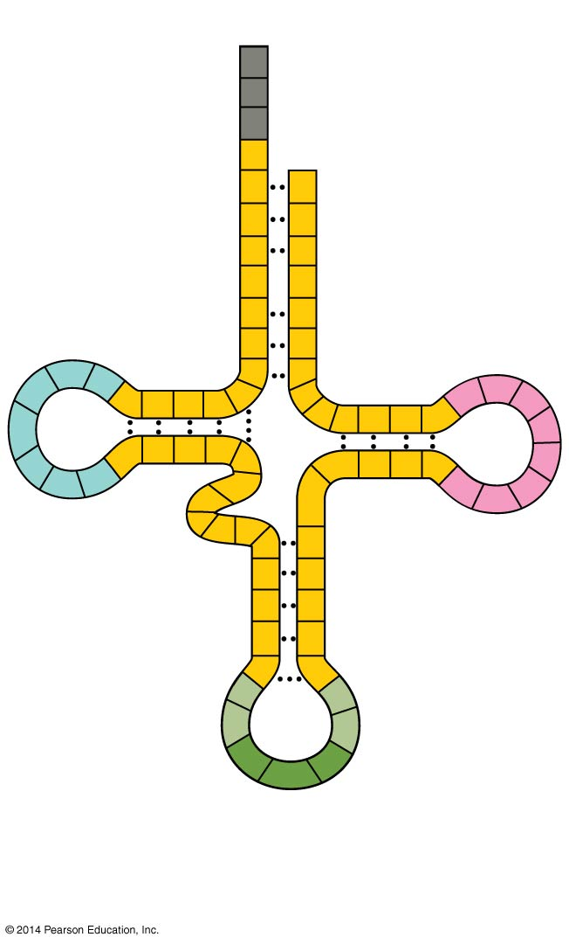
Figure 17.15a
3′
Amino acid
attachment
site
A
C
C
A
5′
C
G
G
C
C
G
U
G
U
A
A
U
*
U
C
A
U
G
C
A
C
A
G
U
A
A
*
G
*
C
U
C
*
C
G
U
G
U
*
C
G
A
G
G
*
*
C
A
G
U
*
G
*
G
A
G
C
Hydrogen
bonds
G
C
U
A
*
G
*
A
A
C
*
U
A
G
A
Anticodon
(a) Two-dimensional structure
Notes:
Figure 17.15a The structure of transfer RNA (tRNA) (part 1: two-dimensional structure)

Slide 52
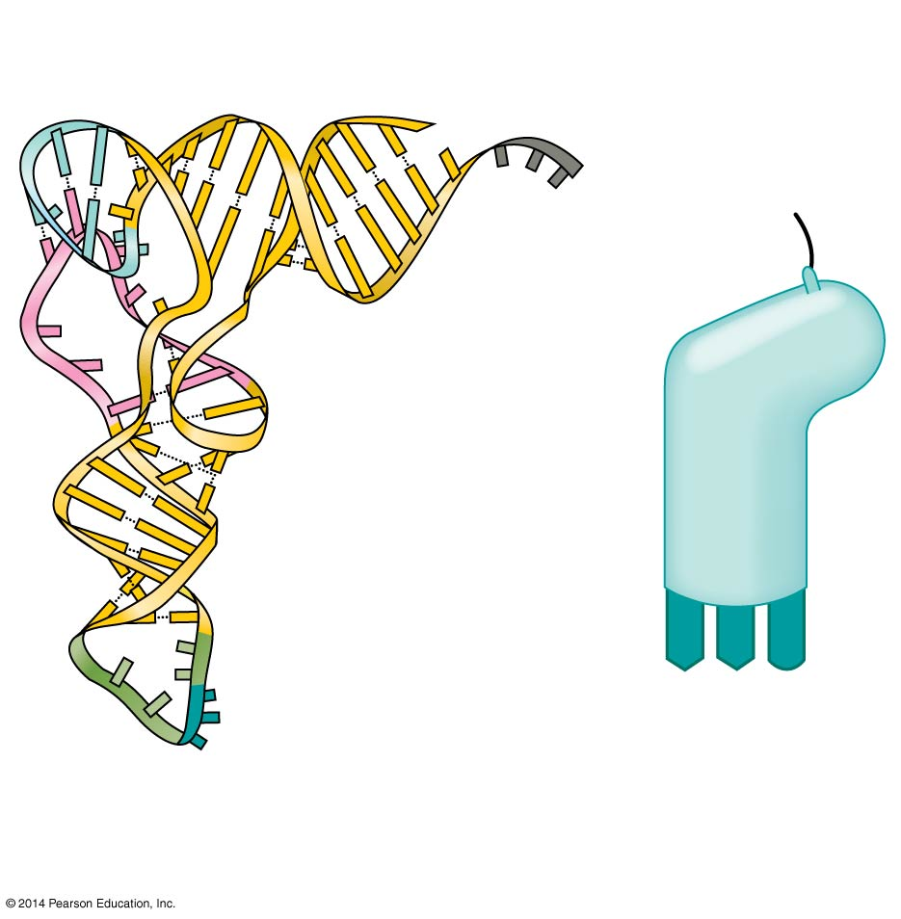
Figure 17.15b
Amino acid
attachment site
5′
3′
Hydrogen
bonds
A
A
G
3′
5′
Anticodon
Anticodon
(b)
Three-dimensional
structure
(c)
Symbol used
in this book
Notes:
Figure 17.15b The structure of transfer RNA (tRNA) (part 2: three-dimensional structure and symbol)

Slide 53
Video: Stick and Ribbon Rendering of a tRNA

Slide 54
Accurate translation requires two steps
First: a correct match between a tRNA and an amino acid, done by the enzyme aminoacyl-tRNA synthetase
Second: a correct match between the tRNA anticodon and an mRNA codon
Flexible pairing at the third base of a codon is called wobble and allows some tRNAs to bind to more than one codon

Slide 55
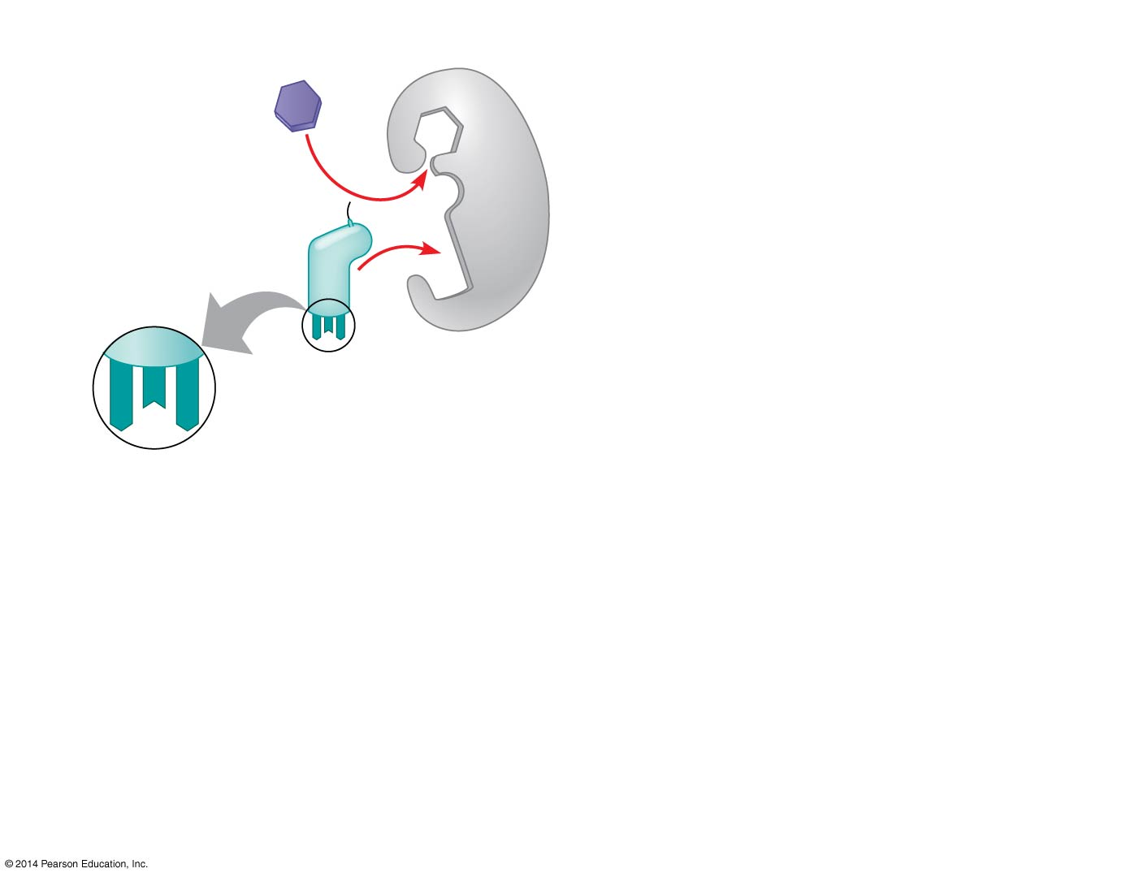
Figure 17.16-1
1
Amino acid
and tRNA
enter active
site.
Tyrosine (Tyr)
(amino acid)
Tyrosyl-tRNA
synthetase
Tyr-tRNA
A
U
A
Complementary
tRNA anticodon
Notes:
Figure 17.16-1 Aminoacyl-tRNA synthetases provide specificity in joining amino acids to their tRNAs (step 1)

Slide 56
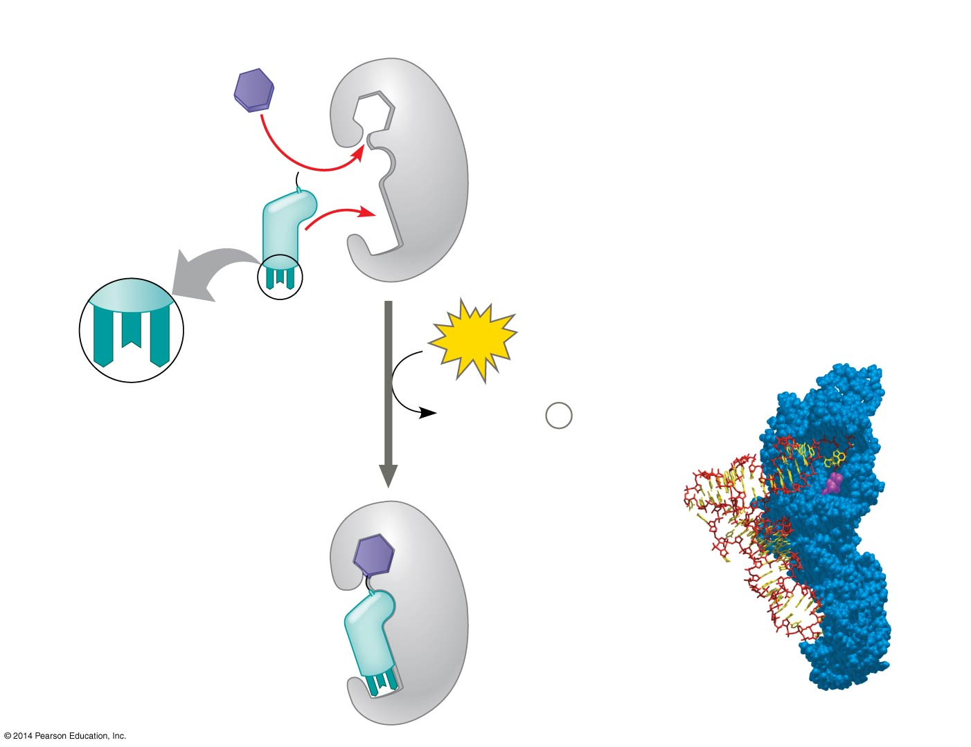
Figure 17.16-2
1
Amino acid
and tRNA
enter active
site.
Tyrosine (Tyr)
(amino acid)
Tyrosyl-tRNA
synthetase
Tyr-tRNA
Aminoacyl-tRNA
synthetase
A
U
A
ATP
Complementary
tRNA anticodon
AMP + 2
P
i
tRNA
2
Using ATP,
synthetase
catalyzes
covalent
bonding.
Amino
acid
Computer model
Notes:
Figure 17.16-2 Aminoacyl-tRNA synthetases provide specificity in joining amino acids to their tRNAs (step 2)

Slide 57
Figure 17.16-3
1
Amino acid
and tRNA
enter active
site.
Tyrosine (Tyr)
(amino acid)
Tyrosyl-tRNA
synthetase
Tyr-tRNA
Aminoacyl-tRNA
synthetase
A
U
A
ATP
Complementary
tRNA anticodon
AMP + 2
P
i
tRNA
3
Aminoacyl
tRNA
released.
2
Using ATP,
synthetase
catalyzes
covalent
bonding.
Amino
acid
Computer model
Notes:
Figure 17.16-3 Aminoacyl-tRNA synthetases provide specificity in joining amino acids to their tRNAs (step 3)

Slide 58
Ribosomes
Ribosomes facilitate specific coupling of tRNA anticodons with mRNA codons in protein synthesis
The two ribosomal subunits (large and small) are made of proteins and ribosomal RNA (rRNA)
Bacterial and eukaryotic ribosomes are somewhat similar but have significant differences: some antibiotic drugs specifically target bacterial ribosomes without harming eukaryotic ribosomes

Slide 59
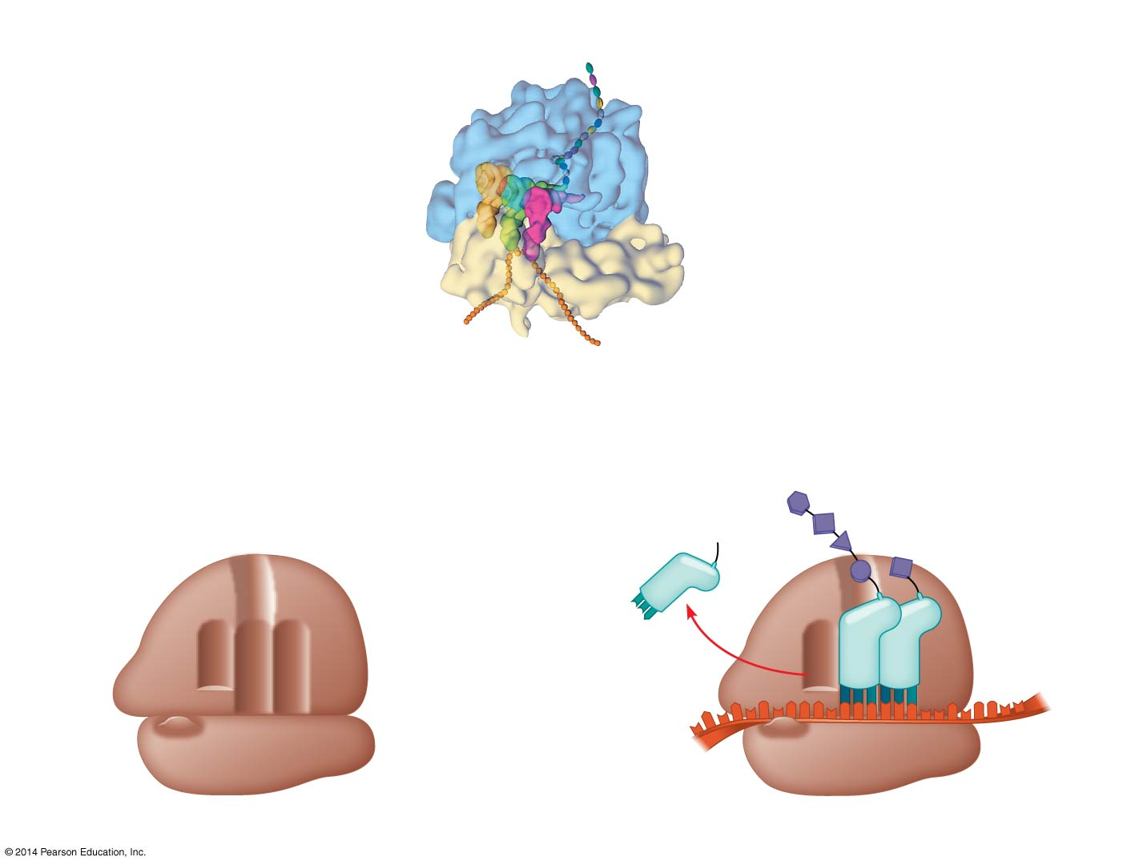
Figure 17.17
Growing
polypeptide
Exit tunnel
tRNA
molecules
Large
subunit
E
P
A
Small
subunit
5′
3′
mRNA
(a) Computer model of functioning ribosome
Growing
polypeptide
P site (Peptidyl-tRNA binding site)
Amino end
Next amino
acid to be
added to
polypeptide
chain
Exit tunnel
A site (Aminoacyl-
tRNA binding site)
E site
(Exit site)
E
P
A
Large
subunit
E
tRNA
mRNA
3′
mRNA
binding site
Small
subunit
5′
Codons
(b) Schematic model showing binding sites
(c) Schematic model with mRNA and tRNA
Notes:
Figure 17.17 The anatomy of a functioning ribosome

Slide 60
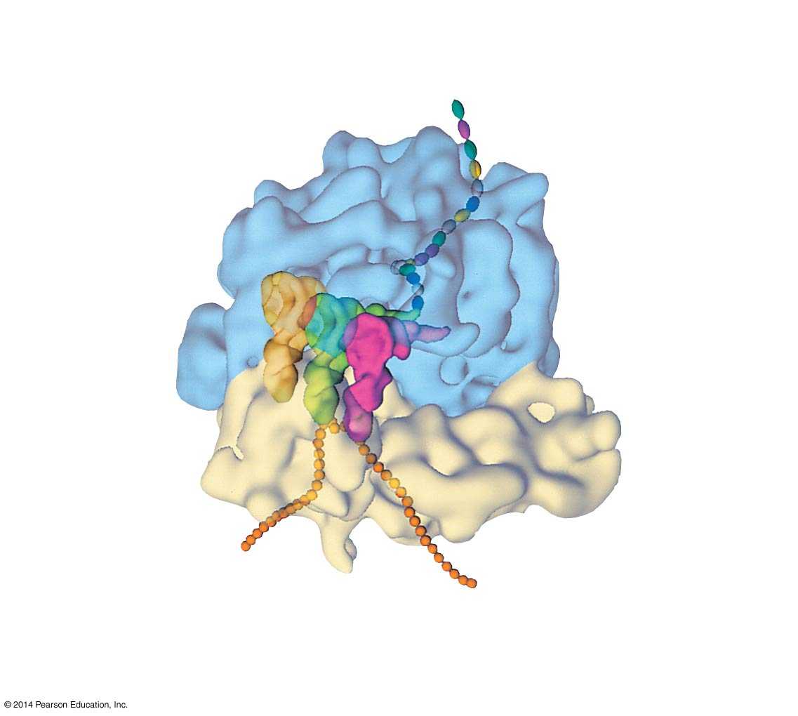
Figure 17.17a
Growing
polypeptide
tRNA
molecules
Exit tunnel
Large
subunit
E
P
A
Small
subunit
5′
mRNA
3′
(a) Computer model of functioning ribosome
Notes:
Figure 17.17a The anatomy of a functioning ribosome (part 1: computer model)

Slide 61
Figure 17.17b
P site (Peptidyl-tRNA binding site)
Exit tunnel
A site (Aminoacyl-
tRNA binding site)
E site
(Exit site)
E
P
A
Large
subunit
mRNA
binding site
Small
subunit
(b) Schematic model showing binding sites
Notes:
Figure 17.17b The anatomy of a functioning ribosome (part 2: binding sites)

Slide 62
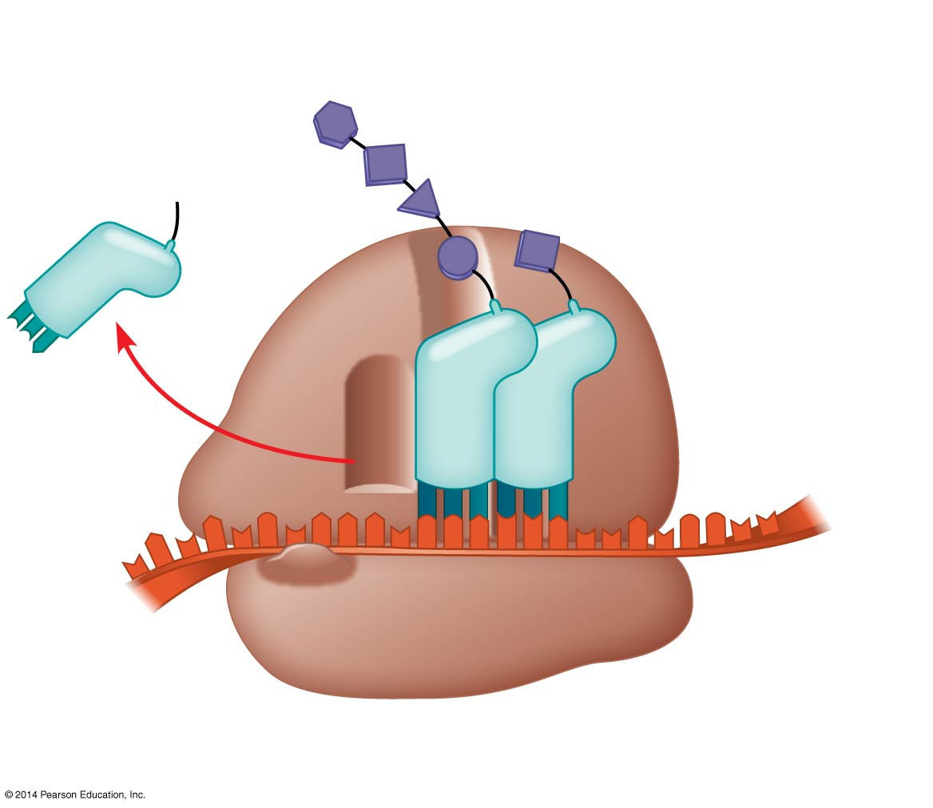
Figure 17.17c
Growing
polypeptide
Amino end
Next amino
acid to be
added to
polypeptide
chain
E
tRNA
mRNA
3′
Codons
5′
(c) Schematic model with mRNA and tRNA
Notes:
Figure 17.17c The anatomy of a functioning ribosome (part 3: mRNA and tRNA)

Slide 63
A ribosome has three binding sites for tRNA
The P site holds the tRNA that carries the growing polypeptide chain
The A site holds the tRNA that carries the next amino acid to be added to the chain
The E site is the exit site, where discharged tRNAs leave the ribosome

Slide 64
Building a Polypeptide
The three stages of translation
Initiation
Elongation
Termination
All three stages require protein “factors” that aid in the translation process
Energy is required for some steps also

Slide 65
Ribosome Association and Initiation of Translation
Initiation brings together mRNA, a tRNA with the first amino acid, and the two ribosomal subunits
First, a small ribosomal subunit binds with mRNA and a special initiator tRNA
Then the small subunit moves along the mRNA until it reaches the start codon (AUG)
Proteins called initiation factors bring in the large subunit that completes the translation initiation complex

Slide 66
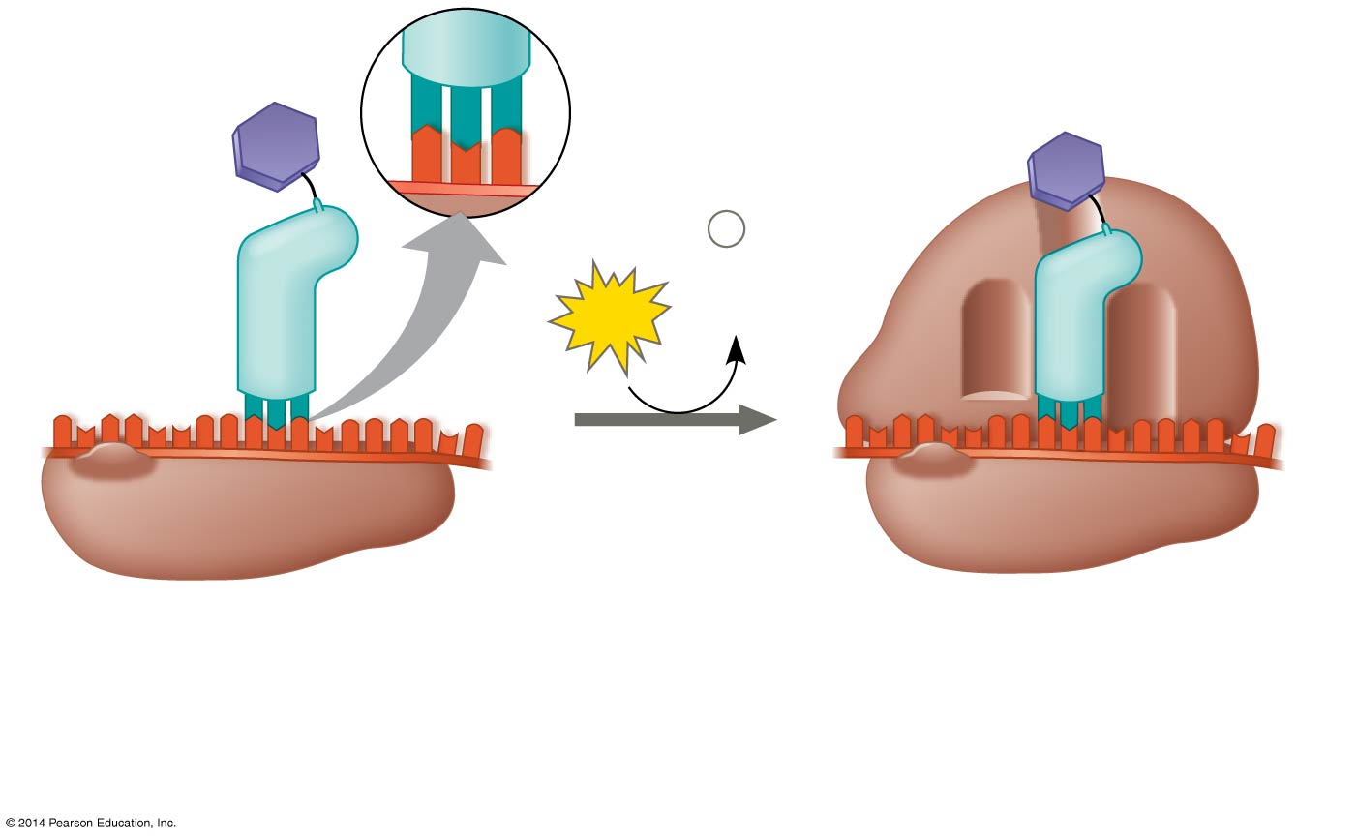
Figure 17.18
Large
ribosomal
subunit
3′
U
A
C
5′
P site
Met
5′
A
U
G
3′
Met
P
i
Initiator
tRNA
+
GTP
GDP
E
A
mRNA
5′
3′
5′
3′
Start codon
Small
ribosomal
subunit
mRNA binding site
Translation initiation complex
1
Small ribosomal subunit binds to mRNA.
2
Large ribosomal subunit
completes the initiation
complex.
Notes:
Figure 17.18 The initiation of translation

Slide 67
Elongation of the Polypeptide Chain
During elongation, amino acids are added one by one to the C-terminus of the growing chain
Each addition involves proteins called elongation factors and occurs in three steps: codon recognition, peptide bond formation, and translocation
Energy expenditure occurs in the first and third steps
Translation proceeds along the mRNA in a 5′ → 3′ direction

Slide 68
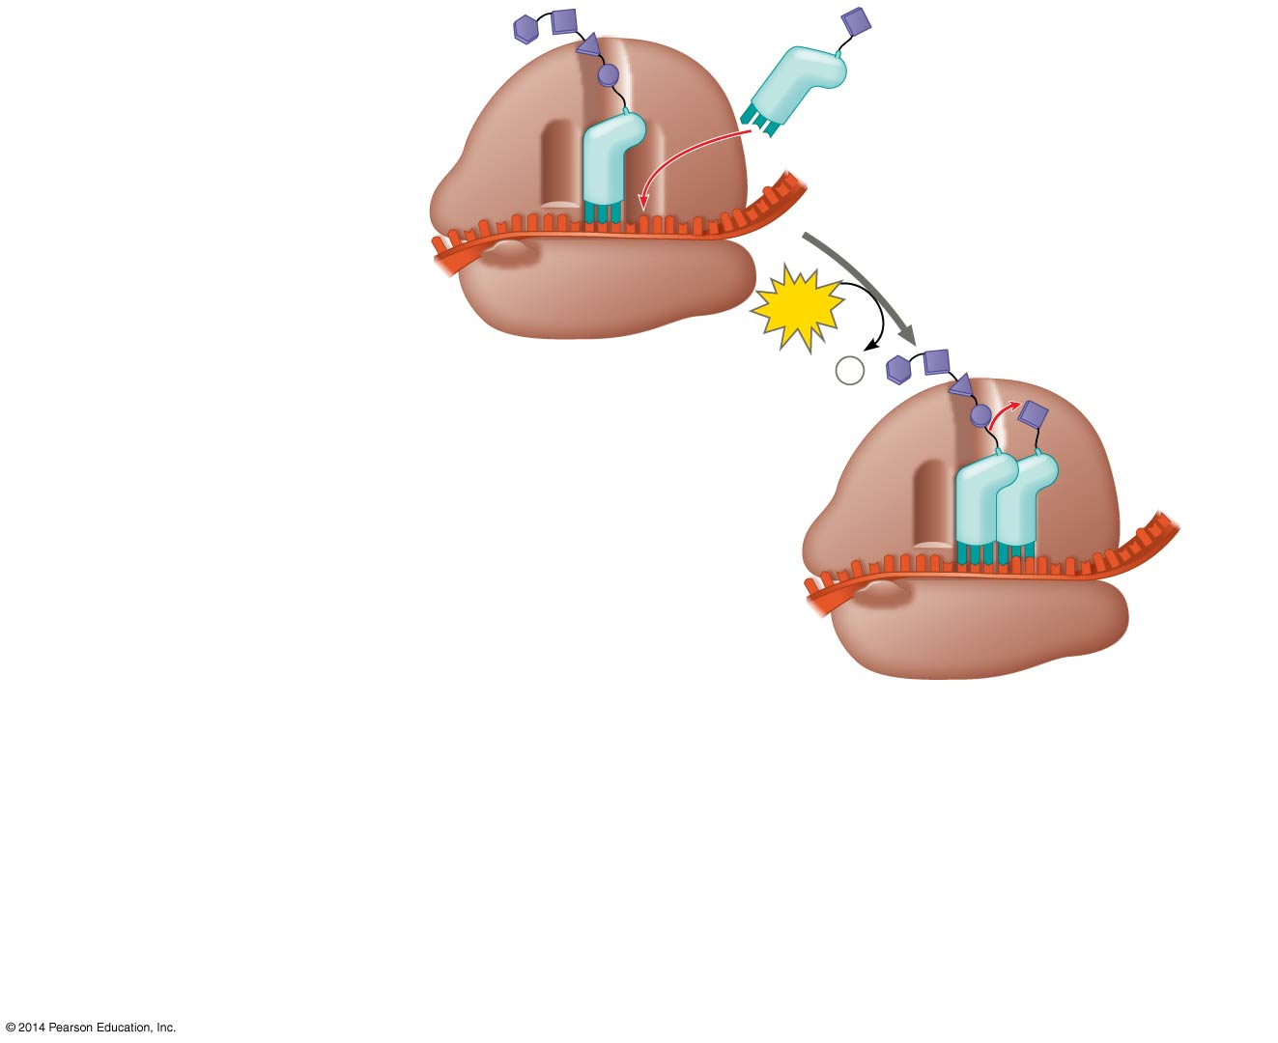
Figure 17.19-1
Amino end
of polypeptide
1
Codon
recognition
E
3′
mRNA
P
A
5′
site
site
GTP
GDP +
P
i
E
P
A
Notes:
Figure 17.19-1 The elongation cycle of translation (step 1)

Slide 69
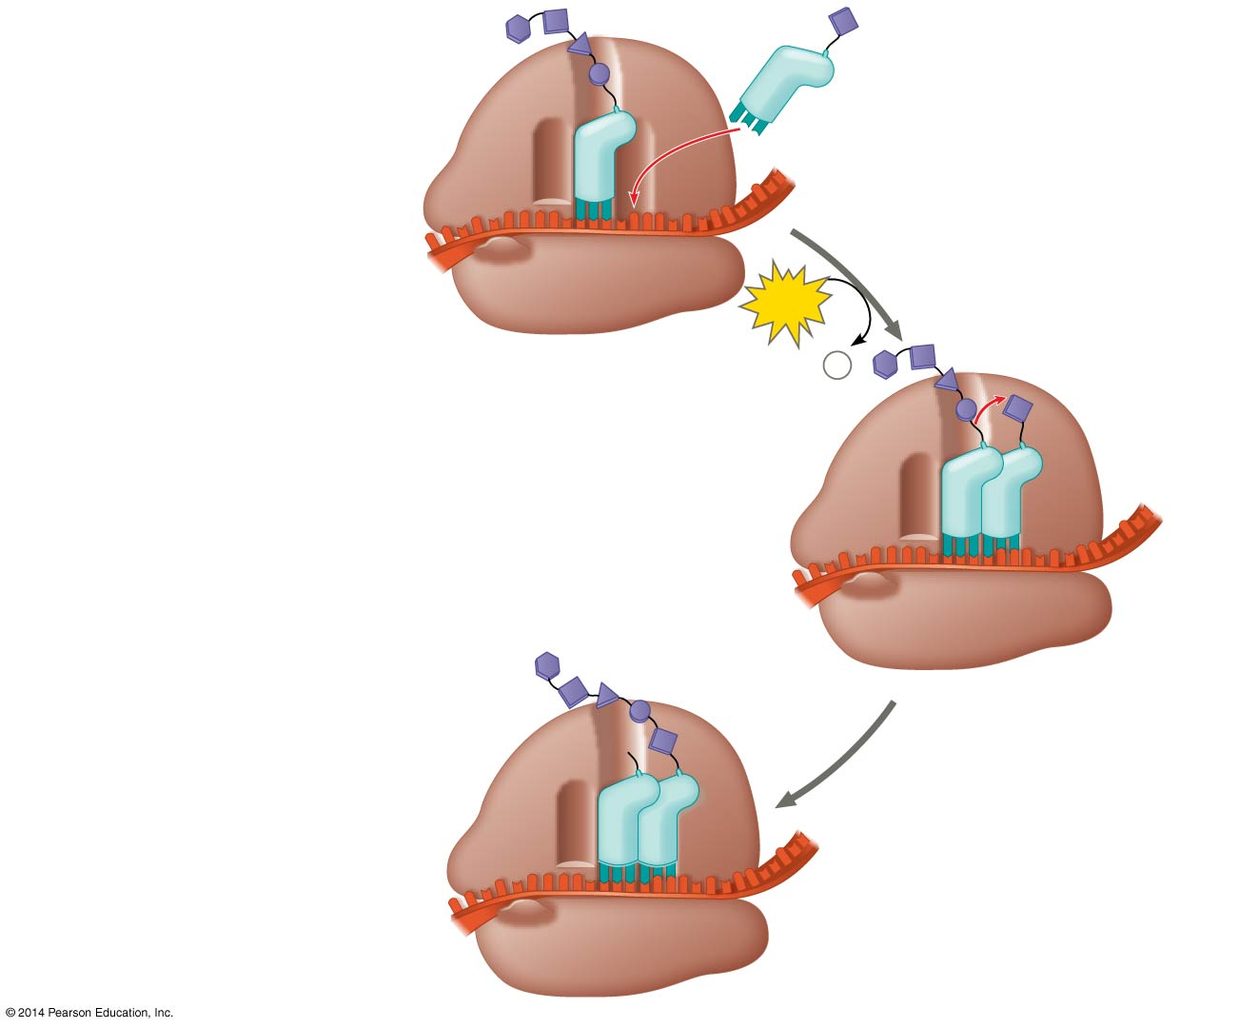
Figure 17.19-2
Amino end
of polypeptide
1
Codon
recognition
E
3′
mRNA
P
A
5′
site
site
GTP
GDP +
P
i
E
P
A
2
Peptide bond
formation
E
P
A
Notes:
Figure 17.19-2 The elongation cycle of translation (step 2)

Slide 70
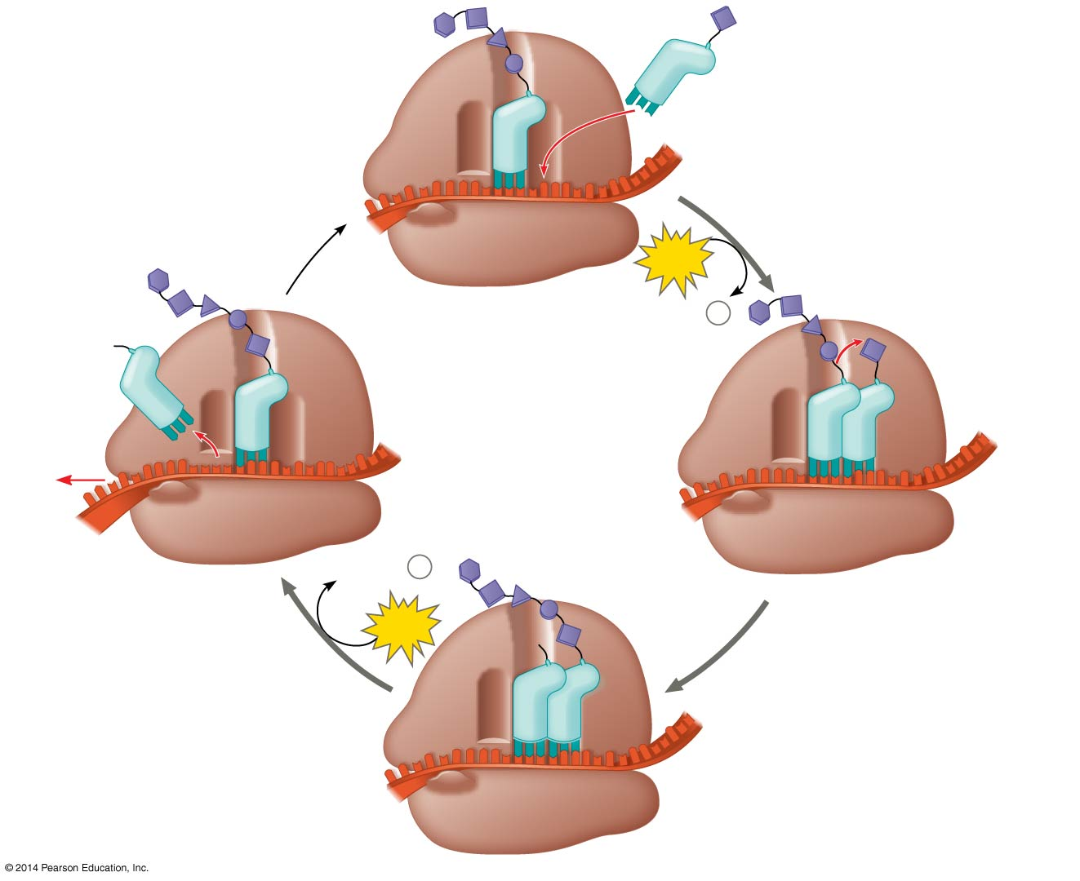
Figure 17.19-3
Amino end
of polypeptide
1
Codon
recognition
E
3′
mRNA
Ribosome ready for
next aminoacyl tRNA
P
A
5′
site
site
GTP
GDP +
P
i
E
E
P
A
P
A
GDP +
P
i
3
Translocation
2
Peptide bond
formation
GTP
E
P
A
Notes:
Figure 17.19-3 The elongation cycle of translation (step 3)

Slide 71
Termination of Translation
Termination occurs when a stop codon in the mRNA reaches the A site of the ribosome
The A site accepts a protein called a release factor
The release factor causes the addition of a water molecule instead of an amino acid
This reaction releases the polypeptide, and the translation assembly comes apart

Slide 72
Figure 17.20-1
Release
factor
3′
5′
Stop codon
(UAG, UAA, or UGA)
1
Ribosome reaches a
stop codon on mRNA.
Notes:
Figure 17.20-1 The termination of translation (step 1)

Slide 73
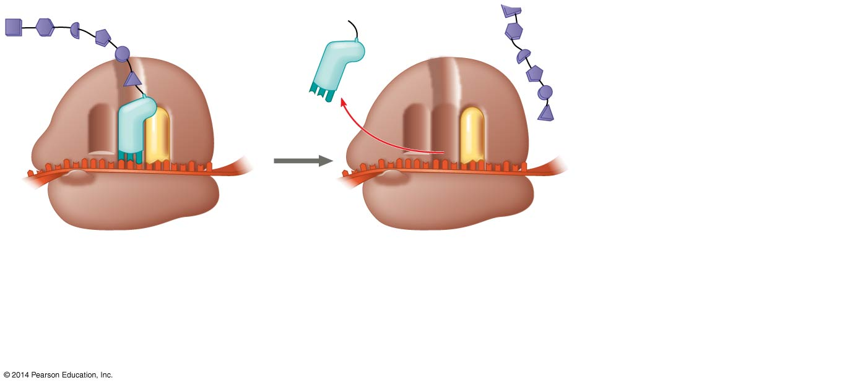
Figure 17.20-2
Release
factor
Free
polypeptide
3′
3′
5′
5′
Stop codon
(UAG, UAA, or UGA)
1
Ribosome reaches a
stop codon on mRNA.
2
Release factor
promotes hydrolysis.
Notes:
Figure 17.20-2 The termination of translation (step 2)

Slide 74
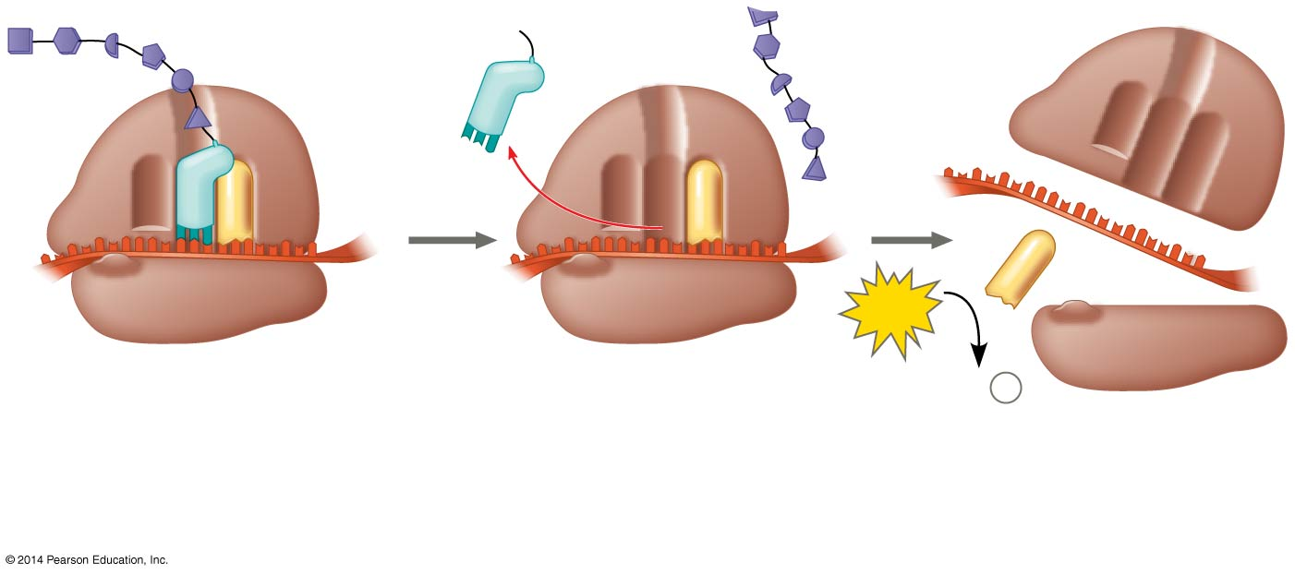
Figure 17.20-3
Release
factor
Free
polypeptide
5′
3′
3′
5′
5′
3′
2
GTP
Stop codon
(UAG, UAA, or UGA)
2 GDP
+
2
P
i
1
Ribosome reaches a
stop codon on mRNA.
2
Release factor
promotes hydrolysis.
3
Ribosomal subunits
and other components
dissociate.
Notes:
Figure 17.20-3 The termination of translation (step 3)

Slide 75
Completing and Targeting the Functional Protein
Often translation is not sufficient to make a functional protein
Polypeptide chains are modified after translation or targeted to specific sites in the cell

Slide 76
Protein Folding and Post-Translational Modifications
During its synthesis, a polypeptide chain begins to coil and fold spontaneously to form a protein with a specific shape—a three-dimensional molecule with secondary and tertiary structure
A gene determines primary structure, and primary structure in turn determines shape
Post-translational modifications may be required before the protein can begin doing its particular job in the cell

Slide 77
Targeting Polypeptides to Specific Locations
Two populations of ribosomes are evident in cells: free ribosomes (in the cytosol) and bound ribosomes (attached to the ER)
Free ribosomes mostly synthesize proteins that function in the cytosol
Bound ribosomes make proteins of the endomembrane system and proteins that are secreted from the cell
Ribosomes are identical and can switch from free to bound

Slide 78
Polypeptide synthesis always begins in the cytosol
Synthesis finishes in the cytosol unless the polypeptide signals the ribosome to attach to the ER
Polypeptides destined for the ER or for secretion are marked by a signal peptide

Slide 79
A signal-recognition particle (SRP) binds to the signal peptide
The SRP brings the signal peptide and its ribosome to the ER

Slide 80
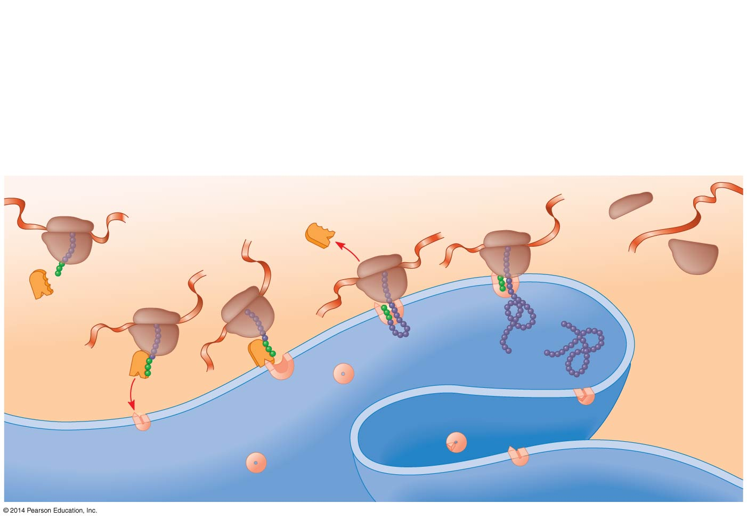
Figure 17.21
1
2
3
4
5
6
Polypeptide
synthesis
begins.
SRP
binds to
signal
peptide.
SRP
binds to
receptor
protein.
SRP
detaches
and
polypeptide
synthesis
resumes.
Signal-
cleaving
enzyme cuts
off signal
peptide.
Completed
polypeptide
folds into
final
conformation.
Ribosome
mRNA
Signal
peptide
ER
membrane
Signal
peptide
removed
SRP
Protein
CYTOSOL
SRP receptor
protein
ER LUMEN
Translocation complex
Notes:
Figure 17.21 The signal mechanism for targeting proteins to the ER

Slide 81
Making Multiple Polypeptides in Bacteria and Eukaryotes
Multiple ribosomes can translate a single mRNA simultaneously, forming a polyribosome (or polysome)
Polyribosomes enable a cell to make many copies of a polypeptide very quickly

Slide 82
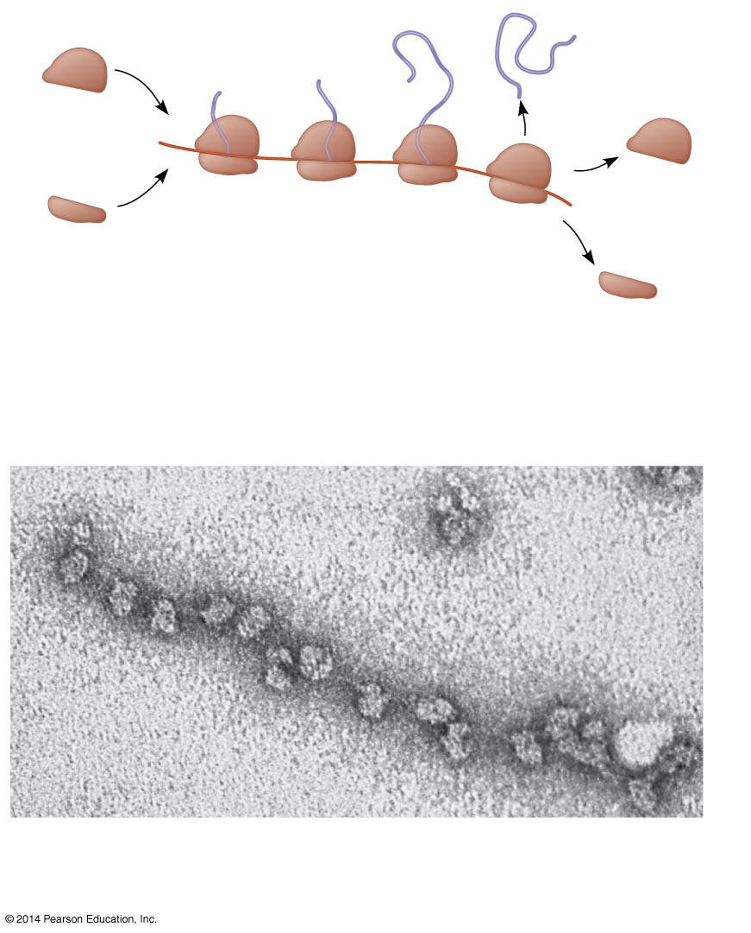
Figure 17.22
Completed
polypeptide
Growing
polypeptides
Incoming
ribosomal
subunits
Polyribosome
Start of
mRNA
(5′ end)
End of
mRNA
(3′ end)
(a)
Several ribosomes simultaneously translating
one mRNA molecule
Ribosomes
mRNA
(b)
A large polyribosome in a bacterial
cell (TEM)
0.1 µm
Notes:
Figure 17.22 Polyribosomes

Slide 83
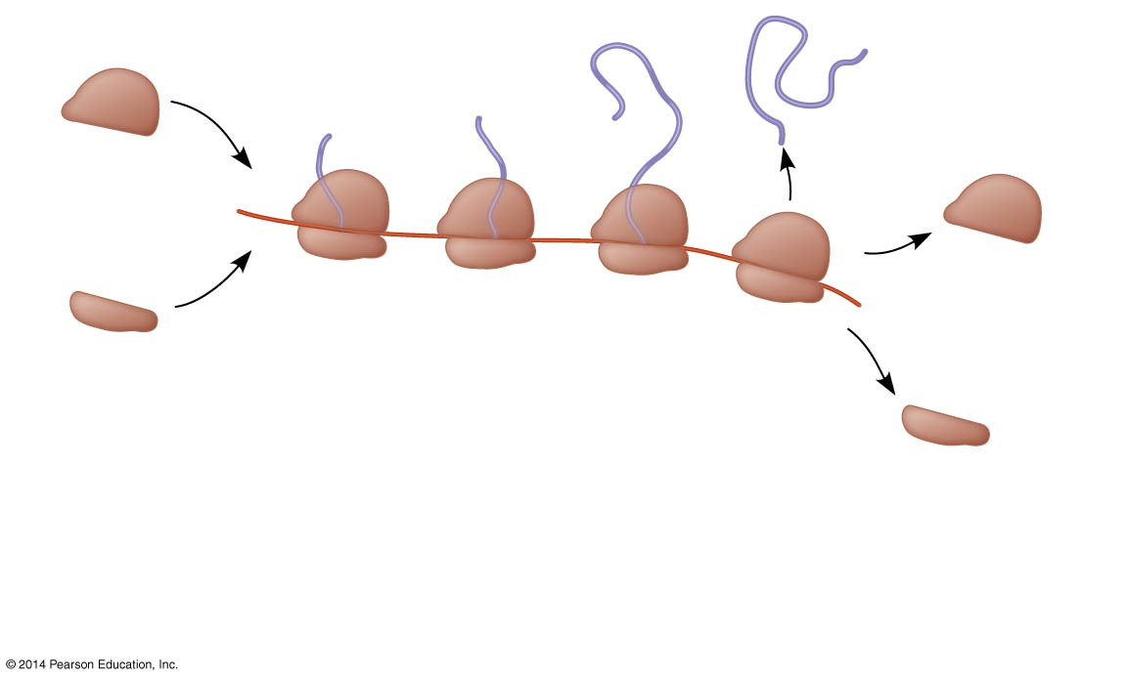
Figure 17.22a
Growing
polypeptides
Completed
polypeptide
Incoming
ribosomal
subunits
Polyribosome
Start of
mRNA
(5′ end)
End of
mRNA
(3′ end)
(a)
Several ribosomes simultaneously translating
one mRNA molecule
Notes:
Figure 17.22a Polyribosomes (part 1: art)

Slide 84
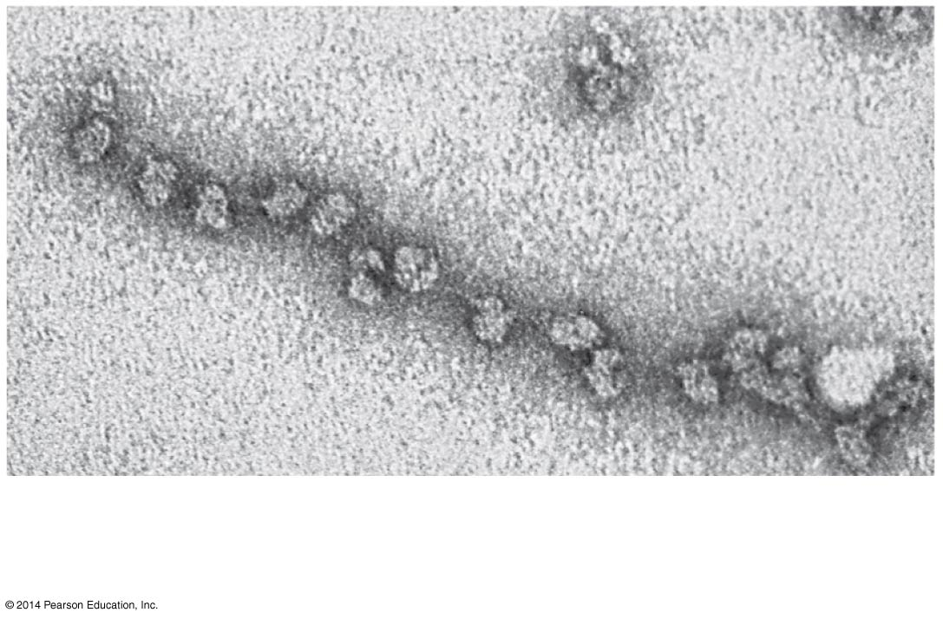
Figure 17.22b
Ribosomes
mRNA
(b)
A large polyribosome in a bacterial
cell (TEM)
0.1 µm
Notes:
Figure 17.22b Polyribosomes (part 2: TEM)

Slide 85
A bacterial cell ensures a streamlined process by coupling transcription and translation
In this case the newly made protein can quickly diffuse to its site of function

Slide 86
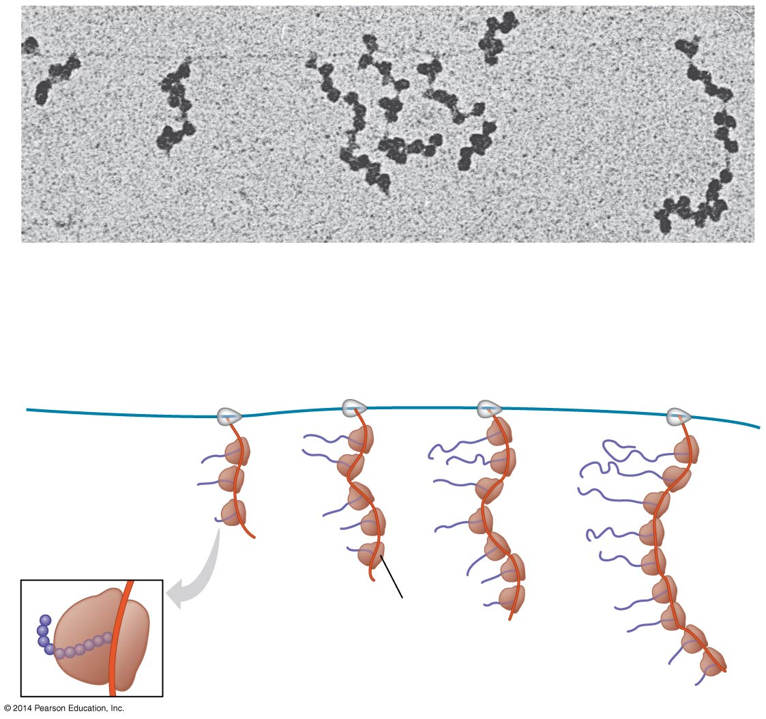
Figure 17.23
RNA polymerase
DNA
mRNA
Polyribosome
Direction of
transcription
0.25 µm
RNA
polymerase
DNA
Polyribosome
Polypeptide
(amino end)
Ribosome
mRNA (5′ end)
Notes:
Figure 17.23 Coupled transcription and translation in bacteria

Slide 87
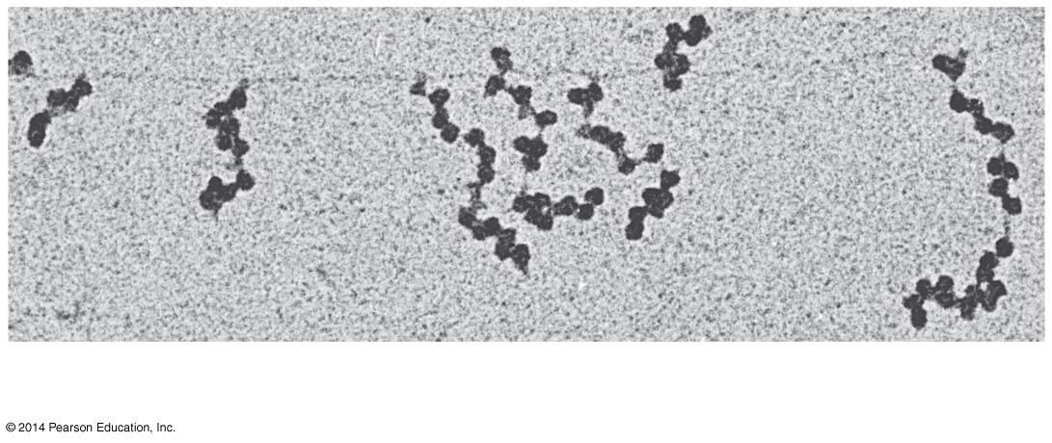
Figure 17.23a
RNA polymerase
DNA
mRNA
Polyribosome
0.25 µm
Notes:
Figure 17.23a Coupled transcription and translation in bacteria (part 1: TEM)

Slide 88
In eukaryotes, the nuclear envelop separates the processes of transcription and translation
RNA undergoes processes before leaving the nucleus

Slide 89
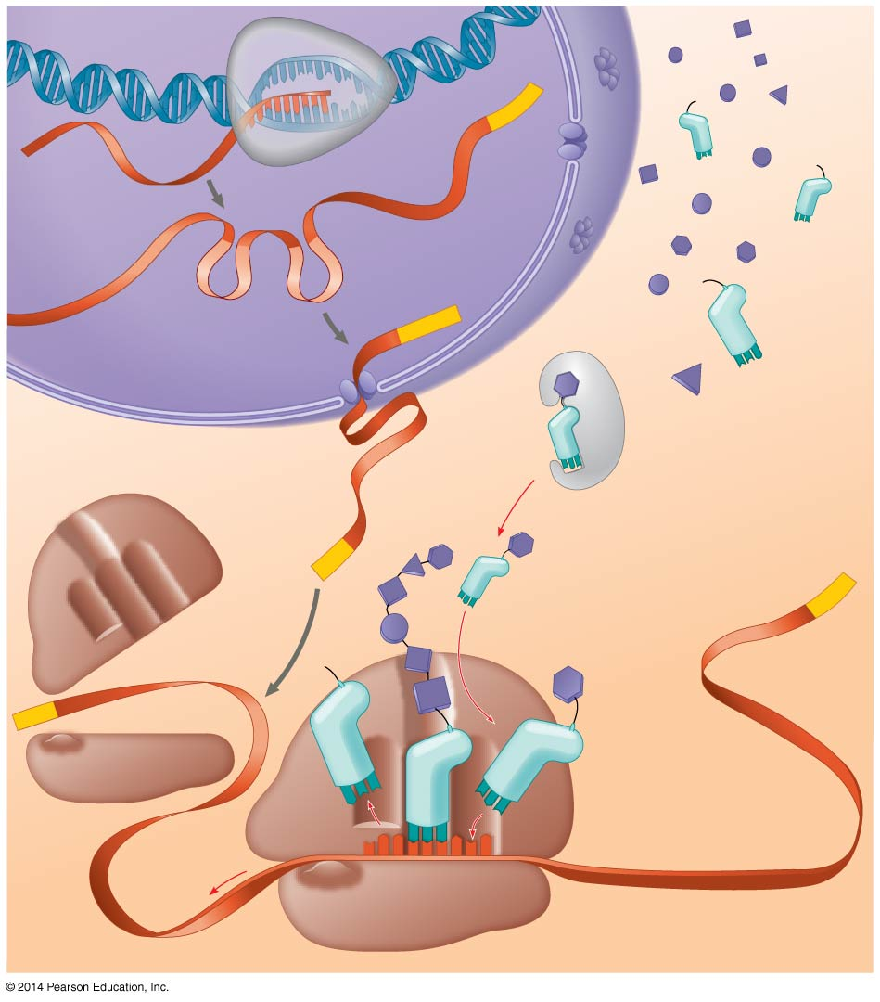
Figure 17.24
DNA
TRANSCRIPTION
3′
Poly-A
5′
RNA
polymerase
RNA
transcript
Exon
RNA PROCESSING
RNA transcript
(pre-mRNA)
Intron
Poly-A
Aminoacyl-tRNA
synthetase
NUCLEUS
Amino
acid
CYTOPLASM
AMINO ACID ACTIVATION
tRNA
mRNA
5′ Cap
3′
P
A
Aminoacyl
(charged)
tRNA
Poly-A
E
Ribosomal
subunits
5′ Cap
C
C
U
TRANSLATION
A
E
A
A
C
A
A
A
A
Anticodon
U
G
G
U
U
U
U
G
Codon
Ribosome
Notes:
Figure 17.24 A summary of transcription and translation in a eukaryotic cell

Slide 90
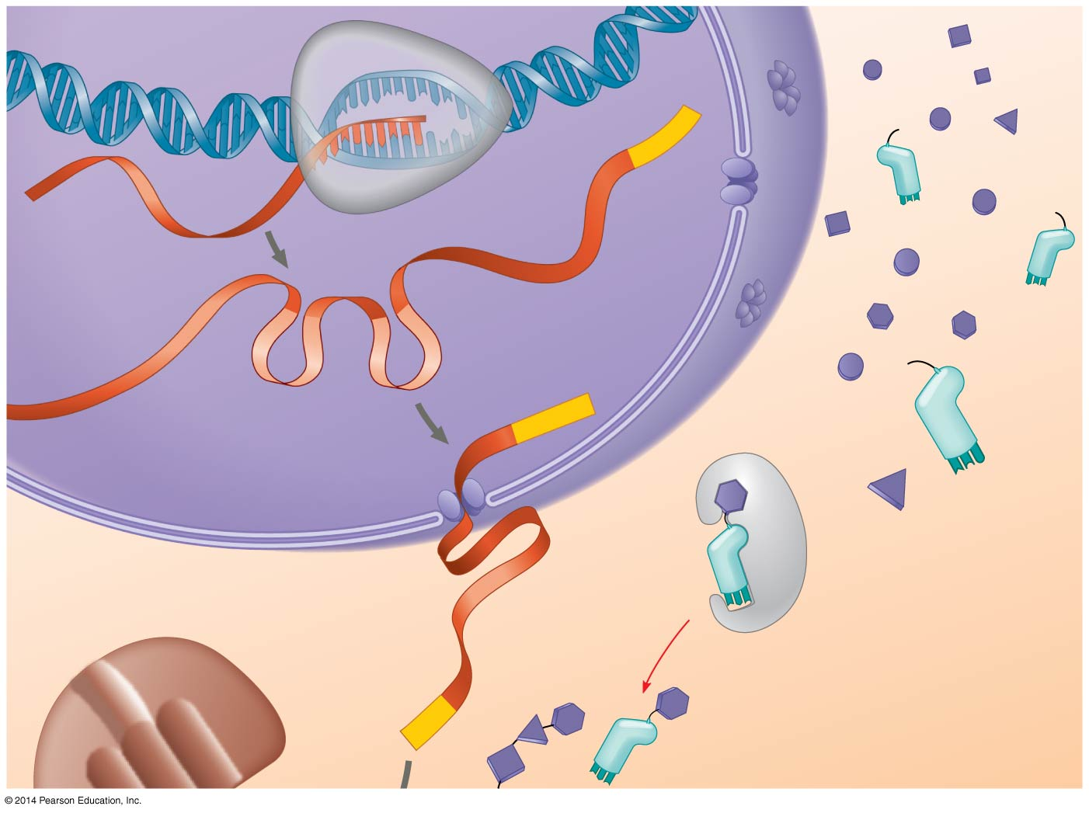
Figure 17.24a
TRANSCRIPTION
DNA
3′
Poly-A
5′
RNA
polymerase
RNA
transcript
Exon
RNA
PROCESSING
RNA transcript
(pre-mRNA)
Intron
Aminoacyl-tRNA
synthetase
Poly-A
NUCLEUS
Amino
acid
CYTOPLASM
AMINO ACID
ACTIVATION
tRNA
mRNA
Aminoacyl
(charged)
tRNA
5′ Cap
Notes:
Figure 17.24a A summary of transcription and translation in a eukaryotic cell (part 1)

Slide 91
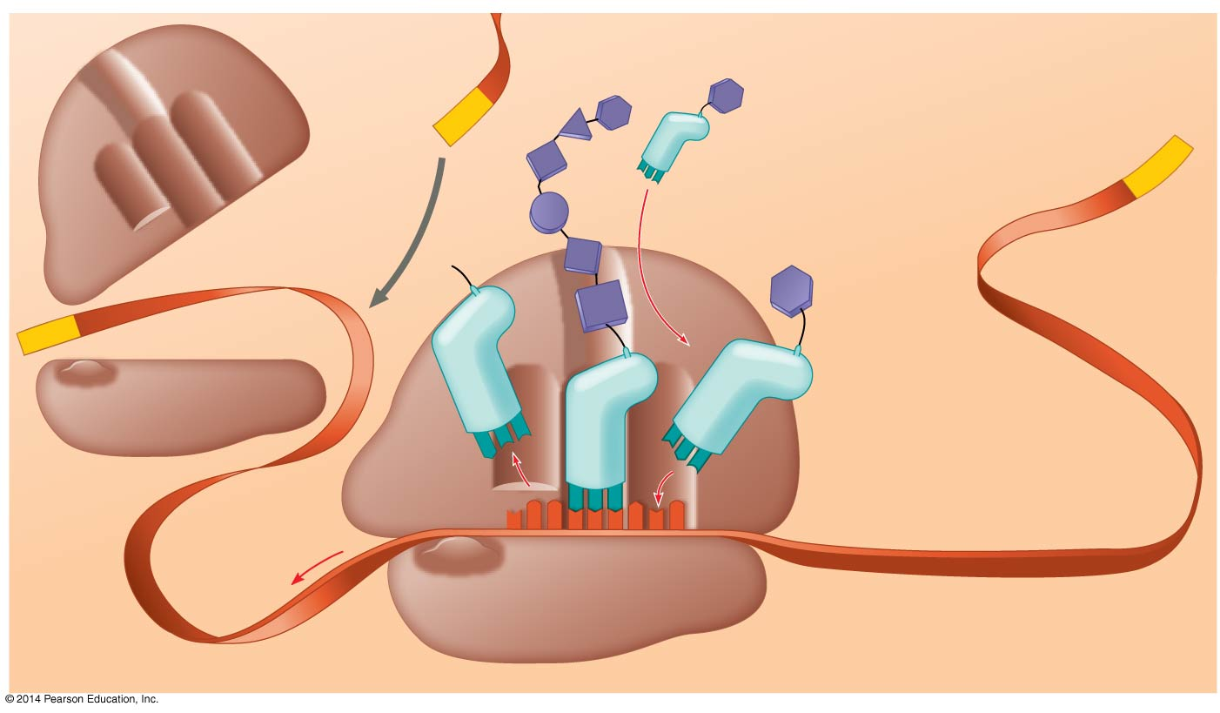
Figure 17.24b
mRNA
Growing
polypeptide
5′ Cap
3′
A
Poly-A
P
Aminoacyl
(charged)
tRNA
E
Ribosomal
subunits
5′ Cap
C
TRANSLATION
A
C
U
A
E
A
C
A
A
A
Anticodon
U
G
G
U
U
U
A
U
G
Codon
Ribosome
Notes:
Figure 17.24b A summary of transcription and translation in a eukaryotic cell (part 2)

Slide 92
BioFlix: Protein Synthesis

Slide 93
Animation: Translation

Slide 94
Concept 17.5: Mutations of one or a few nucleotides can affect protein structure and function
Mutations are changes in the genetic material of a cell or virus
Point mutations are chemical changes in just one base pair of a gene
The change of a single nucleotide in a DNA template strand can lead to the production of an abnormal protein

Slide 95
If a mutation has an adverse effect on the phenotype of the organism the condition is referred to as a genetic disorder or hereditary disease

Slide 96
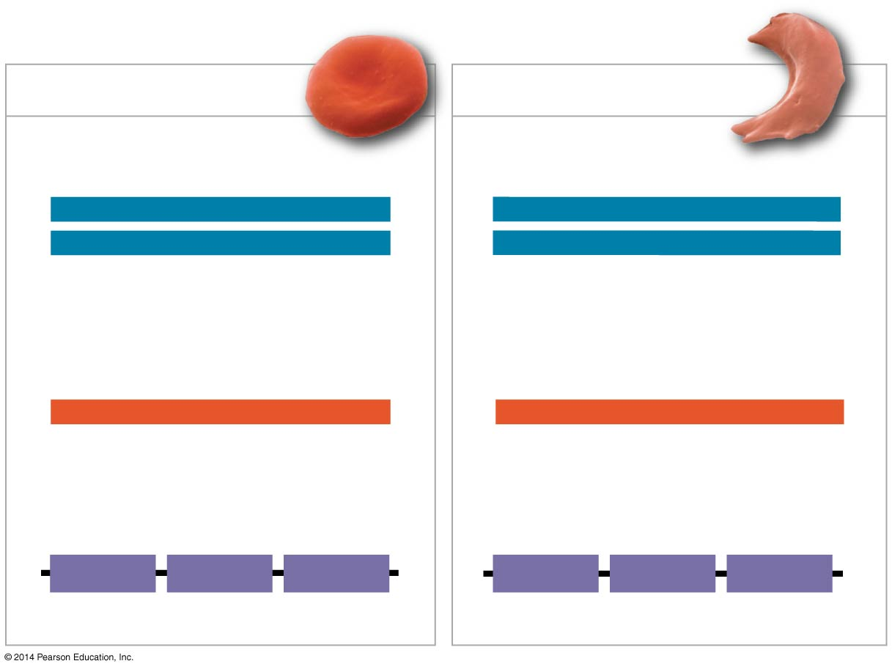
Figure 17.25
Wild-type β-globin
Sickle-cell β-globin
Wild-type β-globin DNA
Mutant β-globin DNA
3′
C
T
C
5′
3′
C
A
C
5′
5′
G
A
G
3′
5′
G
T
G
3′
mRNA
mRNA
5′
G
A
G
3′
5′
G
U
G
3′
Normal hemoglobin
Sickle-cell hemoglobin
Glu
Val
Notes:
Figure 17.25 The molecular basis of sickle-cell disease: a point mutation

Slide 97
Types of Small-Scale Mutations
Point mutations within a gene can be divided into two general categories
Nucleotide-pair substitutions
One or more nucleotide-pair insertions or deletions

Slide 98
Substitutions
A nucleotide-pair substitution replaces one nucleotide and its partner with another pair of nucleotides
Silent mutations have no effect on the amino acid produced by a codon because of redundancy in the genetic code
Missense mutations still code for an amino acid, but not the correct amino acid
Nonsense mutations change an amino acid codon into a stop codon, nearly always leading to a nonfunctional protein

Slide 99
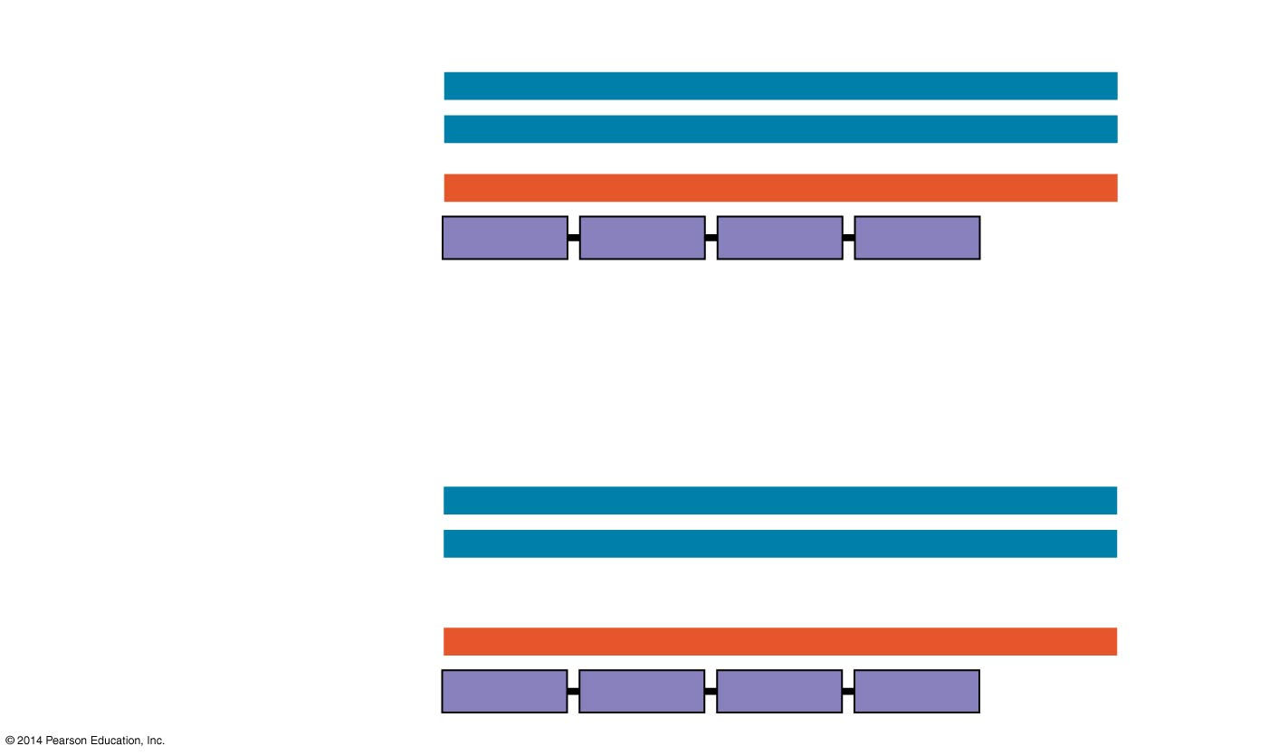
Figure 17.26a
Wild type
DNA template strand
3′
T
A
C
T
T
C
A
A
A
C
C
G
A
T
T
5′
5′
A
T
G
A
A
G
T
T
T
G
G
C
T
A
A
3′
mRNA
Protein
5′
A
U
G
A
A
G
U
U
U
G
G
C
U
A
A
3′
Met
Lys
Phe
Gly
Stop
Amino end
Carboxyl end
Nucleotide-pair substitution: silent
A instead of G
3′
T
A
C
T
T
C
A
A
A
C
C
A
A
T
T
5′
5′
A
T
G
A
A
G
T
T
T
G
G
T
T
A
A
3′
U instead of C
5′
A
U
G
A
A
G
U
U
U
G
G
U
U
A
A
3′
Met
Lys
Phe
Gly
Stop
Notes:
Figure 17.26a Types of small-scale mutations that affect mRNA sequence (part 1: silent)

Slide 100
Insertions and Deletions
Insertions and deletions are additions or losses of nucleotide pairs in a gene
These mutations have a disastrous effect on the resulting protein more often than substitutions do
Insertion or deletion of nucleotides may alter the reading frame, producing a frameshift mutation

Slide 101
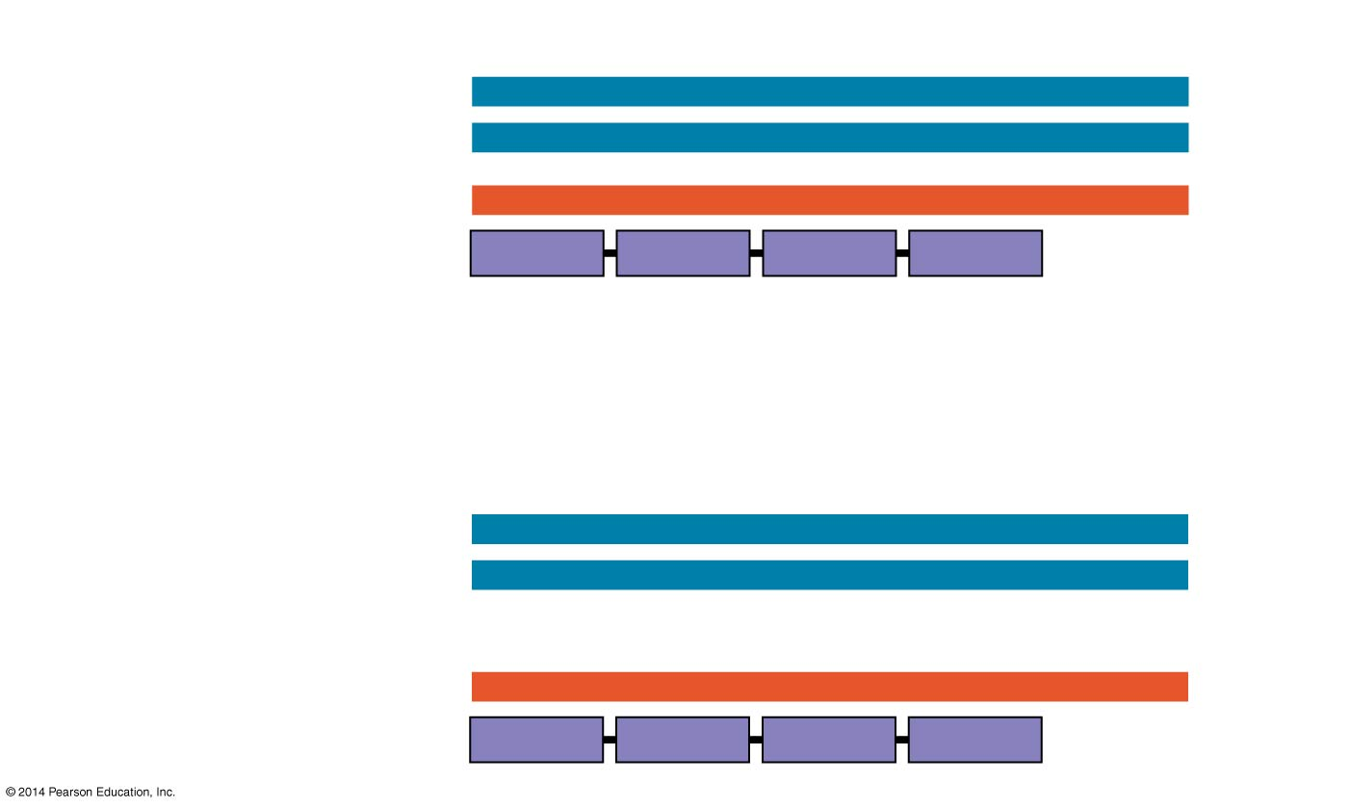
Figure 17.26b
Wild type
DNA template strand
3′
T
A
C
T
T
C
A
A
A
C
C
G
A
T
T
5′
5′
A
T
G
A
A
G
T
T
T
G
G
C
T
A
A
3′
mRNA
Protein
5′
A
U
G
A
A
G
U
U
U
G
G
C
U
A
A
3′
Met
Lys
Phe
Gly
Stop
Amino end
Carboxyl end
Nucleotide-pair substitution: missense
T instead of C
3′
T
A
C
T
T
C
A
A
A
T
C
G
A
T
T
5′
5′
A
T
G
A
A
G
T
T
T
A
G
C
T
A
A
3′
A instead of G
5′
A
U
G
A
A
G
U
U
U
A
G
C
U
A
A
3′
Met
Lys
Phe
Ser
Stop
Notes:
Figure 17.26b Types of small-scale mutations that affect mRNA sequence (part 2: missense)

Slide 102
New Mutations and Mutagens
Spontaneous mutations can occur during DNA replication, recombination, or repair
Mutagens are physical or chemical agents that can cause mutations

Slide 103
What Is a Gene? Revisiting the Question
The idea of the gene has evolved through the history of genetics
We have considered a gene as
A discrete unit of inheritance
A region of specific nucleotide sequence in a chromosome
A DNA sequence that codes for a specific polypeptide chain

Slide 104
A gene can be defined as a region of DNA that can be expressed to produce a final functional product that is either a polypeptide or an RNA molecule

Slide 105
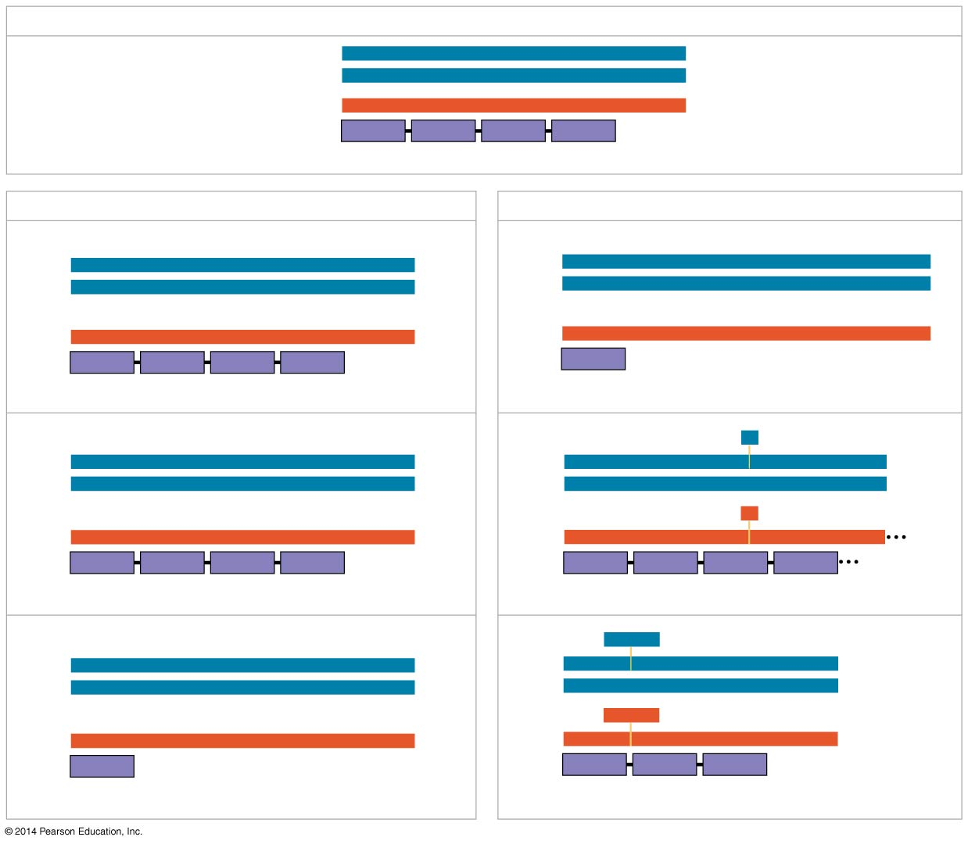
Figure 17.26
Wild type
DNA template strand
3′
T
A
C
T
T
C
A
A
A
C
C
G
A
T
T
5′
5′
A
T
G
A
A
G
T
T
T
G
G
C
T
A
A
3′
mRNA
Protein
5′
A
U
G
A
A
G
U
U
U
G
G
C
U
A
A
3′
Met
Lys
Phe
Gly
Stop
Amino end
Carboxyl end
(a) Nucleotide-pair substitution
(b) Nucleotide-pair insertion or deletion
A instead of G
Extra A
3′
T
A
C
T
T
C
A
A
A
C
C
A
A
T
T
5′
3′
T
A
C
A
T
T
C
A
A
A
C
C
G
A
T
T
5′
5′
A
T
G
A
A
G
T
T
T
G
G
T
T
A
A
3′
5′
A
T
G
T
A
A
G
T
T
T
G
G
C
T
A
A
3′
U instead of C
Extra U
5′
A
U
G
A
A
G
U
U
U
G
G
U
U
A
A
3′
5′
A
U
G
U
A
A
G
U
U
U
G
G
C
U
A
A
3′
Met
Lys
Phe
Gly
Stop
Met
Stop
Stop
Silent
Frameshift (1 nucleotide-pair insertion)
T instead of C
A
missing
3′
T
A
C
T
T
C
A
A
A
T
C
G
A
T
T
5′
3′
T
A
C
T
T
C
A
A
C
C
G
A
T
T
5′
5′
A
T
G
A
A
G
T
T
T
A
G
C
T
A
A
3′
5′
A
T
G
A
A
G
T
T
G
G
C
T
A
A
3′
A instead of G
U
missing
5′
A
U
G
A
A
G
U
U
U
A
G
C
U
A
A
3′
5′
A
U
G
A
A
G
U
U
G
G
C
U
A
A
3′
Met
Lys
Phe
Ser
Stop
Met
Lys
Leu
Ala
Missense
Frameshift (1 nucleotide-pair deletion)
A instead of T
T
T
C
missing
3′
T
A
C
A
T
C
A
A
A
C
C
G
A
T
T
5′
3′
T
A
C
A
A
A
C
C
G
A
T
T
5′
5′
A
T
G
T
A
G
T
T
T
G
G
C
T
A
A
3′
5′
A
T
G
T
T
T
G
G
C
T
A
A
3′
U instead of A
A
A
G
missing
5′
A
U
G
U
A
G
U
U
U
G
G
U
U
A
A
3′
5′
A
U
G
U
U
U
G
G
C
U
A
A
3′
Met
Stop
Met
Phe
Gly
Stop
Nonsense
3 nucleotide-pair deletion
Notes:
Figure 17.26 Types of small-scale mutations that affect mRNA sequence

Slide 106
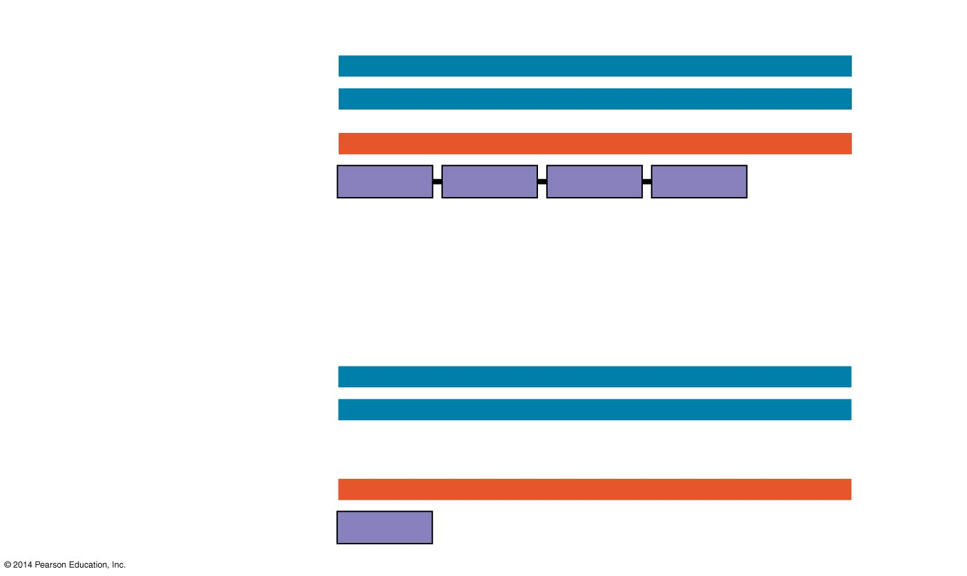
Figure 17.26c
Wild type
DNA template strand
3′
T
A
C
T
T
C
A
A
A
C
C
G
A
T
T
5′
5′
A
T
G
A
A
G
T
T
T
G
G
C
T
A
A
3′
mRNA
Protein
5′
A
U
G
A
A
G
U
U
U
G
G
C
U
A
A
3′
Met
Lys
Phe
Gly
Stop
Amino end
Carboxyl end
Nucleotide-pair substitution: nonsense
A instead of T
3′
T
A
C
A
T
C
A
A
A
C
C
G
A
T
T
5′
5′
A
T
G
T
A
G
T
T
T
G
G
C
T
A
A
3′
U instead of A
5′
A
U
G
U
A
G
U
U
U
G
G
U
U
A
A
3′
Met
Stop
Notes:
Figure 17.26c Types of small-scale mutations that affect mRNA sequence (part 3: nonsense)

Slide 107
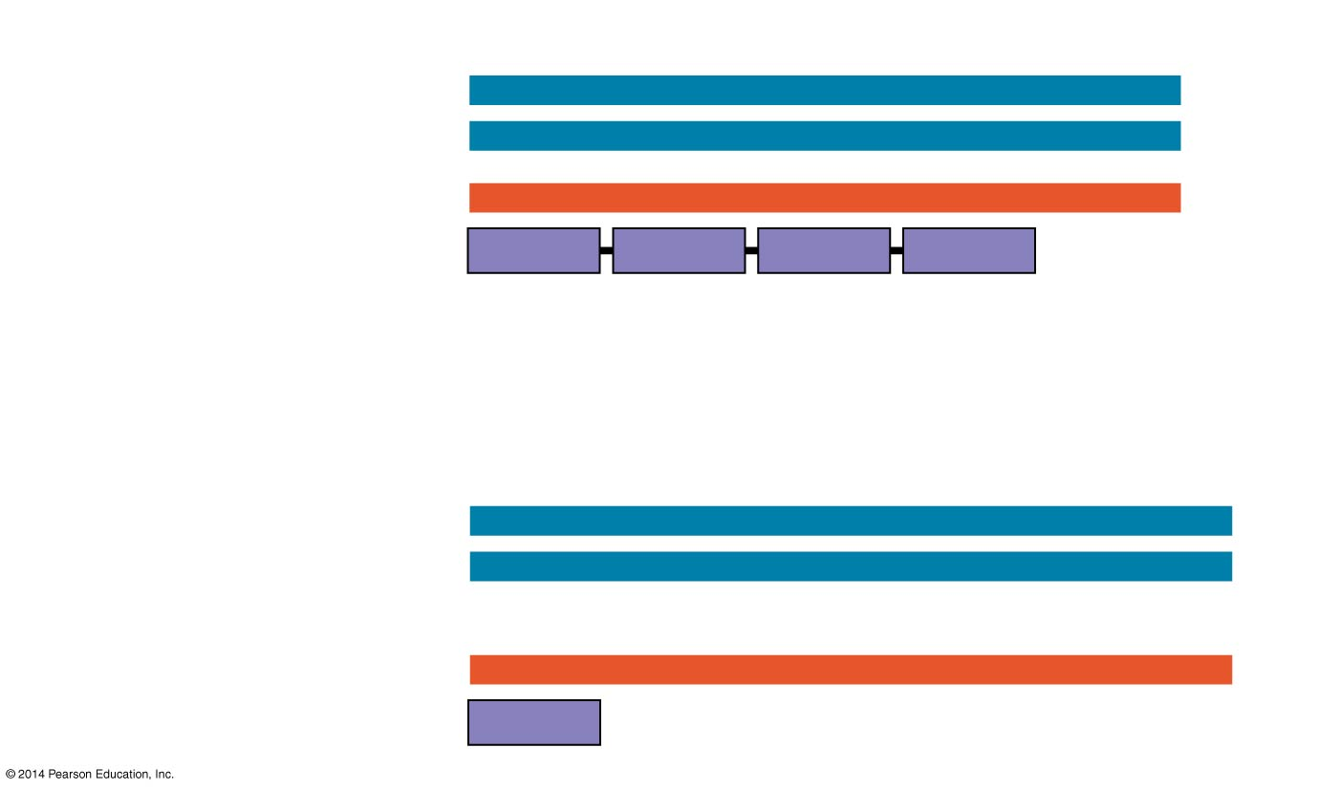
Figure 17.26d
Wild type
DNA template strand
3′
T
A
C
T
T
C
A
A
A
C
C
G
A
T
T
5′
5′
A
T
G
A
A
G
T
T
T
G
G
C
T
A
A
3′
mRNA
Protein
5′
A
U
G
A
A
G
U
U
U
G
G
C
U
A
A
3′
Met
Lys
Phe
Gly
Stop
Amino end
Carboxyl end
Nucleotide-pair insertion: frameshift causing immediate nonsense
Extra A
3′
T
A
C
A
T
T
C
A
A
A
C
C
G
A
T
T
5′
5′
A
T
G
T
A
A
G
T
T
T
G
G
C
T
A
A
3′
5′
A
U
G
U
A
A
G
U
U
U
G
G
C
U
A
A
3′
Met
Stop
Notes:
Figure 17.26d Types of small-scale mutations that affect mRNA sequence (part 4: frameshift, nonsense)

Slide 108
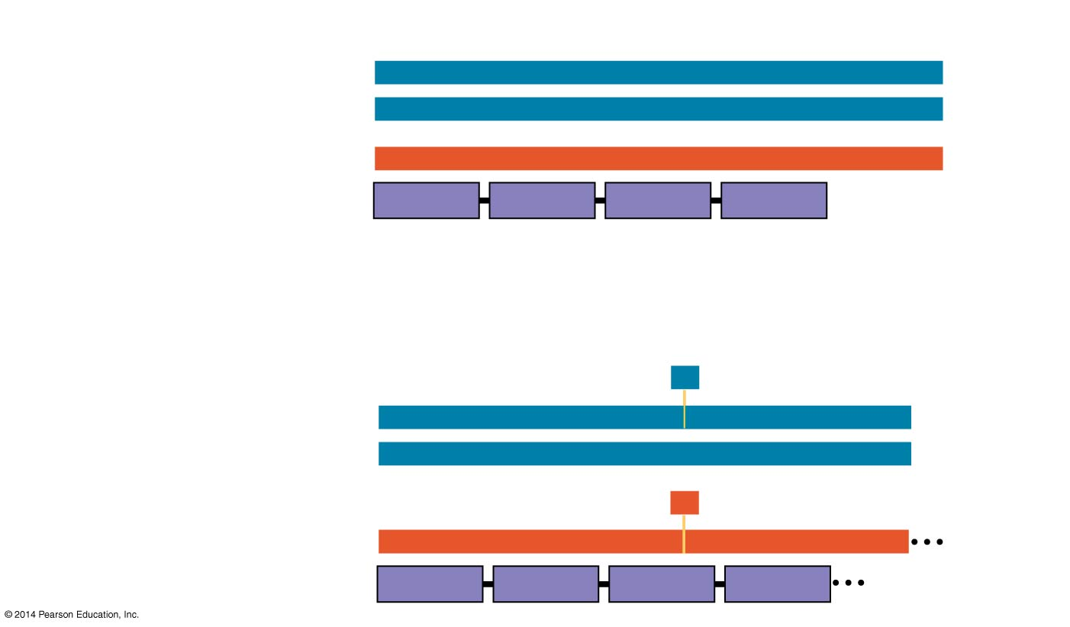
Figure 17.26e
Wild type
DNA template strand
3′
T
A
C
T
T
C
A
A
A
C
C
G
A
T
T
5′
5′
A
T
G
A
A
G
T
T
T
G
G
C
T
A
A
3′
mRNA
Protein
5′
A
U
G
A
A
G
U
U
U
G
G
C
U
A
A
3′
Met
Lys
Phe
Gly
Stop
Amino end
Carboxyl end
Nucleotide-pair deletion: frameshift causing extensive missense
A
missing
3′
T
A
C
T
T
C
A
A
C
C
G
A
T
T
5′
5′
A
T
G
A
A
G
T
T
G
G
C
T
A
A
3′
U
missing
5′
A
U
G
A
A
G
U
U
G
G
C
U
A
A
3′
Met
Lys
Leu
Ala
Notes:
Figure 17.26e Types of small-scale mutations that affect mRNA sequence (part 5: frameshift, missense)

Slide 109
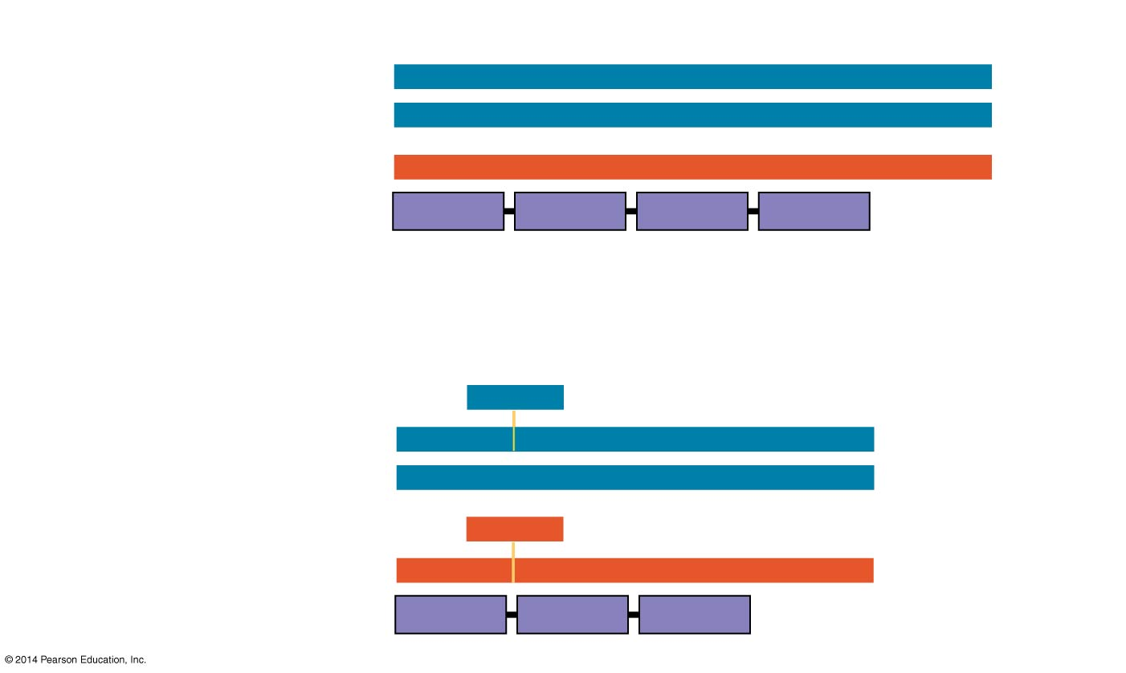
Figure 17.26f
Wild type
DNA template strand
3′
T
A
C
T
T
C
A
A
A
C
C
G
A
T
T
5′
5′
A
T
G
A
A
G
T
T
T
G
G
C
T
A
A
3′
mRNA
Protein
5′
A
U
G
A
A
G
U
U
U
G
G
C
U
A
A
3′
Met
Lys
Phe
Gly
Stop
Amino end
Carboxyl end
3 nucleotide-pair deletion: no frameshift, but one amino acid missing
T
T
C
missing
3′
T
A
C
A
A
A
C
C
G
A
T
T
5′
5′
A
T
G
T
T
T
G
G
C
T
A
A
3′
A
A
G
missing
5′
A
U
G
U
U
U
G
G
C
U
A
A
3′
Met
Phe
Gly
Stop
Notes:
Figure 17.26f Types of small-scale mutations that affect mRNA sequence (part 6: missing amino acid)

