Slide 1
1
Evolution, the Themes of Biology, and Scientific Inquiry
Lecture Presentation by Nicole Tunbridge and
Kathleen Fitzpatrick

Slide 2
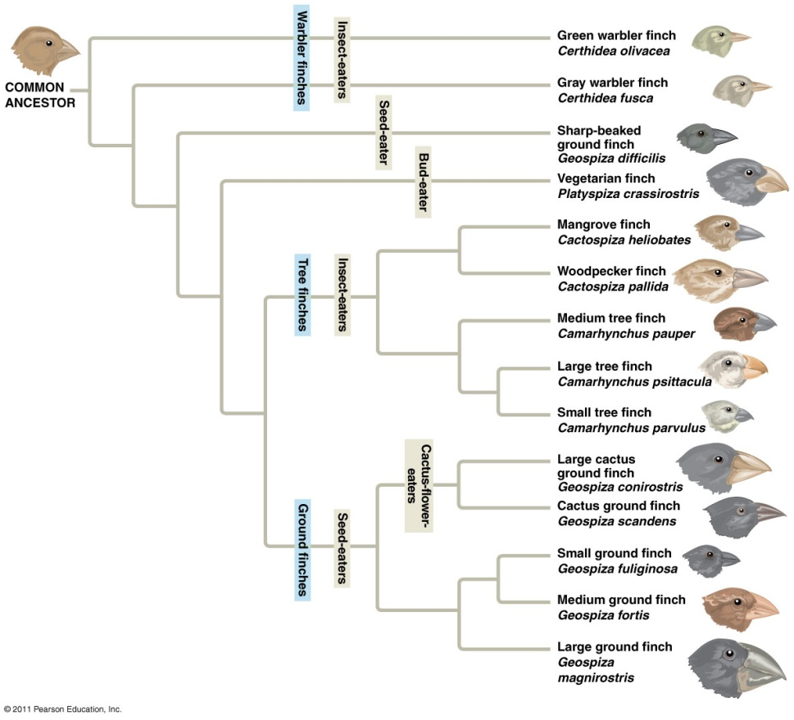
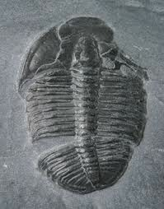
Big Ideas in AP Biology
Big Idea 1: The process of evolution drives the diversity and unity of life.

Slide 3
Inquiring About Life
An organism’s adaptations to its environment are the result of evolution
For example, the seeds of the dandelion are moved by wind due to their parachute-like structures
Evolution is the process of change that has transformed life on Earth

Slide 4
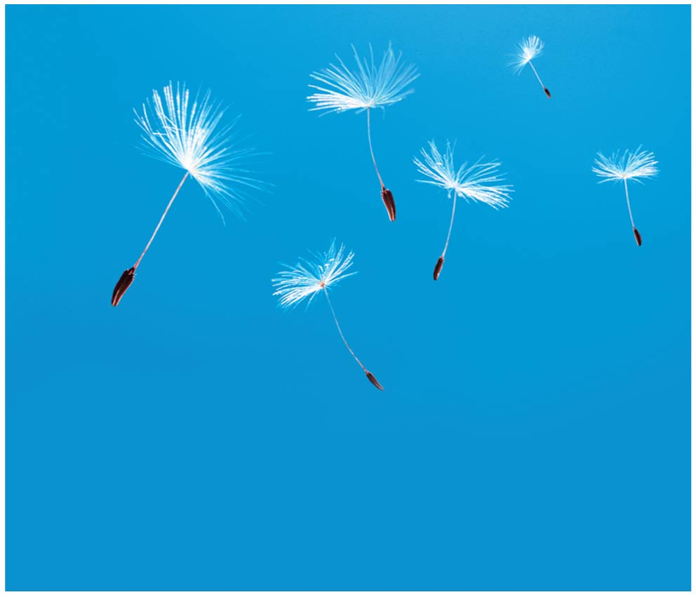
Figure 1.1a
Notes:
Figure 1.1a How is the dandelion adapted to its environment? (part 1: dandelion seeds)

Slide 5
Biology is the scientific study of life
Biologists ask questions such as
How does a single cell develop into an organism?
How does the human mind work?
How do living things interact in communities?
Life defies a simple, one-sentence definition
Life is recognized by what living things do
Notes:
Click to add notes

Slide 6
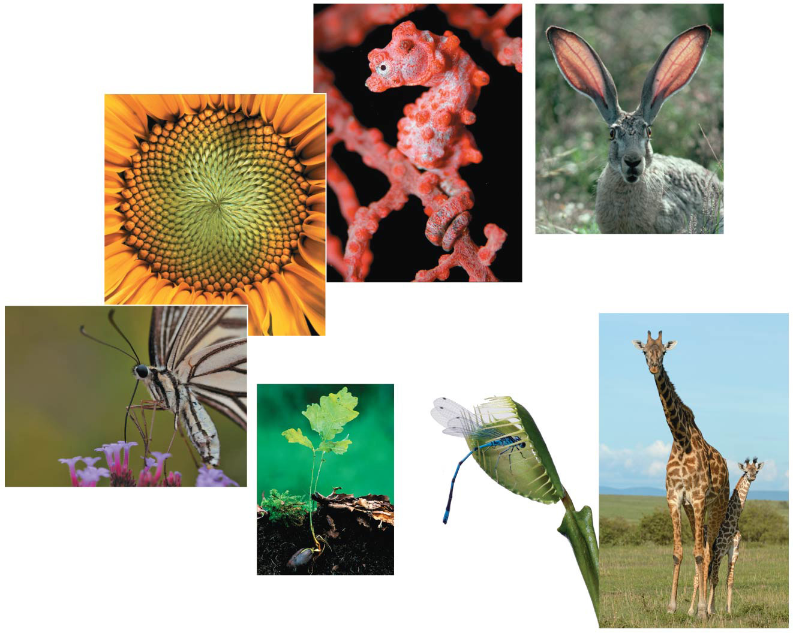
Figure 1.2
Order
Regulation
Evolutionary adaptation
Reproduction
Energy processing
Response to the environment
Growth and development
Notes:
Figure 1.2 Some properties of life

Slide 7
Concept 1.1: The study of life reveals common themes
Biology is a subject of enormous scope
There are five unifying themes
Organization
Information
Energy and matter
Interactions
Evolution

Slide 8
Theme: New Properties Emerge at Successive Levels of Biological Organization
Life can be studied at different levels, from molecules to the entire living planet
This enormous range can be divided into different levels of biological organization

Slide 9
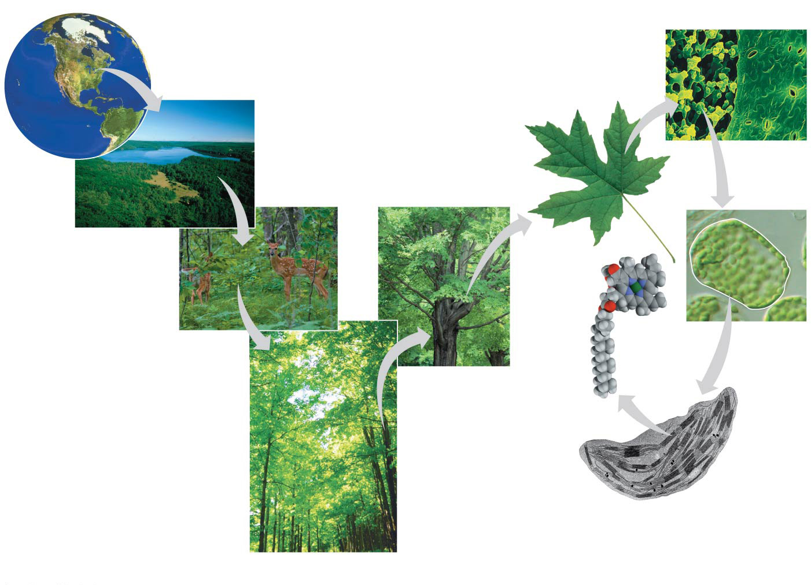
Figure 1.3
1 The Biosphere
7 Tissues
6 Organs and Organ Systems
2
Ecosystems
10
Mole- cules
3
Communities
8
Cells
5
Organisms
9 Organelles
4 Populations
Notes:
Figure 1.3 Exploring levels of biological organization

Slide 10
Emergent Properties
Emergent properties result from the arrangement and interaction of parts within a system
Emergent properties characterize nonbiological entities as well
For example, a functioning bicycle emerges only when all of the necessary parts connect in the correct way

Slide 11
Reductionism is the reduction of complex systems to simpler components that are more manageable to study
For example, studying the molecular structure of DNA helps us to understand the chemical basis of inheritance

Slide 12
To explore emergent properties, biologists complement reductionism with systems biology, analysis of the interactions among the parts of a biological system

Slide 13
Structure and Function
At each level of the biological hierarchy we find a correlation between structure and function

Slide 14
The Cell: An Organism’s Basic Unit of Structure and Function
The cell is the lowest level of organization that can perform all activities required for life
Every cell is enclosed by a membrane that regulates passage of materials between the cell and its environment

Slide 15
A eukaryotic cell has membrane-enclosed organelles, the largest of which is usually the nucleus
By comparison, a prokaryotic cell is simpler and usually smaller, and does not contain a nucleus or other membrane-enclosed organelles

Slide 16
Theme: Life’s Processes Involve the Expression and Transmission of Genetic Information
Within cells, structures called chromosomes contain genetic material in the form of DNA (deoxyribonucleic acid)

Slide 17
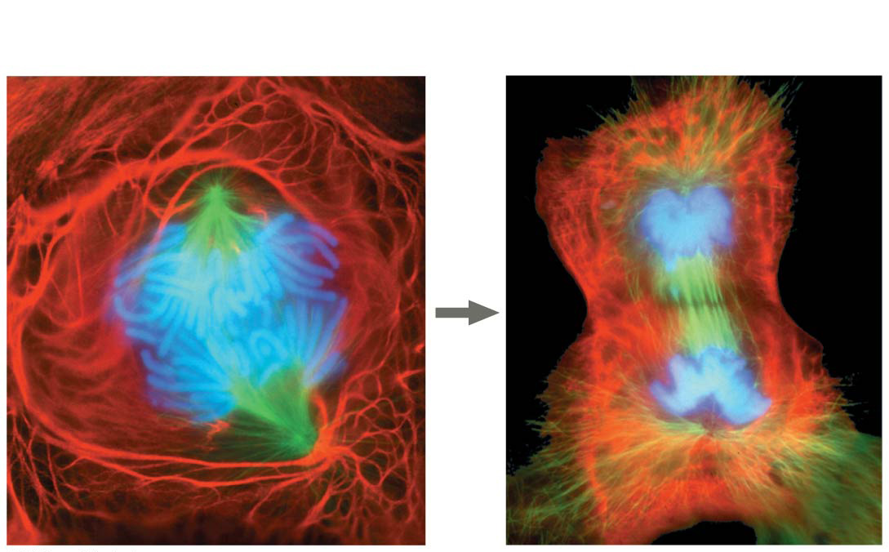
Figure 1.5
25 µm
Notes:
Figure 1.5 A lung cell from a newt divides into two smaller cells that will grow and divide again

Slide 18
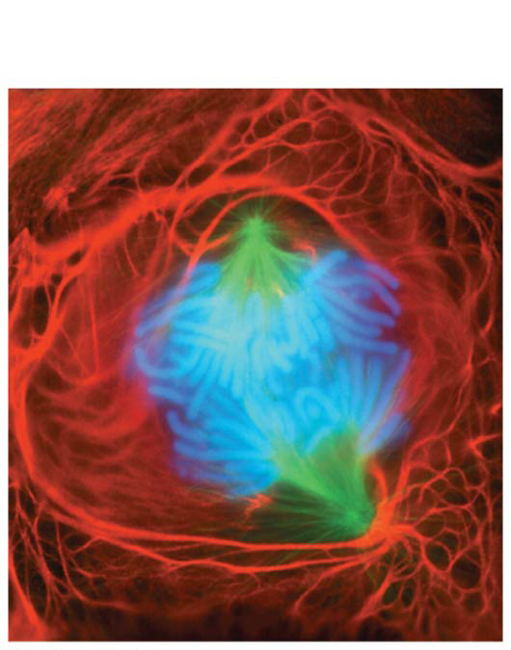
Figure 1.5a
25 µm
Notes:
Figure 1.5a A lung cell from a newt divides into two smaller cells that will grow and divide again (part 1: anaphase)

Slide 19
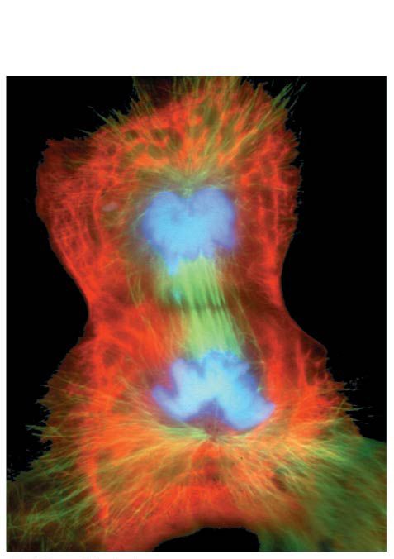
Figure 1.5b
25 µm
Notes:
Figure 1.5b A lung cell from a newt divides into two smaller cells that will grow and divide again (part 2: telophase and cytokinesis)

Slide 20
DNA, the Genetic Material
Each chromosome has one long DNA molecule with hundreds or thousands of genes
Genes encode information for building the molecules synthesized within the cell
Genes are the units of inheritance
DNA controls the development and maintenance of organisms

Slide 21
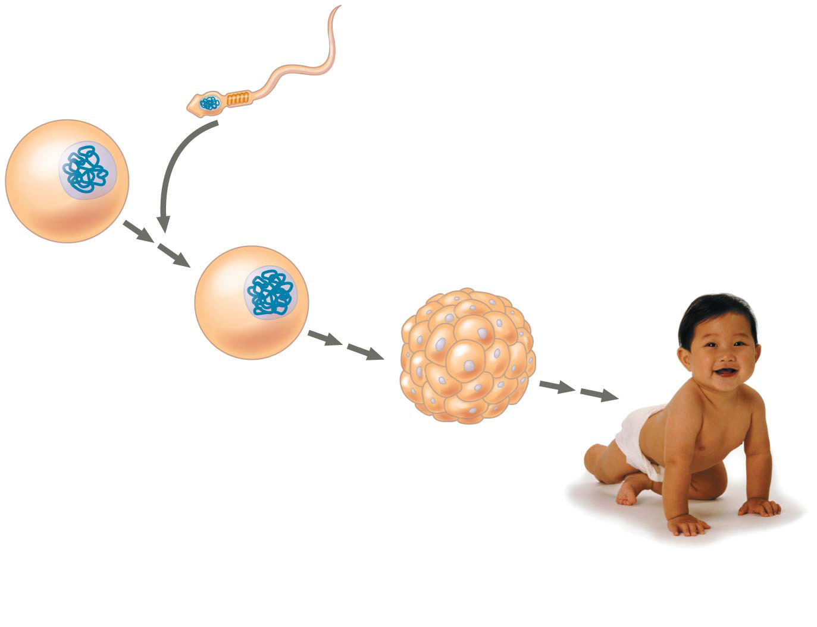
Figure 1.6
Nuclei containing DNA
Sperm cell
Egg cell
Fertilized egg with DNA from both parents
Embryo’s cells with copies of inherited DNA
Offspring with traits inherited from both parents
Notes:
Figure 1.6 Inherited DNA directs development of an organism

Slide 22
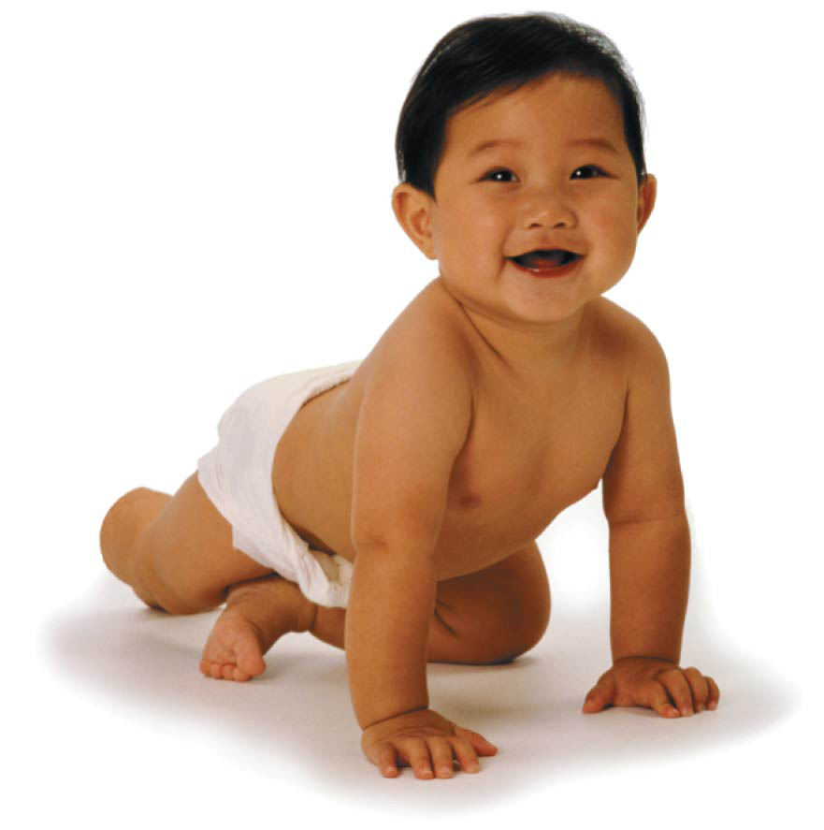
Figure 1.6a
Notes:
Figure 1.6a Inherited DNA directs development of an organism (part 1: photo)

Slide 23
Each DNA molecule is made up of two long chains arranged in a double helix
Each chain is made up of four kinds of chemical building blocks called nucleotides and nicknamed A, G, C, and T

Slide 24
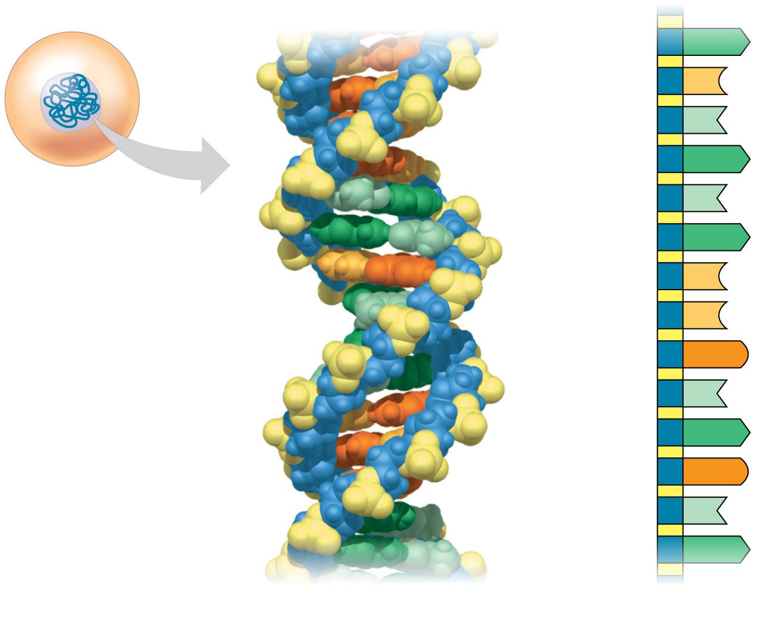
Figure 1.7
A
Nucleus
DNA
C
Nucleotide
T
A
Cell
T
A
C
C
G
T
A
G
T
A
(a) DNA double helix
(b) Single strand of DNA
Notes:
Figure 1.7 DNA: The genetic material

Slide 25
Genes control protein production indirectly
DNA is transcribed into RNA, which is then translated into a protein
Gene expression is the process of converting information from gene to cellular product

Slide 26
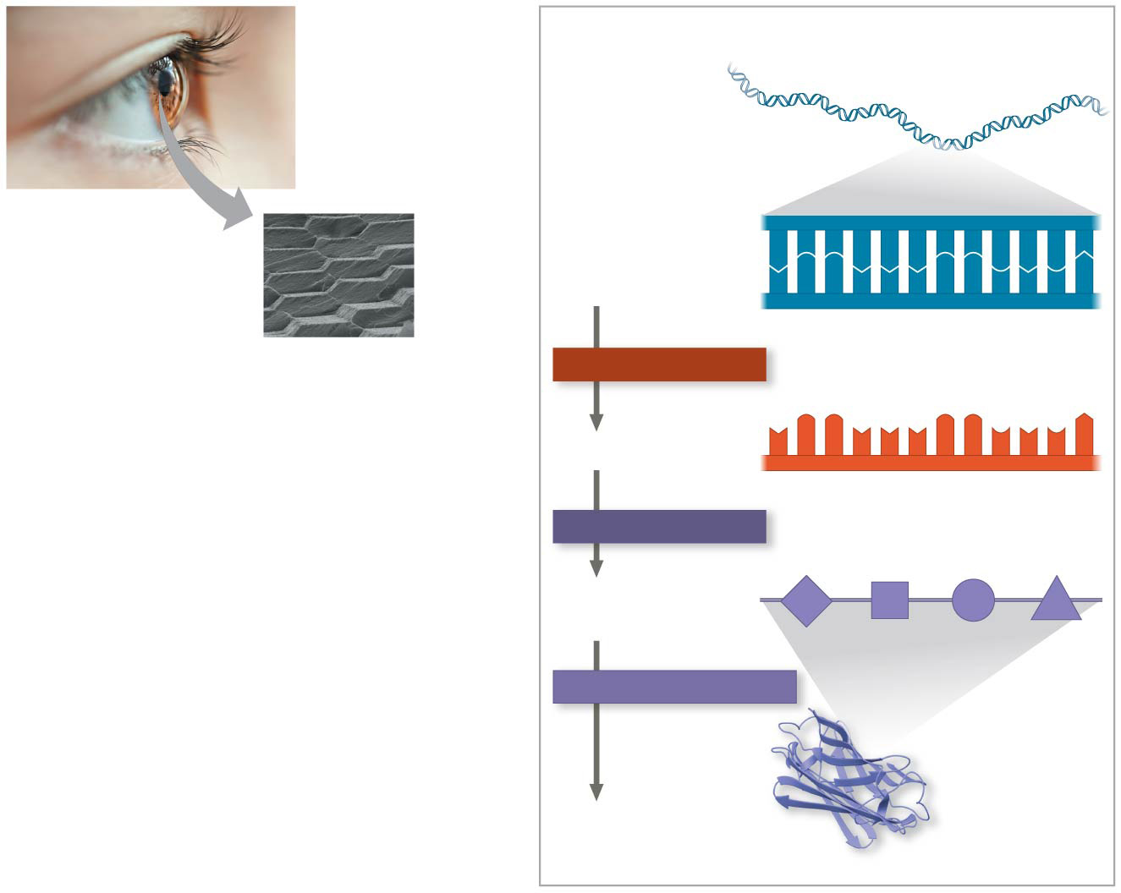
Figure 1.8
(b) How do lens cells make crystallin proteins?
Crystallin gene
(a) Lens cells are tightly packed with transparent proteins called crystallin.
Lens cell
A C C A A A C C G A G T
DNA
T G G T T T G G C T C A
TRANSCRIPTION
mRNA
U G G U U U G G C U C A
TRANSLATION
Chain of amino acids
PROTEIN FOLDING
Protein
Crystallin protein
Notes:
Figure 1.8 Gene expression: The transfer of information from a gene results in a functional protein

Slide 27
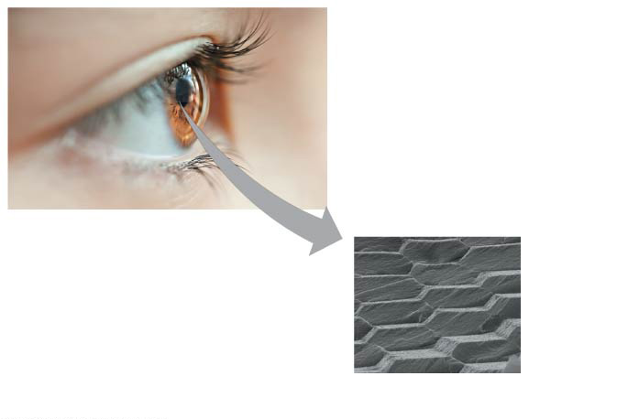
Figure 1.8a
(a) Lens cells are tightly packed with transparent proteins called crystallin.
Lens cell
Notes:
Figure 1.8a Gene expression: The transfer of information from a gene results in a functional protein (part 1: lens of the eye)

Slide 28
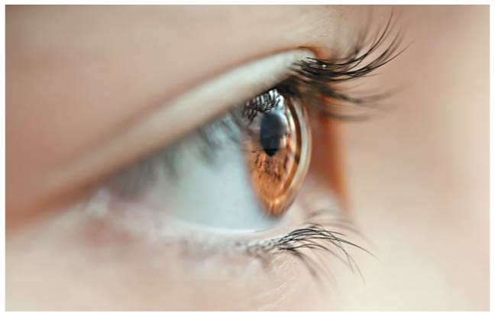
Figure 1.8aa
Notes:
Figure 1.8aa Gene expression: The transfer of information from a gene results in a functional protein (part 1a: eye)

Slide 29
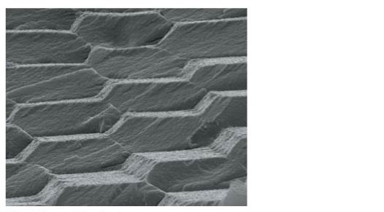
Figure 1.8ab
Lens cell
Notes:
Figure 1.8ab Gene expression: The transfer of information from a gene results in a functional protein (part 1b: lens cells)

Slide 30
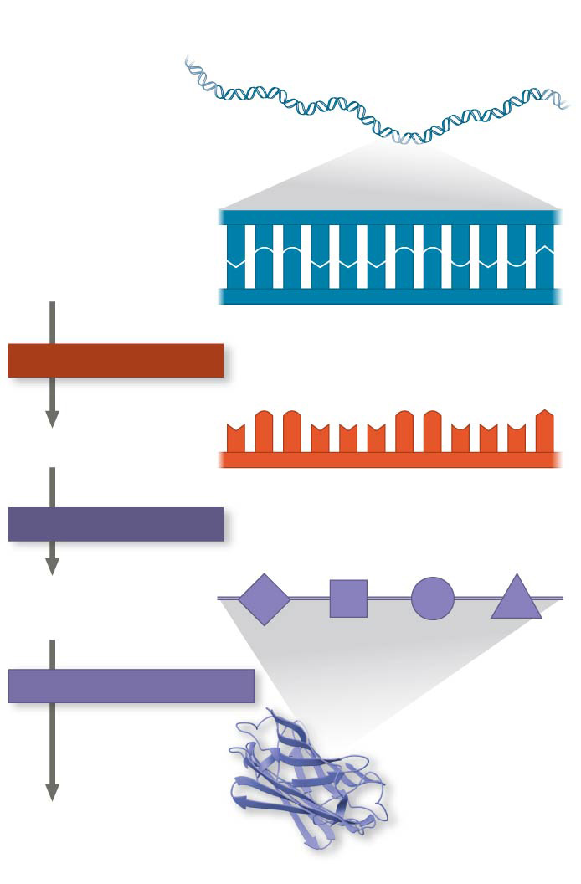
Figure 1.8b
(b) How do lens cells make crystallin proteins?
Crystallin gene
A C C A A A C C G A G T
DNA
T G G T T T G G C T C A
TRANSCRIPTION
mRNA
U G G U U U G G C U C A
TRANSLATION
Chain of amino acids
PROTEIN FOLDING
Protein
Crystallin protein
Notes:
Figure 1.8b Gene expression: The transfer of information from a gene results in a functional protein (part 2: gene expression)

Slide 31
Genomics: Large-Scale Analysis of DNA Sequences
An organism’s genome is its entire set of genetic instructions
The human genome and those of many other organisms have been sequenced
Genomics is the study of sets of genes within and between species
Proteomics is the study of whole sets of proteins encoded by the genome (known as proteomes)

Slide 32
The genomics approach depends on
“High-throughput” technology, which yields enormous amounts of data
Bioinformatics, which is the use of computational tools to process a large volume of data
Interdisciplinary research teams

Slide 33
Theme: Life Requires the Transfer and Transformation of Energy and Matter
The input of energy from the sun and the transformation of energy from one form to another make life possible
When organisms use energy to perform work, some energy is lost to the surroundings as heat
As a result, energy flows through an ecosystem, usually entering as light and exiting as heat

Slide 34
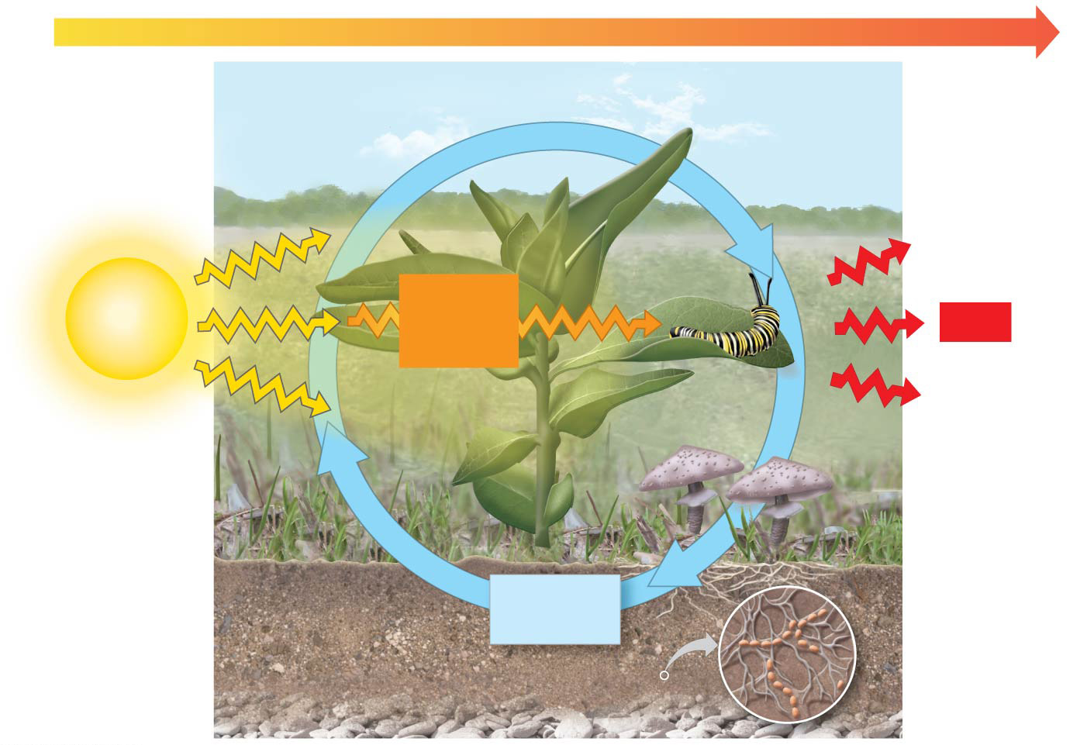
Figure 1.9
ENERGY FLOW
Chemicals pass to organisms that eat the plants.
Light energy
Chemical energy
Heat
Plants take up chemicals from the soil and air.
Decomposers return chemicals to the soil.
Chemicals
Notes:
Figure 1.9 Energy flow and chemical cycling

Slide 35
Theme: From Ecosystems to Molecules, Interactions Are Important in Biological Systems
Interactions between the components of the system ensure smooth integration of all the parts
This holds true equally well for components of an ecosystem and the molecules in a cell

Slide 36
Ecosystems: An Organism’s Interactions with Other Organisms and the Physical Environment
At the ecosystem level, each organism interacts continuously with other organisms
These interactions may be beneficial or harmful to one or both of the organisms
Organisms also interact continuously with the physical factors in their environment, and the environment is affected by the organisms living there

Slide 37
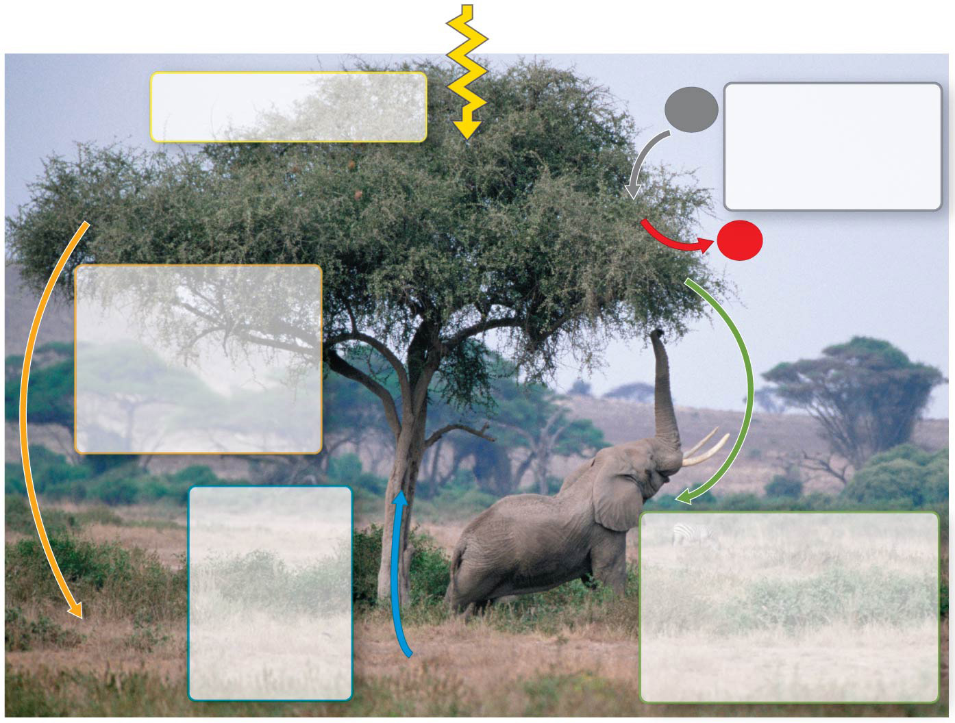
Figure 1.10
Sunlight
Leaves absorb light energy from the sun.
Leaves take in carbon dioxide from the air and release oxygen.
CO₂
O₂
Leaves fall to the ground and are decomposed by organisms that return minerals to the soil.
Water and minerals in the soil are taken up by the tree through its roots.
Animals eat leaves and fruit from the tree, returning nutrients and minerals to the soil in their waste products.
Notes:
Figure 1.10 Interactions of an African acacia tree with other organisms and the physical environment

Slide 38
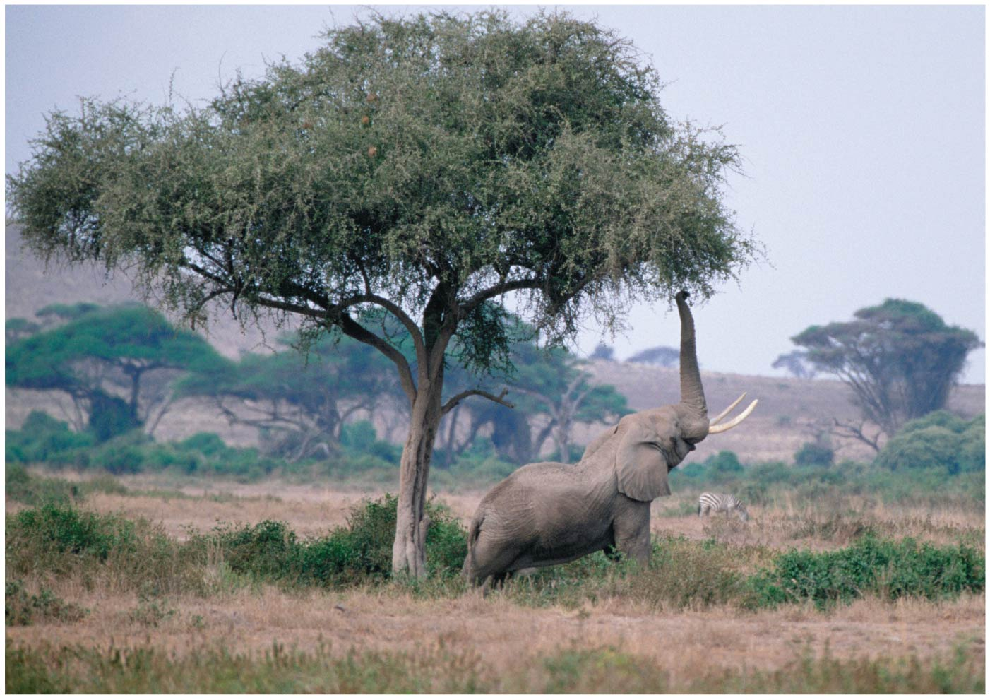
Figure 1.10a
Notes:
Figure 1.10a Interactions of an African acacia tree with other organisms and the physical environment (part 1: photo)

Slide 39
Molecules: Interactions Within Organisms
Interactions between components—organs, tissues, cells, and molecules—that make up living organisms are crucial to their smooth operation
Cells are able to coordinate various chemical pathways through a mechanism called feedback

Slide 40
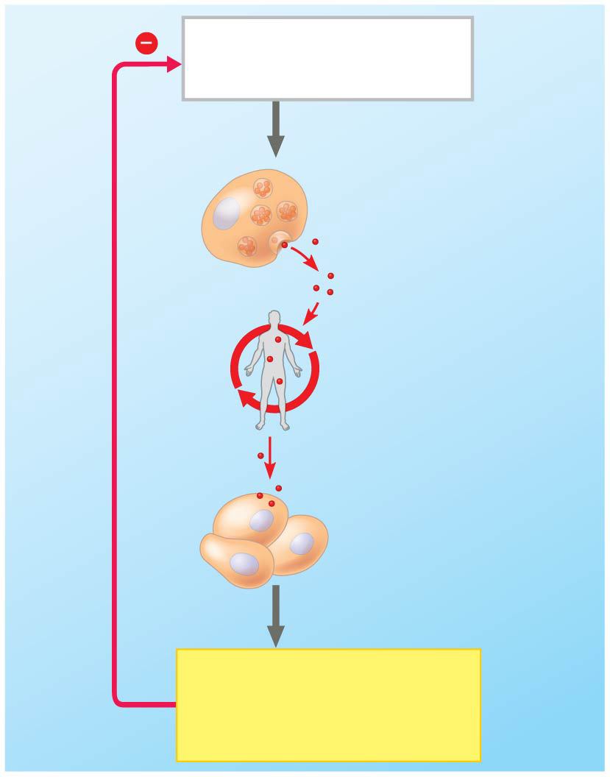
Figure 1.11
STIMULUS: High blood glucose level
Insulin-producing cell in pancreas
Insulin
Circulation throughout body via blood
Negative feedback
Liver and muscle cells
RESPONSE: Glucose uptake by liver and muscle cells
Notes:
Figure 1.11 Feedback regulation

Slide 41
Animation: Negative Feedback

Slide 42
Animation: Positive Feedback

Slide 43
In feedback regulation the output, or product of a process, regulates that very process
The most common form of regulation in living organisms is negative feedback, in which the response reduces the initial stimulus
Feedback is a regulatory motif common to life at all levels

Slide 44
Evolution, the Core Theme of Biology
Evolution is the one idea that makes logical sense of everything we know about living organisms
The scientific explanation for both the unity and diversity of organisms is the concept that living organisms are modified descendants of common ancestors
Many kinds of evidence support the occurrence of evolution

Slide 45
Concept 1.2: The Core Theme: Evolution accounts for the unity and diversity of life
“Nothing in biology makes sense except in the light of evolution”—Theodosius Dobzhansky
Evolutionary mechanisms account for the unity and diversity of all species on Earth

Slide 46
Classifying the Diversity of Life
Approximately 1.8 million species have been identified and named to date, and thousands more are identified each year
Estimates of the total number of species that actually exist range from 10 million to over 100 million

Slide 47
Grouping Species: The Basic Idea
Taxonomy is the branch of biology that names and classifies species into groups of increasing breadth
Domains, followed by kingdoms, are the broadest units of classification

Slide 48
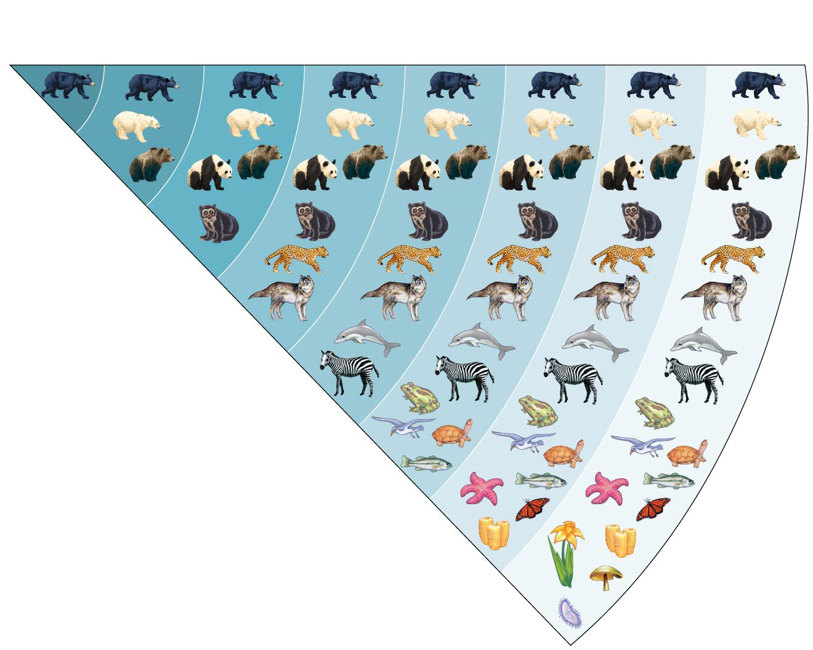
Figure 1.12
Ursus americanus
SPECIES GENUS FAMILY ORDER CLASS PHYLUM KINGDOM DOMAIN
Ursus
Ursidae
Carnivora
Mammalia
Chordata
Animalia
Eukarya
Notes:
Figure 1.12 Classifying life

Slide 49
The Three Domains of Life
Organisms are divided into three domains, named Bacteria, Archaea, and Eukarya
Domain Bacteria and domain Archaea compose the prokaryotes

Slide 50
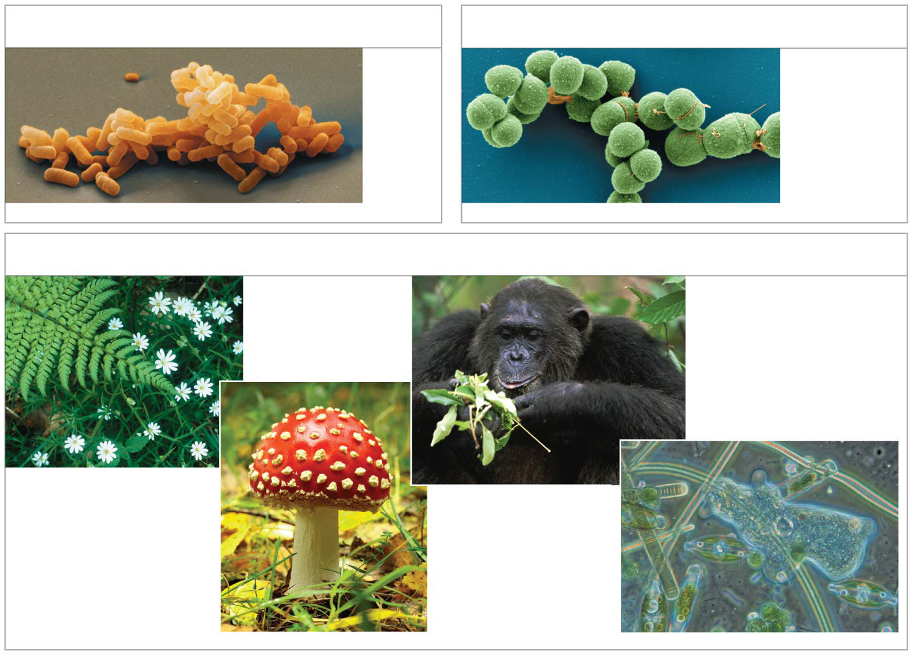
Figure 1.13
(a) Domain Bacteria
(b) Domain Archaea
2 µm
2 µm
(c) Domain Eukarya
Kingdom Animalia
100 µm
Kingdom Plantae
Kingdom Fungi
Protists
Notes:
Figure 1.13 The three domains of life

Slide 51
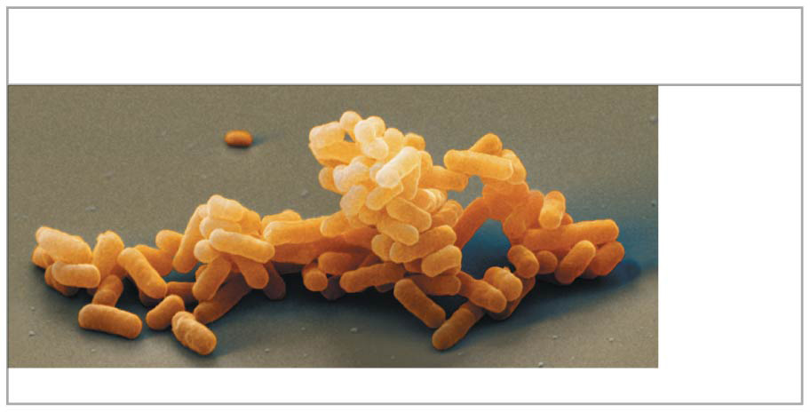
Figure 1.13a
(a) Domain Bacteria
2 µm
Notes:
Figure 1.13a The three domains of life (part 1: domain Bacteria)

Slide 52
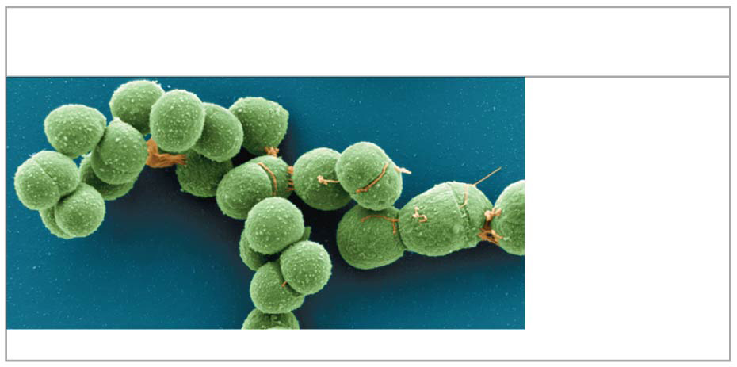
Figure 1.13b
(b) Domain Archaea
2 µm
Notes:
Figure 1.13b The three domains of life (part 2: domain Archaea)

Slide 53
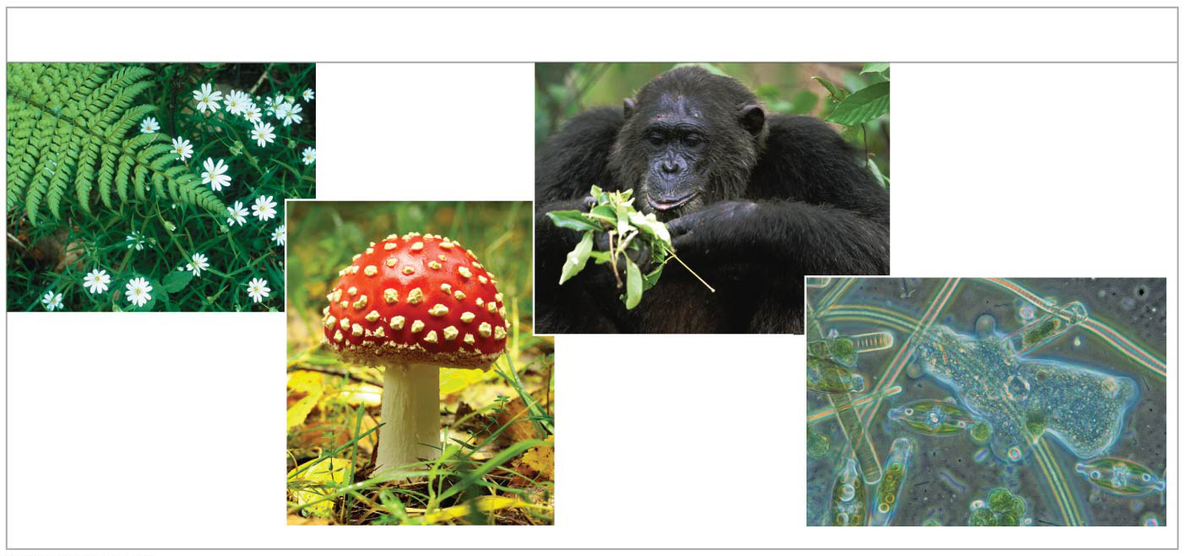
Figure 1.13c
(c) Domain Eukarya
Kingdom Animalia
100 µm
Kingdom Plantae
Kingdom Fungi
Protists
Notes:
Figure 1.13c The three domains of life (part 3: domain Eukarya)

Slide 54
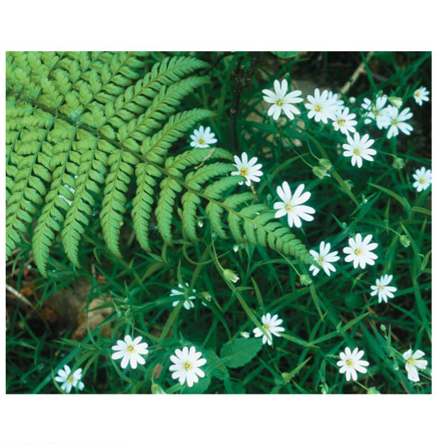
Figure 1.13ca
(c) Domain Eukarya
Kingdom Plantae
Notes:
Figure 1.13ca The three domains of life (part 3a: kingdom Plantae)

Slide 55
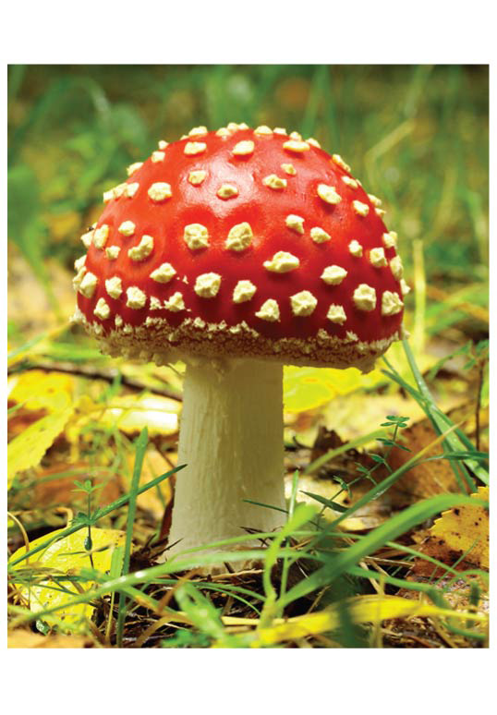
Figure 1.13cb
(c) Domain Eukarya
(c) Domain Eukarya
Kingdom Fungi
Notes:
Figure 1.13cb The three domains of life (part 3b: kingdom Fungi)

Slide 56
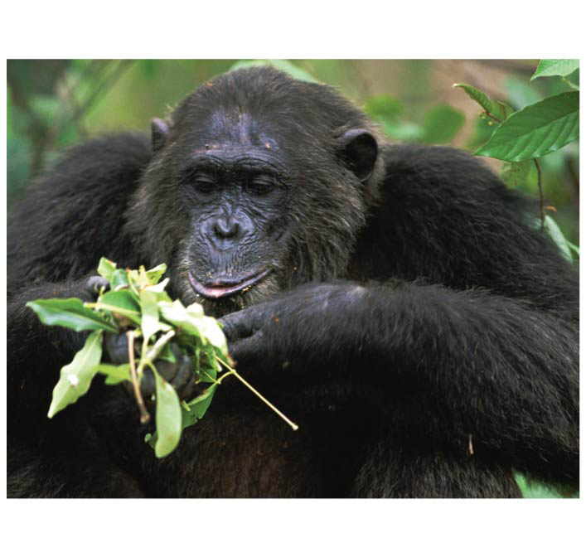
Figure 1.13cc
(c) Domain Eukarya
Kingdom Animalia
Notes:
Figure 1.13cc The three domains of life (part 3c: kingdom Animalia)

Slide 57
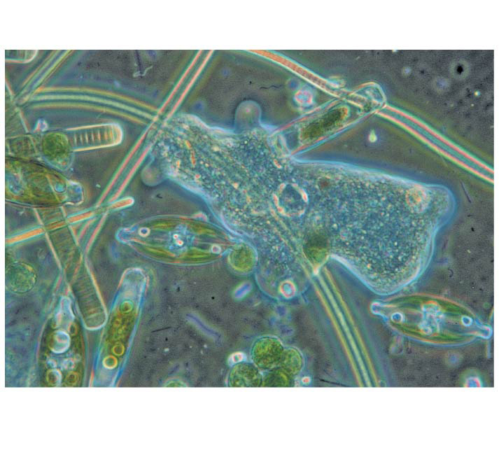
Figure 1.13cd
(c) Domain Eukarya
Protists
100 µm
Notes:
Figure 1.13cd The three domains of life (part 3d: kingdom Protista)

Slide 58
Domain Eukarya includes all eukaryotic organisms
Domain Eukarya includes three multicellular kingdoms
Plants, which produce their own food by photosynthesis
Fungi, which absorb nutrients
Animals, which ingest their food

Slide 59
Other eukaryotic organisms were formerly grouped into the Protist kingdom, though the recent trend has been to split the protists into several kingdoms

Slide 60
Unity in the Diversity of Life
A striking unity underlies the diversity of life; for example
DNA is the universal genetic language common to all organisms
Unity is evident in many features of cell structure

Slide 61
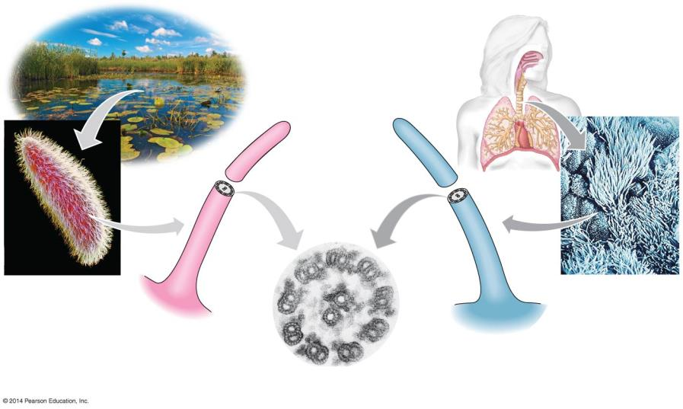
Figure 1.14
5 µm
Cross section of a cilium
15 µm
Cilia of Paramecium
Cilia of windpipe cells
0.1 µm
Notes:
Figure 1.14 An example of unity underlying the diversity of life: the architecture of cilia in eukaryotes

Slide 62
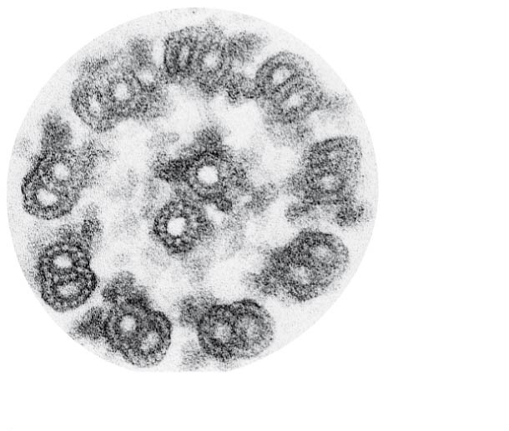
Figure 1.14a
0.1 µm
Cross section of a cilium
Notes:
Figure 1.14a An example of unity underlying the diversity of life: the architecture of cilia in eukaryotes (part 1: cross section of a cilium)

Slide 63
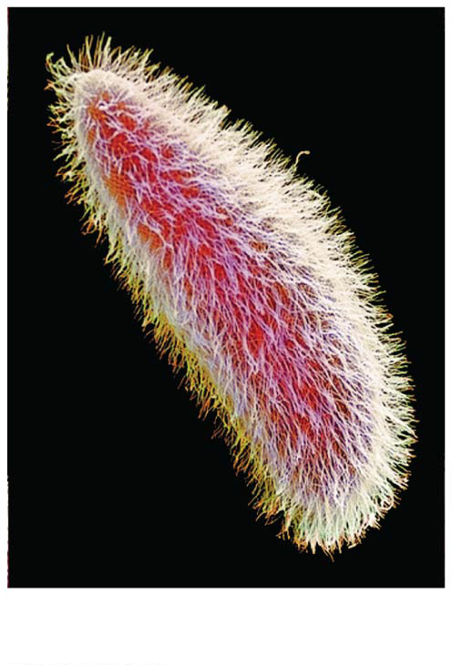
Figure 1.14b
15 µm
Cilia of Paramecium
Notes:
Figure 1.14b An example of unity underlying the diversity of life: the architecture of cilia in eukaryotes (part 2: cilia of Paramecium)

Slide 64
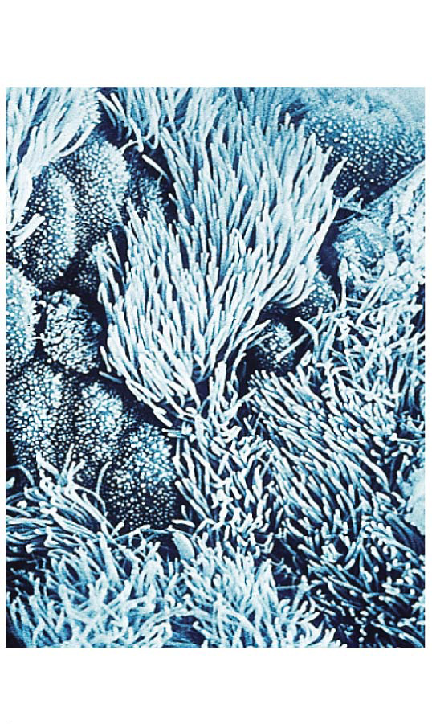
Figure 1.14c
5 µm
Cilia of windpipe cells
Notes:
Figure 1.14c An example of unity underlying the diversity of life: the architecture of cilia in eukaryotes (part 3: cilia of windpipe cells)

Slide 65
Charles Darwin and the Theory of Natural Selection
Fossils and other evidence document the evolution of life on Earth over billions of years

Slide 66
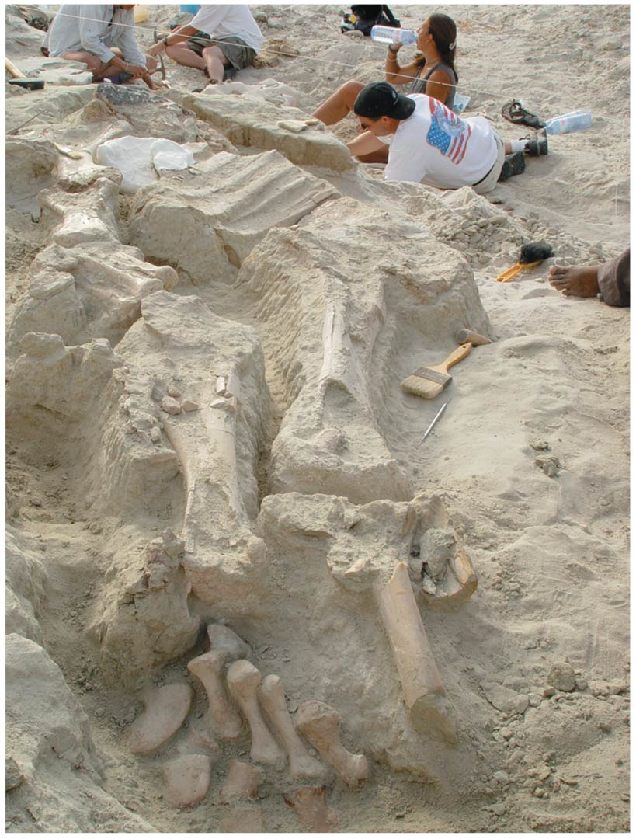
Figure 1.15
Notes:
Figure 1.15 Digging into the past

Slide 67
Charles Darwin published On the Origin of Species by Means of Natural Selection in 1859
Darwin made two main points
Species showed evidence of “descent with modification” from common ancestors
“Natural selection” is the mechanism behind descent with modification
Darwin’s theory explained the duality of unity and diversity

Slide 68
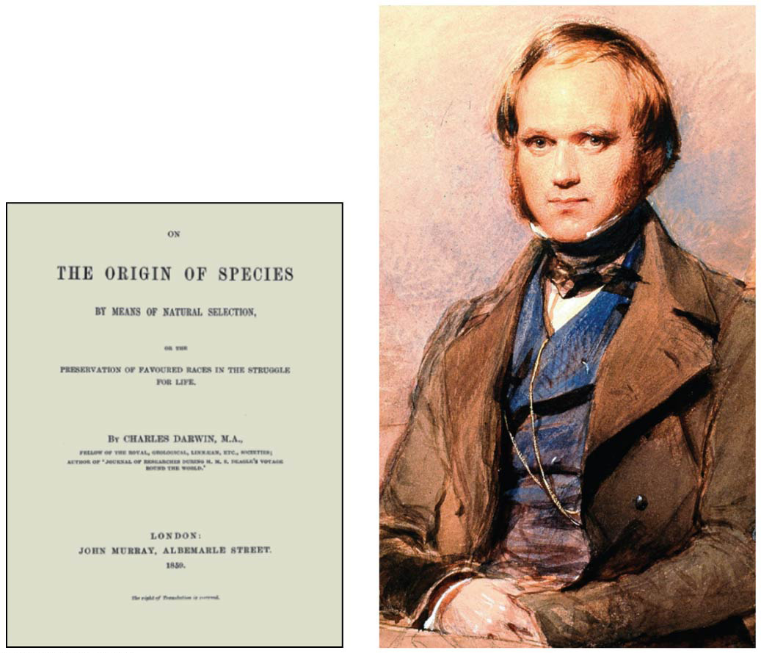
Figure 1.16
Notes:
Figure 1.16 Charles Darwin as a young man

Slide 69
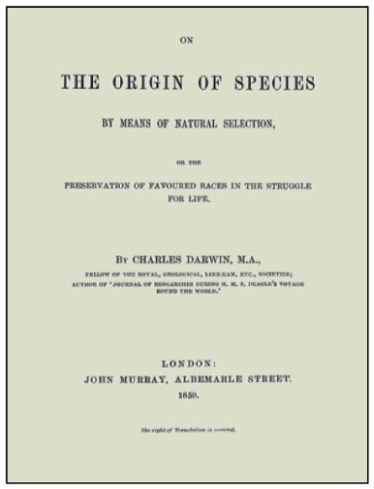
Figure 1.16a
Notes:
Figure 1.16a Charles Darwin as a young man (part 1: Origin of Species title page)

Slide 70
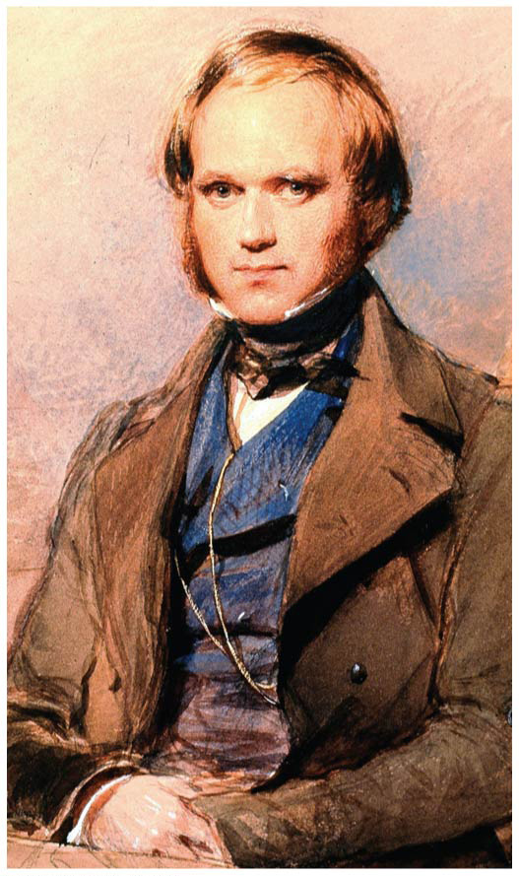
Figure 1.16b
Notes:
Figure 1.16b Charles Darwin as a young man (part 2: portrait)

Slide 71
Video: Soaring Hawk

Slide 72
Video: Albatross Courtship Ritual

Slide 73
Video: Blue-footed Boobies Courtship Ritual

Slide 74
Video: Galápagos Islands Overview

Slide 75
Video: Galápagos Marine Iguana

Slide 76
Video: Galápagos Sea Lion

Slide 77
Video: Galápagos Tortoise

Slide 78
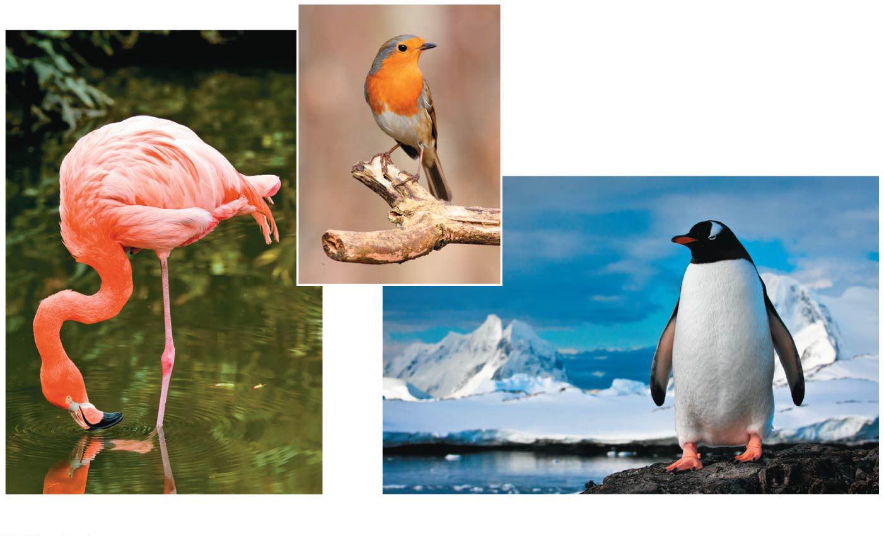
Figure 1.17
European robin
American flamingo
Gentoo penguin
Notes:
Figure 1.17 Unity and diversity among birds

Slide 79
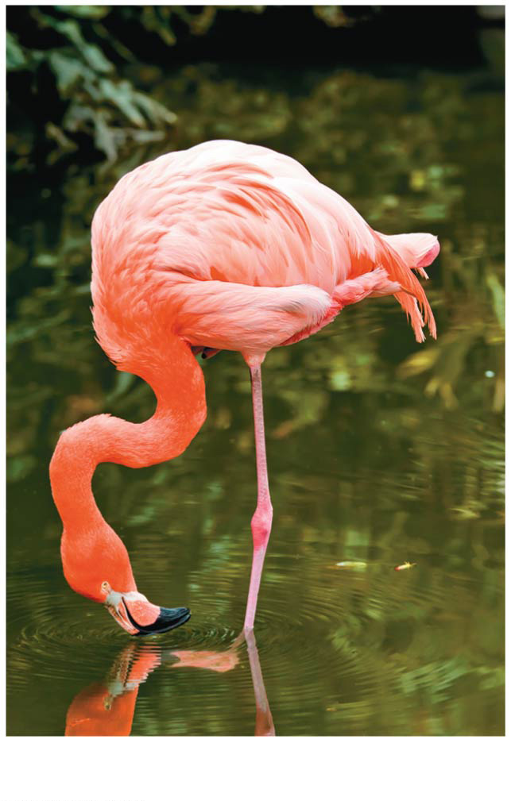
Figure 1.17a
American flamingo
Notes:
Figure 1.17a Unity and diversity among birds (part 1: American flamingo)

Slide 80
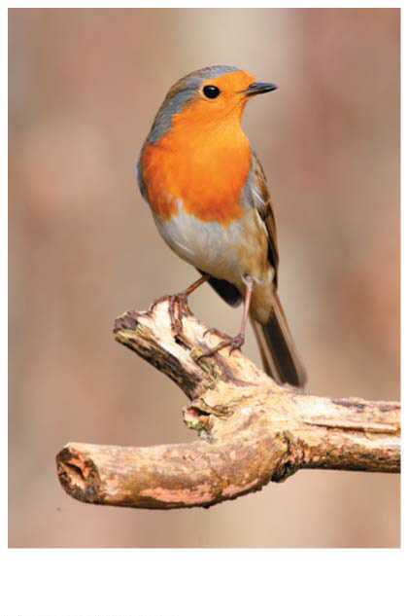
Figure 1.17b
European robin
Notes:
Figure 1.17b Unity and diversity among birds (part 2: European robin)

Slide 81
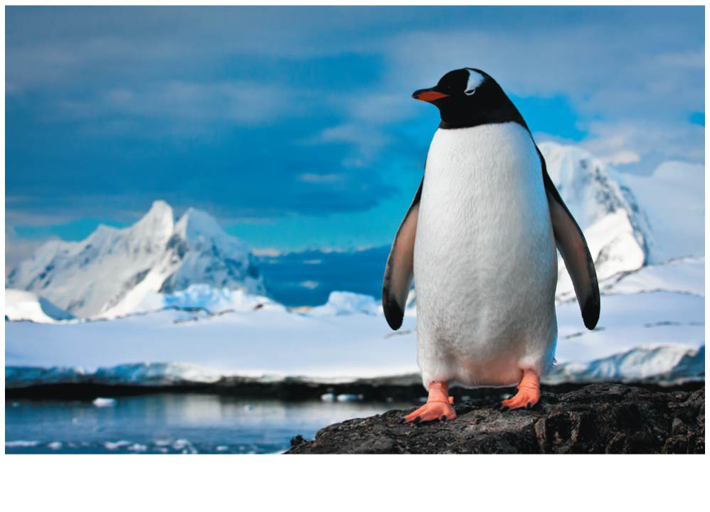
Figure 1.17c
Gentoo penguin
Notes:
Figure 1.17c Unity and diversity among birds (part 3: Gentoo penguin)

Slide 82
Darwin observed that
Individuals in a population vary in their traits, many of which are heritable
More offspring are produced than survive, and competition is inevitable
Species generally suit their environment

Slide 83
Darwin inferred that
Individuals that are best suited to their environment are more likely to survive and reproduce
Over time, more individuals in a population will have the advantageous traits
Evolution occurs as the unequal reproductive success of individuals

Slide 84
In other words, the environment “selects” for the propagation of beneficial traits
Darwin called this process natural selection

Slide 85
Figure 1.18-1
1
Population with varied inherited traits
Notes:
Figure 1.18-1 Natural selection (step 1)

Slide 86
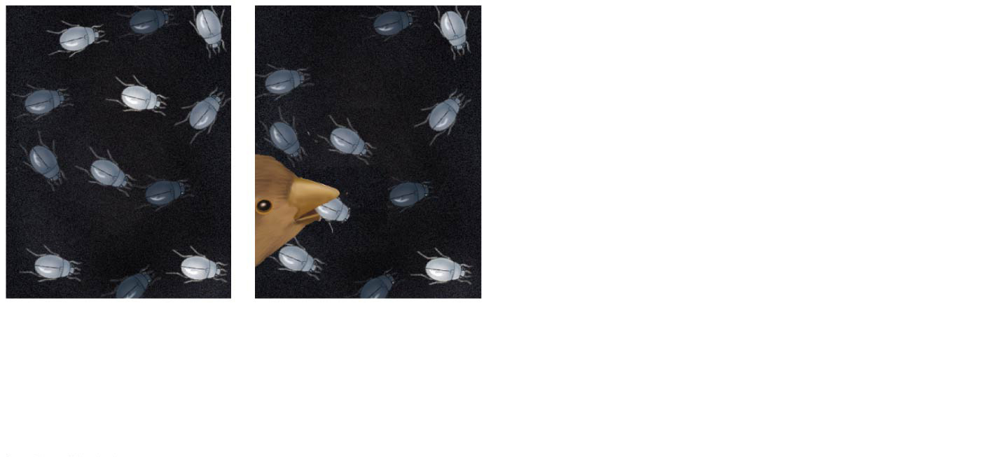
Figure 1.18-2
1
Population with varied inherited traits
2
Elimination of individuals with certain traits
Notes:
Figure 1.18-2 Natural selection (step 2)

Slide 87
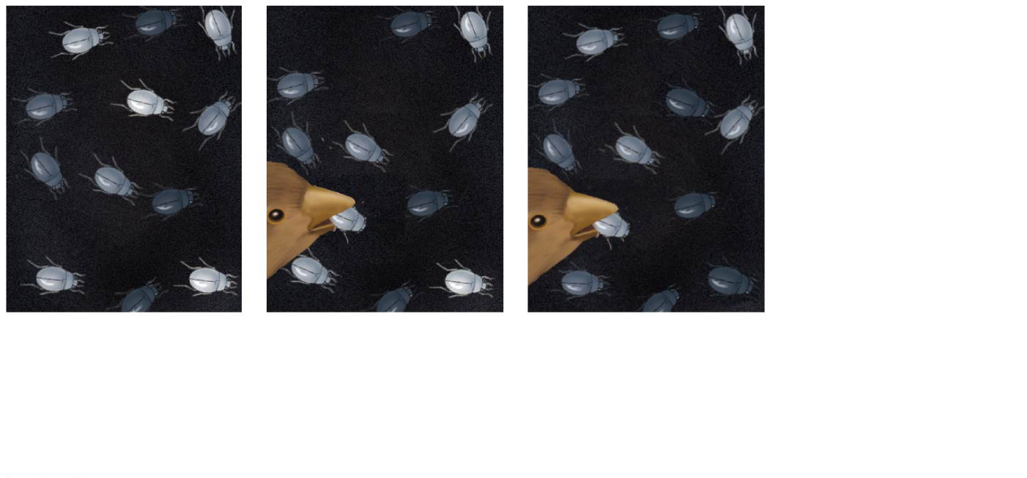
Figure 1.18-3
1
Population with varied inherited traits
2
Elimination of individuals with certain traits
3
Reproduction of survivors
Notes:
Figure 1.18-3 Natural selection (step 3)

Slide 88
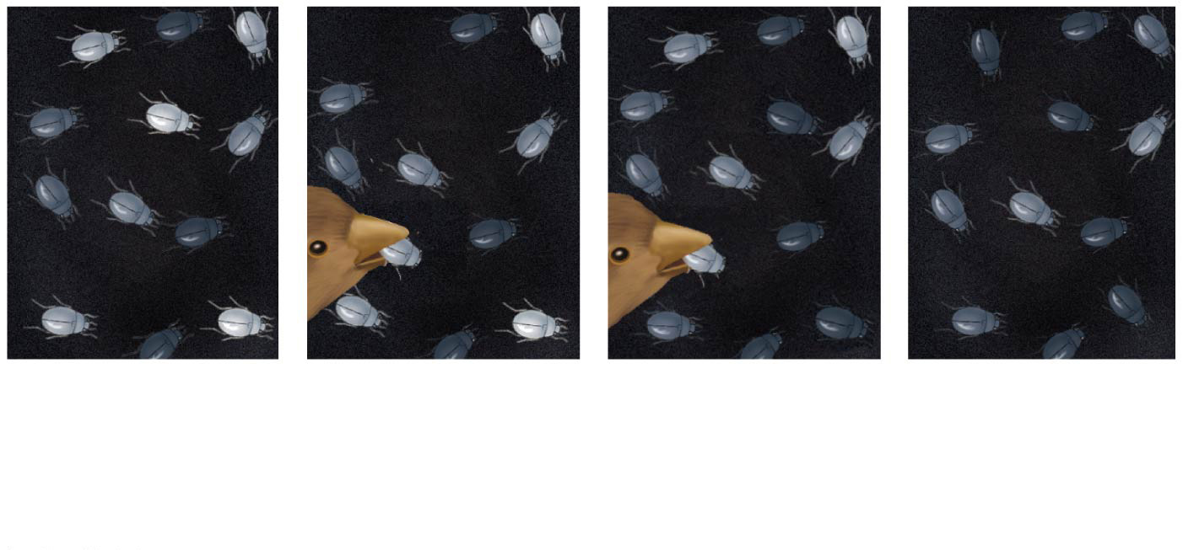
Figure 1.18-4
1
Population with varied inherited traits
2
Elimination of individuals with certain traits
3
Reproduction of survivors
4
Increasing frequency of traits that enhance survival
Notes:
Figure 1.18-4 Natural selection (step 4)

Slide 89
Natural selection results in the adaptation of organisms to their environment
For example, bat wings are an example of adaptation

Slide 90
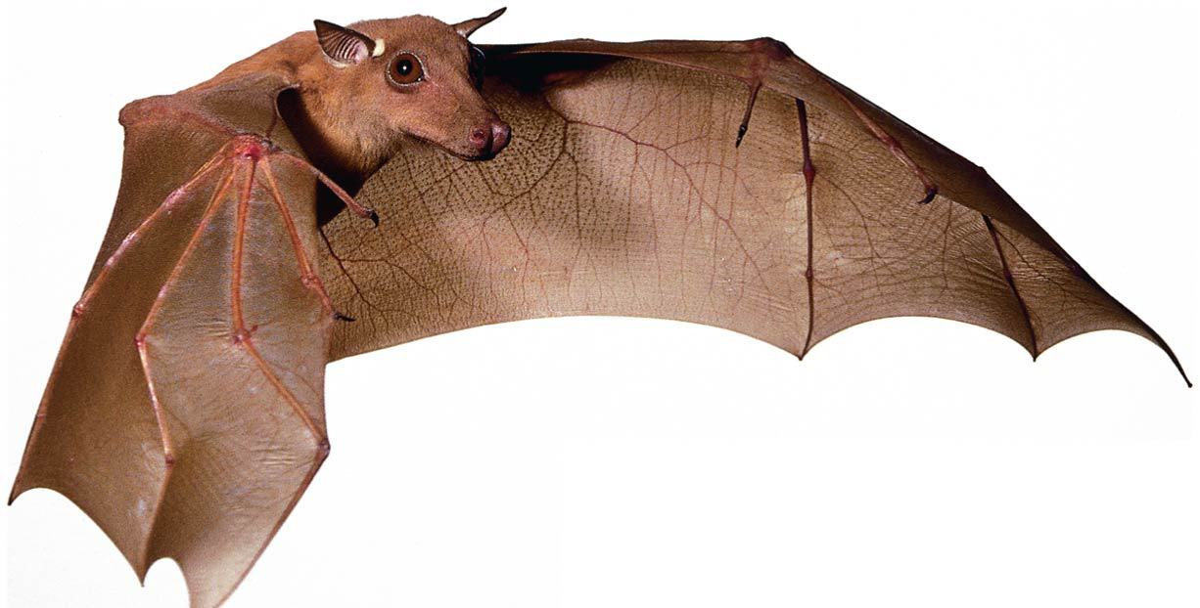
Figure 1.19
Notes:
Figure 1.19 Evolutionary adaptation

Slide 91
The Tree of Life
“Unity in diversity” arises from “descent with modification”
For example, the forelimb of the bat, human, and horse and the whale flipper all share a common skeletal architecture
Fossils provide additional evidence of anatomical unity from descent with modification

Slide 92
Darwin proposed that natural selection could cause an ancestral species to give rise to two or more descendent species
For example, the finch species of the Galápagos Islands are descended from a common ancestor
Evolutionary relationships are often illustrated with treelike diagrams that show ancestors and their descendants

Slide 93
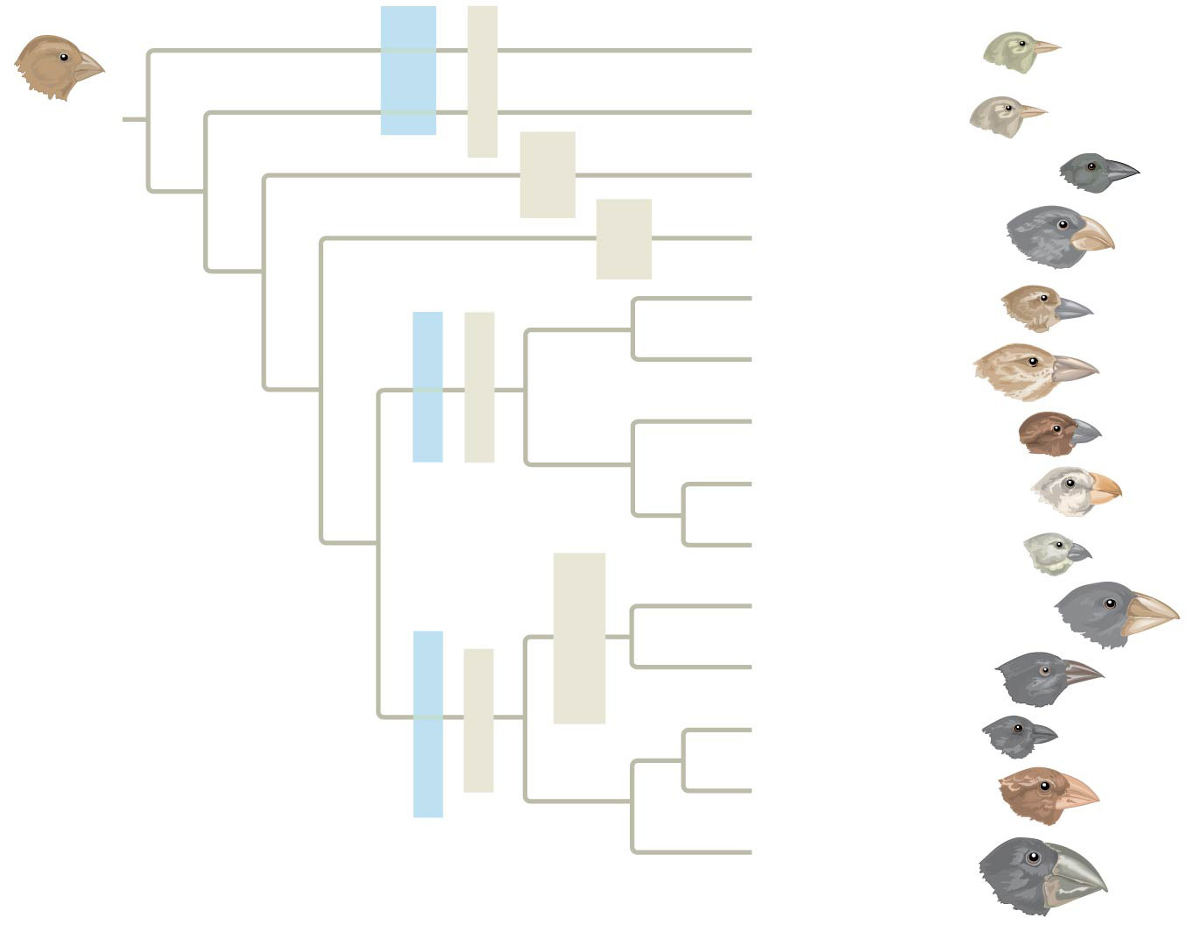
Figure 1.20
Warbler finches
Green warbler finch
Insect-eaters
Certhidea olivacea
COMMON ANCESTOR
Gray warbler finch
Certhidea fusca
Seed- eater
Sharp-beaked ground finch
Geospiza difficilis
Bud- eater
Vegetarian finch
Platyspiza crassirostris
Mangrove finch
Cactospiza heliobates
Woodpecker finch
Insect-eaters
Cactospiza pallida
Tree finches
Medium tree finch
Camarhynchus pauper
Large tree finch
Camarhynchus psittacula
Small tree finch
Camarhynchus parvulus
Large cactus ground finch
Cactus-flower- eaters
Geospiza conirostris
Cactus ground finch
Geospiza scandens
Seed-eaters
Ground finches
Small ground finch
Geospiza fuliginosa
Medium ground finch
Geospiza fortis
Large ground finch
Geospiza magnirostris
Notes:
Figure 1.20 Descent with modification: adaptive radiation of finches on the Galápagos Islands

Slide 94
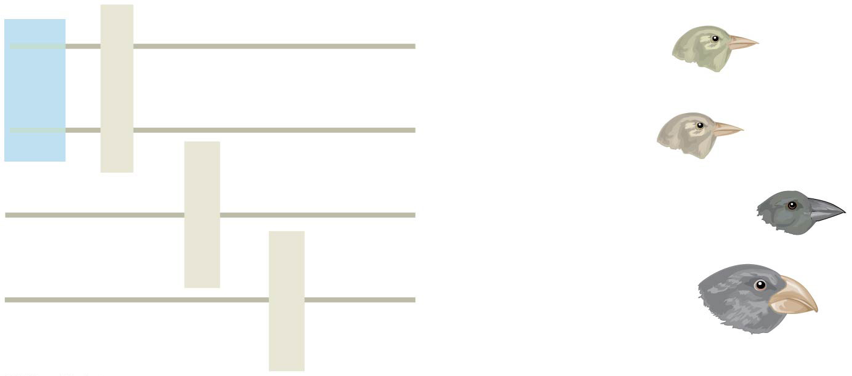
Figure 1.20a
Green warbler finch
Warbler finches
Certhidea olivacea
Insect-eaters
Gray warbler finch
Certhidea fusca
Seed-eater
Sharp-beaked ground finch
Geospiza difficilis
Bud-eater
Vegetarian finch
Platyspiza crassirostris
Notes:
Figure 1.20a Descent with modification: adaptive radiation of finches on the Galápagos Islands (part 1)

Slide 95
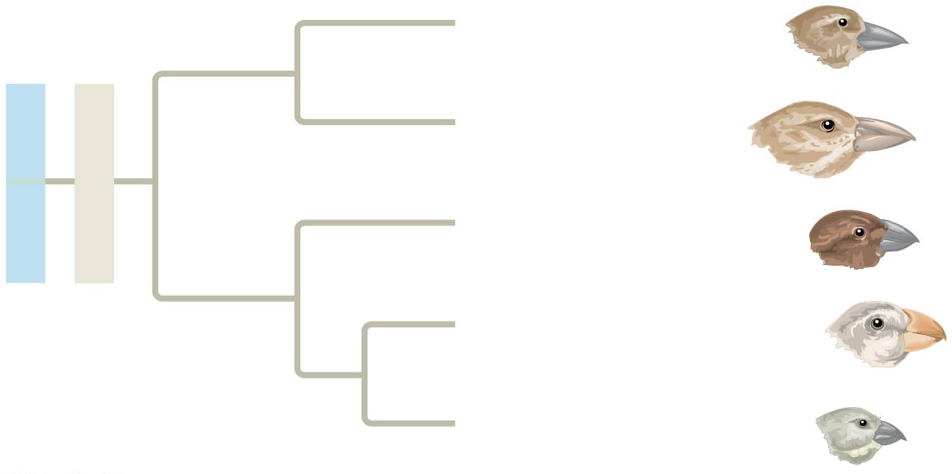
Figure 1.20b
Mangrove finch
Cactospiza heliobates
Woodpecker finch
Cactospiza pallida
Tree finches
Insect-eaters
Medium tree finch
Camarhynchus pauper
Large tree finch
Camarhynchus psittacula
Small tree finch
Camarhynchus parvulus
Notes:
Figure 1.20b Descent with modification: adaptive radiation of finches on the Galápagos Islands (part 2)

Slide 96
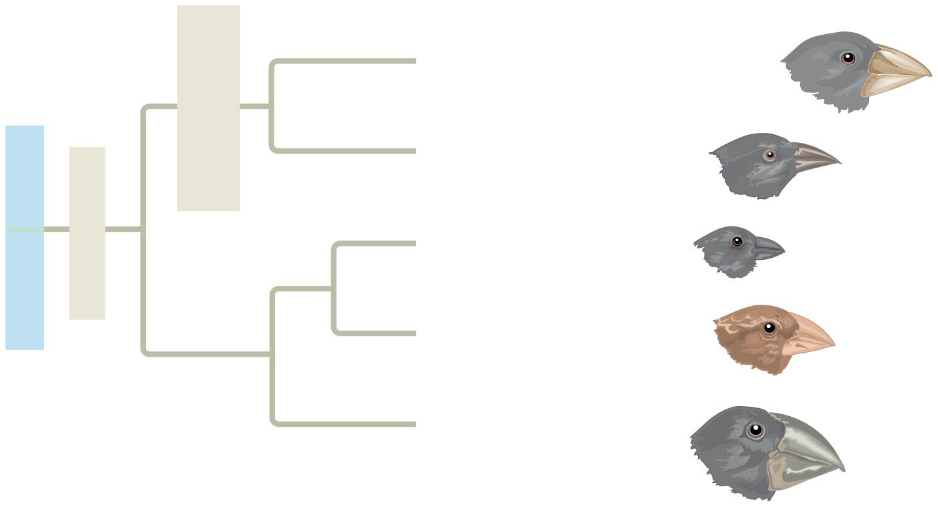
Figure 1.20c
Large cactus ground finch
Geospiza conirostris
Cactus-flower- eaters
Cactus ground finch
Geospiza scandens
Ground finches
Seed-eaters
Small ground finch
Geospiza fuliginosa
Medium ground finch
Geospiza fortis
Large ground finch
Geospiza magnirostris
Notes:
Figure 1.20c Descent with modification: adaptive radiation of finches on the Galápagos Islands (part 3)

Slide 97
Concept 1.3: In studying nature, scientists make observations and form and test hypotheses
The word science is derived from Latin and means “to know”
Inquiry is the search for information and explanations of natural phenomena
The scientific process includes making observations, forming logical hypotheses, and testing them

Slide 98
Making Observations
Biologists describe natural structures and processes
This approach is based on observation and the analysis of data
Recorded observations are called data
Qualitative data often take the form of recorded descriptions
Quantitative data are generally expressed as numerical measurement, organized into tables and graphs

Slide 99
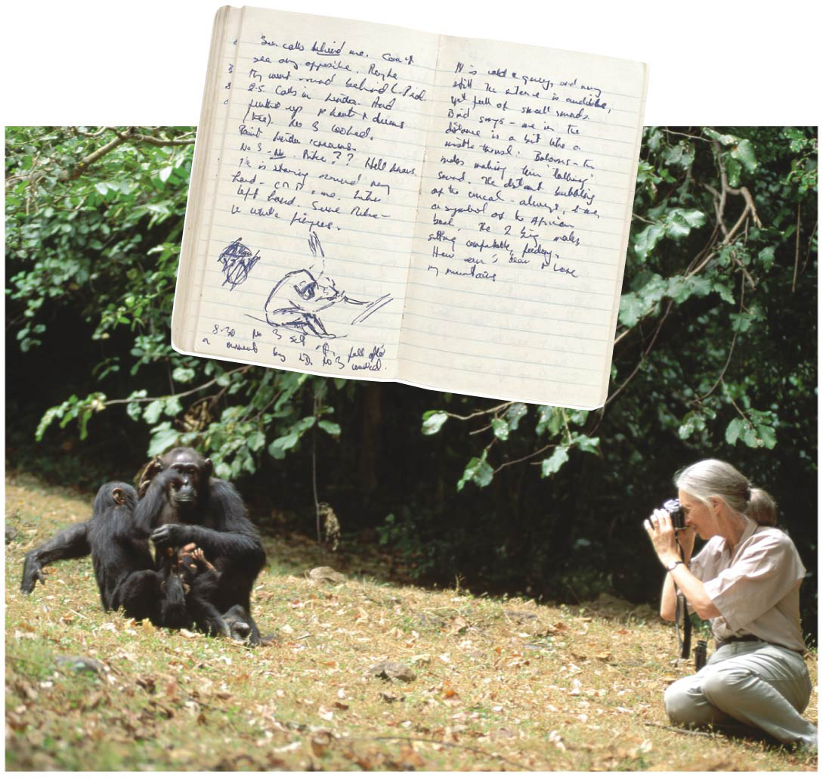
Figure 1.21
Notes:
Figure 1.21 Jane Goodall collecting qualitative data on chimpanzee behavior

Slide 100
Figure 1.21a
Notes:
Figure 1.21a Jane Goodall collecting qualitative data on chimpanzee behavior (part 1: photo)

Slide 101
Figure 1.21b
Notes:
Figure 1.21b Jane Goodall collecting qualitative data on chimpanzee behavior (part 2: notebook)

Slide 102
Inductive reasoning draws conclusions through the logical process of induction
Repeating specific observations can lead to important generalizations
For example, “the sun always rises in the east”

Slide 103
Forming and Testing Hypotheses
In science a hypothesis is a tentative answer to a well-framed scientific question
It is usually a rational accounting for a set of observations
It leads to predictions that can be tested by making additional observations or by performing experiments

Slide 104
For example
Observation: Your flashlight doesn’t work
Question: Why doesn’t your flashlight work?
Hypothesis 1: The batteries are dead
Hypothesis 2: The bulb is burnt out
Both these hypotheses are testable

Slide 105
Figure 1.22
Observation: Flashlight doesn’t work.
Question: Why doesn’t the flashlight work?
Hypothesis #1: Batteries are dead.
Hypothesis #2: Bulb is burnt out.
Prediction: Replacing batteries will fix problem.
Prediction: Replacing bulb will fix problem.
Test of prediction: Replace batteries.
Test of prediction: Replace bulb.
Result: Flashlight doesn’t work. Hypothesis is contradicted.
Result: Flashlight works. Hypothesis is supported.
Notes:
Figure 1.22 A simplified view of the scientific process

Slide 106
Deductive Reasoning
Deductive reasoning uses general premises to make specific predictions
Initial observations may give rise to multiple hypotheses
We can never prove that a hypothesis is true, but testing it in many ways with different sorts of data can increase our confidence in it tremendously

Slide 107
Questions That Can and Cannot Be Addressed by Science
A hypothesis must be testable and falsifiable
For example, a hypothesis that ghosts fooled with the flashlight cannot be tested
Supernatural and religious explanations are outside the bounds of science

Slide 108
The Flexibility of the Scientific Process
The scientific method is an idealized process of inquiry
Hypothesis-based science is based on the “textbook” scientific method but rarely follows all the ordered steps
Backtracking and “rethinking” may be necessary part way through the process

Slide 109
Figure 1.23
EXPLORATION AND DISCOVERY
FORMING AND TESTING HYPOTHESES
SOCIETAL BENEFITS AND OUTCOMES
COMMUNITY ANALYSIS AND FEEDBACK
Notes:
Figure 1.23 The process of science: a more realistic model

Slide 110
Figure 1.23a
Testing Ideas
• Forming hypotheses • Predicting results • Doing experiments and/or making observations • Measuring results
Interpreting Test Results Data may…
• Support a hypothesis • Contradict a hypothesis • Inspire a revised or new hypothesis • Prompt revised assumptions
Notes:
Figure 1.23a The process of science: a more realistic model (part 1: hypotheses)

Slide 111
Figure 1.23b
• Observing nature • Asking questions • Sharing data and ideas • Finding inspiration • Exploring the scientific literature
Notes:
Figure 1.23b The process of science: a more realistic model (part 2: exploration)

Slide 112
Figure 1.23c
• Feedback and peer review • Replication of experiments and observations • Discussion with colleagues • Publication • Devising new ideas and questions • Theory building
Notes:
Figure 1.23c The process of science: a more realistic model (part 3: analysis and feedback)

Slide 113
Figure 1.23d
• Developing technology • Addressing societal issues • Informing policy • Solving everyday problems • Satisfying curiosity • Building knowledge
Notes:
Figure 1.23d The process of science: a more realistic model (part 4: benefits and outcomes)

Slide 114
Figure 1.23e
Notes:
Figure 1.23e The process of science: a more realistic model (part 5: hypotheses photo)

Slide 115
Figure 1.23f
Notes:
Figure 1.23f The process of science: a more realistic model (part 6: exploration photo)

Slide 116
Figure 1.23g
Notes:
Figure 1.23g The process of science: a more realistic model (part 7: analysis and feedback photo)

Slide 117
Figure 1.23h
Notes:
Figure 1.23h The process of science: a more realistic model (part 8: benefits and outcomes photo)

Slide 118
A Case Study in Scientific Inquiry: Investigating Coat Coloration in Mouse Populations
Color patterns of animals vary widely in nature, sometimes even between members of the same species
Two populations of mice belonging to the same species (Peromyscus polionotus) but with different color patterns are found in different environments
The beach mouse lives on white sand dunes with sparse vegetation; the inland mouse lives on darker soil

Slide 119
Figure 1.24
Florida
Inland population
GULF OF MEXICO
Beach population
Beach population
Inland population
Notes:
Figure 1.24 Different coloration in beach and inland populations of Peromyscus polionotus

Slide 120
Figure 1.24a
Notes:
Figure 1.24a Different coloration in beach and inland populations of Peromyscus polionotus (part 1: beach habitat)

Slide 121
Figure 1.24b
Notes:
Figure 1.24b Different coloration in beach and inland populations of Peromyscus polionotus (part 2: inland habitat)

Slide 122
Figure 1.24c
Notes:
Figure 1.24c Different coloration in beach and inland populations of Peromyscus polionotus (part 3: beach population)

Slide 123
Figure 1.24d
Notes:
Figure 1.24d Different coloration in beach and inland populations of Peromyscus polionotus (part 4: inland population)

Slide 124
The two types of mice match the coloration of their habitats
Natural predators of these mice are all visual hunters
Francis Bertody Sumner hypothesized that the color patterns had evolved as adaptations to protect the mice from predators
Hopi Hoekstra and a group of students tested this hypothesis

Slide 125
The researchers predicted that mice that did not match their habitat would be preyed on more heavily than mice that did match the surroundings
They built models of mice, painted them to match one of the surroundings, and placed equal numbers of each type of model in each habitat
They then recorded signs of predation

Slide 126
Figure 1.25
Results
Beach habitat
Inland habitat
100
Percentage of attacked models
50
0
Light models Dark models Light models Dark models
Camouflaged Non-camouflaged Non-camouflaged Camouflaged (control) (experimental) (experimental) (control)
Notes:
Figure 1.25 Inquiry: Does camouflage affect predation rates on two populations of mice?

Slide 127
Figure 1.25a
Camouflaged (control)
Notes:
Figure 1.25a Inquiry: Does camouflage affect predation rates on two populations of mice? (part 1: camouflaged beach mouse)

Slide 128
Figure 1.25b
Non-camouflaged (experimental)
Notes:
Figure 1.25b Inquiry: Does camouflage affect predation rates on two populations of mice? (part 2: non-camouflaged beach mouse)

Slide 129
Figure 1.25c
Non-camouflaged (experimental)
Notes:
Figure 1.25c Inquiry: Does camouflage affect predation rates on two populations of mice? (part 3: non-camouflaged inland mouse)

Slide 130
Figure 1.25d
Camouflaged (control)
Notes:
Figure 1.25d Inquiry: Does camouflage affect predation rates on two populations of mice? (part 4: camouflaged inland mouse)

Slide 131
Experimental Variables and Controls
In a controlled experiment, an experimental group (the non-camouflaged mice in this case) is compared with a control group (the camouflaged mice)
Ideally experimental and control groups differ in only the one factor under investigation
Without controls the researchers would not be able to rule out other factors besides model color that might have affected the results

Slide 132
Theories in Science
In the context of science, a theory is
Broader in scope than a hypothesis
General, and can lead to new testable hypotheses
Supported by a large body of evidence in comparison to a hypothesis

Slide 133
Concept 1.4: Science benefits from a cooperative approach and diverse viewpoints
Most scientists work in teams, which often include graduate and undergraduate students
Good communication is important in order to share results through seminars, publications, and websites

Slide 134
Building on the Work of Others
Scientists check each other’s claims by performing similar experiments
If experimental results are not repeatable, the original claim will have to be revised
It is not unusual for different scientists to work on the same research question
Scientists cooperate by sharing data about model organisms (for example, the fruit fly Drosophila melanogaster)

Slide 135
Science, Technology, and Society
The goal of science is to understand natural phenomena
The goal of technology is to apply scientific knowledge for some specific purpose
Science and technology are interdependent
Biology is marked by “discoveries,” while technology is marked by “inventions”

Slide 136
The combination of science and technology has dramatic effects on society
For example, the discovery of DNA by James Watson and Francis Crick allowed for advances in DNA technology such as testing for hereditary diseases
Ethical issues can arise from new technology, but have as much to do with politics, economics, and cultural values as with science and technology

Slide 137
Figure 1.26
Notes:
Figure 1.26 DNA technology and crime scene investigation

Slide 138
The Value of Diverse Viewpoints in Science
Many important inventions have occurred where different cultures and ideas mix
For example, the printing press relied on innovations from China (paper and ink) and Europe (mass production in mills)
Science benefits from diverse views from different racial and ethnic groups, and from both women and men

Slide 139
Figure 1.UN02a
40
Light coat
40
Light coat
35
Dark coat
35
Dark coat
30
30
25
25
Number of mice caught
Number of mice caught
20
20
15
15
10
10
5
5
0
0
Full moon
No moon
Full moon
No moon
A: Light-colored soil
B: Dark-colored soil
Notes:
Figure 1.UN02a Skills exercise: interpreting a pair of bar graphs (part 1)

Slide 140
Figure 1.UN02b
Notes:
Figure 1.UN02b Skills exercise: interpreting a pair of bar graphs (part 2)

Slide 141
Figure 1.UN03
Notes:
Figure 1.UN03 Summary of key concepts: levels of biological organization

Slide 142
Figure 1.UN04
Notes:
Figure 1.UN04 Summary of key concepts: eukaryotic and prokaryotic cells

Slide 143
Figure 1.UN05
Notes:
Figure 1.UN05 Summary of key concepts: DNA

Slide 144
Figure 1.UN06
ENERGY FLOW
Notes:
Figure 1.UN06 Summary of key concepts: energy flow and chemical cycling

Slide 145
Figure 1.UN07
Notes:
Figure 1.UN07 Summary of key concepts: biological interactions

Slide 146
Figure 1.UN08
STIMULUS
Negative feedback
RESPONSE
Notes:
Figure 1.UN08 Summary of key concepts: feedback regulation

Slide 147
Figure 1.UN09
Notes:
Figure 1.UN09 Summary of key concepts: evolutionary adaptation

Slide 148
Figure 1.UN10
Population of organisms
Hereditary variations
Overproduction of off- spring and competition
Environmental factors
Differences in reproductive success of individuals
Evolution of adaptations in the population
Notes:
Figure 1.UN10 Summary of key concepts: natural selection

Slide 149
Figure 1.UN11
Notes:
Figure 1.UN11 Test your understanding, question 15 (mossy leaf-tailed gecko)

