Slide 1
0
20
DNA Tools and Biotechnology
Lecture Presentation by Nicole Tunbridge and
Kathleen Fitzpatrick

Slide 2
The DNA Toolbox
Recently the genome sequences of two extinct species—Neanderthals and wooly mammoths—have been completed
Advances in sequencing techniques make genome sequencing increasingly faster and less expensive

Slide 3
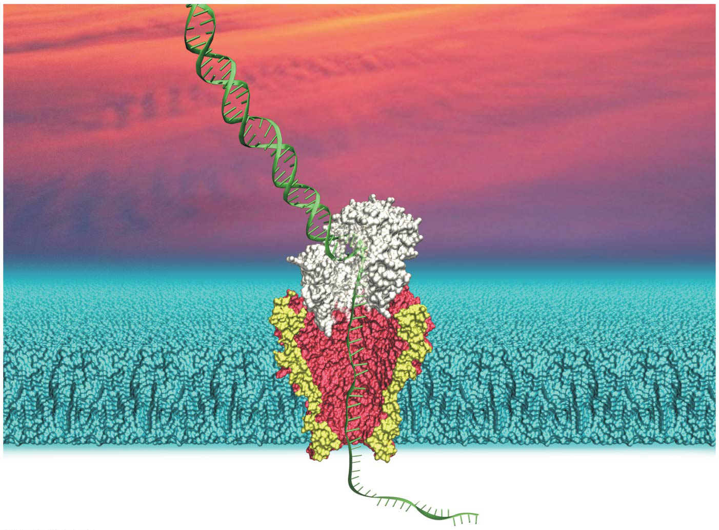
Figure 20.1
Notes:
Figure 20.1 How can the technique shown in this model speed up DNA sequencing?

Slide 4
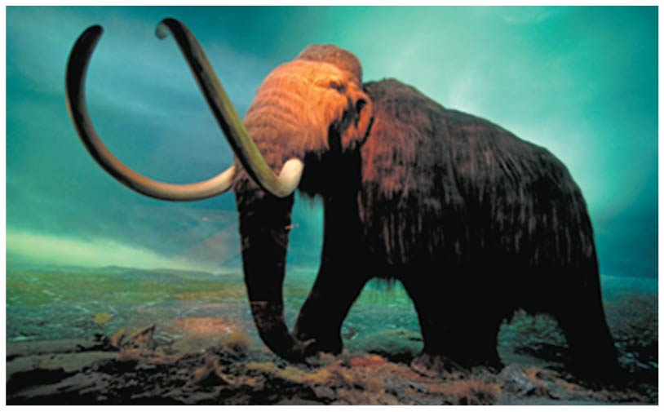
Figure 20.1a
Notes:
Figure 20.1a How can the technique shown in this model speed up DNA sequencing? (part 1: woolly mammoth)

Slide 5
Biotechnology is the manipulation of organisms or their components to make useful products
The applications of DNA technology affect everything from agriculture, to criminal law, to medical research

Slide 6
Concept 20.1: DNA sequencing and DNA cloning are valuable tools for genetic engineering and biological inquiry
The complementarity of the two DNA strands is the basis for nucleic acid hybridization, the base pairing of one strand of nucleic acid to the complementary sequence on another strand
Genetic engineering is the direct manipulation of genes for practical purposes

Slide 7
DNA Sequencing
Researchers can exploit the principle of complementary base pairing to determine a gene’s complete nucleotide sequence, called DNA sequencing
The first automated procedure was based on a technique called dideoxy or chain termination sequencing, developed by Sanger

Slide 8
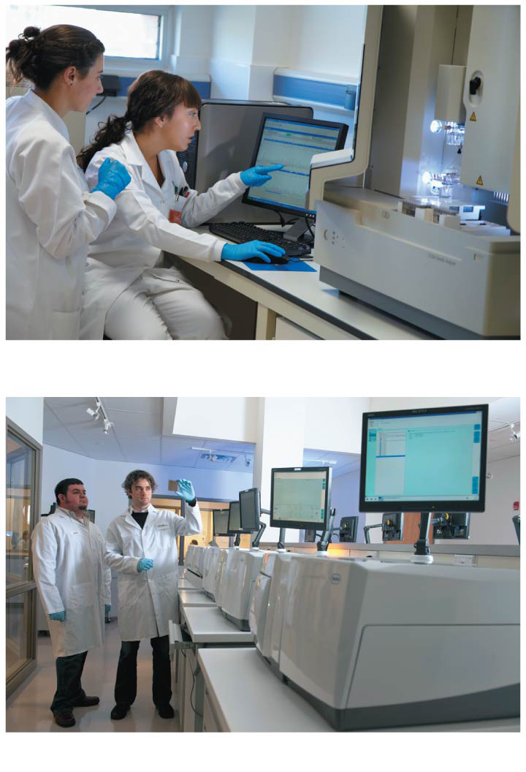
Figure 20.2
(a) Standard sequencing machine
(b) Next-generation sequencing machines
Notes:
Figure 20.2 DNA sequencing machines

Slide 9
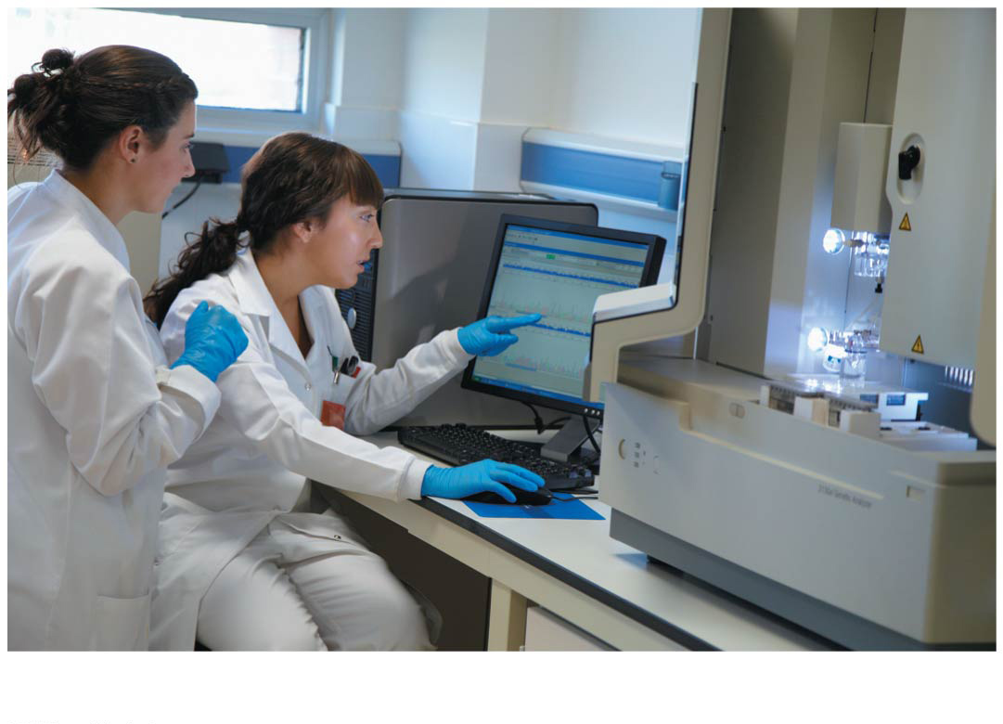
Figure 20.2a
(a) Standard sequencing machine
Notes:
Figure 20.2a DNA sequencing machines (part 1: standard)

Slide 10
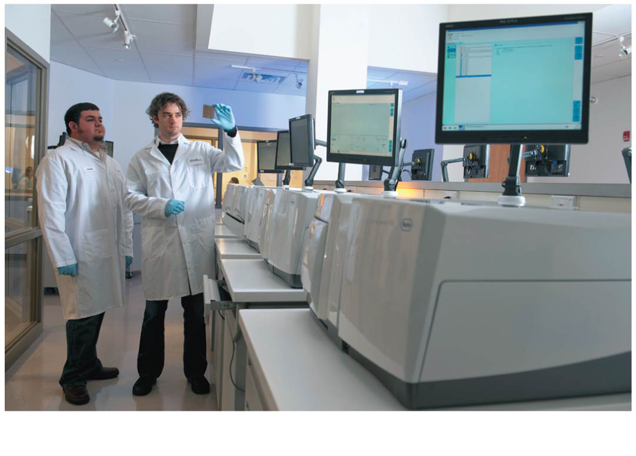
Figure 20.2b
(b) Next-generation sequencing machines
Notes:
Figure 20.2b DNA sequencing machines (part 2: next-generation)

Slide 11
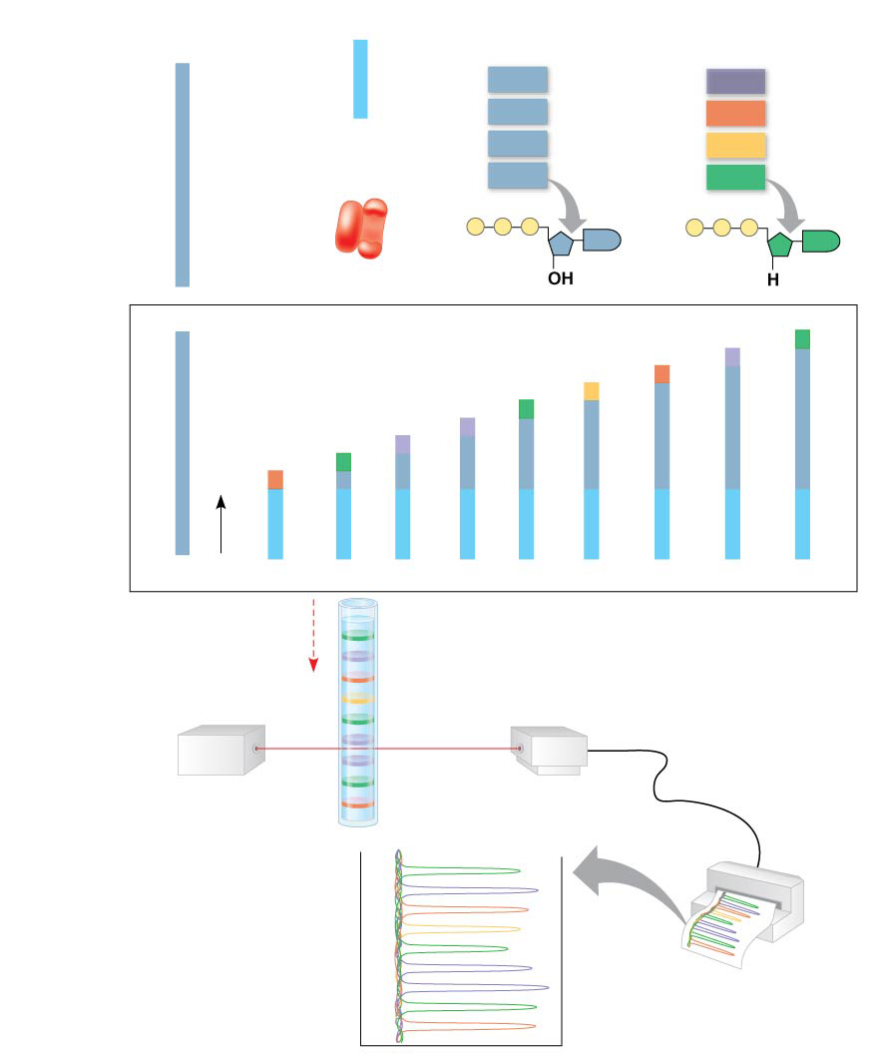
Figure 20.3
Technique
DNA
(template strand)
Primer
Deoxyribo- nucleotides
Dideoxyribonucleotides (fluorescently tagged)
3′
5′
T
G
T
T
C
T
G
A C
T
T
C
G
A
C
A
A
dATP
ddATP
5′
dCTP
ddCTP
DNA
polymerase
dTTP
ddTTP
dGTP
ddGTP
P
P
P
G
P
P
P
G
3′
5′
DNA (template strand)
Labeled strands
dd
3′
C
T
G
A C
T
T
C
G
A
C
A
A
dd
A
C
T
G
A
A
G
G
A
C
T
G
A
dd
T
G
A
A
G
dd
C
T
G
A
A
G
dd
A
A
G
dd
G
A
A
G
dd
G
C
T
G
T
T
dd
A
G
A
G
C
T
G
T
T
dd
C
T
G
T
T
3′
C
T
G
T
T
C
T
G
T
T
C
T
G
T
T
C
T
G
T
T
C
T
G
T
T
C
T
G
T
T
3′
5′
5′
Shortest
Longest
Direction of movement of strands
Longest labeled strand
Detector
Laser
Shortest labeled strand
Results
Last nucleotide of longest labeled strand
G
A
C
T
G
A
A
G
C
Last nucleotide of shortest labeled strand
Notes:
Figure 20.3 Research method: dideoxy chain termination method for sequencing DNA

Slide 12
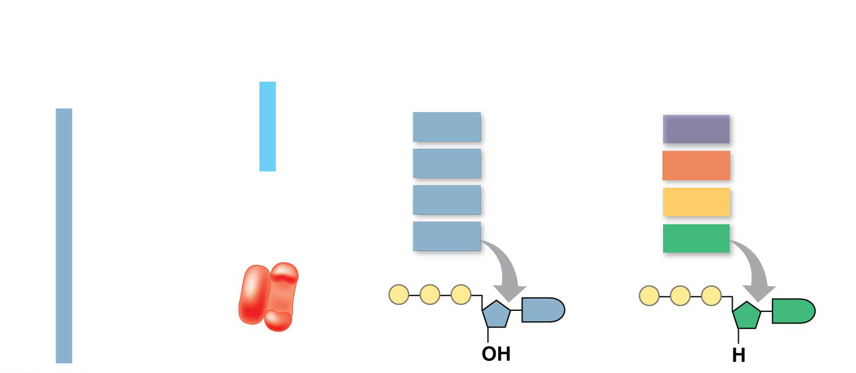
Figure 20.3a
Technique
DNA
(template strand)
Primer
Deoxyribo- nucleotides
Dideoxyribonucleotides (fluorescently tagged)
3′
5′
T
G
T
T
C
T
G
A C
T
T
C
G
A
C
A
A
dATP
ddATP
5′
dCTP
ddCTP
DNA
polymerase
dTTP
ddTTP
dGTP
ddGTP
P
P
P
P
P
P
G
G
3′
Notes:
Figure 20.3a Research method: dideoxy chain termination method for sequencing DNA (part 1)

Slide 13
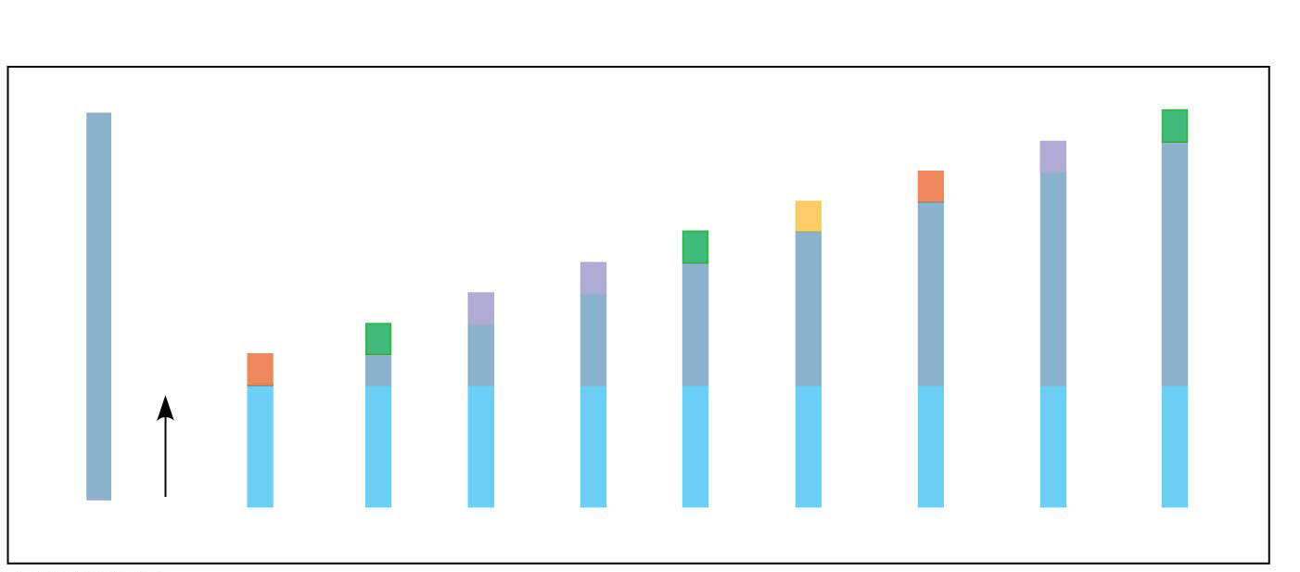
Figure 20.3b
Technique
5′
DNA (template strand)
Labeled strands
3′
C
T
G
A C
T
T
C
G
A
C
A
A
dd
G
A
C
T
G
A
dd
A
C
T
G
A
A
G
dd
C
T
G
A
A
G
dd
T
G
A
A
G
dd
G
A
A
G
dd
A
A
G
dd
A
G
A
G
C
T
G
T
T
3′
dd
G
C
T
G
T
T
dd
C
T
G
T
T
C
T
G
T
T
C
T
G
T
T
C
T
G
T
T
C
T
G
T
T
C
T
G
T
T
C
T
G
T
T
3′
5′
5′
Shortest
Longest
Notes:
Figure 20.3b Research method: dideoxy chain termination method for sequencing DNA (part 2)

Slide 14
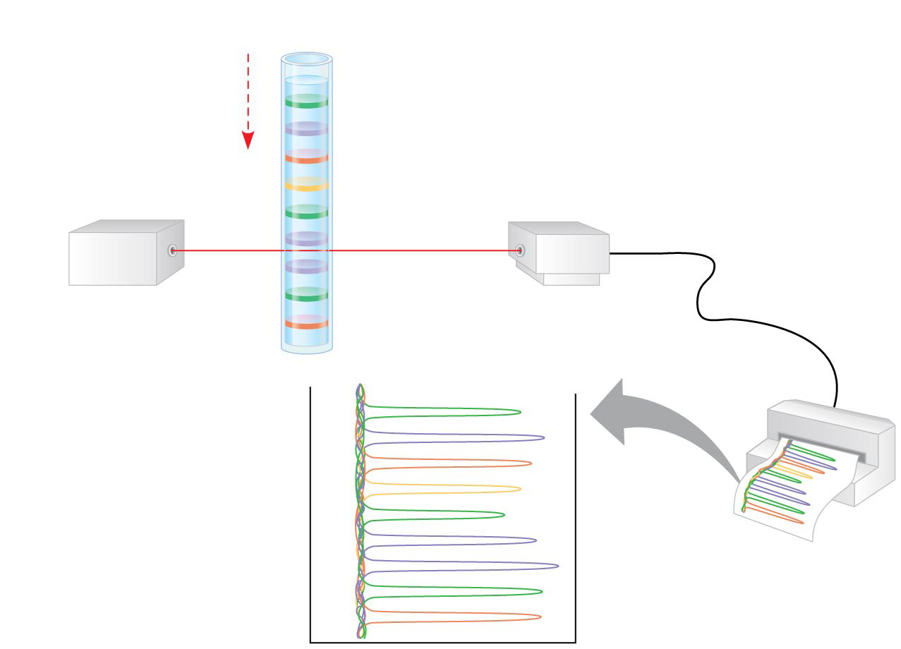
Figure 20.3c
Technique
Direction of movement of strands
Longest labeled strand
Detector
Laser
Shortest labeled strand
Results
Last nucleotide of longest labeled strand
G
A
C
T
G
A
A
G
C
Last nucleotide of shortest labeled strand
Notes:
Figure 20.3c Research method: dideoxy chain termination method for sequencing DNA (part 3)

Slide 15
“Next-generation sequencing” techniques use a single template strand that is immobilized and amplified to produce an enormous number of identical fragments
Thousands or hundreds of thousands of fragments (400–1,000 nucleotides long) are sequenced in parallel
This is a type of “high-throughput” technology

Slide 16
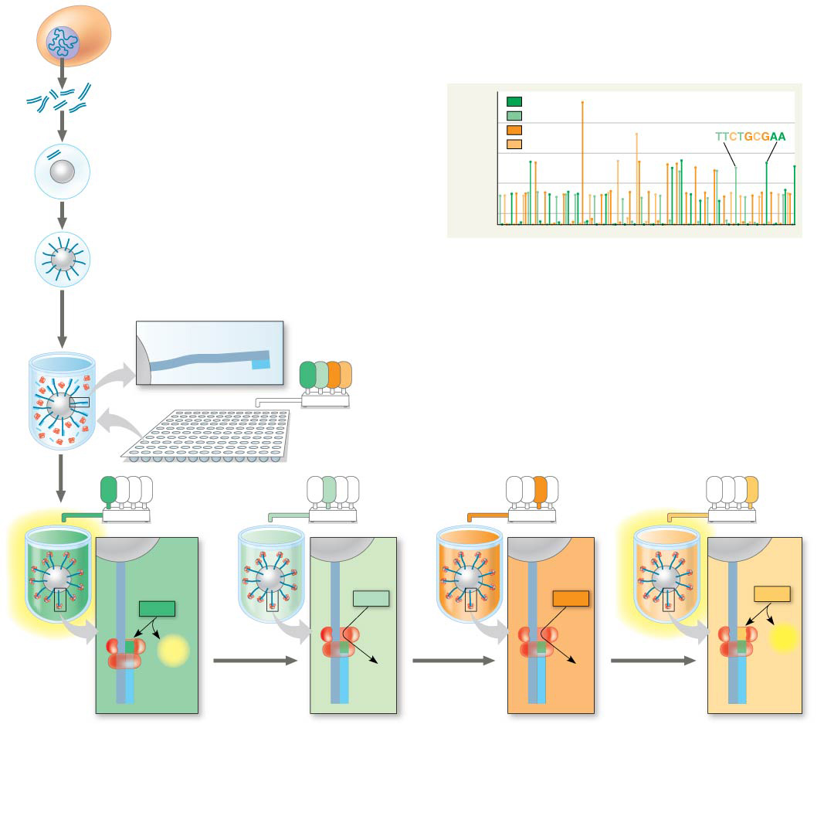
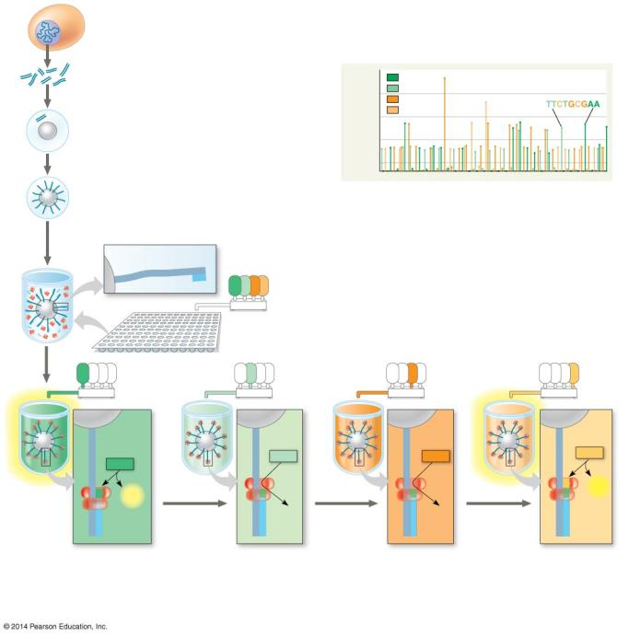
Figure 20.4
Technique
1
Genomic DNA is fragmented.
Results
4-mer
A
2
Each fragment is isolated with a bead.
T
3-mer
G
C
3
Using PCR, 10⁶ copies of each fragment are made, each attached to the bead by 5′ end.
2-mer
1-mer
4
The bead is placed into a well with DNA polymerases and primers.
Template strand of DNA
3′
5′
3′
5′
A
T
G
C
Primer
5
A solution of each of the four nucleotides is added to all wells and then washed off. The entire process is then repeated.
A
T
G
C
A
T
G
C
A
T
G
C
A
T
G
C
C
Template strand of DNA
C
C
C
C
C
C
C
dCTP
A
A
dTTP
A
dGTP
A
A
dATP
A
A
A
T
T
T
T
C
G
A
G
G
A
G
PP_{i}
T
C
PP_{i}
T
A
T
T
A
DNA polymerase
G
C
G
C
G
C
G
C
G
G
C
G
C
G
C
A
G
Primer
A
G
A
G
A
G
T
A
T
A
T
A
T
A
6
If a nucleotide is joined to a growing strand, PP_{i} is released, causing a flash
of light that is recorded.
7
If a nucleotide is not complementary to the next template base, no PP_{i} is released, and no flash of light is recorded.
8
The process is repeated until every fragment has a complete complementary strand. The pattern of flashes reveals the sequence.
Notes:
Figure 20.4 Research method: next-generation sequencing

Slide 17
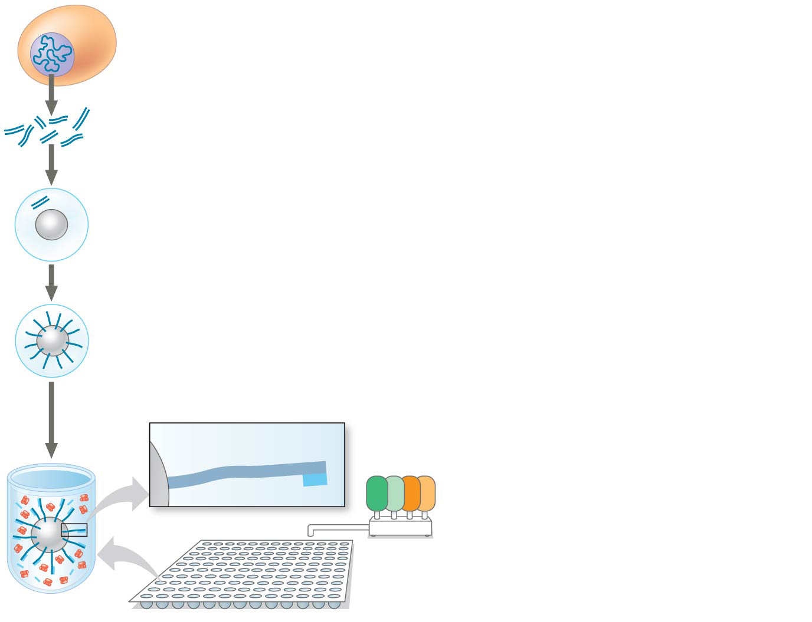
Figure 20.4a
Technique
1
Genomic DNA is fragmented.
2
Each fragment is isolated with a bead.
3
Using PCR, 10⁶ copies of each fragment are made, each attached to the bead by 5′ end.
4
The bead is placed into a well with DNA polymerases and primers.
Template strand of DNA
3′
5′
3′
5′
A
T
G
C
Primer
5
A solution of each of the four nucleotides is added to all wells and then washed off. The entire process is then repeated.
Notes:
Figure 20.4a Research method: next-generation sequencing (part 1)

Slide 18
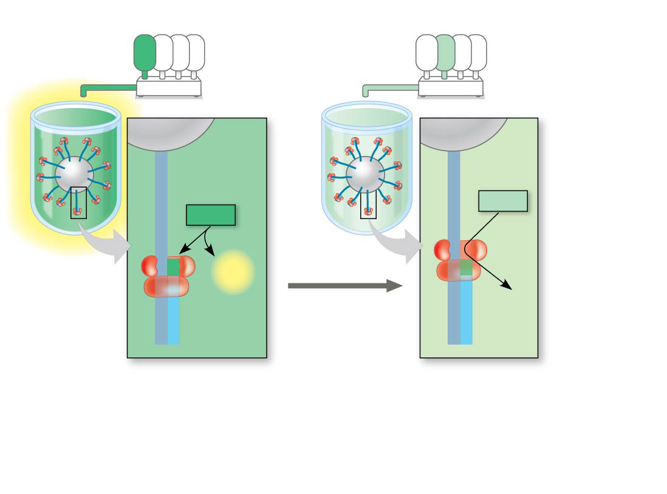
Figure 20.4b
Technique
A
T
G
C
A
T
G
C
C
Template strand of DNA
C
C
C
A
A
dTTP
A
dATP
A
T
T
G
G
T
A
PP_{i}
T
A
DNA polymerase
G
C
G
C
G
C
G
C
A
G
Primer
A
G
T
A
T
A
6
If a nucleotide is joined to a growing strand, PP_{i} is released, causing a flash
of light that is recorded.
7
If a nucleotide is not complementary to the next template base, no PP_{i} is released, and no flash of light is recorded.
Notes:
Figure 20.4b Research method: next-generation sequencing (part 2)

Slide 19
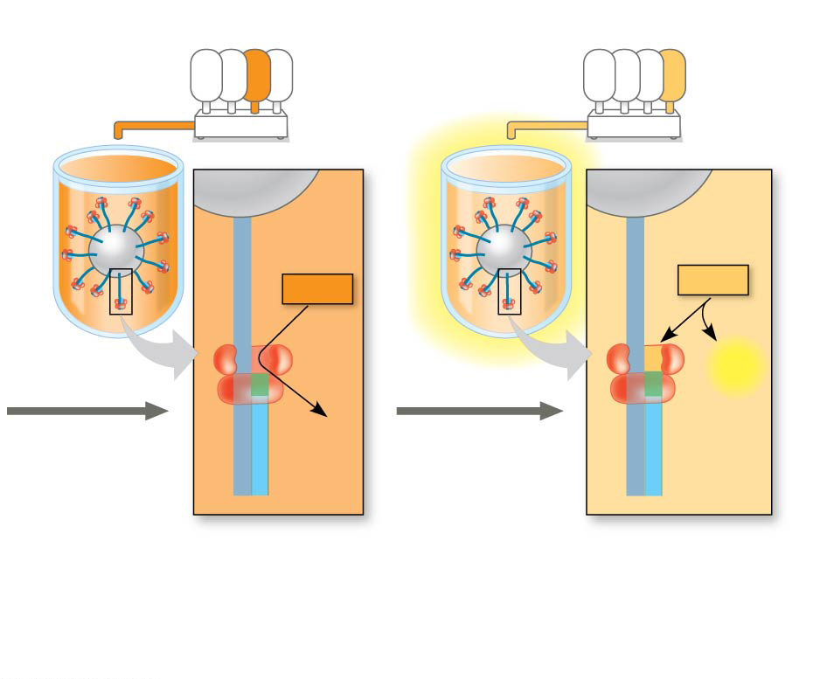
Figure 20.4c
Technique
A
T
G
C
A
T
G
C
C
C
C
C
dCTP
A
dGTP
A
A
A
T
T
G
G
C
PP_{i}
T
A
T
A
G
C
G
C
G
C
G
C
A
G
A
G
T
A
T
A
8
The process is repeated until every fragment has a complete complementary strand. The pattern of flashes reveals the sequence.
Notes:
Figure 20.4c Research method: next-generation sequencing (part 3)

Slide 20
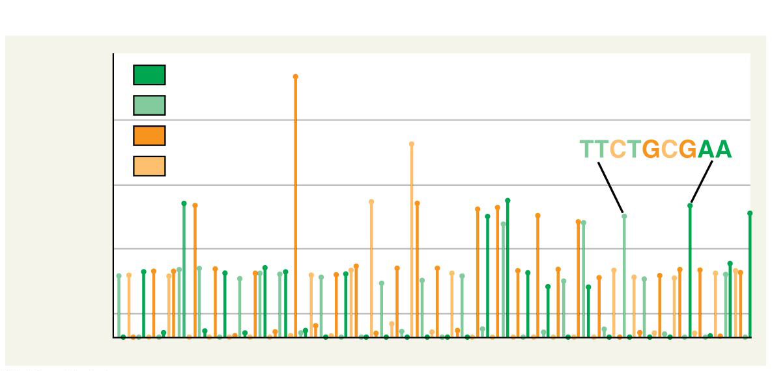
Figure 20.4d
Results
4-mer
A
T
3-mer
G
C
2-mer
1-mer
Notes:
Figure 20.4d Research method: next-generation sequencing (part 4)

Slide 21
In “third-generation sequencing,” the techniques used are even faster and less expensive than the previous

Slide 22
Making Multiple Copies of a Gene or Other DNA Segment
To work directly with specific genes, scientists prepare well-defined DNA segments in multiple identical copies by a process called DNA cloning
Plasmids are small circular DNA molecules that replicate separately from the bacterial chromosome
Researchers can insert DNA into plasmids to produce recombinant DNA, a molecule with DNA from two different sources

Slide 23
Reproduction of a recombinant plasmid in a bacterial cell results in cloning of the plasmid including the foreign DNA
This results in the production of multiple copies of a single gene
The production of multiple copies of a single gene is a type of DNA cloning called gene cloning

Slide 24
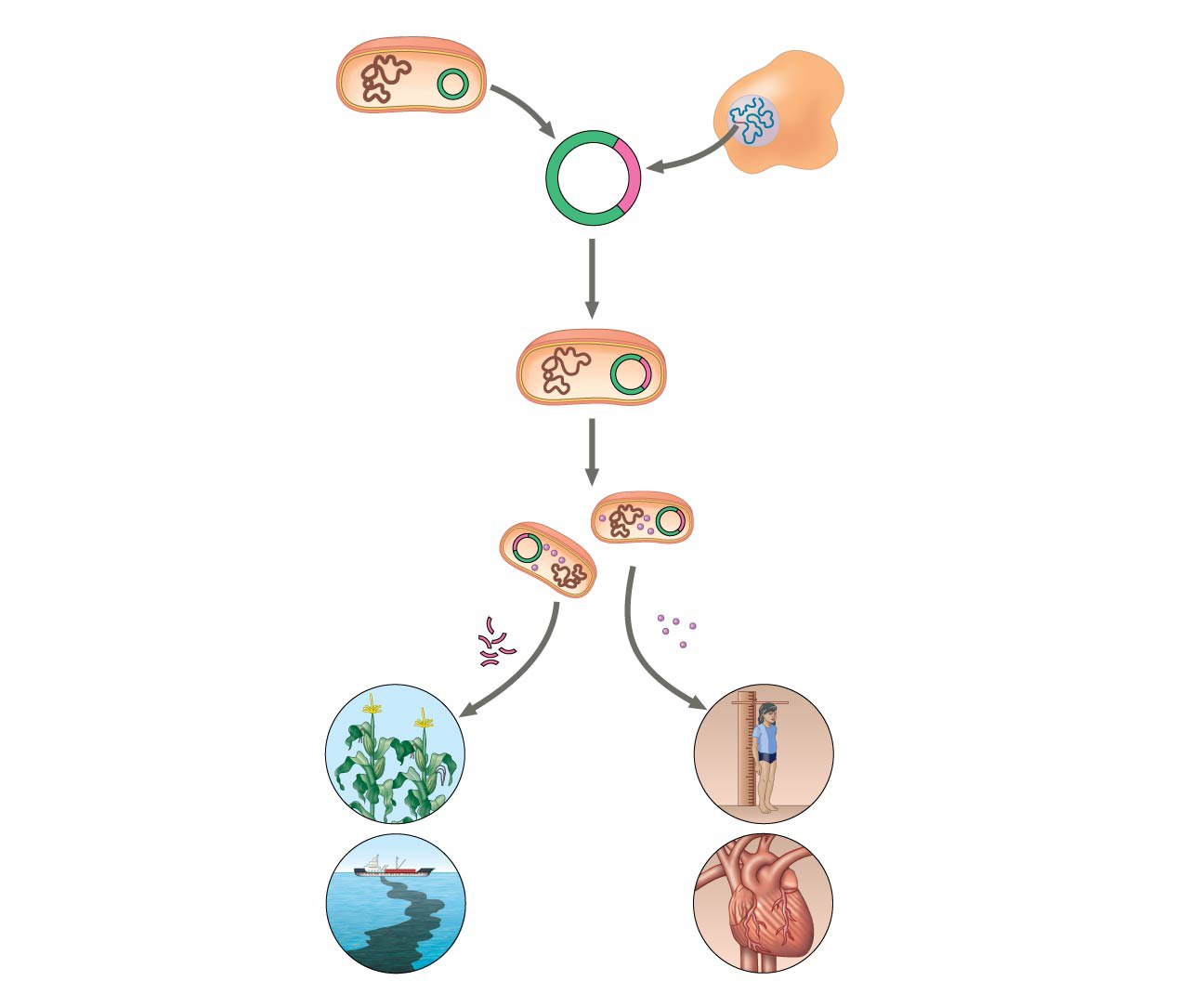
Figure 20.5
Bacterium
Cell containing gene of interest
1
Gene inserted into plasmid
Bacterial chromosome
Plasmid
DNA of chromosome (“foreign” DNA)
Recombinant DNA (plasmid)
Gene of interest
2
Plasmid put into bacterial cell
Recombinant bacterium
3
Host cell grown in culture to form a clone of cells containing the “cloned” gene of interest
Gene of interest
Protein expressed from gene of interest
Copies of gene
Protein harvested
Gene for pest resistance inserted into plants
4
Basic research and various applications
Human growth hormone treats stunted growth
Gene used to alter bacteria for cleaning up toxic waste
Protein dissolves blood clots in heart attack therapy
Notes:
Figure 20.5 Gene cloning and some uses of cloned genes

Slide 25
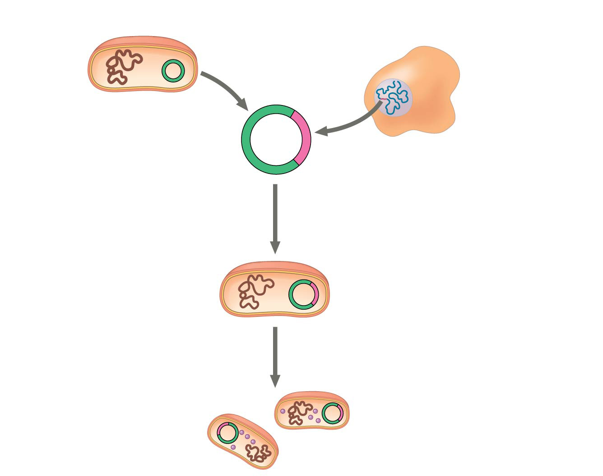
Figure 20.5a
Bacterium
Cell containing gene of interest
1
Gene inserted into plasmid
Bacterial chromosome
Plasmid
DNA of chromosome (“foreign” DNA)
Recombinant DNA (plasmid)
Gene of interest
2
Plasmid put into bacterial cell
Recombinant bacterium
3
Host cell grown in culture to form a clone of cells containing the “cloned” gene of interest
Gene of interest
Gene of interest
Protein expressed from gene of interest
Notes:
Figure 20.5a Gene cloning and some uses of cloned genes (part 1: steps)

Slide 26
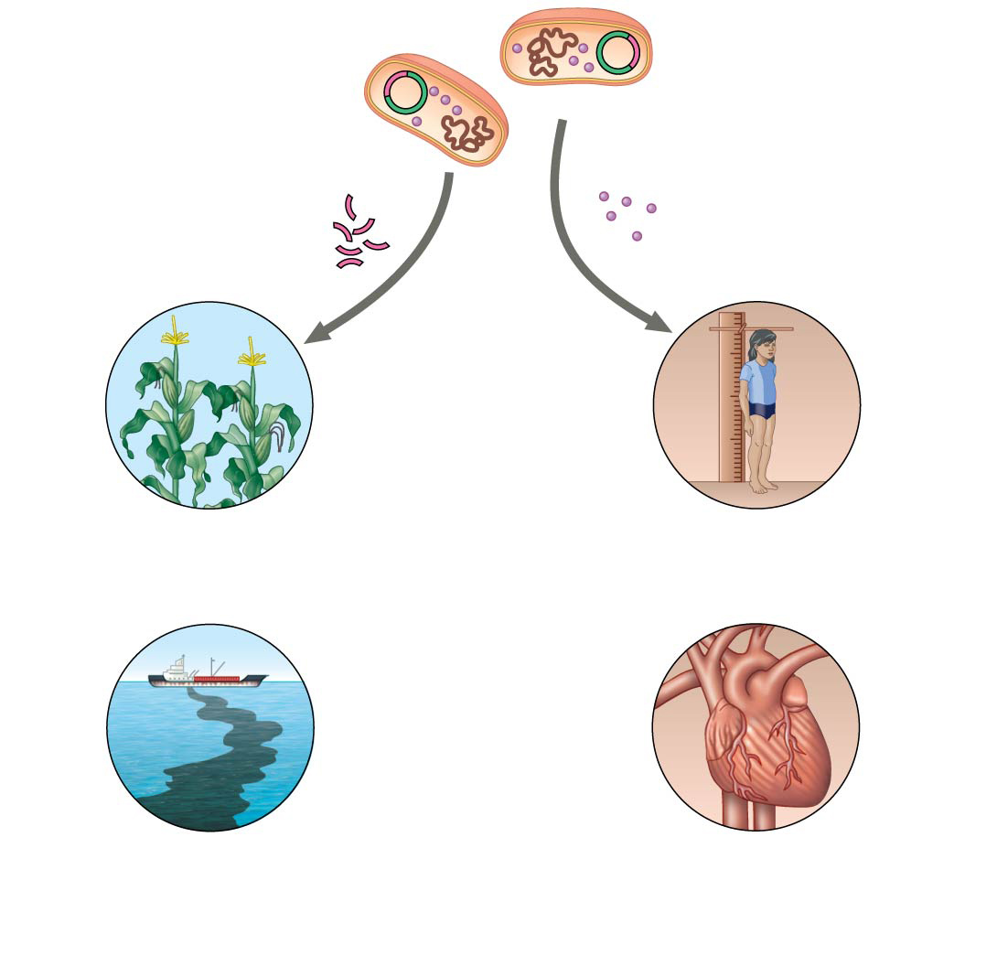
Figure 20.5b
Gene of interest
Protein expressed from gene of interest
Copies of gene
Protein harvested
4
Basic research and various applications
Gene for pest resistance inserted into plants
Human growth hormone treats stunted growth
Gene used to alter bacteria for cleaning up toxic waste
Protein dissolves blood clots in heart attack therapy
Notes:
Figure 20.5b Gene cloning and some uses of cloned genes (part 2: applications)

Slide 27
A plasmid used to clone a foreign gene is called a cloning vector
Bacterial plasmids are widely used as cloning vectors because they are readily obtained, easily manipulated, easily introduced into bacterial cells, and once in the bacteria they multiply rapidly
Gene cloning is useful for amplifying genes to produce a protein product for research, medical, or other purposes

Slide 28
Using Restriction Enzymes to Make a Recombinant DNA Plasmid
Bacterial restriction enzymes cut DNA molecules at specific DNA sequences called restriction sites
A restriction enzyme usually makes many cuts, yielding restriction fragments
The most useful restriction enzymes cut DNA in a staggered way, producing fragments with “sticky ends”

Slide 29
Sticky ends can bond with complementary sticky ends of other fragments
DNA ligase is an enzyme that seals the bonds between restriction fragments

Slide 30
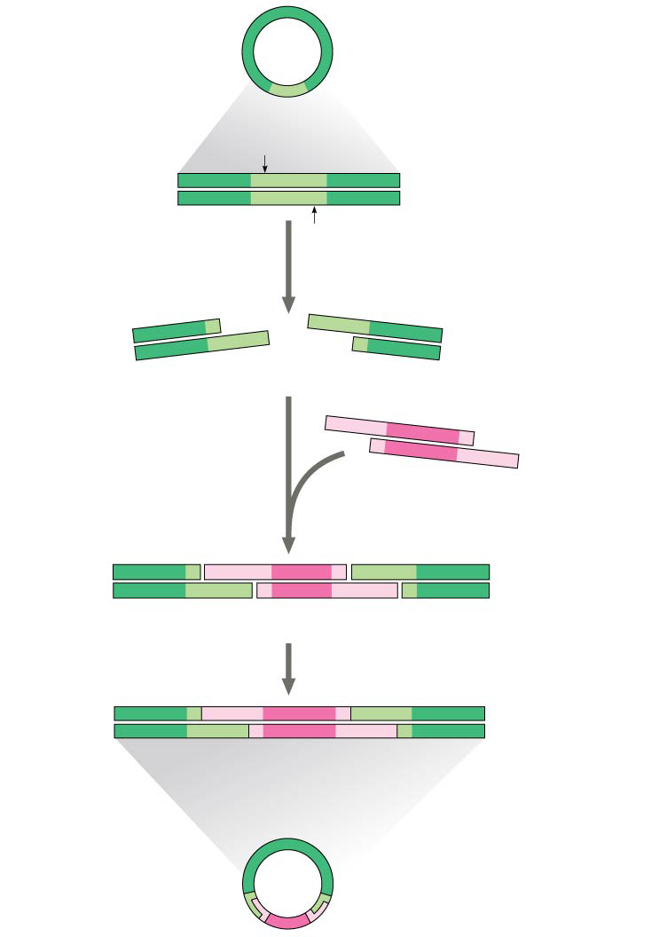
Figure 20.6
Bacterial plasmid
Restriction site
5′
GAATTC
3′
DNA
CTTAAG
3′
5′
1
Restriction enzyme cuts the sugar-phosphate backbones at each arrow.
5′
3′
5′
3′
G
AATTC
CTTAA
G
3′
5′
3′
5′
Sticky end
5′
3′
2
Base pairing of sticky ends produces various combinations.
AATTC
G
G
CTTAA
3′
5′
Fragment from different DNA molecule cut by the same restriction enzyme
5′
3′
5′
3′
5′
T
3′
G
A
A
T
T
C
G
A
A
T
C
C
T
T
A
A
G
C
T
T
A
A
G
3′
5′
3′
5′
3′
5′
3
DNA ligase seals the strands.
One possible combination
5′
3′
3′
Recombinant DNA molecule
5′
Recombinant plasmid
Notes:
Figure 20.6 Using a restriction enzyme DNA ligase to make a recombinant DNA plasmid

Slide 31
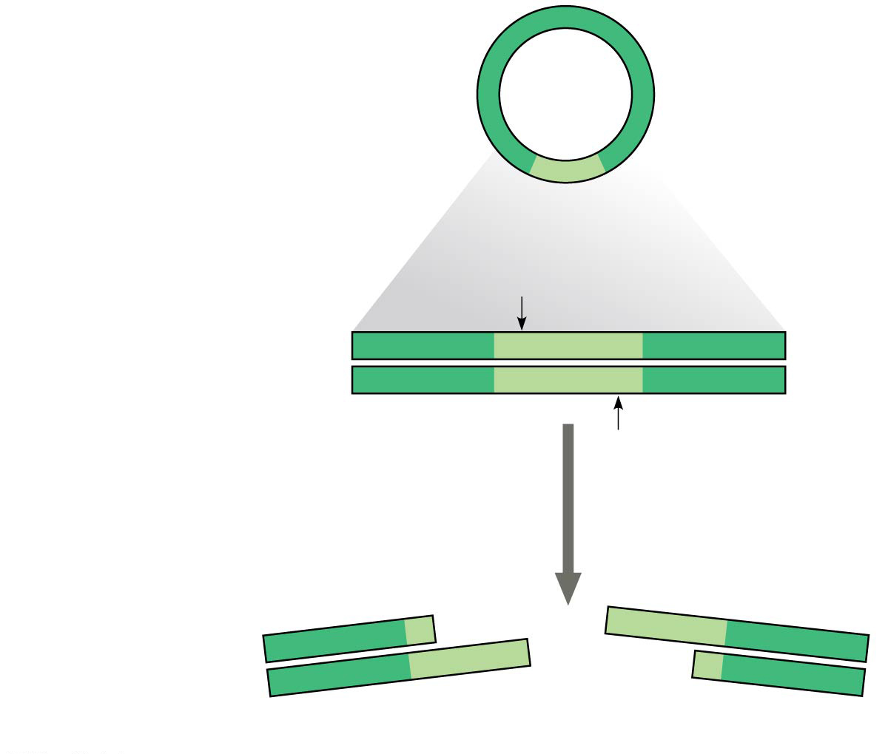
Figure 20.6a
Bacterial plasmid
Restriction site
5′
3′
DNA
GAATTC
CTTAAG
3′
5′
1
Restriction enzyme cuts the sugar-phosphate backbones at each arrow.
3′
5′
5′
AATTC
3′
G
CTTAA
G
5′
3′
3′
Sticky end
5′
Notes:
Figure 20.6a Using a restriction enzyme DNA ligase to make a recombinant DNA plasmid (part 1)

Slide 32
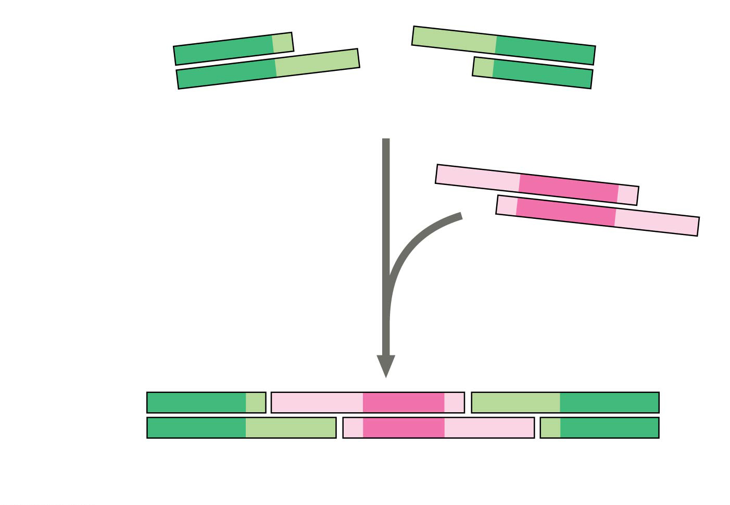
Figure 20.6b
3′
5′
5′
G
AATTC
3′
CTTAA
G
5′
3′
3′
Sticky end
5′
5′
AATTC
3′
2
Base pairing of sticky ends produces various combinations.
G
G
3′
CTTAA
5′
Fragment from different DNA molecule cut by the same restriction enzyme
5′
3′
5′
3′
5′
3′
G
AATT
C
G
AATT
C
C
TTAA
G
C
TTAA
G
3′
5′
3′
5′
3′
5′
One possible combination
Notes:
Figure 20.6b Using a restriction enzyme DNA ligase to make a recombinant DNA plasmid (part 2)

Slide 33
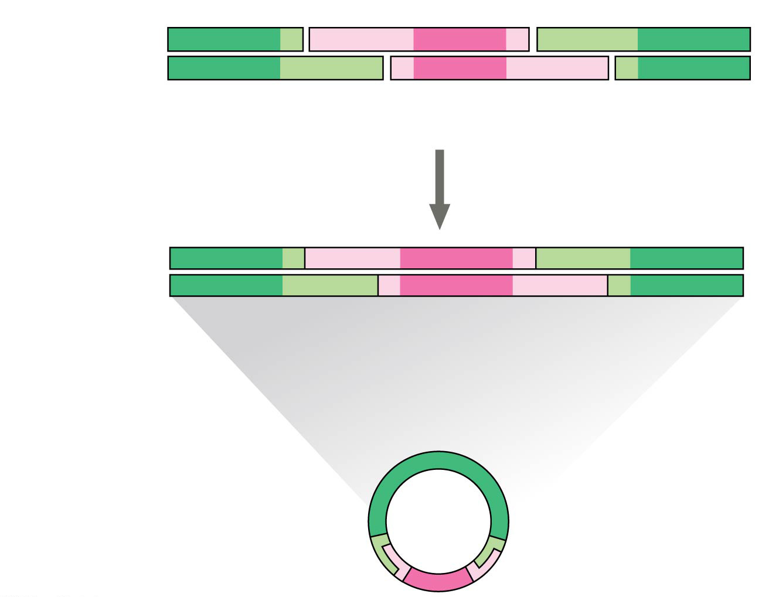
Figure 20.6c
5′
3′
5′
3′
5′
3′
G
AATT
C
G
AATT
C
C
TTAA
G
C
TTAA
G
3′
5′
3′
5′
3′
5′
One possible combination
3
DNA ligase seals the strands
5′
3′
3′
Recombinant DNA molecule
5′
Recombinant plasmid
Notes:
Figure 20.6c Using a restriction enzyme DNA ligase to make a recombinant DNA plasmid (part 3)

Slide 34
Animation: Restriction Enzymes

Slide 35
To check the recombinant plasmid, researchers might cut the products again using the same restriction enzyme
To separate and visualize the fragments produced, gel electrophoresis would be carried out
This technique uses a gel made of a polymer to separate a mixture of nucleic acids or proteins based on size, charge, or other physical properties

Slide 36
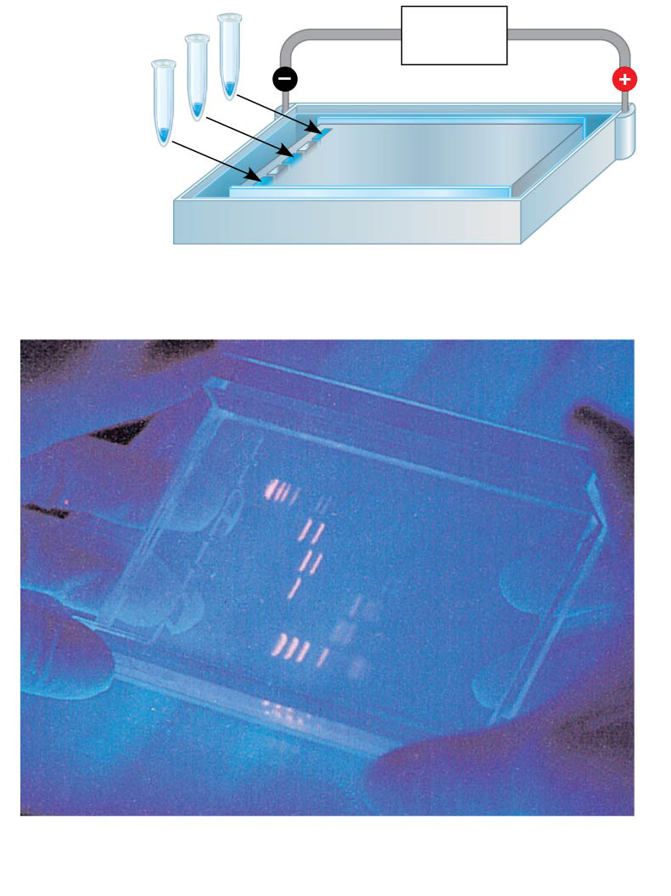
Figure 20.7
Mixture of DNA mol- ecules of different sizes
Power source
Cathode
Anode
Wells
Gel
(a) Negatively charged DNA molecules move toward the positive electrode.
Restriction fragments (size standards)
(b) Shorter molecules are slowed down less than longer ones, so they move faster through the gel.
Notes:
Figure 20.7 Gel electrophoresis

Slide 37
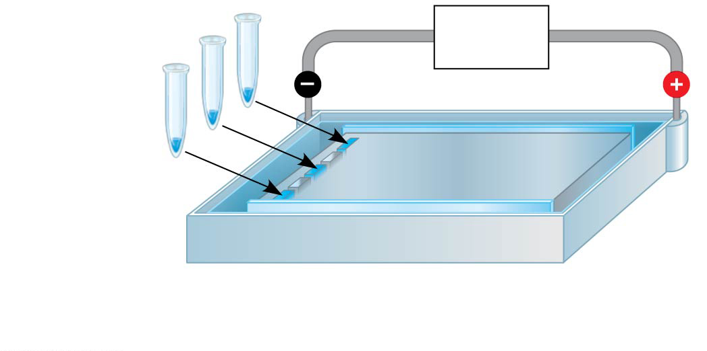
Figure 20.7a
Mixture of DNA mol- ecules of different sizes
Power source
Cathode
Anode
Wells
Gel
(a) Negatively charged DNA molecules move toward the positive electrode.
Notes:
Figure 20.7a Gel electrophoresis (part 1: art)

Slide 38
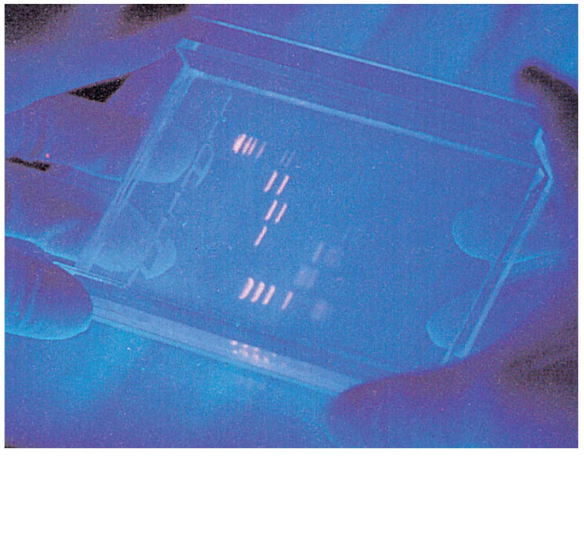
Figure 20.7b
Restriction fragments (size standards)
(b) Shorter molecules are slowed down less than longer ones, so they move faster through the gel.
Notes:
Figure 20.7b Gel electrophoresis (part 2: photo)

Slide 39
Video: Biotechnology Lab

Slide 40
Amplifying DNA: The Polymerase Chain Reaction (PCR) and Its Use in DNA Cloning
The polymerase chain reaction, PCR, can produce many copies of a specific target segment of DNA
A three-step cycle—heating, cooling, and replication—brings about a chain reaction that produces an exponentially growing population of identical DNA molecules

Slide 41
The key to PCR is an unusual, heat-stable DNA polymerase called Taq polymerase
PCR uses a pair of primers specific for the sequence to be amplified
PCR amplification occasionally incorporates errors into the amplified strands and so cannot substitute for gene cloning in cells

Slide 42
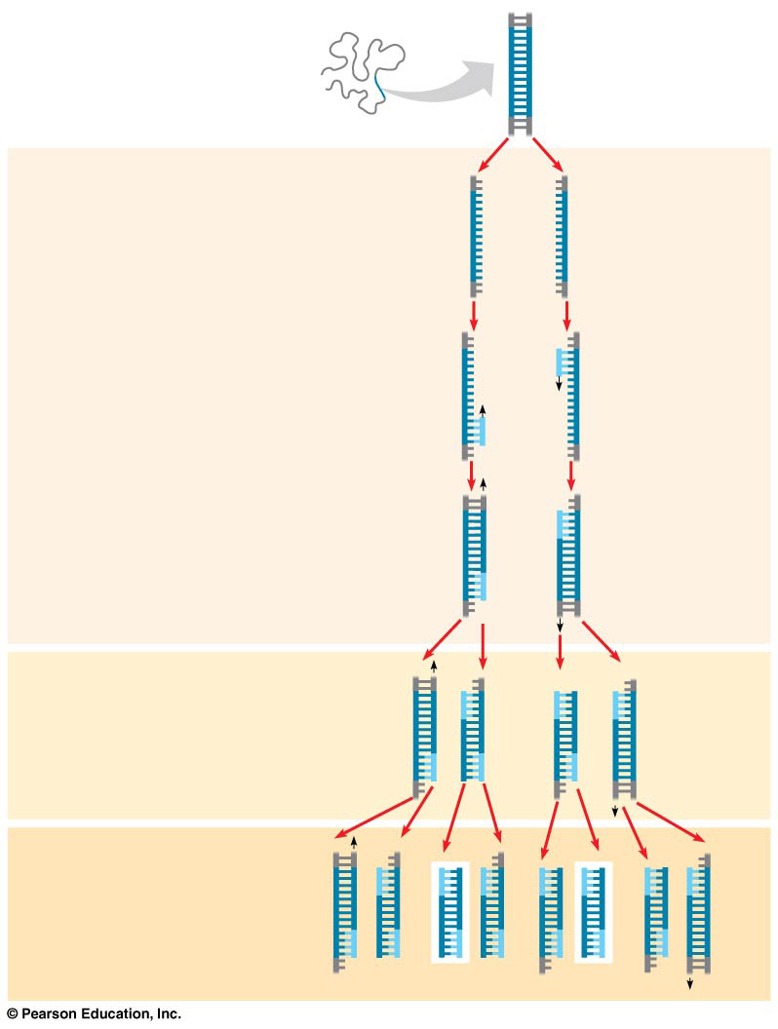
Figure 20.8
Technique
5′
3′
Target sequence
Genomic DNA
3′
5′
1
Denaturation
5′
3′
3′
5′
2
Annealing
Cycle 1 yields 2 molecules
Primers
3
Extension
New
nucleotides
Cycle 2 yields 4 molecules
Cycle 3 yields 8 molecules; 2 molecules (in white boxes) match target sequence
Notes:
Figure 20.8 Research method: the polymerase chain reaction (PCR)

Slide 43
Figure 20.8a
Technique
5′
3′
Target sequence
Genomic DNA
3′
5′
Notes:
Figure 20.8a Research method: the polymerase chain reaction (PCR) (part 1)

Slide 44
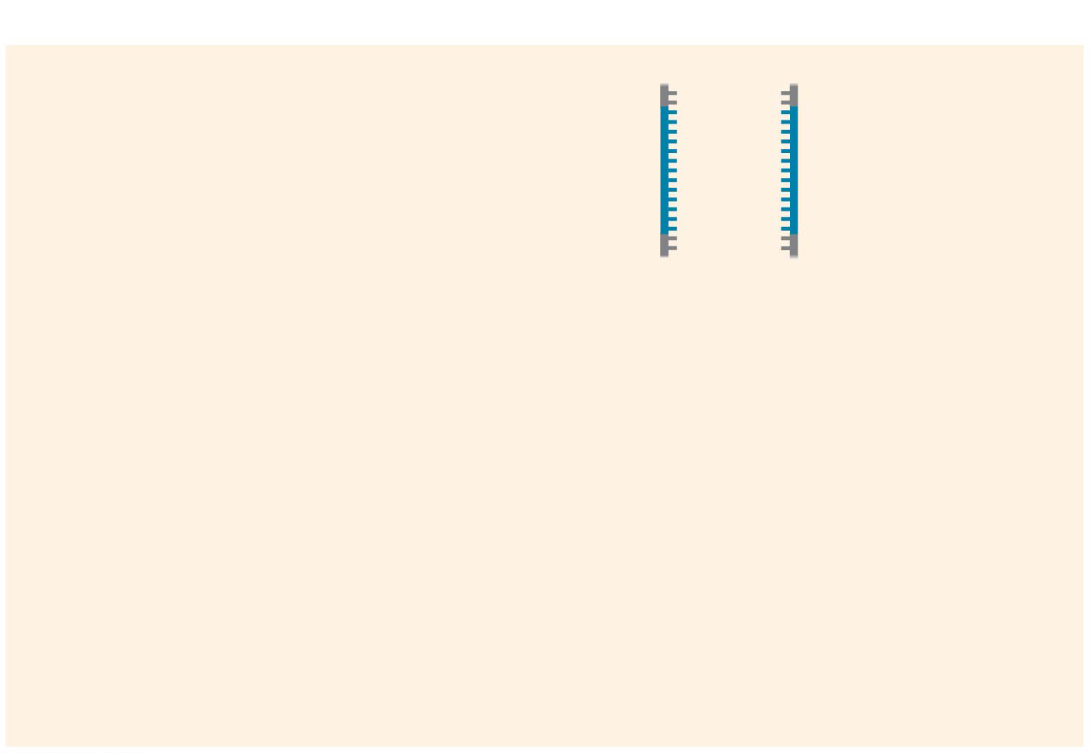
Figure 20.8b-1
Technique
1
Denaturation
5′
3′
3′
5′
Cycle 1 yields 2 molecules
Notes:
Figure 20.8b-1 Research method: the polymerase chain reaction (PCR) (part 2, step 1)

Slide 45
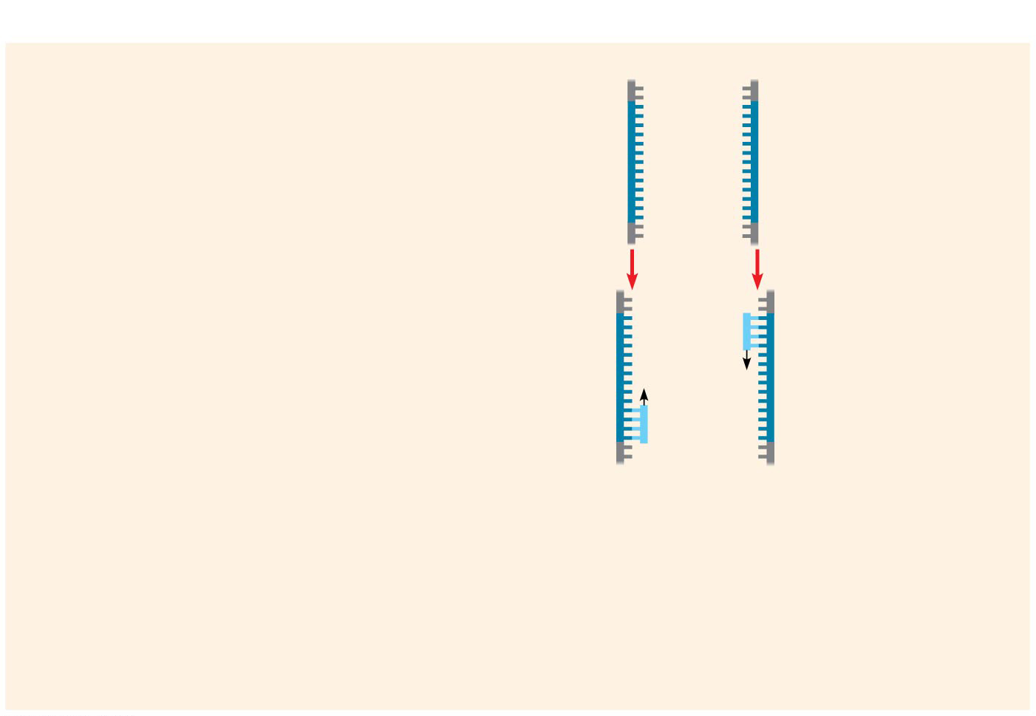
Figure 20.8b-2
Technique
1
Denaturation
5′
3′
3′
5′
2
Annealing
Cycle 1 yields 2 molecules
Primers
Notes:
Figure 20.8b-2 Research method: the polymerase chain reaction (PCR) (part 2, step 2)

Slide 46
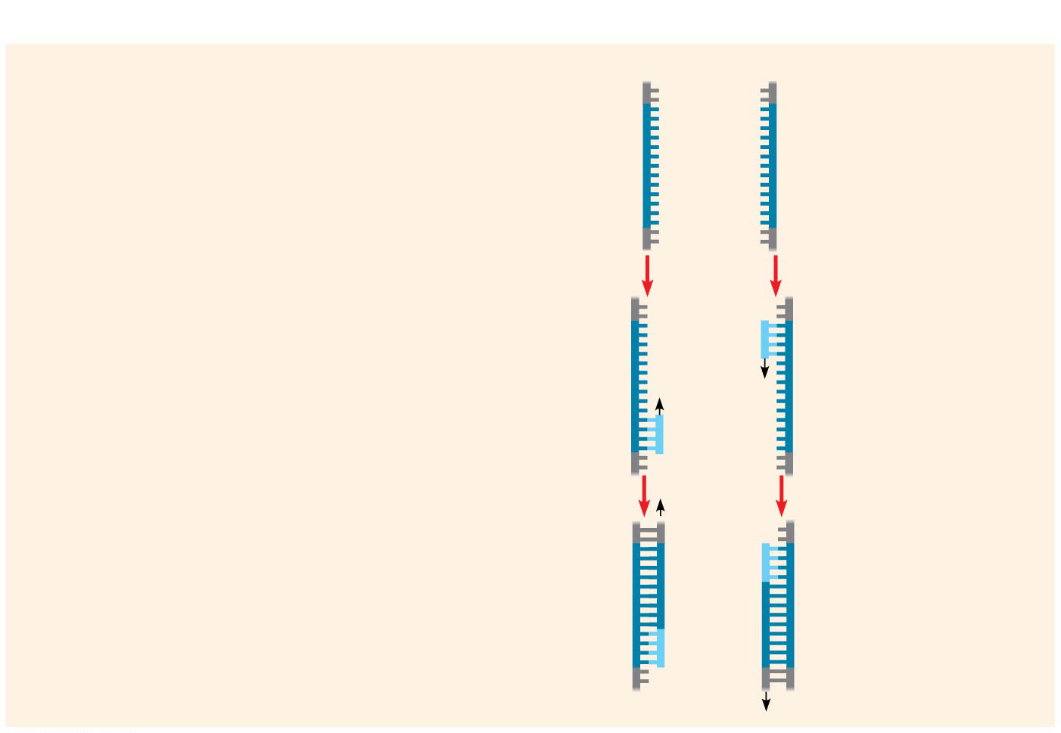
Figure 20.8b-3
Technique
1
Denaturation
5′
3′
3′
5′
2
Annealing
Cycle 1 yields 2 molecules
Primers
3
Extension
New nucleotides
Notes:
Figure 20.8b-3 Research method: the polymerase chain reaction (PCR) (part 2, step 3)

Slide 47
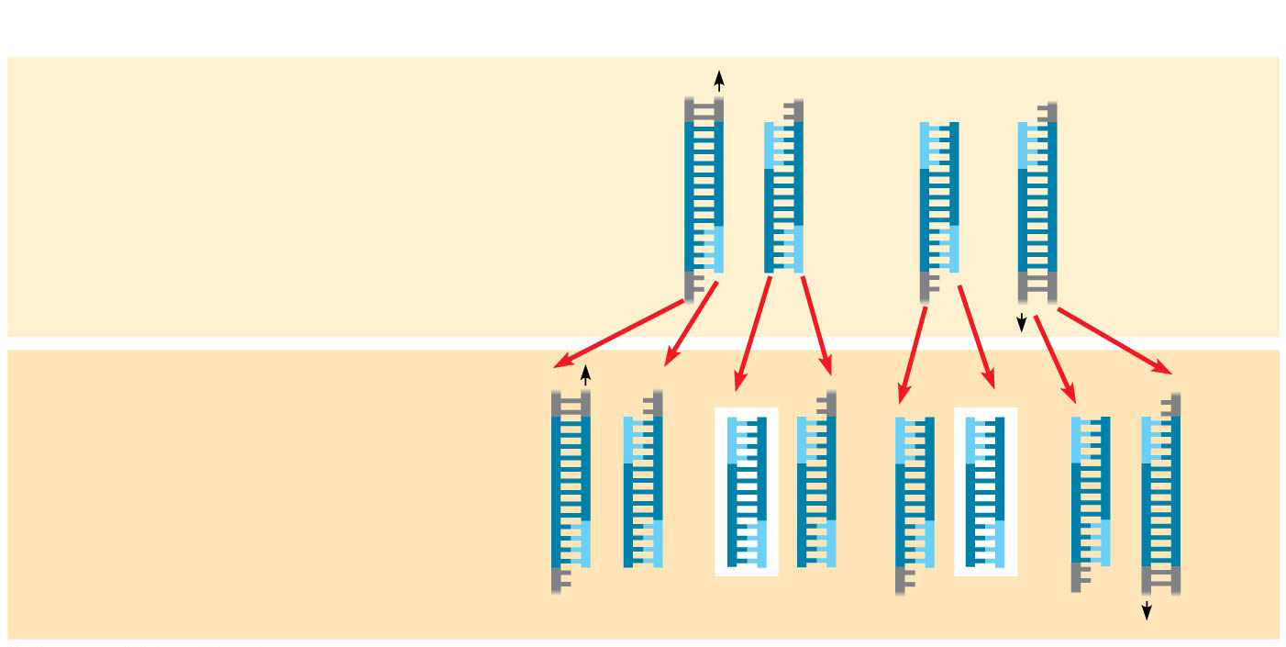
Figure 20.8c
Technique
Cycle 2 yields 4 molecules
Cycle 3 yields 8 molecules; 2 molecules (in white boxes) match target sequence
Results After 30 more cycles, over 1 billion (10⁹) molecules match the target sequence.
Notes:
Figure 20.8c Research method: the polymerase chain reaction (PCR) (part 3)

Slide 48
PCR primers can be designed to include restriction sites that allow the product to be cloned into plasmid vectors
The resulting clones are sequenced and error-free inserts selected

Slide 49
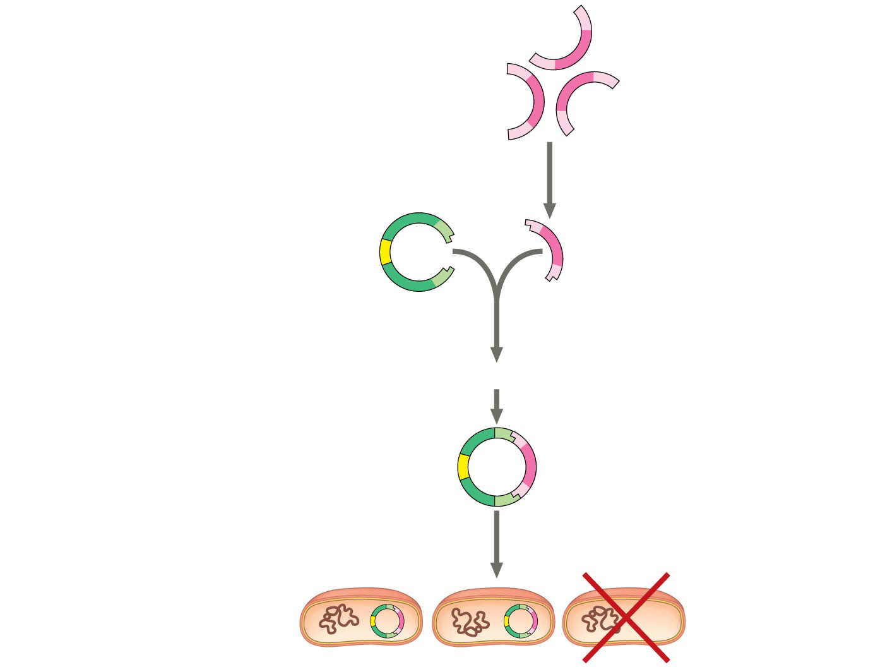
Figure 20.9
DNA fragments obtained by PCR with restriction sites matching those in the cloning vector
Cut with same restriction enzyme used on cloning vector
A gene that makes bacterial cells resistant to an antibiotic is present on the plasmid.
Cloning vector (bacterial plasmid)
Mix and ligate
Recombinant DNA plasmid
Only cells that take up a plasmid will survive
Notes:
Figure 20.9 Use of restriction enzyme and PCR in gene cloning

Slide 50
Animation: Cloning a Gene

Slide 51
Expressing Cloned Eukaryotic Genes
After a gene has been cloned, its protein product can be produced in larger amounts for research
Cloned genes can be expressed as protein in either bacterial or eukaryotic cells

Slide 52
Bacterial Expression Systems
Several technical difficulties hinder expression of cloned eukaryotic genes in bacterial host cells
To overcome differences in promoters and other DNA control sequences, scientists usually employ an expression vector, a cloning vector that contains a highly active bacterial promoter

Slide 53
Another difficulty with eukaryotic gene expression in bacteria is the presence of introns in most eukaryotic genes
Researchers can avoid this problem by using cDNA, complementary to the mRNA, which contains only exons

Slide 54
Eukaryotic DNA Cloning and Expression Systems
Molecular biologists can avoid eukaryote-bacterial incompatibility issues by using eukaryotic cells, such as yeasts, as hosts for cloning and expressing genes
Even yeasts may not possess the proteins required to modify expressed mammalian proteins properly
In such cases, cultured mammalian or insect cells may be used to express and study proteins

Slide 55
One method of introducing recombinant DNA into eukaryotic cells is electroporation, applying a brief electrical pulse to create temporary holes in plasma membranes
Alternatively, scientists can inject DNA into cells using microscopically thin needles
Once inside the cell, the DNA is incorporated into the cell’s DNA by natural genetic recombination

Slide 56
Cross-Species Gene Expression and Evolutionary Ancestry
The remarkable ability of bacteria to express some eukaryotic proteins underscores the shared evolutionary ancestry of living species
For example, Pax-6 is a gene that directs formation of a vertebrate eye; the same gene in flies directs the formation of an insect eye (which is quite different from the vertebrate eye)
The Pax-6 genes in flies and vertebrates can substitute for each other

Slide 57
Concept 20.2: Biologists use DNA technology to study gene expression and function
Analysis of when and where a gene or group of genes is expressed can provide important clues about gene function

Slide 58
Analyzing Gene Expression
The most straightforward way to discover which genes are expressed in certain cells is to identify the mRNAs being made

Slide 59
Studying the Expression of Single Genes
mRNA can be detected by nucleic acid hybridization with complementary molecules
These complementary molecules, of either DNA or RNA, are nucleic acid probes

Slide 60
In situ hybridization uses fluorescent dyes attached to probes to identify the location of specific mRNAs in place in the intact organism

Slide 61
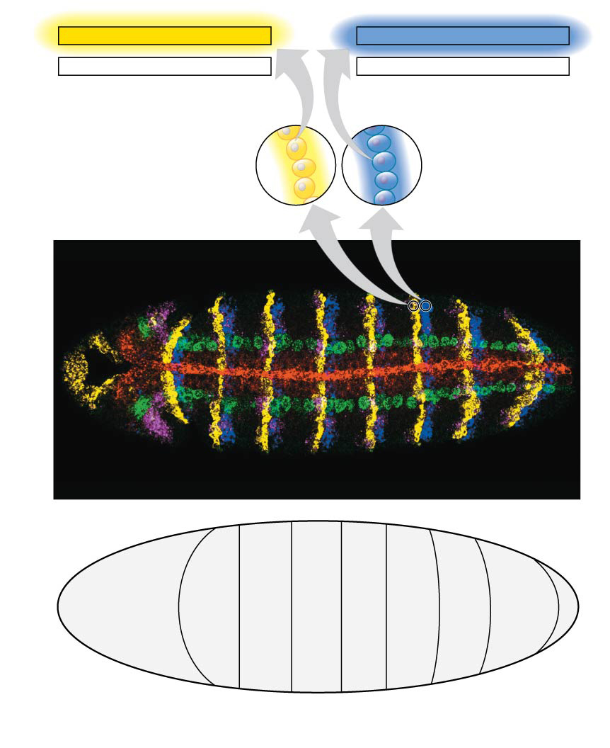
Figure 20.10
3′
5′
3′
5′
TAACGGTTCCAGC
CTCAAGTTGCTCT
ATTGCCAAGGTCG
GAGTTCAACGAGA
5′
3′
5′
3′
wg mRNA
en mRNA
Cells expressing the wg gene
Cells expressing the en gene
Head
Thorax
Abdomen
50 µm
T1
T2
T3
A1
A2
A3
A4
A5
Segment boundary
Head
Thorax
Abdomen
Notes:
Figure 20.10 Determining where genes are expressed by in situ hybridization analysis

Slide 62
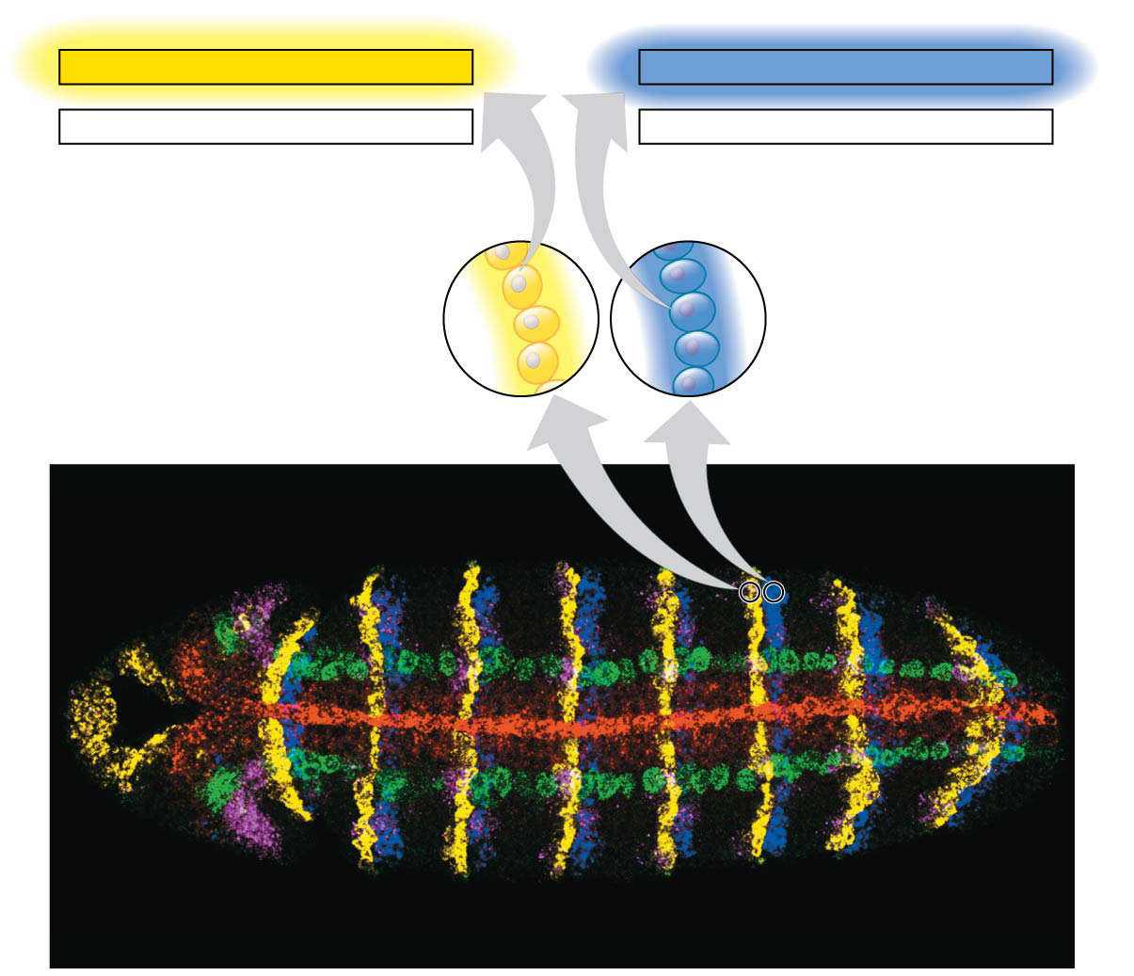
Figure 20.10a
3′
5′
3′
5′
TAACGGTTCCAGC
CTCAAGTTGCTCT
ATTGCCAAGGTCG
GAGTTCAACGAGA
5′
3′
5′
3′
wg mRNA
en mRNA
Cells expressing the wg gene
Cells expressing the en gene
Head
Thorax
Abdomen
50 µm
T1
T2
T3
A1
A2
A3
A4
A5
Notes:
Figure 20.10a Determining where genes are expressed by in situ hybridization analysis (part 1: genes)

Slide 63
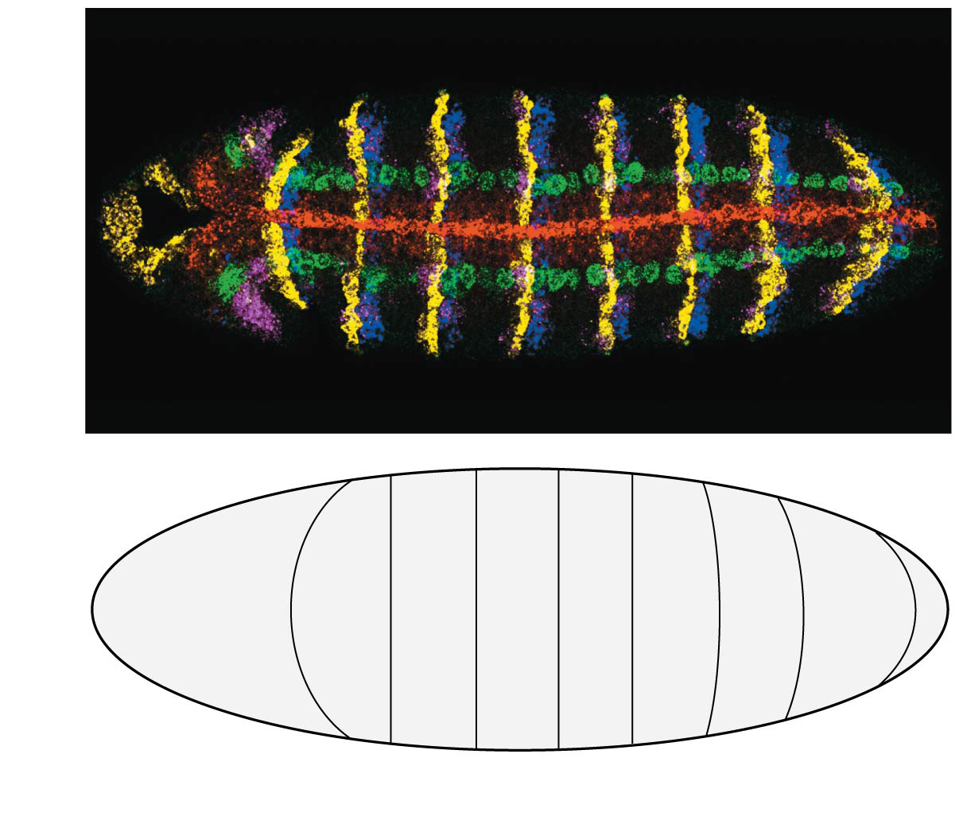
Figure 20.10b
Head
Thorax
Abdomen
50 µm
T1
T2
T3
A1
A2
A3
A4
A5
Segment boundary
Head
Thorax
Abdomen
Notes:
Figure 20.10b Determining where genes are expressed by in situ hybridization analysis (part 2: segment map)

Slide 64
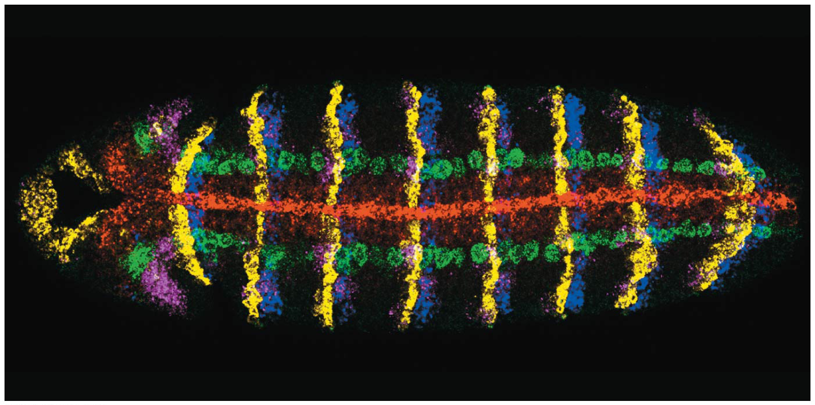
Figure 20.10c
Head
Thorax
Abdomen
50 µm
T1
T2
T3
A1
A2
A3
A4
A5
Notes:
Figure 20.10c Determining where genes are expressed by in situ hybridization analysis (part 3: micrograph)

Slide 65
Reverse transcriptase-polymerase chain reaction (RT-PCR) is useful for comparing amounts of specific mRNAs in several samples at the same time
Reverse transcriptase is added to mRNA to make complementary DNA (cDNA), which serves as a template for PCR amplification of the gene of interest
The products are run on a gel and the mRNA of interest is identified

Slide 66
Figure 20.11-1
DNA in nucleus
mRNAs in cytoplasm
Notes:
Figure 20.11-1 Making complementary DNA (cDNA) from eukaryotic genes (step 1)

Slide 67
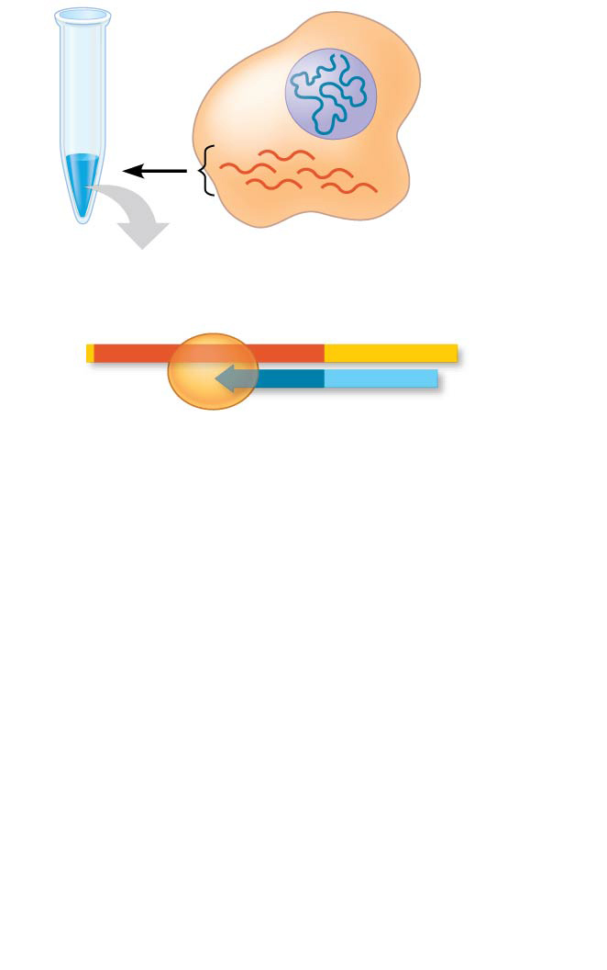
Figure 20.11-2
DNA in nucleus
mRNAs in cytoplasm
Reverse transcriptase
mRNA
Poly-A tail
5′
AAAAAA
3′
3′
TTTTT
5′
DNA strand
Primer (poly-dT)
Notes:
Figure 20.11-2 Making complementary DNA (cDNA) from eukaryotic genes (step 2)

Slide 68
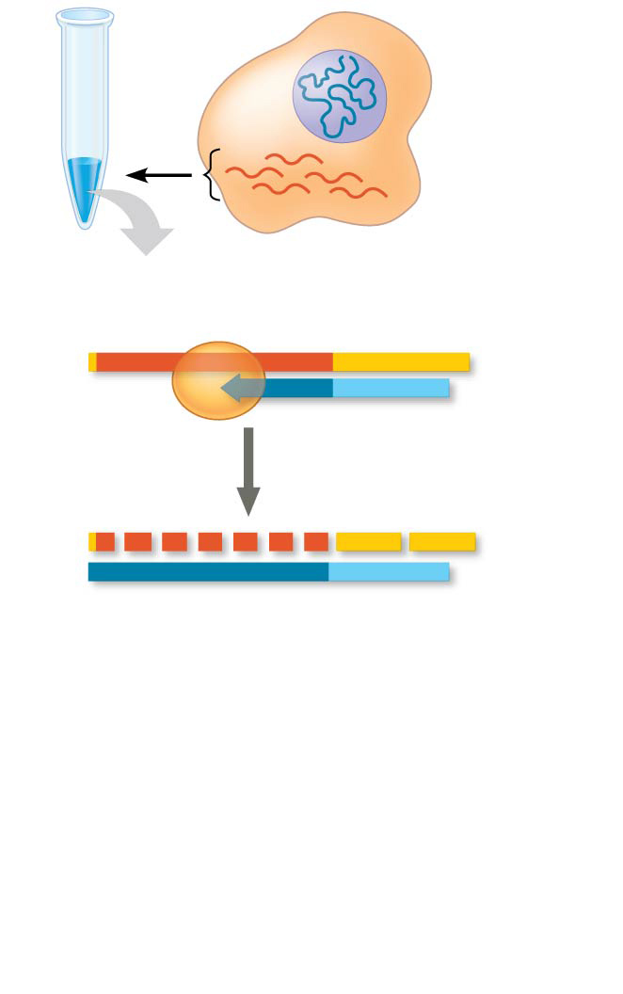
Figure 20.11-3
DNA in nucleus
mRNAs in cytoplasm
Reverse transcriptase
mRNA
Poly-A tail
5′
AAAAAA
3′
3′
TTTTT
5′
DNA strand
Primer (poly-dT)
5′
AAA
AAA
3′
3′
TTTTT
5′
Notes:
Figure 20.11-3 Making complementary DNA (cDNA) from eukaryotic genes (step 3)

Slide 69
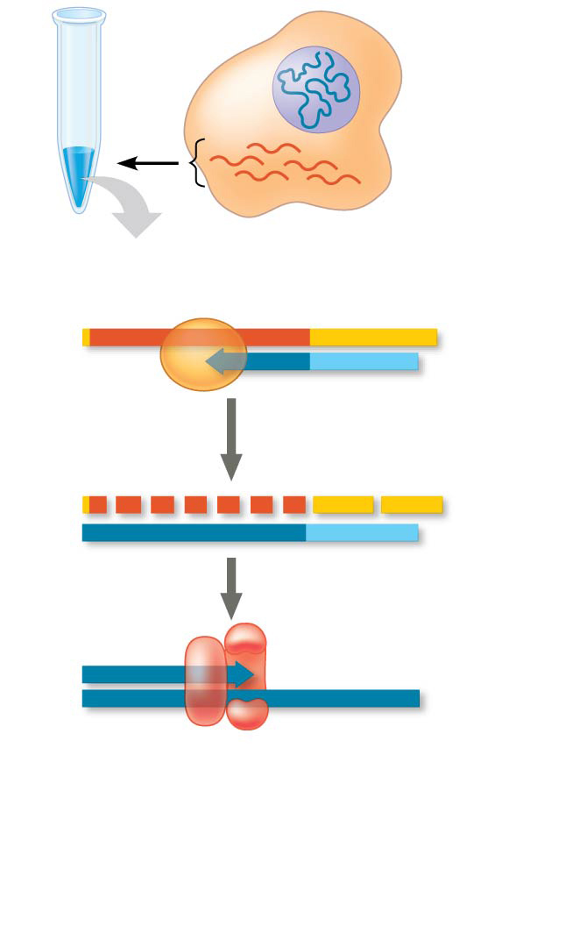
Figure 20.11-4
DNA in nucleus
mRNAs in cytoplasm
Reverse transcriptase
mRNA
Poly-A tail
5′
AAAAAA
3′
3′
TTTTT
5′
DNA strand
Primer (poly-dT)
5′
AAA
AAA
3′
3′
TTTTT
5′
5′
3′
3′
5′
DNA polymerase
Notes:
Figure 20.11-4 Making complementary DNA (cDNA) from eukaryotic genes (step 4)

Slide 70
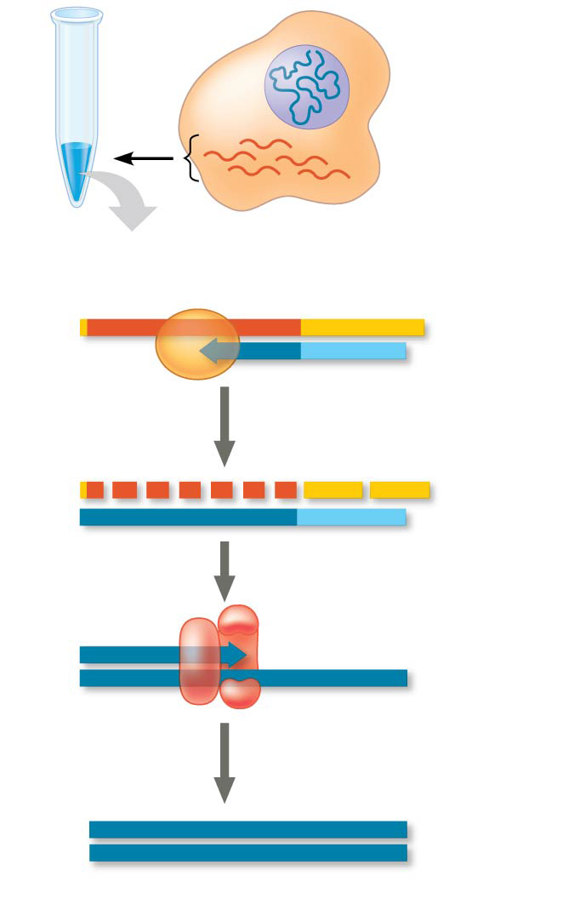
Figure 20.11-5
DNA in nucleus
mRNAs in cytoplasm
Reverse transcriptase
mRNA
Poly-A tail
5′
AAAAAA
3′
3′
TTTTT
5′
DNA strand
Primer (poly-dT)
5′
AAA
AAA
3′
3′
TTTTT
5′
5′
3′
3′
5′
DNA polymerase
5′
3′
3′
5′
cDNA
Notes:
Figure 20.11-5 Making complementary DNA (cDNA) from eukaryotic genes (step 5)

Slide 71
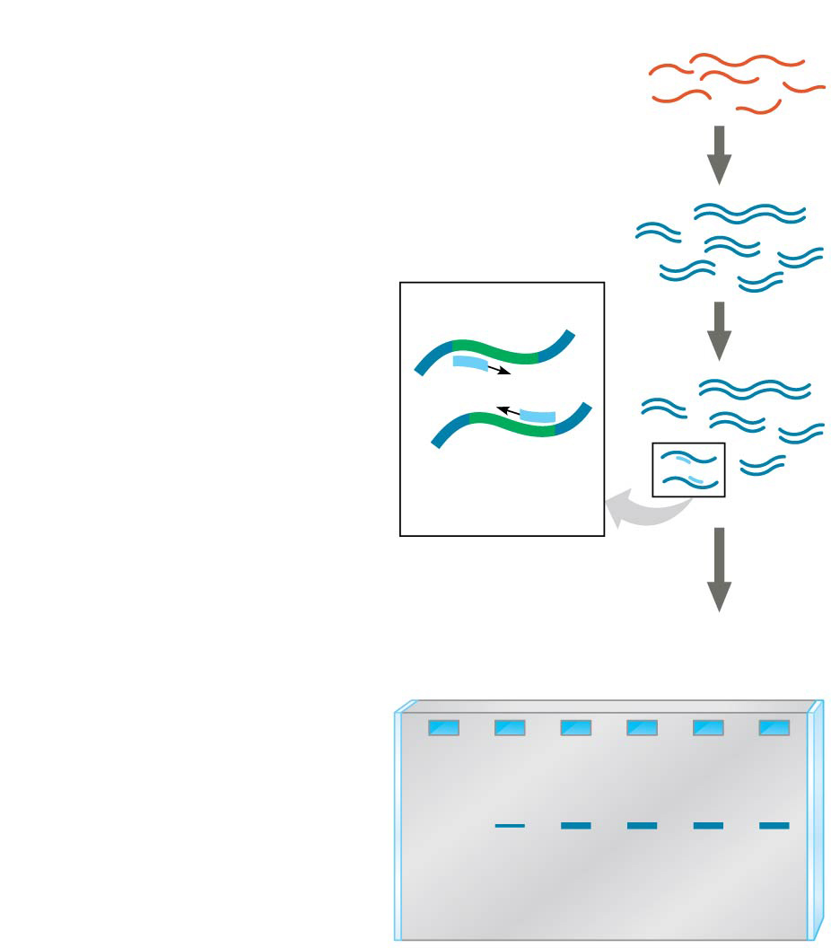
Figure 20.12
Technique
1
cDNA synthesis
mRNAs
cDNAs
Primers
2
PCR amplification
Specific gene
3
Gel electrophoresis
Results
Embryonic stages
1 2 3 4 5 6
Notes:
Figure 20.12 Research method: RT-PCR analysis of the expression of single genes

Slide 72
Studying the Expression of Interacting Groups of Genes
Automation has allowed scientists to measure the expression of thousands of genes at one time using DNA microarray assays
DNA microarray assays compare patterns of gene expression in different tissues, at different times, or under different conditions

Slide 73
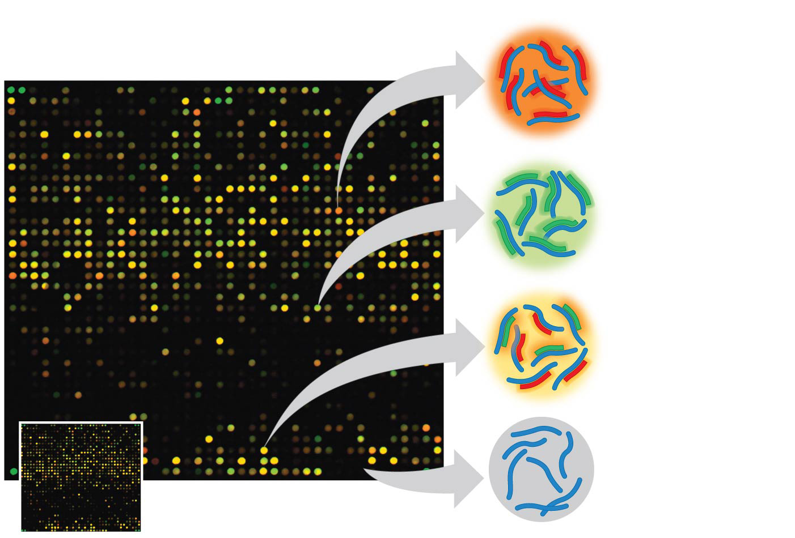
Figure 20.13
Each dot is a well containing identical copies of DNA fragments that carry a specific gene.
Genes expressed in first tissue.
Genes expressed in second tissue.
Genes expressed in both tissues.
Genes expressed in neither tissue.
►
DNA microarray (actual size)
Notes:
Figure 20.13 DNA microarray assay of gene expression levels

Slide 74
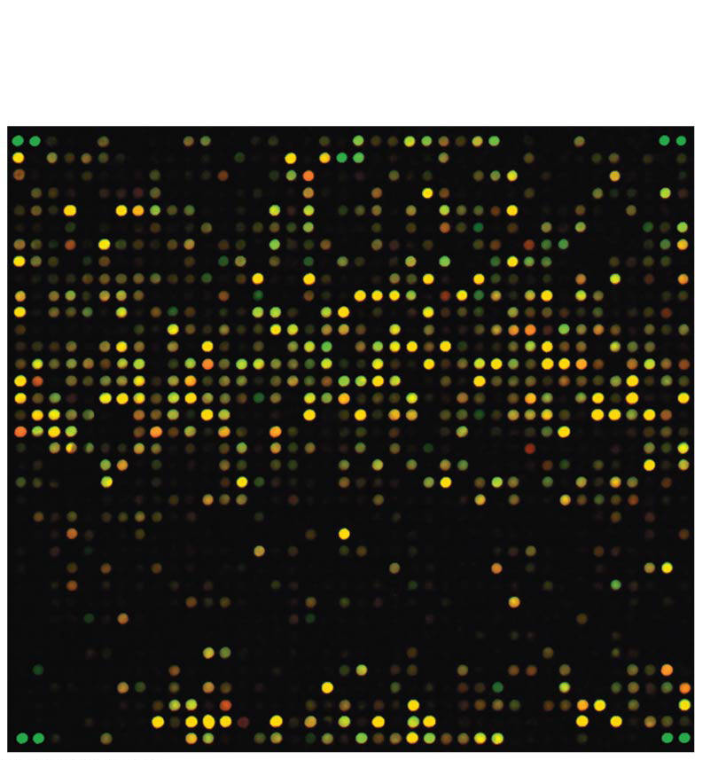
Figure 20.13a
Each dot is a well containing identical copies of DNA fragments that carry a specific gene.
Notes:
Figure 20.13a DNA microarray assay of gene expression levels (part 1: microarray)

Slide 75
With rapid and inexpensive sequencing methods available, researchers can also just sequence cDNA samples from different tissues or embryonic stages to determine the gene expression differences between them
By uncovering gene interactions and clues to gene function DNA microarray assays may contribute to understanding of disease and suggest new diagnostic targets

Slide 76
Determining Gene Function
One way to determine function is to disable the gene and observe the consequences
Using in vitro mutagenesis, mutations are introduced into a cloned gene, altering or destroying its function
When the mutated gene is returned to the cell, the normal gene’s function might be determined by examining the mutant’s phenotype

Slide 77
Gene expression can also be silenced using RNA interference (RNAi)
Synthetic double-stranded RNA molecules matching the sequence of a particular gene are used to break down or block the gene’s mRNA

Slide 78
In humans, researchers analyze the genomes of many people with a certain genetic condition to try to find nucleotide changes specific to the condition
These genome-wide association studies test for genetic markers, sequences that vary among individuals
SNPs (single nucleotide polymorphisms), single nucleotide variants, are among the most useful genetic markers

Slide 79
SNP variants that are found frequently associated with a particular inherited disorder alert researchers to the most likely location for the disease-causing gene
SNPs are rarely directly involved in the disease; they are most often in noncoding regions of the genome

Slide 80
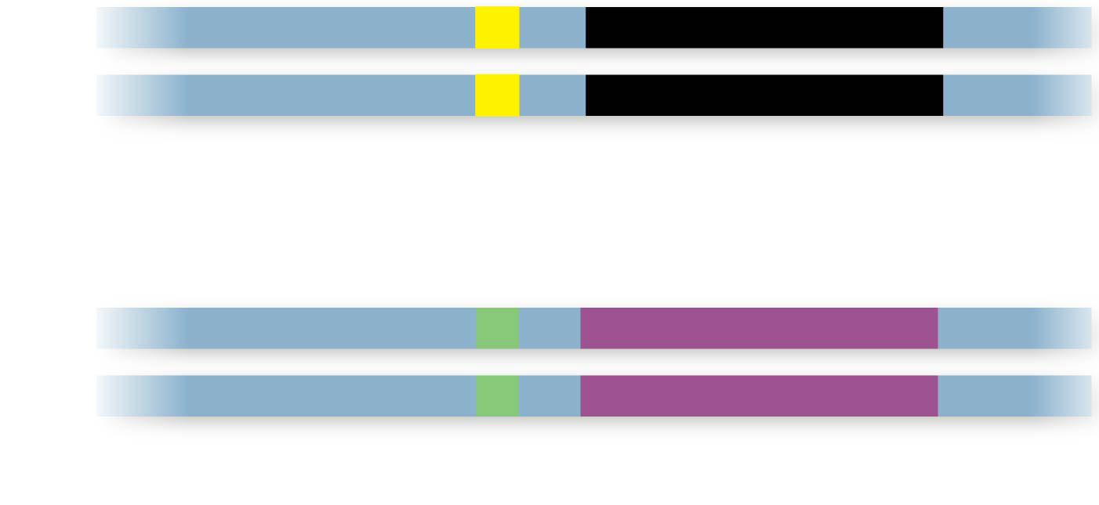
Figure 20.14
A
DNA
T
Normal allele
SNP
C
G
Disease-causing allele
Notes:
Figure 20.14 Single nucleotide polymorphisms (SNPs) as genetic markers for disease-causing alleles

Slide 81
Concept 20.3: Cloned organisms and stem cells are useful for basic research and other applications
Organismal cloning produces one or more organisms genetically identical to the “parent” that donated the single cell
A stem cell is a relatively unspecialized cell that can reproduce itself indefinitely, or under certain conditions can differentiate into one or more types of specialized cells

Slide 82
Cloning Plants: Single-Cell Cultures
In plants, cells can dedifferentiate and then give rise to all the specialized cell types of the organism
A totipotent cell, such as this, is one that can generate a complete new organism
Plant cloning is used extensively in agriculture

Slide 83
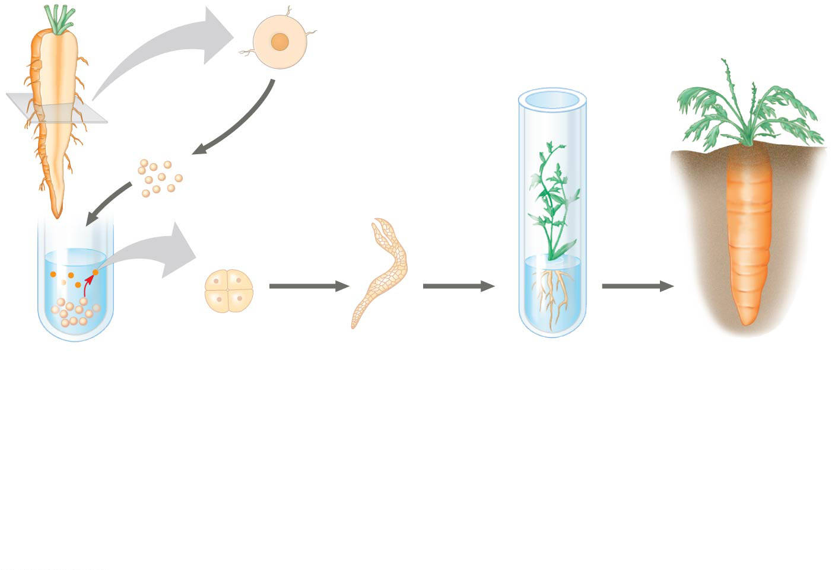
Figure 20.15
Cross section of carrot root
Small fragments
Fragments were cultured in nutrient medium; stirring caused single cells to shear off into the liquid.
Single cells free in suspension began to divide.
Embryonic plant developed from a cultured single cell.
Plantlet was cultured on agar medium. Later it was planted in soil.
Adult plant
Notes:
Figure 20.15 The cloning of a whole carrot plant from a single carrot cell

Slide 84
Cloning Animals: Nuclear Transplantation
In nuclear transplantation, the nucleus of an unfertilized egg cell or zygote is replaced with the nucleus of a differentiated cell
Experiments with frog embryos have shown that a transplanted nucleus can often support normal development of the egg
However, the older the donor nucleus, the lower the percentage of normally developing tadpoles

Slide 85
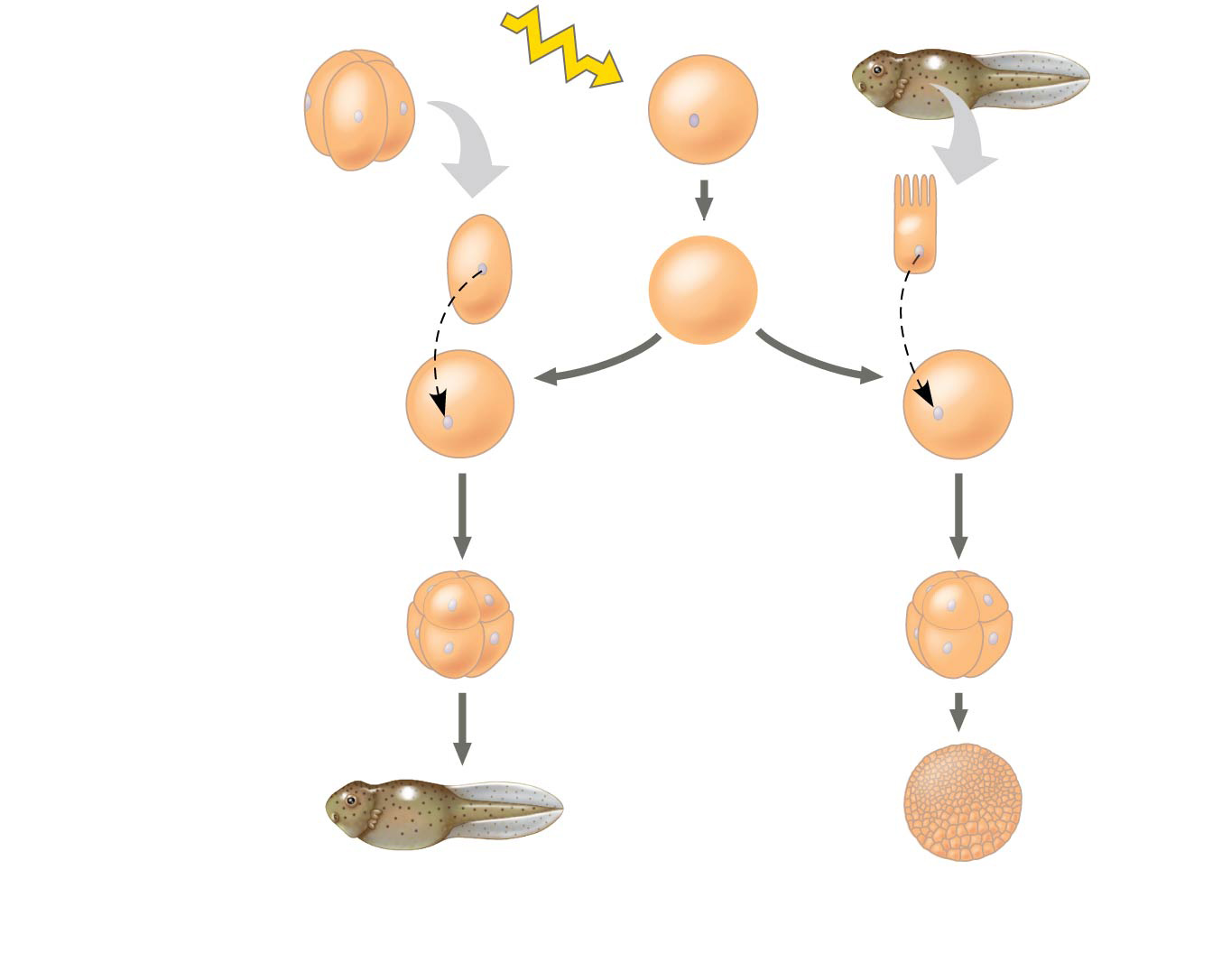
Figure 20.16
Experiment
Frog embryo
Frog egg cell
Frog tadpole
UV
Fully differ- entiated (intestinal) cell
Less differ- entiated cell
Donor nucleus trans- planted
Donor nucleus trans- planted
Enucleated egg cell
Egg with donor nucleus activated to begin development
Results
Most develop into tadpoles.
Most stop developing before tadpole stage.
Notes:
Figure 20.16 Inquiry: Can the nucleus from a differentiated animal cell direct development of an organism?

Slide 86
Reproductive Cloning of Mammals
In 1997, Scottish researchers announced the birth of Dolly, a lamb cloned from an adult sheep by nuclear transplantation from a differentiated mammary cell
Dolly’s premature death in 2003, as well as her arthritis, led to speculation that her cells were not as healthy as those of a normal sheep, possibly reflecting incomplete reprogramming of the original transplanted nucleus

Slide 87
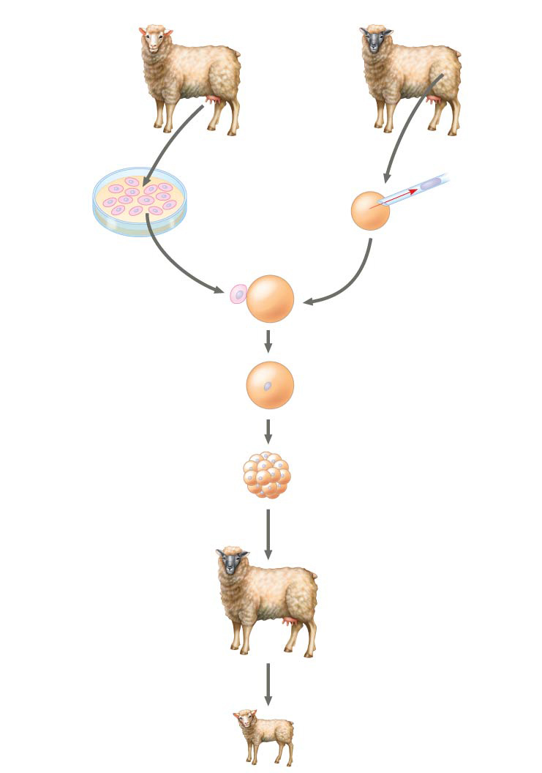
Figure 20.17
Technique
Mammary cell donor
Egg cell donor
1
2
Egg cell from ovary
Nucleus removed
Cultured mammary cells
3
Cells fused
Nucleus from mammary cell
4
Grown in culture
Early embryo
5
Implanted in uterus of a third sheep
Surrogate mother
6
Embryonic development
Lamb (“Dolly”) genetically identical to mammary cell donor
Results
Notes:
Figure 20.17 Research method: reproductive cloning of a mammal by nuclear transplantation

Slide 88
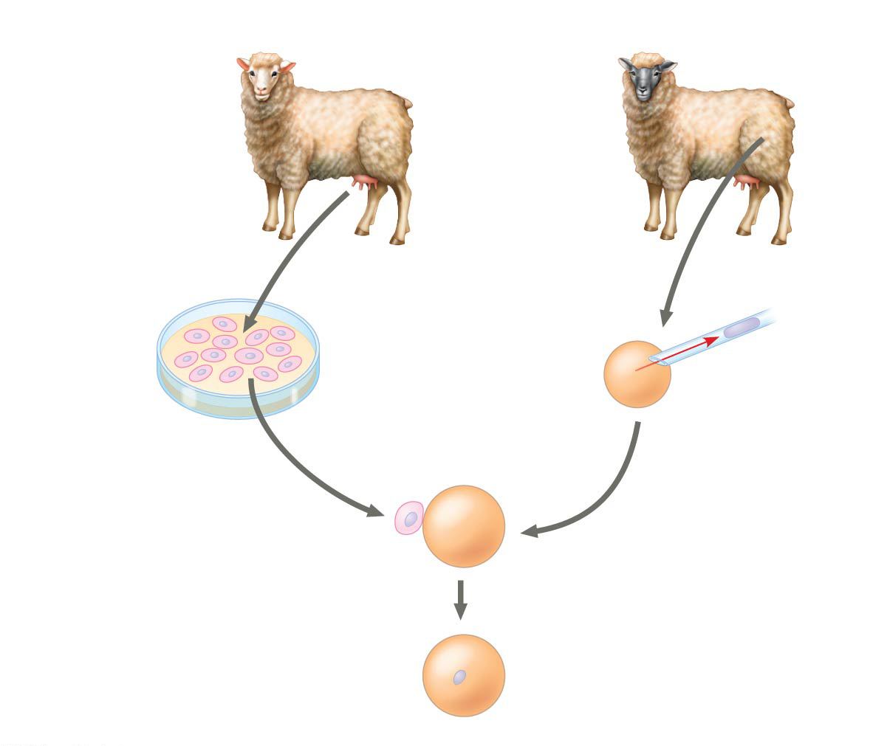
Figure 20.17a
Technique
Mammary cell donor
Egg cell donor
1
2
Egg cell from ovary
Nucleus removed
Cultured mammary cells
3
Cells fused
Nucleus from mammary cell
Notes:
Figure 20.17a Research method: reproductive cloning of a mammal by nuclear transplantation (part 1: technique)

Slide 89
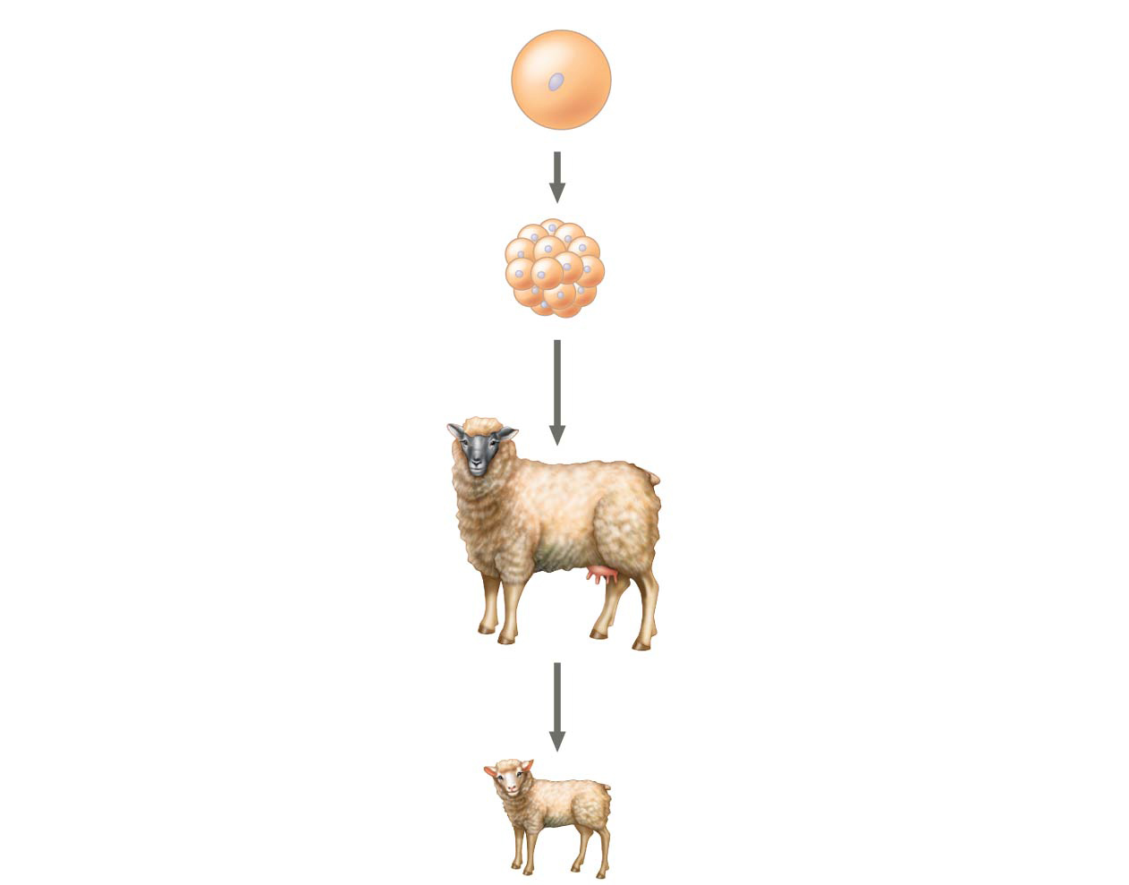
Figure 20.17b
Technique
Nucleus from mammary cell
4
Grown in culture
Early embryo
5
Implanted in uterus of a third sheep
Surrogate mother
6
Embryonic development
Lamb (“Dolly”) genetically identical to mammary cell donor
Results
Notes:
Figure 20.17b Research method: reproductive cloning of a mammal by nuclear transplantation (part 2: results)

Slide 90
Since 1997, cloning has been demonstrated in many mammals, including mice, cats, cows, horses, mules, pigs, and dogs
CC (for Carbon Copy) was the first cat cloned; however, CC differed somewhat from her female “parent”
Cloned animals do not always look or behave exactly the same

Slide 91
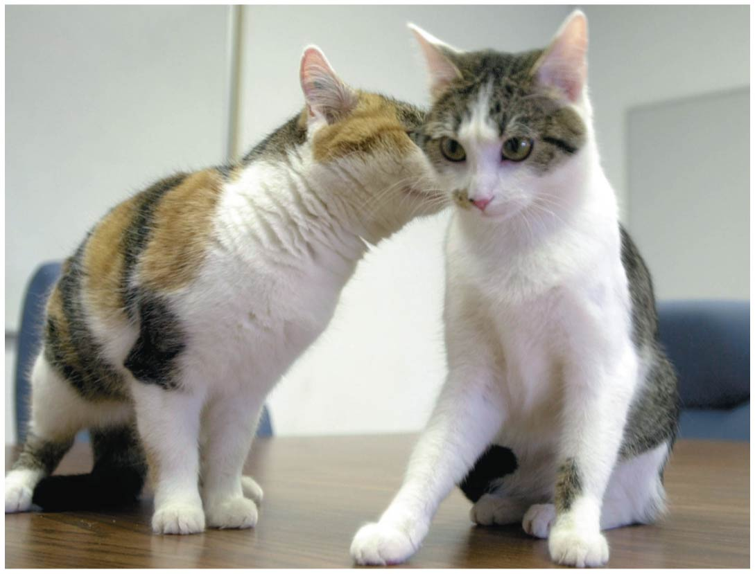
Figure 20.18
Notes:
Figure 20.18 CC, the first cloned cat (right), and her single parent

Slide 92
Faulty Gene Regulation in Cloned Animals
In most nuclear transplantation studies, only a small percentage of cloned embryos have developed normally to birth, and many cloned animals exhibit defects
Many epigenetic changes, such as acetylation of histones or methylation of DNA, must be reversed in the nucleus from a donor animal in order for genes to be expressed or repressed appropriately for early stages of development

Slide 93
Stem Cells of Animals
Stem cells are relatively unspecialized cells that can both reproduce indefinitely and, under certain conditions, differentiate into one or more specialized cell types

Slide 94
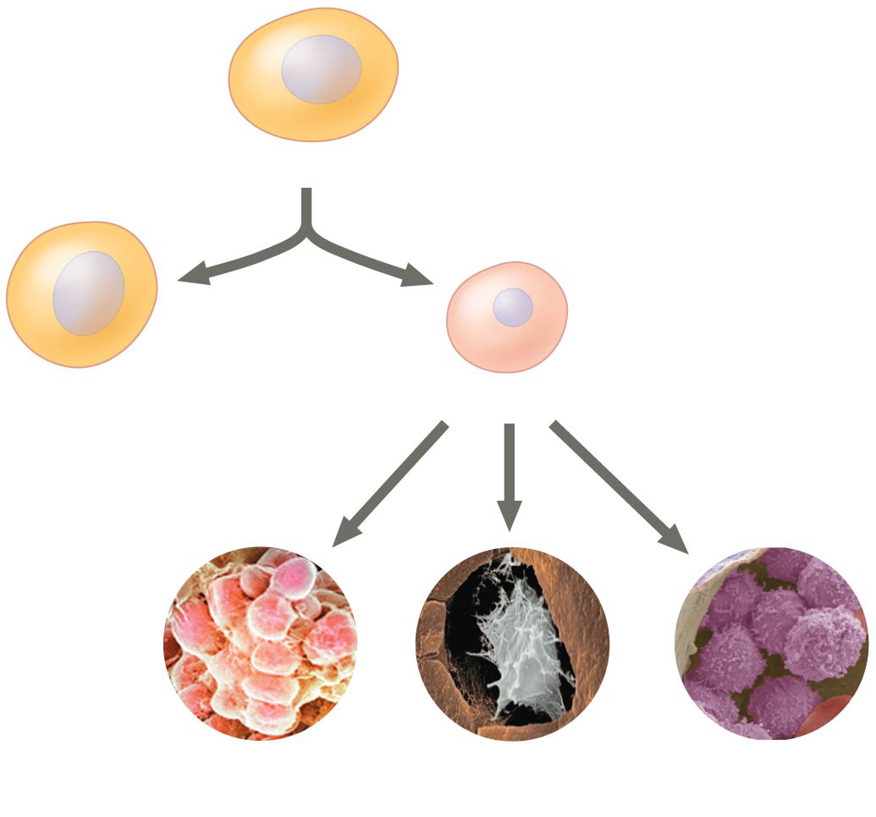
Figure 20.19
Stem cell
Cell division
Stem cell
and
Precursor cell
Fat cells
or
Bone cells
or
White blood cells
Notes:
Figure 20.19 How stem cells maintain their own population and generate differentiated cells

Slide 95
Embryonic and Adult Stem Cells
Many early embryos contain stem cells capable of giving rise to differentiated embryonic cells of any type
In culture, these embryonic stem cells reproduce indefinitely
Depending on culture conditions, they can be made to differentiate into a variety of specialized cells
Adult stem cells can generate multiple (but not all) cell types and are used in the body to replace nonreproducing cells as needed

Slide 96
Figure 20.20
Embryonic stem cells
Adult stem cells
Cells that can generate all embryonic cell types
Cells that generate a limited number of cell types
Cultured stem cells
Different culture conditions
Liver cells
Nerve cells
Blood cells
Different types of differentiated cells
Notes:
Figure 20.20 Working with stem cells

Slide 97
Embryonic stem (ES) cells are pluripotent, capable of differentiating into many different cell types
The ultimate aim of research with stem cells is to supply cells for the repair of damaged or diseased organs
ES cells present ethical and political issues

Slide 98
Induced Pluripotent Stem (iPS) Cells
Researchers can treat differentiated cells, and reprogram them to act like ES cells
Researchers used retroviruses to induce extra copies of four stem cell master regulatory genes to produce induced pluripotent stem (iPS) cells
iPS cells can perform most of the functions of ES cells
iPS cells can be used as models for study of certain diseases and potentially as replacement cells for patients

Slide 99
Figure 20.21
Experiment
Stem cell
Precursor cell
Skin fibroblast cell
Oct3/4
Sox2
Four “stem cell” master regulator genes were introduced, using the retroviral cloning vector.
c-Myc
Klf4
Induced pluripotent stem (iPS) cell
Notes:
Figure 20.21 Inquiry: Can a fully differentiated human cell be “deprogrammed” to become a stem cell?

Slide 100
Concept 20.4: The practical applications of DNA-based biotechnology affect our lives in many ways
Many fields benefit from DNA technology and genetic engineering

Slide 101
Medical Applications
One benefit of DNA technology is identification of human genes in which mutation plays a role in genetic diseases
Researchers use microarray assays or other tools to identify genes turned on or off in particular diseases
The genes and their products are then potential targets for prevention or therapy

Slide 102
Diagnosis and Treatment of Diseases
Scientists can diagnose many human genetic disorders using PCR and sequence-specific primers, then sequencing the amplified product to look for the disease-causing mutation
SNPs may be associated with a disease-causing mutation
SNPs may also be correlated with increased risks for conditions such as heart disease or certain types of cancer

Slide 103
Human Gene Therapy
Gene therapy is the alteration of an afflicted individual’s genes
Gene therapy holds great potential for treating disorders traceable to a single defective gene
Vectors are used for delivery of genes into specific types of cells, for example bone marrow
Gene therapy provokes both technical and ethical questions

Slide 104
Figure 20.22
Cloned gene
1
Insert RNA version of normal allele into retrovirus or other viral vector.
Viral RNA
2
Let virus infect bone marrow cells that have been removed from the patient and cultured.
Viral capsid
3
Viral DNA carrying the normal allele inserts into chromosome.
Bone marrow cell from patient
4
Inject engineered cells into patient.
Bone marrow
Notes:
Figure 20.22 Gene therapy using a retroviral vector

Slide 105
Pharmaceutical Products
Advances in DNA technology and genetic research are important to the development of new drugs to treat diseases

Slide 106
Synthesis of Small Molecules for Use as Drugs
The drug imatinib is a small molecule that inhibits overexpression of a specific leukemia-causing receptor
This approach is feasible for treatment of cancers in which the molecular basis is well-understood

Slide 107
Protein Production in Cell Cultures
Host cells in culture can be engineered to secrete a protein as it is made, simplifying the task of purifying it
This is useful for the production of insulin, human growth hormones, and vaccines

Slide 108
Protein Production by “Pharm” Animals
Transgenic animals are made by introducing genes from one species into the genome of another animal
Transgenic animals are pharmaceutical “factories,” producers of large amounts of otherwise rare substances for medical use

Slide 109
Figure 20.23
Notes:
Figure 20.23 Goats as “pharm” animals

Slide 110
Figure 20.23a
Notes:
Figure 20.23a Goats as “pharm” animals (part 1: goat)

Slide 111
Figure 20.23b
Notes:
Figure 20.23b Goats as “pharm” animals (part 2: milk)

Slide 112
Video: Pronuclear Injection

Slide 113
Forensic Evidence and Genetic Profiles
An individual’s unique DNA sequence, or genetic profile, can be obtained by analysis of tissue or body fluids
DNA testing can identify individuals with a high degree of certainty
Genetic profiles are currently analyzed using genetic markers called short tandem repeats (STRs)

Slide 114
STRs are variations in the number of repeats of specific DNA sequences
PCR and gel electrophoresis are used to amplify and then identify STRs of different lengths
The probability that two people who are not identical twins have the same STR markers is exceptionally small
As of 2013 more than 300 innocent people have been released from prison as a result of STR analysis of old DNA evidence

Slide 115
Figure 20.24
(a) Earl Washington just before his release in 2001, after 17 years in prison.
Source of sample
STR marker 1
STR marker 2
STR marker 3
Semen on victim 17,19 13,16 12,12
Earl Washington 16,18 14,15 11,12
Kenneth Tinsley 17,19 13,16 12,12
(b) These and other STR data (not shown) exonerated Washington and led Tinsley to plead guilty to the murder.
Notes:
Figure 20.24 STR analysis used to release an innocent man from prison

Slide 116
Figure 20.24a
(a) Earl Washington just before his release in 2001, after 17 years in prison.
Notes:
Figure 20.24a STR analysis used to release an innocent man from prison (part 1: photo)

Slide 117
Figure 20.24b
Source of sample
STR marker 1
STR marker 2
STR marker 3
Semen on victim 17,19 13,16 12,12
Earl Washington 16,18 14,15 11,12
Kenneth Tinsley 17,19 13,16 12,12
(b) These and other STR data (not shown) exonerated Washington and led Tinsley to plead guilty to the murder.
Notes:
Figure 20.24b STR analysis used to release an innocent man from prison (part 2: chart)

Slide 118
Environmental Cleanup
Genetic engineering can be used to modify the metabolism of microorganisms
Some modified microorganisms can be used to extract minerals from the environment or degrade potentially toxic waste materials

Slide 119
Agricultural Applications
DNA technology is being used to improve agricultural productivity and food quality
Genetic engineering of transgenic animals speeds up the selective breeding process
Beneficial genes can be transferred between varieties or species

Slide 120
Agricultural scientists have endowed a number of crop plants with genes for desirable traits
The Ti plasmid is the most commonly used vector for introducing new genes into plant cells
Genetic engineering in plants has been used to transfer many useful genes including those for herbicide resistance, increased resistance to pests, increased resistance to salinity, and improved nutritional value of crops

Slide 121
Safety and Ethical Questions Raised by DNA Technology
Potential benefits of genetic engineering must be weighed against potential hazards of creating harmful products or procedures
Guidelines are in place in the United States and other countries to ensure safe practices for recombinant DNA technology

Slide 122
Most public concern about possible hazards centers on genetically modified (GM) organisms used as food
Some are concerned about the creation of “super weeds” from the transfer of genes from GM crops to their wild relatives
Other worries include the possibility that transgenic protein products might cause allergic reactions

Slide 123
As biotechnology continues to change, so does its use in agriculture, industry, and medicine
National agencies and international organizations strive to set guidelines for safe and ethical practices in the use of biotechnology

Slide 124
Figure 20.UN01
5′
CUCAUCACCGGC
3′
Notes:
Figure 20.UN01 In-text figure, DNA target, p. 418

Slide 125
Figure 20.UN02
3′
5′
GAGTAGTGGCCG
Notes:
Figure 20.UN02 In-text figure, DNA probe, p. 418

Slide 126
Figure 20.UN03
Regulatory region
Promoter
Gene
A
B
C
Hoxd13
Hoxd13 mRNA
Treatments
A
B
C
Segments being tested
A
B
C
A
B
C
A
B
C
0 20 40 60 80 100
Blue = Hoxd13 mRNA; white triangles = future thumb locations
Relative amount of Hoxd13 mRNA (%)
Notes:
Figure 20.UN03 Skills exercise: analyzing quantitative and spatial gene expression data

Slide 127
Figure 20.UN04
5′
3′
5′
3′
G
AATTC
CTTAA
G
3′
5′
3′
5′
Sticky end
Notes:
Figure 20.UN04 Summary of key concepts: restriction fragments

Slide 128
Figure 20.UN05
Cloning vector (often a bacterial plasmid)
DNA fragments obtained by PCR or from another source (cut by same restriction enzyme used on cloning vector)
Mix and ligate
Recombinant DNA plasmids
Notes:
Figure 20.UN05 Summary of key concepts: gene cloning

Slide 129
Figure 20.UN06
5′
GAATTCTAAAGCGCTTATGAATTC
3′
3′
CTTAAGATTTCGCGAATACTTAAG
5′
Aardvark DNA
Plasmid
Notes:
Figure 20.UN06 Test your understanding, question 10 (gene cloning)

Slide 130
Figure 20.UN07
Notes:
Figure 20.UN07 Test your understanding, question 14 (thermophiles)

