Slide 1
22
Descent with Modification: A Darwinian View of Life
Lecture Presentation by Nicole Tunbridge and
Kathleen Fitzpatrick

Slide 2
Darwin noted that current species are descendants of ancestral species
Evolution can be defined by Darwin’s phrase descent with modification
Evolution can be viewed as both a pattern and a process

Slide 3
Figure 22.2
1809
Lamarck publishes his
hypothesis of evolution.
1798
Malthus publishes
“Essay on the Principle
of Population.”
Sketch of a flying
frog by Wallace
1812
Cuvier publishes his
extensive studies of
vertebrate fossils.
1858
While studying species in the
Malay Archipelago, Wallace
(shown above in 1848) sends
Darwin his hypothesis of
natural selection.
1795
Hutton proposes
his principle of
gradualism.
1830
Lyell publishes
Principles of Geology.
1790
1870
1809
Charles Darwin
is born.
1831–1836
Darwin travels
around the world
on HMS Beagle.
1859
On the Origin of
Species is published.
1844
Darwin writes his
essay on descent
with modification.
Marine iguana
in the
Galápagos
Islands
Notes:
Figure 22.2 The intellectual context of Darwin’s ideas

Slide 4
Scala Naturae and Classification of Species
The Greek philosopher Aristotle viewed species as fixed and arranged them on a scala naturae
The Old Testament holds that species were individually designed by God and therefore perfect

Slide 5
Carolus Linnaeus interpreted organismal adaptations as evidence that the Creator had designed each species for a specific purpose
Linnaeus was the founder of taxonomy, the branch of biology concerned with classifying organisms
He developed the binomial format for naming species (for example, Homo sapiens)

Slide 6
Ideas About Change over Time
The study of fossils helped to lay the groundwork for Darwin’s ideas
Fossils are remains or traces of organisms from the past, usually found in sedimentary rock, which appears in layers called strata

Slide 7
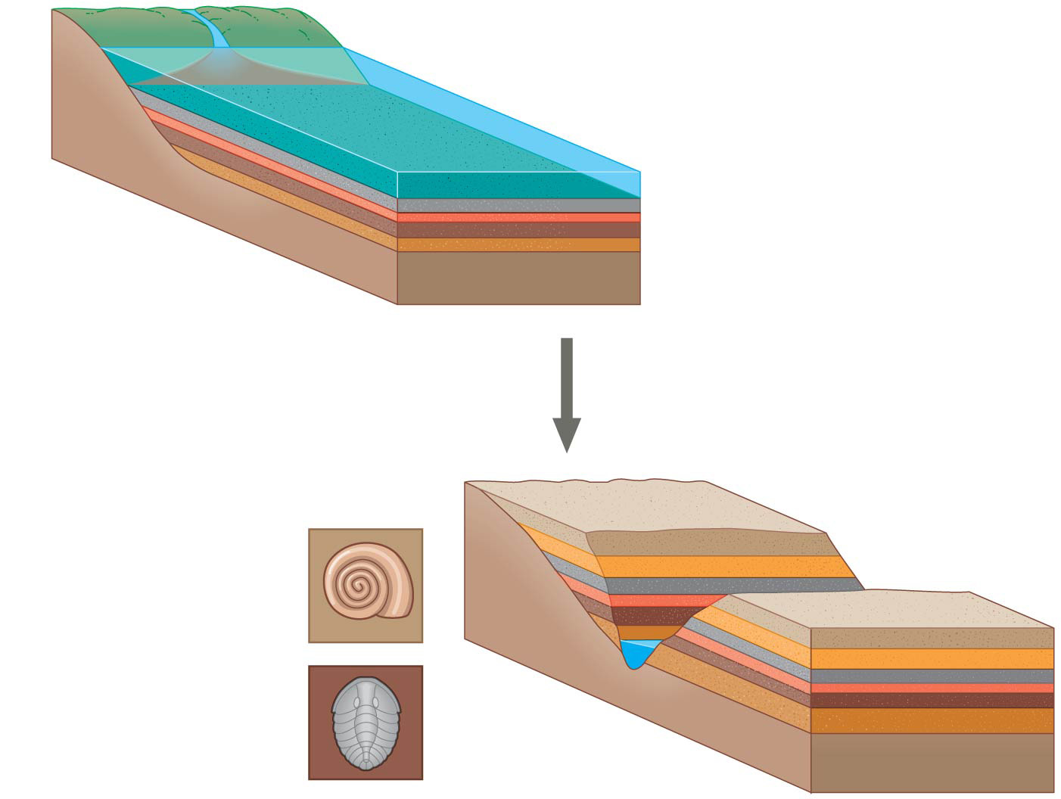
Figure 22.3
Sedimentary rock
layers (strata)
Younger stratum
with more recent
fossils
Older stratum
with older fossils
Notes:
Figure 22.3 Formation of sedimentary strata with fossils

Slide 8
Paleontology, the study of fossils, was largely developed by French scientist Georges Cuvier
Cuvier speculated that the boundaries between strata represent catastrophic events

Slide 9
Geologists James Hutton and Charles Lyell perceived that changes in Earth’s surface can result from slow continuous actions still operating today, and at the same rate
This view strongly influenced Darwin’s thinking

Slide 10
Lamarck’s Hypothesis of Evolution
Lamarck hypothesized that species evolve through use and disuse of body parts and the inheritance of acquired characteristics
The mechanisms he proposed are unsupported by evidence

Slide 11
Concept 22.2: Descent with modification by natural selection explains the adaptations of organisms and the unity and diversity of life
Some doubt about the permanence of species preceded Darwin’s ideas

Slide 12
Darwin’s Research
As a boy and into adulthood, Charles Darwin had a consuming interest in nature
Darwin first studied medicine (unsuccessfully), and then theology at Cambridge University
After graduating, he took an unpaid position as naturalist and companion to Captain Robert FitzRoy for a 5-year around the world voyage on the Beagle

Slide 13
The Voyage of the Beagle
During his travels on the Beagle, Darwin collected specimens of South American plants and animals
He observed that fossils resembled living species from the same region, and living species resembled other species from nearby regions
He experienced an earthquake in Chile and observed the uplift of rocks

Slide 14
Darwin was influenced by Lyell’s Principles of Geology and thought that the earth was more than 6,000 years old
His interest in geographic distribution of species was kindled by a stop at the Galápagos Islands west of South America
He hypothesized that species from South America had colonized the Galápagos and speciated on the islands

Slide 15
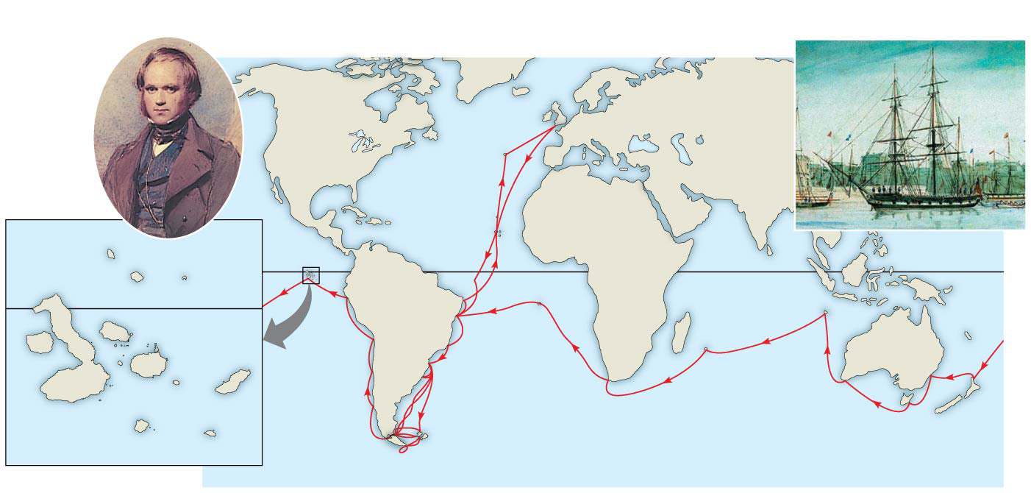
Figure 22.5
Darwin in 1840,
after his return
from the
voyage
HMS Beagle in port
Great
Britain
EUROPE
NORTH
AMERICA
ATLANTIC
OCEAN
The
Galápagos
Islands
PACIFIC
OCEAN
AFRICA
Pinta
Genovesa
SOUTH
AMERICA
Equator
Malay
Archipelago
Marchena
Equator
Santiago
PACIFIC
OCEAN
Daphne
Islands
Chile
Brazil
Fernandina
Pinzón
AUSTRALIA
Andes Mtns.
Isabela
Santa
Cruz
PACIFIC
OCEAN
Cape of
Good Hope
Santa
Fe
San
Cristobal
0
20
40
Florenza
Argentina
Tasmania
Española
New
Zealand
Kilometers
Cape Horn
Notes:
Figure 22.5 The voyage of HMS Beagle (December 1831–October 1836)

Slide 16
Darwin’s Focus on Adaptation
In reassessing his observations, Darwin perceived adaptation to the environment and the origin of new species as closely related processes
From studies made years after Darwin’s voyage, biologists have concluded that this is what happened to the Galápagos finches

Slide 17
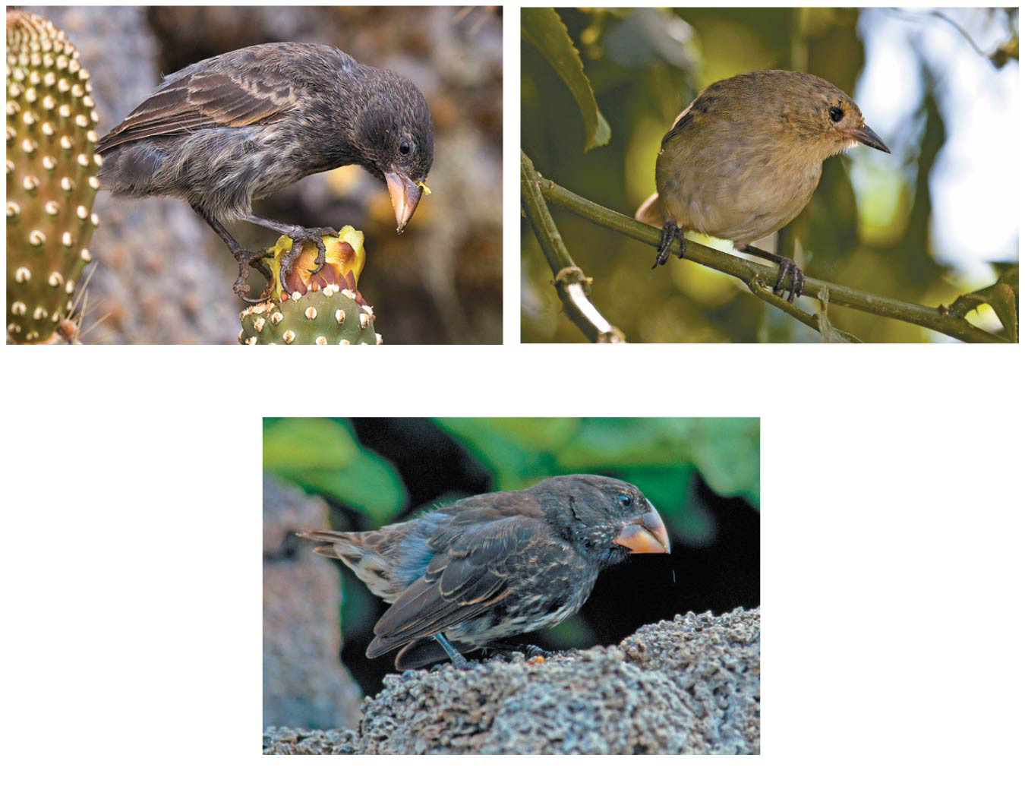
Figure 22.6
(a) Cactus-eater
(b) Insect-eater
(c) Seed-eater
Notes:
Figure 22.6 Three examples of beak variation in Galápagos finches

Slide 18
In 1844, Darwin wrote an essay on natural selection as the mechanism of descent with modification, but did not introduce his theory publicly
Natural selection is a process in which individuals with favorable inherited traits are more likely to survive and reproduce
In June 1858, Darwin received a manuscript from Alfred Russel Wallace, who had developed a theory of natural selection similar to Darwin’s
Darwin quickly finished The Origin of Species and published it the next year

Slide 19
The Origin of Species
Darwin explained three broad observations
The unity of life
The diversity of life
The match between organisms and their environment

Slide 20
Descent with Modification
Darwin never used the word evolution in the first edition of The Origin of Species
The phrase descent with modification summarized Darwin’s perception of the unity of life
The phrase refers to the view that all organisms are related through descent from an ancestor that lived in the remote past

Slide 21
In the Darwinian view, the history of life is like a tree with branches representing life’s diversity
Darwin reasoned that large morphological gaps between related groups could be explained by this branching process and past extinction events

Slide 22
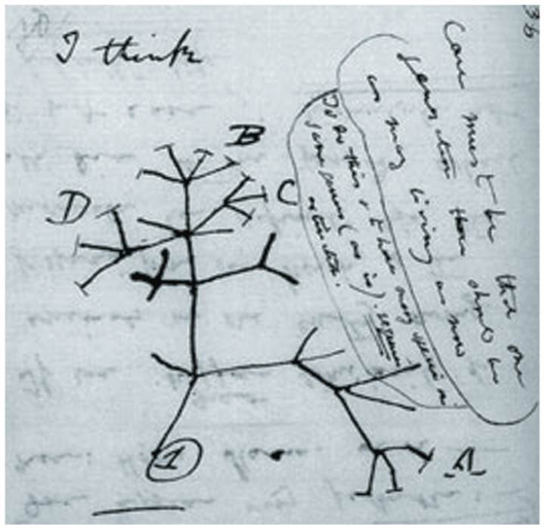
Figure 22.7
Notes:
Figure 22.7 “I think. . . .” In this 1837 sketch, Darwin envisioned the branching pattern of evolution.

Slide 23
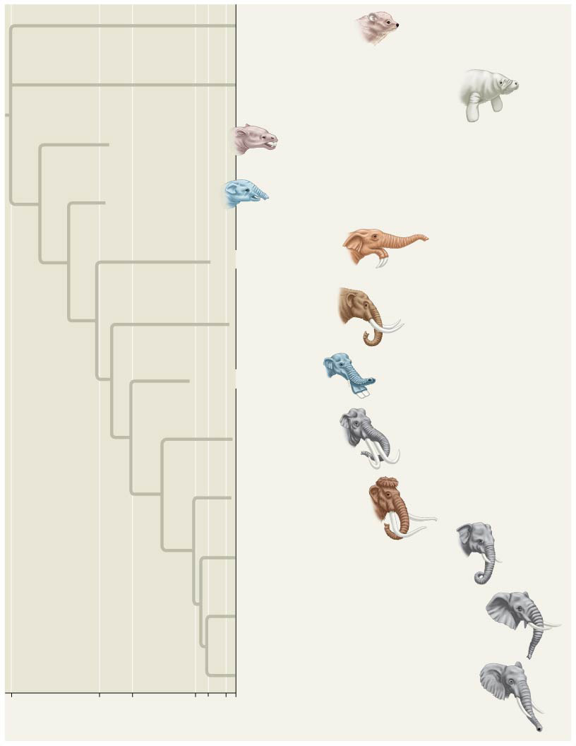
Figure 22.8
Hyracoidea
(Hyraxes)
Sirenia
(Manatees and relatives)
†Moeritherium
†Barytherium
†Deinotherium
†Mammut
†Platybelodon
†Stegodon
†Mammuthus
Elephas maximus (Asia)
Loxodonta africana (Africa)
Loxodonta cyclotis (Africa)
60
34
24
2
5.5
10⁴
0
Millions of years ago
Years ago
Notes:
Figure 22.8 Descent with modification.
The dagger symbol (†) denotes extinction.

Slide 24
Artificial Selection, Natural Selection, and Adaptation
Darwin noted that humans have modified other species by selecting and breeding individuals with desired traits, a process called artificial selection
Darwin drew two inferences from two observations

Slide 25
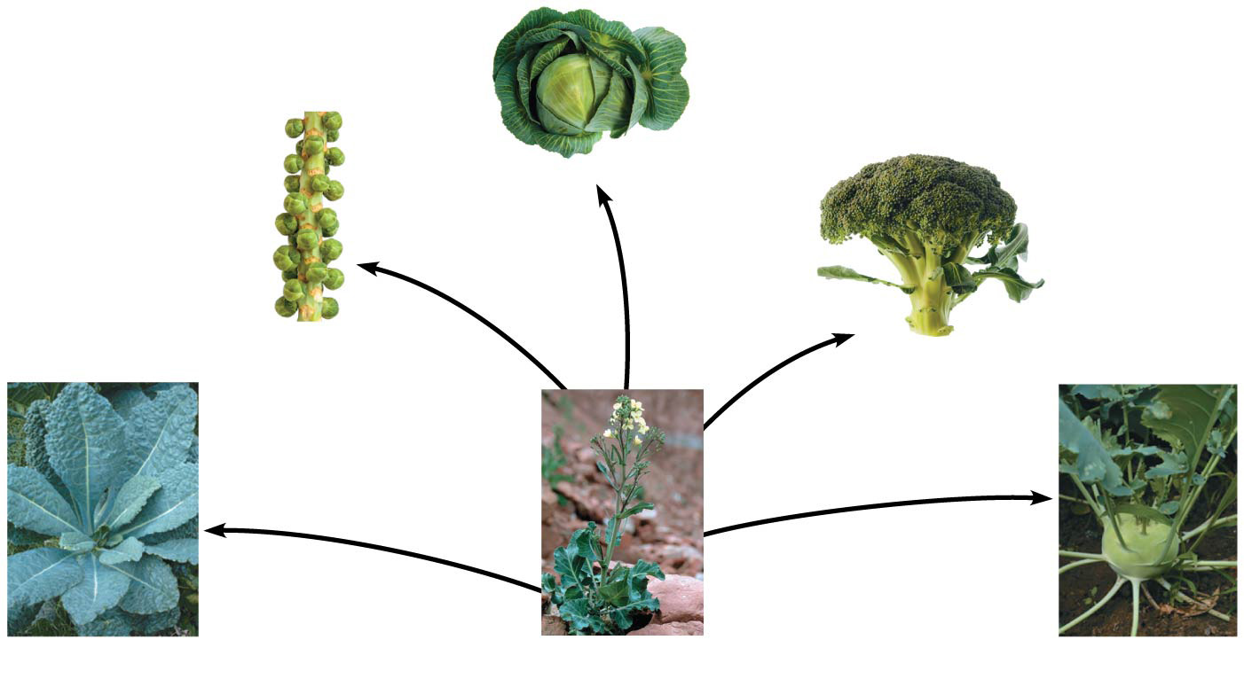
Figure 22.9
Cabbage
Selection
for apical
(tip) bud
Brussels
sprouts
Selection for
axillary (side)
buds
Broccoli
Selection for
flowers and stems
Selection
for stems
Selection
for leaves
Kale
Wild mustard
Kohlrabi
Notes:
Figure 22.9 Artificial selection

Slide 26
Observation #1: Members of a population often vary in their inherited traits

Slide 27
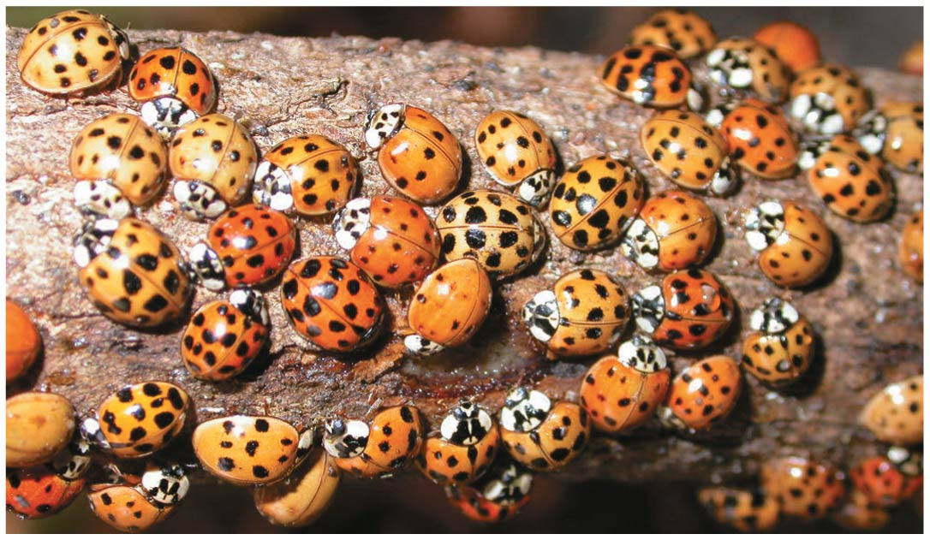
Figure 22.10
Notes:
Figure 22.10 Variation in a population

Slide 28
Observation #2: All species can produce more offspring than the environment can support, and many of these offspring fail to survive and reproduce

Slide 29
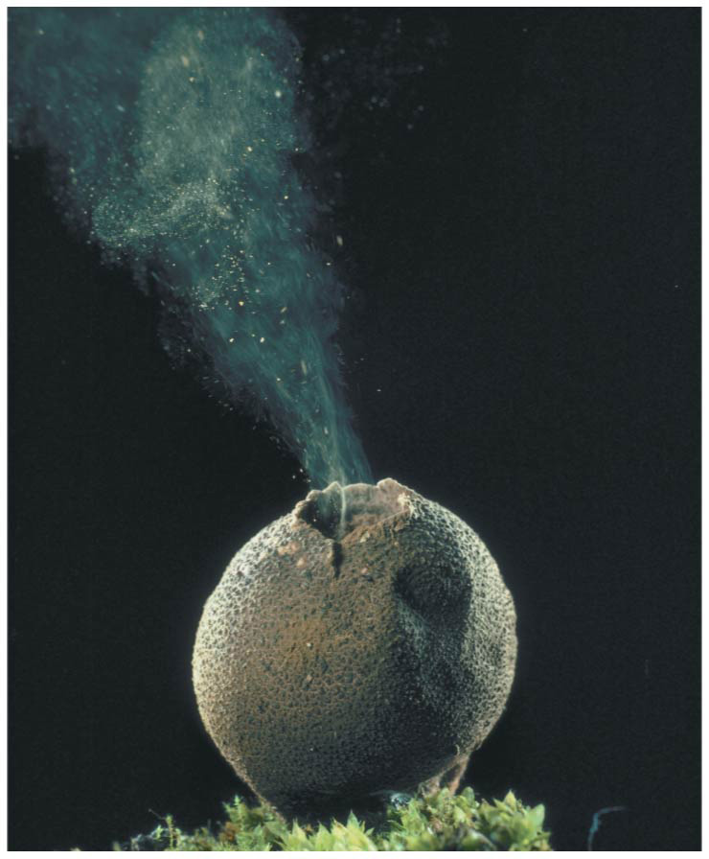
Figure 22.11
Spore
cloud
Notes:
Figure 22.11 Overproduction of offspring

Slide 30
Inference #1: Individuals whose inherited traits give them a higher probability of surviving and reproducing in a given environment tend to leave more offspring than other individuals

Slide 31
Inference #2: This unequal ability of individuals to survive and reproduce will lead to the accumulation of favorable traits in the population over generations

Slide 32
Darwin was influenced by Thomas Malthus, who noted the potential for human population to increase faster than food supplies and other resources
If some heritable traits are advantageous, these will accumulate in a population over time, and this will increase the frequency of individuals with these traits
This process explains the match between organisms and their environment

Slide 33
Natural Selection: A Summary
Individuals with certain heritable traits survive and reproduce at a higher rate than other individuals
Natural selection increases the match between organisms and their environment over time
If an environment changes over time, natural selection may result in adaptation to these new conditions and may give rise to new species

Slide 34
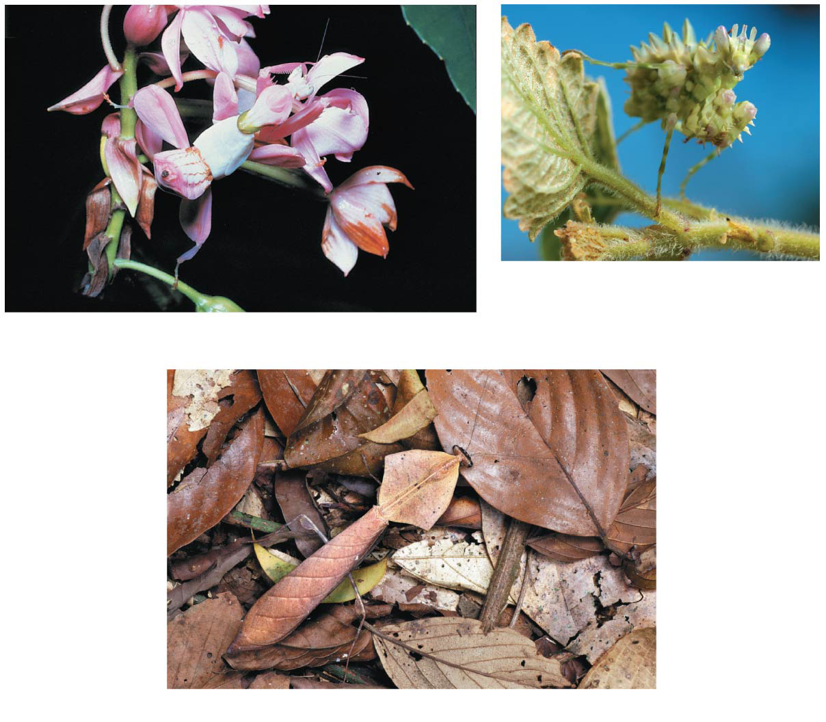
Figure 22.12
A flower-eyed mantid in South Africa
A flower mantid in Malaysia
A leaf mantid in Borneo
Notes:
Figure 22.12 Camouflage as an example of evolutionary adaptation

Slide 35
Note that individuals do not evolve; populations evolve over time
Natural selection can only increase or decrease heritable traits that vary in a population
Adaptations vary with different environments

Slide 36
Concept 22.3: Evolution is supported by an overwhelming amount of scientific evidence
New discoveries continue to fill the gaps identified by Darwin in The Origin of Species
There are four types of data that document the pattern of evolution
Direct observations
Homology
The fossil record
Biogeography

Slide 37
Direct Observations of Evolutionary Change
Two examples provide evidence for natural selection: natural selection in response to introduced plant species, and the evolution of drug-resistant bacteria

Slide 38
Natural selection does not create new traits, but edits or selects for traits already present in the population
The current, local environment determines which traits will be selected for or selected against in any specific population

Slide 39
Homology
Homology is similarity resulting from common ancestry

Slide 40
Anatomical and Molecular Homologies
Homologous structures are anatomical resemblances that represent variations on a structural theme present in a common ancestor

Slide 41
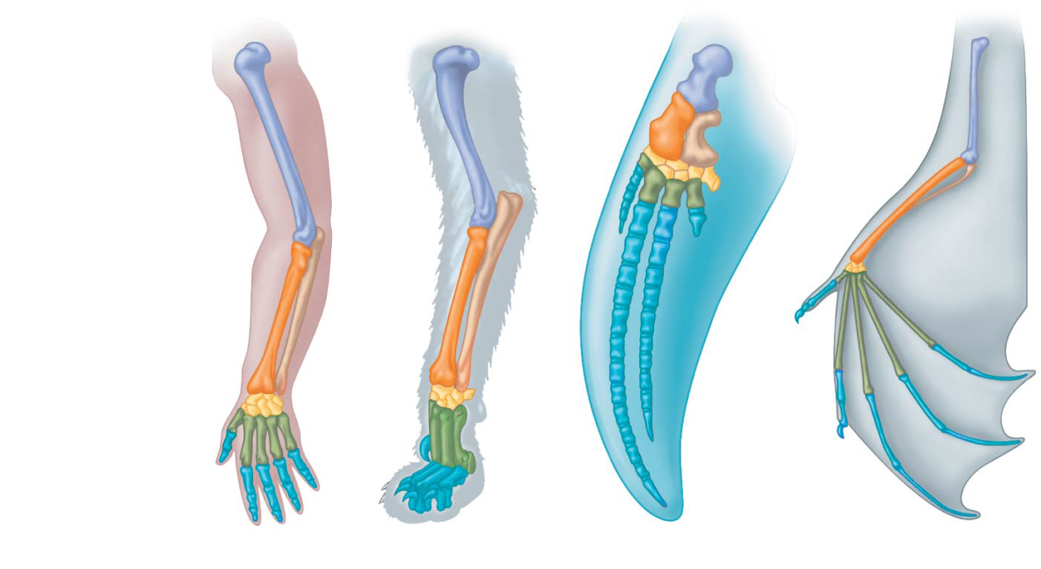
Figure 22.15
Humerus
Radius
Ulna
Carpals
Metacarpals
Phalanges
Human
Cat
Whale
Bat
Notes:
Figure 22.15 Mammalian forelimbs: homologous structures

Slide 42
Comparative embryology reveals anatomical homologies not visible in adult organisms
For example, all vertebrate embryos have a post-anal tail and pharyngeal arches

Slide 43
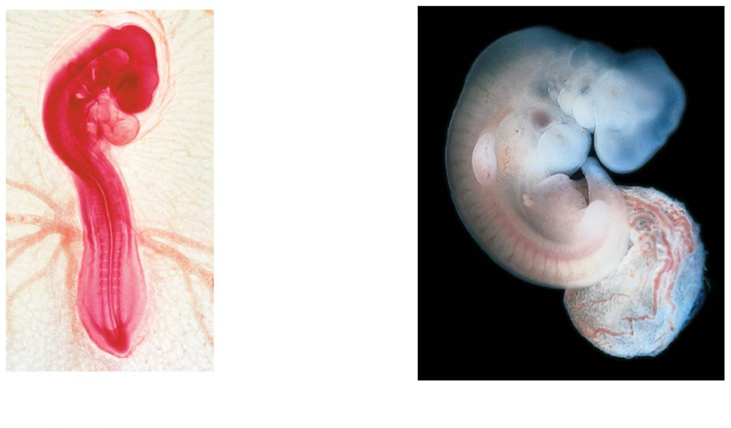
Figure 22.16
Pharyngeal
arches
Post-anal
tail
Chick embryo (LM)
Human embryo
Notes:
Figure 22.16 Anatomical similarities in vertebrate embryos

Slide 44
Vestigial structures are remnants of features that served important functions in the organism’s ancestors
Examples of homologies at the molecular level are genes shared among organisms inherited from a common ancestor

Slide 45
Homologies and “Tree Thinking”
Evolutionary trees are hypotheses about the relationships among different groups
Homologies form nested patterns in evolutionary trees
Evolutionary trees can be made using different types of data, for example, anatomical and DNA sequence data

Slide 46
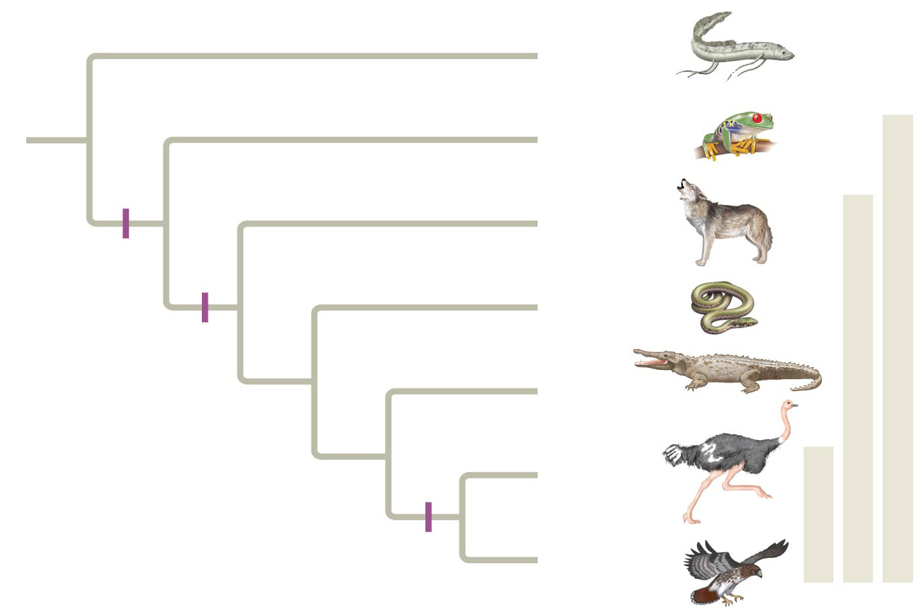
Figure 22.17
Branch point
Lungfishes
1
Amphibians
Tetrapods
2
Mammals
Digit-bearing
limbs
Amniotes
Lizards
and snakes
3
Amnion
4
Crocodiles
Homologous
characteristic
5
Ostriches
Birds
6
Feathers
Hawks and
other birds
Notes:
Figure 22.17 Tree thinking: information provided in an evolutionary tree

Slide 47
A Different Cause of Resemblance: Convergent Evolution
Convergent evolution is the evolution of similar, or analogous, features in distantly related groups
Analogous traits arise when groups independently adapt to similar environments in similar ways
Convergent evolution does not provide information about ancestry

Slide 48
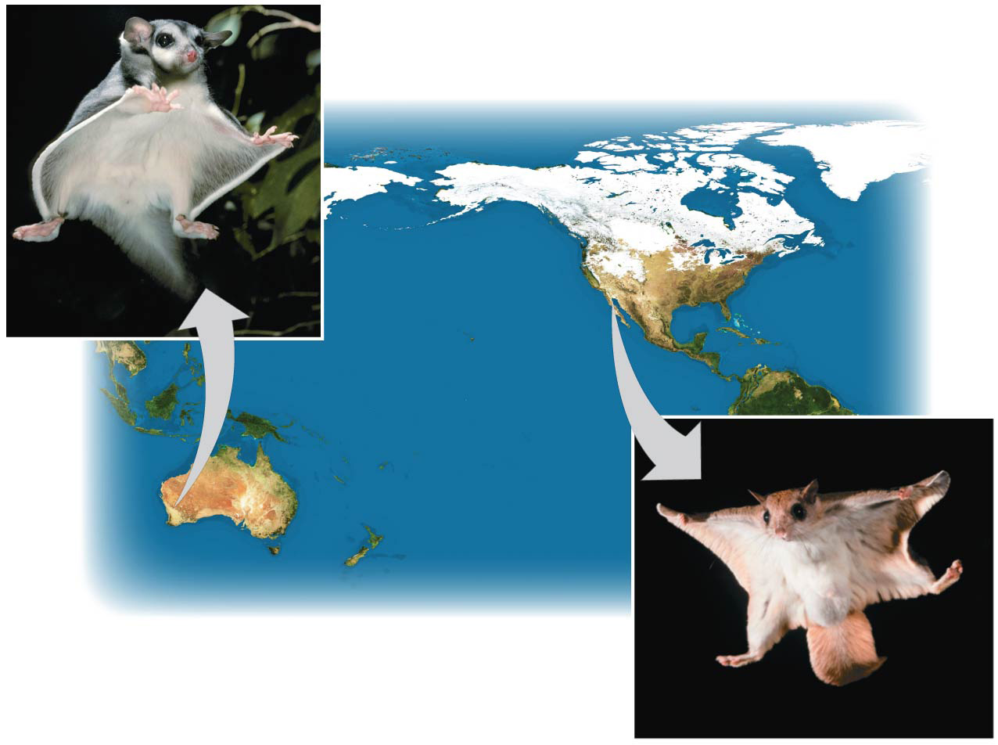
Figure 22.18
Sugar
glider
NORTH
AMERICA
AUSTRALIA
Flying squirrel
Notes:
Figure 22.18 Convergent evolution

Slide 49
The Fossil Record
The fossil record provides evidence of the extinction of species, the origin of new groups, and changes within groups over time

Slide 50
Fossils can document important transitions
For example, the transition from land to sea in the ancestors of cetaceans

Slide 51
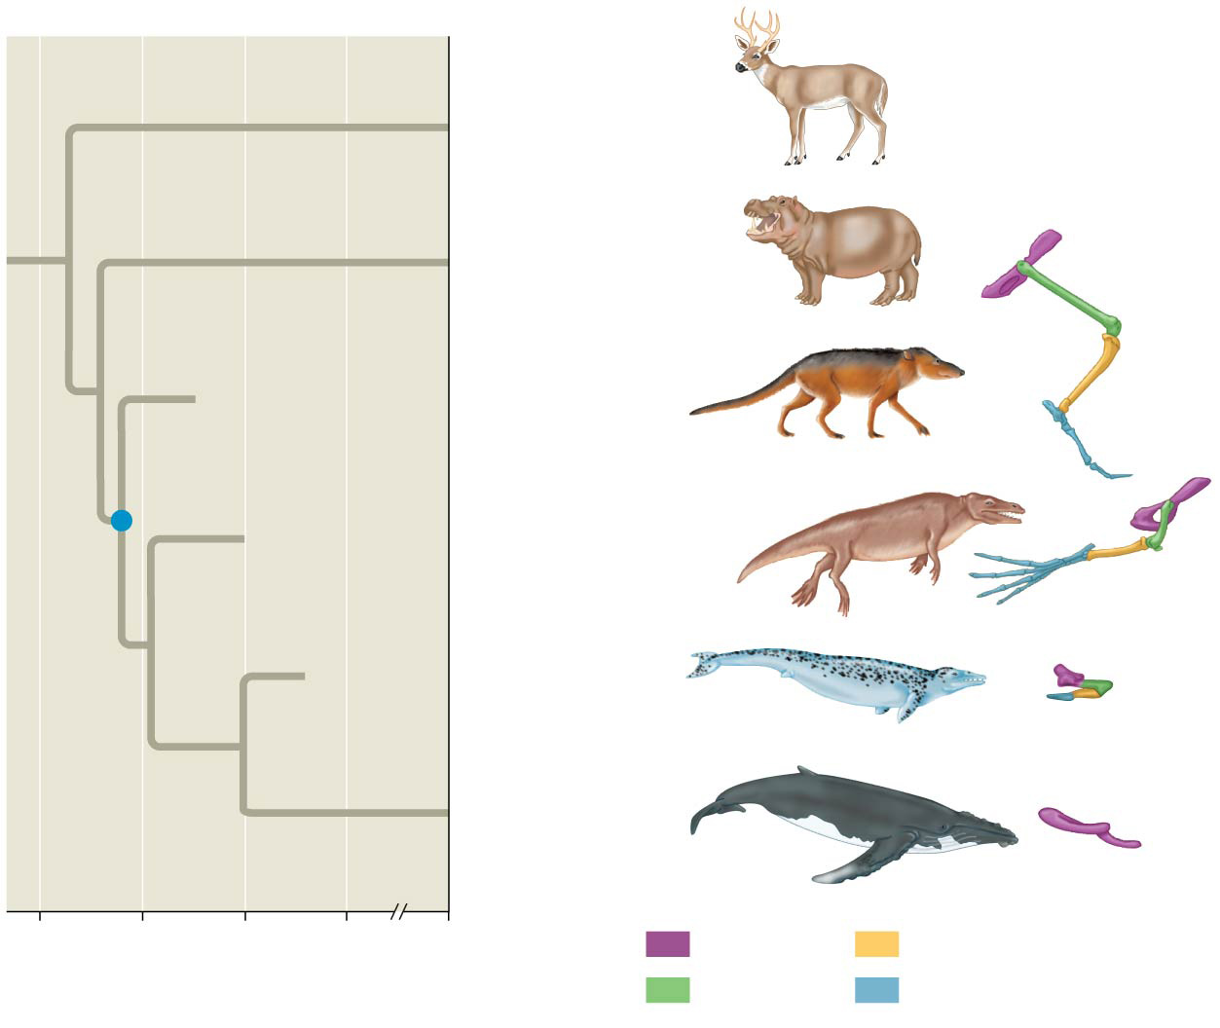
Figure 22.20
Other even-toed
ungulates
Hippopotamuses
†Pakicetus
†Rodhocetus
†Dorudon
Common
ancestor
of cetaceans
Living
cetaceans
60
50
40
30
0
Key
Pelvis
Tibia
Millions of years ago
Femur
Foot
Notes:
Figure 22.20 The transition to life in the sea
The dagger symbol (†) denotes extinction.

Slide 52
Biogeography
Biogeography, the scientific study of the geographic distribution of species, provides evidence of evolution
Earth’s continents were formerly united in a single large continent called Pangaea, but have since separated by continental drift
An understanding of continent movement and modern distribution of species allows us to predict when and where different groups evolved

Slide 53
Endemic species are species that are not found anywhere else in the world
Islands have many endemic species that are often closely related to species on the nearest mainland or island
Darwin explained that species from the mainland colonized islands and gave rise to new species as they adapted to new environments

Slide 54
What Is Theoretical About Darwin’s View of Life?
In science, a theory accounts for many observations and data and attempts to explain and integrate a great variety of phenomena
Darwin’s theory of evolution by natural selection integrates diverse areas of biological study and stimulates many new research questions
Ongoing research adds to our understanding of evolution

Slide 55
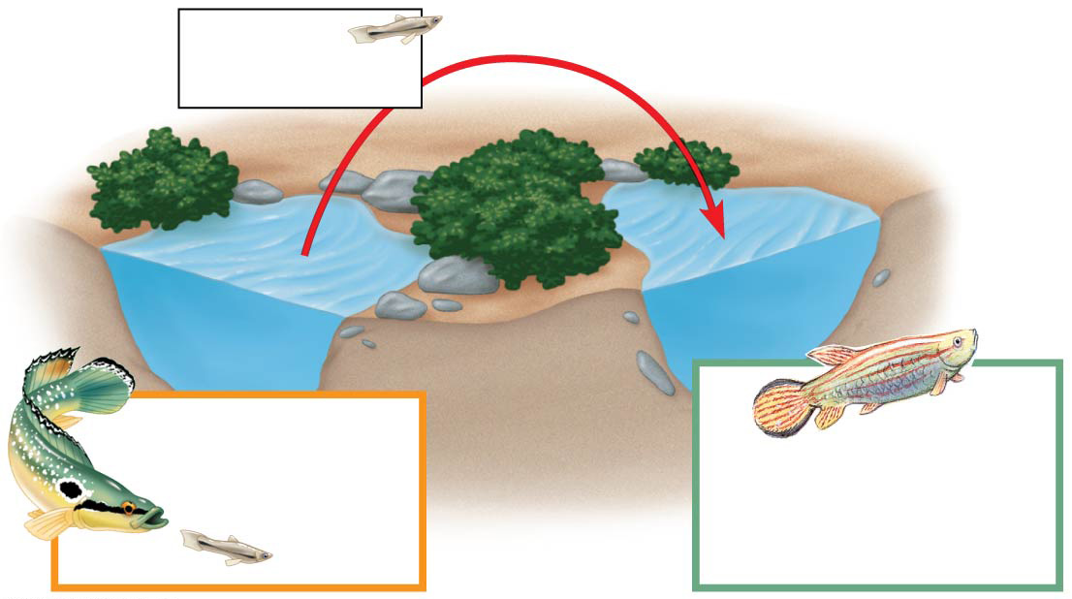
Figure 22.UN02a
Guppies
transplanted
Pools with
pike-cichlids
and guppies
Pools with killifish,
but no guppies
prior to transplant
Notes:
Figure 22.UN02a Skills exercise: making and testing predictions (part 1)

Slide 56
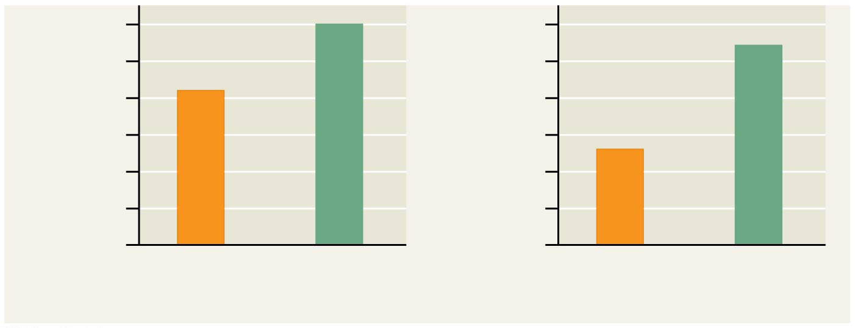
Figure 22.UN02b
12
12
10
10
8
8
Number of
colored spots
Area of colored
spots (mm²)
6
6
4
4
2
2
0
0
Source
population
Transplanted
population
Source
population
Transplanted
population
Notes:
Figure 22.UN02b Skills exercise: making and testing predictions (part 2)

Slide 57
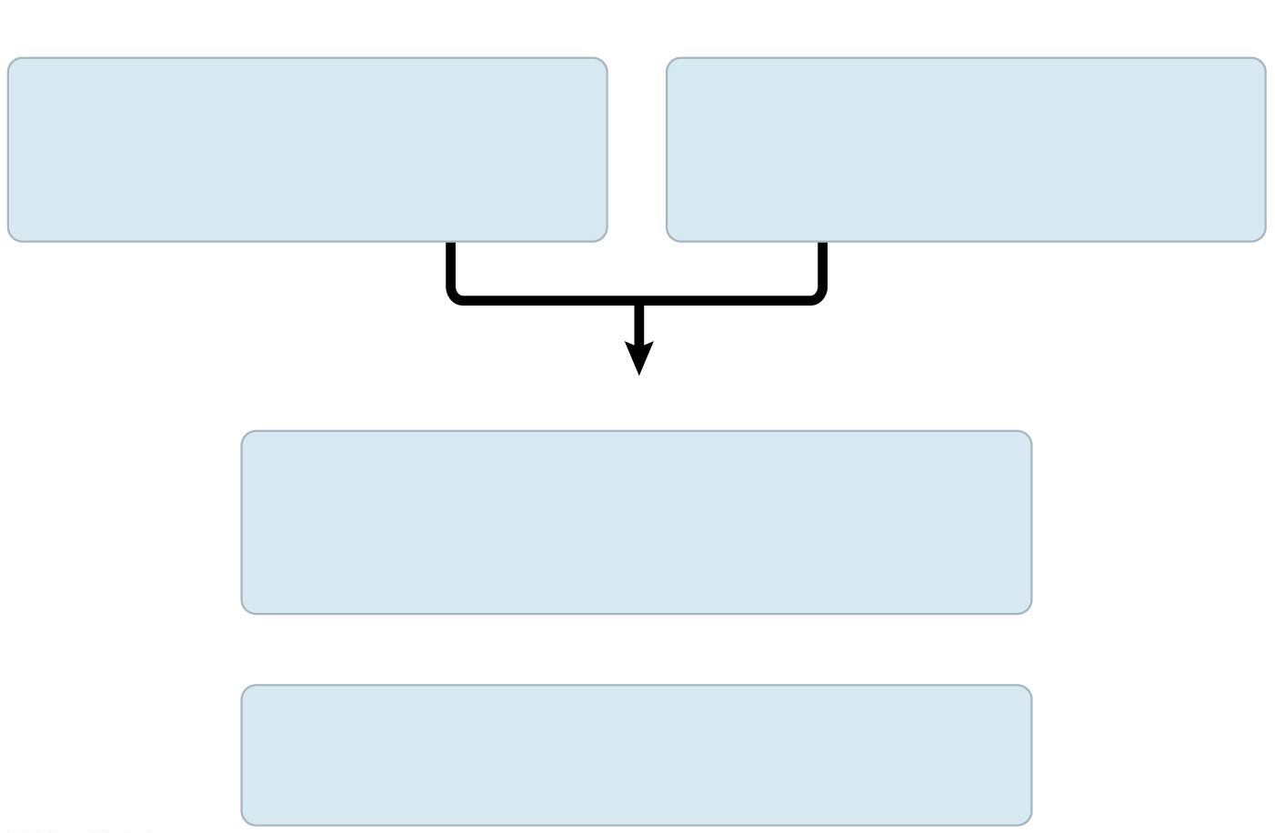
Figure 22.UN03
Observations
Individuals in a population
vary in their heritable
characteristics.
Organisms produce more
offspring than the
environment can support.
Inferences
Individuals that are well suited
to their environment tend to leave more
offspring than other individuals.
and
Over time, favorable traits
accumulate in the population.
Notes:
Figure 22.UN03 Summary of key concepts: natural selection

