Slide 1
29
Plant Diversity I: How Plants Colonized Land
Lecture Presentation by Nicole Tunbridge and
Kathleen Fitzpatrick

Slide 2
The Greening of Earth
For much of Earth’s history, the terrestrial surface was lifeless
Cyanobacteria and protists likely existed on land 1.2 billion years ago
Around 500 million years ago, small plants, fungi, and animals emerged on land

Slide 3
Since colonizing land, plants have diversified into roughly 290,000 living species
Land plants are defined as having terrestrial ancestors, even though some are now aquatic
Land plants do not include photosynthetic protists (algae)
Plants supply oxygen and are the ultimate source of most food eaten by land animals

Slide 4
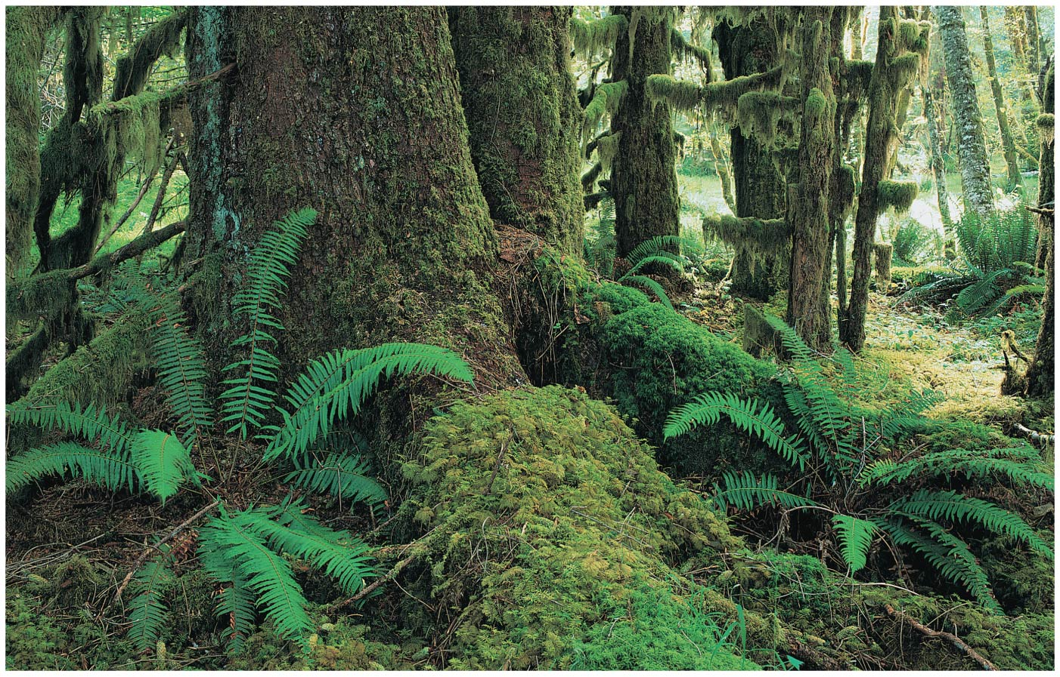
Figure 29.1
Notes:
Figure 29.1 How did plants change the world?

Slide 5
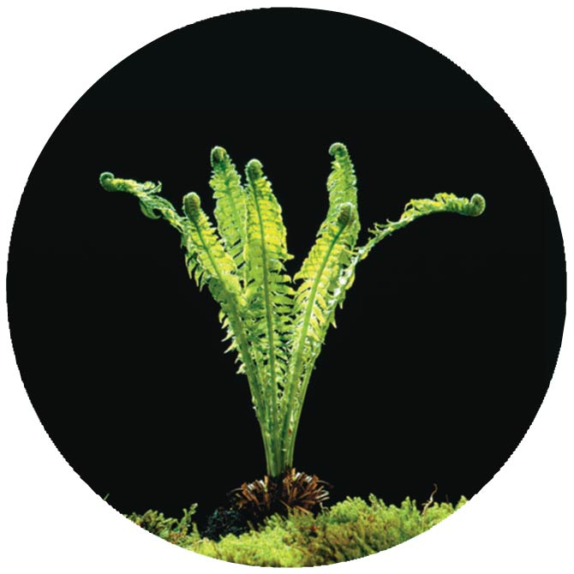
Figure 29.1a
Notes:
Figure 29.1a How did plants change the world? (part 1: fern)

Slide 6
Concept 29.1: Land plants evolved from green algae
Green algae called charophytes are the closest relatives of land plants

Slide 7
Morphological and Molecular Evidence
Many characteristics of land plants also appear in some algae
However, land plants share the following traits with only charophytes
Rings of cellulose-synthesizing proteins
Structure of flagellated sperm
Formation of a phragmoplast

Slide 8
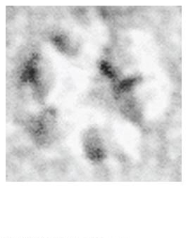
Figure 29.UN01
30 nm
Notes:
Figure 29.UN01 In-text figure, rings of cellulose-synthesizing proteins, p. 613

Slide 9
Comparisons of both nuclear and chloroplast genes point to charophytes as the closest living relatives of land plants
Note that land plants are not descended from modern charophytes, but share a common ancestor with modern charophytes

Slide 10
Adaptations Enabling the Move to Land
In charophytes a layer of a durable polymer called sporopollenin prevents exposed zygotes from drying out
Sporopollenin is also found in plant spore walls
The movement onto land by charophyte ancestors provided unfiltered sun, more plentiful CO₂, and nutrient-rich soil
Land presented challenges: a scarcity of water and lack of structural support

Slide 11
Land plants diversified as adaptations evolved that enabled them to thrive despite challenges
The placement of the boundary dividing land plants from algae is the subject of ongoing debate
Until this debate is resolved, we define plants as embryophytes, plants with embryos

Slide 12
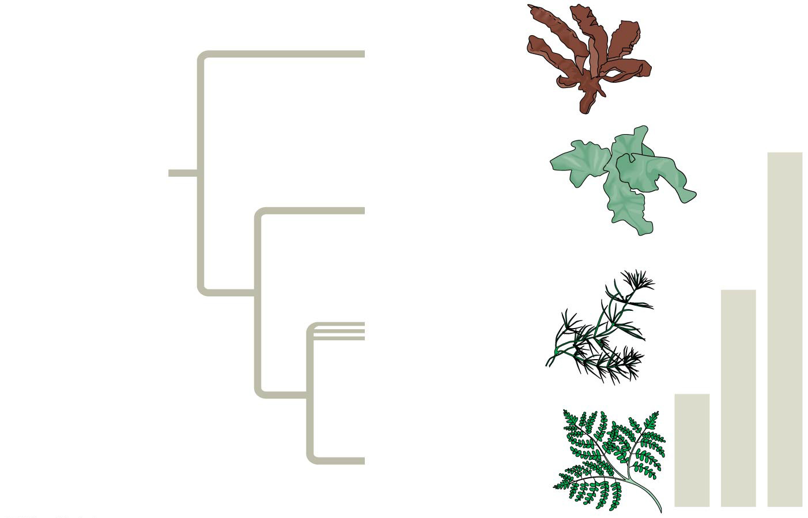
Figure 29.2
Red algae
ANCESTRAL ALGA
Chlorophytes
Viridiplantae
Charophytes
Streptophyta
Embryophytes
Plantae
Notes:
Figure 29.2 Three possible “plant” kingdoms

Slide 13
Derived Traits of Plants
Five key traits appear in nearly all land plants but are absent in the charophytes
Alternation of generations
Multicellular, dependent embryos
Walled spores produced in sporangia
Multicellular gametangia
Apical meristems

Slide 14
Alternation of Generations
Plants alternate between two multicellular stages, a reproductive cycle called alternation of generations
The gametophyte is haploid and produces haploid gametes by mitosis
Fusion of the gametes gives rise to the diploid sporophyte, which produces haploid spores by meiosis

Slide 15
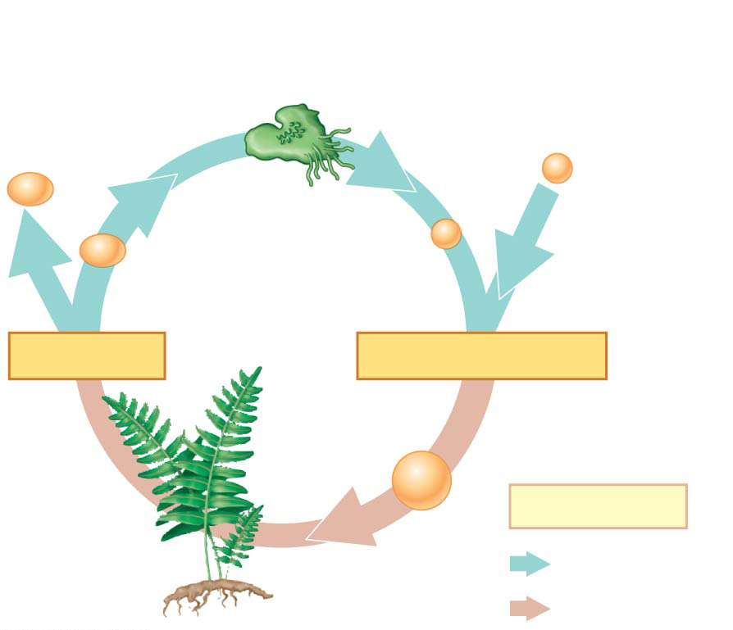
Figure 29.3a
Alternation of generations
Gametophyte (n)
Gamete from another plant
Mitosis
Mitosis
n
n
n
n
Spore
Gamete
MEIOSIS
FERTILIZATION
Zygote
2n
Key
Sporophyte (2n)
Mitosis
Haploid (n)
Diploid (2n)
Notes:
Figure 29.3a Exploring derived traits of land plants (part 1: alternation of generations)

Slide 16
Multicellular, Dependent Embryos
The diploid embryo is retained within the tissue of the female gametophyte
Nutrients are transferred from parent to embryo through placental transfer cells
Land plants are called embryophytes because of the dependency of the embryo on the parent

Slide 17
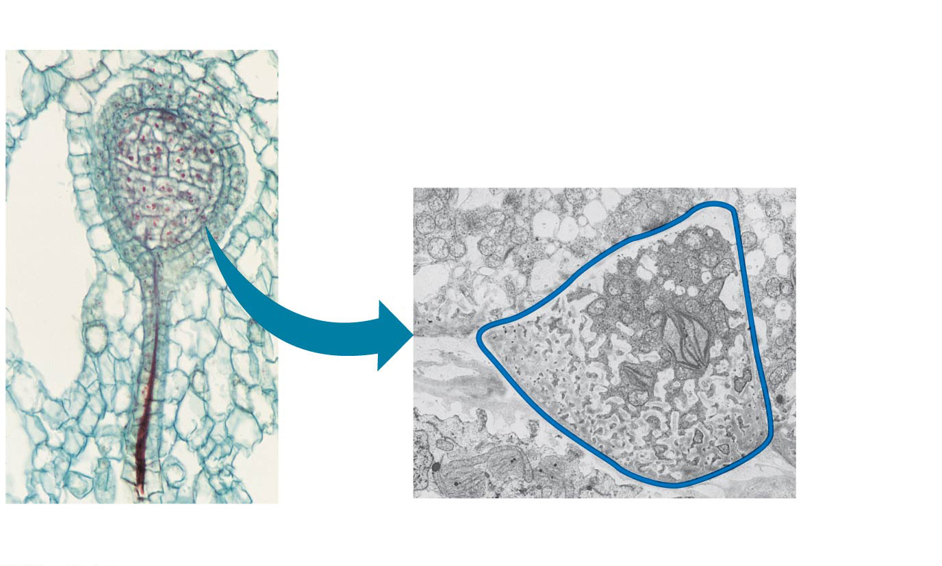
Figure 29.3b
Multicellular, dependent embryos
Embryo (LM) and placental transfer cell (TEM) of Marchantia (a liverwort)
Embryo
Maternal tissue
Wall ingrowths
2 µm
10 µm
Placental transfer cell (blue outline)
Notes:
Figure 29.3b Exploring derived traits of land plants (part 2: multicellular, dependent embryos)

Slide 18
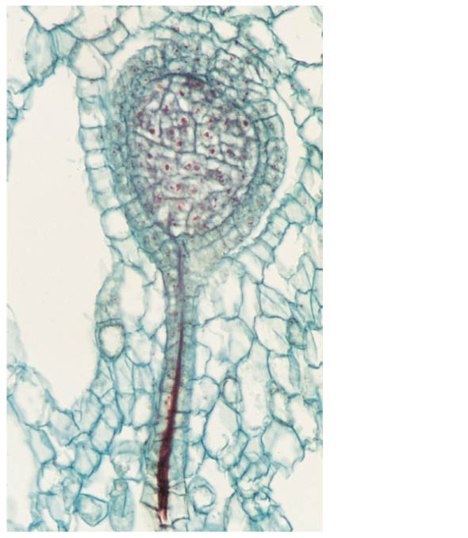
Figure 29.3ba
Embryo
Maternal tissue
10 µm
Notes:
Figure 29.3ba Exploring derived traits of land plants (part 2a: multicellular, dependent embryos)

Slide 19
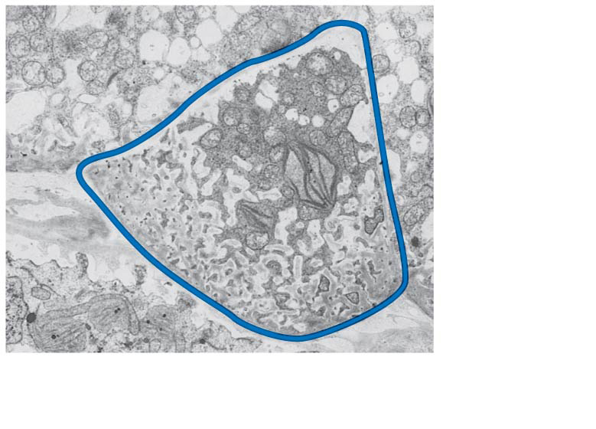
Figure 29.3bb
Wall ingrowths
2 µm
Placental transfer cell (blue outline)
Notes:
Figure 29.3bb Exploring derived traits of land plants (part 2b: multicellular, dependent embryos)

Slide 20
Walled Spores Produced in Sporangia
The sporophyte produces spores in organs called sporangia
Diploid cells called sporocytes undergo meiosis to generate haploid spores
Spore walls contain sporopollenin, which makes them resistant to harsh environments

Slide 21
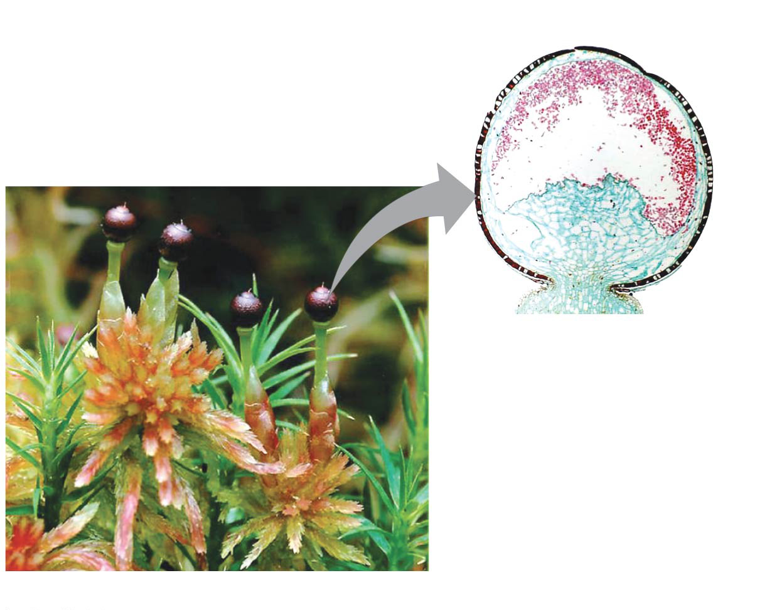
Figure 29.3c
Walled spores produced in sporangia
Spores
Sporangium
Longitudinal section of Sphagnum sporangium (LM)
Sporophyte
Gametophyte
Sporophytes and sporangia of Sphagnum (a moss)
Notes:
Figure 29.3c Exploring derived traits of land plants (part 3: walled spores produced in sporangia)

Slide 22
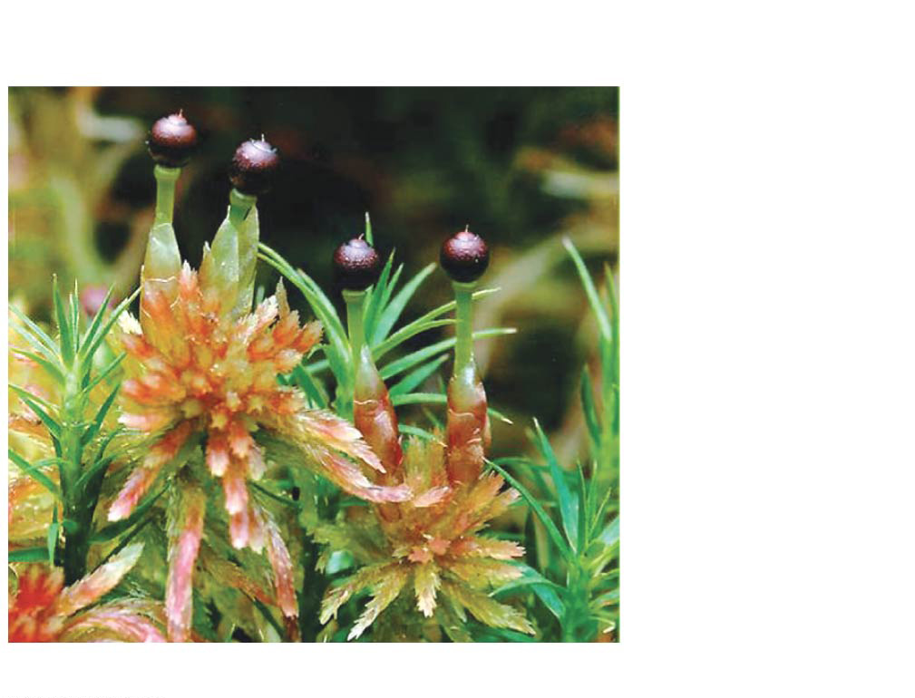
Figure 29.3ca
Sporangium
Sporophyte
Gametophyte
Sporophytes and sporangia of Sphagnum (a moss)
Notes:
Figure 29.3ca Exploring derived traits of land plants (part 3a: walled spores produced in sporangia)

Slide 23
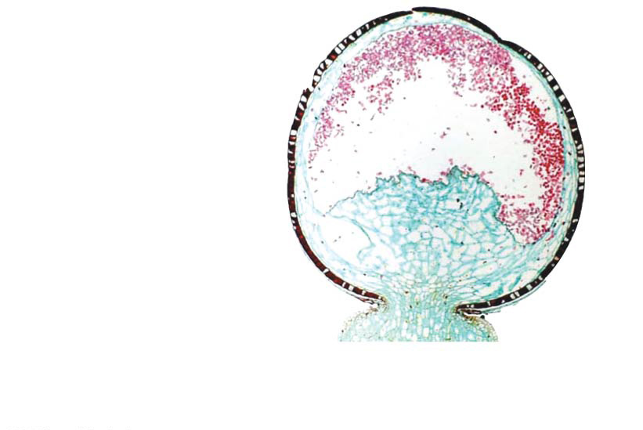
Figure 29.3cb
Spores
Sporangium
Longitudinal section of Sphagnum sporangium (LM)
Notes:
Figure 29.3cb Exploring derived traits of land plants (part 3b: walled spores produced in sporangia)

Slide 24
Multicellular Gametangia
Gametes are produced within organs called gametangia
Female gametangia, called archegonia, produce eggs and are the site of fertilization
Male gametangia, called antheridia, produce and release sperm

Slide 25
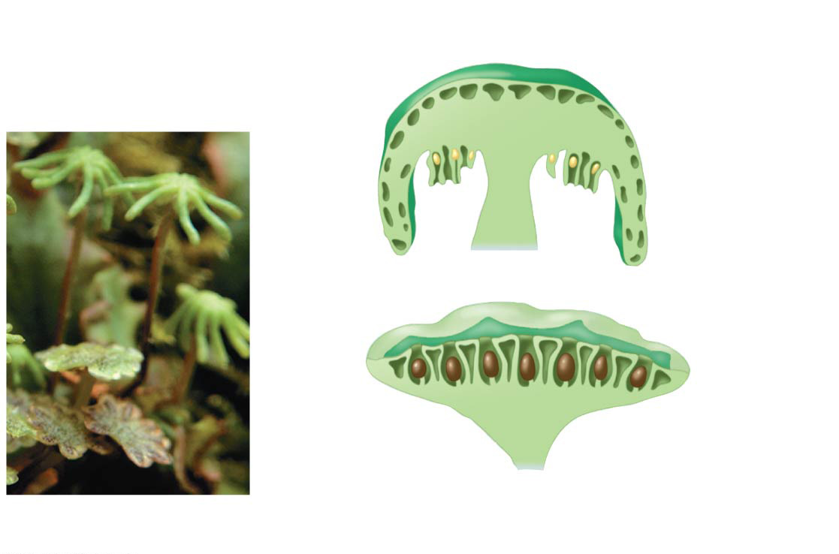
Figure 29.3d
Multicellular gametangia
Female gametophyte
Archegonia, each with an egg (yellow)
Antheridia (brown), containing sperm
Male gametophyte
Archegonia and antheridia of Marchantia (a liverwort)
Notes:
Figure 29.3d Exploring derived traits of land plants (part 4: multicellular gametangia)

Slide 26
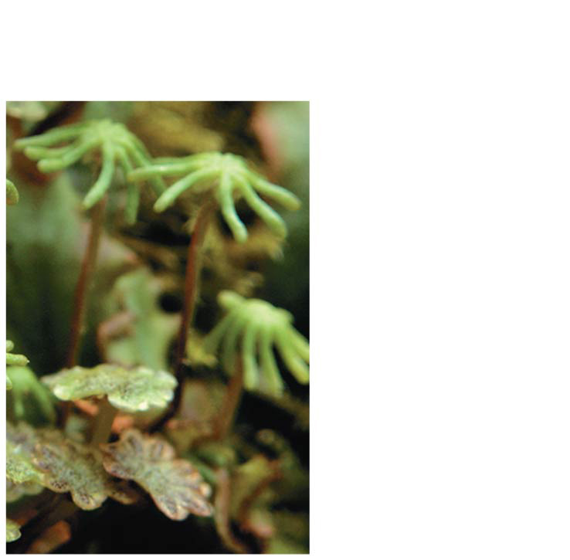
Figure 29.3da
Female gametophyte
Male gametophyte
Notes:
Figure 29.3da Exploring derived traits of land plants (part 4a: multicellular gametangia)

Slide 27
Apical Meristems
Plants sustain continual growth in their apical meristems
Cells from the apical meristems differentiate into various tissues

Slide 28
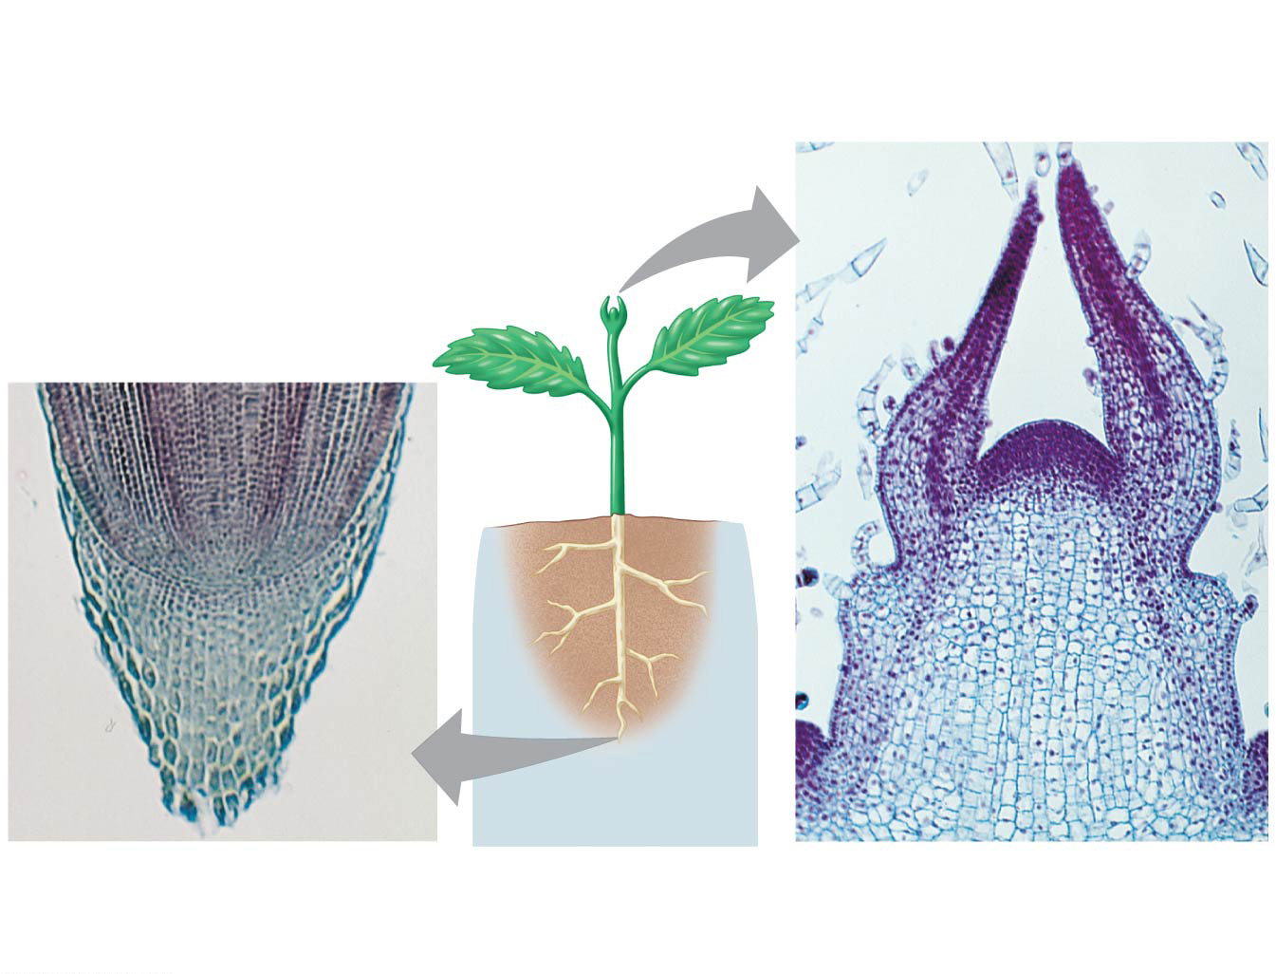
Figure 29.3e
Apical meristems
Apical meristem of shoot
Developing leaves
Apical meristem of root
Root
100 µm
Shoot
100 µm
Apical meristems of plant roots and shoots
Notes:
Figure 29.3e Exploring derived traits of land plants (part 5: apical meristems)

Slide 29
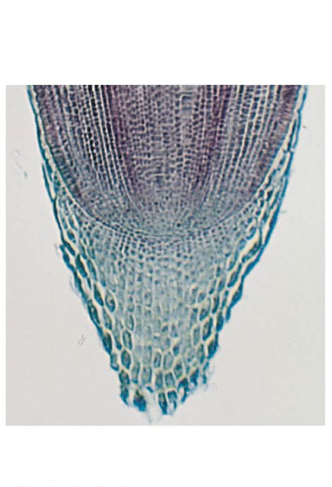
Figure 29.3ea
Apical meristem of root
Root
100 µm
Notes:
Figure 29.3ea Exploring derived traits of land plants (part 5a: apical meristems)

Slide 30
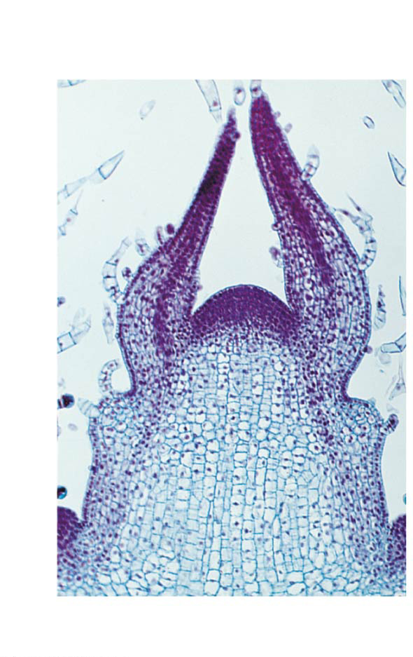
Figure 29.3eb
Apical meristem of shoot
Developing leaves
Shoot
100 µm
Notes:
Figure 29.3eb Exploring derived traits of land plants (part 5b: apical meristems)

Slide 31
Additional derived traits include
Cuticle, a waxy covering of the epidermis
Stomata are specialized cells that allow for gas exchange between the outside air and the plant
Mycorrhizae, symbiotic associations between fungi and land plants that may have helped plants without true roots to obtain nutrients

Slide 32
The Origin and Diversification of Plants
Fossil evidence indicates that plants were on land at least 470 million years ago
Fossilized spores and tissues have been extracted from 450-million-year-old rocks

Slide 33
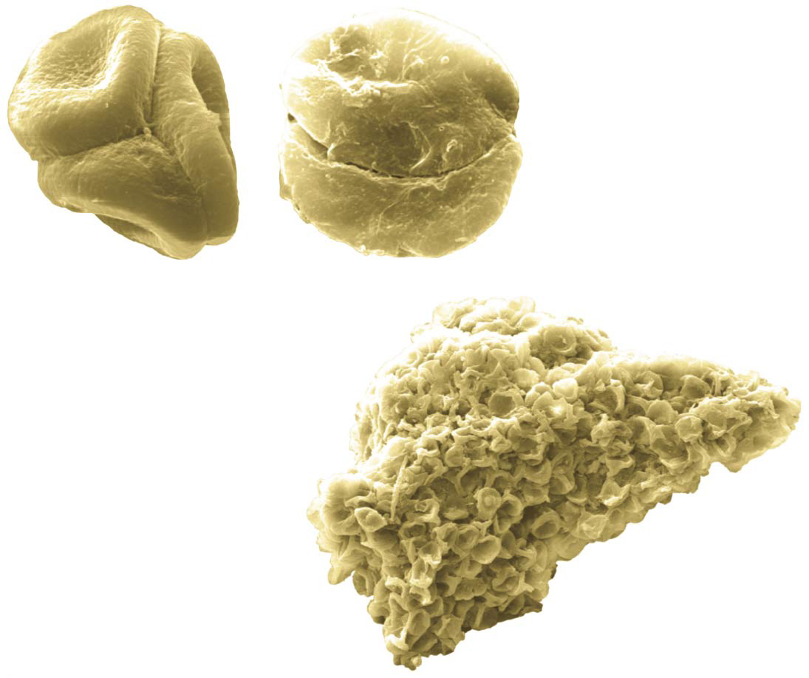
Figure 29.4
(a) Fossilized spores
(b) Fossilized sporophyte tissue
Notes:
Figure 29.4 Ancient plant spores and tissue

Slide 34
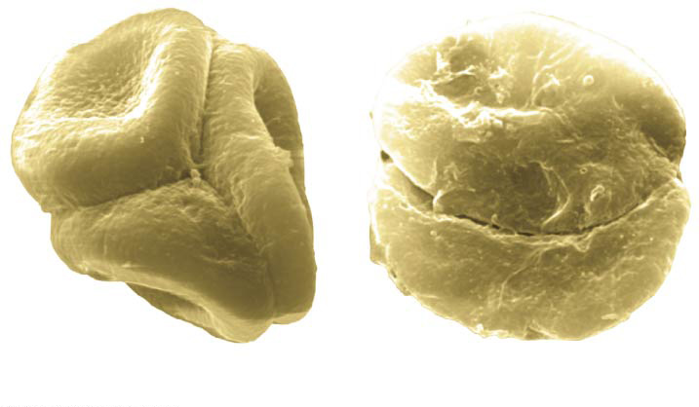
Figure 29.4a
(a) Fossilized spores
Notes:
Figure 29.4a Ancient plant spores and tissue (part 1: spores)

Slide 35
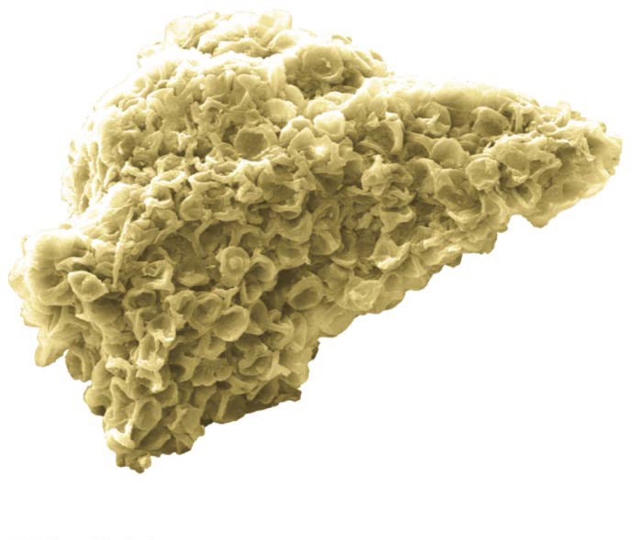
Figure 29.4b
(b) Fossilized sporophyte tissue
Notes:
Figure 29.4b Ancient plant spores and tissue (part 2: tissue)

Slide 36
Fossils of larger structures, such as sporangium, date to 425 million years ago

Slide 37
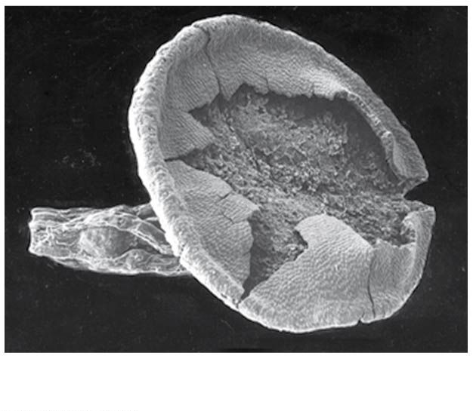
Figure 29.UN02
0.3 mm
Cooksonia sporangium fossil
Notes:
Figure 29.UN02 In-text figure, Cooksonia sporangium fossil, p. 616

Slide 38
Ancestral species gave rise to a vast diversity of modern plants

Slide 39
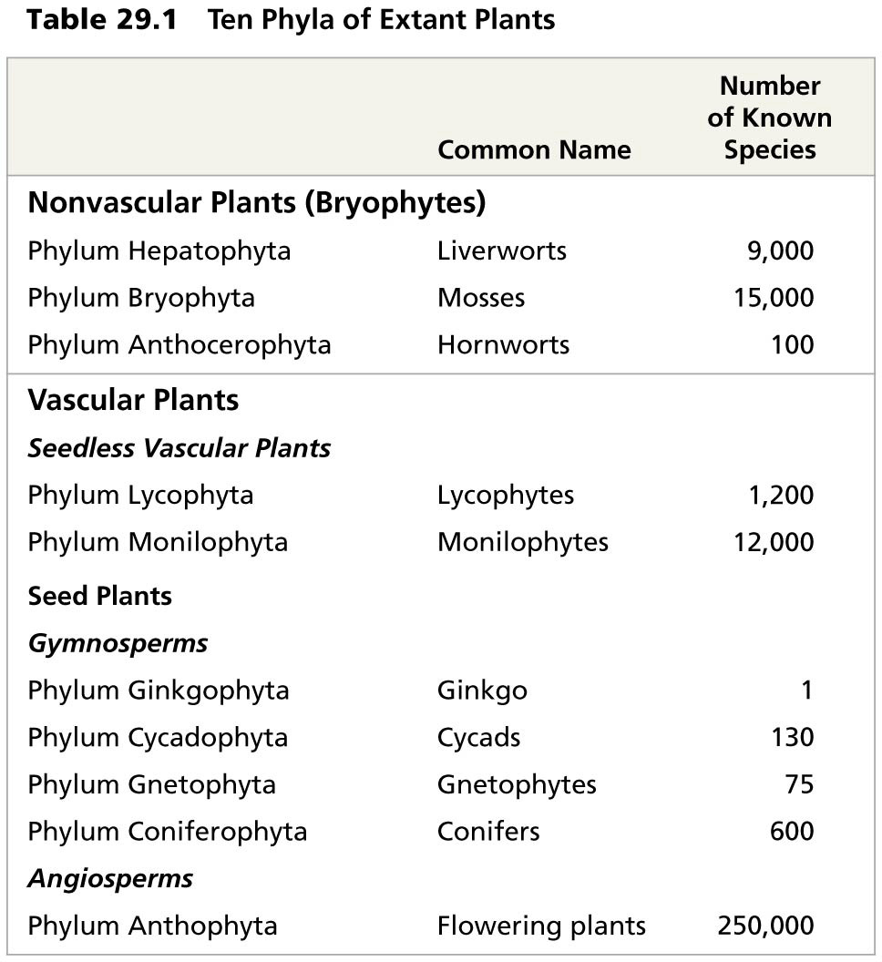
Table 29.1
Notes:
Table 29.1 Ten phyla of extant plants

Slide 40
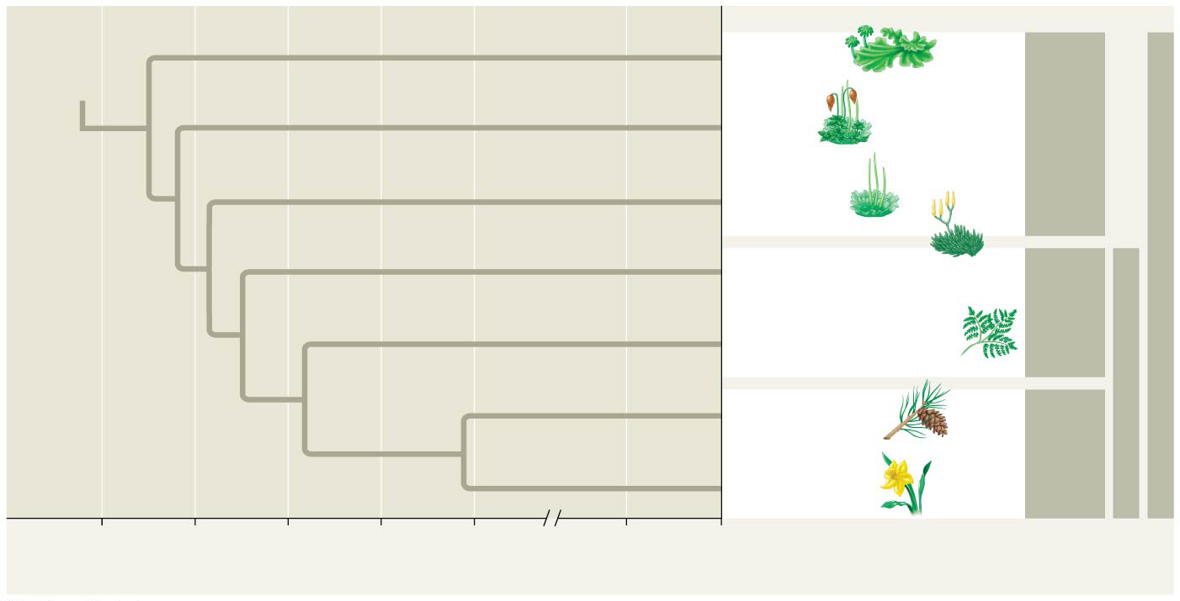
Figure 29.5
ANCESTRAL GREEN ALGA
Liverworts
Origin of land plants
Nonvascular plants (bryophytes)
1
Mosses
Land plants
Hornworts
Lycophytes (club mosses, spike mosses, quillworts)
Origin of vascular plants
Seedless vascular plants
2
Monilophytes (ferns, horsetails, whisk ferns)
Vascular plants
Gymnosperms
Seed plants
Origin of extant seed plants
3
Angiosperms
500 450 400 350 300 50 0
Millions of years ago (mya)
Notes:
Figure 29.5 Highlights of plant evolution

Slide 41
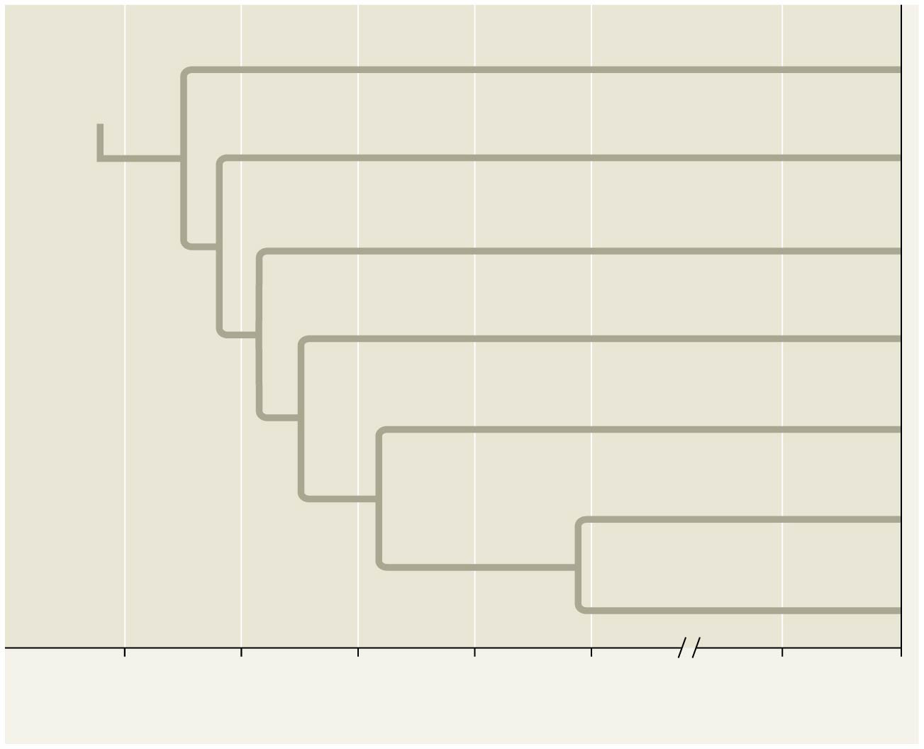
Figure 29.5a
ANCESTRAL GREEN ALGA
Liverworts
Origin of land plants
Mosses
1
Hornworts
Lycophytes
Origin of vascular plants
Monilophytes
2
Origin of extant seed plants
Gymnosperms
3
Angiosperms
500 450 400 350 300 50 0
Millions of years ago (mya)
Notes:
Figure 29.5a Highlights of plant evolution (part 1: tree)

Slide 42
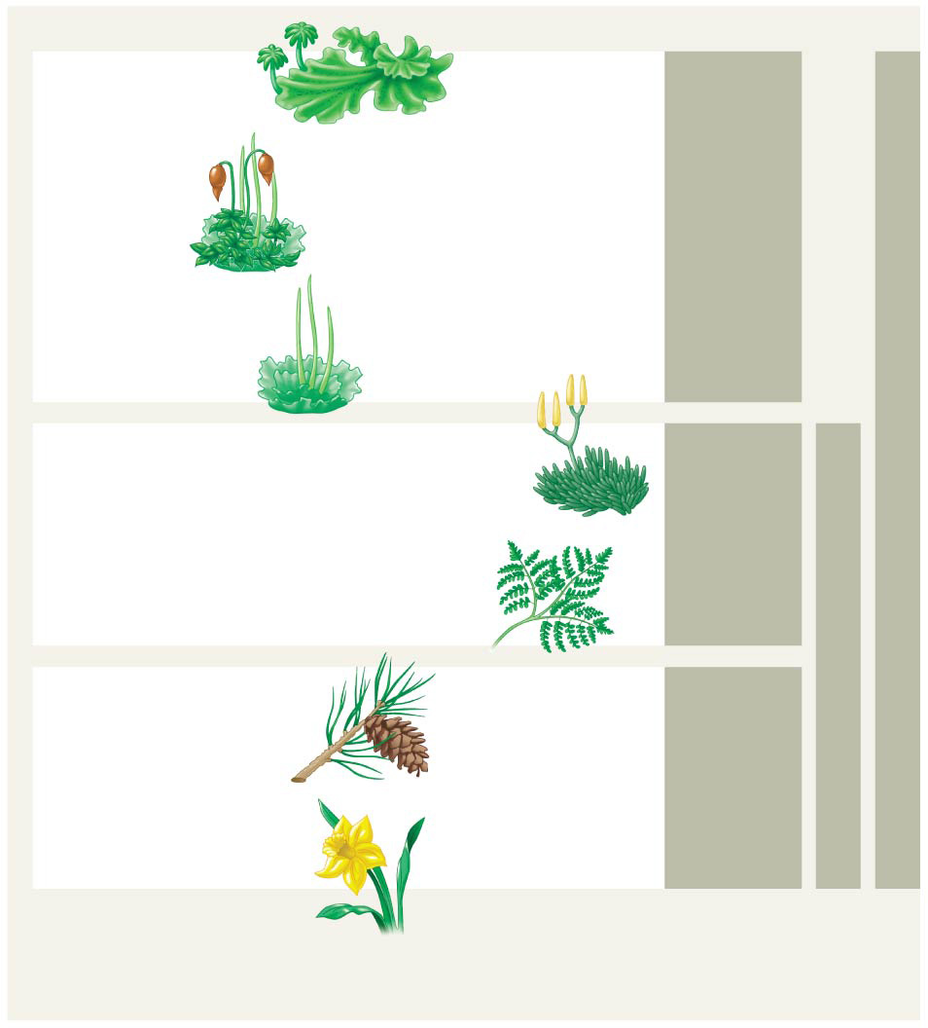
Figure 29.5b
Liverworts
Nonvascular plants (bryophytes)
Land plants
Mosses
Hornworts
Lycophytes (club mosses, spike mosses, quillworts)
Seedless vascular plants
Monilophytes (ferns, horsetails, whisk ferns)
Vascular plants
Gymnosperms
Seed plants
Angiosperms
Notes:
Figure 29.5b Highlights of plant evolution (part 2: art)

Slide 43
Land plants can be informally grouped based on the presence or absence of vascular tissue
Most plants have vascular tissue; these constitute the vascular plants
Nonvascular plants are commonly called bryophytes
Bryophytes are not a monophyletic group

Slide 44
Seedless vascular plants can be divided into clades
Lycophytes (club mosses and their relatives)
Monilophytes (ferns and their relatives)
Seedless vascular plants do not form a clade
Organisms that are grouped based on shared key biological features, rather than shared ancestry, can be referred to as a grade

Slide 45
A seed is an embryo and nutrients surrounded by a protective coat
Seed plants form a clade and can be divided into further clades
Gymnosperms, the “naked seed” plants, including the conifers
Angiosperms, the flowering plants

Slide 46
Concept 29.2: Mosses and other nonvascular plants have life cycles dominated by gametophytes
Bryophytes are represented today by three phyla of small herbaceous (nonwoody) plants
Liverworts, phylum Hepatophyta
Mosses, phylum Bryophyta
Hornworts, phylum Anthocerophyta
These groups are thought to represent the earliest lineages to diverge from the common ancestor of land plants

Slide 47
Figure 29.UN03
Nonvascular plants (bryophytes)
Seedless vascular plants
Gymnosperms
Angiosperms
Notes:
Figure 29.UN03 In-text figure, nonvascular mini-tree, p. 618

Slide 48
Bryophyte Gametophytes
In all three bryophyte phyla, gametophytes are larger and longer-living than sporophytes
Sporophytes are typically present only part of the time

Slide 49
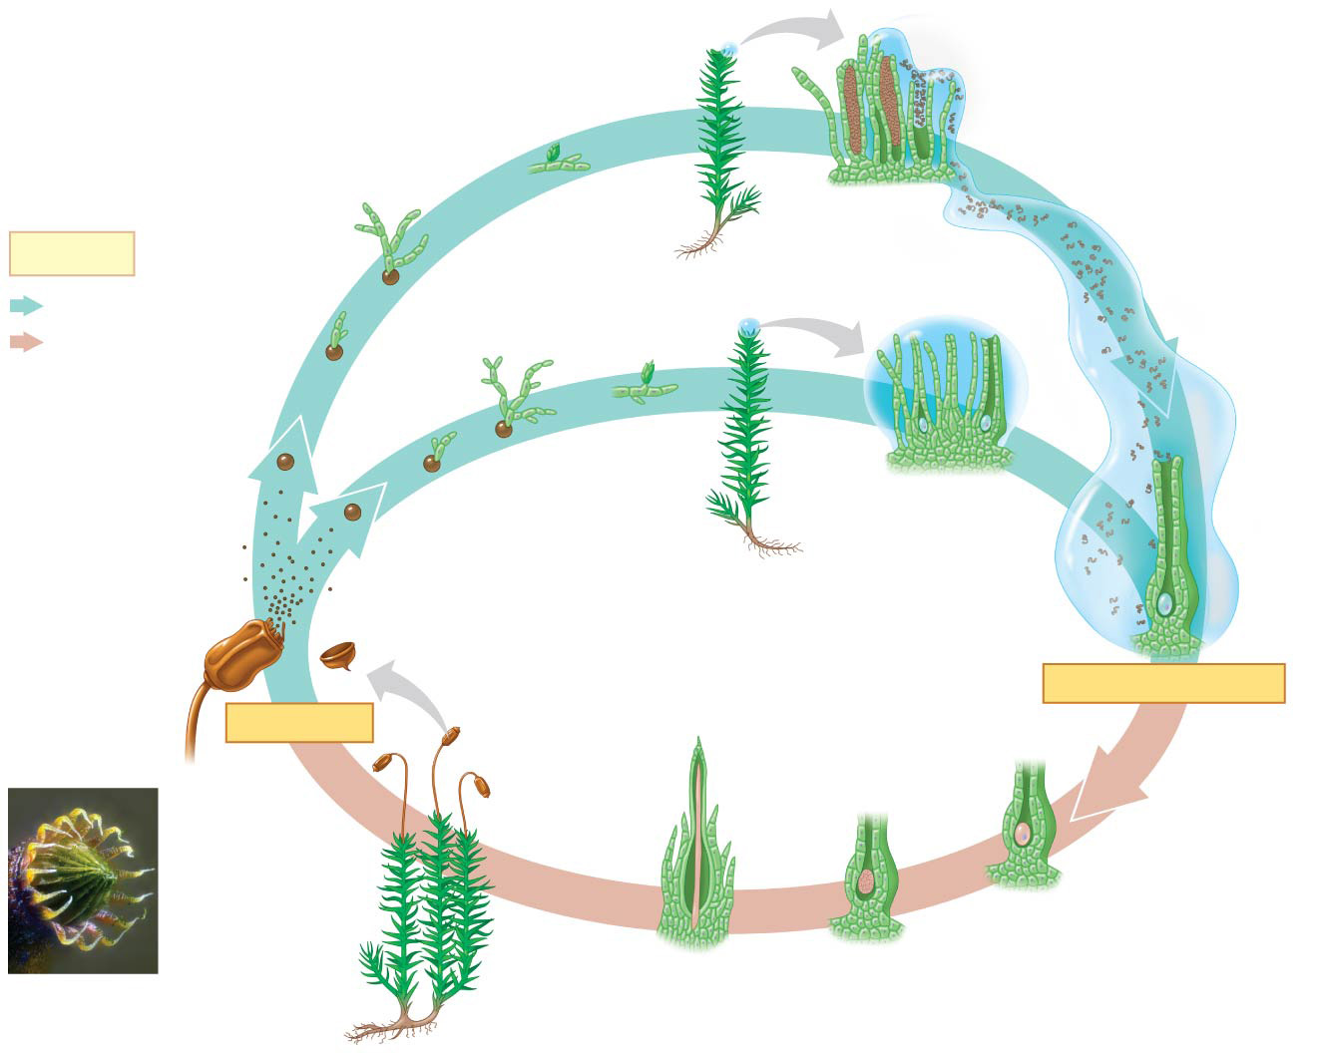
Figure 29.6
“Bud”
Protonemata (n)
Sperm
Antheridia
Key
Male gametophyte (n)
Haploid (n) Diploid (2n)
“Bud”
Egg
Spores
Gametophore
Spore dispersal
Archegonia
Female gametophyte (n)
Rhizoid
Peristome
Sporangium
Seta
FERTILIZATION
MEIOSIS
Capsule (sporangium)
(within archegonium)
Zygote (2n)
Mature sporophytes
Foot
Embryo
Archegonium
2 mm
Young sporophyte (2n)
Capsule with peristome (LM)
Female gametophyte
Notes:
Figure 29.6 The life cycle of a moss

Slide 50
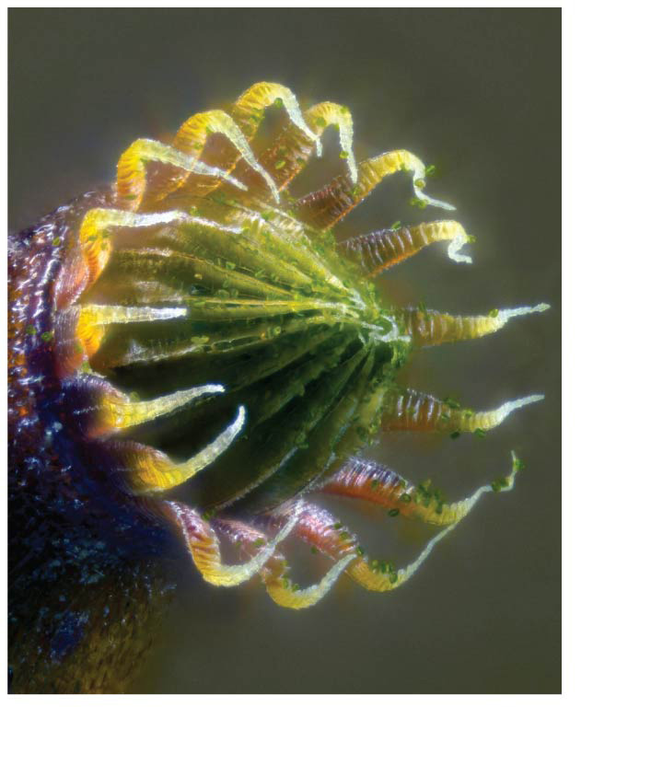
Figure 29.6a
2 mm
Capsule with peristome (LM)
Notes:
Figure 29.6a The life cycle of a moss (part 1: LM)

Slide 51
Figure 29.6b-1
Spore dispersal
Spores
Peristome
Sporangium
Key
Haploid (n)
Notes:
Figure 29.6b-1 The life cycle of a moss (part 2: step 1)

Slide 52
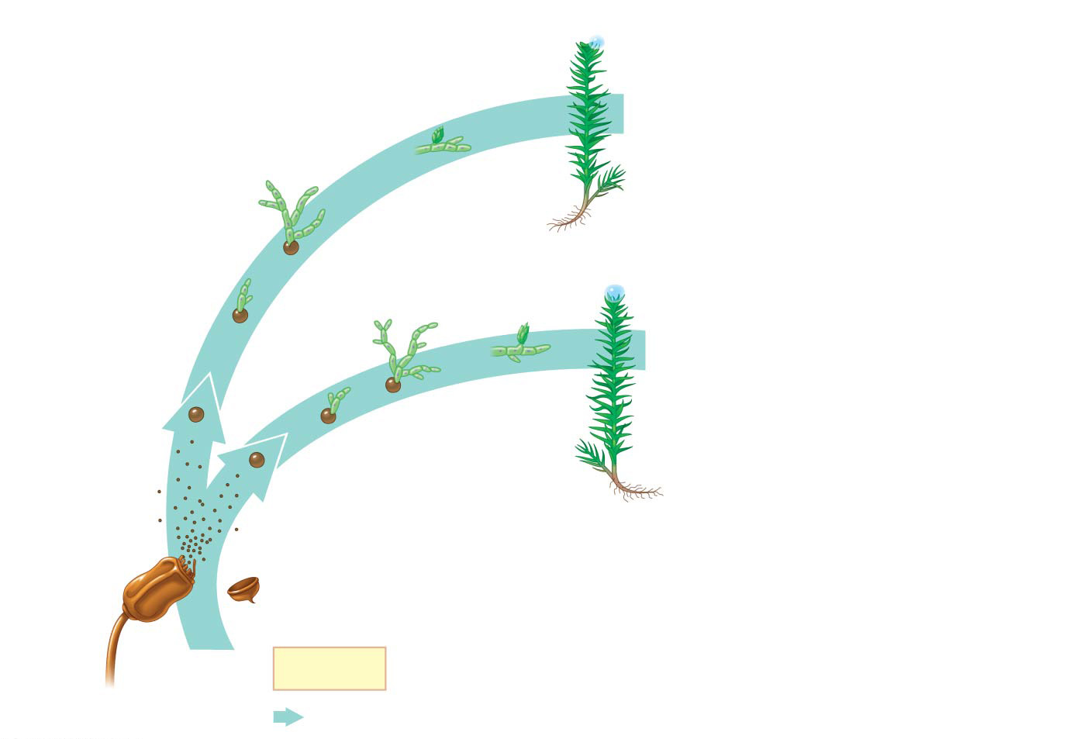
Figure 29.6b-2
“Bud”
Protonemata (n)
Male gametophyte (n)
“Bud”
Spore dispersal
Spores
Gametophore
Female gametophyte (n)
Rhizoid
Peristome
Sporangium
Key
Haploid (n)
Notes:
Figure 29.6b-2 The life cycle of a moss (part 2: step 2)

Slide 53
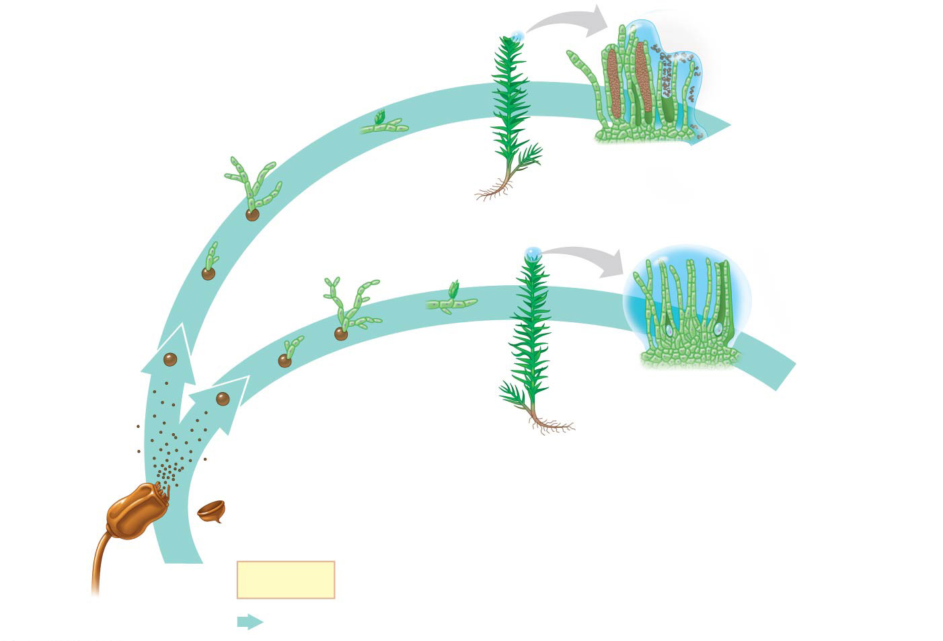
Figure 29.6b-3
“Bud”
Protonemata (n)
Antheridia
Male gametophyte (n)
“Bud”
Egg
Spore dispersal
Spores
Gametophore
Archegonia
Female gametophyte (n)
Rhizoid
Peristome
Sporangium
Key
Haploid (n)
Notes:
Figure 29.6b-3 The life cycle of a moss (part 2: step 3)

Slide 54
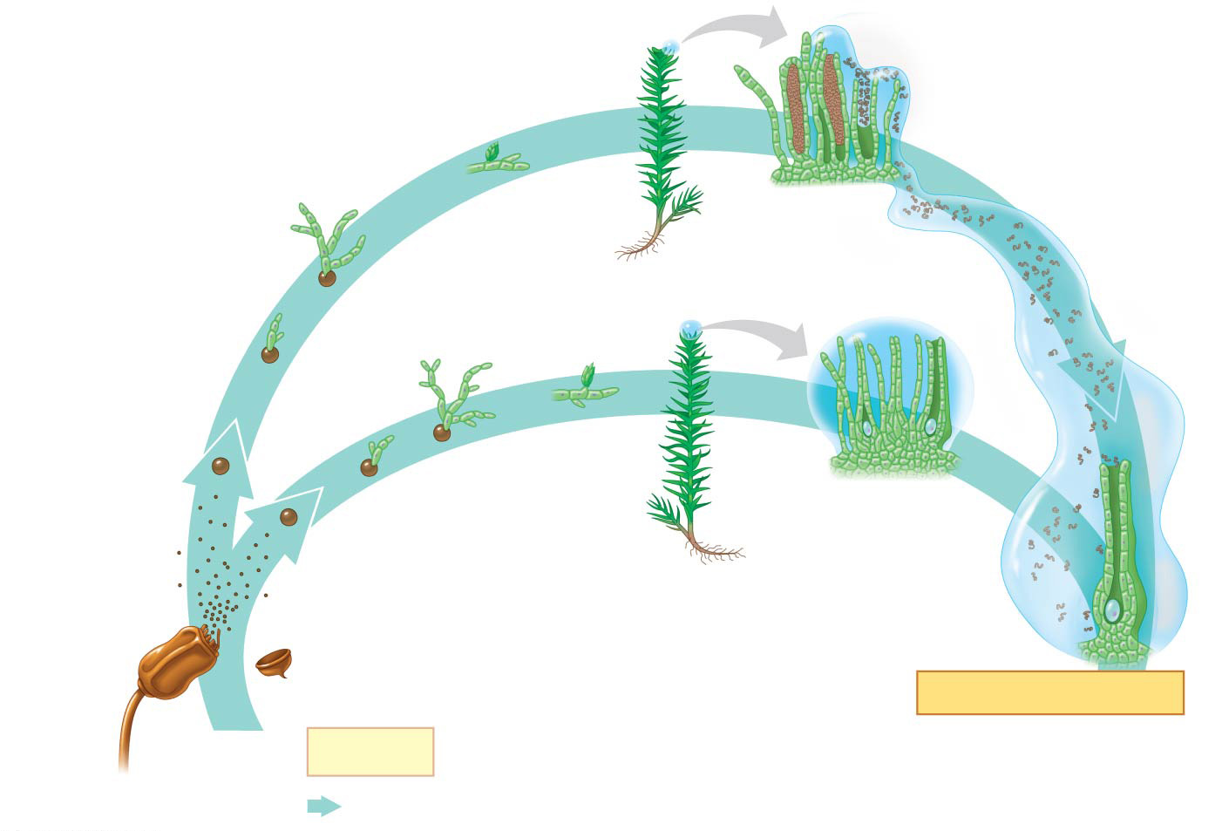
Figure 29.6b-4
“Bud”
Protonemata (n)
Sperm
Antheridia
Male gametophyte (n)
“Bud”
Egg
Spore dispersal
Spores
Gametophore
Archegonia
Female gametophyte (n)
Rhizoid
Peristome
Sporangium
FERTILIZATION
Key
(within archegonium)
Haploid (n)
Notes:
Figure 29.6b-4 The life cycle of a moss (part 2: step 4)

Slide 55
Figure 29.6c-1
FERTILIZATION
(within archegonium)
Zygote (2n)
Archegonium
Key
Diploid (2n)
Notes:
Figure 29.6c-1 The life cycle of a moss (part 3: step 1)

Slide 56
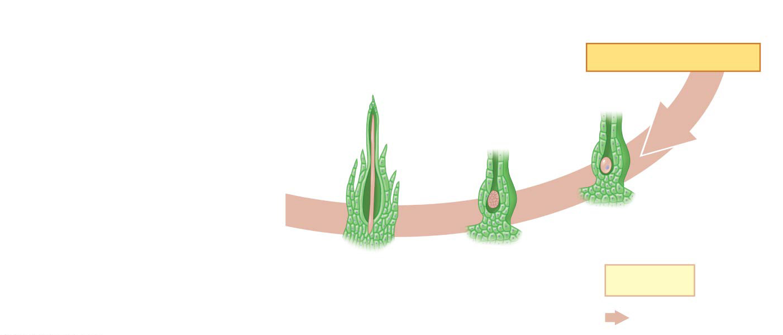
Figure 29.6c-2
FERTILIZATION
(within archegonium)
Zygote (2n)
Embryo
Archegonium
Young sporophyte (2n)
Key
Diploid (2n)
Notes:
Figure 29.6c-2 The life cycle of a moss (part 3: step 2)

Slide 57
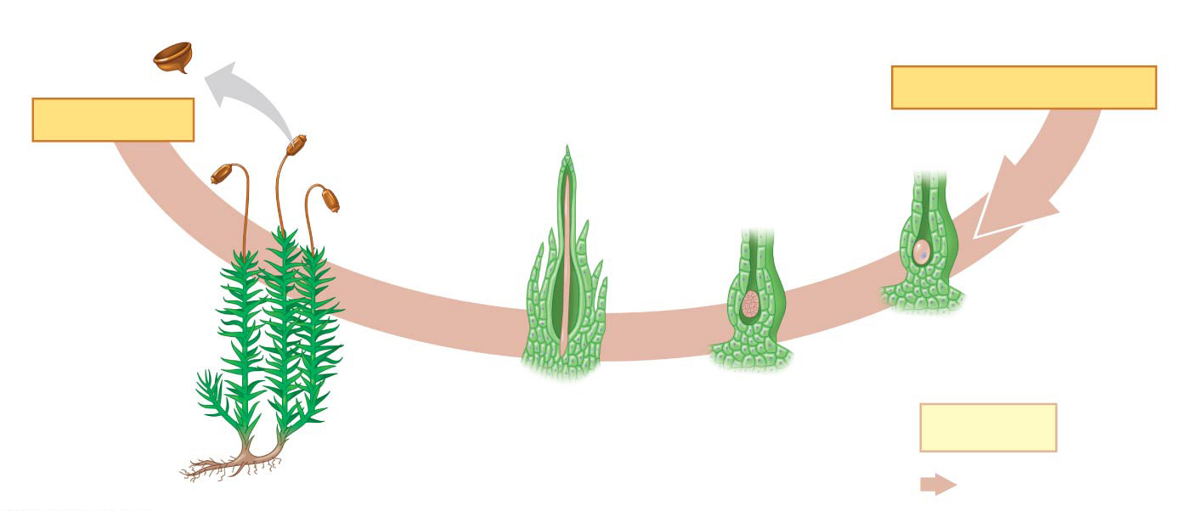
Figure 29.6c-3
Sporangium
Seta
FERTILIZATION
MEIOSIS
Capsule (sporangium)
(within archegonium)
Zygote (2n)
Mature sporophytes
Embryo
Foot
Archegonium
Young sporophyte (2n)
Female gametophyte
Key
Diploid (2n)
Notes:
Figure 29.6c-3 The life cycle of a moss (part 3: step 3)

Slide 58
Animation: Moss Life Cycle

Slide 59
A spore germinates into a gametophyte composed of a protonema and gamete-producing gametophore
The height of gametophytes is constrained by lack of vascular tissues
Rhizoids anchor gametophytes to substrate
Mature gametophytes produce flagellated sperm in antheridia and an egg in each archegonium
Sperm swim through a film of water to reach and fertilize the egg

Slide 60
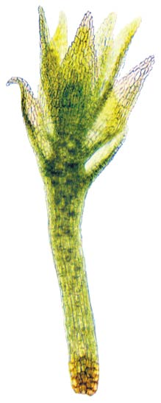
Figure 29.UN04
Notes:
Figure 29.UN04 In-text figure, brood bodies, p. 621

Slide 61
Bryophyte Sporophytes
Bryophyte sporophytes grow out of archegonia, and are the smallest and simplest sporophytes of all extant plant groups
A sporophyte consists of a foot, a seta (stalk), and a sporangium, also called a capsule, which discharges spores through a peristome
Hornwort and moss sporophytes have stomata; liverworts do not

Slide 62
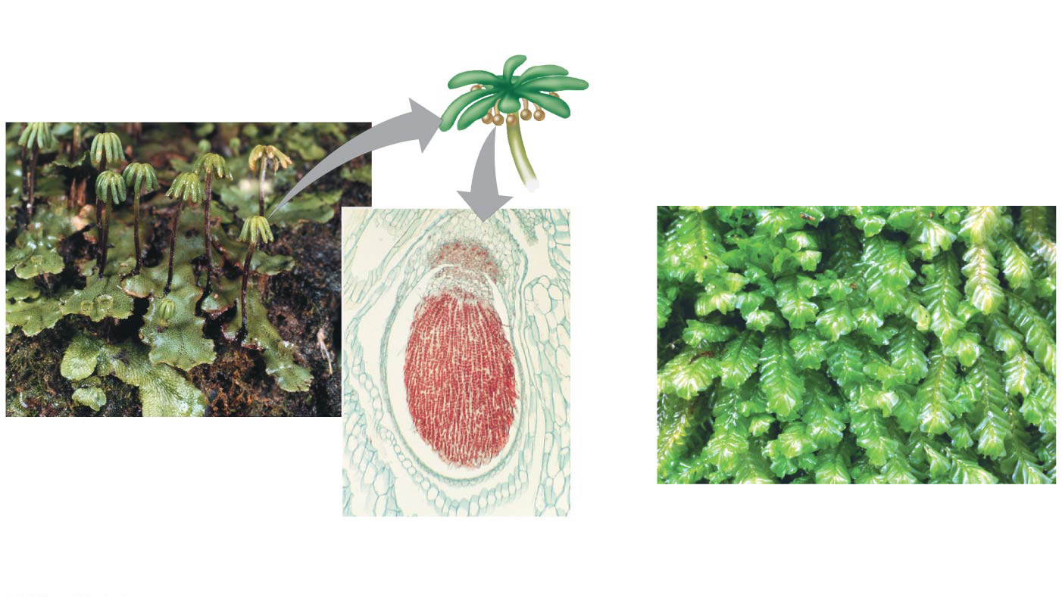
Figure 29.7a
Liverworts (Phylum Hepatophyta)
Gametophore of female gametophyte
Thallus
Sporophyte
Foot
Seta
Marchantia polymorpha, a “thalloid” liverwort
500 µm
Marchantia sporophyte (LM)
Plagiochila deltoidea, a “leafy” liverwort
Capsule (sporangium)
Notes:
Figure 29.7a Exploring bryophyte diversity (part 1: liverworts)

Slide 63
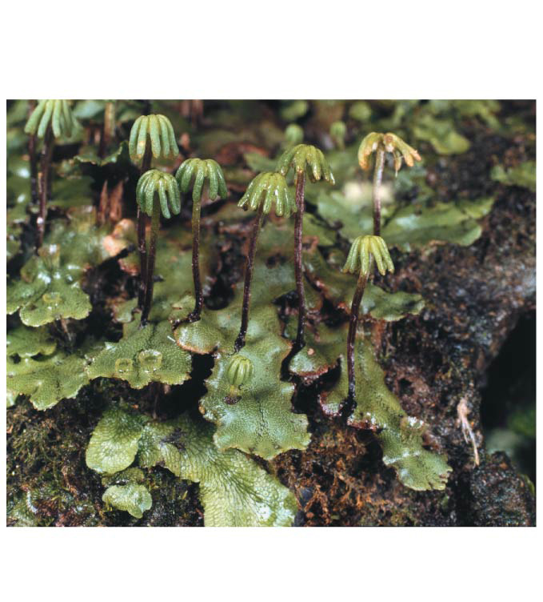
Figure 29.7aa
Gametophore of female gametophyte
Thallus
Marchantia polymorpha, a “thalloid” liverwort
Notes:
Figure 29.7aa Exploring bryophyte diversity (part 1a: liverworts)

Slide 64
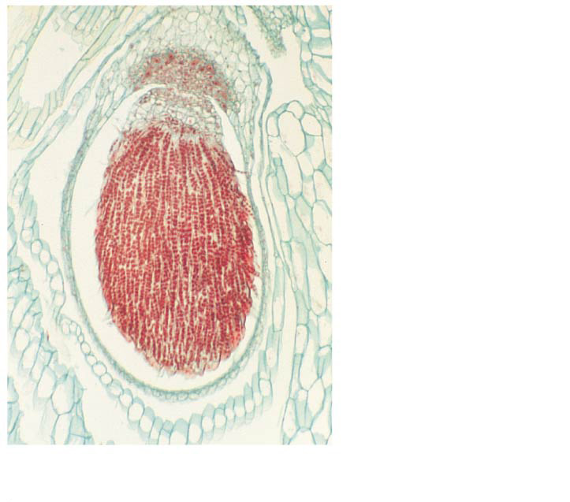
Figure 29.7ab
Foot
Seta
Capsule (sporangium)
500 µm
Marchantia sporophyte (LM)
Notes:
Figure 29.7ab Exploring bryophyte diversity (part 1b: liverworts)

Slide 65
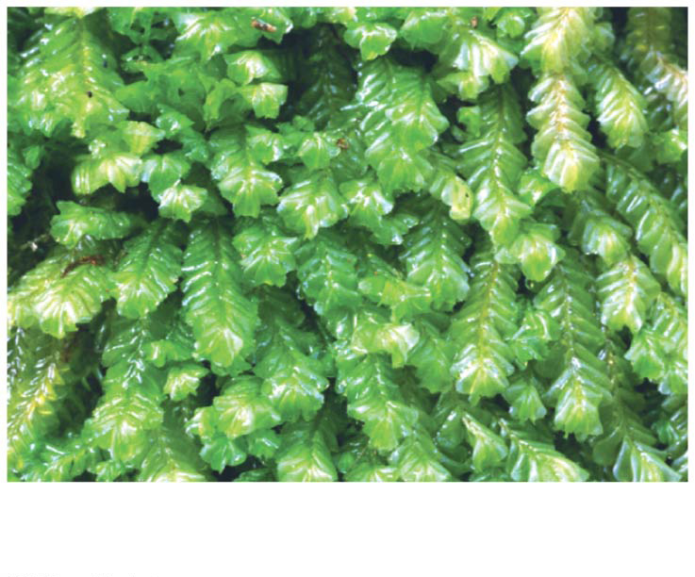
Figure 29.7ac
Plagiochila deltoidea, a “leafy” liverwort
Notes:
Figure 29.7ac Exploring bryophyte diversity (part 1c: liverworts)

Slide 66
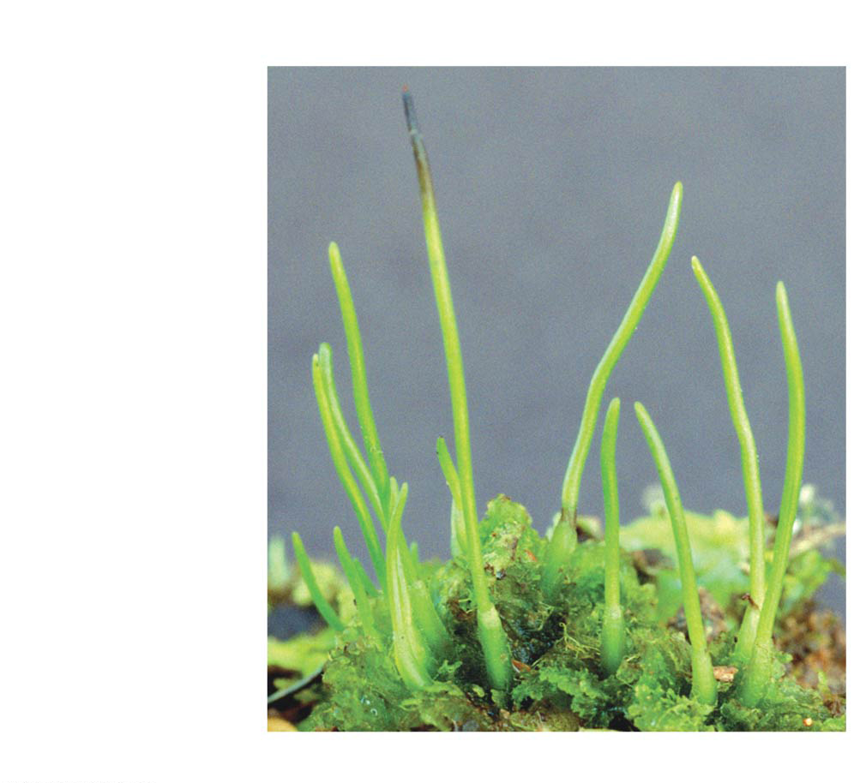
Figure 29.7b
Hornworts (Phylum Anthocerophyta)
Sporophyte
Gametophyte
An Anthoceros hornwort species
Notes:
Figure 29.7b Exploring bryophyte diversity (part 2: hornworts)

Slide 67
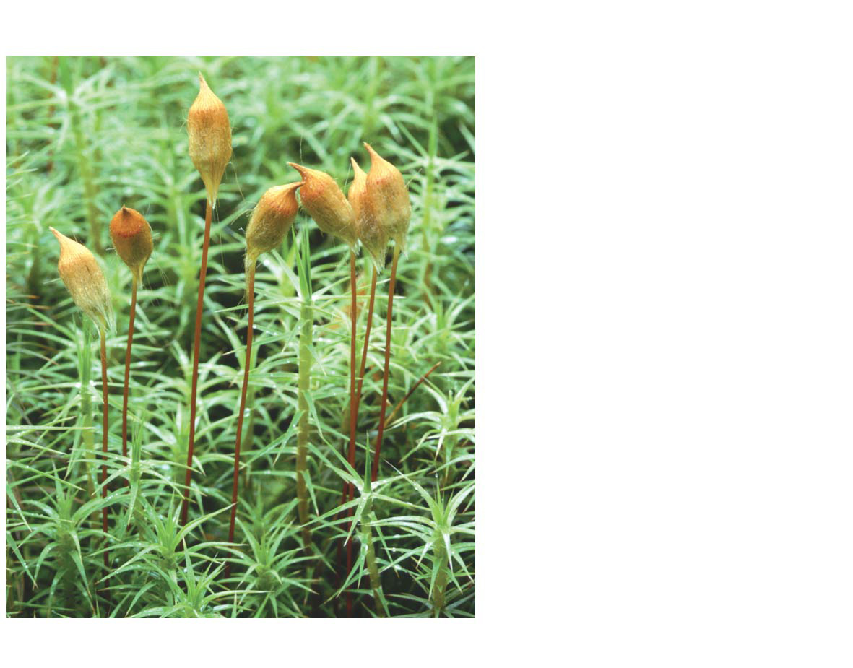
Figure 29.7c
Mosses (Phylum Bryophyta)
Sporophyte (a sturdy plant that takes months to grow)
Capsule
Seta
Gametophyte
Polytrichum commune, hairy-cap moss
Notes:
Figure 29.7c Exploring bryophyte diversity (part 3: mosses)

Slide 68
The Ecological and Economic Importance of Mosses
Mosses are capable of inhabiting diverse and sometimes extreme environments, but are especially common in moist forests and wetlands
Some mosses might help retain nitrogen in the soil

Slide 69
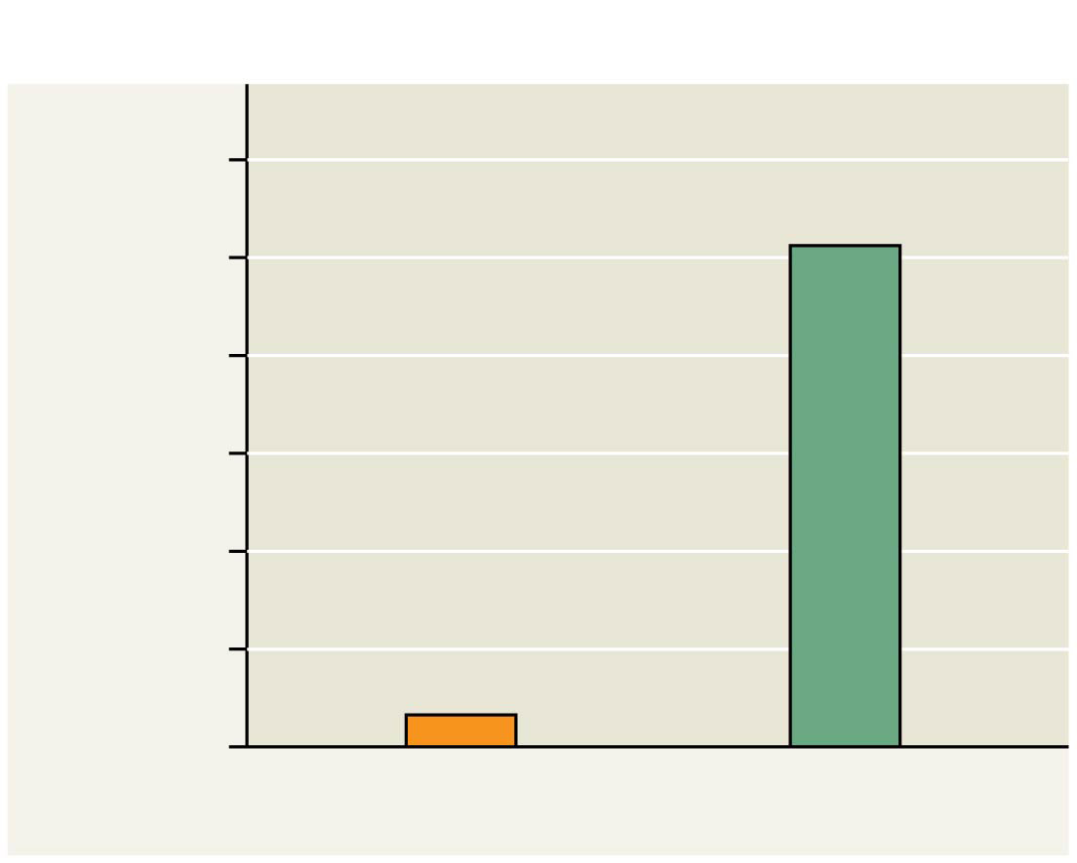
Figure 29.8
Results
6
5
4
Annual nitrogen loss (kg/ha)
3
2
1
0
With moss
Without moss
Notes:
Figure 29.8 Inquiry: Can bryophytes reduce the rate at which key nutrients are lost from soils?

Slide 70
Sphagnum, or “peat moss,” forms extensive deposits of partially decayed organic material known as peat
Peat can be used as a source of fuel
Low temperature, pH, and oxygen level of peatlands inhibits decay of moss and other organisms

Slide 71
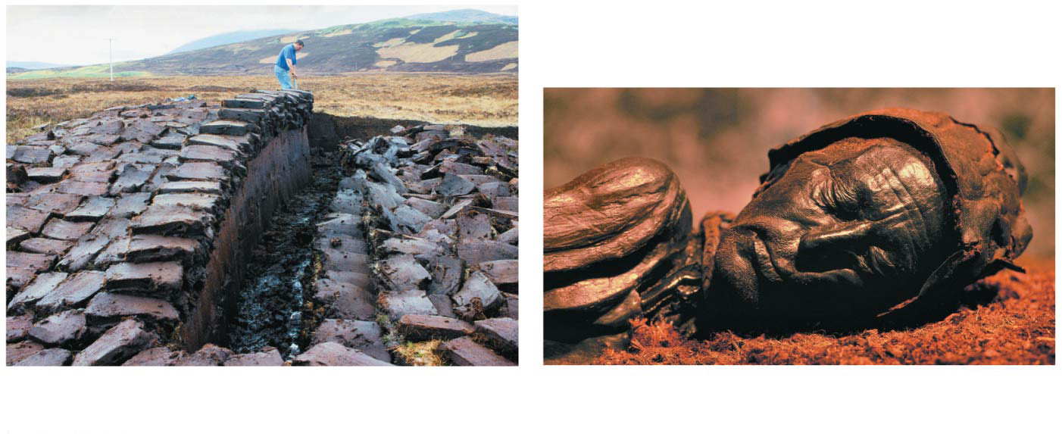
Figure 29.9
(a) Peat being harvested from a peatland
(b) “Tollund Man,” a bog mummy dating from 405–100 B.C.E.
Notes:
Figure 29.9 Sphagnum, or peat moss: a bryophyte with economic, ecological, and archaeological significance

Slide 72
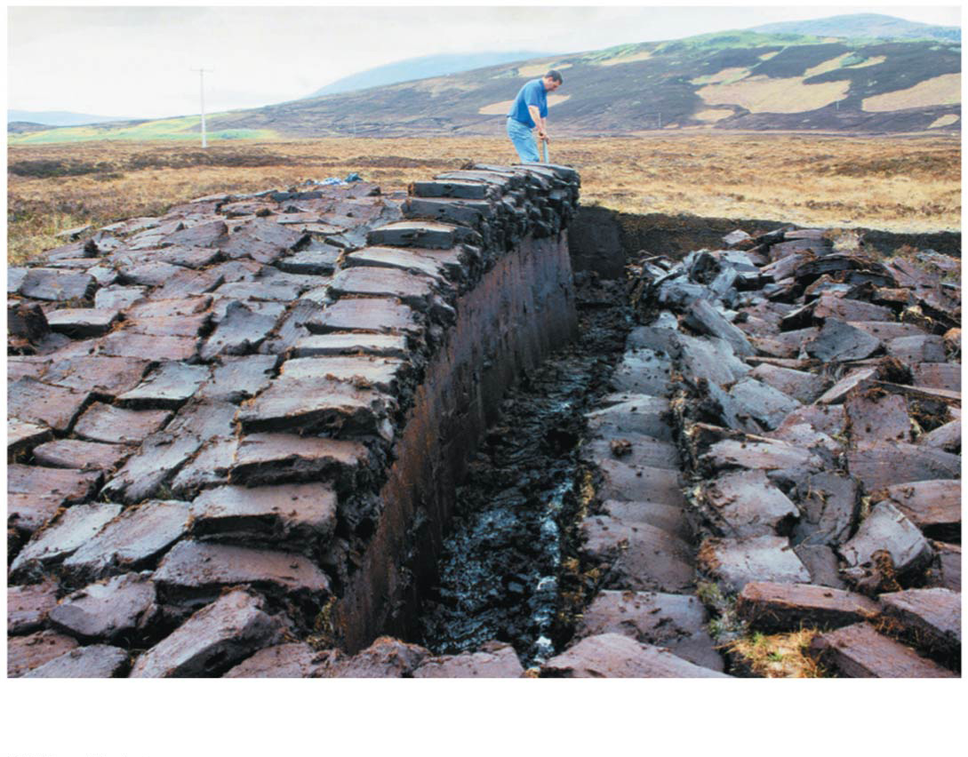
Figure 29.9a
(a) Peat being harvested from a peatland
Notes:
Figure 29.9a Sphagnum, or peat moss: a bryophyte with economic, ecological, and archaeological significance (part 1: peatland)

Slide 73
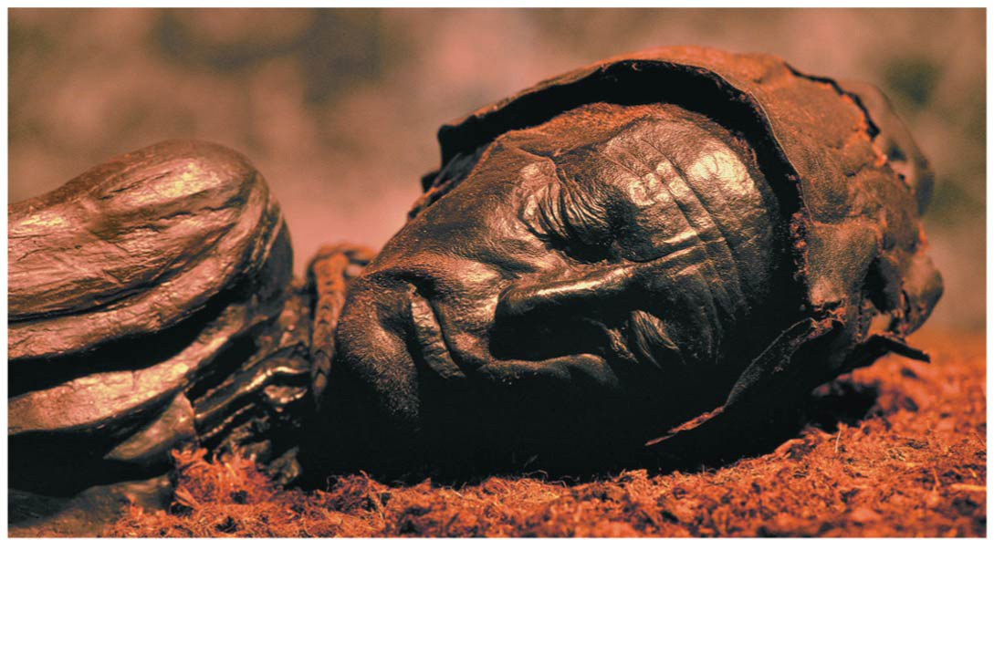
Figure 29.9b
(b) “Tollund Man,” a bog mummy dating from 405–100 B.C.E.
Notes:
Figure 29.9b Sphagnum, or peat moss: a bryophyte with economic, ecological, and archaeological significance (part 2: “Tolland Man”)

Slide 74
Sphagnum is an important global reservoir of organic carbon
Overharvesting of Sphagnum and/or a drop in water level in peatlands could release stored CO₂ to the atmosphere

Slide 75
Concept 29.3: Ferns and other seedless vascular plants were the first plants to grow tall
Bryophytes were prominent types of vegetation during the first 100 million years of plant evolution
The earliest fossils of vascular plants date to 425 million years ago
Vascular tissue allowed these plants to grow tall
Seedless vascular plants have flagellated sperm and are usually restricted to moist environments

Slide 76
Figure 29.UN05
Nonvascular plants (bryophytes)
Seedless vascular plants
Gymnosperms
Angiosperms
Notes:
Figure 29.UN05 In-text figure, seedless vascular mini-tree, p. 622

Slide 77
Origins and Traits of Vascular Plants
Early vascular plants had independent, branching sporophytes
Living vascular plants are characterized by
Life cycles with dominant sporophytes
Vascular tissues called xylem and phloem
Well-developed roots and leaves

Slide 78
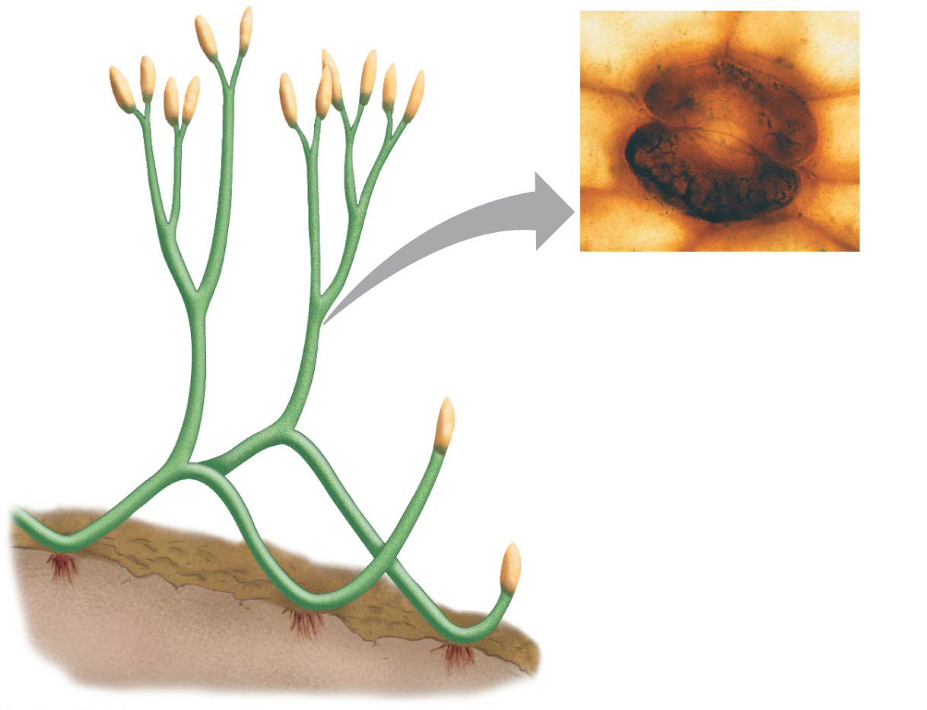
Figure 29.10
Sporangia
25 µm
2 cm
Rhizoids
Notes:
Figure 29.10 Sphorophytes of Aglaophyton major, an ancient relative of living vascular plants

Slide 79
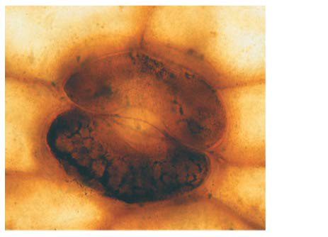
Figure 29.10a
25 µm
Notes:
Figure 29.10a Sphorophytes of Aglaophyton major, an ancient relative of living vascular plants (part 1: LM)

Slide 80
Life Cycles with Dominant Sporophytes
In contrast with bryophytes, sporophytes of seedless vascular plants are the larger generation, as in familiar ferns
The gametophytes are tiny plants that grow on or below the soil surface

Slide 81
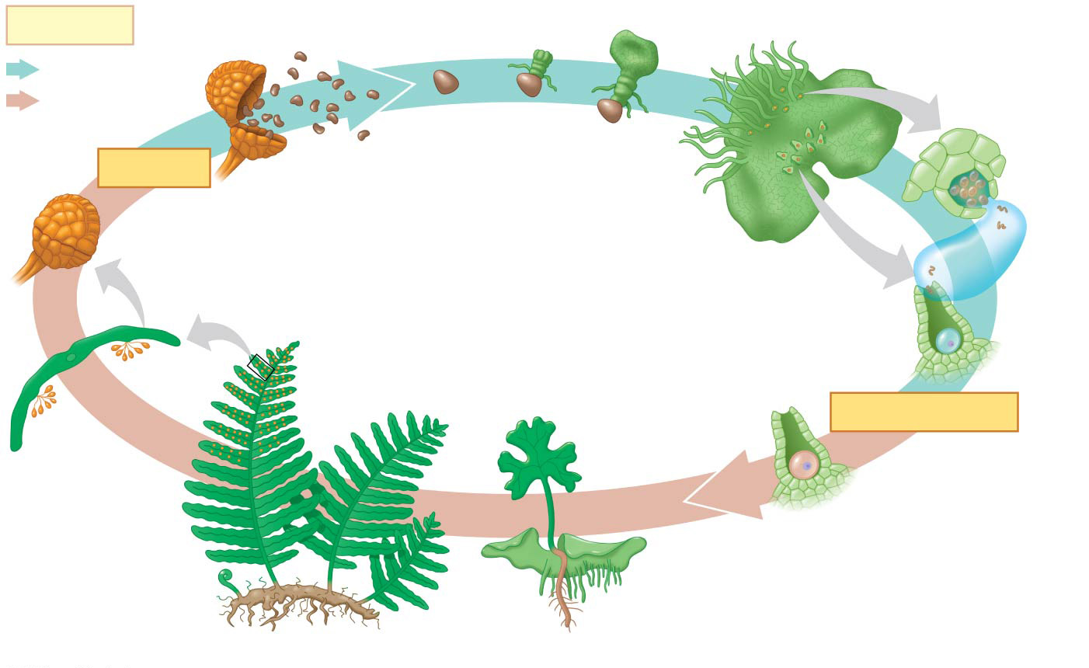
Figure 29.11
Key
Haploid (n) Diploid (2n)
Spore (n)
Young gametophyte
Antheridium
Spore dispersal
MEIOSIS
Rhizoid
Sporangium
Underside of mature gametophyte (n)
Sperm
Archegonium
Mature sporophyte (2n)
New sporophyte
Egg
Sporangium
Zygote (2n)
FERTILIZATION
Sorus
Gametophyte
Fiddlehead (young leaf)
Notes:
Figure 29.11 The life cycle of a fern

Slide 82
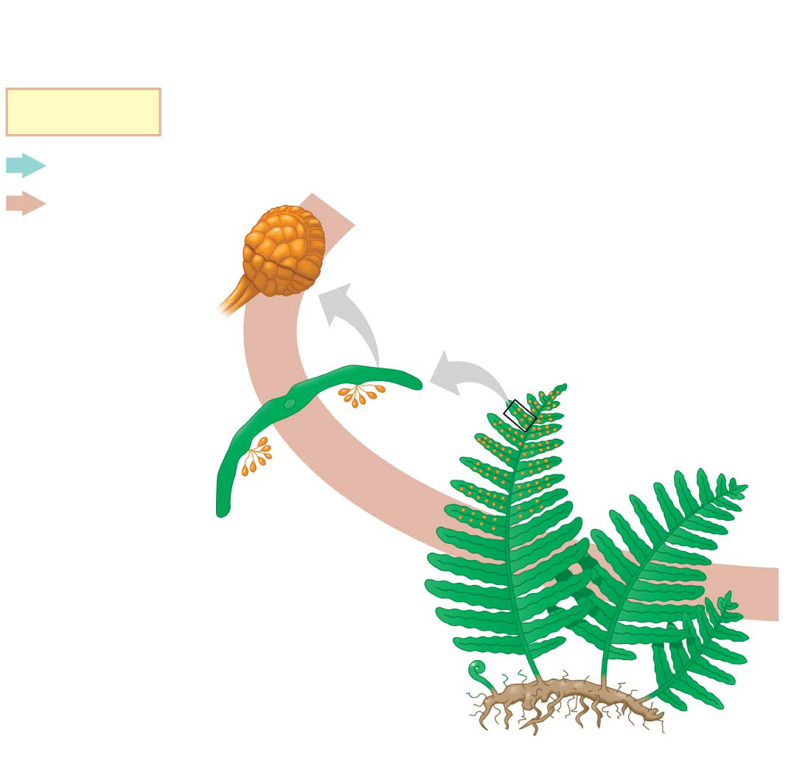
Figure 29.11a-1
Key
Haploid (n) Diploid (2n)
Sporangium
Mature sporophyte (2n)
Sporangium
Sorus
Fiddlehead (young leaf)
Notes:
Figure 29.11a-1 The life cycle of a fern (part 1, step 1)

Slide 83
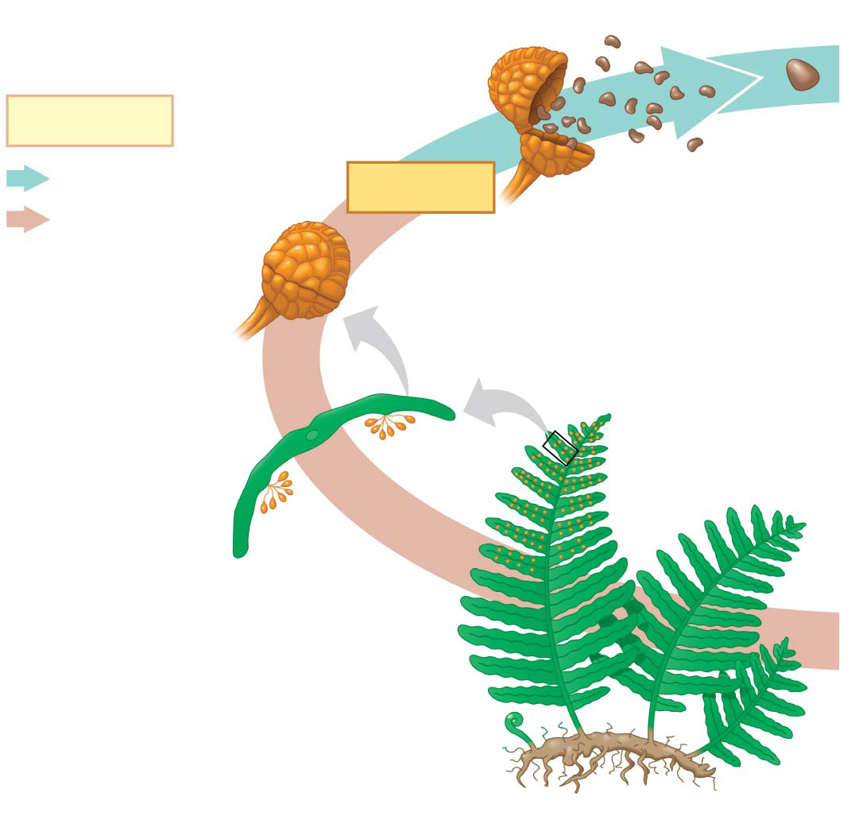
Figure 29.11a-2
Key
Spore (n)
Haploid (n) Diploid (2n)
Spore dispersal
MEIOSIS
Sporangium
Mature sporophyte (2n)
Sporangium
Sorus
Fiddlehead (young leaf)
Notes:
Figure 29.11a-2 The life cycle of a fern (part 1, step 2)

Slide 84
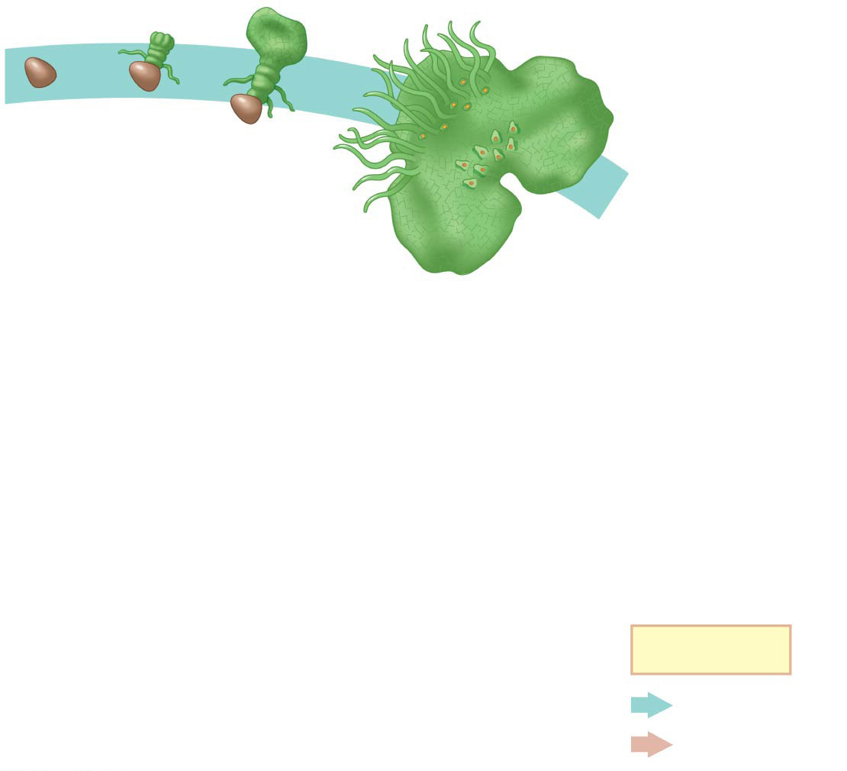
Figure 29.11b-1
Spore (n)
Young gametophyte
Rhizoid
Underside of mature gametophyte (n)
Key
Haploid (n) Diploid (2n)
Notes:
Figure 29.11b-1 The life cycle of a fern (part 2, step 1)

Slide 85
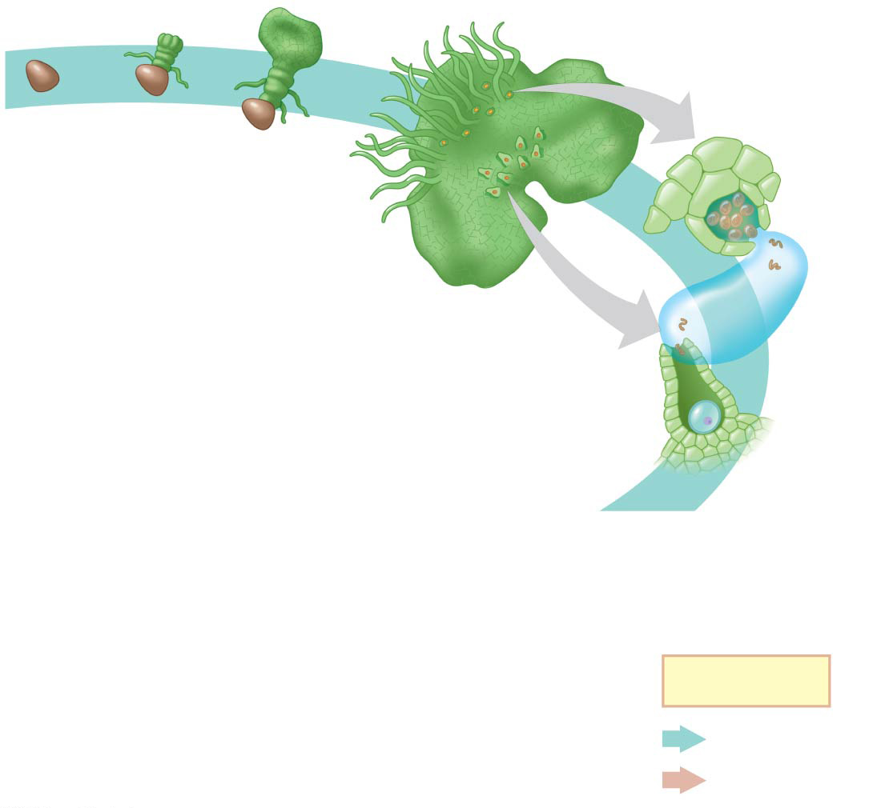
Figure 29.11b-2
Spore (n)
Young gametophyte
Antheridium
Rhizoid
Underside of mature gametophyte (n)
Sperm
Archegonium
Egg
Key
Haploid (n) Diploid (2n)
Notes:
Figure 29.11b-2 The life cycle of a fern (part 2, step 2)

Slide 86
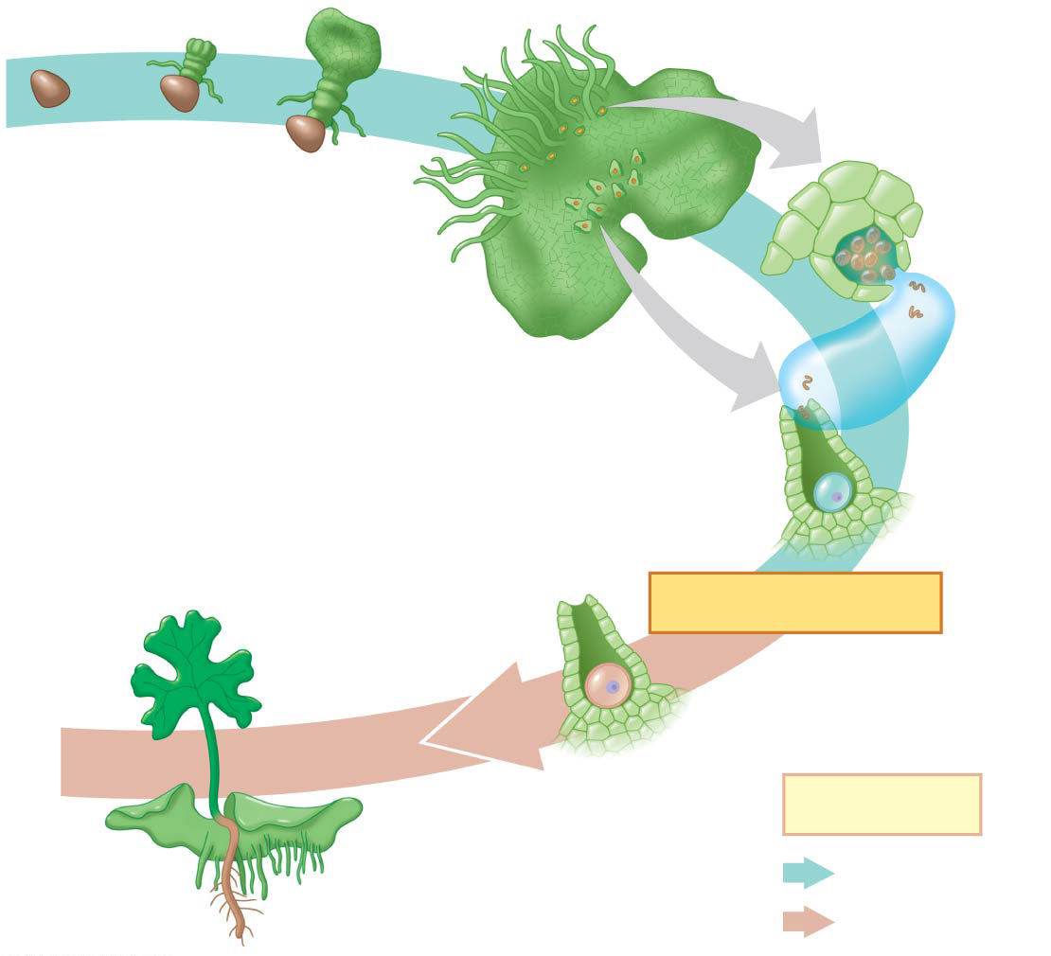
Figure 29.11b-3
Spore (n)
Young gametophyte
Antheridium
Rhizoid
Underside of mature gametophyte (n)
Sperm
Archegonium
New sporophyte
Egg
Zygote (2n)
FERTILIZATION
Key
Gametophyte
Haploid (n) Diploid (2n)
Notes:
Figure 29.11b-3 The life cycle of a fern (part 2, step 3)

Slide 87
Animation: Fern Life Cycle

Slide 88
Transport in Xylem and Phloem
Vascular plants have two types of vascular tissue: xylem and phloem
Xylem conducts most of the water and minerals and includes tube-shaped cells called tracheids
Water-conducting cells are strengthened by lignin and provide structural support
Phloem has cells arranged into tubes that distribute sugars, amino acids, and other organic products
Vascular tissue allowed for increased height, which provided an evolutionary advantage

Slide 89
Evolution of Roots
Roots are organs that anchor vascular plants
They enable vascular plants to absorb water and nutrients from the soil
Roots may have evolved from subterranean stems

Slide 90
Evolution of Leaves
Leaves are organs that increase the surface area of vascular plants, thereby capturing more solar energy that is used for photosynthesis
Leaves are categorized by two types
Microphylls, leaves with a single vein
Megaphylls, leaves with a highly branched vascular system

Slide 91
Figure 29.12
Microphyll leaves
Microphylls
Unbranched vascular tissue
Selaginella kraussiana (Krauss’s spike moss)
Megaphyll leaves
Megaphylls
Branched vascular tissue
Hymenophyllum tunbrigense (Tunbridge filmy fern)
Notes:
Figure 29.12 Microphyll and megaphyll leaves

Slide 92
Figure 29.12a
Selaginella kraussiana (Krauss’s spike moss)
Notes:
Figure 29.12a Microphyll and megaphyll leaves (part 1: microphyll leaves)

Slide 93
Figure 29.12b
Hymenophyllum tunbrigense (Tunbridge filmy fern)
Notes:
Figure 29.12b Microphyll and megaphyll leaves (part 2: megaphyll leaves)

Slide 94
Sporophylls and Spore Variations
Sporophylls are modified leaves with sporangia
Sori are clusters of sporangia on the undersides of sporophylls
Strobili are cone-like structures formed from groups of sporophylls

Slide 95
Most seedless vascular plants are homosporous, producing one type of spore that develops into a bisexual gametophyte
All seed plants and some seedless vascular plants are heterosporous
Heterosporous species produce megaspores, which give rise to female gametophytes, and microspores, which give rise to male gametophytes

Slide 96
Figure 29.UN07
Homosporous spore production
Typically a bisexual gametophyte
Eggs
Sperm
Sporangium on sporophyll
Single type of spore
Heterosporous spore production
Megasporangium on megasporophyll
Female gametophyte
Megaspore
Eggs
Microsporangium on microsporophyll
Male gametophyte
Microspore
Sperm
Notes:
Figure 29.UN07 In-text figure, spore production, p. 625

Slide 97
Classification of Seedless Vascular Plants
There are two clades of seedless vascular plants
Phylum Lycophyta includes club mosses, spike mosses, and quillworts
Phylum Monilophyta includes ferns, horsetails, and whisk ferns and their relatives

Slide 98
Phylum Lycophyta: Club Mosses, Spike Mosses, and Quillworts
Giant lycophyte trees thrived for millions of years in moist swamps
Surviving species are small herbaceous plants
Club mosses and spike mosses have vascular tissues and are not true mosses

Slide 99
Figure 29.13a
Lycophytes (Phylum Lycophyta)
2.5 cm
Isoetes gunnii, a quillwort
Strobili (clusters of sporophylls)
Selaginella moellendorffii, a spike moss
1 cm
Diphasiastrum tristachyum, a club moss
Notes:
Figure 29.13a Exploring seedless vascular plant diversity (part 1: lycophytes)

Slide 100
Figure 29.13aa
1 cm
Selaginella moellendorffii, a spike moss
Notes:
Figure 29.13aa Exploring seedless vascular plant diversity (part 1a: lycophytes)

Slide 101
Figure 29.13ab
Isoetes gunnii, a quillwort
Notes:
Figure 29.13ab Exploring seedless vascular plant diversity (part 1b: lycophytes)

Slide 102
Figure 29.13ac
2.5 cm
Strobili (clusters of sporophylls)
Diphasiastrum tristachyum, a club moss
Notes:
Figure 29.13ac Exploring seedless vascular plant diversity (part 1c: lycophytes)

Slide 103
Phylum Monilophyta: Ferns, Horsetails, and Whisk Ferns and Relatives
Ferns are the most widespread seedless vascular plants, with more than 12,000 species
They are most diverse in the tropics but also thrive in temperate forests
Horsetails were diverse during the Carboniferous period, but are now restricted to the genus Equisetum
Whisk ferns resemble ancestral vascular plants but are closely related to modern ferns

Slide 104
Figure 29.13b
Monilophytes (Phylum Monilophyta)
Strobilus on fertile stem
Vegetative stem
25 cm
3 cm
4 cm
Athyrium filix-femina, lady fern
Equisetum telmateia, giant horsetail
Psilotum nudum, a whisk fern
Notes:
Figure 29.13b Exploring seedless vascular plant diversity (part 2: monilophytes)

Slide 105
Figure 29.13ba
25 cm
Athyrium filix-femina, lady fern
Notes:
Figure 29.13ba Exploring seedless vascular plant diversity (part 2a: monilophytes)

Slide 106
Figure 29.13bb
Strobilus on fertile stem
Vegetative stem
3 cm
Equisetum telmateia, giant horsetail
Notes:
Figure 29.13bb Exploring seedless vascular plant diversity (part 2b: monilophytes)

Slide 107
Figure 29.13bc
4 cm
Psilotum nudum, a whisk fern
Notes:
Figure 29.13bc Exploring seedless vascular plant diversity (part 2c: monilophytes)

Slide 108
The Significance of Seedless Vascular Plants
The ancestors of modern lycophytes, horsetails, and ferns grew to great heights during the Devonian and Carboniferous, forming the first forests
Increased growth and photosynthesis removed CO₂ from the atmosphere and may have contributed to global cooling at the end of the Carboniferous period
The decaying plants of these Carboniferous forests eventually became coal

Slide 109
Figure 29.14
Horsetail
Fern
Notes:
Figure 29.14 Artist’s conception of a Carboniferous forest based on fossil evidence

Slide 110
Figure 29.UN06a
Notes:
Figure 29.UN06a Skills exercise: making bar graphs and interpreting the data (part 1)

Slide 111
Figure 29.UN06b
Notes:
Figure 29.UN06b Skills exercise: making bar graphs and interpreting the data (part 2)

Slide 112
Figure 29.UN08
Apical meristem of shoot
Developing leaves
Gametophyte
Mitosis
Mitosis
n
n
n
Spore
n
Gamete
MEIOSIS
FERTILIZATION
2n
Zygote
Mitosis
Haploid
Sporophyte
Diploid
1
Alternation of generations
2
Apical meristems
Archegonium with egg
Antheridium with sperm
Sporangium
Spores
3
Multicellular gametangia
4
Walled spores in sporangia
Notes:
Figure 29.UN08 Summary of key concepts: traits of land plants

Slide 113
Figure 29.UN08a
Gametophyte
Mitosis
Mitosis
n
n
n
Spore
n
Gamete
MEIOSIS
FERTILIZATION
2n
Zygote
Mitosis
Haploid
Sporophyte
Diploid
1
Alternation of generations
Notes:
Figure 29.UN08a Summary of key concepts: traits of land plants (part 1: alternation of generations)

Slide 114
Figure 29.UN08b
Apical meristem of shoot
Developing leaves
2
Apical meristems
Notes:
Figure 29.UN08b Summary of key concepts: traits of land plants (part 2: apical meristems)

Slide 115
Figure 29.UN08c
Archegonium with egg
Antheridium with sperm
3
Multicellular gametangia
Notes:
Figure 29.UN08c Summary of key concepts: traits of land plants (part 3: multicellular gametangia)

Slide 116
Figure 29.UN08d
Sporangium
Spores
4
Walled spores in sporangia
Notes:
Figure 29.UN08d Summary of key concepts: traits of land plants (part 4: walled spores in sporangia)

Slide 117
Figure 29.UN09
Notes:
Figure 29.UN09 Test your understanding, question 8 (nitrogen fixation)

Slide 118
Figure 29.UN10
Notes:
Figure 29.UN10 Test your understanding, question 10 (horsetail stomata)

