Slide 1
0
2
The Chemical Context of Life
Lecture Presentation by Nicole Tunbridge and
Kathleen Fitzpatrick

Slide 2
A Chemical Connection to Biology
Biology is the study of life
Living organisms and their environments are subject to basic laws of physics and chemistry
One example is the use of formic acid by ants to protect themselves against predators and microbial parasites

Slide 3
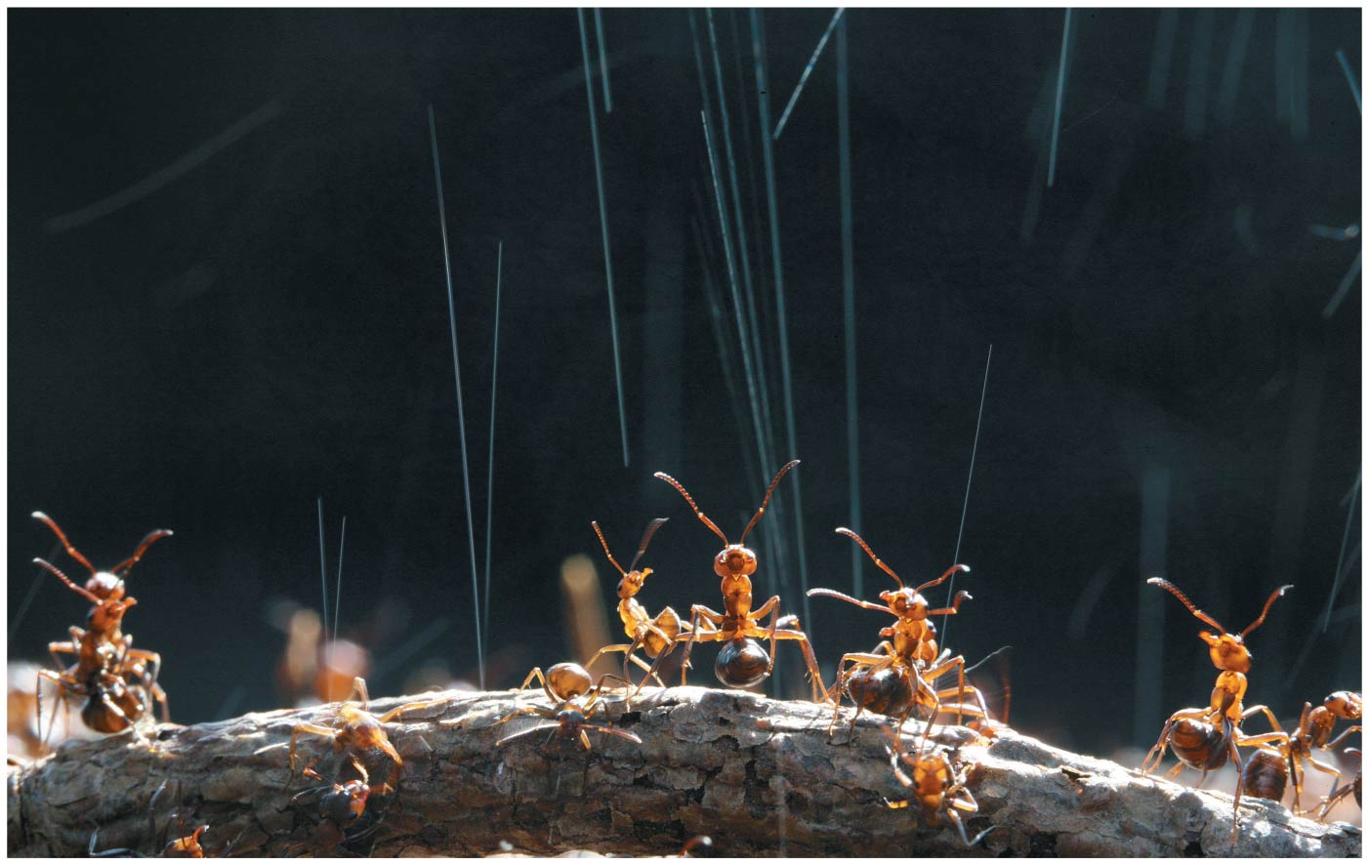
Figure 2.1
Notes:
Figure 2.1 What weapon are these wood ants shooting into the air?

Slide 4
Concept 2.1: Matter consists of chemical elements in pure form and in combinations called compounds
Organisms are composed of matter
Matter is anything that takes up space and has mass

Slide 5
Elements and Compounds
Matter is made up of elements
An element is a substance that cannot be broken down to other substances by chemical reactions
A compound is a substance consisting of two or more elements in a fixed ratio
A compound has characteristics different from those of its elements

Slide 6
The Elements of Life
About 20–25% of the 92 elements are essential to life (essential elements)
Carbon, hydrogen, oxygen, and nitrogen make up 96% of living matter
Most of the remaining 4% consists of calcium, phosphorus, potassium, and sulfur
Trace elements are those required by an organism in only minute quantities

Slide 7
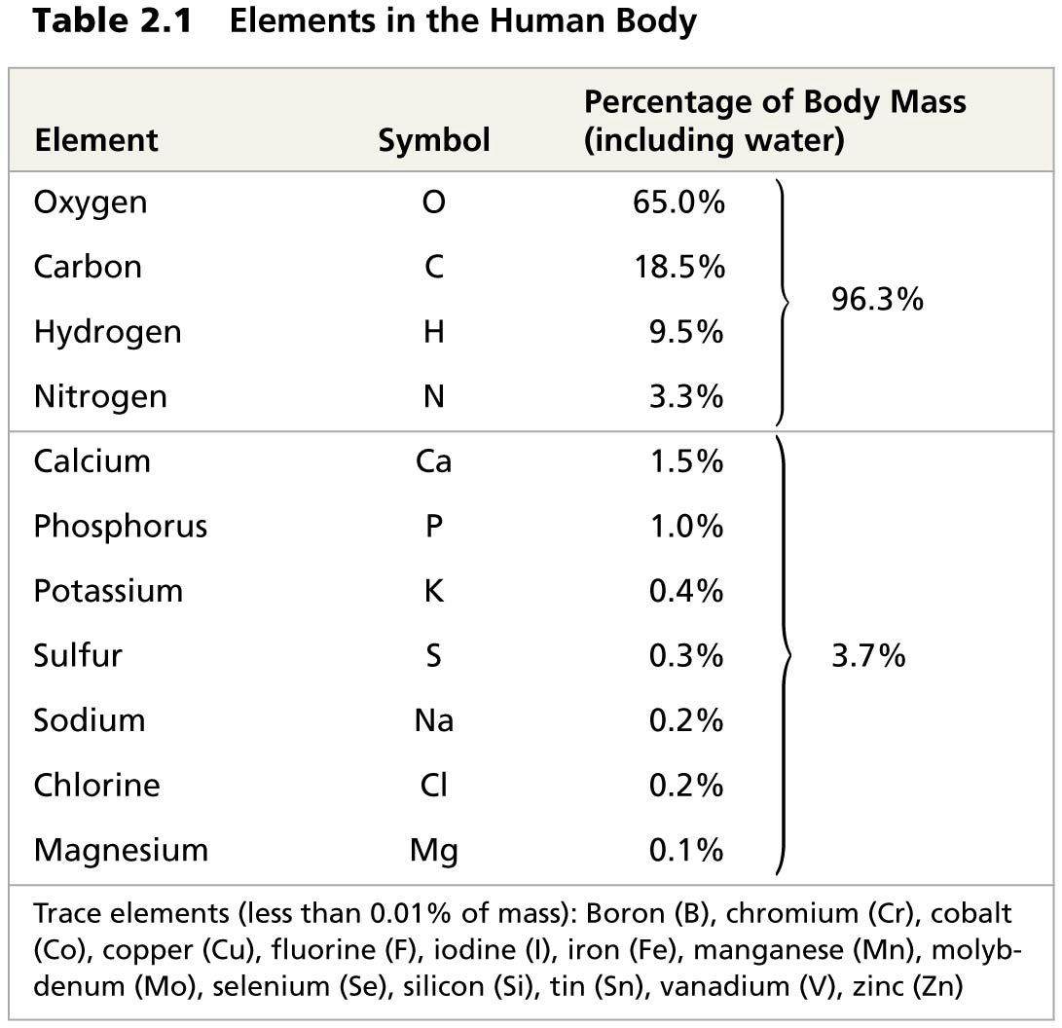
Table 2.1
Notes:
Table 2.1 Elements in the human body

Slide 8
Concept 2.2: An element’s properties depend on the structure of its atoms
Each element consists of unique atoms
An atom is the smallest unit of matter that still retains the properties of an element

Slide 9
Subatomic Particles
Atoms are composed of subatomic particles
Relevant subatomic particles include
Neutrons (no electrical charge)
Protons (positive charge)
Electrons (negative charge)

Slide 10
Neutrons and protons form the atomic nucleus
Electrons form a cloud around the nucleus
Neutron mass and proton mass are almost identical and are measured in daltons

Slide 11
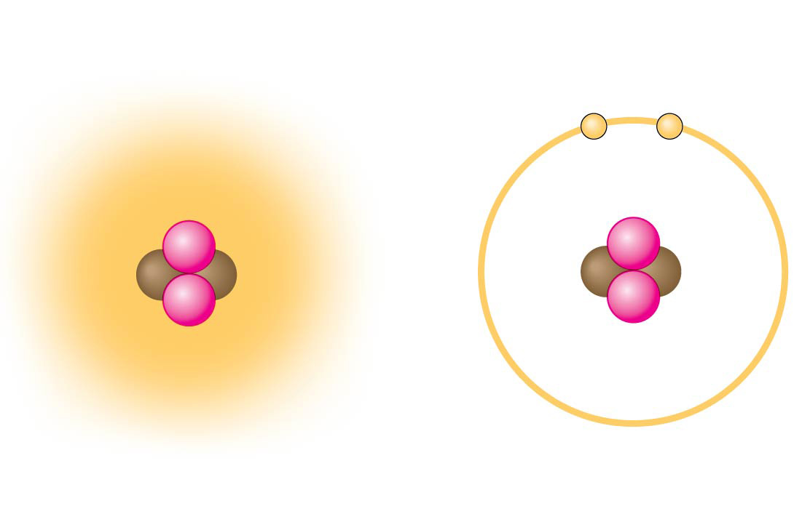
Figure 2.4
Cloud of negative
charge (2 electrons)
Electrons
Nucleus
−
−
+
+
+
+
(a)
(b)
Notes:
Figure 2.4 Simplified models of a helium (He) atom

Slide 12
Atomic Number and Atomic Mass
Atoms of the various elements differ in number of subatomic particles
An element’s atomic number is the number of protons in its nucleus
An element’s mass number is the sum of protons plus neutrons in the nucleus
Atomic mass, the atom’s total mass, can be approximated by the mass number

Slide 13
Isotopes
All atoms of an element have the same number of protons but may differ in number of neutrons
Isotopes are two atoms of an element that differ in number of neutrons
Radioactive isotopes decay spontaneously, giving off particles and energy

Slide 14
Radioactive Tracers
Radioactive isotopes are often used as diagnostic tools in medicine
Radioactive tracers can be used to track atoms through metabolism
They can also be used in combination with sophisticated imaging instruments

Slide 15
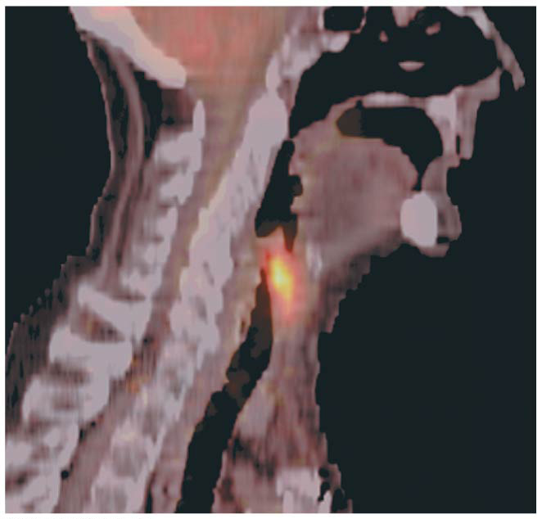
Figure 2.5
Cancerous throat tissue
Notes:
Figure 2.5 A PET scan, a medical use for radioactive isotopes

Slide 16
Radiometric Dating
A “parent” isotope decays into its “daughter” isotope at a fixed rate, expressed as the half-life
In radiometric dating, scientists measure the ratio of different isotopes and calculate how many half-lives have passed since the fossil or rock was formed
Half-life values vary from seconds or days to billions of years

Slide 17
The Energy Levels of Electrons
Energy is the capacity to cause change
Potential energy is the energy that matter has because of its location or structure
The electrons of an atom differ in their amounts of potential energy
An electron’s state of potential energy is called its energy level, or electron shell

Slide 18
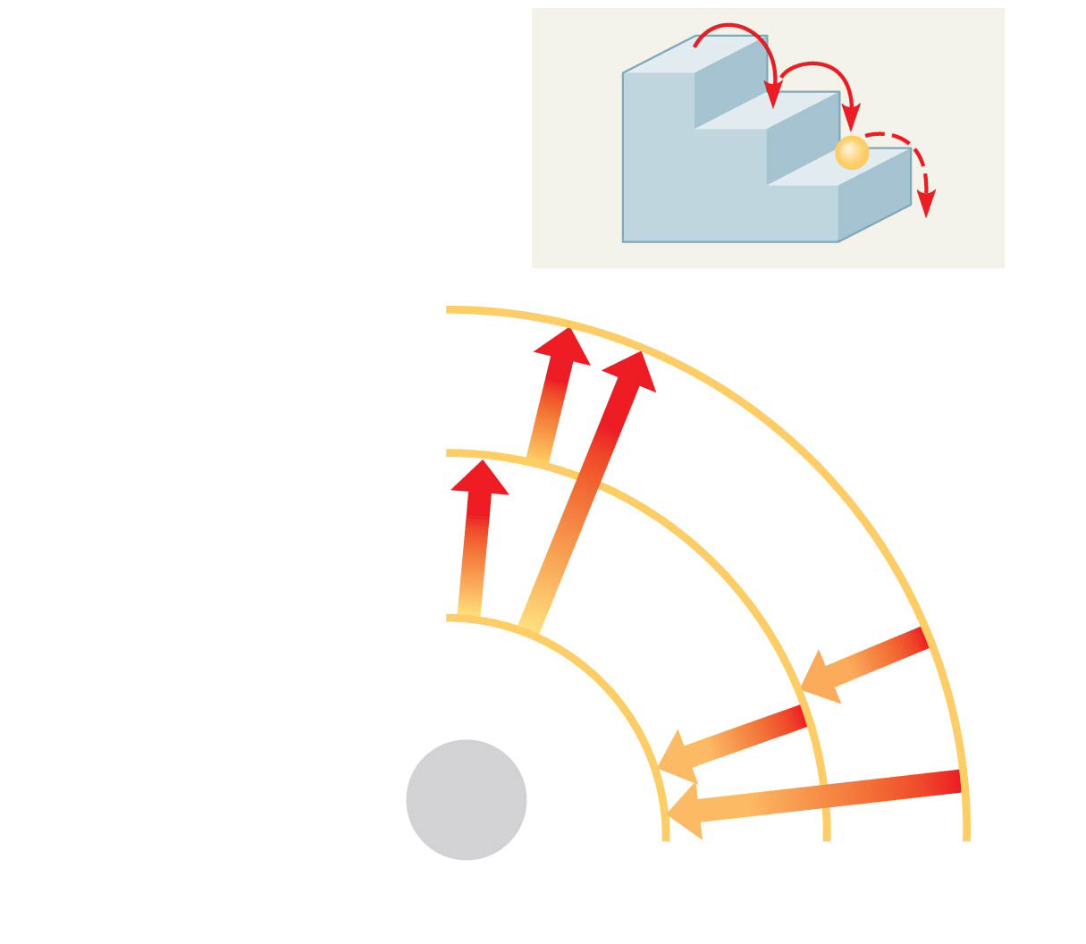
Figure 2.6
(a) A ball bouncing down a flight of stairs provides an analogy for energy levels of electrons.
Third shell (highest energy level in this model)
Second shell (next highest energy level)
Energy absorbed
First shell (lowest energy level)
Energy lost
Atomic nucleus
(b)
Notes:
Figure 2.6 Energy levels of an atom’s electrons

Slide 19
Electron Distribution and Chemical Properties
The chemical behavior of an atom is determined by the distribution of electrons in electron shells
The periodic table of the elements shows the electron distribution for each element

Slide 20
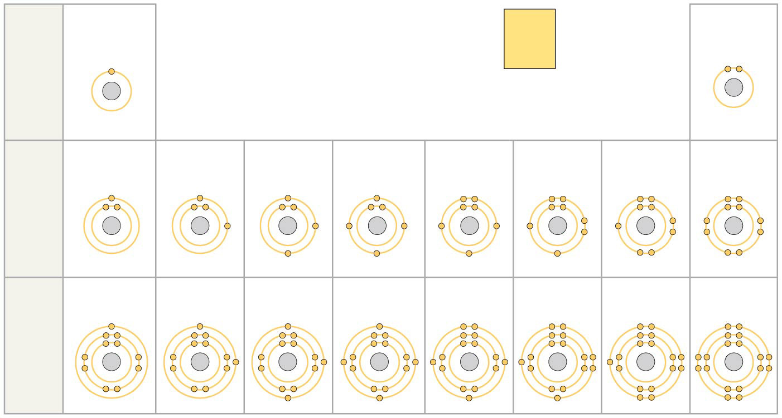
Figure 2.7
Hydrogen
₁H
2
Atomic number
Helium
₂He
He
Atomic mass
4.003
Element symbol
First shell
Electron distribution diagram
Lithium
₃Li
Beryllium
₄Be
Boron
₅B
Carbon
₆C
Nitrogen
₇N
Oxygen
₈O
Fluorine
₉F
Neon
₁₀Ne
Second shell
Sodium
₁₁Na
Magnesium
₁₂Mg
Aluminum
₁₃Al
Silicon
₁₄Si
Phosphorus
₁₅P
Sulfur
₁₆S
Chlorine
₁₇Cl
Argon
₁₈Ar
Third shell
Notes:
Figure 2.7 Electron distribution diagrams for the first 18 elements in the periodic table

Slide 21
Figure 2.7a
2
Helium
₅He
Atomic number
He
4.003
Element symbol
Atomic mass
Electron distribution diagram
Notes:
Figure 2.7a Electron distribution diagrams for the first 18 elements in the periodic table (part 1)

Slide 22
Valence electrons are those in the outermost shell, or valence shell
The chemical behavior of an atom is mostly determined by the valence electrons
Elements with a full valence shell are chemically inert

Slide 23
Concept 2.3: The formation and function of molecules depend on chemical bonding between atoms
Atoms with incomplete valence shells can share or transfer valence electrons with certain other atoms
These interactions usually result in atoms staying close together, held by attractions called chemical bonds

Slide 24
Covalent Bonds
A covalent bond is the sharing of a pair of valence electrons by two atoms
In a covalent bond, the shared electrons count as part of each atom’s valence shell

Slide 25
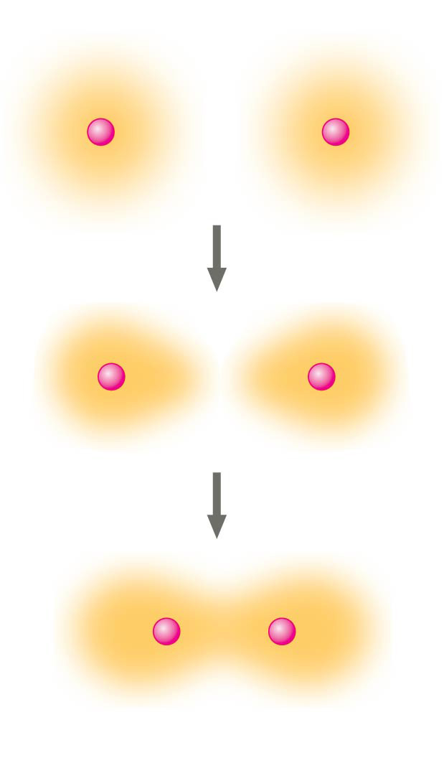
Figure 2.9-3
Hydrogen atoms (2 H)
+
+
+
+
+
+
Hydrogen molecule (H₂)
Notes:
Figure 2.9-3 Formation of a covalent bond (step 3)

Slide 26
A molecule consists of two or more atoms held together by covalent bonds
A single covalent bond, or single bond, is the sharing of one pair of valence electrons
A double covalent bond, or double bond, is the sharing of two pairs of valence electrons

Slide 27
The notation used to represent atoms and bonding is called a structural formula
For example, H—H
This can be abbreviated further with a molecular formula
For example, H₂

Slide 28
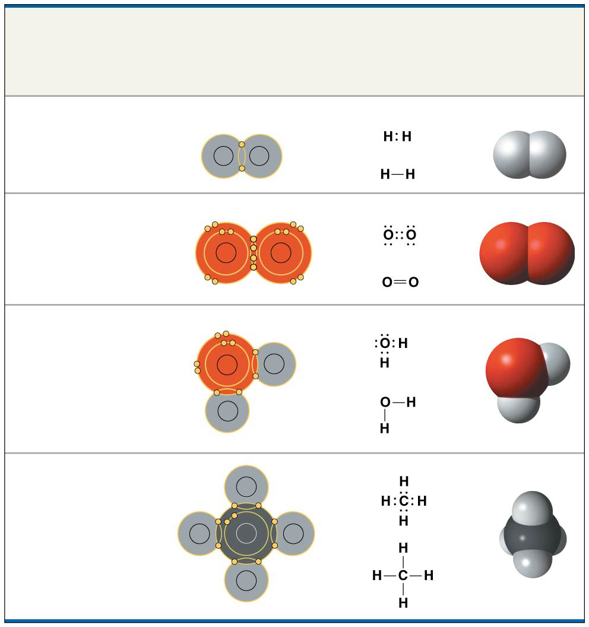
Figure 2.10
Name and Molecular Formula
Electron
Distribution
Diagram
Lewis Dot
Structure and
Structural
Formula
Space-
Filling
Model
(a) Hydrogen (H₂)
H
H
(b) Oxygen (O₂)
O
O
(c) Water (H₂O)
O
H
H
(d) Methane (CH₄)
H
H
C
H
H
Notes:
Figure 2.10 Covalent bonding in four molecules

Slide 29
Covalent bonds can form between atoms of the same element or atoms of different elements
A compound is a combination of two or more different elements
Bonding capacity is called the atom’s valence

Slide 30
Atoms in a molecule attract electrons to varying degrees
Electronegativity is an atom’s attraction for the electrons in a covalent bond
The more electronegative an atom, the more strongly it pulls shared electrons toward itself

Slide 31
In a nonpolar covalent bond, the atoms share the electron equally
In a polar covalent bond, one atom is more electronegative, and the atoms do not share the electron equally
Unequal sharing of electrons causes a partial positive or negative charge for each atom or molecule

Slide 32
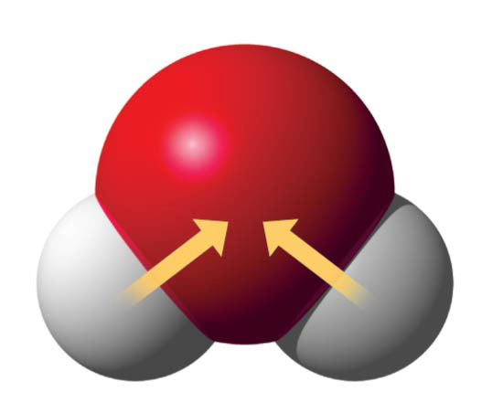
Figure 2.11
δ−
O
H
H
δ+
δ+
H₂O
Notes:
Figure 2.11 Polar covalent bonds in a water molecule

Slide 33
Ionic Bonds
Atoms sometimes strip electrons from their bonding partners
An example is the transfer of an electron from sodium to chlorine
After the transfer of an electron, both atoms have charges
A charged atom (or molecule) is called an ion

Slide 34
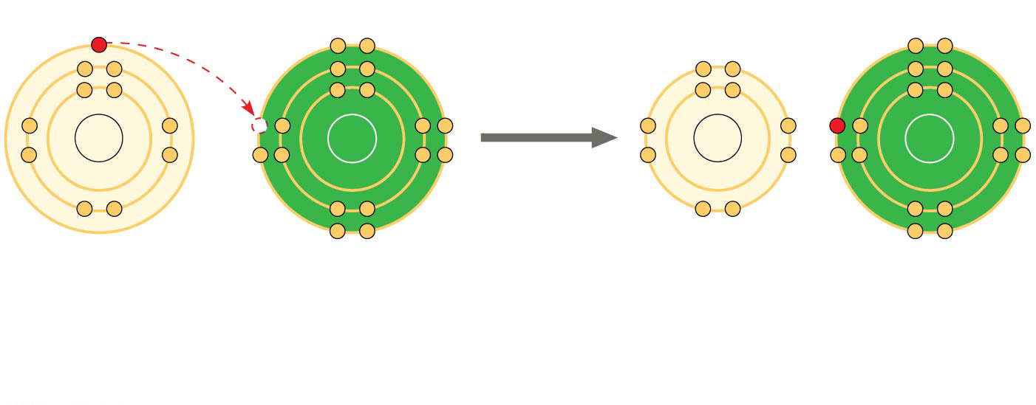
Figure 2.12-2
+
−
Na
Cl
Na
Cl
Na Sodium atom
Cl
Chlorine atom
Na⁺ Sodium ion (a cation)
Cl⁻ Chloride ion (an anion)
Sodium chloride (NaCl)
Notes:
Figure 2.12-2 Electron transfer and ionic bonding (step 2)

Slide 35
A cation is a positively charged ion
An anion is a negatively charged ion
An ionic bond is an attraction between an anion and a cation

Slide 36
Compounds formed by ionic bonds are called ionic compounds, or salts
Salts, such as sodium chloride (table salt), are often found in nature as crystals

Slide 37
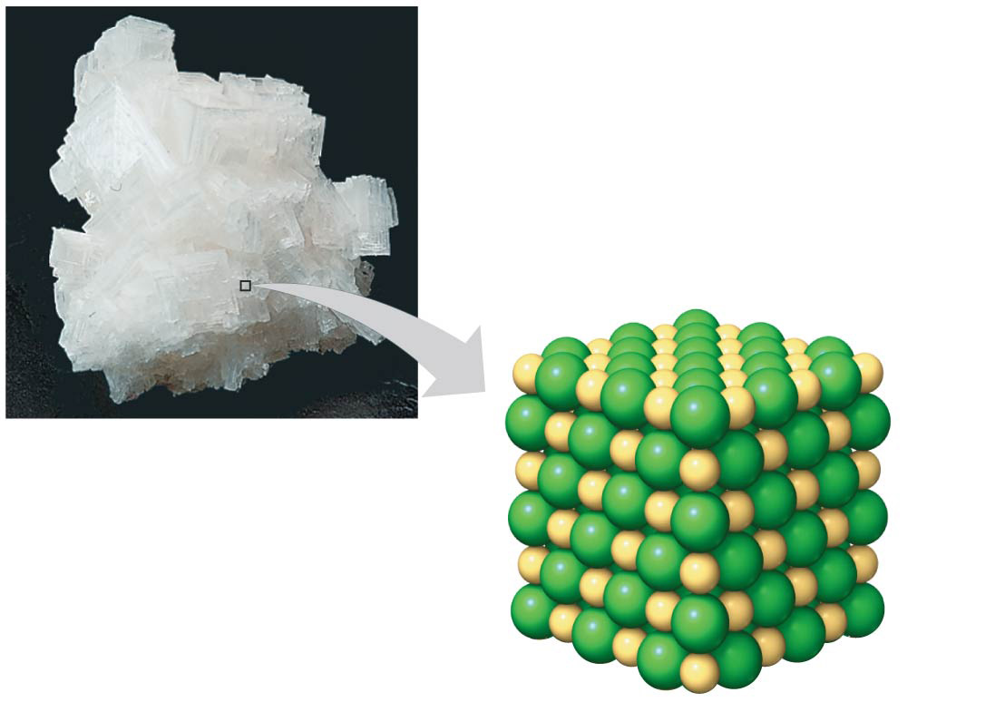
Figure 2.13
Na⁺
Cl⁻
Notes:
Figure 2.13 A sodium chloride (NaCl) crystal

Slide 38
Weak Chemical Bonds
Most of the strongest bonds in organisms are covalent bonds that form a cell’s molecules
Weak chemical bonds are also indispensable
Many large biological molecules are held in their functional form by weak bonds
The reversibility of weak bonds can be an advantage

Slide 39
Hydrogen Bonds
A hydrogen bond forms when a hydrogen atom covalently bonded to one electronegative atom is also attracted to another electronegative atom
In living cells, the electronegative partners are usually oxygen or nitrogen atoms

Slide 40
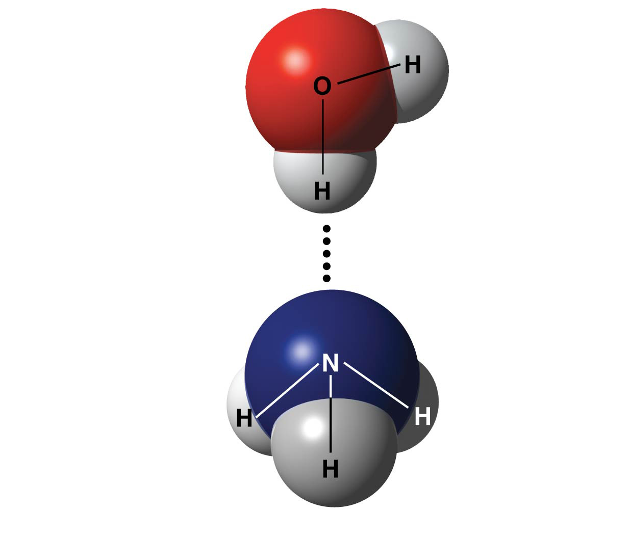
Figure 2.14
δ−
δ+
Water (H₂O)
δ+
Hydrogen bond
δ−
Ammonia (NH₃)
δ+
δ+
δ+
Notes:
Figure 2.14 A hydrogen bond

Slide 41
Van der Waals Interactions
If electrons are distributed asymmetrically in molecules or atoms, they may accumulate by chance in one part of a molecule
Van der Waals interactions are attractions between molecules that are close together as a result of these charges

Slide 42
Collectively, such interactions can be strong, as between molecules of a gecko’s toe hairs and a wall surface

Slide 43
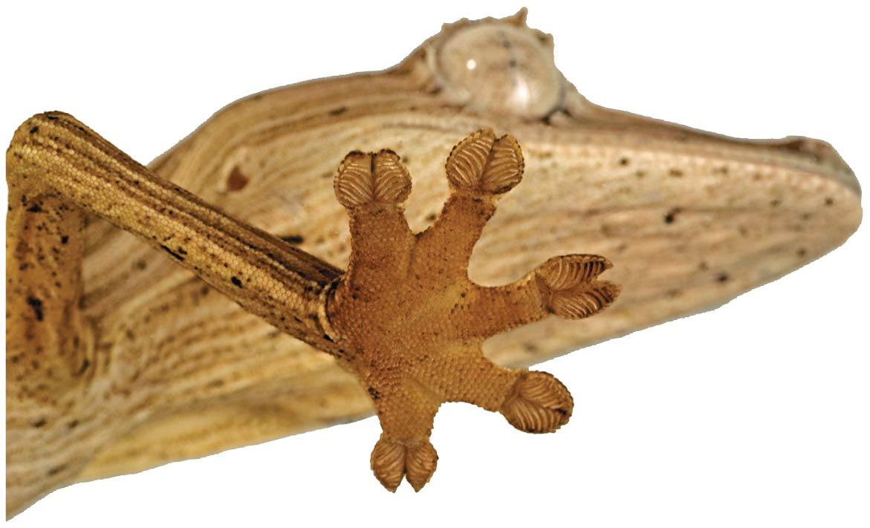
Figure 2.UN02
Notes:
Figure 2.UN02 In-text figure, gecko, p. 39

Slide 44
Molecular Shape and Function
A molecule’s shape is usually very important to its function
A molecule’s shape is determined by the positions of its atoms’ orbitals
In a covalent bond, the s and p orbitals may hybridize, creating specific molecular shapes

Slide 45
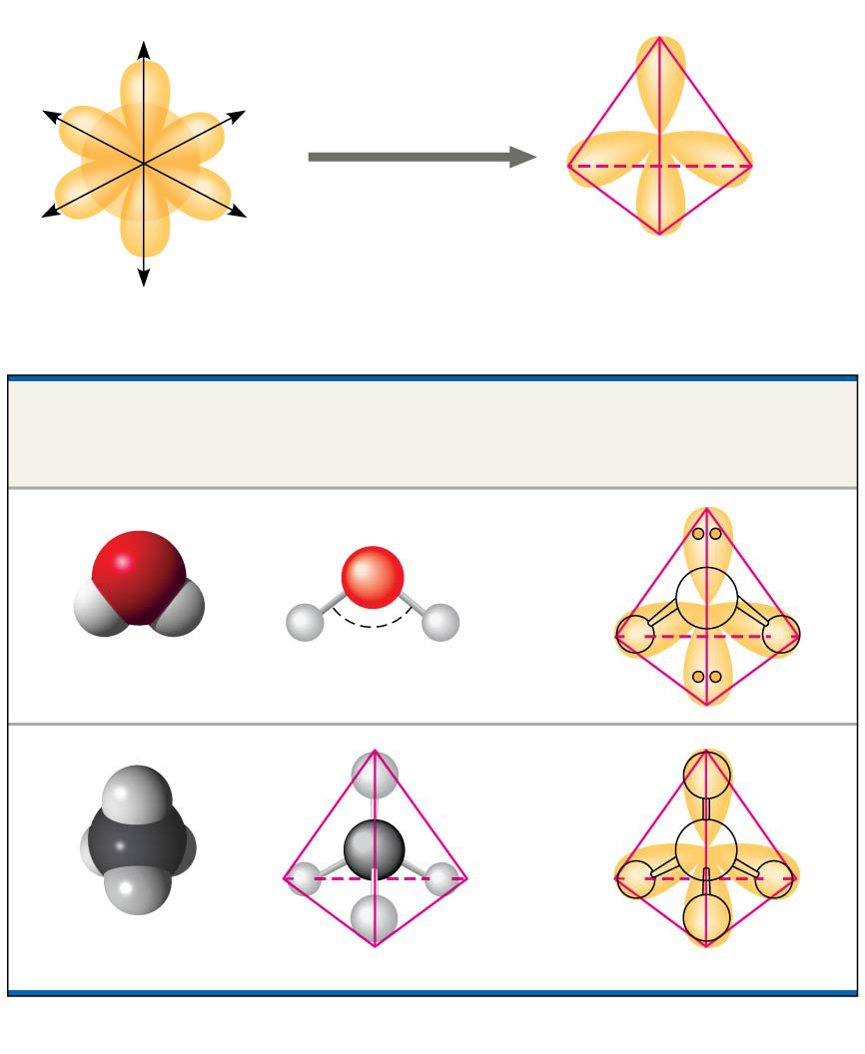
Figure 2.15
Four hybrid orbitals
s orbital
z
Three p orbitals
x
y
Tetrahedron
(a) Hybridization of orbitals
Space-Filling Model
Ball-and-Stick Model
Hybrid-Orbital Model (with ball-and-stick model superimposed)
Unbonded electron pair
O
O
H
H
H
H
104.5°
Water (H₂O)
H
H
C
C
H
H
H
H
H
H
Methane (CH₄)
(b) Molecular-shape models
Notes:
Figure 2.15 Molecular shapes due to hybrid orbitals

Slide 46
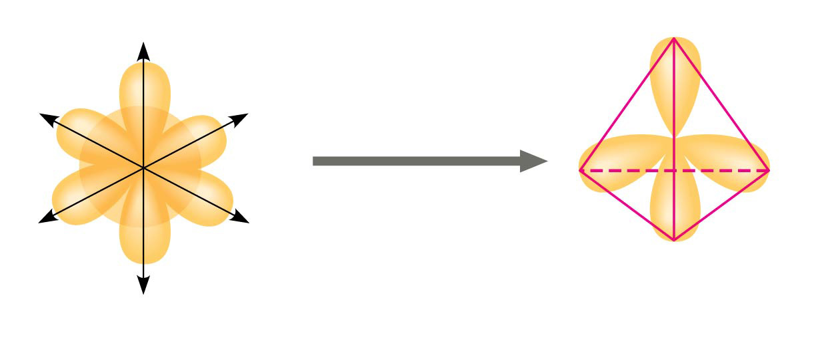
Figure 2.15a
z
Three p orbitals
Four hybrid orbitals
s orbital
x
y
Tetrahedron
(a) Hybridization of orbitals
Notes:
Figure 2.15a Molecular shapes due to hybrid orbitals (part 1: hybridization)

Slide 47
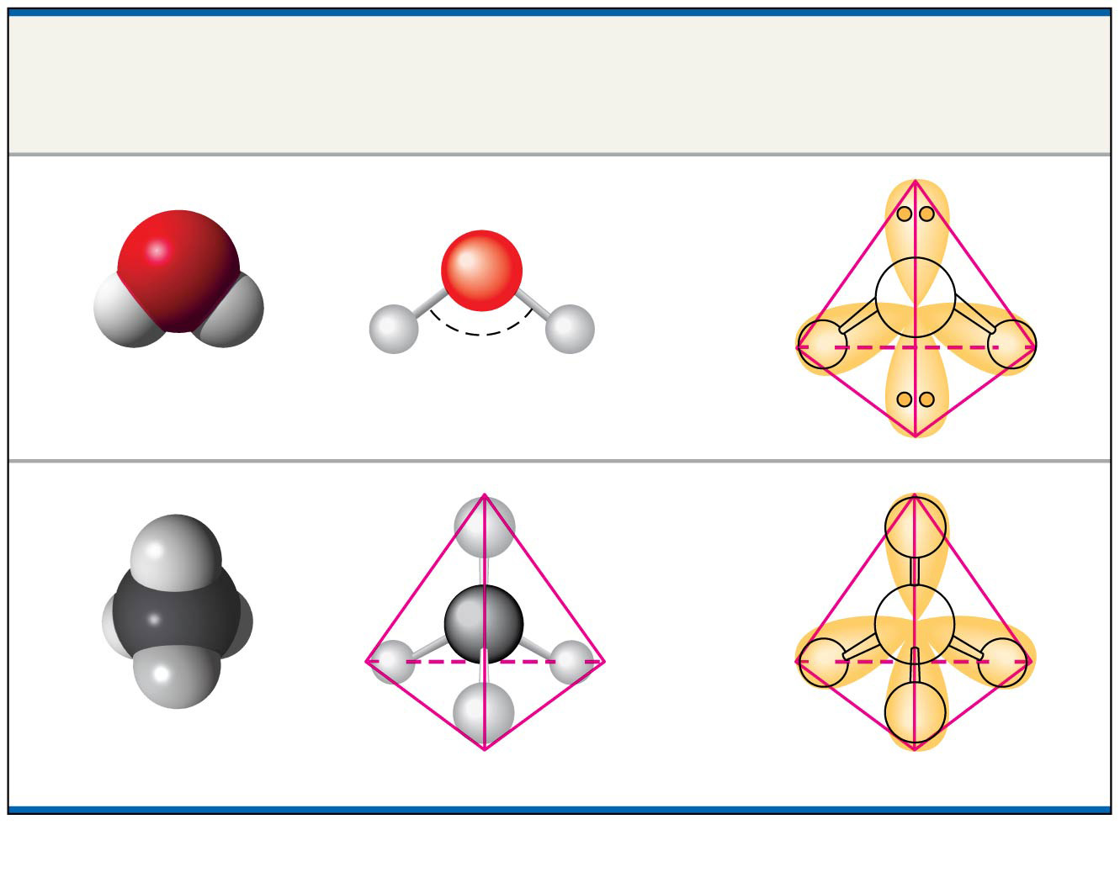
Figure 2.15b
Space-Filling
Model
Ball-and-Stick
Model
Hybrid-Orbital Model
(with ball-and-stick
model superimposed)
Unbonded
electron
pair
O
O
H
H
H
H
104.5°
Water (H₂O)
H
H
C
C
H
H
H
H
H
H
Methane (CH₄)
(b) Molecular-shape models
Notes:
Figure 2.15b Molecular shapes due to hybrid orbitals (part 2: models)

Slide 48
Molecular shape is crucial in biology because it determines how biological molecules specifically recognize and respond to one another
Opiates, such as morphine, and naturally produced endorphins have similar effects because their shapes are similar and they bind the same receptors in the brain

Slide 49
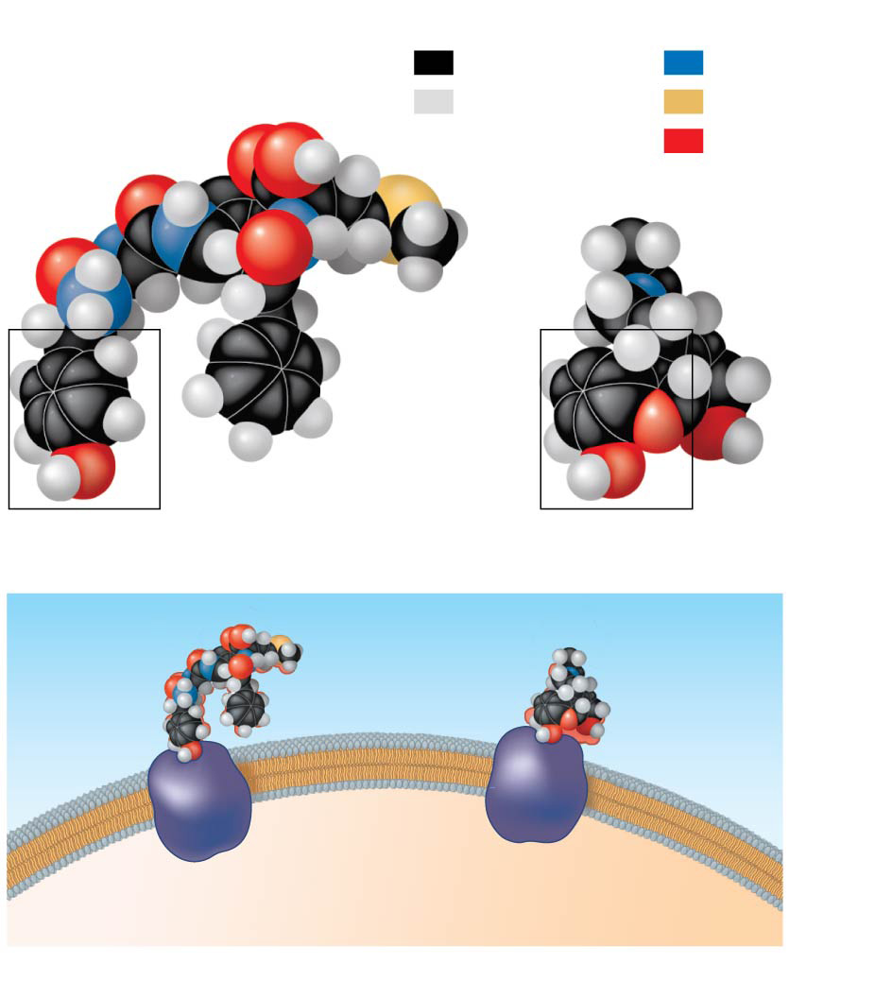
Figure 2.16
Key
Natural endorphin
Carbon
Nitrogen
Hydrogen
Sulfur
Oxygen
Morphine
(a) Structures of endorphin and morphine
Natural
endorphin
Morphine
Endorphin
receptors
Brain cell
(b) Binding to endorphin receptors
Notes:
Figure 2.16 A molecular mimic

Slide 50
Concept 2.4: Chemical reactions make and break chemical bonds
Chemical reactions are the making and breaking of chemical bonds
The starting molecules of a chemical reaction are called reactants
The final molecules of a chemical reaction are called products

Slide 51
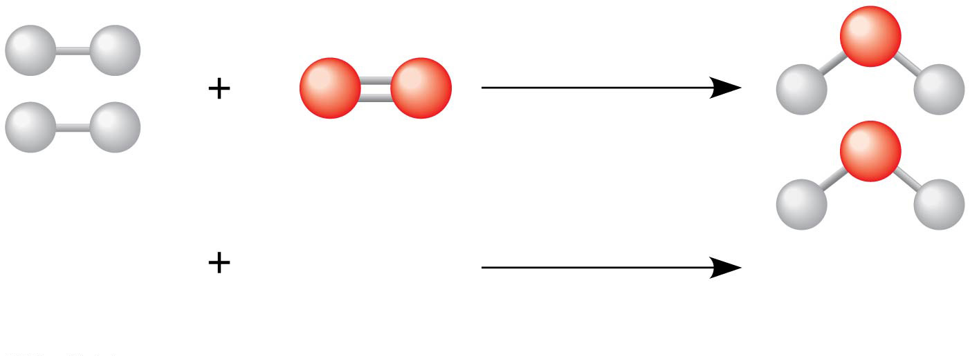
Figure 2.UN03
2 H₂
O₂
2 H₂O
Reactants
Reaction
Products
Notes:
Figure 2.UN03 In-text figure, water formation, p. 40

Slide 52
Photosynthesis is an important chemical reaction
Sunlight powers the conversion of carbon dioxide and water to glucose and oxygen
6 CO₂ + 6 H₂O → C₆H₁₂O₆ + 6 O₂

Slide 53
All chemical reactions are reversible: products of the forward reaction become reactants for the reverse reaction
Chemical equilibrium is reached when the forward and reverse reactions occur at the same rate
At equilibrium the relative concentrations of reactants and products do not change

