Slide 1
50
Sensory and Motor Mechanisms
Lecture Presentation by Nicole Tunbridge and
Kathleen Fitzpatrick

Slide 2
Sense and Sensibility
The star-nosed mole can catch insect prey in near total darkness in as little as 120 milliseconds
It uses the 11 pairs of appendages protruding from its nose to locate and capture prey
Sensory processes convey information about an animal’s environment to its brain, and muscles and skeletons carry out movements as instructed by the brain

Slide 3
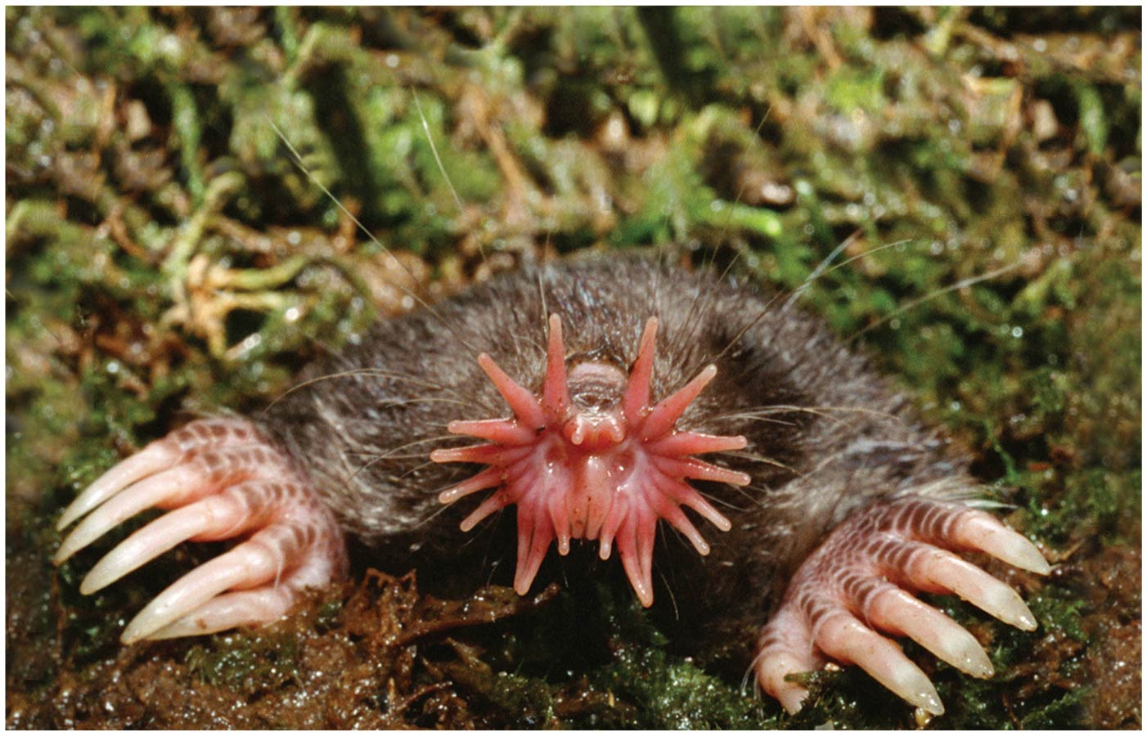
Figure 50.1
Notes:
Figure 50.1 Of what use is a star-shaped nose?

Slide 4
Concept 50.1: Sensory receptors transduce stimulus energy and transmit signals to the central nervous system
All stimuli represent forms of energy
Sensation involves converting energy into a change in the membrane potential of sensory receptors
When a stimulus’s input to the nervous system is processed a motor response may be generated
This may involve a simple reflex or more elaborate processing

Slide 5
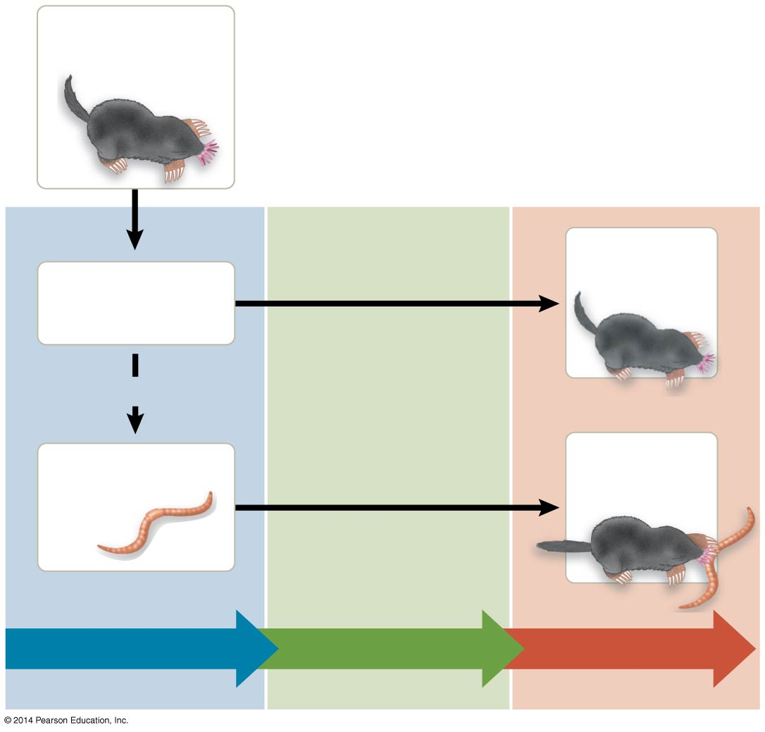
Figure 50.2
Mole forages along tunnel.
Mole moves on.
Food absent
OR
Food present
Mole bites.
Sensory input
Integration
Motor output
Notes:
Figure 50.2 A simple response pathway: foraging by a star-nosed mole

Slide 6
Sensory pathways have four basic functions in common
Sensory reception
Transduction
Transmission
Integration

Slide 7
Sensory Reception and Transduction
Sensations and perceptions begin with sensory reception, detection of stimuli by sensory receptors
Sensory receptors interact directly with stimuli, both inside and outside the body

Slide 8
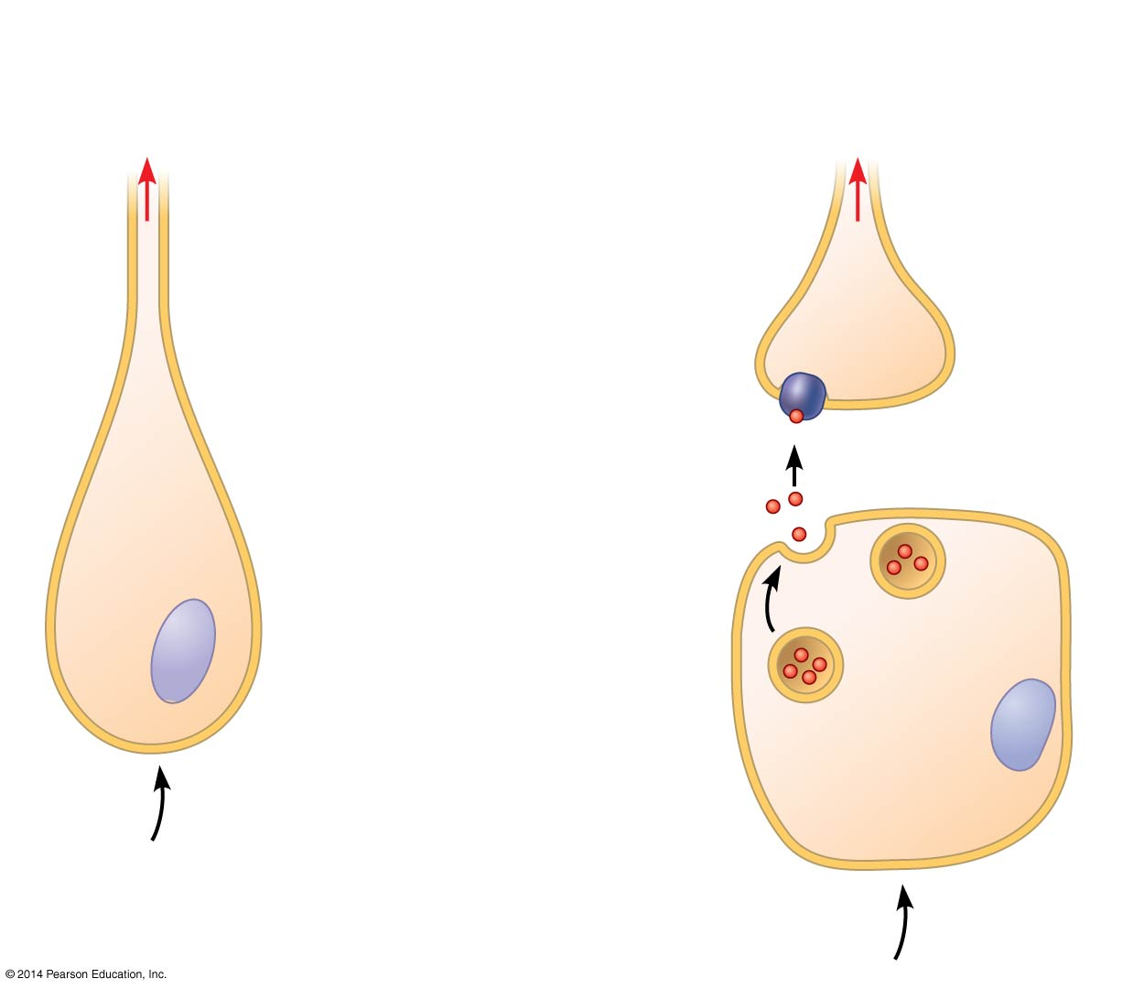
Figure 50.3
Neuronal receptors: Receptor is afferent neuron.
Non-neuronal receptors: Receptor regulates afferent neuron.
To CNS
To CNS
Afferent neuron
Afferent neuron
Receptor protein
Neurotransmitter
Sensory receptor
Stimulus leads to neuro- transmitter release.
Stimulus
Sensory receptor cell
Stimulus
Notes:
Figure 50.3 Categories of sensory receptors

Slide 9
Sensory transduction is the conversion of stimulus energy into a change in the membrane potential of a sensory receptor
This change in membrane potential is called a receptor potential
Receptor potentials are graded potentials; their magnitude varies with the strength of the stimulus

Slide 10
Transmission
For many sensory receptors, transducing the energy in a stimulus into a receptor potential initiates action potentials that are transmitted to the CNS
Some sensory receptors are specialized neurons while others are specialized cells that regulate neurons

Slide 11
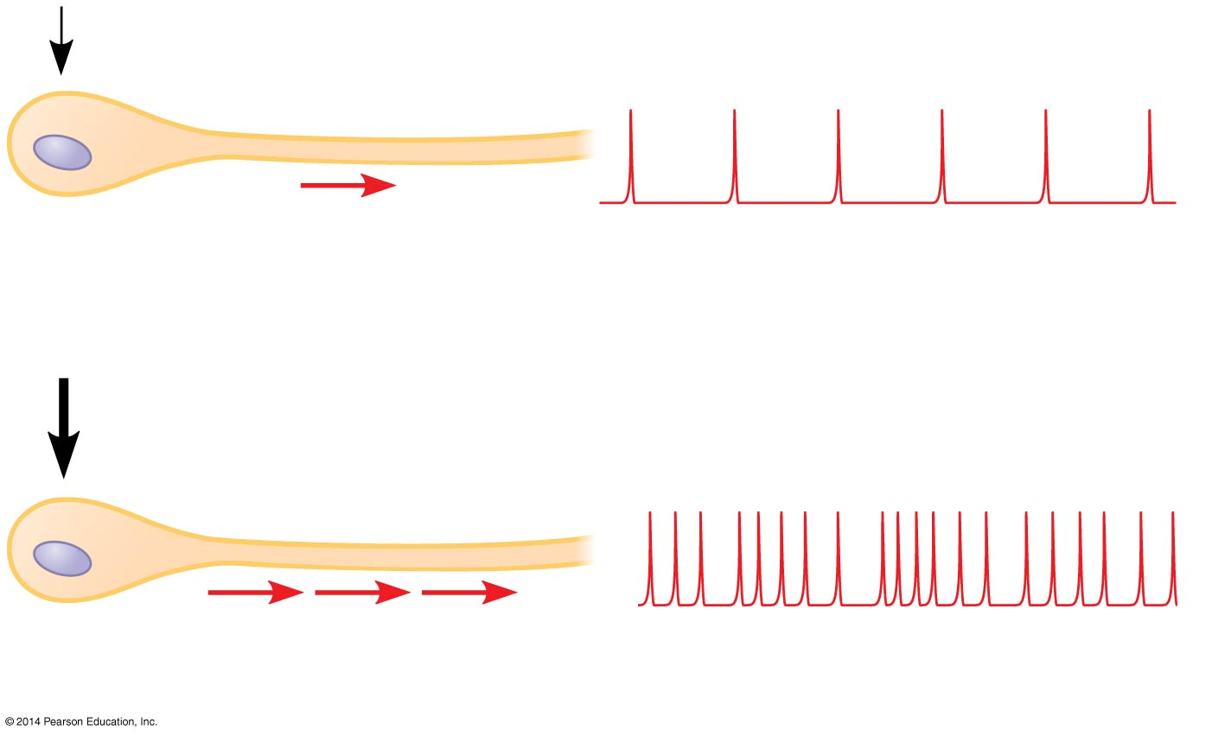
Figure 50.4
Gentle pressure
Sensory receptor
Low frequency of action potentials per receptor
More pressure
High frequency of action potentials per receptor
Notes:
Figure 50.4 Coding of stimulus intensity by a single sensory receptor

Slide 12
The response of a sensory receptor varies with intensity of stimuli
If the receptor is a neuron, a larger receptor potential results in more frequent action potentials
If the receptor is not a neuron, a larger receptor potential causes more neurotransmitters to be released

Slide 13
Processing of sensory information can occur before, during, and after transmission of action potentials to the CNS
Usually, integration of sensory information begins as soon as the information is received

Slide 14
Perception
Perceptions are the brain’s construction of stimuli
Stimuli from different sensory receptors travel as action potentials along dedicated neural pathways
The brain distinguishes stimuli from different receptors based on the area in the brain where the action potentials arrive

Slide 15
Amplification and Adaptation
Amplification is the strengthening of a sensory signal during transduction
Sensory adaptation is a decrease in responsiveness to continued stimulation

Slide 16
Types of Sensory Receptors
Based on energy transduced, sensory receptors fall into five categories
Mechanoreceptors
Chemoreceptors
Electromagnetic receptors
Thermoreceptors
Pain receptors

Slide 17
Mechanoreceptors
Mechanoreceptors sense physical deformation caused by stimuli such as pressure, stretch, motion, and sound
The knee-jerk response is triggered by the vertebrate stretch receptor, a mechanoreceptor that detects muscle movement
The mammalian sense of touch relies on mechanoreceptors that are dendrites of sensory neurons

Slide 18
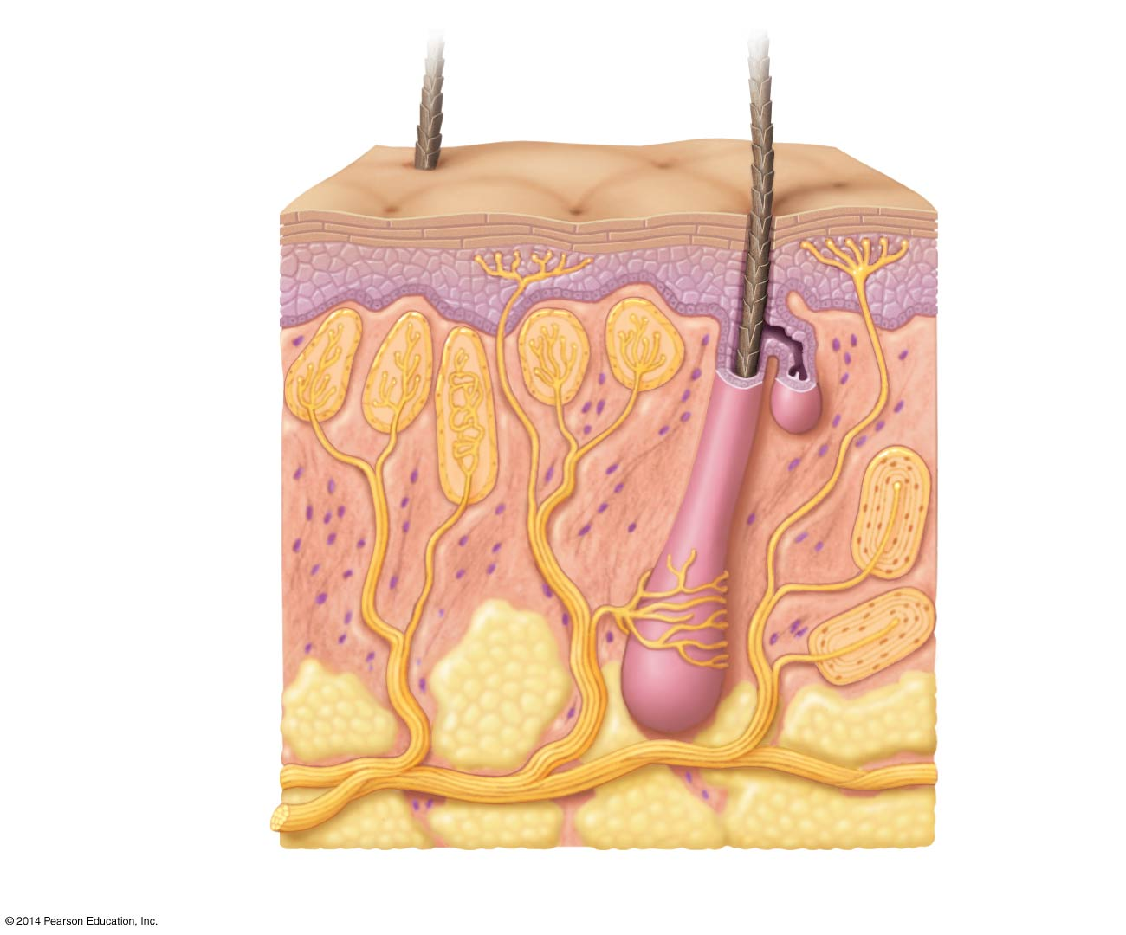
Figure 50.5
Gentle pressure, vibration, and temperature
Connective tissue
Pain
Hair
Epidermis
Dermis
Strong pressure
Hypodermis
Nerve
Hair movement
Notes:
Figure 50.5 Sensory receptors in human skin

Slide 19
Chemoreceptors
General chemoreceptors transmit information about the total solute concentration of a solution
Specific chemoreceptors respond to individual kinds of molecules
When a stimulus molecule binds to a chemoreceptor, the chemoreceptor becomes more or less permeable to ions
The antennae of the male silkworm moth have very sensitive specific chemoreceptors

Slide 20
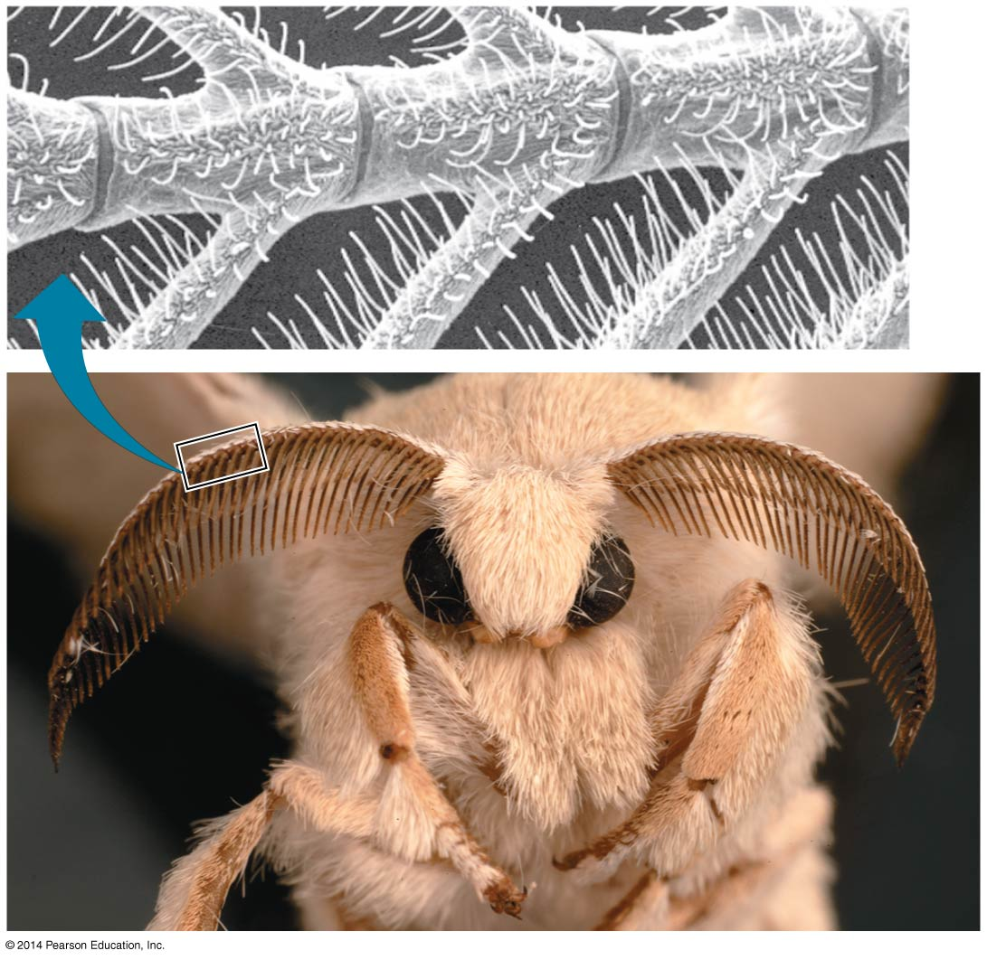
Figure 50.6
0.1 mm
Notes:
Figure 50.6 Chemoreceptors in an insect

Slide 21
Electromagnetic Receptors
Electromagnetic receptors detect electromagnetic energy such as light, electricity, and magnetism
Some snakes have very sensitive infrared receptors that detect body heat of prey against a colder background
Many animals apparently migrate using Earth’s magnetic field to orient themselves

Slide 22
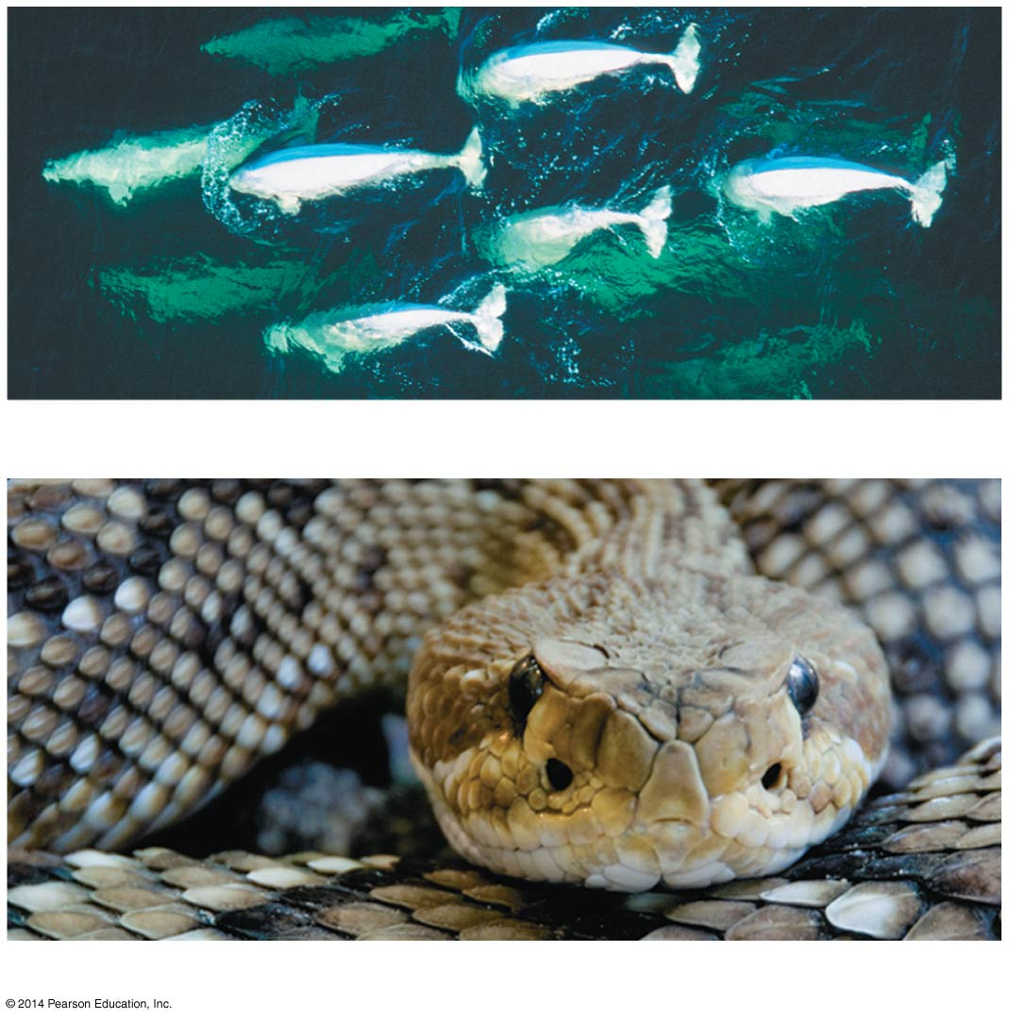
Figure 50.7
(a) Beluga whales
Eye
Heat-sensing organ
(b) Rattlesnake
Notes:
Figure 50.7 Examples of electromagnetic reception and thermoreception

Slide 23
Thermoreceptors
Thermoreceptors, which respond to heat or cold, help regulate body temperature by signaling both surface and body core temperature
Mammals have a variety of thermoreceptors, each specific for a particular temperature range

Slide 24
Pain Receptors
In humans, pain receptors, or nociceptors, detect stimuli that reflect harmful conditions
They respond to excess heat, pressure, or chemicals released from damaged or inflamed tissues

Slide 25
Concept 50.2: The mechanoreceptors responsible for hearing and equilibrium detect moving fluid or settling particles
Hearing and perception of body equilibrium are related in most animals
For both senses, settling particles or moving fluid is detected by mechanoreceptors

Slide 26
Sensing Gravity and Sound in Invertebrates
Most invertebrates maintain equilibrium using mechanoreceptors located in organs called statocysts
Statocysts contain mechanoreceptors that detect the movement of granules called statoliths

Slide 27
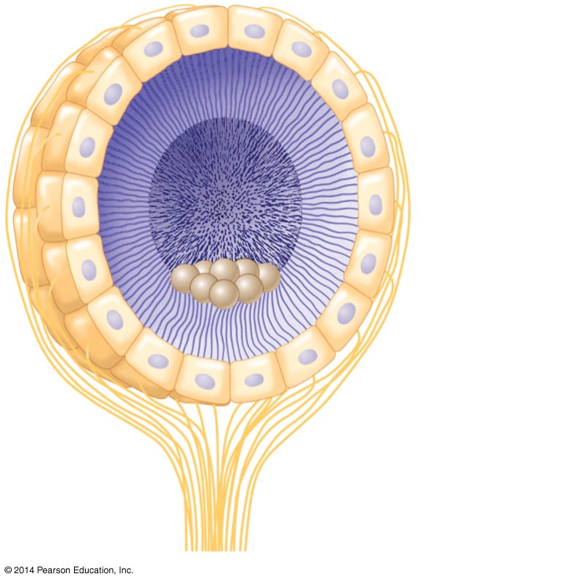
Figure 50.8
Ciliated receptor cells
Cilia
Statolith
Sensory nerve fibers (axons)
Notes:
Figure 50.8 The statocyst of an invertebrate

Slide 28
Many arthropods sense sounds with body hairs that vibrate or with localized “ears” consisting of a tympanic membrane stretched over an internal air chamber

Slide 29
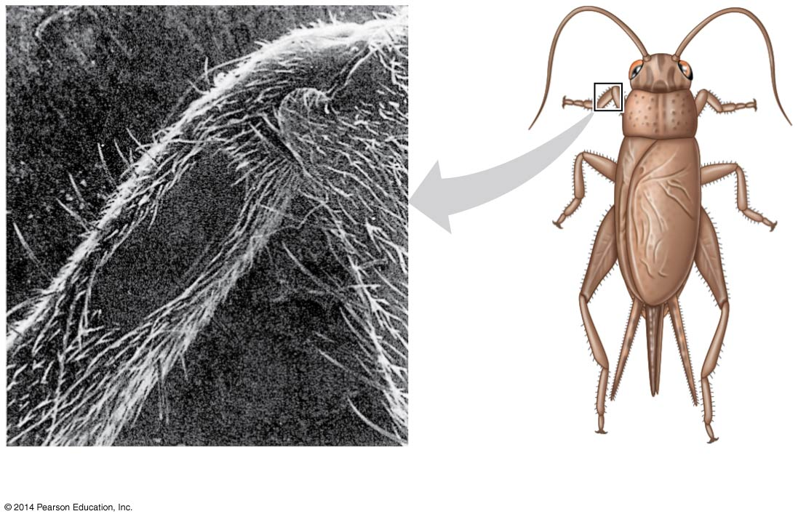
Figure 50.9
Tympanic membrane
1 mm
Notes:
Figure 50.9 An insect’s “ear”—on its leg

Slide 30
Hearing and Equilibrium in Mammals
In most terrestrial vertebrates, sensory organs for hearing and equilibrium are closely associated in the ear

Slide 31
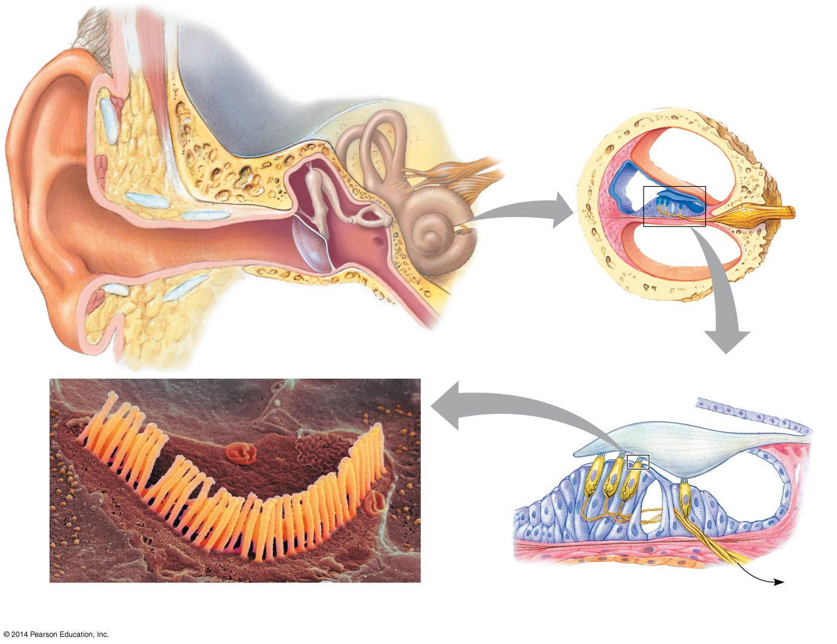
Figure 50.10
Outer ear
Middle ear
Inner ear
Skull
bone
Stapes
Semicircular canals
Incus
Cochlear duct
Malleus
Bone
Auditory nerve to brain
Auditory nerve
Vestibular canal
Tympanic canal
Cochlea
Organ of Corti
Auditory canal
Oval window
Eustachian tube
Pinna
Tympanic membrane
Round window
Tectorial membrane
1 µm
Bundled hairs projecting from a single mammalian hair cell (SEM)
Basilar membrane
Hair cells
Axons of sensory neurons
To auditory nerve
Notes:
Figure 50.10 Exploring the structure of the human ear

Slide 32
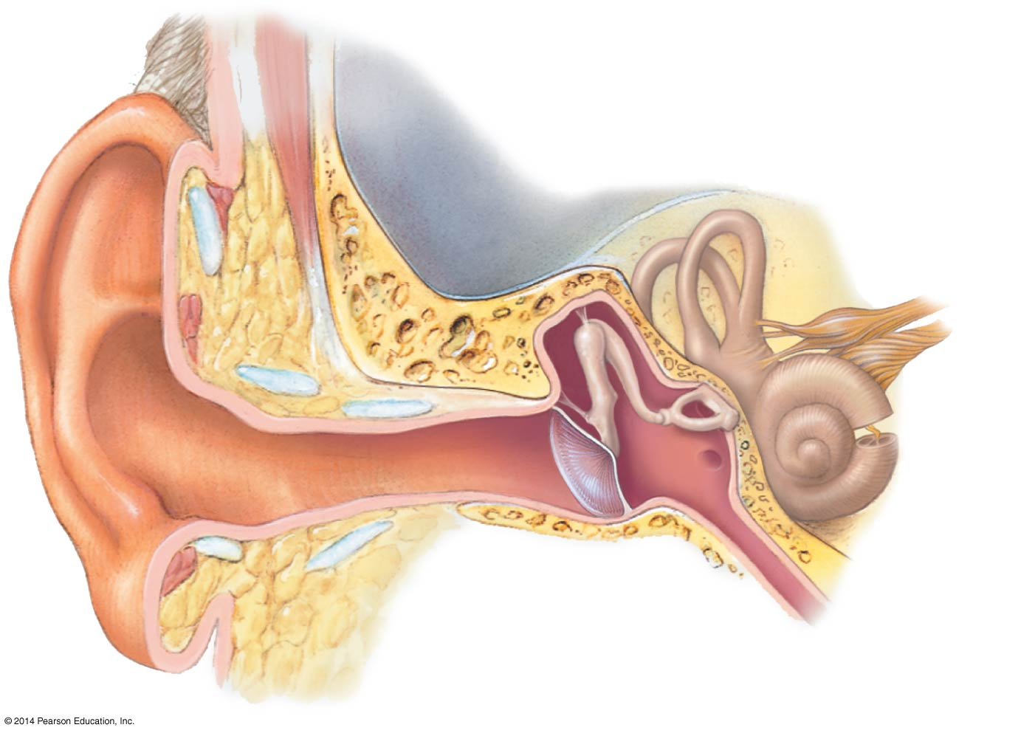
Figure 50.10a
Outer ear
Middle ear
Inner ear
Skull
bone
Stapes
Semicircular canals
Incus
Malleus
Auditory nerve to brain
Cochlea
Oval window
Auditory canal
Eustachian tube
Pinna
Tympanic membrane
Round window
Notes:
Figure 50.10a Exploring the structure of the human ear (part 1: overview)

Slide 33
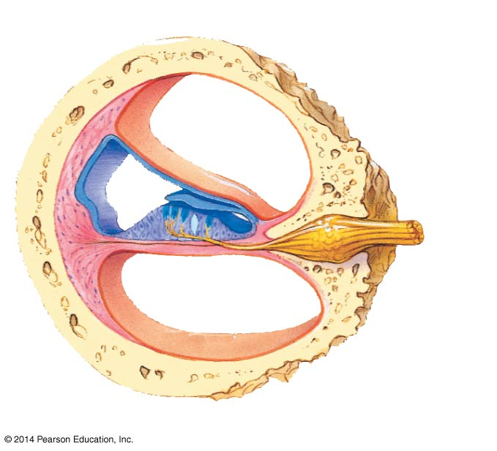
Figure 50.10b
Cochlear duct
Bone
Auditory nerve
Vestibular canal
Tympanic canal
Organ of Corti
Notes:
Figure 50.10b Exploring the structure of the human ear (part 2: cochlea)

Slide 34
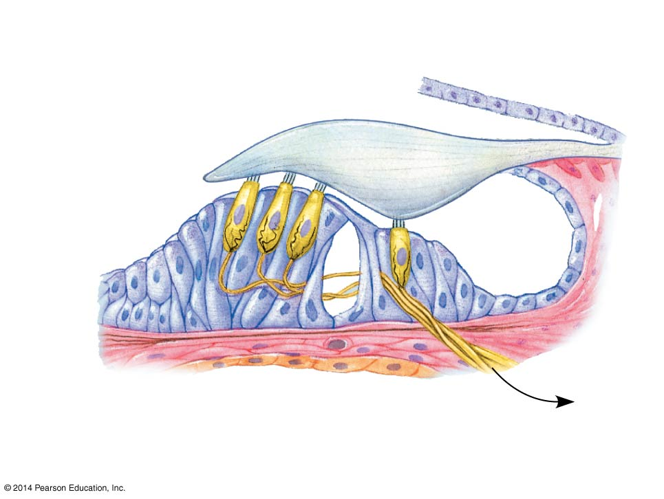
Figure 50.10c
Tectorial membrane
Hair cells
Basilar membrane
Axons of sensory neurons
To auditory nerve
Notes:
Figure 50.10c Exploring the structure of the human ear (part 3: organ of Corti)

Slide 35
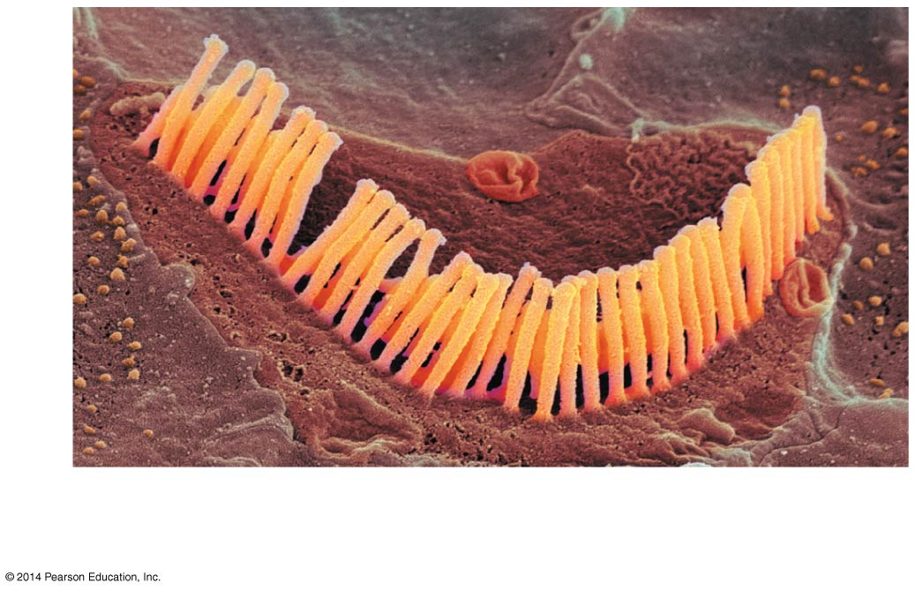
Figure 50.10d
1 µm
Bundled hairs projecting from a single mammalian hair cell (SEM)
Notes:
Figure 50.10d Exploring the structure of the human ear (part 4: hair cell, SEM)

Slide 36
Hearing
Vibrating objects create percussion waves in the air that cause the tympanic membrane to vibrate
The three bones of the middle ear transmit the vibrations of moving air to the oval window on the cochlea
These vibrations create pressure waves in the fluid in the cochlea that travel through the vestibular canal

Slide 37
Pressure waves in the canal cause the basilar membrane to vibrate, bending its hair cells
This bending of hair cells depolarizes the membranes of mechanoreceptors and sends action potentials to the brain via the auditory nerve

Slide 38
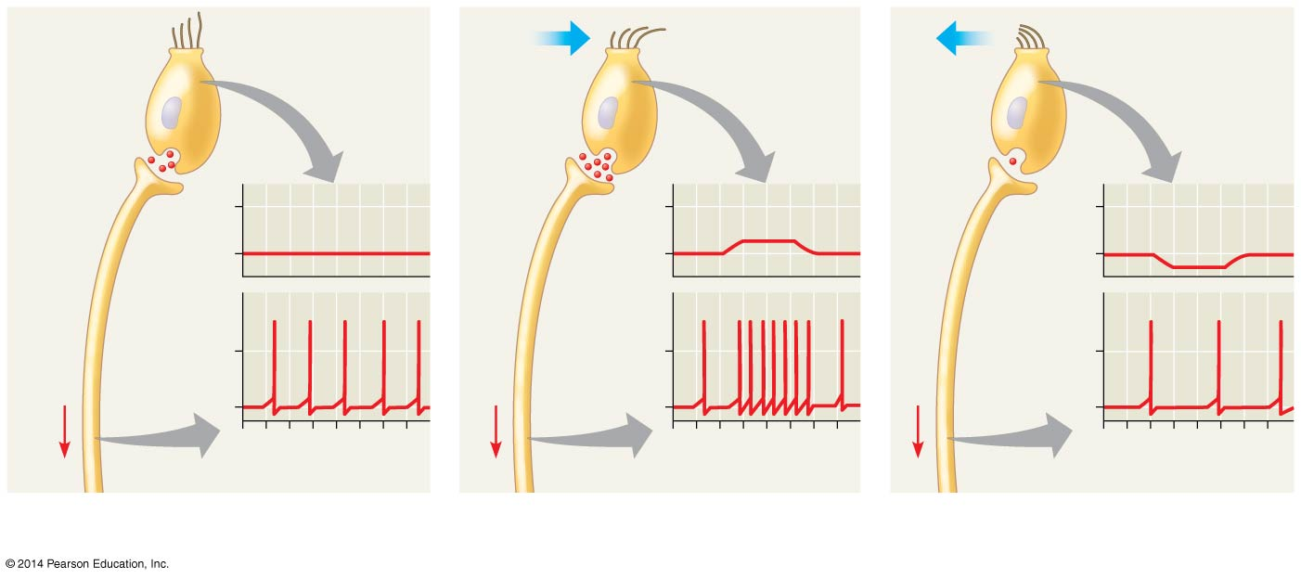
Figure 50.11
“Hairs” of hair cell
Neuro- transmitter at synapse
More
neuro- trans- mitter
Less
neuro- trans- mitter
Sensory neuron
−50
−50
Receptor potential
−50
−70
−70
−70
Membrane potential (mV)
Membrane potential (mV)
Membrane potential (mV)
Action potentials
Signal
0
Signal
0
Signal
0
−70
−70
−70
0 1 2 3 4 5 6 7
0 1 2 3 4 5 6 7
0 1 2 3 4 5 6 7
Time (sec)
Time (sec)
Time (sec)
(a) No bending of hairs
(b) Bending of hairs in one direction
(c) Bending of hairs in other direction
Notes:
Figure 50.11 Sensory reception by hair cells

Slide 39
The fluid waves dissipate when they strike the round window at the end of the tympanic canal

Slide 40
The ear conveys information about
Volume, the amplitude of the sound wave
Pitch, the frequency of the sound wave
The cochlea can distinguish pitch because the basilar membrane is not uniform along its length
Each region of the basilar membrane is tuned to a particular vibration frequency

Slide 41
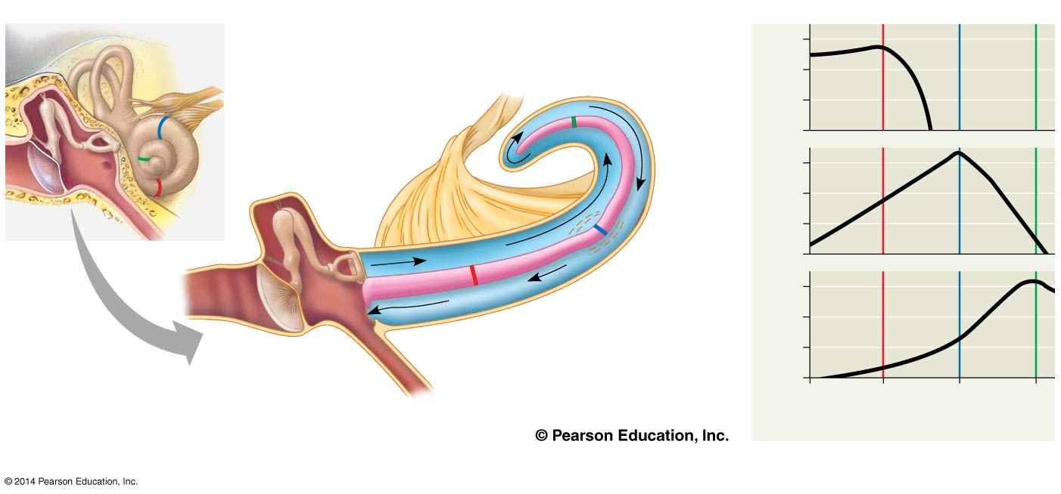
Figure 50.12
A B C
Axons of sensory neurons
Point C
3
6,000 Hz
Apex
B
Stapes
Vestibular canal
0
C
3
1,000 Hz
Oval window
A
Cochlea
Relative motion of basilar membrane
Basilar membrane
0
Point B
3
100 Hz
Tympanic membrane
Tympanic canal
Displayed as if cochlea partially uncoiled
Base
Round window
Point A
0
0 10 20 30
Distance from oval window (mm)
(a)
(b)
Notes:
Figure 50.12 Transduction in the cochlea

Slide 42
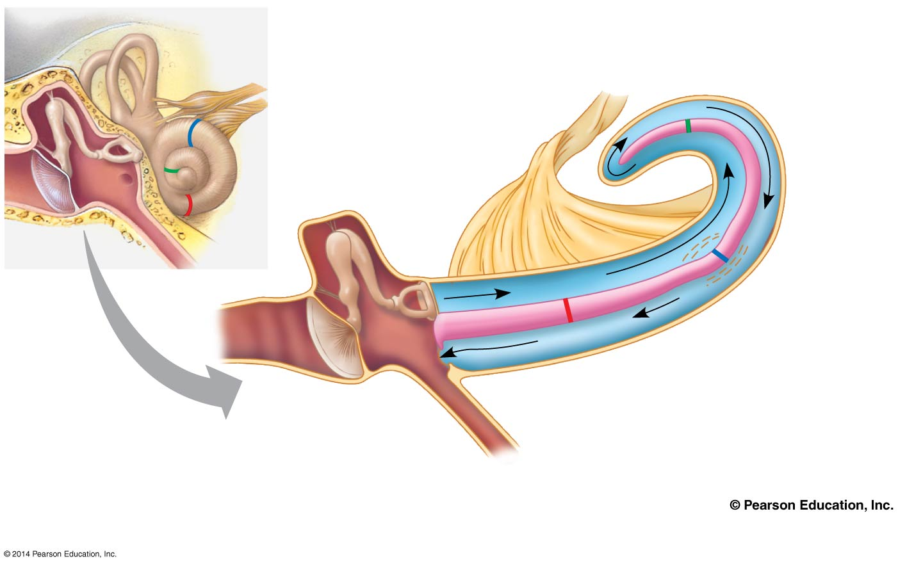
Figure 50.12a
Axons of sensory neurons
Point C
Apex
B
Vestibular canal
C
Stapes
Oval window
A
Cochlea
Basilar membrane
Tympanic membrane
Point B
Tympanic canal
Displayed as if cochlea partially uncoiled
Base
Round window
Point A
(a)
Notes:
Figure 50.12a Transduction in the cochlea (part 1: art)

Slide 43
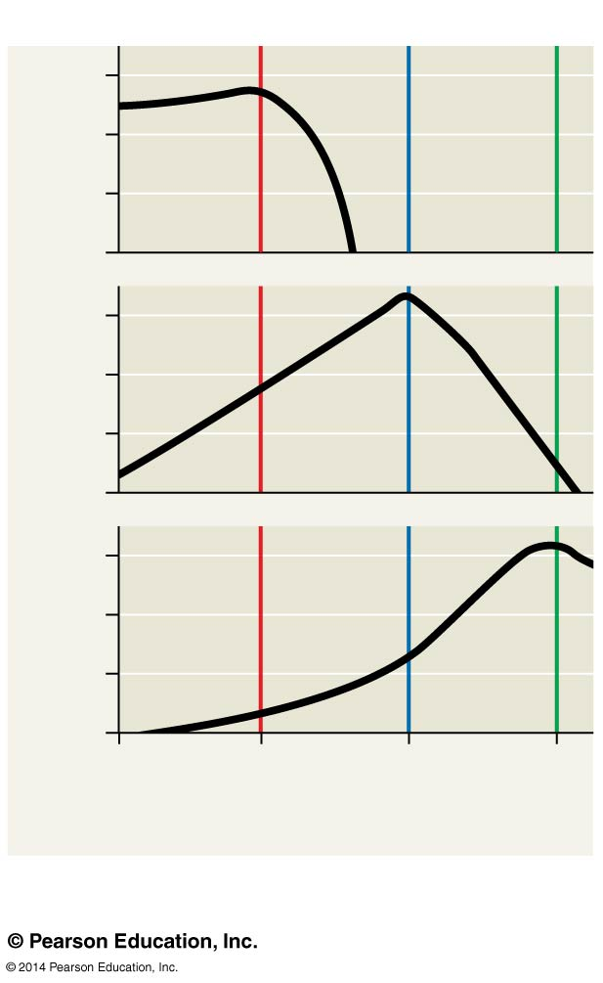
Figure 50.12b
A B C
3
6,000 Hz
0
3
1,000 Hz
Relative motion of basilar membrane
0
3
100 Hz
0
0 10 20 30
Distance from oval window (mm)
(b)
Notes:
Figure 50.12b Transduction in the cochlea (part 2: graph)

Slide 44
Equilibrium
Several organs of the inner ear detect body movement, position, and balance
The utricle and saccule contain granules called otoliths that allow us to perceive position relative to gravity or linear movement
Three semicircular canals contain fluid and can detect angular movement in any direction

Slide 45
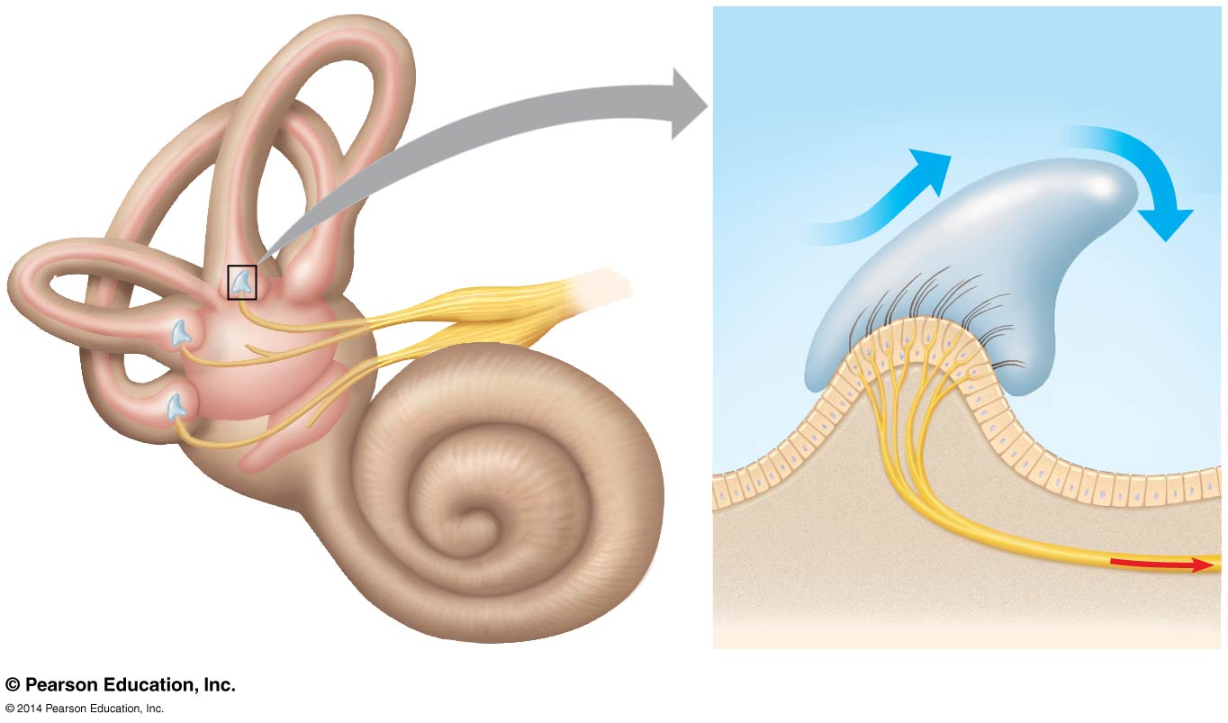
Figure 50.13
PERILYMPH
Cupula
Fluid flow
Vestibular nerve
Vestibule
Hairs
Hair cell
Nerve fibers
Utricle
Body movement
Saccule
Notes:
Figure 50.13 Organs of equilibrium in the inner ear

Slide 46
Hearing and Equilibrium in Other Vertebrates
Unlike mammals, fishes have only a pair of inner ears near the brain
Most fishes and aquatic amphibians also have a lateral line system along both sides of their body
The lateral line system contains mechanoreceptors with hair cells that detect and respond to water movement

Slide 47
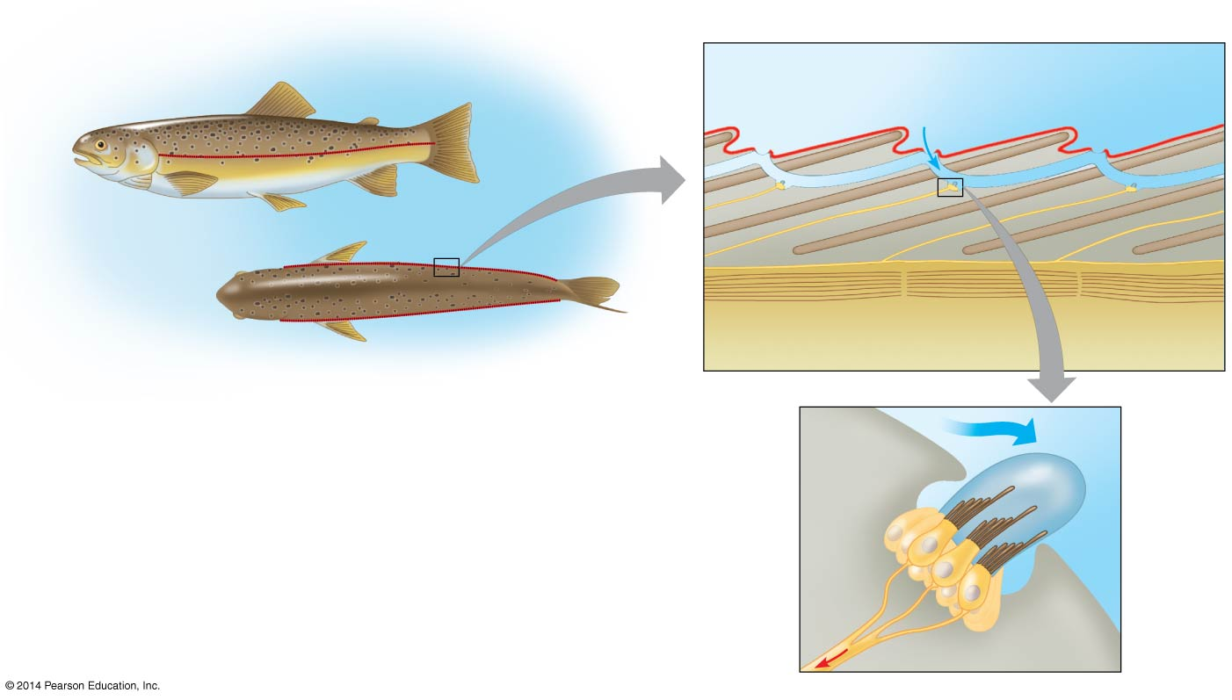
Figure 50.14
SURROUNDING WATER
Lateral line
epidermis
Lateral line canal
Opening of lateral line canal
Water flow
Side view
Lateral line
Cross section
Nerve
Lateral nerve
Scale
Segmental muscle
Top view
FISH BODY WALL
Water flow
Cupula
Supporting cell
Sensory hairs
Nerve fiber
Hair cell
Action potentials
Notes:
Figure 50.14 The lateral line system in a fish

Slide 48
Concept 50.3: The diverse visual receptors of animals depend on light-absorbing pigments
Animals use a diverse set of organs for vision, but the underlying mechanism for capturing light is the same, suggesting a common evolutionary origin

Slide 49
Evolution of Visual Perception
Light detectors in the animal kingdom range from simple clusters of cells that detect direction and intensity of light to complex organs that form images
Light detectors all contain photoreceptors, cells that contain light-absorbing pigment molecules

Slide 50
Light-Detecting Organs
Most invertebrates have a light-detecting organ
One of the simplest light-detecting organs is that of planarians
A pair of ocelli called eyespots are located near the head
These allow planarians to move away from light and seek shaded locations

Slide 51
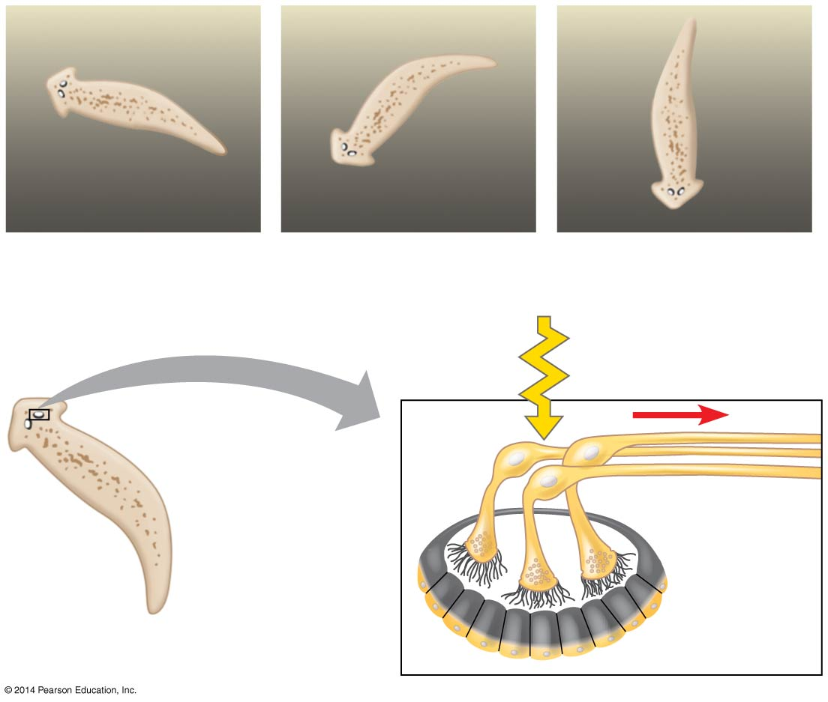
Figure 50.15
LIGHT
DARK
(a)
Light
Photoreceptor
Ocellus
Nerve to brain
Visual pigment
Screening pigment
(b)
Notes:
Figure 50.15 Ocelli and orientation behavior of a planarian

Slide 52
Compound Eyes
Insects and crustaceans have compound eyes, which consist of up to several thousand light detectors called ommatidia
Compound eyes are very effective at detecting movement
Insects have excellent color vision, and some can see into the ultraviolet range

Slide 53
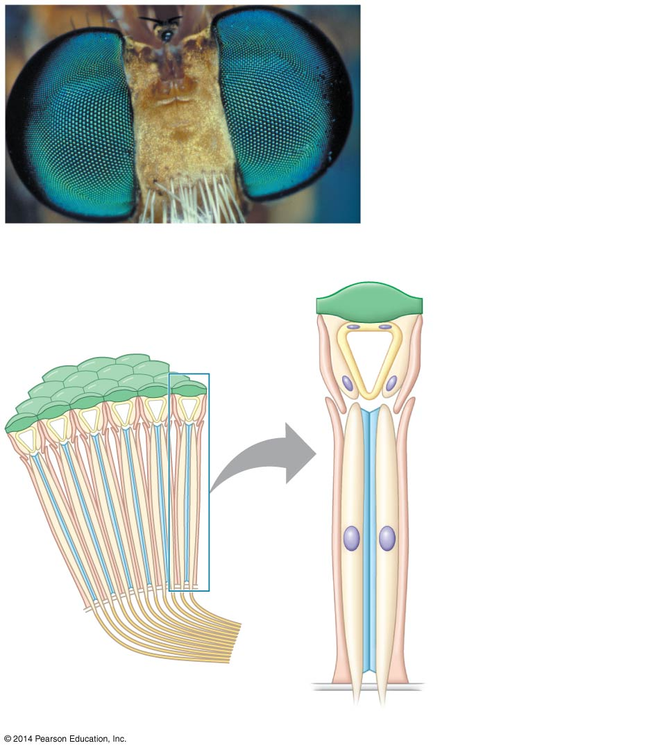
Figure 50.16
(a) Fly eyes
2 mm
Cornea
Crystalline cone
Lens
Rhabdom
Photoreceptor
Axons
(b) Ommatidia
Ommatidium
Notes:
Figure 50.16 Compound eyes

Slide 54
Single-Lens Eyes
Among invertebrates, single-lens eyes are found in some jellies, polychaetes, spiders, and many molluscs
They work on a camera-like principle: the iris changes the diameter of the pupil to control how much light enters
The eyes of all vertebrates have a single lens

Slide 55
The Vertebrate Visual System
In vertebrates the eye detects color and light, but the brain assembles the information and perceives the image

Slide 56
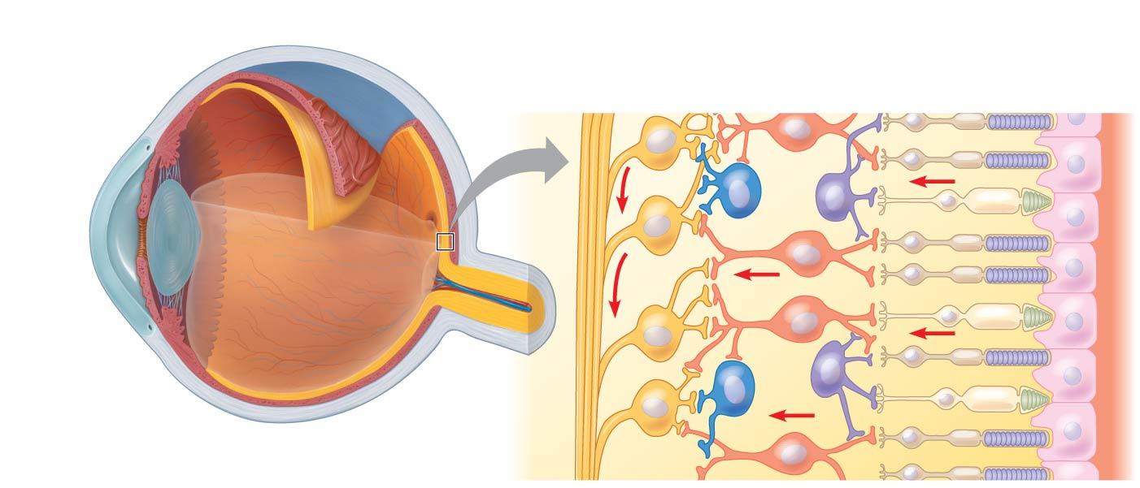
Figure 50.17a
Choroid
Retina
Sclera
Retina
Photoreceptors
Suspensory ligament
Fovea
Neurons
Cone
Rod
Cornea
Iris
Optic nerve
Pupil
Aqueous humor
Lens
Central artery and vein of the retina
Vitreous humor
Optic disk
Amacrine cell
Horizontal cell
Optic nerve fibers
Bipolar cell
Pigmented epithelium
Ganglion cell
Notes:
Figure 50.17a Exploring the structure of the human eye (part 1)

Slide 57
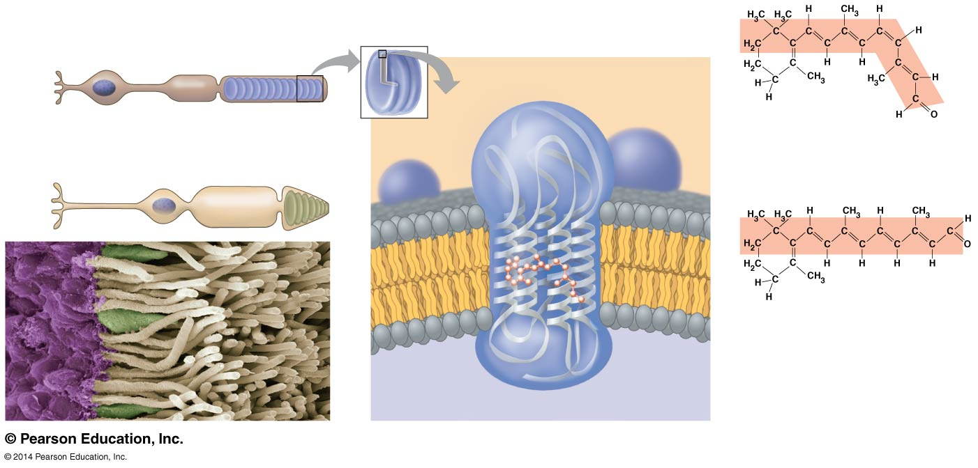
Figure 50.17b
CYTOSOL
Rod
Synaptic terminal
Cell body
Outer segment
Disks
Retinal: cis isomer
Light
Enzymes
Cone
Rod
Retinal: trans isomer
Cone
Retinal
Rhodopsin
INSIDE OF DISK
Opsin
Notes:
Figure 50.17b Exploring the structure of the human eye (part 2)

Slide 58
Sensory Transduction in the Eye
Transduction of visual information to the nervous system begins when light induces the conversion of cis-retinal to trans-retinal
Trans-retinal activates rhodopsin, which activates a G protein, eventually leading to hydrolysis of cyclic GMP

Slide 59
When cyclic GMP breaks down, Na⁺ channels close
This hyperpolarizes the cell
The signal transduction pathway usually shuts off again as enzymes convert retinal back to the cis form

Slide 60
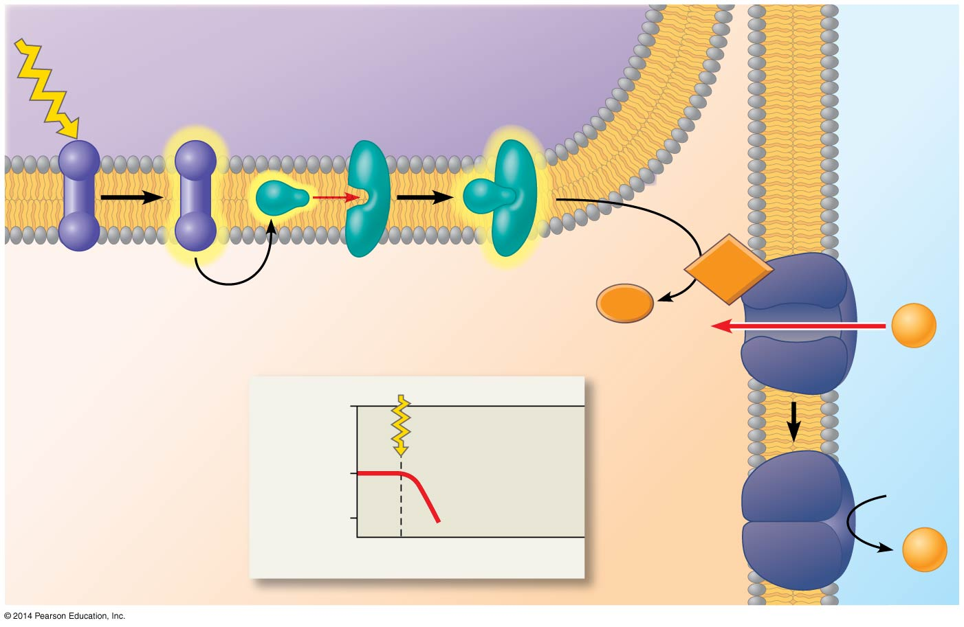
Figure 50.18
INSIDE OF DISK
EXTRA- CELLULAR FLUID
Light
Disk membrane
Active rhodopsin
Phosphodiesterase
Plasma membrane
CYTOSOL
Inactive rhodopsin
Transducin
cGMP
GMP
Na⁺
0
Light strikes retina
Membrane potential (mV)
−40
Hyper- polarization
−70
Time
Na⁺
Notes:
Figure 50.18 Production of the receptor potential in a rod cell

Slide 61
Processing of Visual Information in the Retina
Processing of visual information begins in the retina
In the dark, rods and cones continually release the neurotransmitter glutamate into synapses with neurons called bipolar cells
Some bipolar cells are hyperpolarized in response to glutamate while others are depolarized

Slide 62
In the light, rods and cones hyperpolarize, shutting off release of glutamate
The bipolar cells are then either depolarized or hyperpolarized

Slide 63
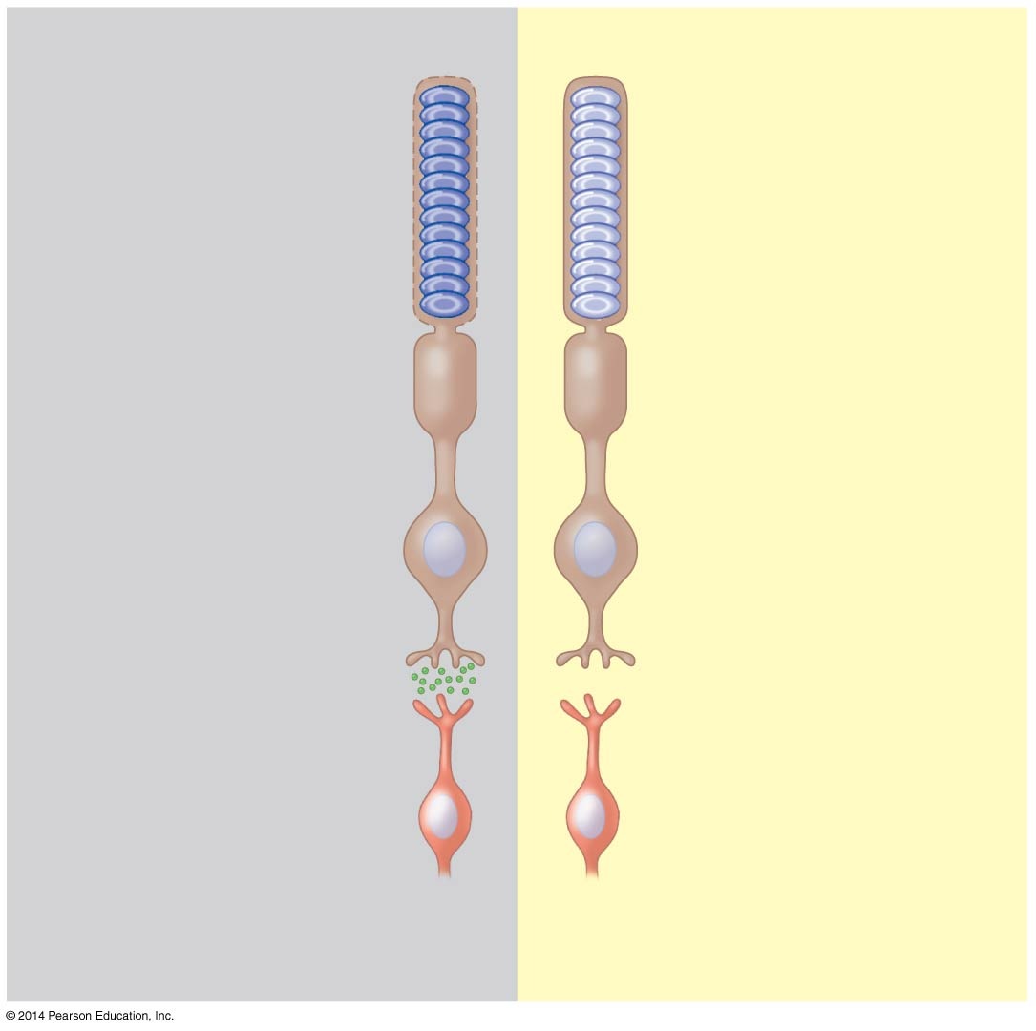
Figure 50.19
Dark Responses
Light Responses
Rhodopsin inactive
Rhodopsin active
Na⁺ channels open
Na⁺ channels closed
Rod depolarized
Rod hyperpolarized
Glutamate released
No glutamate released
Bipolar cell either depolarized or hyperpolarized, depending on glutamate receptors
Bipolar cell either hyperpolarized or depolarized, depending on glutamate receptors
Notes:
Figure 50.19 Synaptic activity of rod cells in light and dark

Slide 64
Horizontal cells, stimulated by illuminated rods and cones, enhance contrast of the image, a process called lateral inhibition
Amacrine cells distribute information from one bipolar cell to several ganglion cells
Lateral inhibition is repeated by the interaction of amacrine and ganglion cells and occurs at all levels of visual processing in the brain
Rods and cones that feed information to one ganglion cell define a receptive field

Slide 65
Processing of Visual Information in the Brain
The optic nerves meet at the optic chiasm near the cerebral cortex
Sensations from the left visual field of both eyes are transmitted to the right side of the brain
Sensations from the right visual field of both eyes are transmitted to the left side of the brain

Slide 66
Most ganglion cell axons lead to the lateral geniculate nuclei
The lateral geniculate nuclei relay information to the primary visual cortex in the cerebrum
At least 30% of the cerebral cortex, in dozens of integrating centers, is active in creating visual perceptions

Slide 67
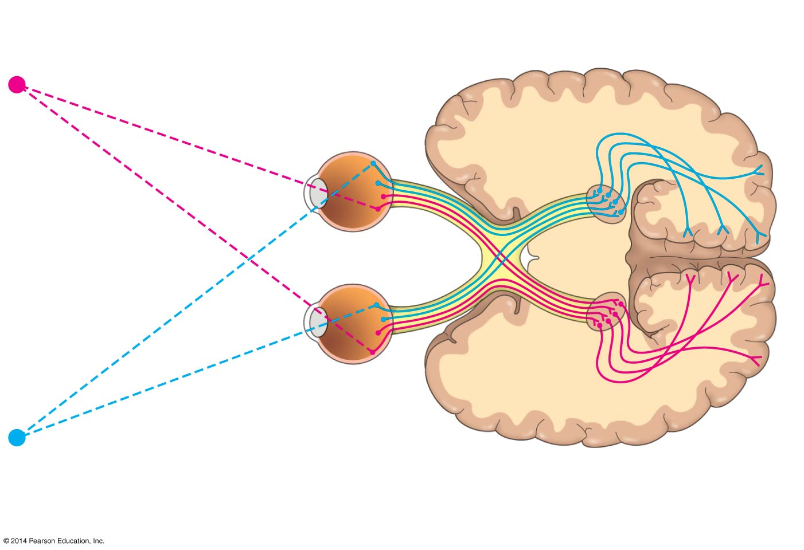
Figure 50.20
Right visual field
Optic chiasm
Right eye
Left eye
Left visual field
Optic nerve
Lateral geniculate nucleus
Primary visual cortex
Notes:
Figure 50.20 Neural pathways for vision

Slide 68
Color Vision
Among vertebrates, most fish, amphibians, and reptiles, including birds, have very good color vision
Humans and other primates are among the minority of mammals with the ability to see color well
Mammals that are nocturnal usually have a high proportion of rods in the retina

Slide 69
In humans, perception of color is based on three types of cones, each with a different visual pigment: red, green, or blue
These pigments are called photopsins and are formed when retinal binds to three distinct opsin proteins

Slide 70
Abnormal color vision results from alterations in the genes for one or more photopsin proteins
In 2009, researchers studying color blindness in squirrel monkeys made a breakthrough in gene therapy

Slide 71
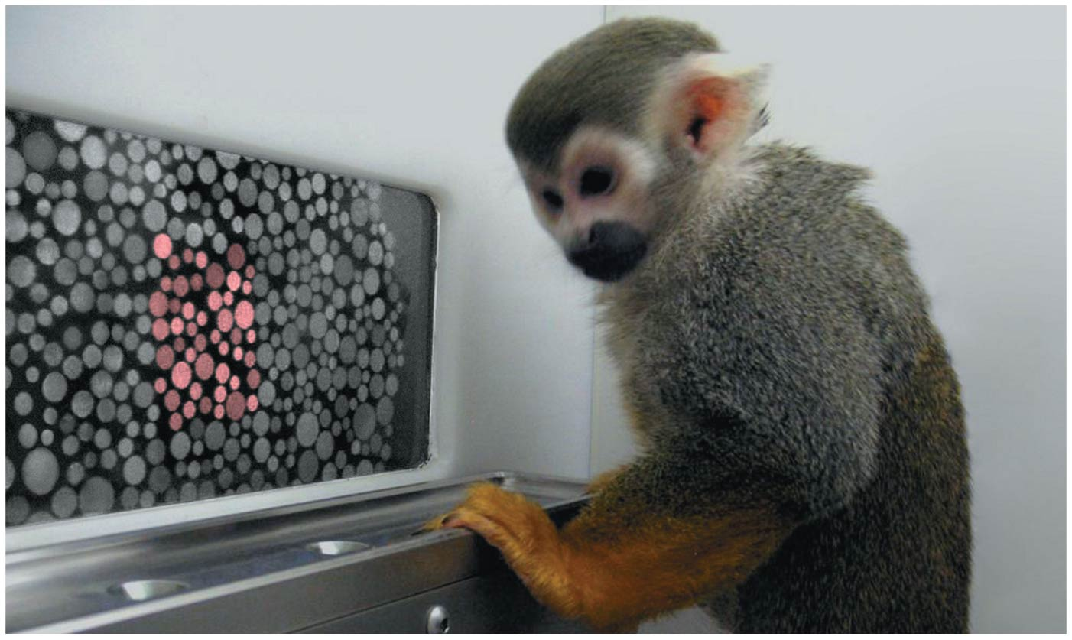
Figure 50.21
Notes:
Figure 50.21 Gene therapy for vision

Slide 72
The Visual Field
The brain processes visual information and controls what information is captured
Focusing occurs by changing the shape of the lens
The fovea is the center of the visual field and contains no rods, but a high density of cones

Slide 73
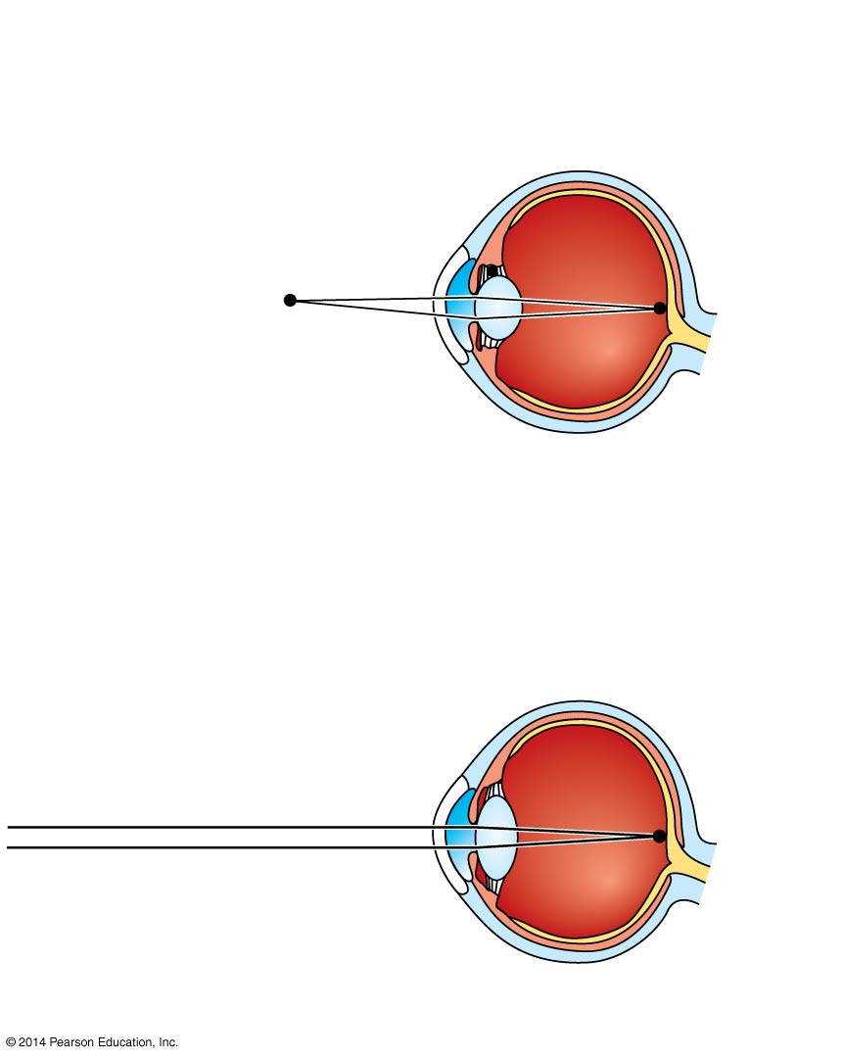
Figure 50.22
(a) Near vision (accommodation)
Ciliary muscles contract, pulling border of choroid toward lens.
Choroid
Suspensory ligaments relax.
Retina
Lens becomes thicker and rounder, focusing on nearby objects.
(b) Distance vision
Ciliary muscles relax, and border of choroid moves away from lens.
Suspensory ligaments pull against lens.
Lens becomes flatter, focusing on distant objects.
Notes:
Figure 50.22 Focusing in the mammalian eye

Slide 74
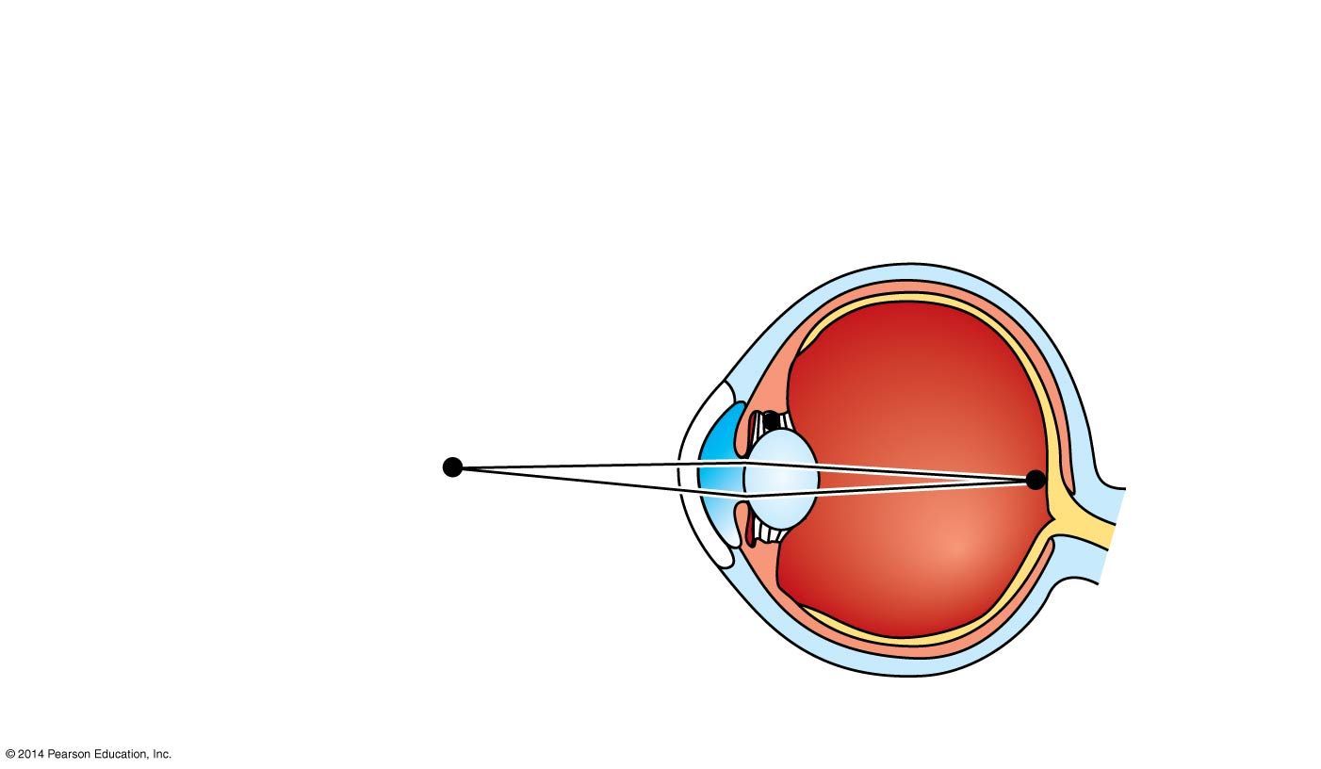
Figure 50.22a
(a) Near vision (accommodation)
Ciliary muscles contract, pulling border of choroid toward lens.
Choroid
Suspensory ligaments relax.
Retina
Lens becomes thicker and rounder, focusing on nearby objects.
Notes:
Figure 50.22a Focusing in the mammalian eye (part 1: near vision)

Slide 75
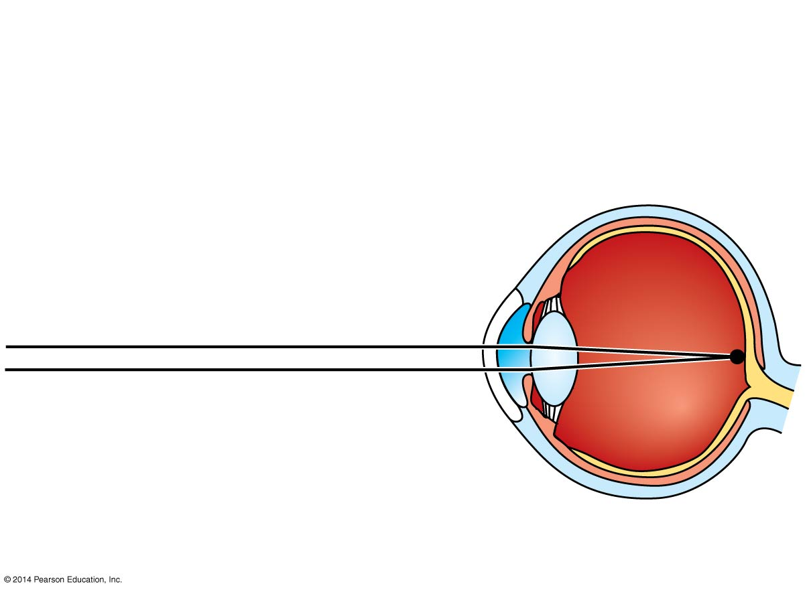
Figure 50.22b
(b) Distance vision
Ciliary muscles relax, and border of choroid moves away from lens.
Suspensory ligaments pull against lens.
Lens becomes flatter, focusing on distant objects.
Notes:
Figure 50.22b Focusing in the mammalian eye (part 2: distance vision)

Slide 76
Concept 50.4: The senses of taste and smell rely on similar sets of sensory receptors
In terrestrial animals
Gustation (taste) is dependent on the detection of chemicals called tastants
Olfaction (smell) is dependent on the detection of odorant molecules
In aquatic animals there is no distinction between taste and smell
Taste receptors of insects are in sensory hairs located on feet and in mouth parts

Slide 77
Taste in Mammals
In humans and other mammals, there are five taste perceptions: sweet, sour, salty, bitter, and umami (elicited by glutamate)
Researchers have identified receptors for all five tastes
Researchers believe that an individual taste cell expresses one receptor type and detects one of the five tastes

Slide 78
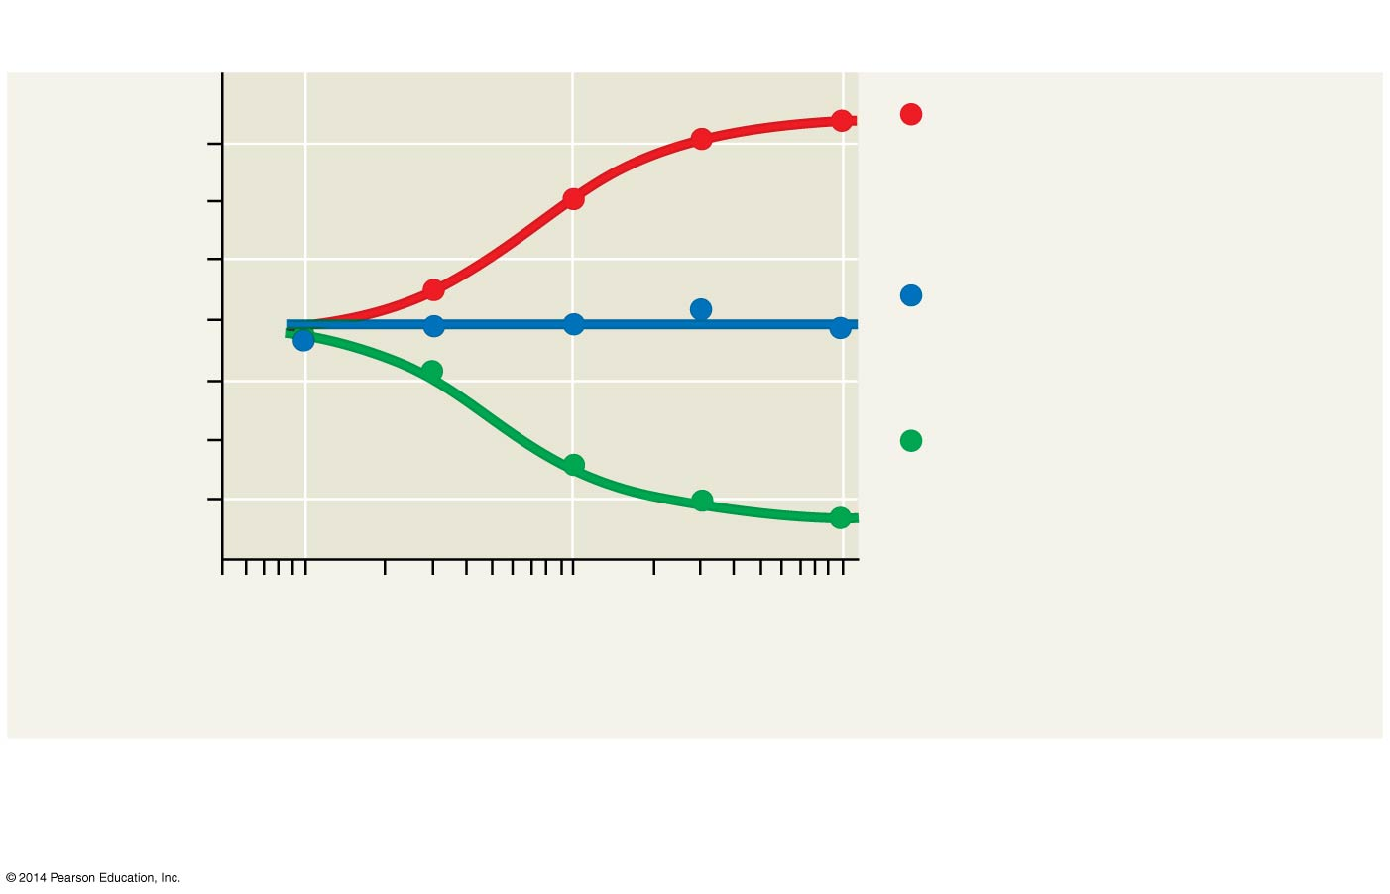
Figure 50.23
Results
PBDG receptor expression in cells for sweet taste
80
60
Relative consumption (%)
No PBDG receptor gene
40
PBDG receptor expression in cells for bitter taste
20
0.1
1
10
Concentration of PBDG (mM ) (log scale)
Relative consumption = (Fluid intake from bottle containing PBDG ÷ Total fluid intake) × 100%
Notes:
Figure 50.23 Inquiry: How do mammals detect different tastes?

Slide 79
Receptor cells for taste in mammals are modified epithelial cells organized into taste buds, located in several areas of the tongue and mouth
Most taste buds are associated with projections called papillae
Any region with taste buds can detect any of the five types of taste

Slide 80
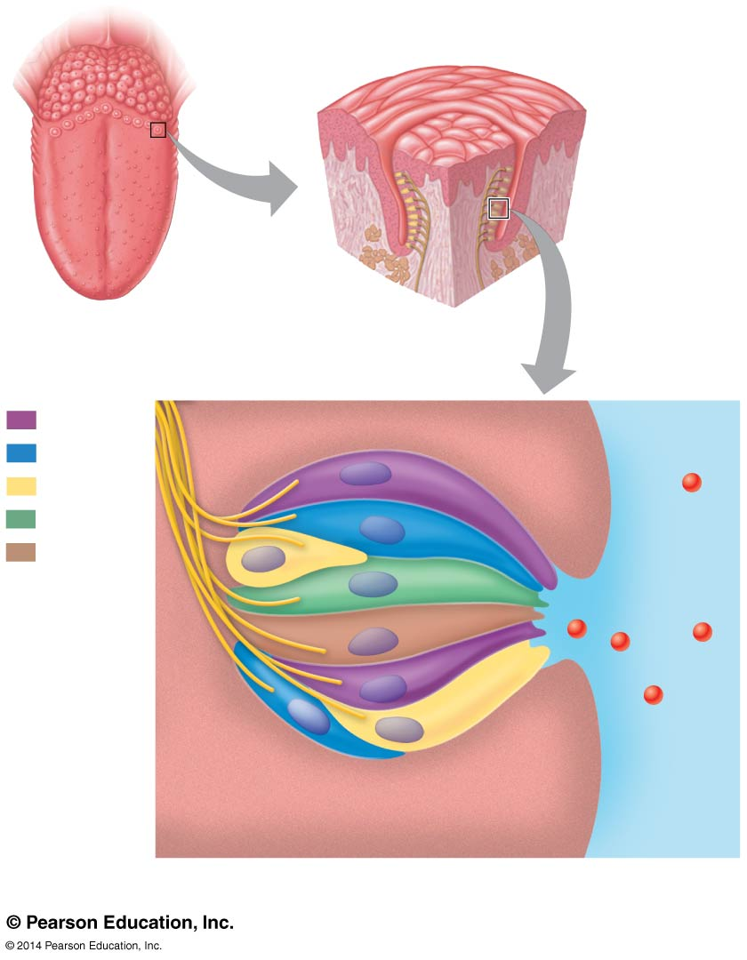
Figure 50.24
Papilla
Papillae
Taste buds
Tongue
(a) The tongue
Sweet
Taste bud
Salty
Sour
Bitter
Umami
Taste pore
Sensory receptor cells
Food molecules
Sensory neuron
(b) A taste bud
Notes:
Figure 50.24 Human taste receptors

Slide 81
Taste receptors are of three types
The sensations of sweet, umami, and bitter require specific G protein-coupled receptors (GPCRs)
The receptor for sour belongs to the TRP family and is similar to the capsaicin and other thermoreceptor proteins
The taste receptor for salt is a sodium channel

Slide 82
Smell in Humans
Olfactory receptor cells are neurons that line the upper portion of the nasal cavity
Binding of odorant molecules to receptors triggers a signal transduction pathway, sending action potentials to the brain
Humans can distinguish thousands of different odors
Although receptors and brain pathways for taste and smell are independent, the two senses do interact

Slide 83
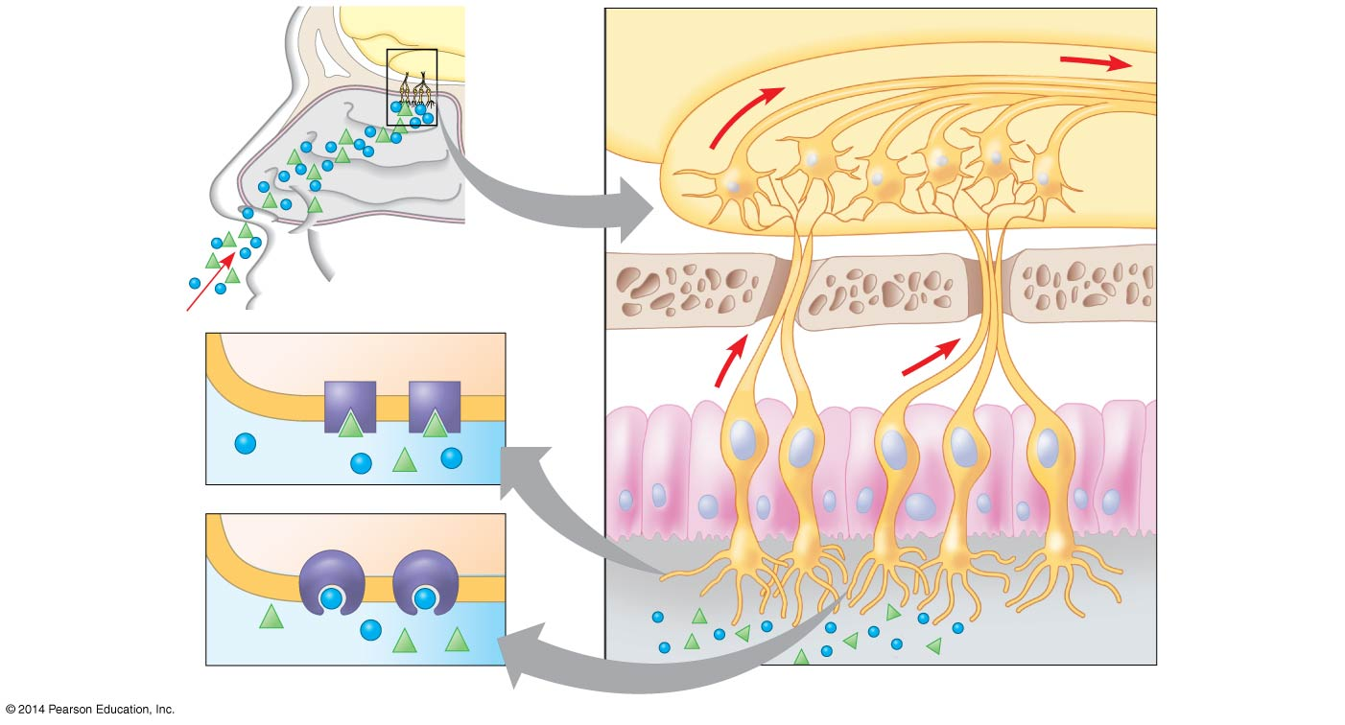
Figure 50.25
Brain
Olfactory bulb of brain
Nasal cavity
Odorants
Bone
Chemo- receptors for different odorants
Epithelial cell
Olfactory receptor cell
Plasma membrane
Cilia
Odorants
Mucus
Notes:
Figure 50.25 Smell in humans

Slide 84
Concept 50.5: The physical interaction of protein filaments is required for muscle function
Muscle activity is a response to input from the nervous system
Muscle cell contraction relies on the interaction between thin filaments, composed mainly of actin, and thick filaments, staggered arrays of myosin

Slide 85
Vertebrate Skeletal Muscle
Vertebrate skeletal muscle moves bones and the body and is characterized by a hierarchy of smaller and smaller units
A skeletal muscle consists of a bundle of long fibers, each a single cell, running parallel to the length of the muscle
Each muscle fiber is itself a bundle of smaller myofibrils arranged longitudinally

Slide 86
Skeletal muscle is also called striated muscle because the regular arrangement of myofilaments creates a pattern of light and dark bands
The functional unit of a muscle is called a sarcomere and is bordered by Z lines, where thin filaments attach

Slide 87
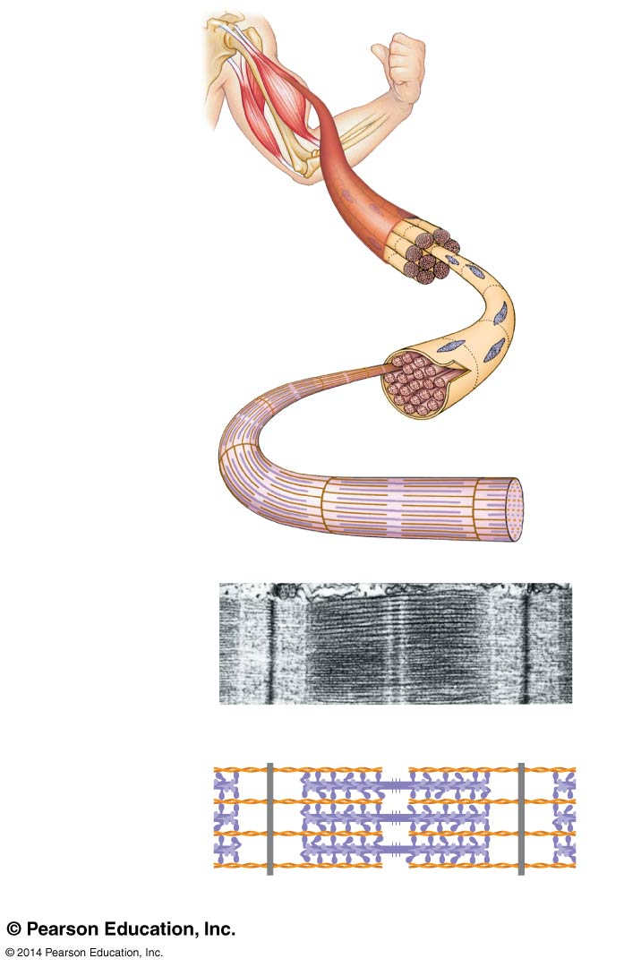
Figure 50.26
Muscle
Bundle of muscle fibers
Nuclei
Single muscle fiber (cell)
Plasma membrane
Myofibril
Z lines
Sarcomere
TEM
M line
0.5 mm
Thick filaments (myosin)
Thin filaments (actin)
Z line
Sarcomere
Z line
Notes:
Figure 50.26 The structure of skeletal muscle

Slide 88
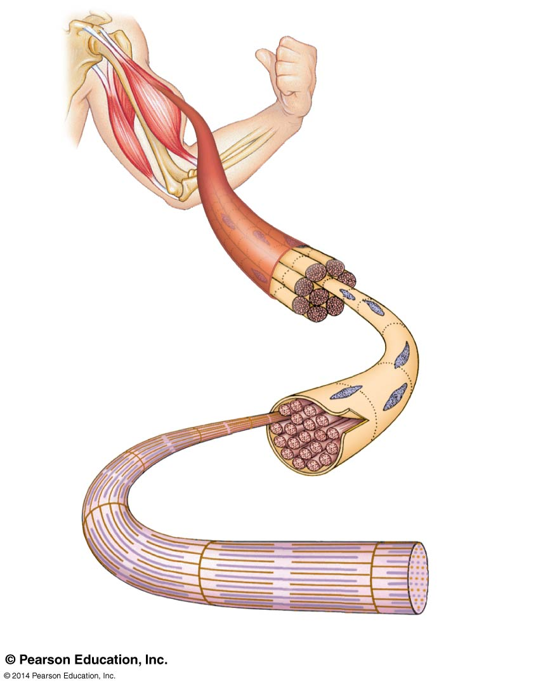
Figure 50.26a
Muscle
Bundle of muscle fibers
Nuclei
Single muscle fiber (cell)
Plasma membrane
Myofibril
Z lines
Sarcomere
Notes:
Figure 50.26a The structure of skeletal muscle (part 1: muscle fibers)

Slide 89
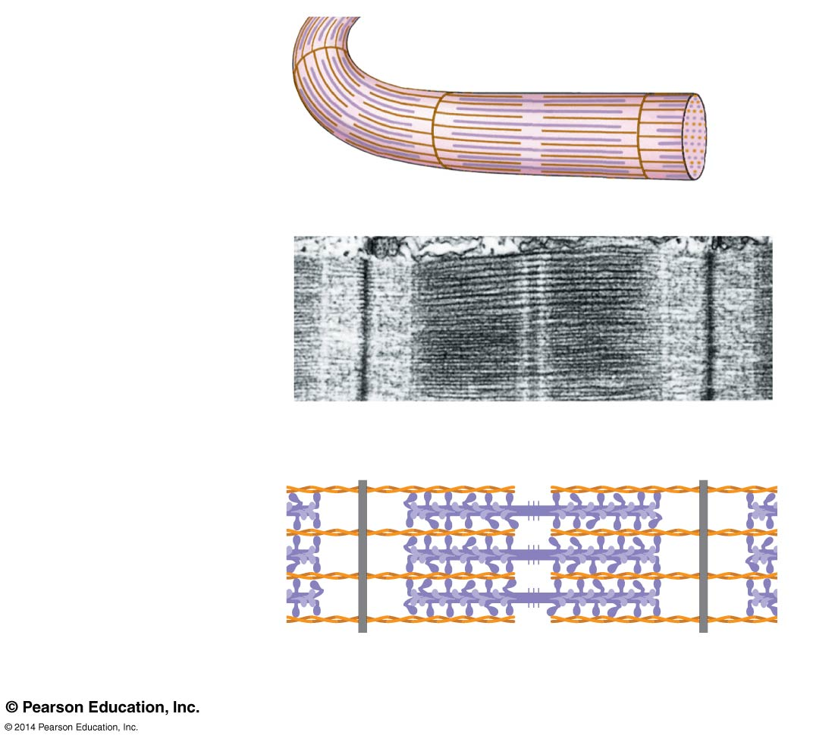
Figure 50.26b
Z lines
Sarcomere
TEM
0.5 mm
M line
Thick filaments (myosin)
Thin filaments (actin)
Z line
Z line
Sarcomere
Notes:
Figure 50.26b The structure of skeletal muscle (part 2: sarcomere)

Slide 90
The Sliding-Filament Model of Muscle Contraction
According to the sliding-filament model, thin and thick filaments slide past each other longitudinally, powered by the myosin molecules

Slide 91
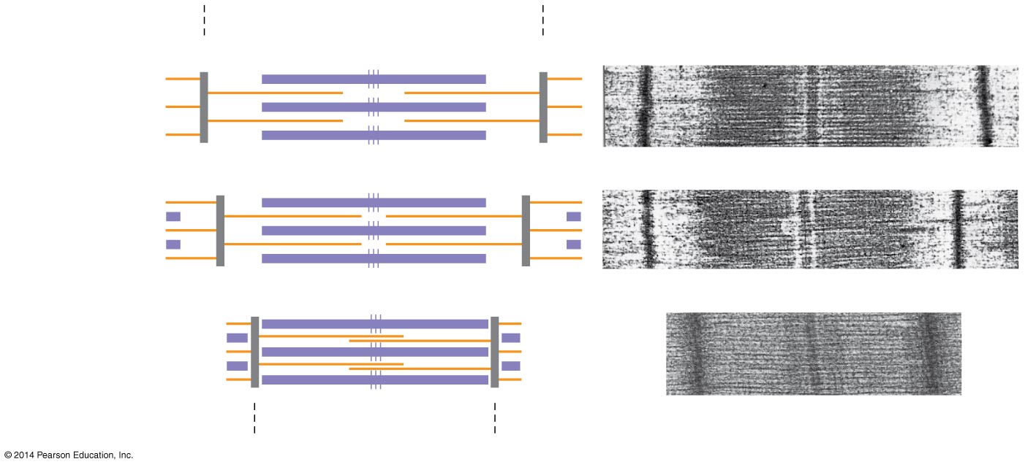
Figure 50.27
Sarcomere
0.5 µm
Z M
Z
Relaxed muscle
Contracting muscle
Fully contracted muscle
Contracted sarcomere
Notes:
Figure 50.27 The sliding-filament model of muscle contraction

Slide 92
The sliding of filaments relies on interaction between actin and myosin
The “head” of a myosin molecule binds to an actin filament, forming a cross-bridge and pulling the thin filament toward the center of the sarcomere
Muscle contraction requires repeated cycles of binding and release

Slide 93
Glycolysis and aerobic respiration generate the ATP needed to sustain muscle contraction

Slide 94
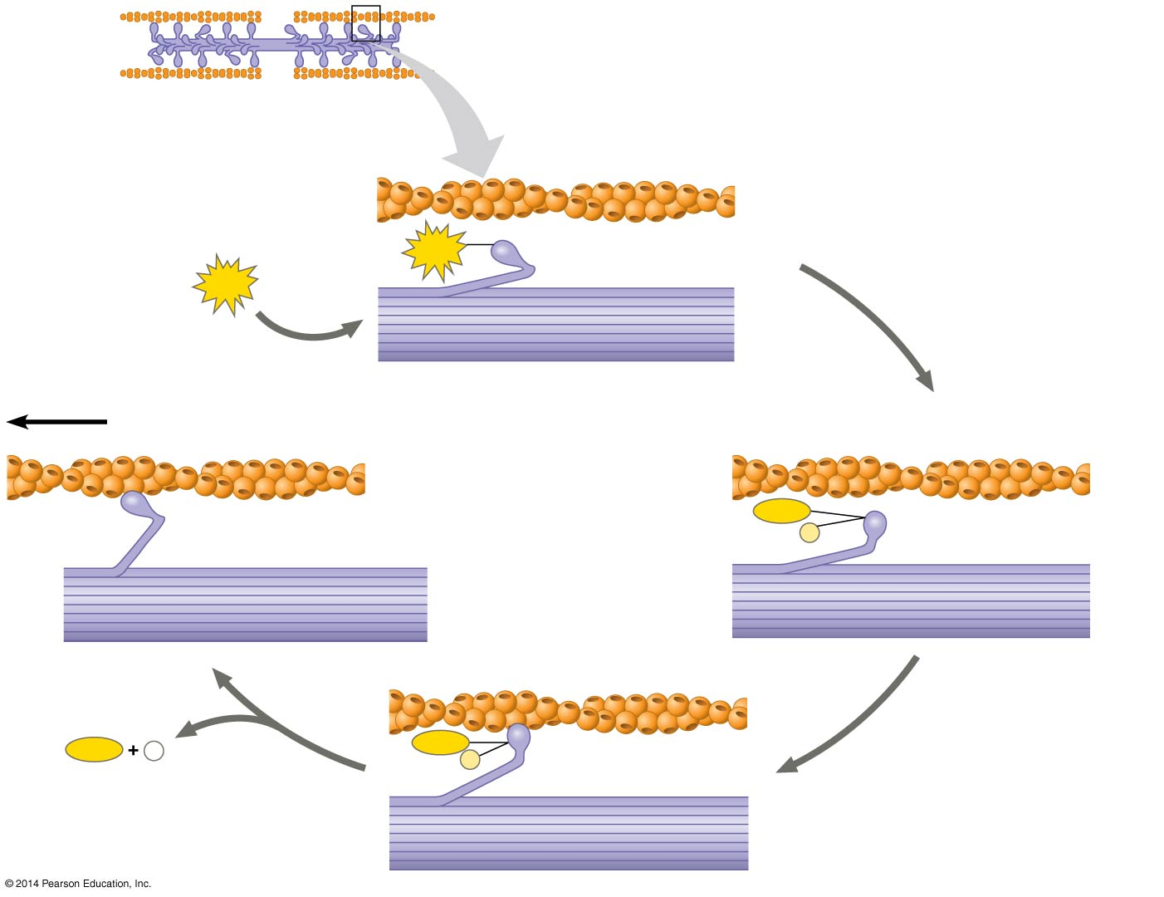
Figure 50.28
Thin filaments
Thick filaments
1
Thin filament
ATP
Myosin head (low- energy configuration
ATP
2
Thick filament
5
Thin filament moves toward center of sarcomere.
Myosin- binding sites
Actin
Myosin head (low- energy configuration)
ADP
Myosin head (high- energy configuration)
P
ADP
+
P _{i}
ADP
P
Cross-bridge
3
4
Notes:
Figure 50.28 Myosin-actin interactions underlying muscle fiber contraction

Slide 95
The Role of Calcium and Regulatory Proteins
The regulatory protein tropomyosin and the troponin complex, a set of additional proteins, bind to actin strands on thin filaments when a muscle fiber is at rest
This prevents actin and myosin from interacting

Slide 96
For a muscle fiber to contract, myosin-binding sites must be uncovered
This occurs when calcium ions (Ca²⁺) bind to the troponin complex and expose the myosin-binding sites
Contraction occurs when the concentration of Ca²⁺ is high; muscle fiber contraction stops when the concentration of Ca²⁺ is low

Slide 97
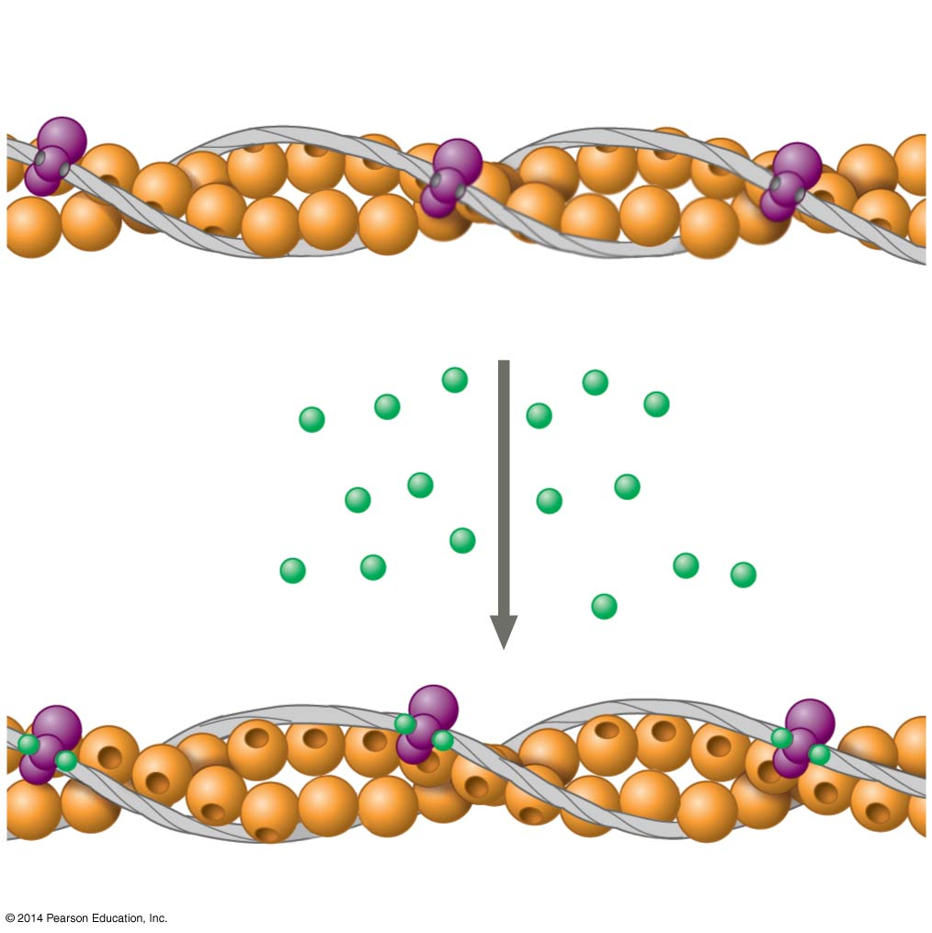
Figure 50.29
Tropomyosin
Ca²⁺-binding sites
Actin
Troponin complex
(a) Myosin-binding sites blocked
Ca²⁺
Myosin- binding site
(b) Myosin-binding sites exposed
Notes:
Figure 50.29 The role of regulatory proteins and calcium in muscle fiber contraction

Slide 98
The stimulus leading to contraction of a muscle fiber is an action potential in a motor neuron that makes a synapse with the muscle fiber
The synaptic terminal of the motor neuron releases the neurotransmitter acetylcholine
Acetylcholine depolarizes the muscle, causing it to produce an action potential

Slide 99
Action potentials travel to the interior of the muscle fiber along transverse (T) tubules
The action potential along T tubules causes the sarcoplasmic reticulum (SR) to release Ca²⁺
The Ca²⁺ binds to the troponin complex on the thin filaments
This binding exposes myosin-binding sites and allows the cross-bridge cycle to proceed

Slide 100
When motor neuron input stops, the muscle cell relaxes
Transport proteins in the SR pump Ca²⁺ out of the cytosol
Regulatory proteins bound to thin filaments shift back to the myosin-binding sites

Slide 101
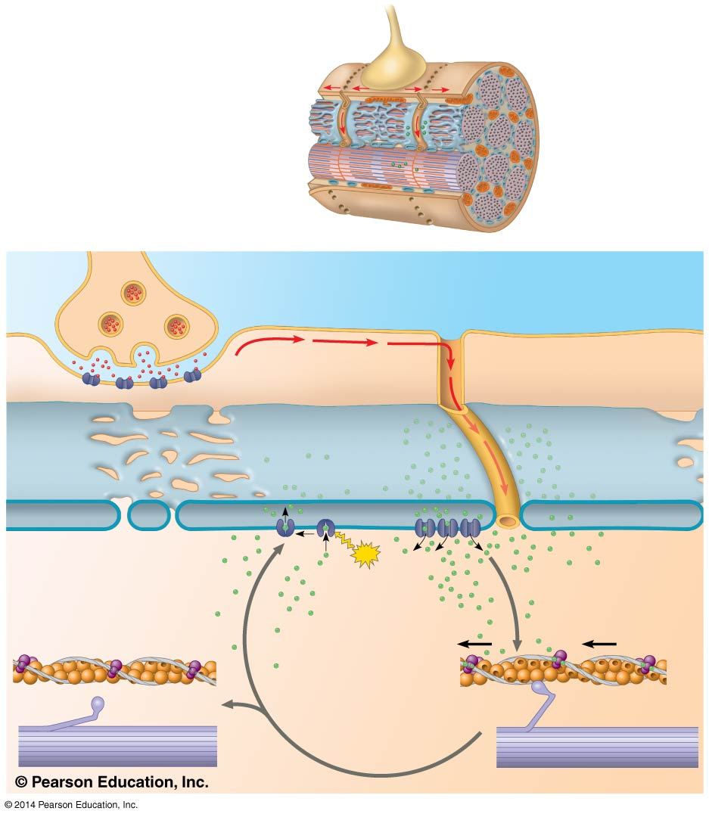
Figure 50.30
Synaptic terminal
Axon of motor neuron
T tubule
Mitochondrion
Sarcoplasmic reticulum (SR)
Myofibril
Plasma membrane of muscle fiber
Ca²⁺ released from SR
Sarcomere
1
Synaptic terminal of motor neuron
Plasma membrane
Synaptic cleft
T tubule
ACh
2
Sarcoplasmic reticulum (SR)
3
Ca²⁺
Ca²⁺ pump
ATP
4
7
CYTOSOL
Ca²⁺
6
5
Notes:
Figure 50.30 Exploring the regulation of skeletal muscle contraction

Slide 102
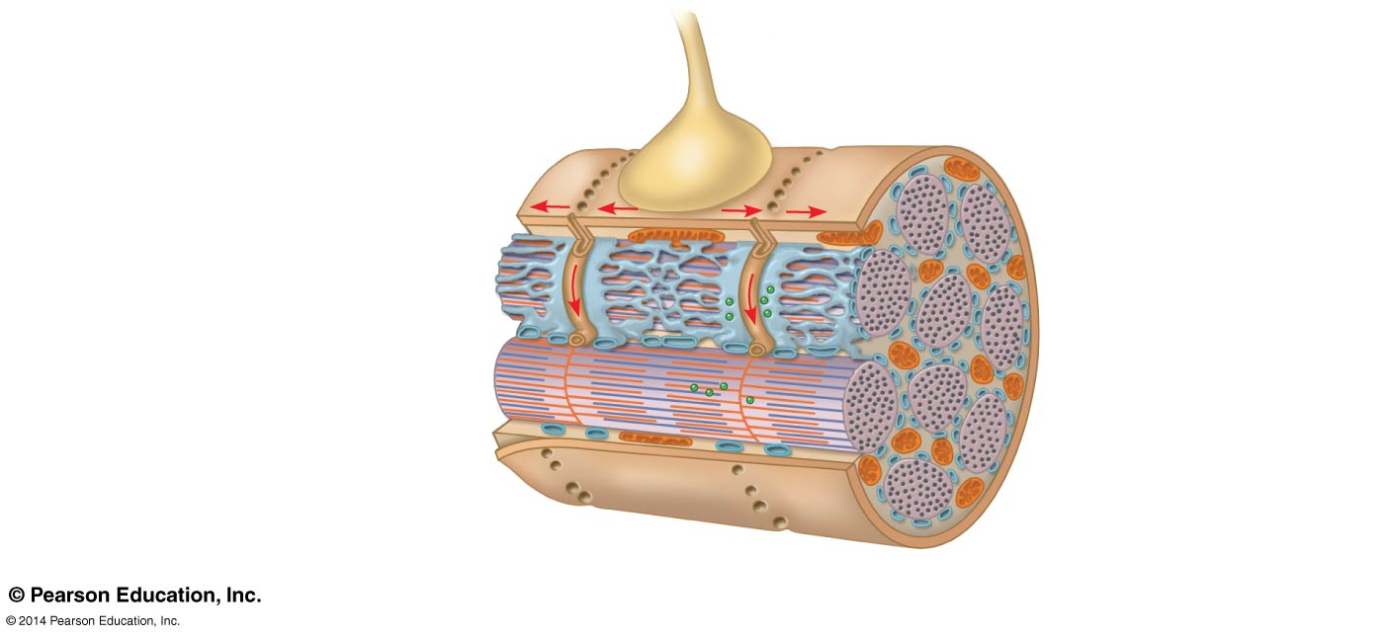
Figure 50.30a
Synaptic terminal
Axon of motor neuron
T tubule
Sarcoplasmic reticulum (SR)
Mitochondrion
Myofibril
Plasma membrane of muscle fiber
Ca²⁺ released from SR
Sarcomere
Notes:
Figure 50.30a Exploring the regulation of skeletal muscle contraction (part 1: detail of synaptic terminal)

Slide 103
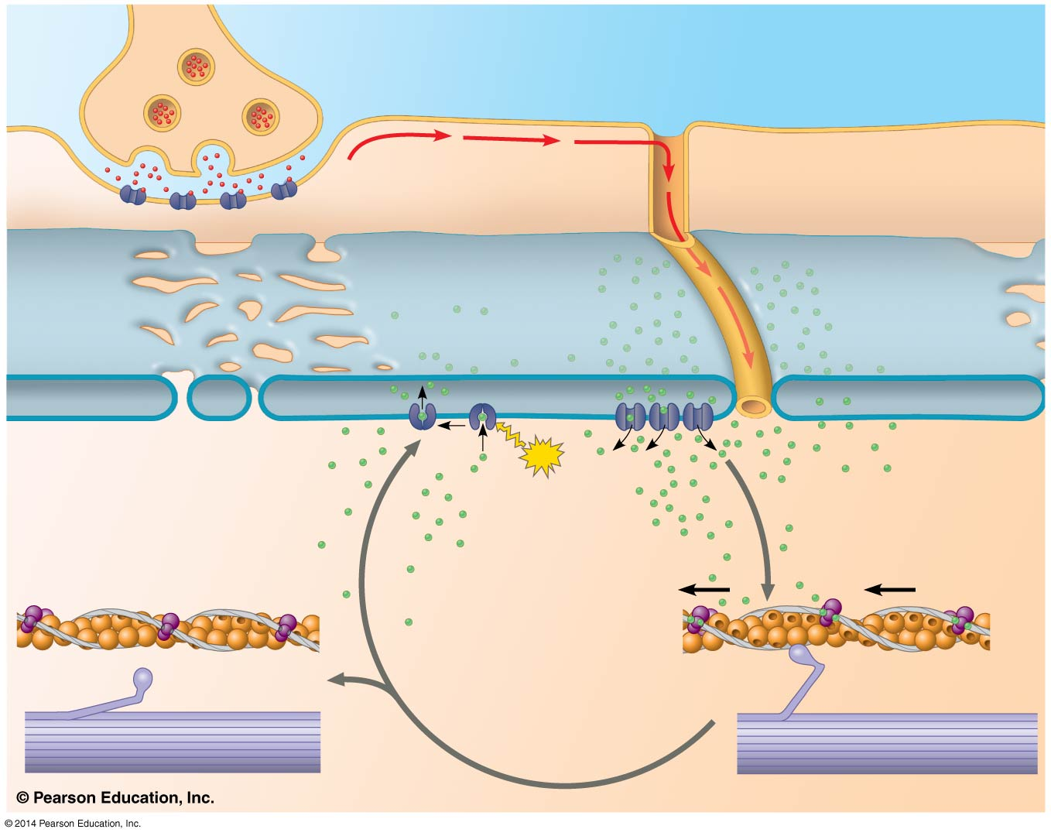
Figure 50.30b
1
Synaptic terminal of motor neuron
Plasma membrane
Synaptic cleft
T tubule
2
Sarcoplasmic reticulum (SR)
ACh
3
Ca²⁺
Ca²⁺ pump
ATP
4
CYTOSOL
7
Ca²⁺
6
5
Notes:
Figure 50.30b Exploring the regulation of skeletal muscle contraction (part 2: steps of process)

Slide 104
Amyotrophic lateral sclerosis (ALS), formerly called Lou Gehrig’s disease, interferes with the excitation of skeletal muscle fibers; this disease is usually fatal
Myasthenia gravis is an autoimmune disease that attacks acetylcholine receptors on muscle fibers; treatments exist for this disease

Slide 105
Nervous Control of Muscle Tension
Contraction of a whole muscle is graded, which means that the extent and strength of its contraction can be voluntarily altered
There are two basic mechanisms by which the nervous system produces graded contractions
Varying the number of fibers that contract
Varying the rate at which fibers are stimulated

Slide 106
In vertebrates, each motor neuron may synapse with multiple muscle fibers, although each fiber is controlled by only one motor neuron
A motor unit consists of a single motor neuron and all the muscle fibers it controls

Slide 107
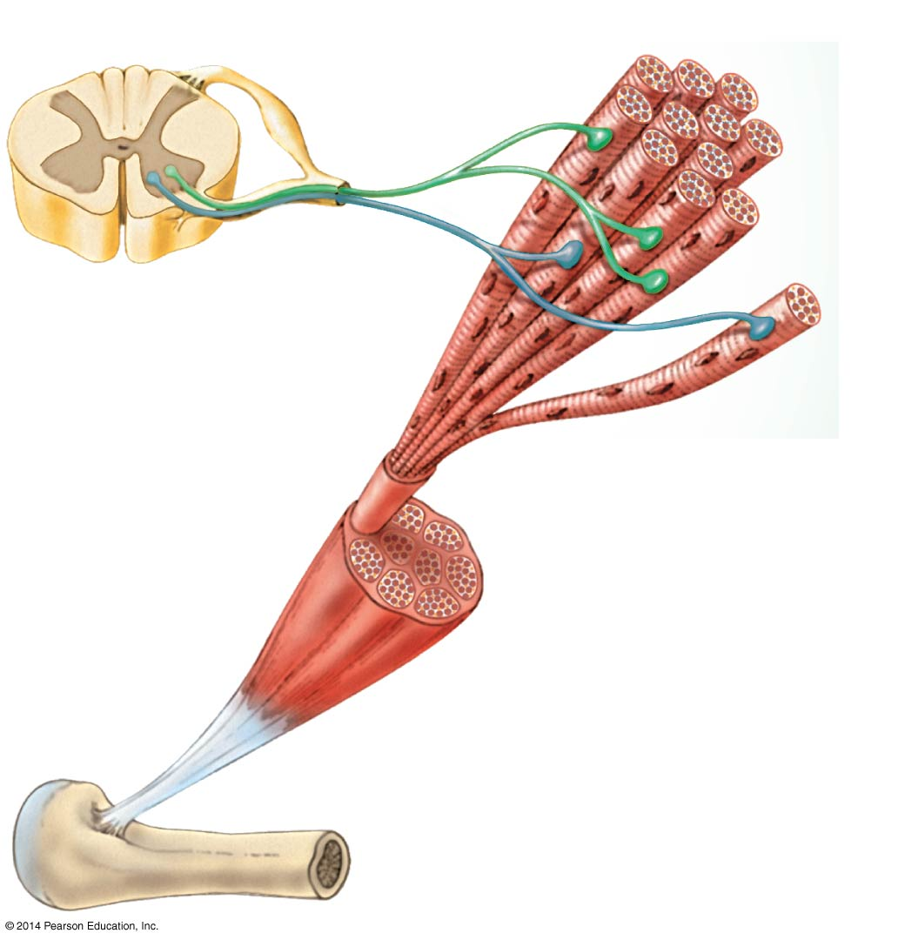
Figure 50.31
Spinal cord
Motor unit 1
Motor unit 2
Synaptic terminals
Nerve
Motor neuron cell body
Motor neuron axon
Muscle
Muscle fibers
Tendon
Notes:
Figure 50.31 Motor units in a vertebrate skeletal muscle

Slide 108
Recruitment of multiple motor neurons results in stronger contractions
A twitch results from a single action potential in a motor neuron
More rapidly delivered action potentials produce a graded contraction by summation

Slide 109
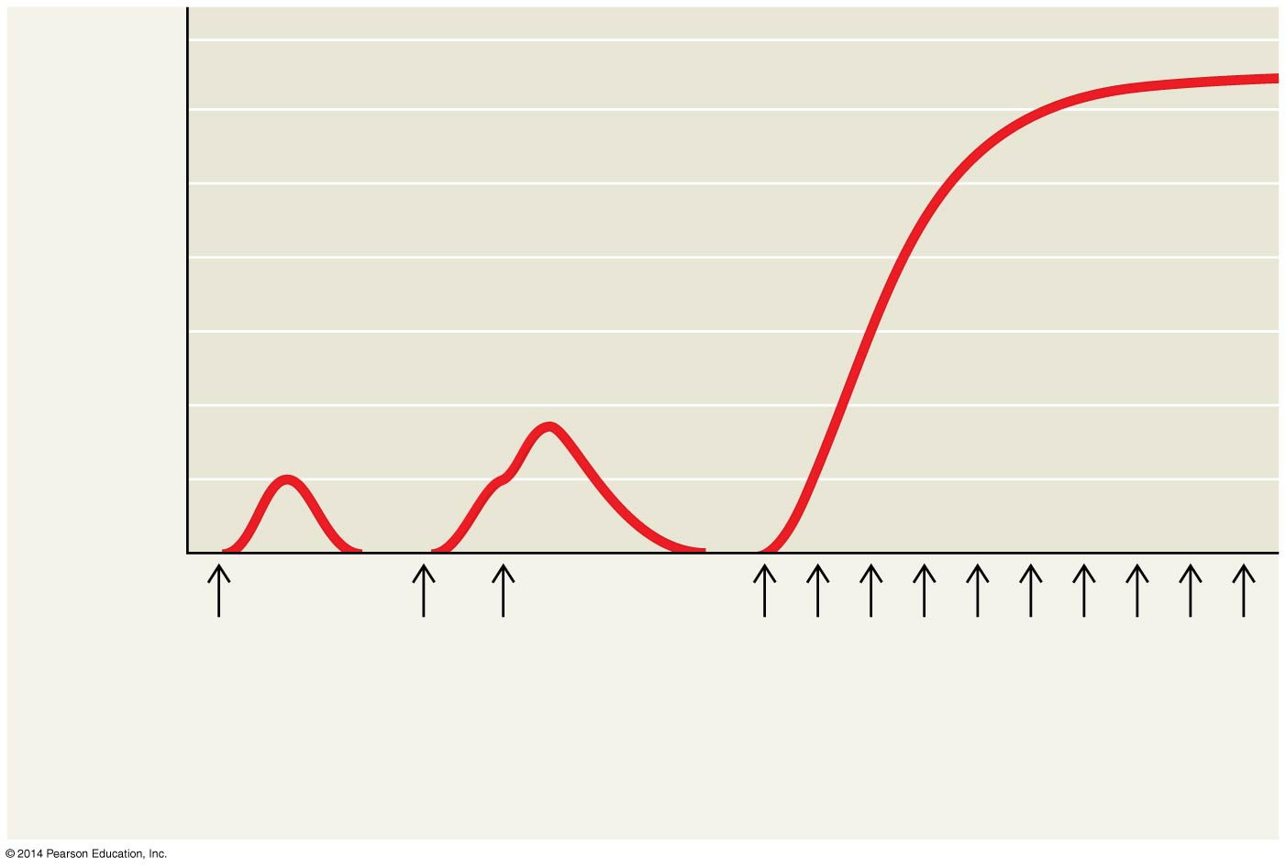
Figure 50.32
Tetanus
Summation of two twitches
Tension
Single twitch
Time
Action potential
Pair of action potentials
Series of action potentials at high frequency
Notes:
Figure 50.32 Summation of twitches

Slide 110
Tetanus is a state of smooth and sustained contraction produced when motor neurons deliver a volley of action potentials

Slide 111
Types of Skeletal Muscle Fibers
There are several distinct types of skeletal muscles, each of which is adapted to a particular function
They are classified by the source of ATP powering the muscle activity or by the speed of muscle contraction

Slide 112
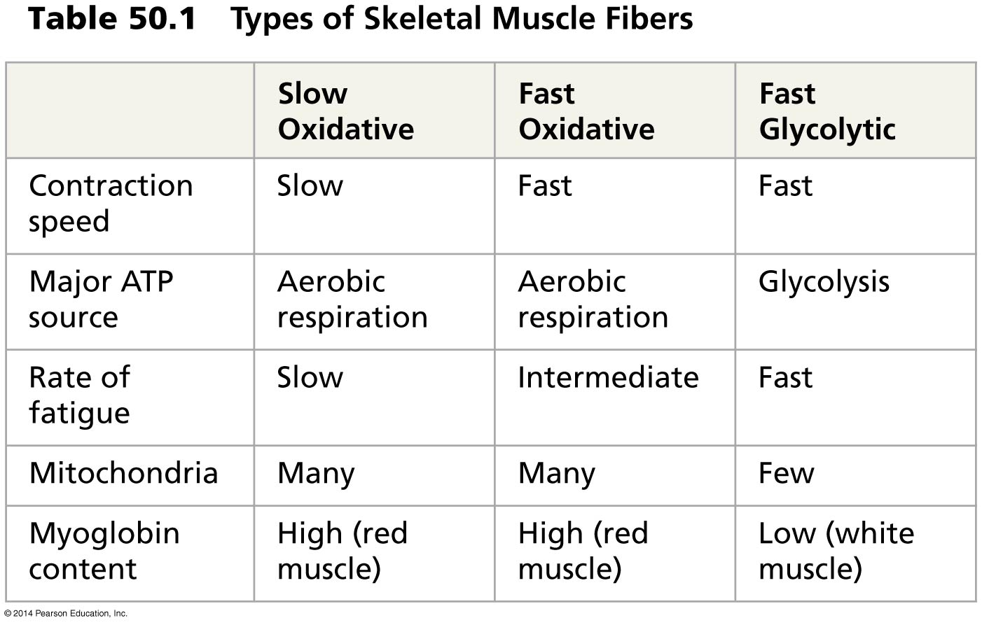
Table 50.1
Notes:
Table 50.1 Types of skeletal muscle fibers

Slide 113
Oxidative and Glycolytic Fibers
Oxidative fibers rely mostly on aerobic respiration to generate ATP
These fibers have many mitochondria, a rich blood supply, and a large amount of myoglobin
Myoglobin is a protein that binds oxygen more tightly than hemoglobin does

Slide 114
Glycolytic fibers use glycolysis as their primary source of ATP
Glycolytic fibers have less myoglobin than oxidative fibers and tire more easily
In poultry and fish, light meat is composed of glycolytic fibers, while dark meat is composed of oxidative fibers

Slide 115
Fast-Twitch and Slow-Twitch Fibers
Slow-twitch fibers contract more slowly but sustain longer contractions
All slow-twitch fibers are oxidative
Fast-twitch fibers contract more rapidly but sustain shorter contractions
Fast-twitch fibers can be either glycolytic or oxidative

Slide 116
Most skeletal muscles contain both slow-twitch and fast-twitch fibers in varying ratios
Some vertebrates have muscles that twitch at rates much faster than human muscles
In producing its characteristic mating call, the male toadfish can contract and relax certain muscles more than 200 times per second

Slide 117
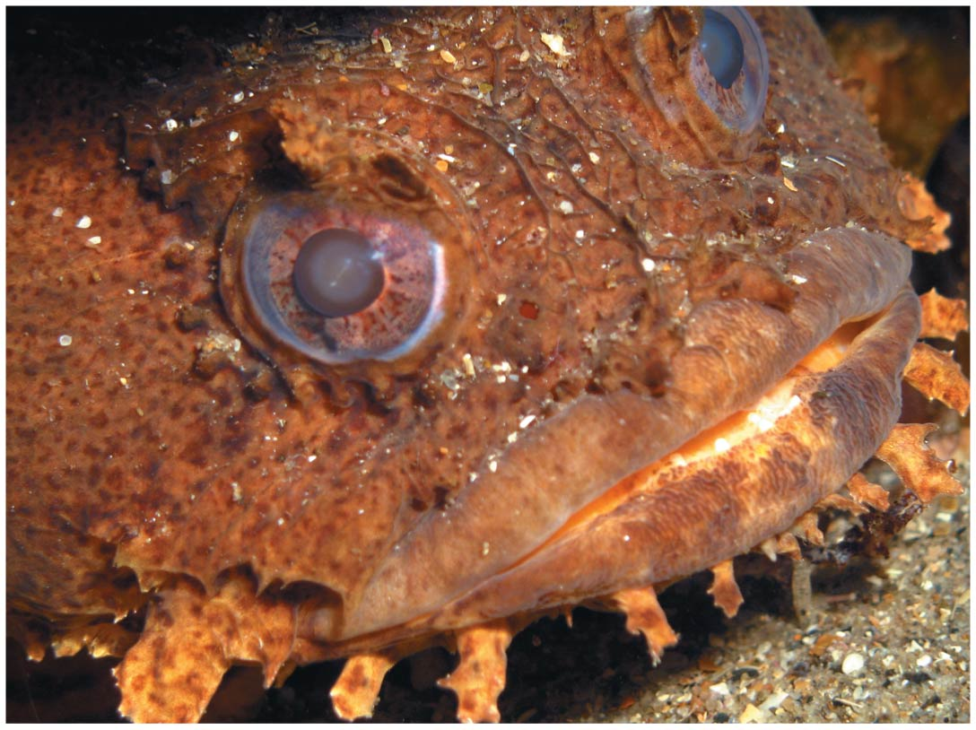
Figure 50.33
Notes:
Figure 50.33 Specialization of skeletal muscles

Slide 118
Other Types of Muscle
In addition to skeletal muscle, vertebrates have cardiac muscle and smooth muscle
Cardiac muscle, found only in the heart, consists of striated cells electrically connected by intercalated disks
Cardiac muscle can generate action potentials without neural input

Slide 119
In smooth muscle, found mainly in walls of hollow organs such as those of the digestive tract, contractions are relatively slow and may be initiated by the muscles themselves
Contractions may also be caused by stimulation from neurons in the autonomic nervous system

Slide 120
Concept 50.6: Skeletal systems transform muscle contraction into locomotion
Skeletal muscles are attached in antagonistic pairs, the actions of which are coordinated by the nervous system
The skeleton provides a rigid structure to which muscles attach
Skeletons function in support, protection, and movement

Slide 121
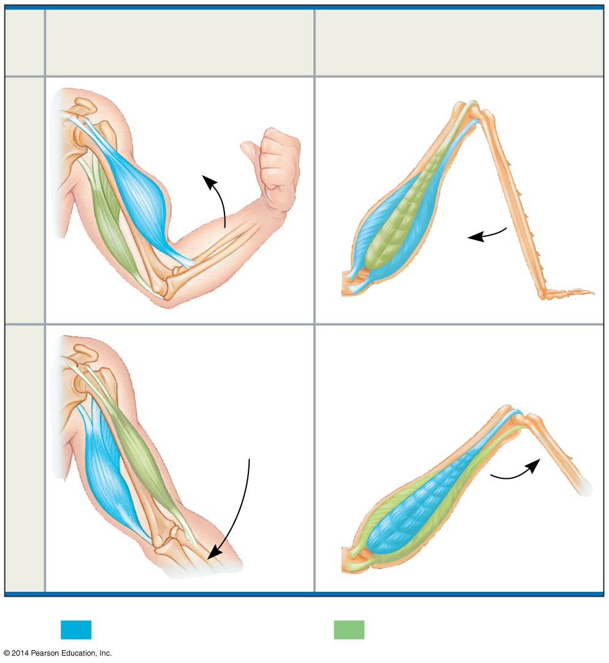
Figure 50.34
Human forearm
(internal skeleton)
Grasshopper tibia (external skeleton)
Biceps
Extensor muscle
Flexion
Flexor muscle
Triceps
Biceps
Extensor muscle
Extension
Flexor muscle
Triceps
Key
Contracting muscle
Relaxing muscle
Notes:
Figure 50.34 The interaction of muscles and skeletons in movement

Slide 122
Types of Skeletal Systems
The three main types of skeletons are
Hydrostatic skeletons (lack hard parts)
Exoskeletons (external hard parts)
Endoskeletons (internal hard parts)

Slide 123
Hydrostatic Skeletons
A hydrostatic skeleton consists of fluid held under pressure in a closed body compartment
This is the main type of skeleton in most cnidarians, flatworms, nematodes, and annelids
Annelids use their hydrostatic skeleton for peristalsis, a type of movement produced by rhythmic waves of muscle contractions from front to back

Slide 124
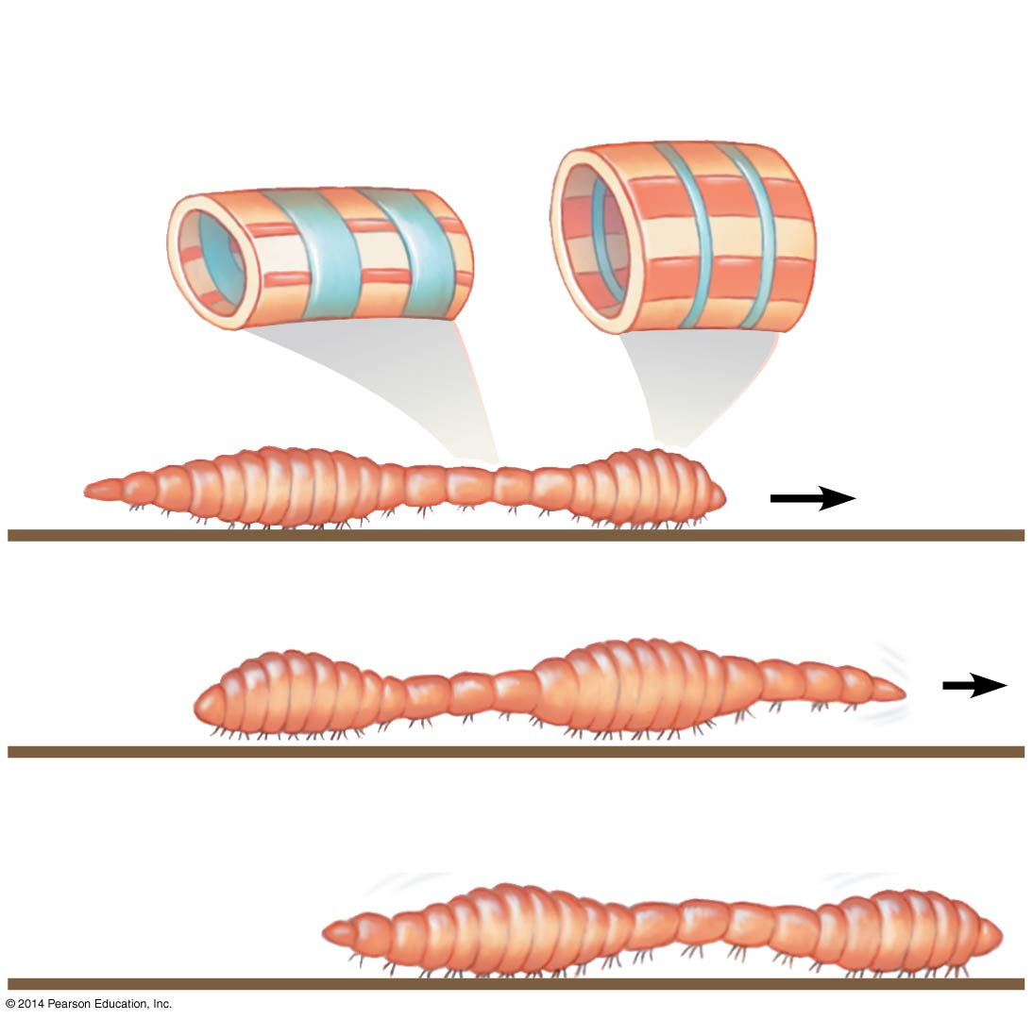
Figure 50.35
Longitudinal muscle relaxed (extended)
Circular muscle contracted
Circular muscle relaxed
Longitudinal muscle contracted
Bristles
Head end
1
Head end
2
Head end
3
Notes:
Figure 50.35 Crawling by peristalsis

Slide 125
Exoskeletons
An exoskeleton is a hard encasement deposited on the surface of an animal
Exoskeletons are found in most molluscs and arthropods
Arthropods have a jointed exoskeleton called a cuticle, which can be both strong and flexible
The polysaccharide chitin is often found in arthropod cuticle

Slide 126
Endoskeletons
An endoskeleton consists of a hard internal skeleton, buried in soft tissue
Endoskeletons are found in organisms ranging from sponges to mammals
A mammalian skeleton has more than 200 bones
Some bones are fused; others are connected at joints by ligaments that allow freedom of movement

Slide 127
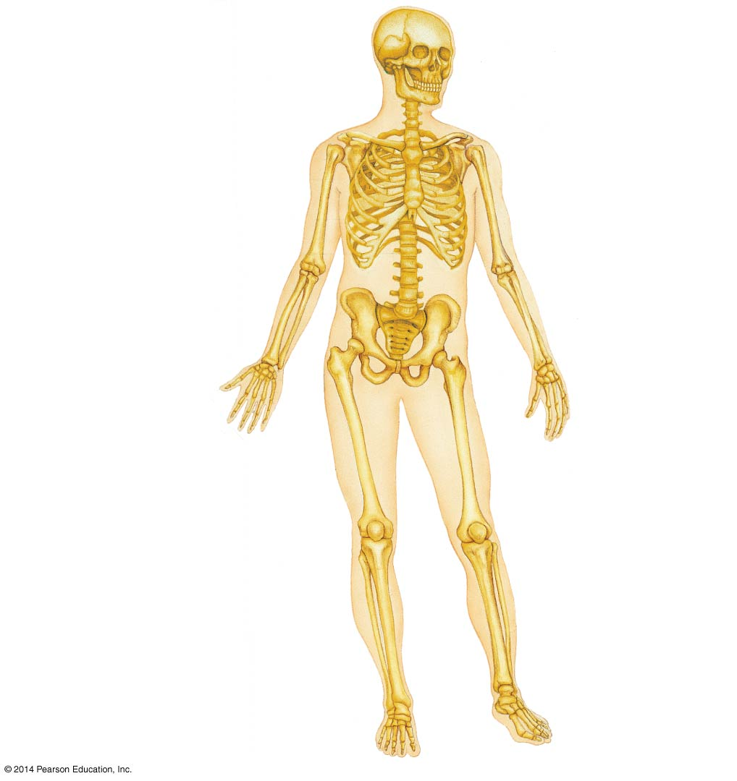
Figure 50.36
Types of joints
Shoulder girdle
Skull
Clavicle
Scapula
Ball-and-socket joint
Sternum
Rib
Humerus
Hinge joint
Vertebra
Pivot joint
Radius
Ulna
Pelvic girdle
Carpals
Phalanges
Metacarpals
Femur
Patella
Tibia
Fibula
Tarsals
Metatarsals
Phalanges
Notes:
Figure 50.36 Bones and joints of the human skeleton

Slide 128
Figure 50.37
Ball-and-socket joint
Hinge joint
Pivot joint
Head of humerus
Humerus
Scapula
Ulna
Ulna
Radius
Notes:
Figure 50.37 Types of joints

Slide 129
The skeletons of small and large animals have different proportions
In mammals and birds, the position of legs relative to the body is very important in determining how much weight the legs can bear

Slide 130
Types of Locomotion
Most animals are capable of locomotion, or active travel from place to place
In locomotion, energy is expended to overcome friction and gravity

Slide 131
Locomotion on Land
Walking, running, hopping, or crawling on land requires an animal to support itself and move against gravity
Diverse adaptations for locomotion on land have evolved in vertebrates

Slide 132
Air poses relatively little resistance for land locomotion
Maintaining balance is a prerequisite to walking, running, or hopping
Crawling poses a different challenge; a crawling animal must exert energy to overcome friction

Slide 133
Swimming
In water, friction is a bigger problem than gravity
Fast swimmers usually have a sleek, torpedo-like shape to minimize friction
Animals swim in diverse ways
Paddling with their legs as oars
Jet propulsion
Undulating their body and tail from side to side, or up and down

Slide 134
Flying
Active flight requires that wings develop enough lift to overcome the downward force of gravity
Many flying animals have adaptations that reduce body mass
For example, birds have no urinary bladder or teeth and have relatively large bones with air-filled regions

Slide 135
Figure 50.UN01a
Flying
Running
10²
10
Energy cost (cal/kg
・
m)
(log scale)
1
Swimming
10⁻¹
10⁻³
1
10³
10⁶
Body mass (g) (log scale)
Notes:
Figure 50.UN01a Skills exercise: interpreting a graph with log scales (part 1)

