Slide 1
1
Environmental Problems, Their Causes, and Sustainability

Slide 2
Core Case Study: A Vision of a More Sustainable World in 2065
A transition in human attitudes toward the environment, and a shift in behavior, can lead to a much better future for the planet in 2065
Sustainability
The capacity of the earth’s natural systems and human cultural systems to survive, flourish, and adapt into the very long-term future

Slide 3
1-1: What Are Some Principles of Sustainability?
Nature has sustained itself for billions of years by using solar energy, biodiversity, and nutrient cycling
Our lives and economies depend on energy from the sun and on natural resources and natural services (natural capital) provided by the earth

Slide 4
1-1: What Are Some Principles of Sustainability? (cont’d.)
Shift toward living more sustainably by:
Applying full-cost pricing, searching for win-win solutions
Committing to preserving the earth’s life-support system for future generations

Slide 5
Environmental Science Is a Study of Connections in Nature
Environment: everything around us
Environmental science: interdisciplinary science connecting information and ideas from:
Natural sciences: ecology, biology, geology, chemistry
Social sciences: geography, politics, economics
Humanities: ethics, philosophy

Slide 6
Three Scientific Principles of Sustainability
Dependence on solar energy
The sun provides warmth and fuels photosynthesis
Biodiversity
Astounding variety and adaptability of natural systems and species
Chemical cycling
From the environment to organisms and then back to the environment

Slide 7
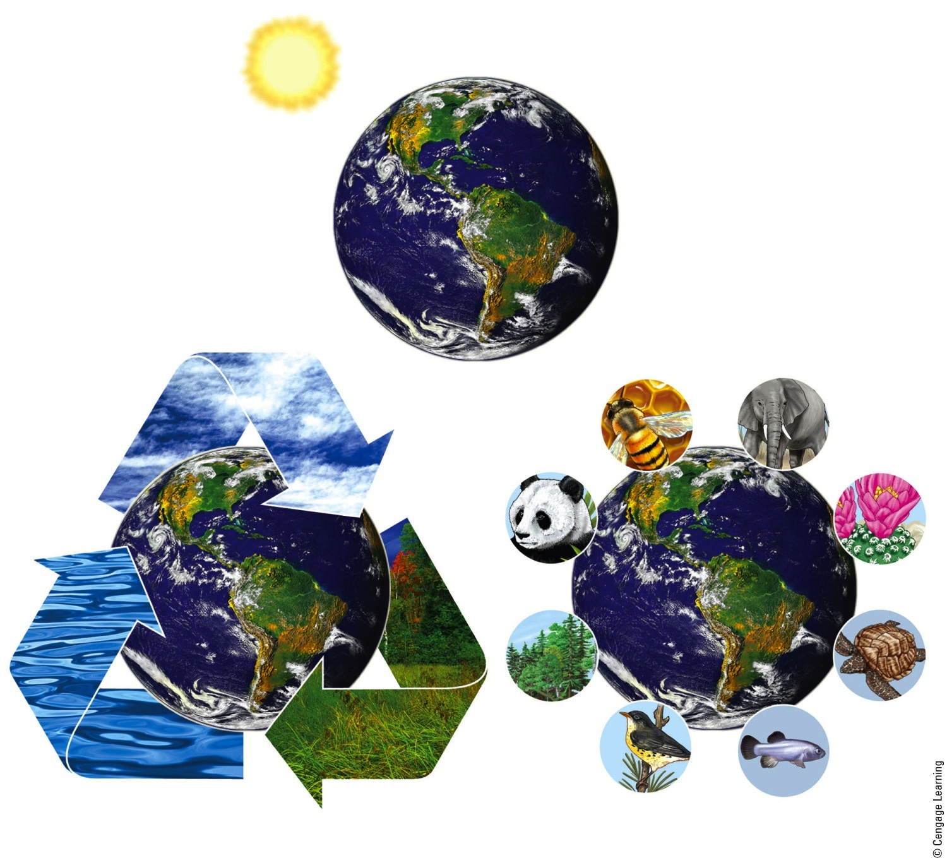
Three Principles of Sustainability
Solar Energy
Chemical Cycling
Biodiversity
Fig. 1-3, p. 8
Notes:
Figure 1.2 Three scientific principles of sustainability based on how nature has sustained a huge variety of life on the earth for 3.5 billion years, despite drastic changes in environmental conditions

Slide 8
Sustainability Has Certain Key Components
Natural capital: keep species alive
Natural resources: useful materials and energy in nature
Natural services: important nature processes such as renewal of air, water, and soil
Ecosystem services
Processes provided by healthy ecosystems

Slide 9
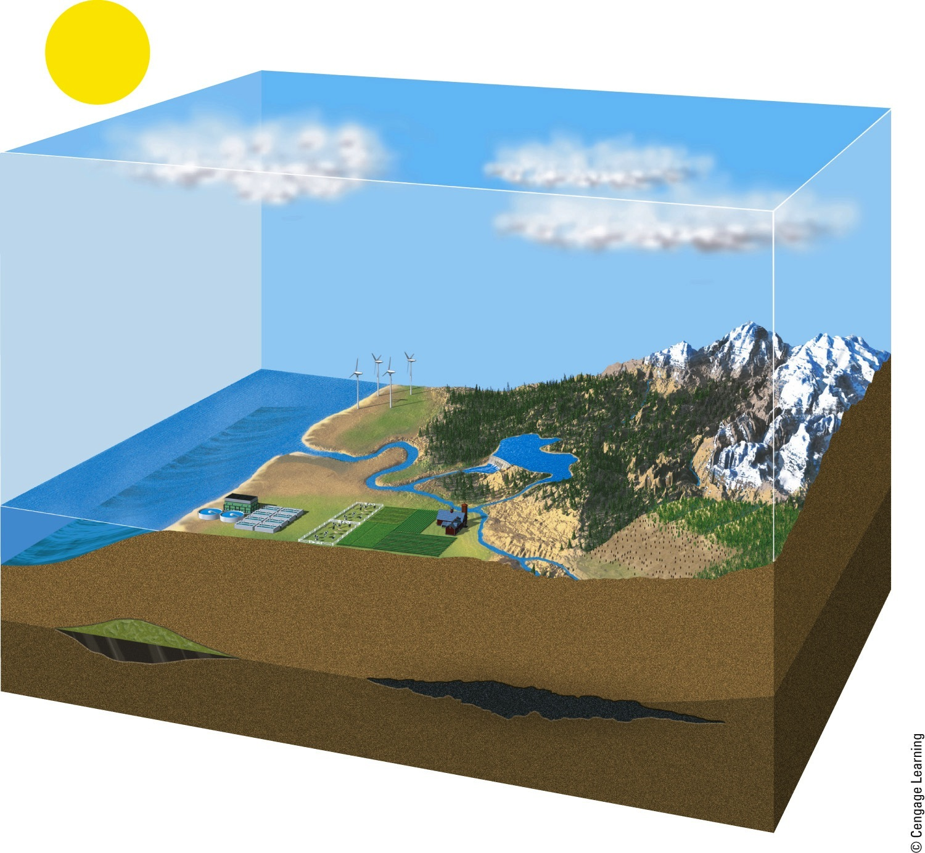
Natural Capital
Natural Capital = Natural Resources + Ecosystem Services
Solar energy
Air
Renewable energy (sun, wind, water flows)
Air purification
Climate control
UV protection
(ozone layer)
Life
(biodiversity)
Water
Population control
Water purification
Pest control
Waste treatment
Nonrenewable minerals
(iron, sand)
Soil
Land
Soil renewal
Food production
Natural gas
Nutrient recycling
Oil
Nonrenewable energy
(fossil fuels)
Coal seam
Natural resources
Ecosystem services
Fig. 1-3, p. 7
Notes:
Figure 1.3 Natural capital consists of natural resources (blue) and natural or ecosystem services (orange) that support and sustain the earth’s life and human economies (Concept 1-1A).

Slide 10
Other Principles of Sustainability Come from the Social Sciences
Full-cost pricing
Include harmful health and environmental costs of goods and services
Win-win solutions
Benefit people and the environment
A responsibility to future generations

Slide 11
Some Resources Are Renewable and Some Are Not
Resources
Anything we obtain from the environment to meet our needs
Some directly available for use: sunlight
Some not directly available for use: petroleum
An inexhaustible resource
Solar energy

Slide 12
Some Resources Are Renewable and Some Are Not (cont’d.)
Renewable resource
Several days to several hundred years to renew
Examples: forests, grasslands, and fertile soil
Sustainable yield
Highest rate at which we can use a renewable resource without reducing available supply
Notes:
12

Slide 13
Some Resources Are Renewable and Some Are Not (cont’d.)
Nonrenewable resources
Finite stock on earth
Energy resources
Metallic mineral resources
Nonmetallic mineral resources

Slide 14
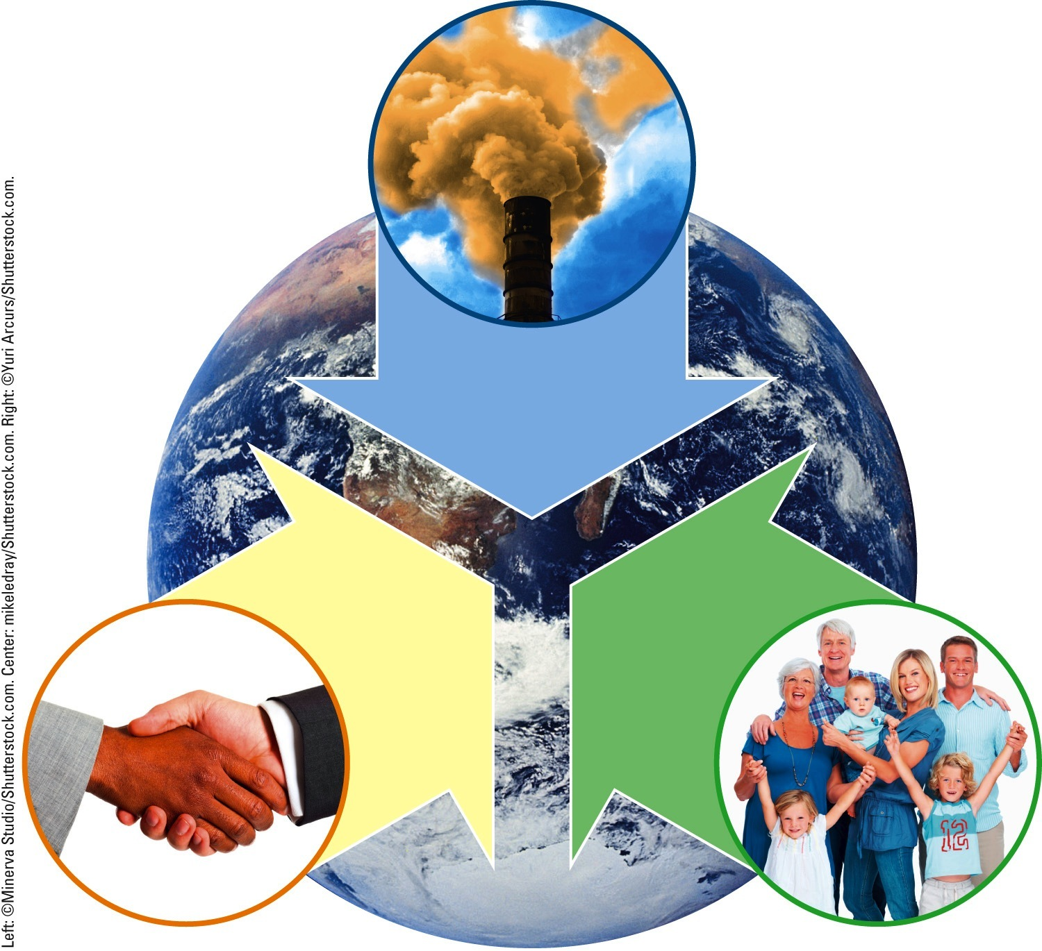
Principles of Sustainability
ECONOMICS
Full-cost pricing
POLITICS
Win-win results
ETHICS
Responsibility to
future generations
Fig. 1-5, p. 9
Notes:
Figure 1.5 Three social science principles of sustainability can help us make a transition to a more environmentally and economically sustainable future.

Slide 15
Countries Differ in their Resource Use and Environmental Impact
More-developed countries
Industrialized nations with high average income
17% of the world’s population
Less-developed countries
83% of the world’s population

Slide 16
1-2: How Are Our Ecological Footprints Affecting the Earth?
As our ecological footprints grow, we are depleting and degrading more of the earth’s natural capital

Slide 17
We Are Living Unsustainably
Environmental degradation: wasting, depleting, and degrading the earth’s natural capital
Happening at an accelerating rate

Slide 18
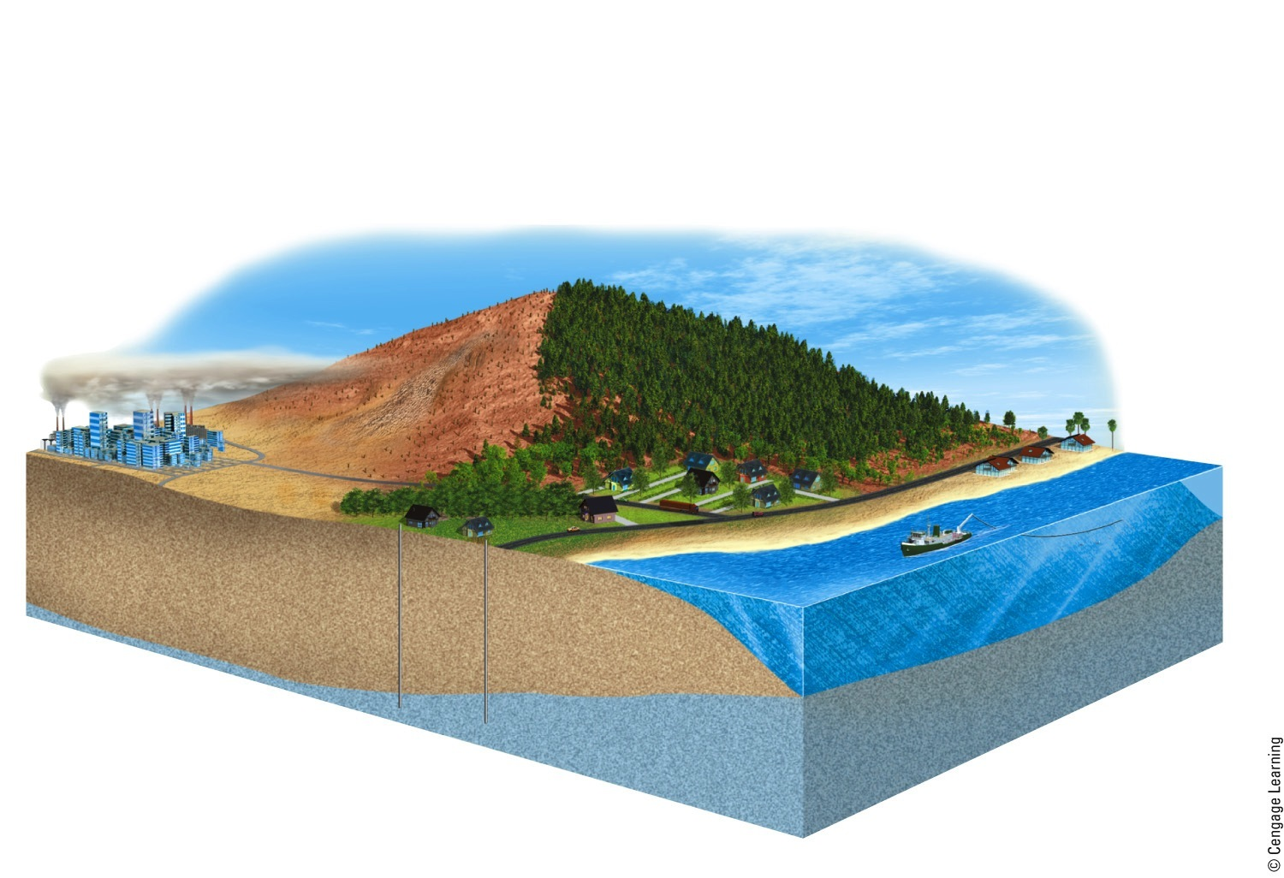
Natural Capital Degradation
Degradation of Normally Renewable Natural Resources
Shrinking forests
Climate change
Decreased wildlife habitats
Air pollution
Species extinction
Soil erosion
Water pollution
Declining ocean fisheries
Aquifer depletion
Fig. 1-7, p. 11
Notes:
Figure 1.7 Natural capital degradation: Examples of the degradation of normally renewable natural resources and natural services (Figure 1-3) in parts of the world, mostly as a result of growing populations and rising rates of resource use per person.

Slide 19
Pollution Comes from a Number of Sources
Sources of pollution
Point sources
Single, identifiable source
Nonpoint sources
Disbursed and difficult to identify
What are some strategies for pollution cleanup and prevention?

Slide 20
Point-Source Air Pollution
Fig. 1-8, p. 11
Notes:
Figure 1-8: Point-source air pollution from smokestacks in a coal burning industrial plant.

Slide 21
Nonpoint Source Water Pollution
Fig. 1-9, p. 11
Notes:
Figure 1-9: The trash in this river came from a large area of land and is an example of nonpoint water pollution.

Slide 22
The Tragedy of the Commons: Degrading Commonly Shared Renewable Resources
Types of resources
Open access renewable resources
Shared resources
Tragedy of the commons
Common property and open-access renewable resources are degraded from overuse
What are some solutions?

Slide 23
Ecological Footprints: A Model of Unsustainable Use of Resources
Ecological footprint
Amount of biologically productive land and water needed to provide a person or area with renewable resources, and to recycle wastes and pollution
Per capita ecological footprint
Ecological deficit
Footprint is larger than biological capacity for replenishment

Slide 24
Natural Capital Use and Degradation
Fig. 1-11, p. 13
Notes:
Figure 1-11: Natural capital use and degradation. These graphs show the total and per capita ecological footprints of selected countries.

Slide 25
IPAT is Another Environmental Impact Model
I = P x A x T
I = Environmental impact
P = Population
A = Affluence
T = Technology

Slide 26
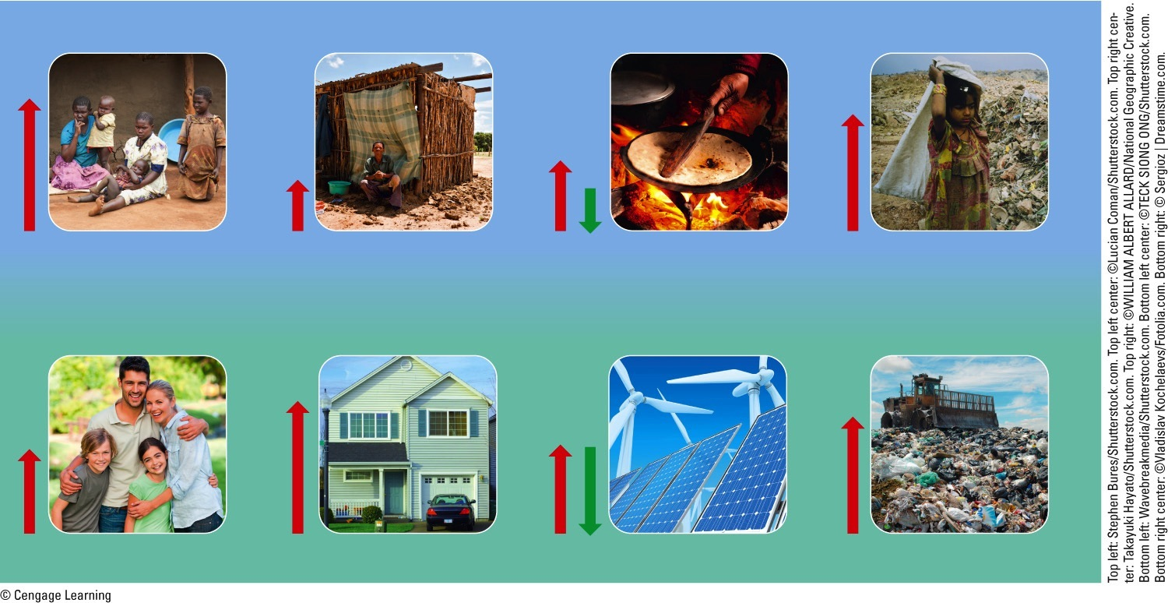
IPAT
Less-Developed Countries
Consumption per person (affluence, A)
Technological impact per unit of consumption (T)
Environmental impact of population (I)
Population (P)
X
X
=
More-Developed Countries
Fig. 1-14, p. 17
Notes:
Figure 1.14 This simple model demonstrates how three factors—population size, affluence (resource use per person), and technology—help to determine the environmental impacts of populations in lessdeveloped countries (top) and more-developed countries (bottom). Red arrows show generalized harmful impacts and green arrows show generalized beneficial impacts.

Slide 27
Case Study: China’s Growing Number of Affluent Consumers
World’s largest population
Second largest economy
Two-thirds of the most polluted cities are in China
Projections for next decade
Largest consumer and producer of cars

Slide 28
Cultural Changes Can Grow or Shrink Our Ecological Footprints
Humans were hunters and gatherers 12,000 years ago
Three major cultural events
Agricultural revolution
Industrial-medical revolution
Information-globalization revolution
Current need for a sustainability revolution

Slide 29
1-3: Why Do We Have Environmental Problems?
Major causes of environmental problems
Population growth, unsustainable resource use, poverty, avoidance of full-cost pricing, and increasing isolation from nature
Our environmental worldviews play a key role in determining whether we live unsustainably or more sustainably

Slide 30
Experts Have Identified Several Causes of Environmental Problems
Population growth
Wasteful and unsustainable resource use
Poverty
Failure to include the harmful environmental costs of goods and services in market prices
Increasing isolation from nature

Slide 31
Causes of Environmental Problems
Causes of Environmental Problems
Excluding
environmental costs from market prices
Increasing
isolation
from nature
Population
growth
Unsustainable
resource use
Poverty
Fig. 1-15, p. 16
Notes:
Figure 1-15: Environmental and social scientists have identified four basic causes of the environmental problems we face (Concept 1-3). Question: For each of these causes, what are two environmental problems that result?

Slide 32
The Human Population is Growing at a Rapid Rate
Exponential growth
Population increases at a fixed percentage per unit time
No one knows how many people the earth can support indefinitely

Slide 33
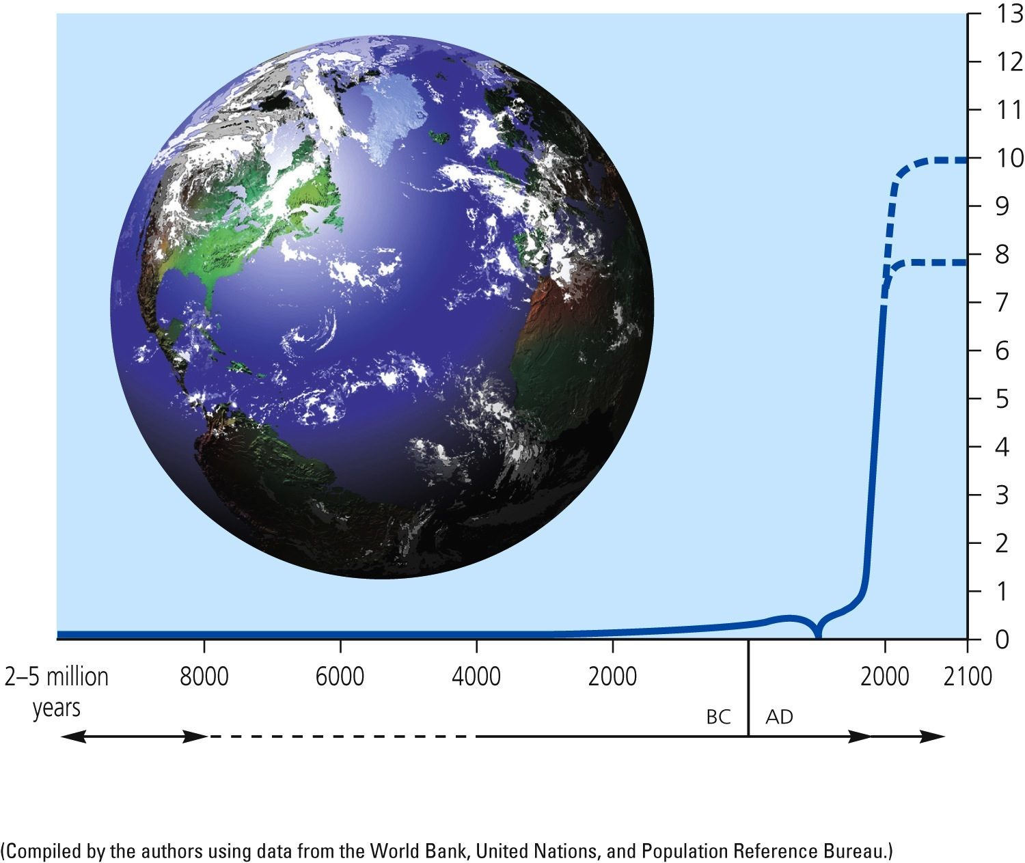
Exponential Growth of Human Population
?
Billions of people
Industrial revolution
Black Death—the Plague
Time
Hunting and gathering
Agricultural revolution
Industrial revolution
Fig. 1-16, p. 17
Notes:
Figure 1.16 Exponential growth: The J-shaped Industrial revolution Black Death—the Plague curve represents past exponential world population growth, with projections to 2100 showing possible population stabilization as the J-shaped curve of growth changes to an S-shaped curve. (This figure is not to scale.)

Slide 34
Affluence Has Harmful and Beneficial Environmental Effects
Harmful environmental impact due to:
High levels of consumption
High levels of pollution
Unnecessary waste of resources
Affluence can provide funding for developing technologies to reduce:
Pollution
Environmental degradation
Resource waste

Slide 35
Poverty Has Harmful Environmental and Health Effects
Unable to fulfill basic needs
Adequate food, water, shelter, health care, and education
Working to survive

Slide 36
Prices of Goods and Services Do Not Include the Harmful Environmental Costs
Companies do not pay the environmental cost of resource use
Goods and services do not include the harmful environmental costs
Companies receive tax breaks and subsidies

Slide 37
We are Increasingly Isolated from Nature
Increasing populations in urban areas
Nature deficit disorder
Not having enough contact with nature

Slide 38
People Have Different Views on Environmental Problems/Solutions
Environmental ethics: What is right and wrong with how we treat the environment?
Planetary management worldview
We are separate from and in charge of nature
Stewardship worldview
Manage earth for our benefit with ethical responsibility to be stewards
Environmental wisdom worldview
We are part of nature and must engage in sustainable use

Slide 39
1-4: What Is an Environmentally Sustainable Society?
Living sustainably
Live off the earth’s natural income without depleting or degrading the natural capital that supplies it

Slide 40
Environmentally Sustainable Societies
Environmentally sustainable society
Meets current needs in a just and equitable manner without compromising future generations’ ability to meet their needs
Natural income
Renewable resources

Slide 41
A More Sustainable Future is Possible
Overall attitude that combines environmental wisdom with compassion for all life
Social scientists suggest it only takes 5-10% of the population to bring about major social change
Significant social change can occur more quickly than we often think

Slide 42
Three Big Ideas
A more sustainable future will require that we:
Rely more on energy from the sun and other renewable energy sources
Protect biodiversity through the preservation of natural capital
Avoid disrupting the earth’s vitally important chemical cycles

Slide 43
Three Big Ideas (cont’d.)
A major goal for becoming more sustainable is full-cost pricing—the inclusion of harmful environmental and health costs in the market prices of goods and services

Slide 44
Three Big Ideas (cont’d.)
We will benefit ourselves and future generations if we commit ourselves to:
Finding win-win-win solutions to our problems
Leaving the planet’s life-support system in at least as good a shape as what we now enjoy

Slide 45
Tying It All Together
The key to environmental solutions
Apply the principles of sustainability to the design of our economic and social systems, and individual lifestyles
The 21st century’s transition generation will decide the path which humanity takes

