Slide 1
10
Sustaining Terrestrial Biodiversity: Saving Ecosystems and Ecosystem Services

Slide 2
Core Case Study: Costa Rica – A Global Conservation Leader
Suffered widespread deforestation
Still harbors great biodiversity
Microclimates provide variety of habitats
More than 25% of its land is nature reserves and national parks
Government pays landowners to restore forests

Slide 3
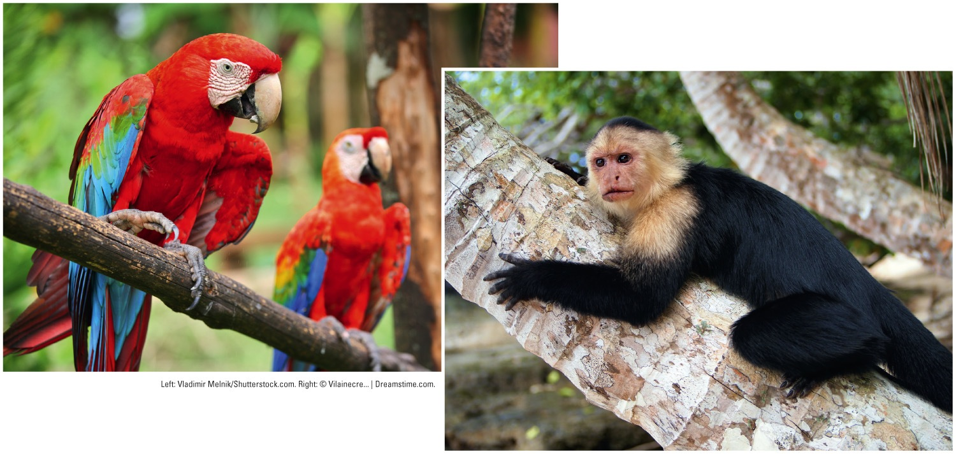
Fig. 10-1, p. 218
Notes:
Figure 10-1: Costa Rica is one of the world’s most biologically rich places. Two of its half-million species are the scarlet macaw parrot (left) and the white-faced capuchin monkey (right).

Slide 4
10-1 What Are the Major Threats to Forest Ecosystems?
Forest ecosystems provide ecosystem services far greater in value than the value of raw materials obtained from forests
Chief threats to forest ecosystems
Unsustainable cutting and burning of forests
Diseases and insects
Projected climate change

Slide 5
Forests Vary in Their Age, Make-Up, and Origins
Old-growth or primary forest (about 36%)
Uncut not disturbed for several hundred years
Reservoirs of biodiversity
Second-growth forest
Secondary ecological succession
Tree plantation (tree farm, commercial forest)
May supply most industrial wood in the future

Slide 6
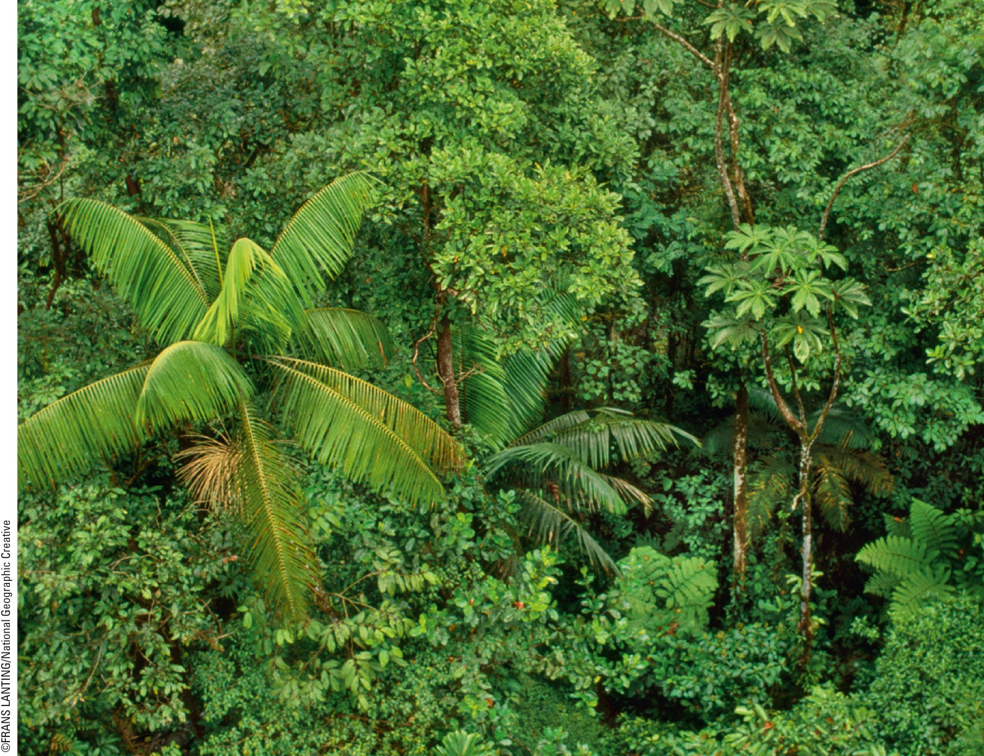
Fig. 10-2, p. 219
Notes:
Figure 10-2: This protected old-growth rain forest at a high altitude in Monteverde, Costa Rica (Core Case Study), is home for a rich diversity of plant and animal species.

Slide 7
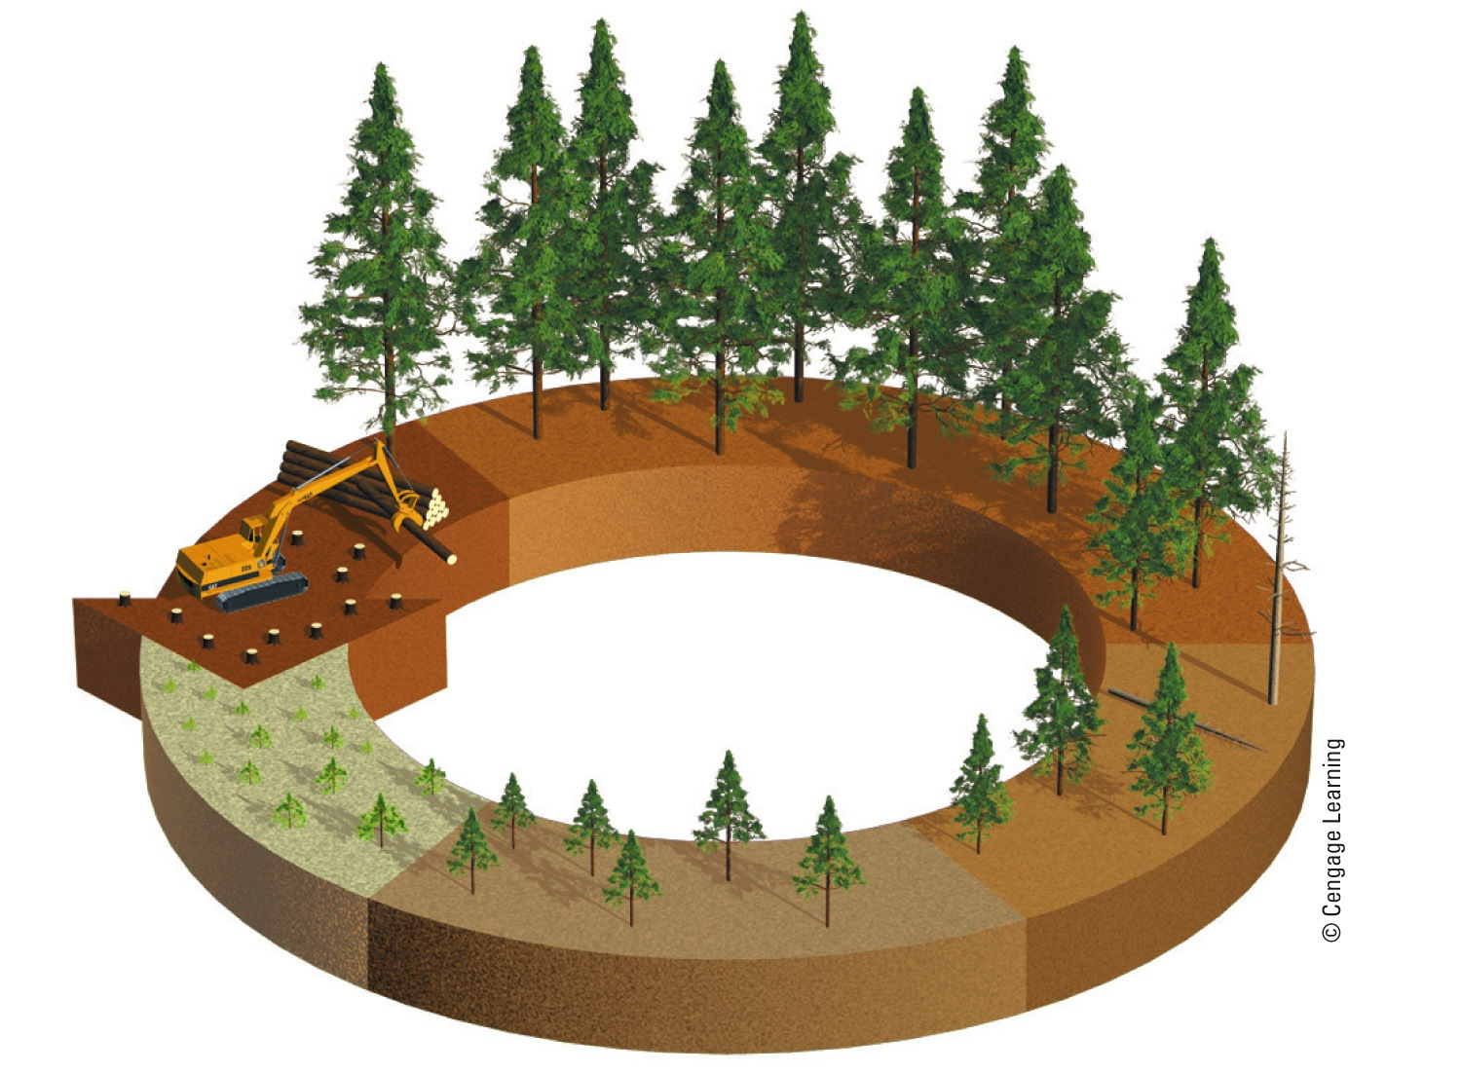
Weak trees removed
25 yrs
Clear cut
30 yrs
Years of growth
15 yrs
Seedlings planted
5 yrs
10 yrs
Fig. 10-3a, p. 219
Notes:
Figure 10.3 The rotation cycle of cutting and regrowth of monoculture tree plantations is short, usually 20–30 years. In tropical countries, where trees can grow more rapidly year-round, the rotation cycle can be 6–10 years. Like most tree plantations, the pine tree plantation in this photo was grown on land that had been cleared of an old-growth or second-growth forest.

Slide 8
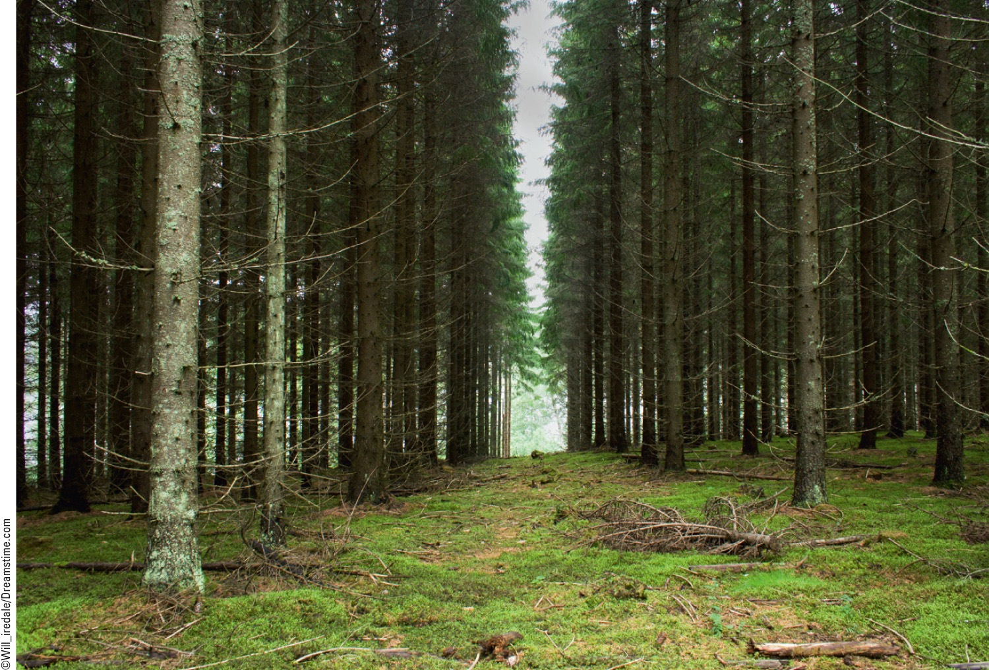
Fig. 10-3b, p. 219
Notes:
Figure 10.3 The rotation cycle of cutting and regrowth of monoculture tree plantations is short, usually 20–30 years. In tropical countries, where trees can grow more rapidly year-round, the rotation cycle can be 6–10 years. Like most tree plantations, the pine tree plantation in this photo was grown on land that had been cleared of an oldgrowth or second-growth forest.

Slide 9
Forests Provide Important Economic and Ecosystem Services
Store atmospheric carbon
Provide habitats
Influence local and regional climate
Provide raw materials
Provide health benefits
Medicines derived from plant species

Slide 10
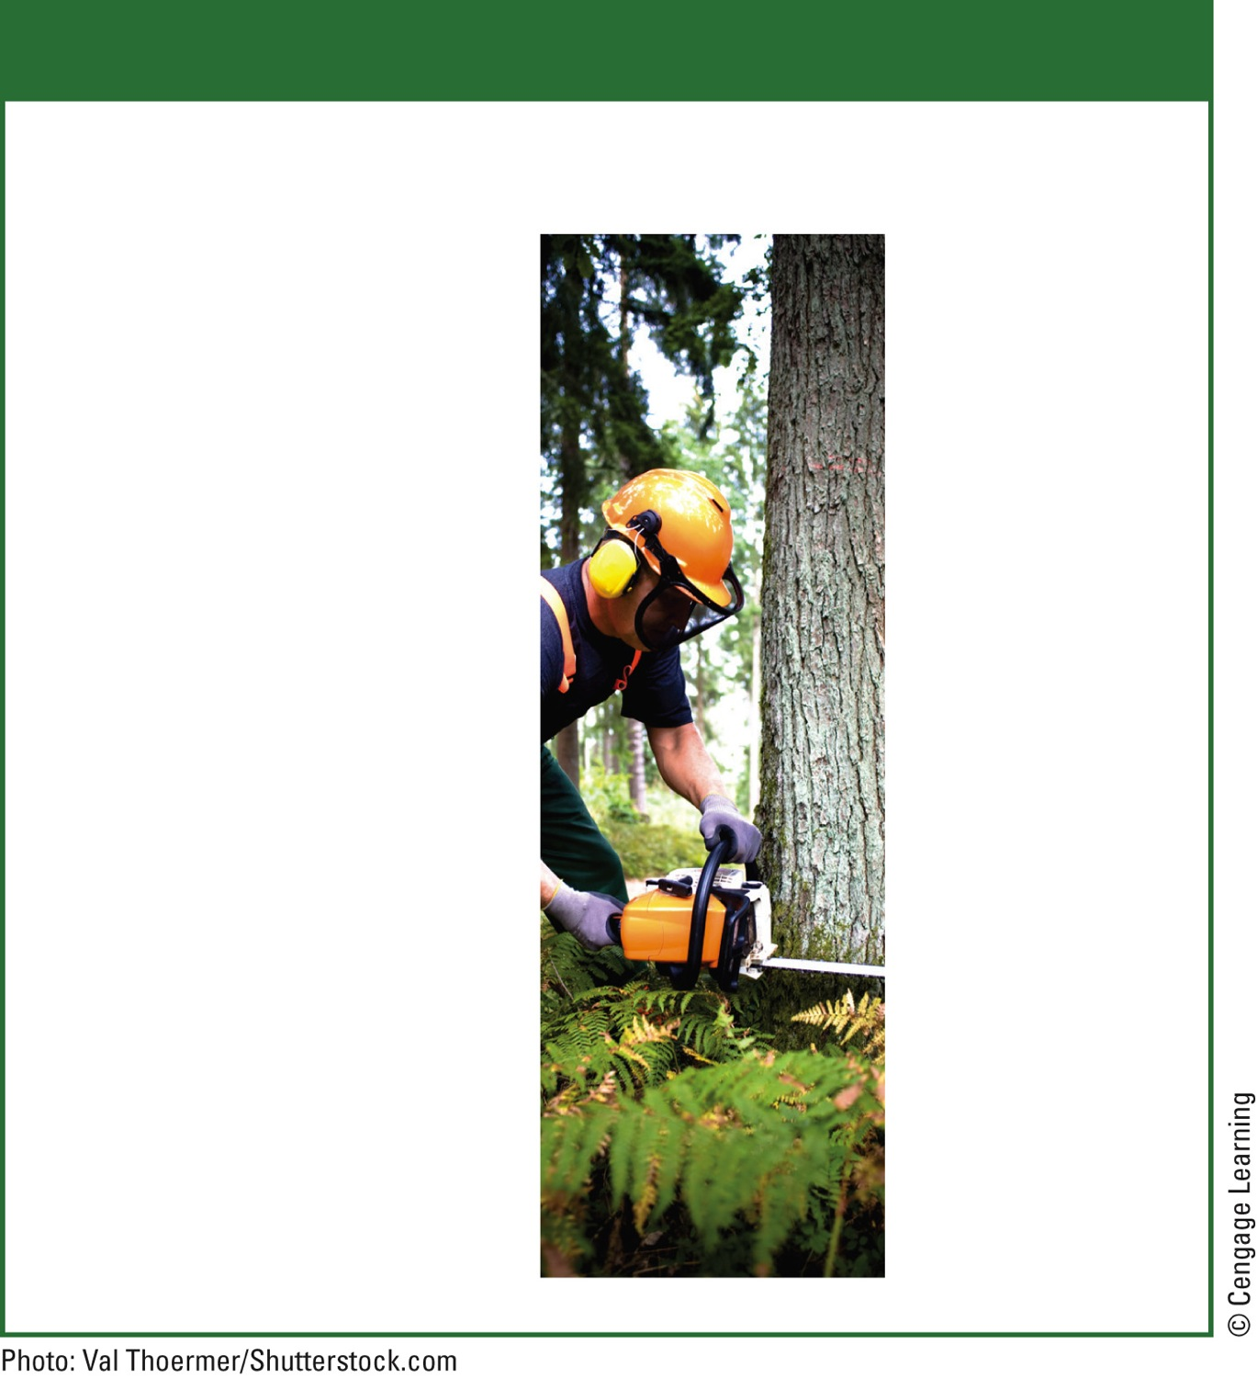
Natural Capital
Forests
Ecological Services
Economic Services
Support energy flow and chemical cycling
Fuelwood
Reduce soil erosion
Lumber
Absorb and release water
Pulp to make paper
Purify water and air
Mining
Influence local and regional climate
Livestock grazing
Store atmospheric carbon
Recreation
Provide numerous wildlife habitats
Jobs
Fig. 10-4, p. 220
Notes:
Figure 10.4 Forests provide many important ecosystem and economic services (Concept 10-1A). Question: Which two ecosystem services and which two economic services do you think are the most important?

Slide 11
There Are Several Ways to Harvest Trees
One of the world’s largest industries
Selective cutting
Intermediate-age or mature trees are cut singly or in small groups
Clear-cutting
All trees in an area are removed
Strip cutting
Clear-cutting in strips

Slide 12
Cleared plots
for grazing
New highway
Highway
Cleared plots
for agriculture
Old growth
Fig. 10-5, p. 221
Notes:
Figure 10-5: Natural capital degradation: Building roads into previously inaccessible forests is the first step in harvesting timber, but it also paves the way to Fragmentation, destruction, and degradation of forest ecosystems.

Slide 13
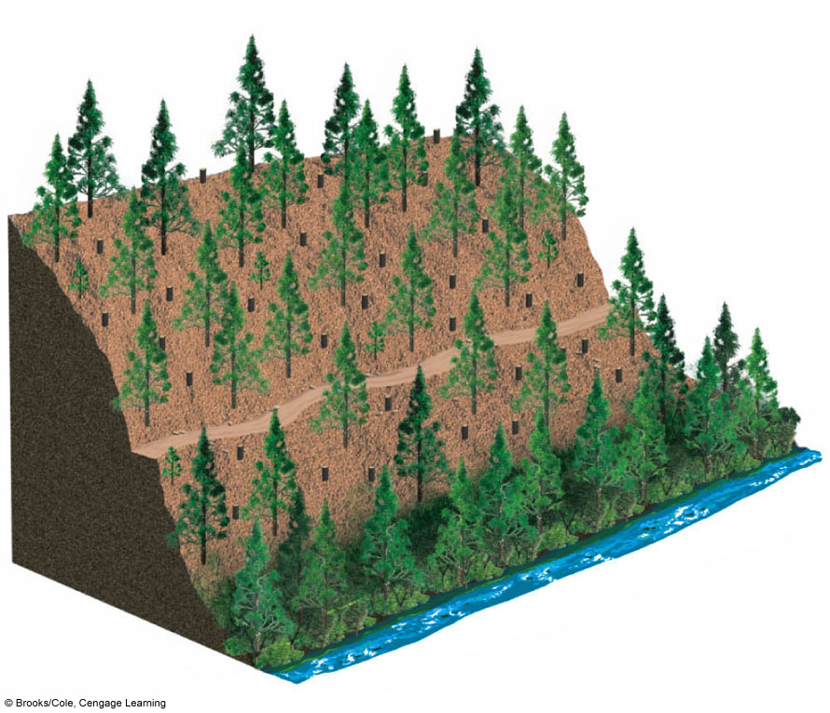
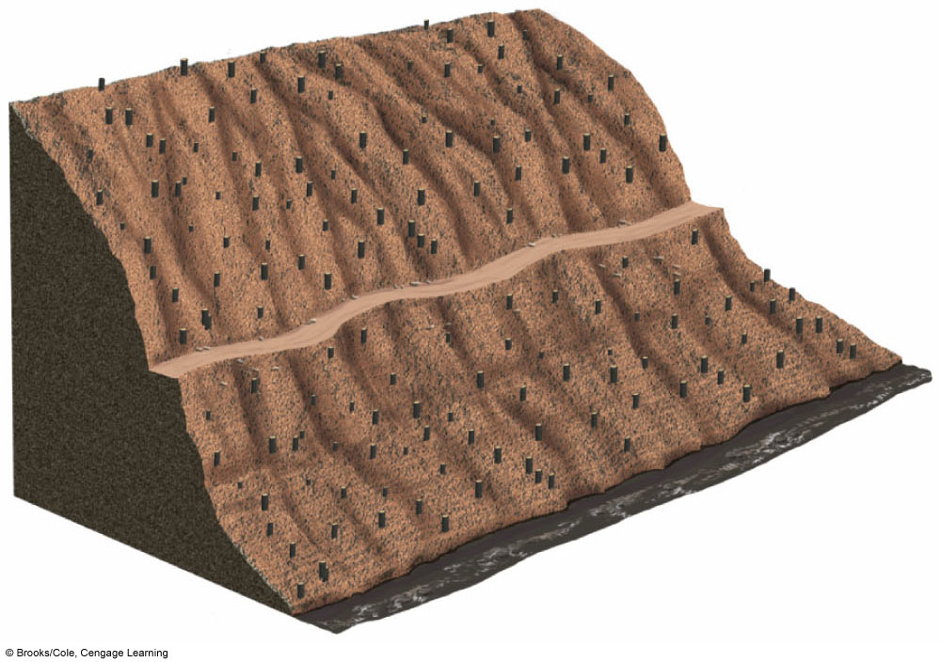
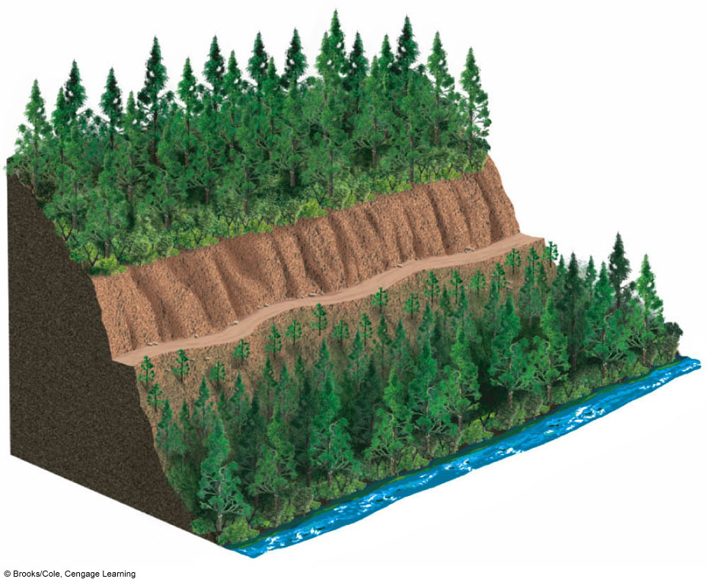
(a) Selective cutting
(b) Clear-cutting
Clear stream
Muddy stream
(c) Strip cutting
Uncut
Cut 1 year ago
Dirt road
Cut 3–10 years ago
Uncut
Clear stream
Stepped Art
Fig. 10-6, p. 222

Slide 14
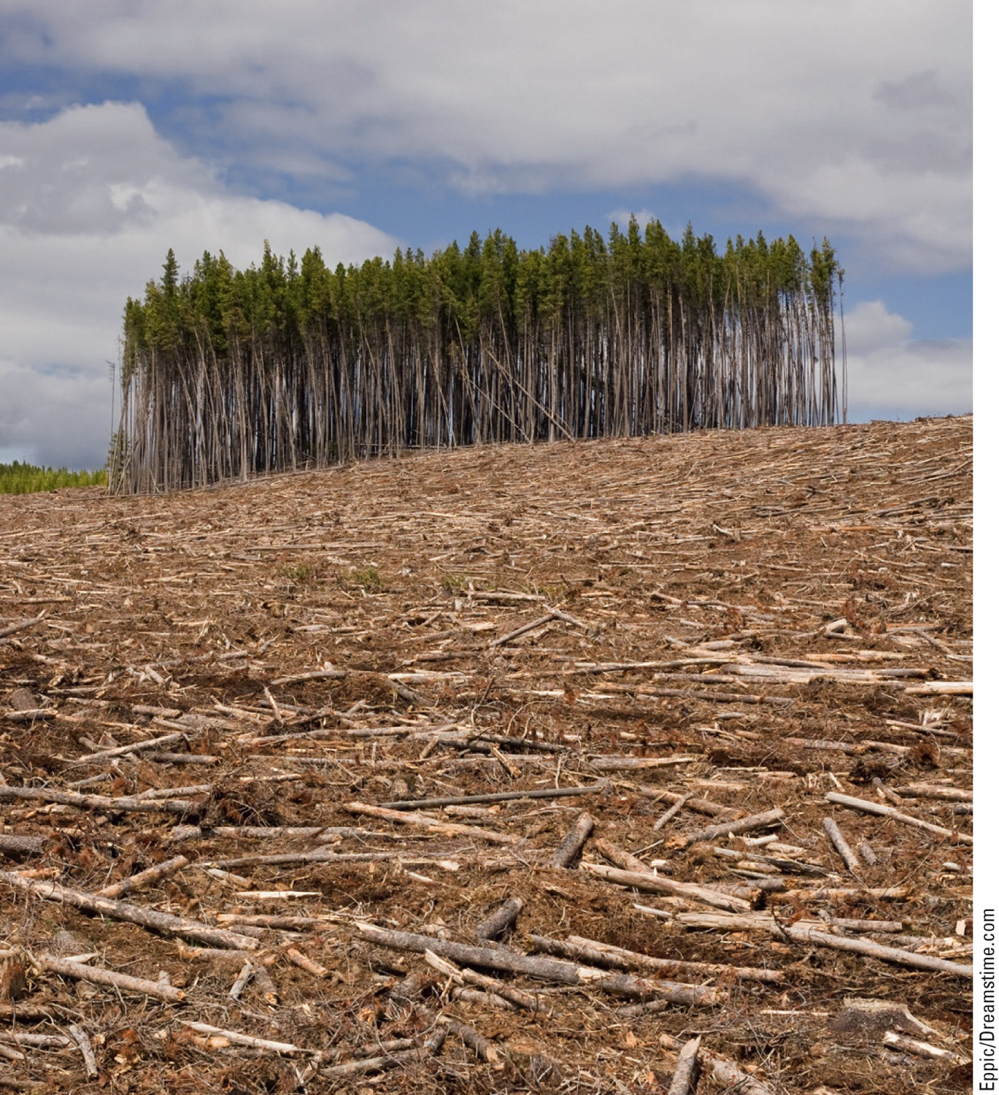
Fig. 10-7, p. 222
Notes:
Figure 10-7: Clear-cut forest.

Slide 15
Trade-Offs
Clear-Cutting Forests
Advantages
Disadvantages
Higher timber yields
Reduces biodiversity
Maximum profits in shortest time
Destroys and fragments wildlife habitats
Can reforest with fast-growing trees
Can lead to water pollution, flooding, and erosion, especially on steep slopes
Fig. 10-8, p. 222
Notes:
Figure 10-8: There are advantages and disadvantages to clear-cutting a forest. Questions: Which single advantage and which single disadvantage do you think are the most important? Why?

Slide 16
Fire, Insects, and Climate Change Can Threaten Forest Ecosystems
Surface fires
Usually burn leaf litter and undergrowth
Provide many ecological benefits
Crown fires
Extremely hot – burns whole trees
Kill wildlife
Increase soil erosion

Slide 17
Fire, Insects, and Climate Change Can Threaten Forest Ecosystems (cont’d.)
Introduction of foreign diseases and insects
Accidental or deliberate
Global warming
Rising temperatures
Trees more susceptible to diseases and pests
Drier forests – more fires
More greenhouse gases

Slide 18
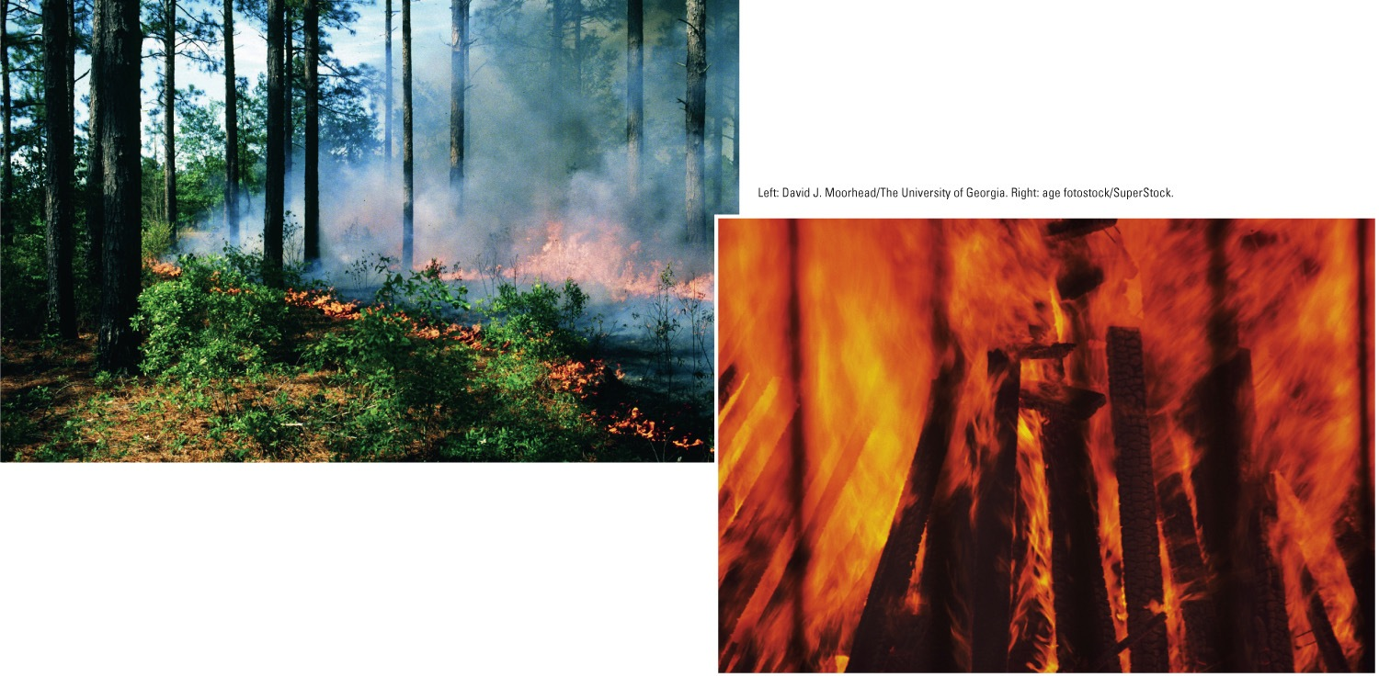
Fig. 10-9, p. 223
Notes:
Figure 10.9: Surface fires (left) usually burn only undergrowth and leaf litter on a forest floor. They can help to prevent more destructive crown fires (right) by removing flammable ground material.

Slide 19
Almost Half of the World’s Forests Have Been Cut Down
Deforestation
Temporary or permanent removal of large expanses of forest for agriculture, settlements, or other uses
Tropical forests
Especially in Latin America, Indonesia, and Africa
Boreal forests
Especially in Alaska, Canada, Scandinavia, and Russia

Slide 20
Almost Half of the World’s Forests Have Been Cut Down (cont’d.)
Encouraging news
Recent increases in forest cover
Due to:
Reforestation of cleared areas and abandoned croplands
Tree plantations

Slide 21
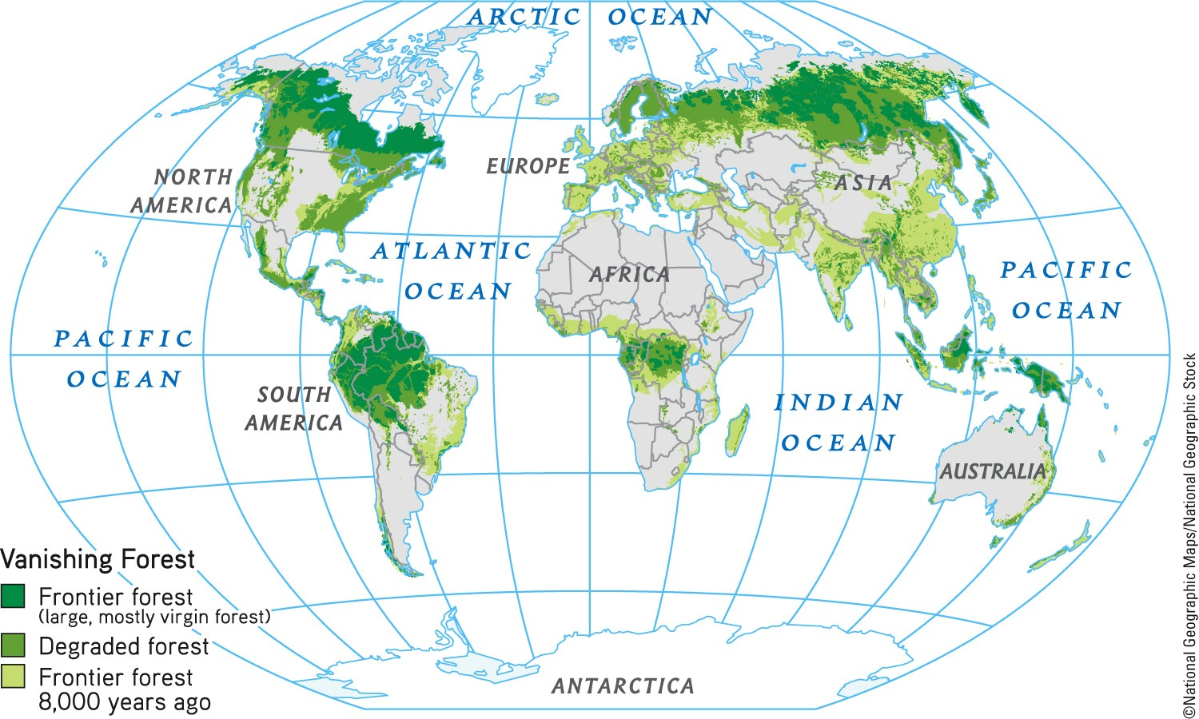
Fig. 10-10, p. 223
Notes:
Figure 10-10: Global deforestation over the past 8,000 years.

Slide 22
Fig. 10-11, p. 224
Notes:
Figure 10-11: Deforestation has some harmful environmental effects that can reduce biodiversity and degrade the ecosystem services provided by forests (Figure 10-4, left).

Slide 23
Case Study: Many Cleared Forests in the United States Have Grown Back
Forests of the eastern United States decimated between 1620 and 1920
Grown back naturally through secondary ecological succession in the eastern states
Biologically simplified tree plantations
Reduce biodiversity and deplete nutrients from soil

Slide 24
Tropical Forests are Disappearing Rapidly
Majority of loss since 1950
Mostly in Africa, Southeast Asia, South America
Clearing trees can accelerate climate change
Drier climate
Risk of larger and more frequent forest fires
Ecological tipping point
Forest cannot grow back

Slide 25
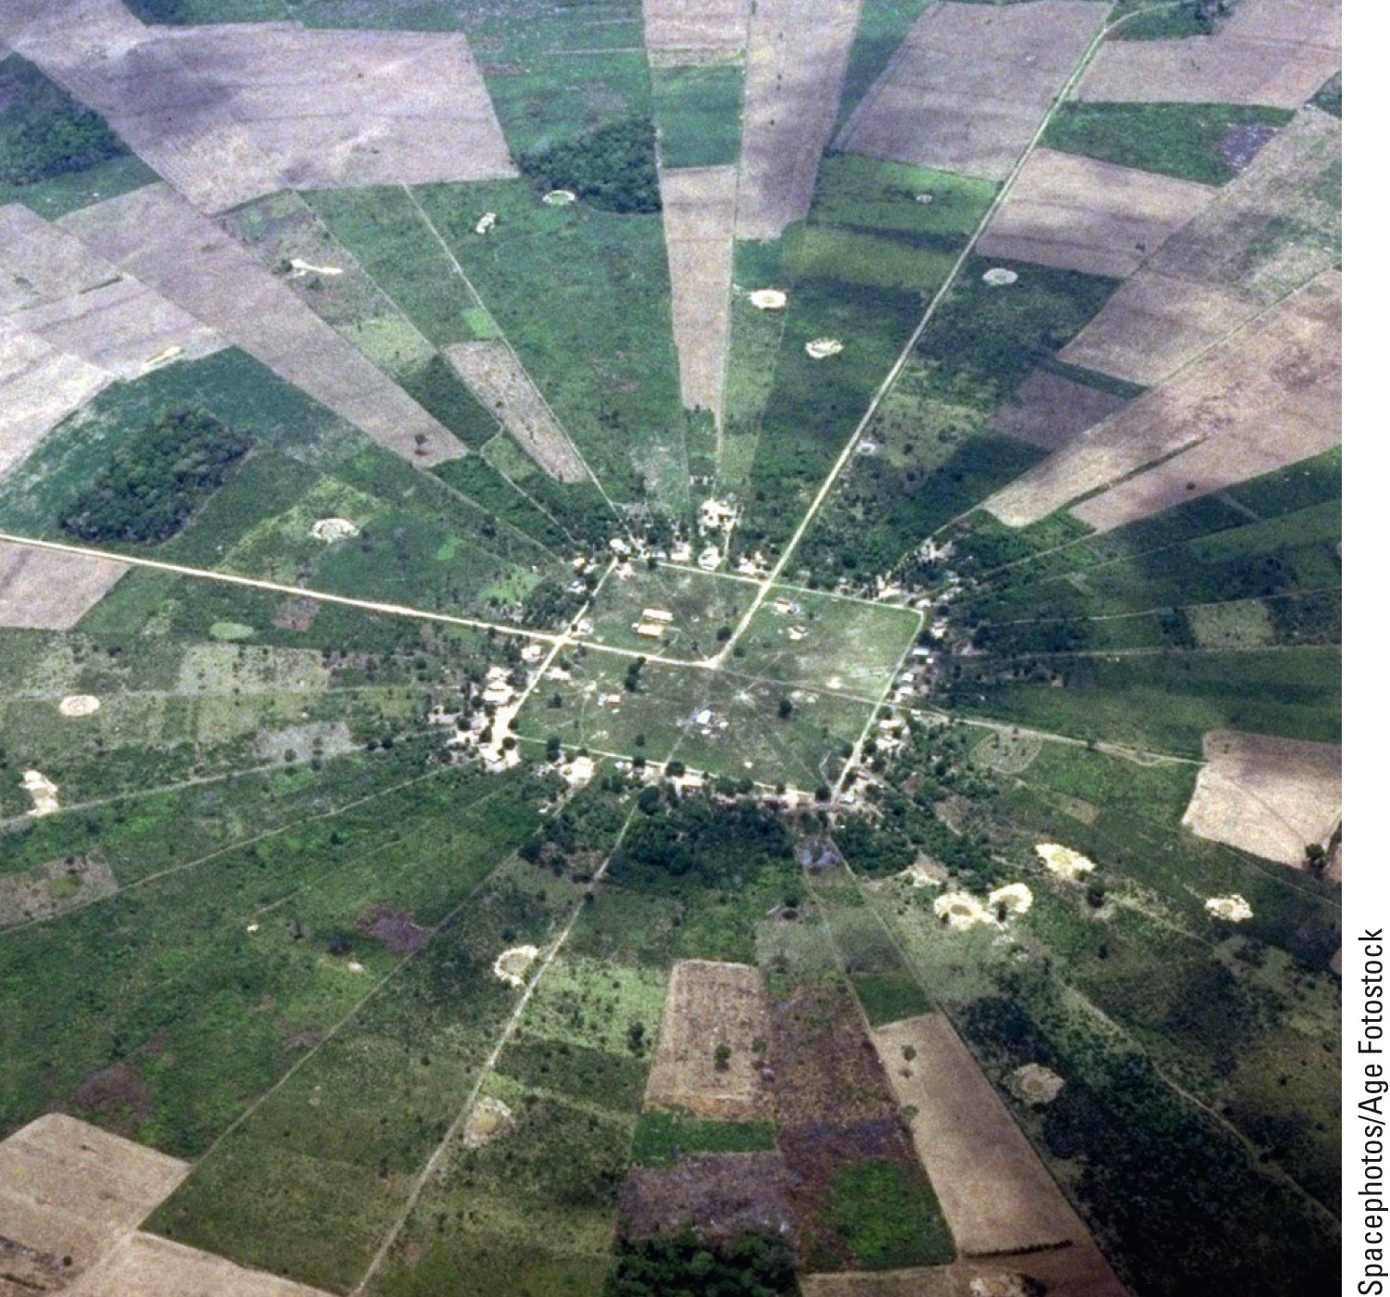
Fig. 10-15, p. 225
Notes:
Figure 10-15: Natural capital degradation. Conversion of tropical rain forest into agricultural settlements near Santa Cruz la Sierra, Bolivia, between 1970 and 2000.

Slide 26
Causes of Tropical Deforestation Are Varied and Complex
Various causes
Population growth
Poverty of subsistence farmers
Ranching
Lumber
Plantation farms – palm oil
Begins with building of roads
Many forests burned

Slide 27
10-2 How Should We Manage and Sustain Forests?
We can sustain forests by:
Emphasizing the economic value of their ecosystem services
Removing government subsidies that hasten their destruction
Protecting old-growth forests
Harvesting trees no faster than they are replenished
Planting trees

Slide 28
Solutions: Sustainable Forestry
Fig. 10-16, p. 227
Notes:
Figure 10-16: There are a number of ways to grow and harvest trees more sustainably (Concept 10-2). Questions: Which three of these methods of more sustainable forestry do you think are the best methods? Why?

Slide 29
We Can Manage Forests More Sustainably
Certify sustainably produced forest products
Use more sustainable logging practices in tropical forests
Phase out government subsidies

Slide 30
We Can Improve the Management of Forest Fires
The U.S. Smokey Bear educational campaign
What are the pros and cons?
Prescribed fires
Remove flammable material
Allow fires on public lands to burn

Slide 31
We Can Improve the Management of Forest Fires (cont’d.)
Protect structures in fire-prone areas
Thin trees and vegetation within 60m of a structure
Thin forests in fire-prone areas
Clear away small trees and underbrush

Slide 32
We Can Reduce the Demand for Harvested Trees
Improve the efficiency of wood use
60% of U.S. wood use is wasted
Make tree-free paper
Kenaf
Hemp

Slide 33
Solutions: Fast-Growing Plant: Kenaf
Fig. 10-17, p. 228
Notes:
Figure 10-17: Solutions. The pressure to cut trees to make paper could be greatly reduced by planting and harvesting a fast-growing plant known as kenaf.

Slide 34
Case Study: Deforestation and the Fuelwood Crisis
How is Haiti an example of an ecological disaster?
Possible solutions
Establish small plantations of fast-growing fuelwood trees and shrubs
Burn wood more efficiently
Solar or wind-generated electricity
Burn garden waste

Slide 35
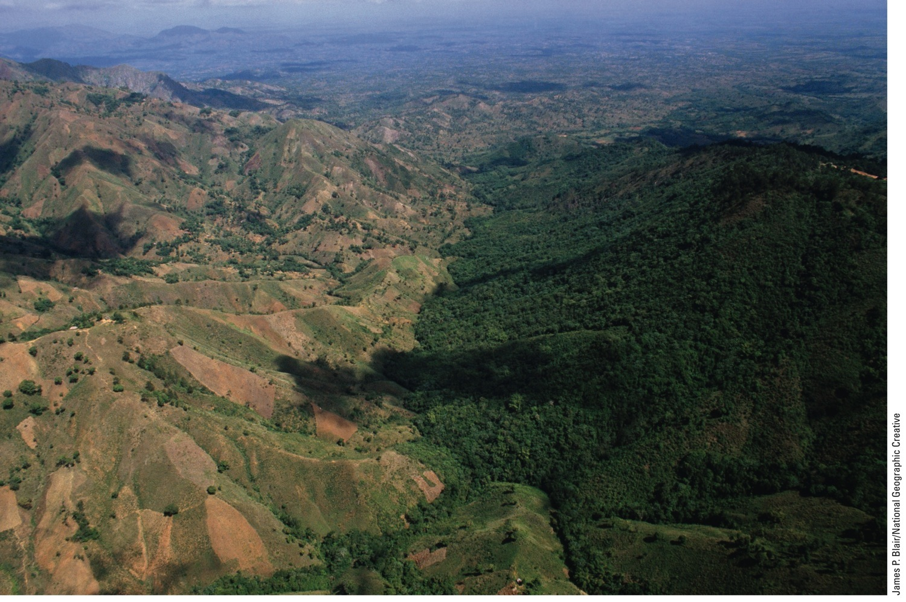
Fig. 10-18, p. 229
Notes:
Figure 10-18: Natural capital degradation: Haiti’s deforested brown landscape (left) contrasts sharply with the heavily forested green landscape of its neighboring country, the Dominican Republic.

Slide 36
There Are Several Ways to Reduce Tropical Deforestation
Debt-for-nature swaps/conservation concessions
Protect forests in return for aid
Crack down on logging
End subsidies
Plant trees

Slide 37
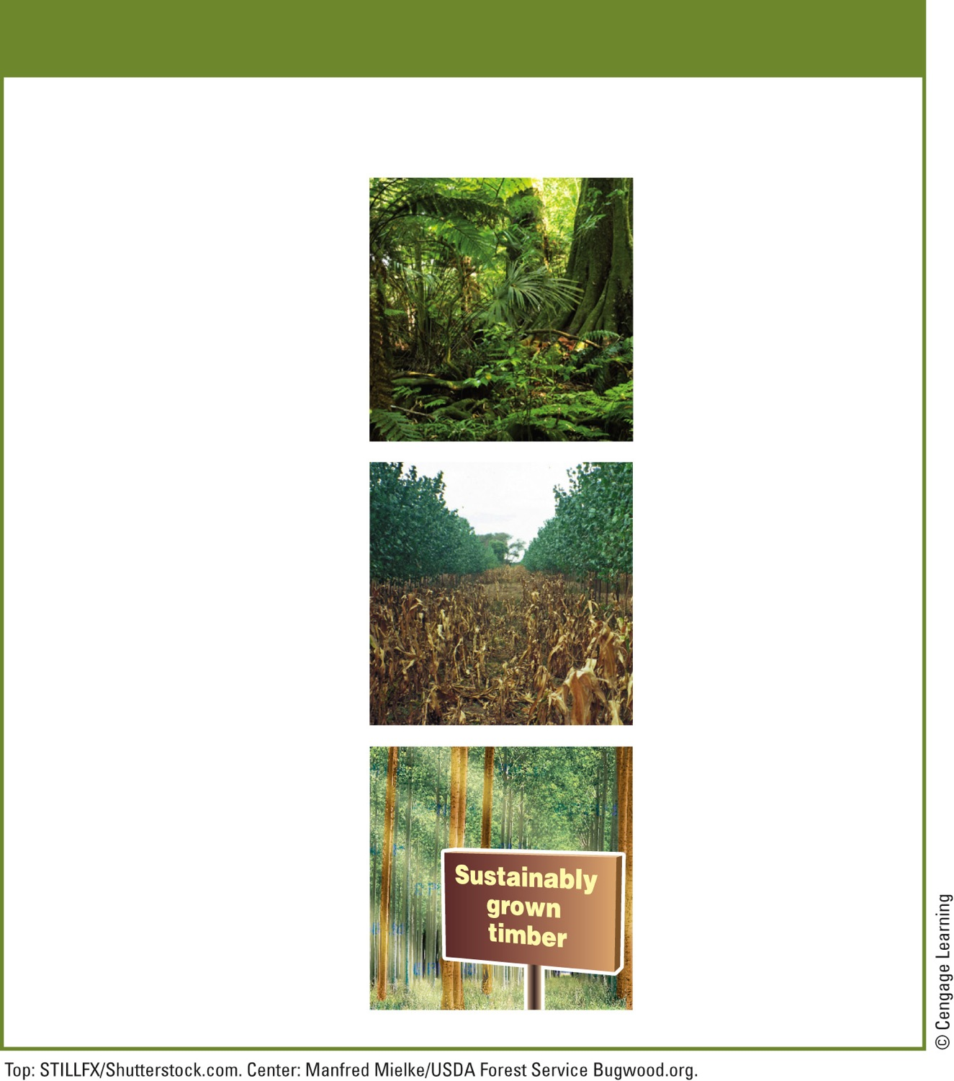
Solutions
Sustaining Tropical Forests
Prevention
Restoration
Protect the most diverse and endangered areas
Encourage regrowth through secondary succession
Educate settlers about sustainable agriculture and forestry
Subsidize only sustainable forest use
Rehabilitate degraded areas
Protect forests through
debt-for-nature swaps and conservation concessions
Concentrate farming and ranching in already-cleared areas
Certify sustainably grown timber
Reduce poverty and slow population growth
Fig. 10-19, p. 230
Notes:
Figure 10.19 These are some effective ways to protect tropical forests and to use them more sustainably (Concept 10-2). Questions: Which three of these solutions do you think are the best ones? Why?

Slide 38
10-3 How Should We Manage and Sustain Grasslands?
We can sustain the productivity of grasslands by:
Controlling the numbers and distribution of grazing livestock
Restoring degraded grasslands

Slide 39
Some Rangelands Are Overgrazed
Rangelands
Unfenced grasslands in temperate and tropical climates that provide forage for animals
Pastures
Managed grasslands and fences meadows used for grazing livestock

Slide 40
Some Rangelands are Overgrazed (cont’d.)
Overgrazing of rangelands
Reduces grass cover
Leads to erosion of soil by water and wind
Soil becomes compacted
Enhances invasion of plant species that cattle won’t eat

Slide 41
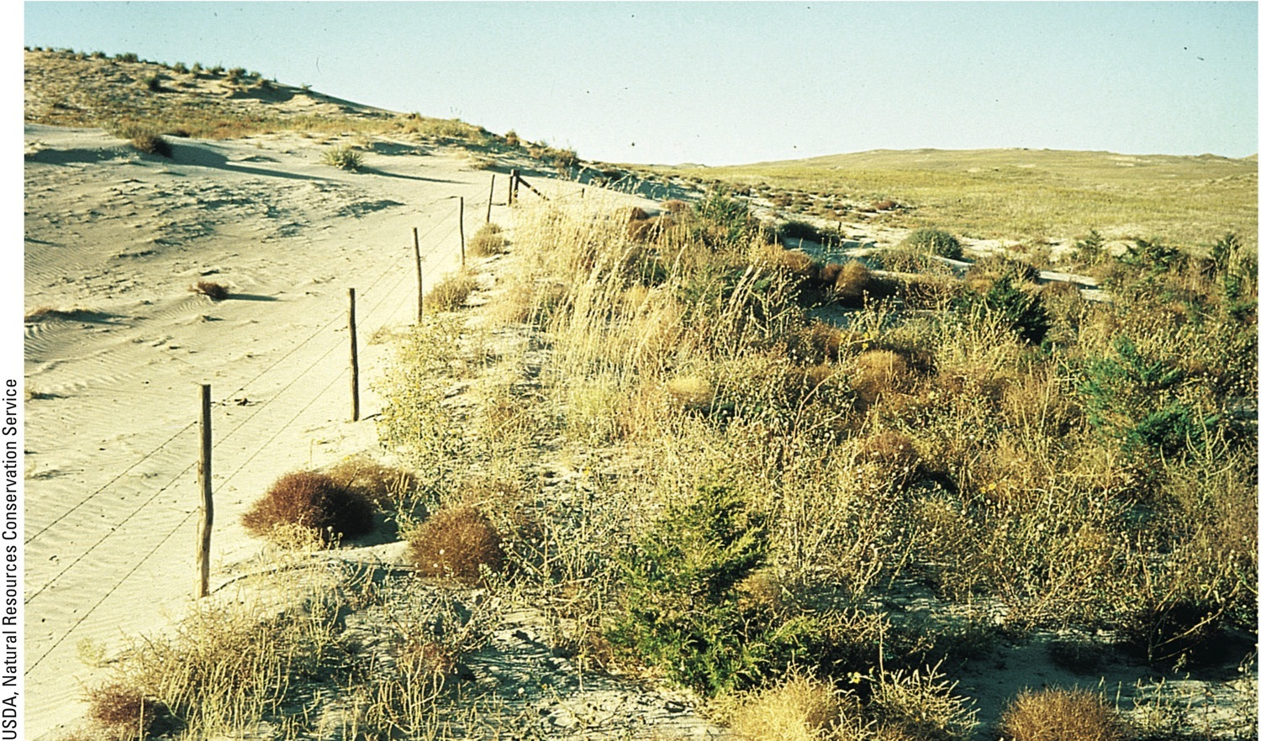
Fig. 10-22, p. 231
Notes:
Figure 10-22: Natural capital degradation. To the left of the fence is overgrazed rangeland. The land to the right of the fence is lightly grazed.

Slide 42
We Can Manage Rangelands More Sustainably
Rotational grazing
Cattle moved around
Fence damaged areas
Suppress growth of unwanted plants
Herbicides
Controlled burning

Slide 43
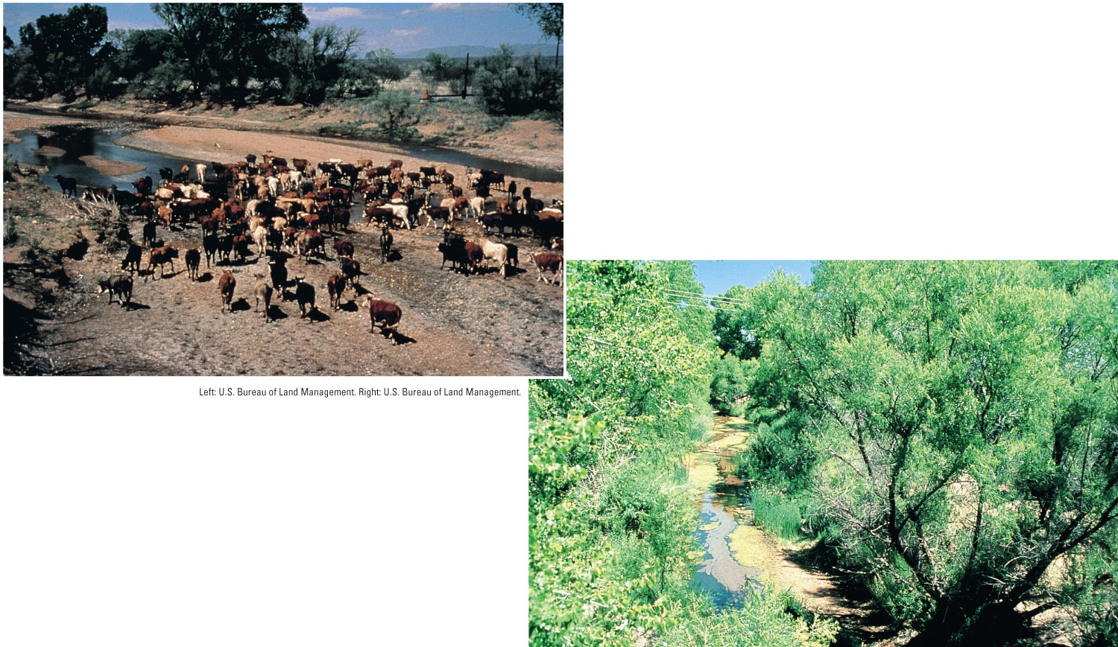
Fig. 10-23, p. 232
Notes:
Figure 10-23: Natural capital restoration. In the mid-1980s, cattle had degraded the vegetation and soil on this stream bank along the San Pedro River in the U.S. state of Arizona (left). Within 10 years, the area was restored through secondary ecological succession (right) after grazing and off-road vehicle use were banned (Concept 10-3).

Slide 44
Case Study: Grazing and Urban Development the American West
American southwest population surge since 1980
Land trust groups – conservation easements
Reduce the harmful environmental impact of herds
Operate ranch more economically and sustainably

Slide 45
10-4 How Should We Manage and Sustain Parks and Natural Reserves?
Sustaining biodiversity will require:
More effective protection of existing parks and nature reserves
The protection of much more of the earth’s remaining undisturbed land area

Slide 46
National Parks Face Many Environmental Threats
Worldwide – 6600 national parks
Parks in developing countries
Greatest biodiversity
1% protected against illegal:
Animal poaching
Logging and mining

Slide 47
Case Study: Stresses on U.S. Public Parks
There are 58 major national parks in the U.S.
The biggest problem may be popularity
Other problems include:
Nonnative species
Poaching
Commercial development
Park maintenance

Slide 48
Grand Teton National Park
Fig. 10-24, p. 234
Notes:
Figure 10-24: Grand Teton National Park in the U.S. state of Wyoming.

Slide 49
Nature Reserves Occupy Only a Small Part of the Earth’s Land
Currently less than 13% is protected
Conservationists’ goal – protect 20%
Size and design of protected area is important
Buffer zone
Habitat corridor

Slide 50
Case Study: Identifying and Protecting Biodiversity in Costa Rica
Megareserves – large conservation areas
Designed to sustain about 80% of the country’s biodiversity
Large eco-tourism industry

Slide 51
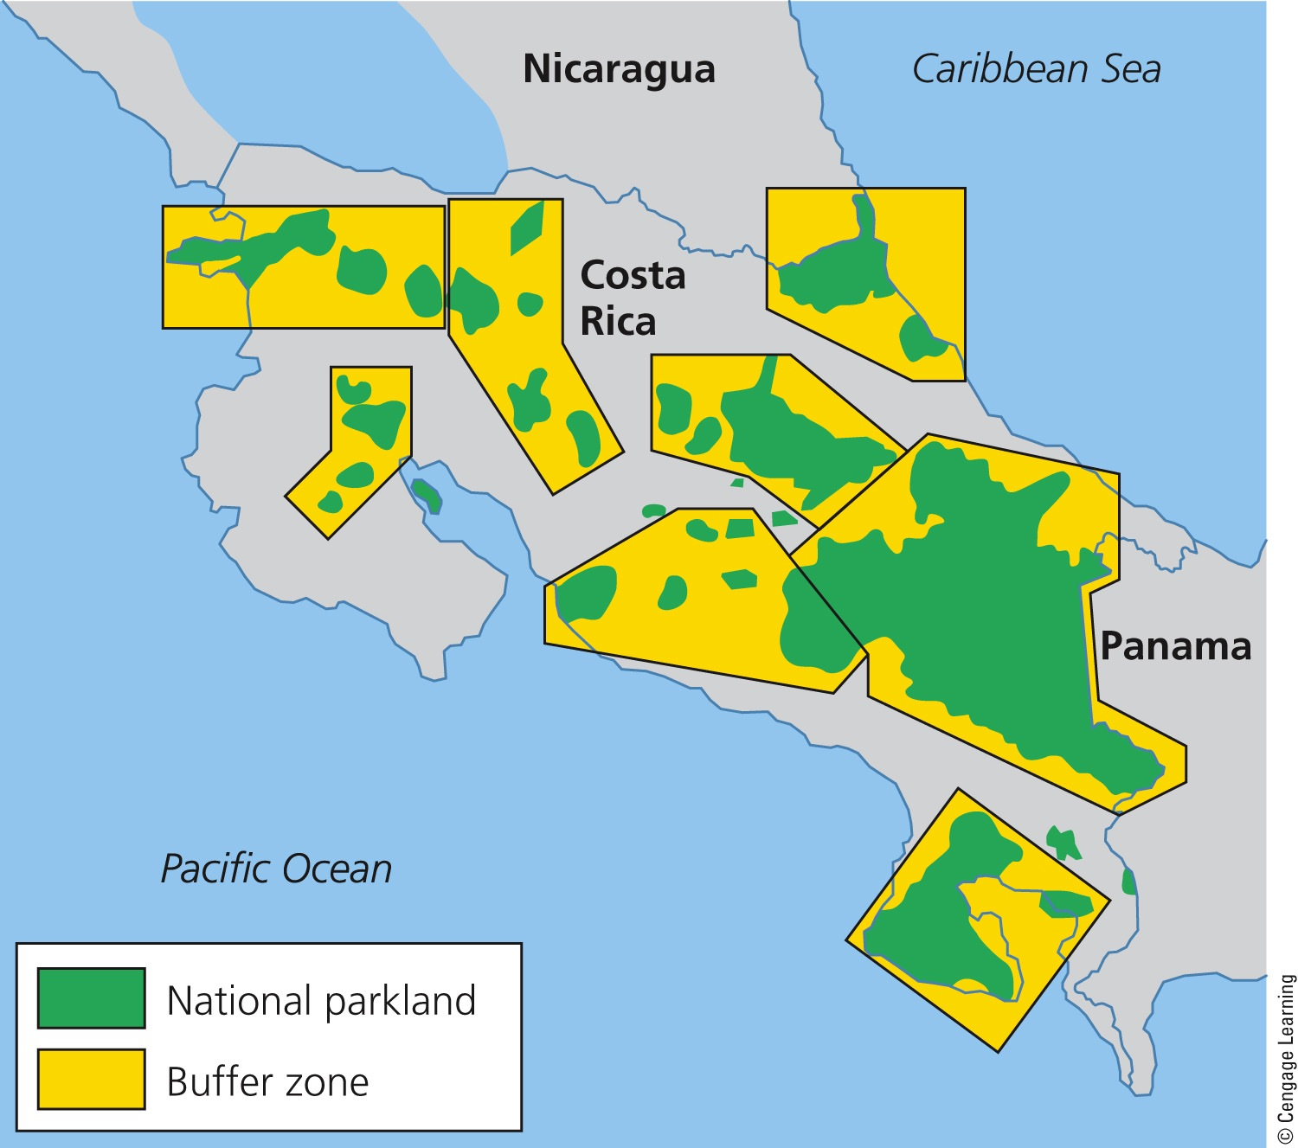
Fig. 10-25, p. 236
Notes:
Figure 10-25: Solutions. Costa Rica has created several megareserves. Green areas are protected natural parklands and yellow areas are the surrounding buffer zones.

Slide 52
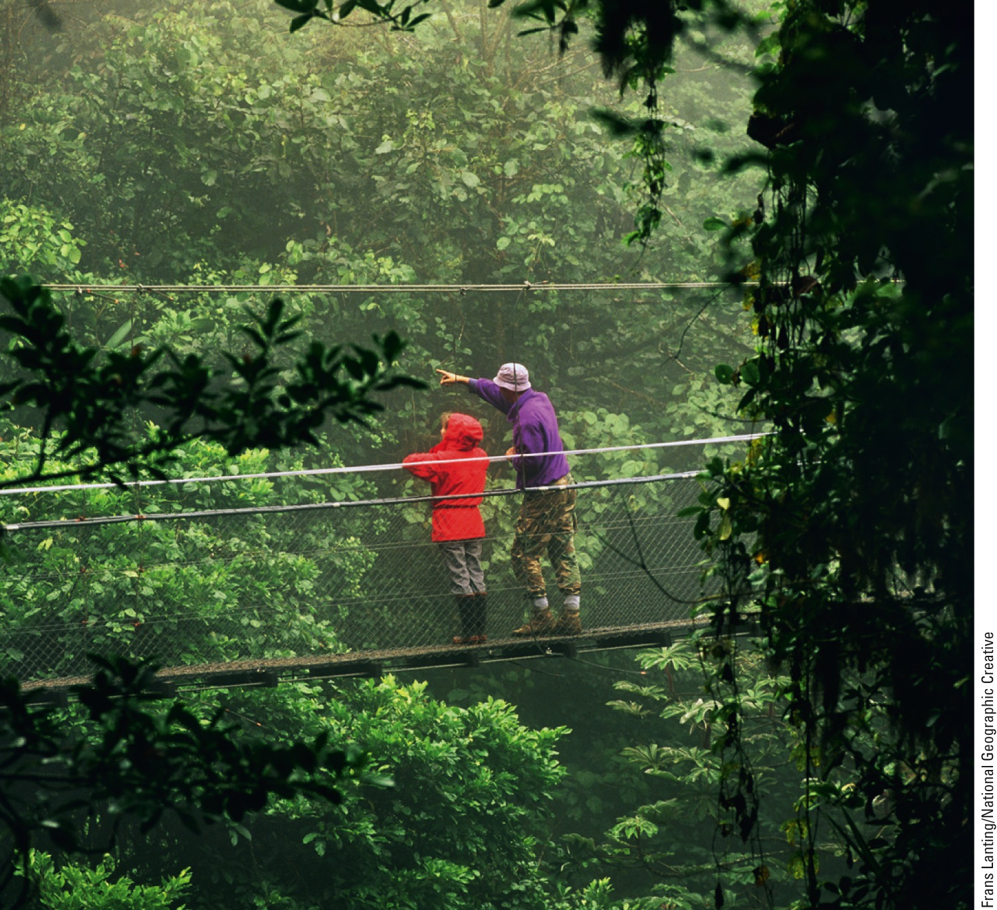
Fig. 10-26, p. 236
Notes:
Figure 10-26: These tourists are exploring a forest canopy via a walkway in Costa Rica’s Monteverde Cloud Forest Reserve.

Slide 53
Protecting Wilderness Is an Important Way to Preserve Biodiversity
Wilderness
Land officially designated as having no serious disturbance from human activities
Wilderness Act of 1964
5% of U.S. land protected as wilderness
Why is wilderness protection being eroded today?

Slide 54
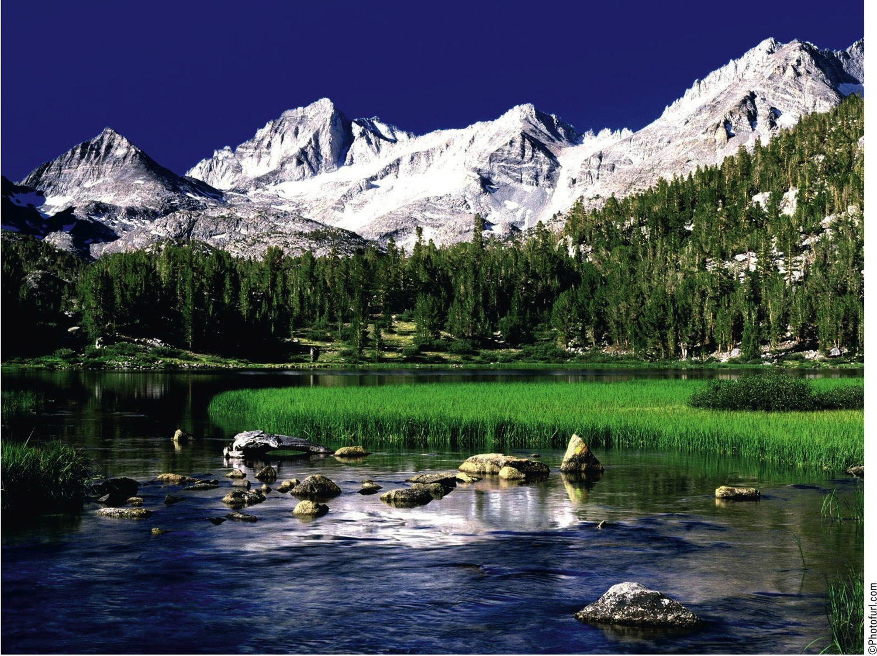
Fig. 10-27, p. 237
Notes:
Figure 10-27: The John Muir Wilderness in the U.S. state of California was among the first areas to be designated as wilderness.

Slide 55
10-5 What is the Ecosystem Approach to Sustaining Terrestrial Biodiversity?
We can help to sustain terrestrial biodiversity by:
Identifying and protecting severely threatened areas (biodiversity hotspots), sustaining ecosystem services
Restoring damaged ecosystems (using restoration ecology)
Sharing with other species much of the land we dominate (using reconciliation ecology)

Slide 56
The Ecosystems Approach: A Five-Point Strategy
Map global ecosystems and identify species
Identify resilient and fragile ecosystems
Protect the most endangered
Restore as many degraded ecosystems as possible
Make development biodiversity friendly

Slide 57
Protecting Global Biodiversity Hot Spots Is an Urgent Priority
34 biodiversity hot spots are rich in plant species
2% of earth’s surface, but 50% of flowering plant species and 42% of terrestrial vertebrates
1.2 billion people

Slide 58
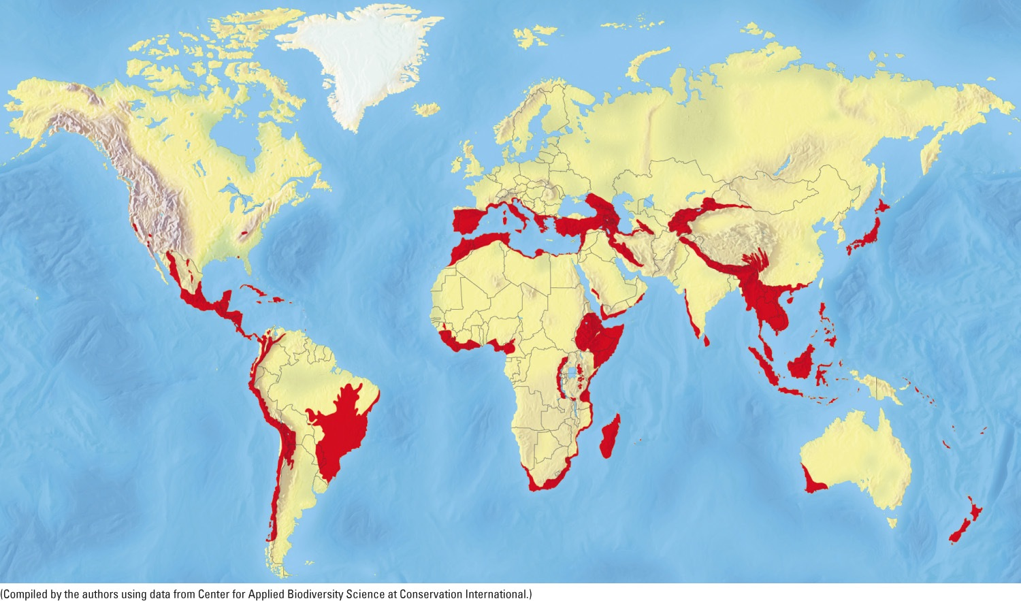
Fig. 10-28, p. 238
Notes:
Figure 10-28: Endangered natural capital. Biologists have identified these 34 biodiversity hotspots. Compare this map with the global map of the human ecological footprint, shown in Figure 1-12, p. 13. Question: Why do you think so many hotspots are located near coastal areas?

Slide 59
Case Study: Madagascar: An Endangered Center of Biodiversity
The world’s fourth largest island
Roughly 90% of the species found there are unique
Severe habitat loss
Population growth
Less than 3% of the land area is officially protected

Slide 60
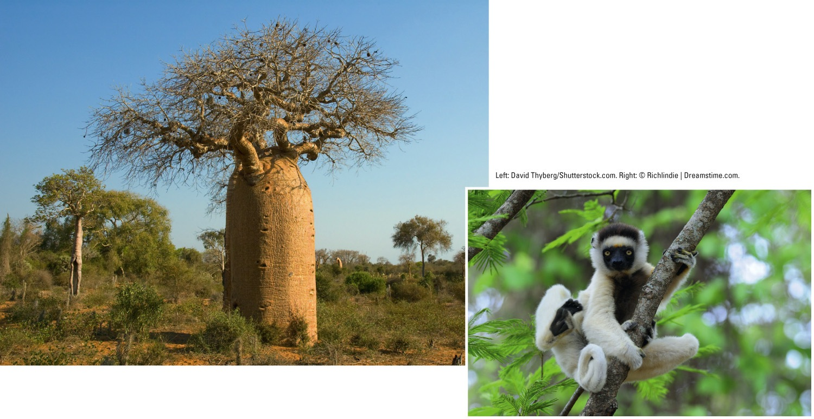
Fig. 10-29, p. 239
Notes:
Figure 10-29: Madagascar is the only home for six of the world’s eight baobab tree species (left), old-growth trees that are disappearing. This tree survives the desertlike conditions on part of the island by storing water in its large bottle-shaped trunk. The island is also the only home of more than 70 species of lemurs, including the threatened Verreaux’s sifaka, or dancing lemur (right).

Slide 61
Protecting Ecosystem Services Is Also an Urgent Priority
2005 U.N. Millennium Ecosystem Assessment
Identify key ecosystem services
Human activities degrade or overuse 60% of the earth’s natural services
Identify highly stressed life raft ecosystems
Residents, public officials, and conservation scientists would work together

Slide 62
We Can Rehabilitate and Partially Restore Ecosystems That We Have Damaged
Ecological restoration
Repairing damage
Succession processes
Restoration
Rehabilitation
Replacement
Creating artificial ecosystems

Slide 63
We Can Rehabilitate and Partially Restore Ecosystems (cont’d.)
Carrying out rehabilitation
Identify what caused the degradation
Stop the abuse
Reintroduce species, if possible
Protect from further degradation

Slide 64
We Can Share Areas We Dominate With Other Species
Reconciliation ecology
Invent and maintain habitats for species diversity where people live, work, and play
Community-based conservation
Protect vital insect pollinators

Slide 65
What Can You Do? Sustaining Terrestrial Biodiversity
Fig. 10-30, p. 242
Notes:
Figure 10-30: Individuals matter. These are some ways in which you can help to sustain terrestrial biodiversity. Questions: Which two of these actions do you think are the most important? Why? Which of these things do you already do?

Slide 66
Three Big Ideas
The economic values of the important ecological services provided by the world’s ecosystems are far greater than the value of the raw materials obtained from those systems

Slide 67
Three Big Ideas (cont’d.)
We can manage forests, grasslands, and nature reserves more effectively by:
Protecting more land
Preventing overuse and degradation of these areas and the renewable resources they contain

Slide 68
Three Big Ideas (cont’d.)
We can sustain terrestrial biodiversity and ecosystem services by:
Protecting biodiversity hotspots and ecosystem services
Restoring damaged ecosystems
Sharing with other species much of the land we dominate

Slide 69
Tying It All Together: Sustaining Costa Rica’s Biodiversity
Costa Rica protects a larger portion of its land than any other country
Principles of biodiversity
Respect biodiversity and understand the value of sustaining it
Place an economic value on ecosystem services
Encourage people to work together

