Slide 1
23
Economics, Environment, and Sustainability

Slide 2
Case Study: Germany: Using Economics to Spur a Shift to Renewable Energy
Phase out dependence on fossil fuels and nuclear energy
By 2050
80% of electricity from renewable sources
Government legislation
Offshore wind farms

Slide 3
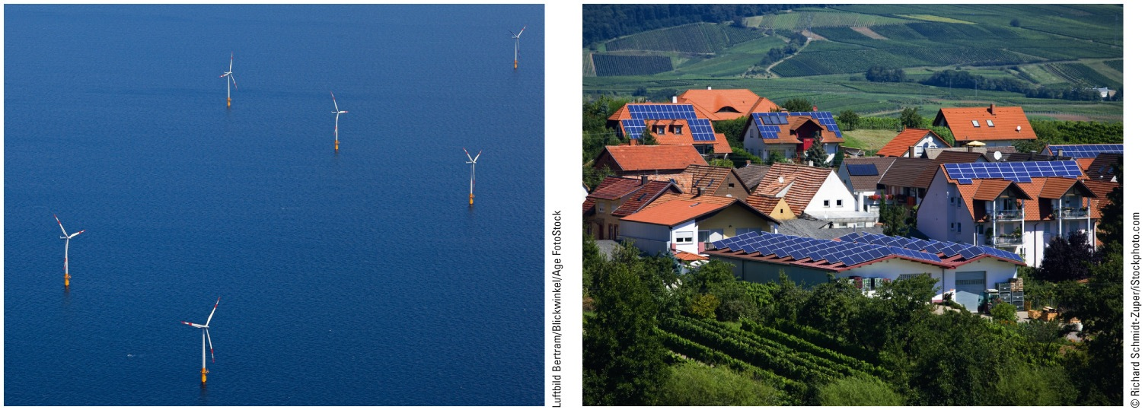
Fig. 23-1, p. 632
Notes:
Figure 23-1: This wind farm (left) is located off Germany’s coast, and this rural village (right) in Germany’s Rhineland-Palatinate is typical for German towns in having several rooftop solar panels.

Slide 4
23-1 How Are Economic Systems Related to the Biosphere?
Ecological economists and most sustainability experts regard human economic systems as subsystems of the biosphere

Slide 5
Economic Systems Vary, But All Depend on Natural Capital
Economics
Goods and services
Economic system
Social institution
Free-market system
Supply and demand

Slide 6
Economic Systems Vary, But All Depend on Natural Capital (cont’d.)
Natural capital
Resources provided by the earth’s natural processes
Human capital
People’s physical and mental talents
Manufactured capital
Tools and materials

Slide 7
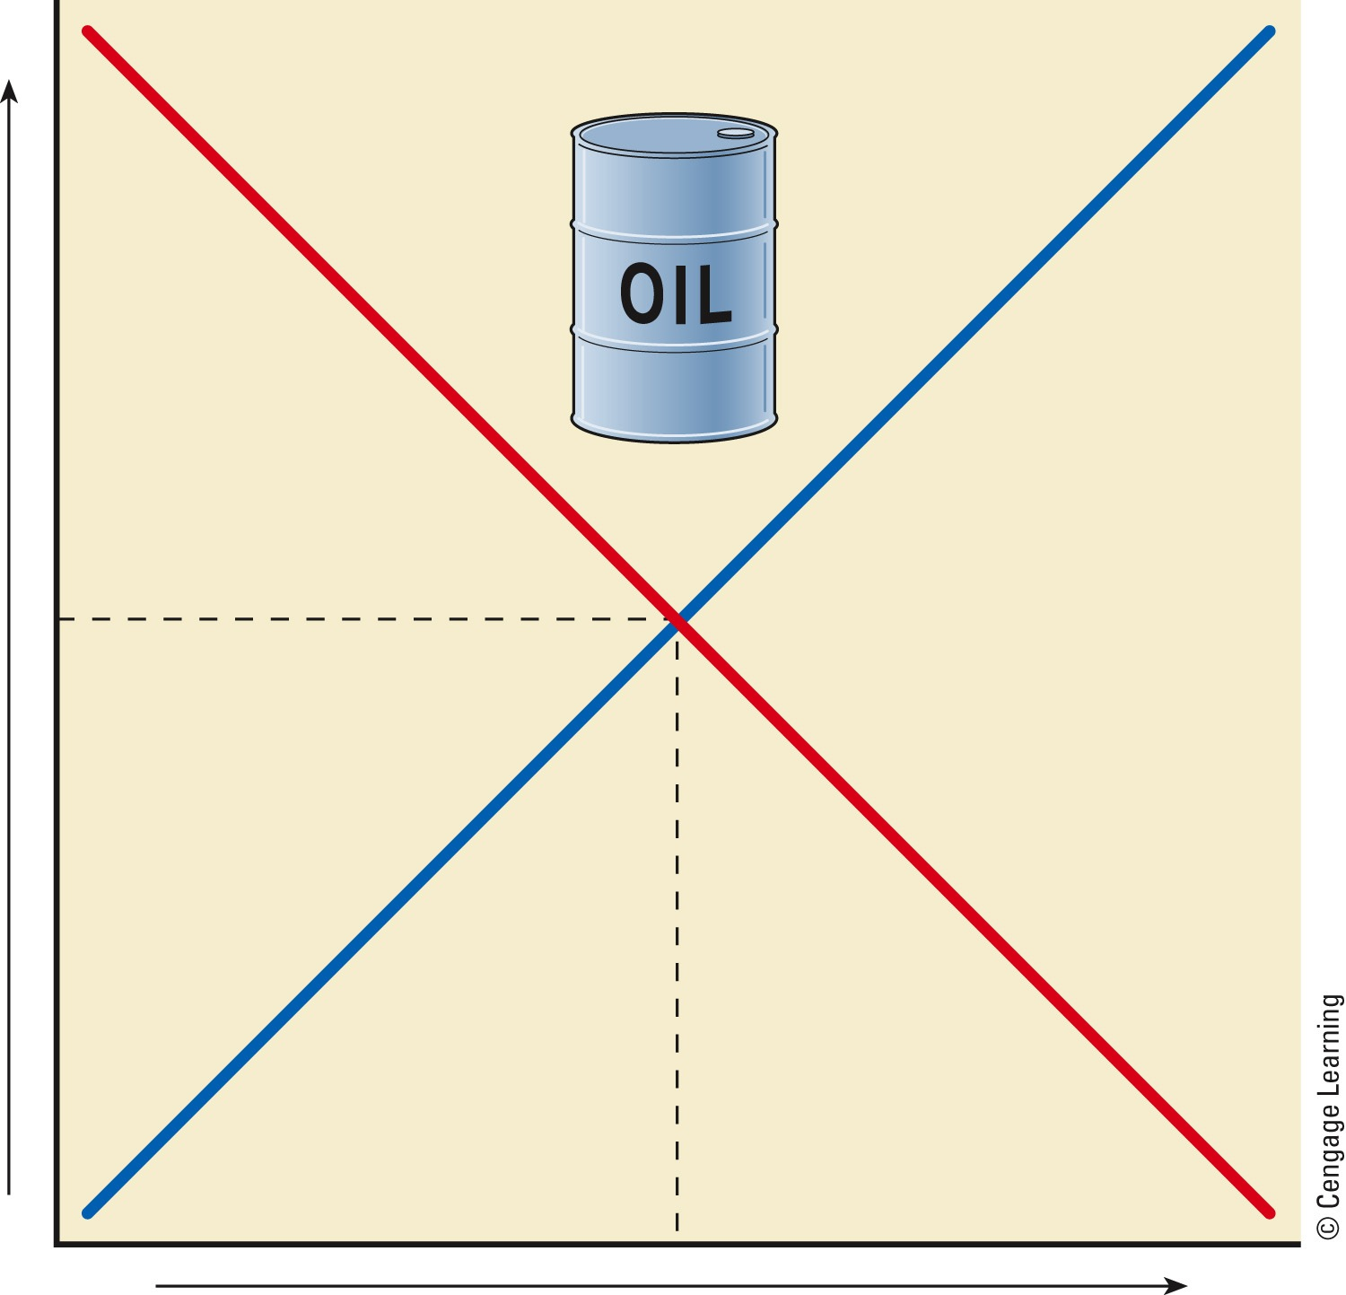
High
Demand
Supply
Price
Market equilibrium
Low
Low
High
Quantity
Fig. 23-2, p. 633
Notes:
Figure 23-2: Supply and demand curves for a saleable product in a free market economic system. If all factors except supply, demand, and price are held fixed, market equilibrium occurs at the point where the supply and demand curves intersect. Question: How would a decrease in the available supply of oil shift the market equilibrium point on this diagram?

Slide 8
Governments Intervene to Help Correct Market Failures
Market failures
Provide public services
Inability to prevent degradation of open-access resources
No monetary value assigned to natural capital

Slide 9
Economists Disagree
Economic growth
Increased capacity to supply goods and services
Requires increased production and consumption
Requires more consumers
High-throughput economy

Slide 10
Economists Disagree (cont’d.)
Economic development
Improvement of living standards
Environmentally sustainable economic development
Environmentally beneficial

Slide 11
Inputs
(from environment)
System throughputs
Outputs
(into environment)
High-quality energy
Low-quality energy (heat)
High-waste
economy
High-quality matter
Waste and pollution
Fig. 23-4, p. 634
Notes:
Animated Figure 23-4: The high-throughput economies of most of the world’s more-developed countries rely on continually increasing the flow of energy and matter resources to promote economic growth. Question: What are three ways in which you regularly add to this throughput of matter and energy through your daily activities?

Slide 12
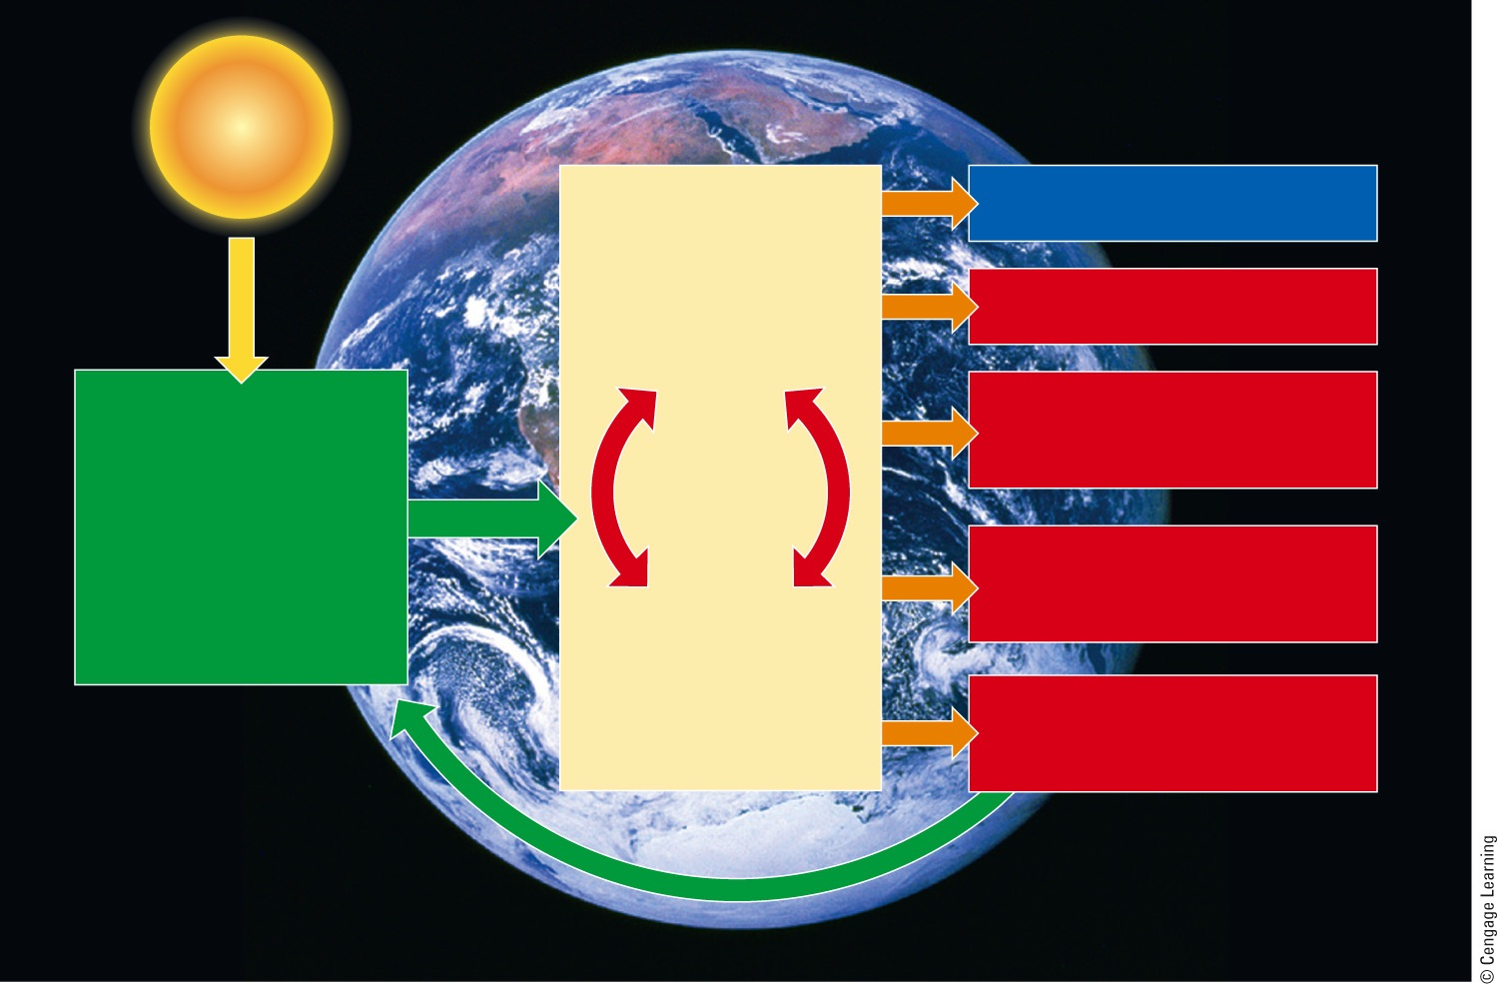
Solar Capital
Goods and services
Economic Systems
Heat
Production
Natural Capital
Depletion of nonrenewable resources
Natural resources such as air, land, soil, biodiversity, minerals, and energy, and natural services such as air and water purification, nutrient cycling, and climate control
Degradation of renewable resources (used faster
than replenished)
Consumption
Pollution and waste
(overloading nature’s waste disposal and recycling systems)
Recycling and reuse
Fig. 23-5, p. 635
Notes:
Figure 23-5: Ecological economists see all human economies as subsystems of the biosphere that depend on natural resources and services provided by the sun and earth. Question: Do you agree or disagree with this model? Explain.

Slide 13
Economists Disagree (cont’d.)
Neoclassical economists
View the earth’s natural capital as part of a human economic system
Ecological economists
View human economic systems as subsystems of the biosphere
Believe that conventional economic growth will become unsustainable
Environmental economists: middle ground

Slide 14
23-2 How Can We Estimate Natural Capital, Pollution Control, Resource Use?
Economists have developed several ways to estimate:
Present and future values of a resource or ecosystem service
Optimum levels of pollution control and resource use
Comparing the likely costs and benefits of an environmental action is useful, but it involves many uncertainties

Slide 15
There Are Various Ways to Value Natural Capital
Estimating the values of the earth’s natural capital
Monetary worth
Estimate nonuse values
Existence value
Aesthetic value
Bequest value, option value

Slide 16
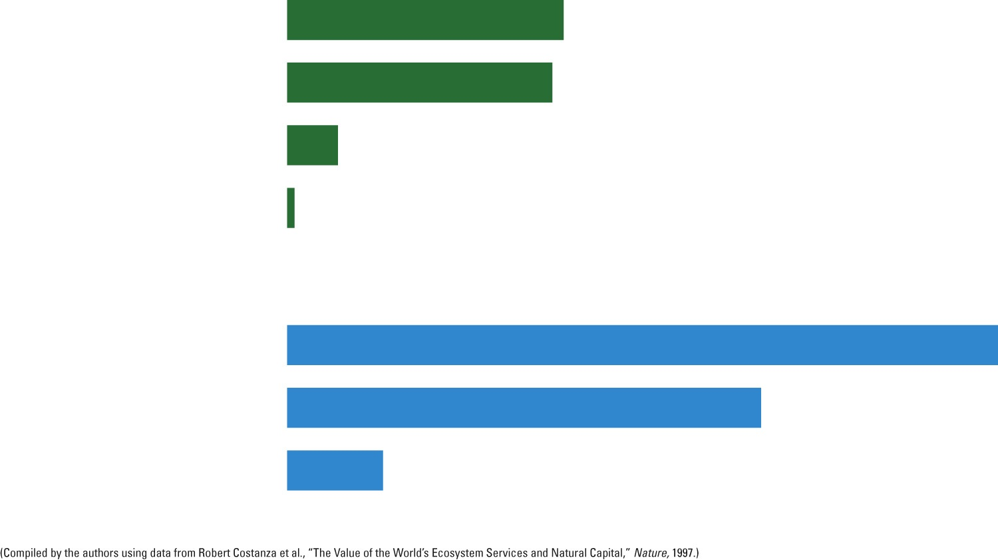
Terrestrial
Wetlands
$4.9 trillion
Forests
$4.7 trillion
$0.9 trillion
Grasslands and rangelands
Cropland
$0.13 trillion
Aquatic
Coastal waters
$12.6 trillion
Open ocean
$8.4 trillion
Lakes and rivers
$1.7 trillion
Fig. 23-6, p. 636
Notes:
Figure 23-6: Natural capital: Estimated monetary value of ecosystem services provided each year by the world’s major terrestrial and aquatic ecosystems.

Slide 17
Estimating the Future Value of a Resource Is Controversial
Discount rates
Estimate of a resource’s future economic value compared to its present value
Proponents of a high discount rate
Inflation
Critics of a high discount rate
Encourages rapid exploitation of resources

Slide 18
We Can Estimate Optimum Levels of Pollution Control and Resource Use
Marginal cost of resource production
Cost of removal goes up with each additional unit taken
Optimum level of resource use
Intersection of supply and demand curves
Optimum level for pollution cleanup
Equilibrium point

Slide 19
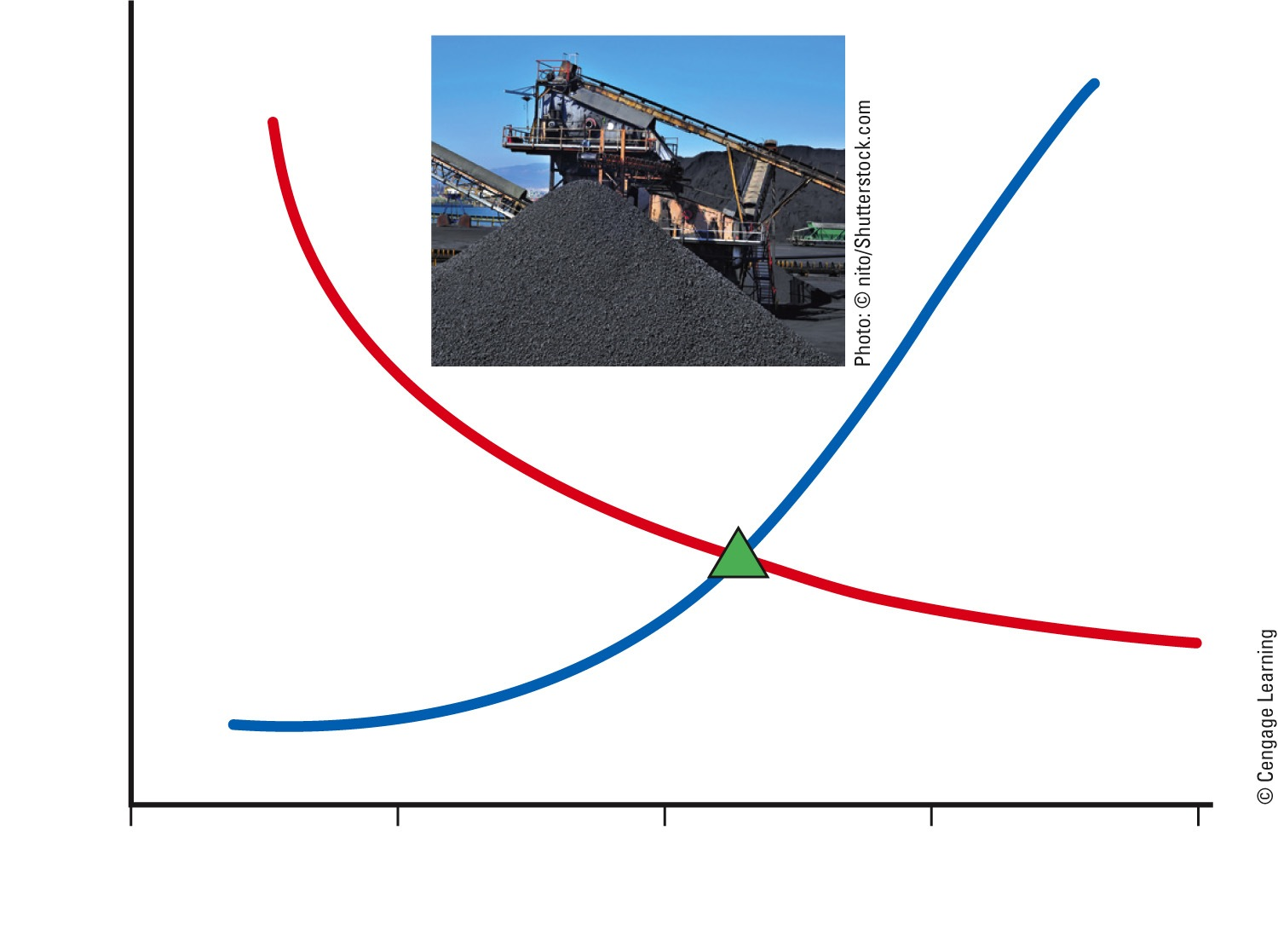
High
Marginal cost of resource production
Marginal benefit of resource use
Cost
Optimum level of resource use
Low
0
25
50
75
100
Coal removed (%)
Fig. 23-8, p. 638
Notes:
Figure 23-8: Optimum resource use: The cost of extracting coal (blue line) from a particular mine rises with each additional unit removed. Mining a certain amount of coal is profitable, but at some point, the marginal cost of further removal exceeds the monetary benefits (red line). Question: How would the location of the optimum level of resource use shift if the price of coal doubled?

Slide 20
Cost-Benefit Analysis Is a Useful but Crude Tool
Cost-benefit analysis follows guidelines
State all assumptions used
Include estimates of the ecological services
Estimate short-and long-term benefits and costs
Compare the costs and benefits of alternative courses of action
There are always uncertainties

Slide 21
23-3 How Can We Use Economic Tools to Deal with Environmental Problems?
We can use resources more sustainably by:
Including the harmful environmental and health costs of producing goods and services in their market prices (full-cost pricing)
Subsidizing environmentally beneficial goods and services
Taxing pollution and waste instead of wages and profits

Slide 22
We Can Apply the Principle of Full-Cost Pricing
Market price
Does not include indirect, external, or hidden costs
What are the direct and indirect costs of a car?
Full-cost pricing
Includes estimated costs of harmful environmental and health effects of production

Slide 23
Subsidies Can Be Environmentally Harmful or Beneficial
Perverse subsidies
Lead to environmental damage
Should be phased out
Lobbying groups
Influence governments
Subsidies can also be used for environmental benefits

Slide 24
Environmental Economic Indicators Could Help Reduce Our Environmental Impact
Measurement and comparison of the economic output of nations
Gross domestic product (GDP)
Per capita GDP
Newer methods of comparison
Genuine progress indicator (GPI)
GDP plus estimated value of beneficial transactions

Slide 25
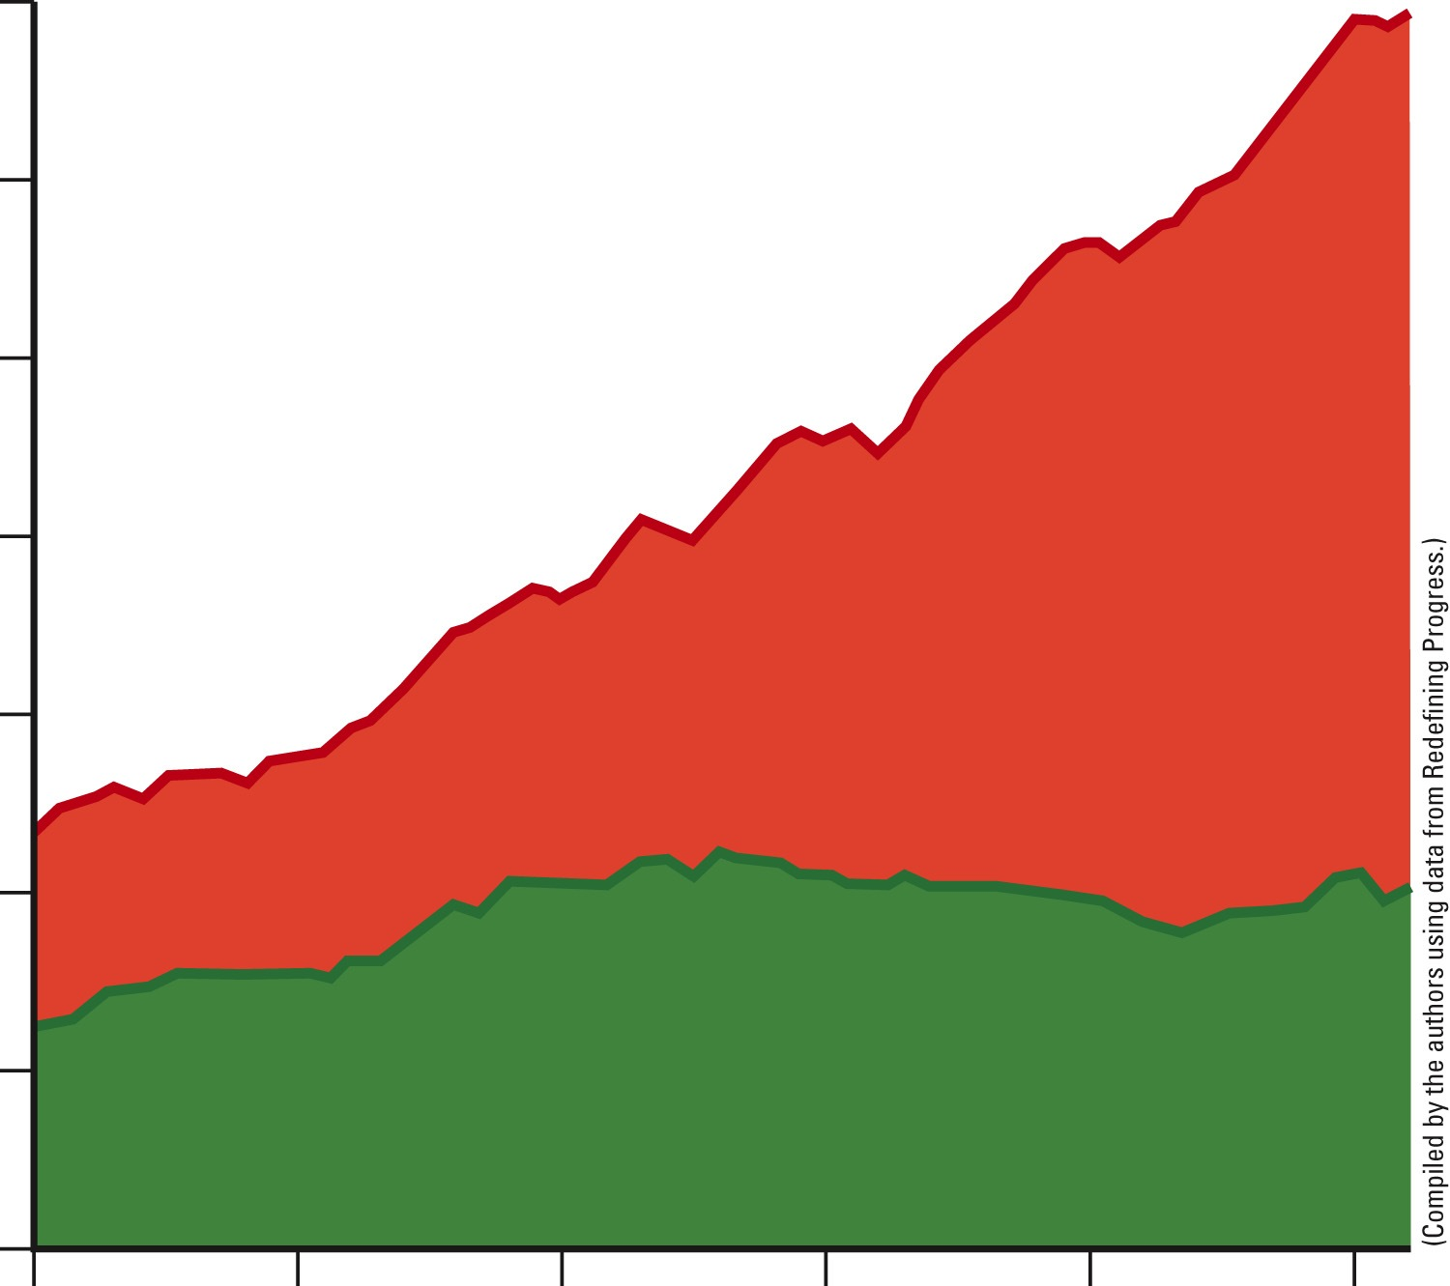
35,000
30,000
25,000
20,000
1996 Dollars per person
Per capita gross domestic product (GDP)
15,000
10,000
5,000
Per capita genuine progress indicator (GPI)
0
1950
1960
1970
1980
1990
2000
Year
Fig. 23-10, p. 641
Notes:
Figure 23-10: Monitoring environmental progress: The per capita gross domestic product (GDP) compared with the per capita genuine progress indicator (GPI) in the United States between 1950 and 2004. Questions: Would you favor making widespread use of this or similar green economic indicators? Why do you think this hasn’t been done?

Slide 26
Tax Pollution and Wastes Instead of Wages and Profits
Green taxes
So that harmful products and services are at true cost
Steps for successful implementation of green taxes
Phased in slowly, other taxes reduced, safety-net for the poor
Costa Rica
3.5% tax on market prices of fossil fuels

Slide 27
Trade-Offs
Environmental Taxes and Fees
Advantages
Disadvantages
Help bring about full-cost pricing
Low-income groups are penalized unless safety nets are provided
Encourage businesses to develop environmentally beneficial technologies and goods
Hard to determine optimal level for taxes and fees
If set too low, wealthy polluters can absorb taxes as costs
Easily administered by existing tax agencies
Fig. 23-11, p. 641
Notes:
Figure 23-11: Using green taxes to help reduce pollution and resource waste has advantages and disadvantages. Questions: Which single advantage and which single disadvantage do you think are the most important? Why?

Slide 28
We Could Label Environmentally Beneficial Goods and Services
Product eco-labeling
Help consumers
Greenwashing
Deceptive practice
Spin environmentally harmful products as green

Slide 29
Environmental Regulations Can Discourage or Encourage Innovation
Environmental regulation
Control pollution and reduce environmental degradation
Command and control approach
Incentive-based environmental regulations
Uses economic forces
Innovation-friendly regulations
Frees industries and allows time for innovation

Slide 30
Using the Marketplace to Reduce Pollution and Resource Waste
Incentive-based regulation example
Tradable pollution or resource-use permits
Cap-and-trade approach used to reduce SO₂

Slide 31
Trade-Offs
Tradable Environmental Permits
Advantages
Disadvantages
Flexible and easy to administer
Wealthy polluters and resource users can buy their way out
Encourage pollution prevention and waste reduction
Caps can be too high and not regularly reduced to promote progress
Permit prices determined by market transactions
Self-monitoring
of emissions can allow cheating
Fig. 23-13, p. 644
Notes:
Figure 23-13: Using tradable pollution and resource-use permits to reduce pollution and resource waste has advantages and disadvantages. Question: Which two advantages and which two disadvantages do you think are the most important? Why?

Slide 32
Reducing Pollution and Resource Waste by Selling Services Instead of Goods
Shift from material-flow to service-flow economy
Lease or rent services that goods provide
Shift underway in some businesses
Xerox
Carrier

Slide 33
23-4 How Can Reducing Poverty Help Us to Deal with Environmental Problems?
Reducing poverty can help us to reduce:
Population growth
Resource use
Environmental degradation

Slide 34
We Can Reduce Poverty
Poverty
People cannot meet basic needs
One fifth of the world’s population lives on less than $1.25 per day
Reducing poverty benefits society

Slide 35
We Can Reduce Poverty (cont’d.)
Important measures
Combat malnutrition and infectious diseases
Enact universal primary school education
Stabilize population growth
Reduce total and per-capita ecological footprints
Large investments in small-scale infrastructure

Slide 36
Case Study: Microlending
Microloans give hope to the poor
Microloans help more than direct aid
$5 to $500
Mostly to women

Slide 37
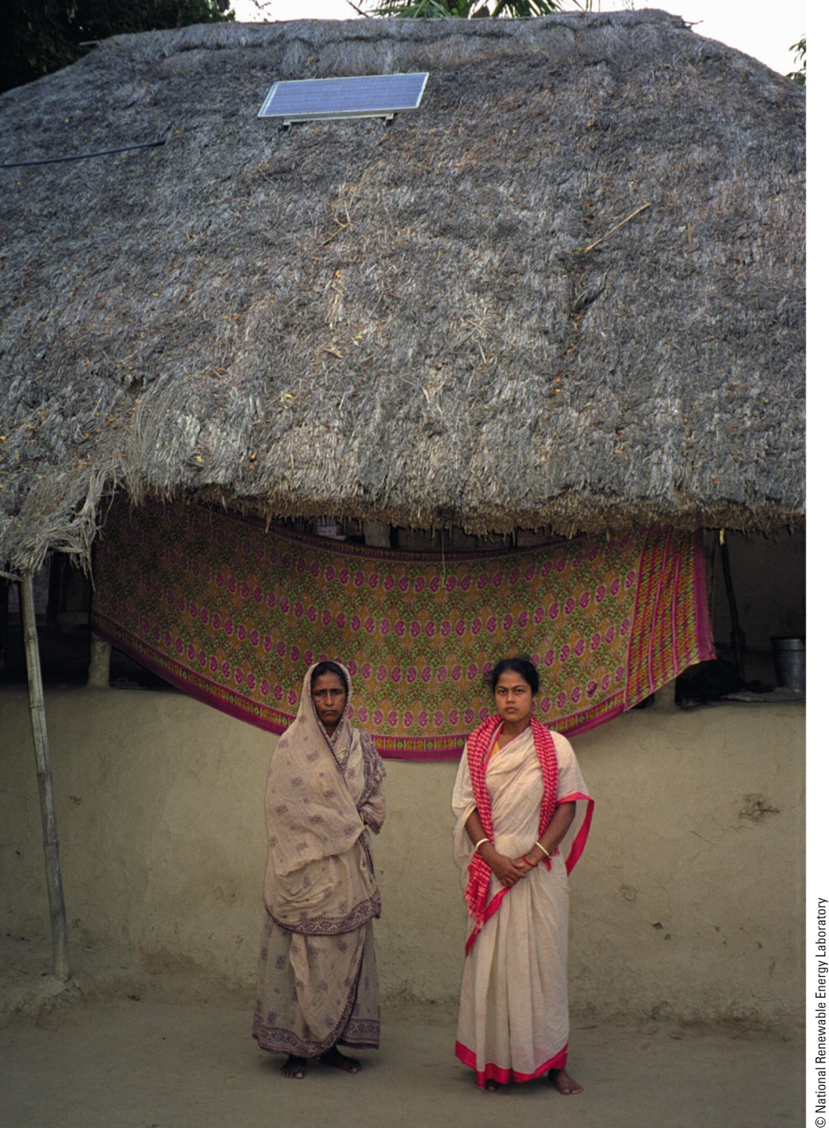
Fig. 23-15, p. 645
Notes:
Figure 23-15: A microloan helped these women in a rural village in India to buy a small solar-cell panel (installed on the roof behind them) that provides electricity to help them make a living, thus applying the solar energy principle of sustainability.

Slide 38
Working Toward the Millennium Development Goals
Millennium development goals
Sharply reduce hunger and poverty
Improve health care
Empower women
Environmental sustainability by 2015
Developed countries: spend 0.7% of national budget toward these goals

Slide 39
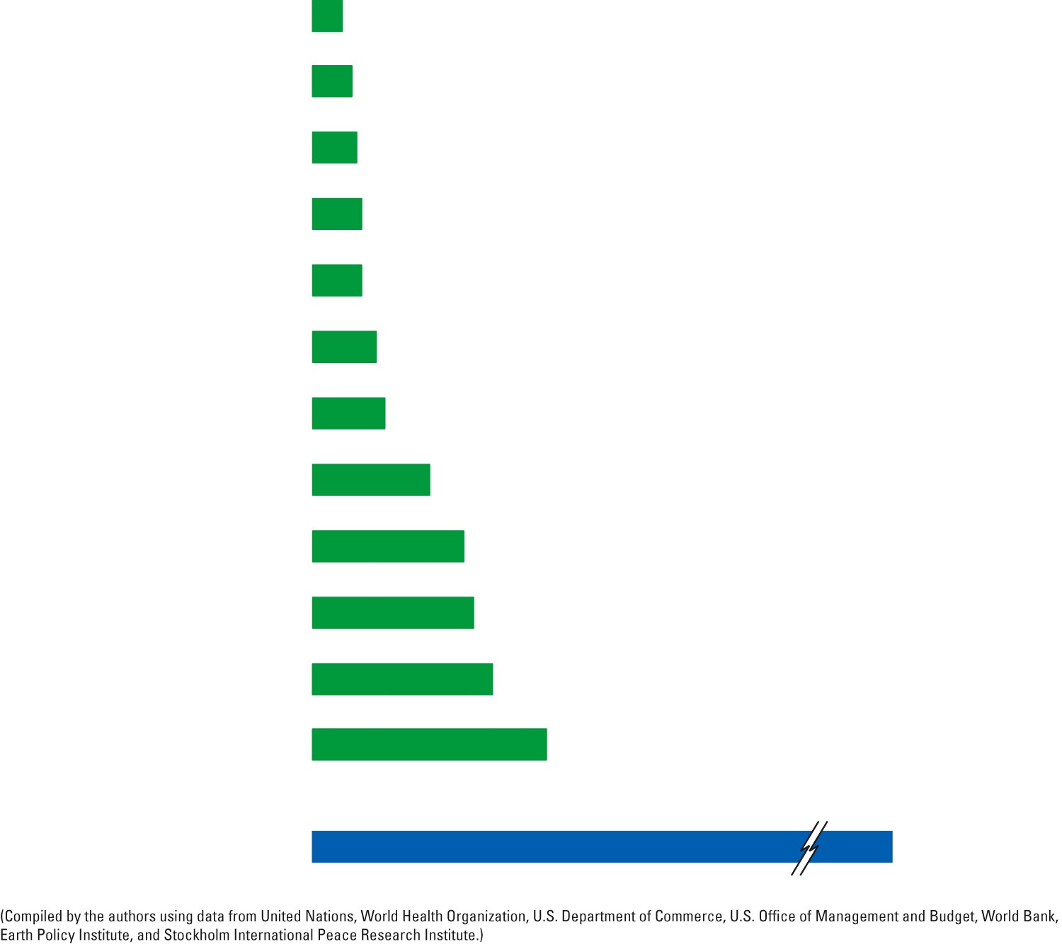
Expenditures
per year needed to
Reforest the earth
$6 billion
Protect tropical forests
$8 billion
Restore rangelands
$9 billion
Stabilize water tables
$10 billion
Deal with global HIV/AIDS
$10 billion
Restore fisheries
$13 billion
Provide universal primary education and eliminate illiteracy
$14 billion
Protect topsoil on cropland
$24 billion
Protect biodiversity
$31 billion
Provide basic health care for all
$33 billion
Provide clean drinking water and sewage treatment for all
$37 billion
Eliminate hunger and malnutrition
$48 billion
Total Earth Restoration and Social Budget
$245 billion
Fig. 23-16a, p. 647
Notes:
Figure 23.16 What should our priorities be? Question: Which item on the right side of the figure would you do without or reduce to pay for solving some of the problems listed on the left side of the figure?

Slide 40
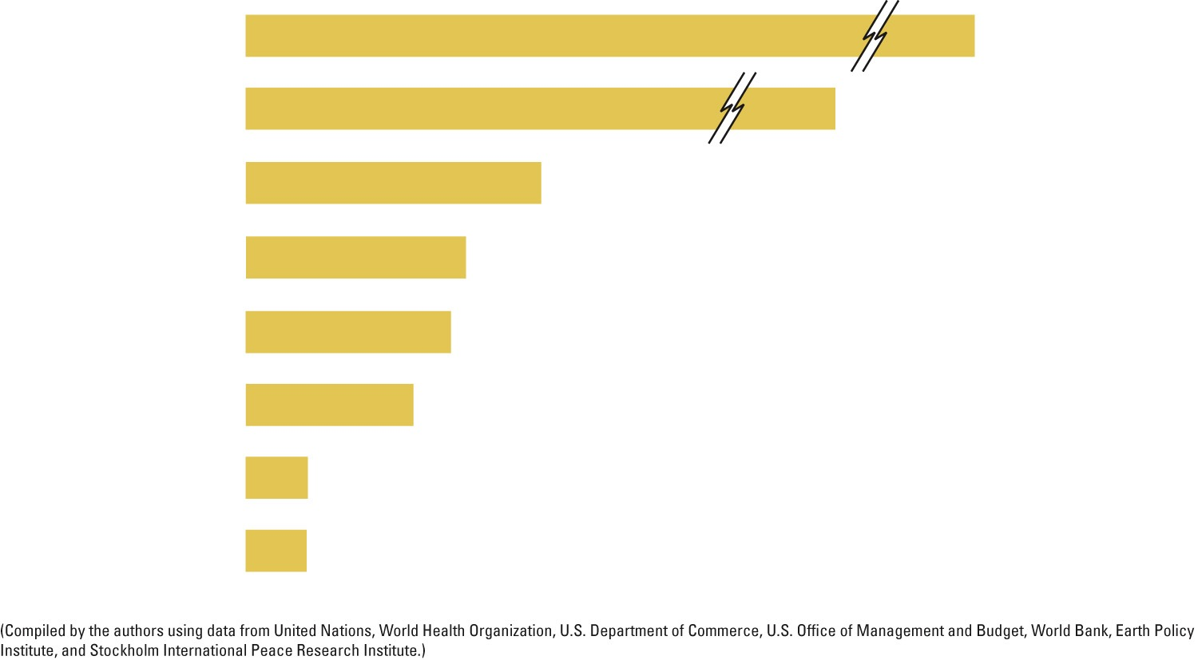
Expenditures
per year (2008)
World military
$1.4 trillion
U.S. military
$734 billion
U.S. dog food
$39 billion
U.S. highways
$29 billion
U.S. foreign aid
$27 billion
U.S. potato chips and similar snacks
$22 billion
U.S. cosmetics
$8 billion
U.S. EPA
$7.2 billion
Fig. 23-16b, p. 647
Notes:
Figure 23.16 What should our priorities be? Question: Which item on the right side of the figure would you do without or reduce to pay for solving some of the problems listed on the left side of the figure?

Slide 41
23-5 Making the Transition to More Environmentally Sustainable Economics
We can use the principles of sustainability, as well as various economic and environmental strategies, to develop more environmentally sustainable economies

Slide 42
We Are Living Unsustainably
We are depleting natural capital
Convert linear throughput economy to circular matter recycling and reuse economy
Mimics nature

Slide 43
Low-Throughput Economies Are More Sustainable
Low-throughput economy
Based on energy flow and matter recycling
Reusing and recycling nonrenewable matter
Don’t use renewable resources too fast
Reduce waste with efficiency
Reduce harmful forms of consumption
Promote pollution prevention and waste reduction

Slide 44
Inputs
(from environment)
System throughputs
Outputs
(into environment)
High-quality energy
Energy conservation
Low-quality energy (heat)
Low-waste economy
High-quality matter
Waste and pollution prevention
Pollution control
Waste and pollution
Recycle and reuse
Fig. 23-17, p. 648
Notes:
Animated Figure 23-17: Solutions. Learning and applying lessons from nature can help us design and manage more sustainable low-throughput economies. Question: What are three ways in which your school could decrease any unsustainable economic and environmental practices, and three ways that it could promote more sustainable economic and environmental practices?

Slide 45
We Can Shift to More Sustainable Economies
Economic succession
New and more innovative businesses
Green jobs
Environmentally friendly
Require governments and industries to increase spending on research and development

Slide 46
No-till cultivation
Forest conservation
Production of energy-efficient electric cars recharged by
wind and solar energy
Sustainable organic agriculture and drip-irrigation
Sustainable fishing and aquaculture
Solar-cell fields
High-speed trains
Eco-village
Wind farms
Water conservation
Bicycling
Communities of passive solar homes (eco-villages)
Reuse, recycling, and composting
Recycling facility
Fig. 23-18, p. 649
Notes:
Figure 23-18: Solutions. Some of the components of more environmentally sustainable economic development favored by ecological and environmental economists. Question: What are three new types of jobs that could be generated by such an economy?

Slide 47
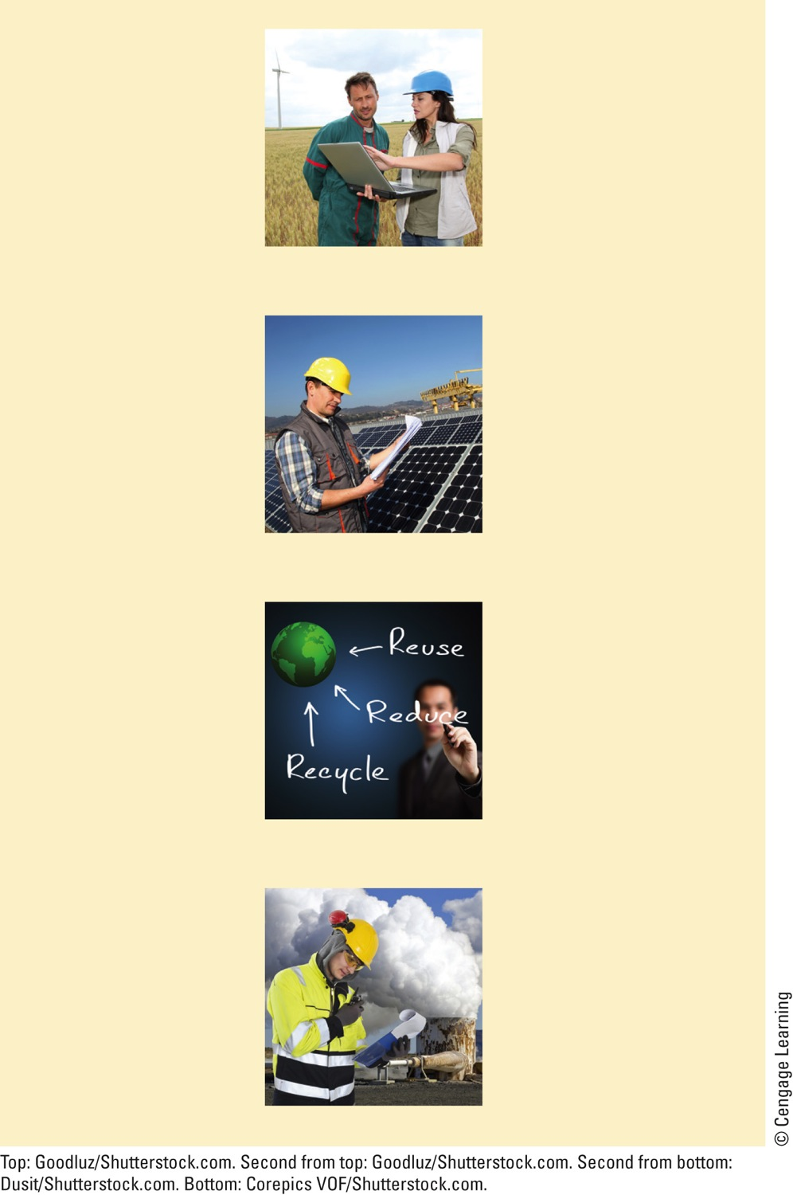
Environmentally Sustainable Businesses and Careers
Aquaculture
Environmental law
Biodiversity protection
Environmental nanotechnology
Biofuels
Fuel cell technology
Climate change research
Geographic information systems (GIS)
Conservation biology
Geothermal geologist
Ecotourism management
Hydrogen energy
Hydrologist
Energy-efficient product design
Marine science
Pollution prevention
Environmental chemistry
Recycling and reuse
Environmental design and architecture
Selling services in place of products
Solar cell technology
Environmental economics
Sustainable agriculture
Environmental education
Sustainable forestry
Environmental engineering
Urban gardening
Urban planning
Environmental entrepreneur
Waste reduction
Watershed hydrologist
Environmental health
Water conservation
Wind energy
Fig. 23-19, p. 651
Notes:
Figure 23-19: Green careers: Some key environmental businesses and careers are expected to flourish during this century, while environmentally harmful, or sunset, businesses are expected to decline. See the website for this book for more information on various environmental careers. Question: How could some of these careers help you to apply the three principles of sustainability?

Slide 48
Lessons From Nature Will Help Us in Making the Transition
For the earth:
Just so much and no more
Take what you need and leave your competitor enough to live
Never take more in your generation than you can give back to the next

Slide 49
Three Big Ideas
Making a transition to more sustainable economies will require finding ways to estimate and include the harmful environmental and health costs of producing goods and services in their market prices

Slide 50
Three Big Ideas (cont’d.)
Making this economic transition will also mean phasing out environmentally harmful subsidies and tax breaks, and replacing them with environmentally beneficial subsidies and tax breaks

Slide 51
Three Big Ideas (cont’d.)
Another way to further this transition would be to tax pollution and wastes instead of wages and profits, and to use most of the revenues from these taxes to promote environmental sustainability and reduce poverty

Slide 52
Tying It All Together: Germany’s Transition and Sustainability
A country can use economic policy to affect the energy market
Economics can play a major role in determining the size of a country’s ecological footprint
Use renewable energy resources
Use full-cost pricing

