Slide 1
7
Climate and Biodiversity

Slide 2
Core Case Study: A Temperate Deciduous Forest
Why do forests grow in some areas and not others?
Climate
Tropical
Polar
Temperate
Temperate deciduous forests
Globally more disturbed than any other ecosystem

Slide 3
Three Major Climate Zones
Fig. 7-1, p. 144
Notes:
Figure 7-1: A temperate deciduous forest in fall (left) and in winter (right).

Slide 4
7-1 What Factors Influence Climate?
Key factors that determine an area’s climate
Incoming solar energy
The earth’s rotation
Global patterns of air and water movement
Gases in the atmosphere
The earth’s surface features

Slide 5
The Earth Has Many Different Climates
Weather
Temperature, precipitation, wind speed, cloud cover
Hours to days
Climate
Area’s general pattern of atmospheric conditions over decades and longer

Slide 6
The Earth Has Many Different Climates (cont’d.)
Fig. 7-2, p. 145
Notes:
Animated Figure 7-2: Natural capital. This generalized map of the earth’s current climate zones also shows the major ocean currents and upwelling areas (where currents bring nutrients from the ocean bottom to the surface). Question: Based on this map, what is the general type of climate where you live?

Slide 7
The Earth Has Many Different Climates (cont’d.)
Ocean currents
Prevailing winds
Earth’s rotation
Redistribution of heat from the sun
Surface currents and deep currents

Slide 8
The Earth Has Many Different Climates (cont’d.)
Air circulation in lower atmosphere due to
Uneven heating of the earth’s surface by sun
Rotation of the earth on its axis
Properties of air, water, and land

Slide 9
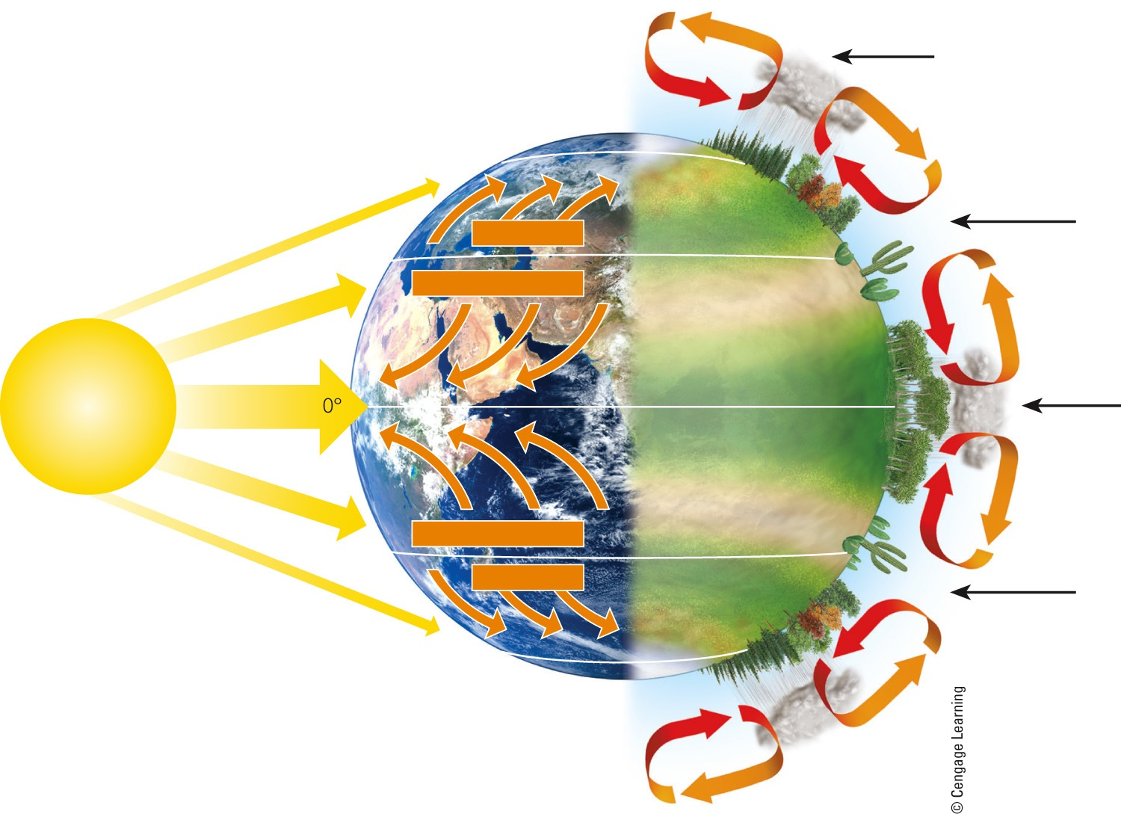
The Earth Has Many Different Climates (cont’d.)
Moist air rises, cools, and releases moisture as rain
Polar cap
Cold deserts
60°N
Air cools and descends at lower latitudes.
Evergreen coniferous forest
The highest solar energy input is at the equator.
Westerlies
Temperate deciduous
forest and grassland
30°N
Northeast trades
Hot desert
Tropical deciduous forest
Warm air rises and moves toward the poles.
Solar energy
Equator
Tropical rain forest
Tropical deciduous forest
Southeast trades
Hot desert
30°S
Air cools and descends
at lower latitudes.
Westerlies
Temperate deciduous forest and grassland
60°S
Cold deserts
Polar cap
Fig. 7-3, p. 146
Notes:
Figure 7.3 Global air circulation: As air over the equator is heated, it rises and moves toward the poles. However, the earth’s rotation deflects this movement of the air over different parts of the planet (left). This creates global patterns of prevailing winds that help to distribute heat and moisture in the atmosphere, which leads to the earth’s variety of forests, grasslands, and deserts (right).

Slide 10
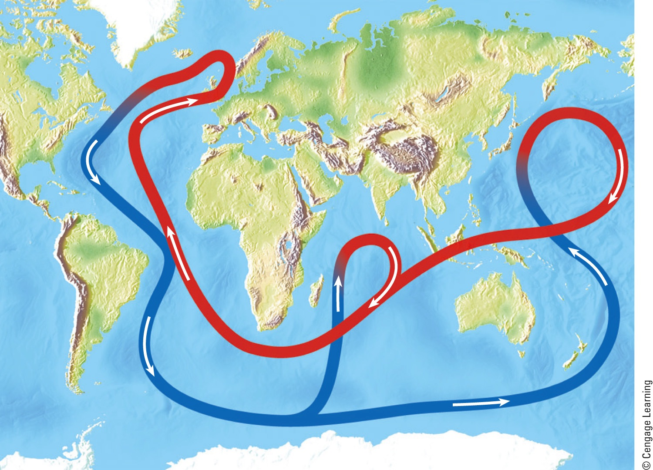
The Earth Has Many Different Climates (cont’d.)
Warm, less salty, shallow current
Cold, salty, deep current
Fig. 7-5, p. 147
Notes:
Figure 7.5 A connected loop of deep and shallow ocean currents transports warm and cool water to various parts of the earth.

Slide 11
The Earth Has Many Different Climates (cont’d.)
El Niño-Southern Oscillation
Occurs every few years
Prevailing winds in tropical Pacific Ocean change direction
Affects much of earth’s weather for 1-2 years
What is the link between air circulation, ocean currents, and biomes?

Slide 12
Greenhouse Gases Warm the Lower Atmosphere
Greenhouse gases
H₂O
CO₂
CH₄
N₂O
Natural greenhouse effect
Gases keep earth habitable
Human-enhanced global warming

Slide 13
Earth’s Surface Features Affect Local Climates
Mountains interrupt flow of prevailing winds
Rain shadow effect
Most precipitation falls on the windward side of mountain ranges
Deserts leeward
Cities create microclimates

Slide 14
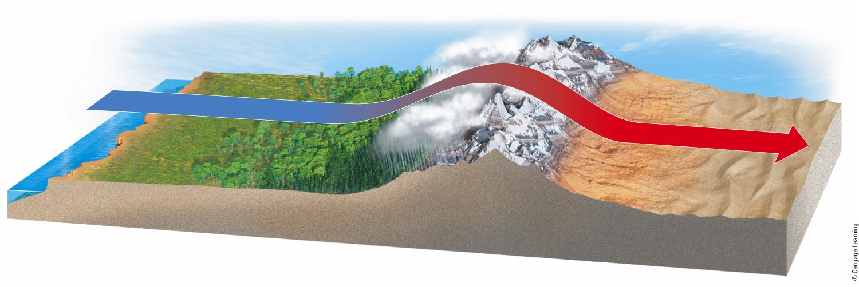
Earth’s Surface Features Affect Local Climates (cont’d.)
Prevailing winds pick up moisture from an ocean.
On the windward side of a mountain range, air rises, cools, and releases moisture.
On the leeward side of the mountain range, air descends, warms, and releases little moisture, causing rain shadow effect.
Fig. 7-6, p. 148
Notes:
Figure 7-6: The rain shadow effect is a reduction of rainfall and loss of moisture from the landscape on the leeward side of a mountain. Warm, moist air in onshore winds loses most of its moisture as rain and snow that fall on the windward slopes of a mountain range. This leads to semiarid and arid conditions on the leeward side of the mountain range and on the land beyond.

Slide 15
7-2 How Does Climate Affect the Nature and Locations of Biomes?
Differences in average annual precipitation and temperature lead to the formation of tropical, temperate, and cold deserts, grasslands, and forests, and largely determine their locations

Slide 16
Climate Helps Determine Where Organisms Can Live
Major biomes
Large land regions with certain types of climate and dominant plant life
Not uniform
Mosaic of patches
Change with latitude and elevation

Slide 17
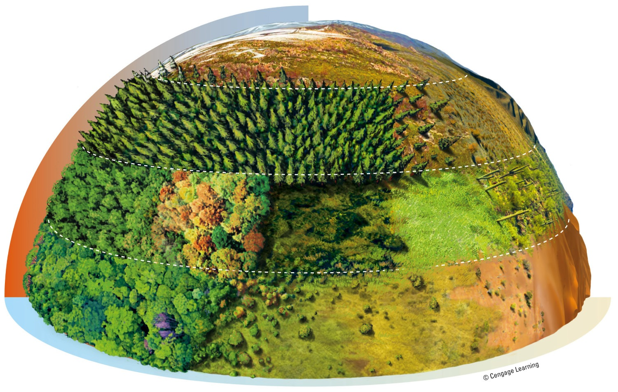
Climate Helps Determine Where Organisms Can Live (cont’d.)
Cold
Arctic tundra
Evergreen coniferous forest
Cold desert
Temperate desert
Temperate deciduous forest
Chaparral
Temperate grassland
Hot Wet
Tropical desert
Tropical rain forest
Dry
Tropical grassland (savanna)
Fig. 7-7, p. 149
Notes:
Figure 7-7: Natural capital. Average precipitation and average temperature, acting together as limiting factors over a long time, help to determine the type of desert, grassland, or forest in any particular area, and thus the types of plants, animals, and decomposers found in that area (assuming it has not been disturbed by human activities).

Slide 18
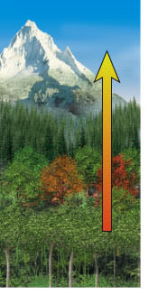
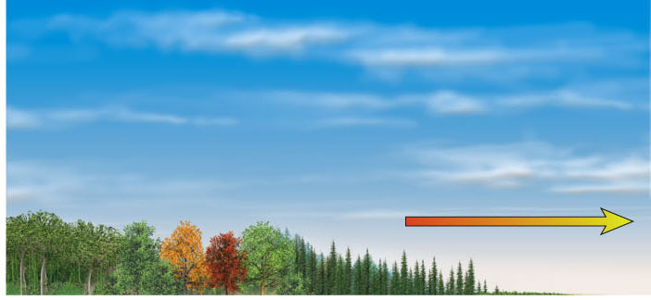
Elevation
Mountain ice and snow
Tundra (herbs, lichens, mosses)
Coniferous Forest
Deciduous Forest
Latitude
Tropical Forest
Tropical Forest
Deciduous Forest
Coniferous Forest
Tundra (herbs, lichens, mosses)
Polar ice and snow
Stepped Art
Fig. 7-8, p. 153
Notes:
Figure 7-8 Biomes and climate both change with elevation (left), as well as with latitude (right).

Slide 19
Climate Helps Determine Where Organisms Can Live (cont’d.)
Fig. 7-9, p. 150
Notes:
Animated Figure 7-9: Natural capital. The earth’s major biomes result primarily from differences in climate.

Slide 20
There Are Three Major Types of Deserts
Desert – annual precipitation low and often scattered through the year
Tropical deserts
Temperate deserts
Cold deserts
Why are deserts fragile ecosystems?

Slide 21
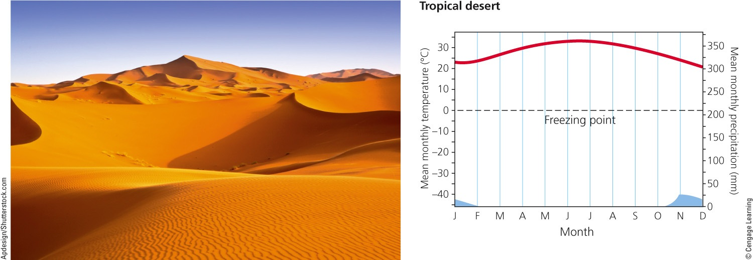
There Are Three Major Types of Deserts (cont’d.)
Fig. 7-10a, p. 150
Notes:
Figure 7.10 These climate graphs track the typical variations in annual temperature (red) and precipitation (blue) in tropical, temperate, and cold deserts. Top photo: a tropical desert in Morocco. Center photo: a temperate desert in southeastern California, with saguaro cactus, a prominent species in this ecosystem. Bottom photo: a cold desert, Mongolia’s Gobi Desert, where Bactrian camels live. Question: Which month of the year has the highest temperature and which month has the lowest rainfall for each of the three types of deserts?

Slide 22
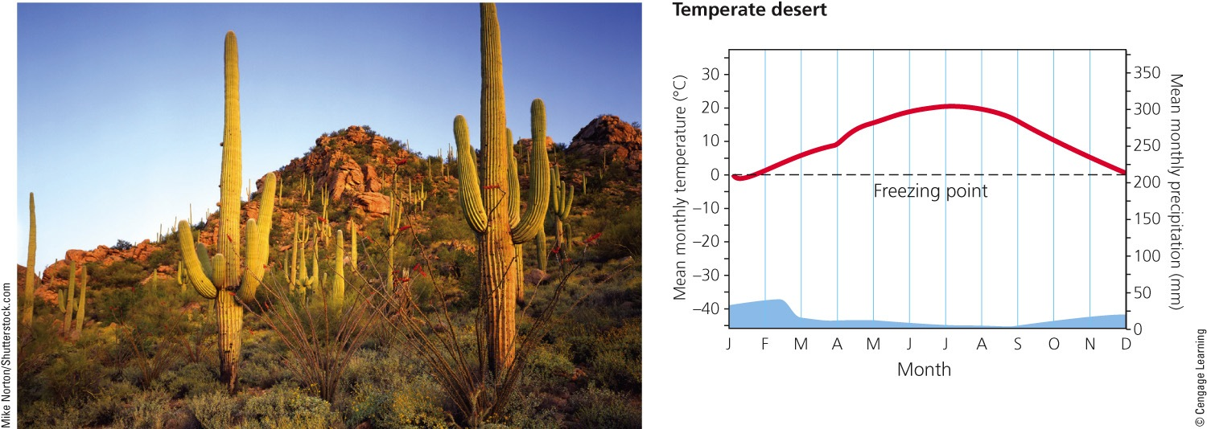
There Are Three Major Types of Deserts (cont’d.)
Fig. 7-10b, p. 150
Notes:
Figure 7.10 These climate graphs track the typical variations in annual temperature (red) and precipitation (blue) in tropical, temperate, and cold deserts. Top photo: a tropical desert in Morocco. Center photo: a temperate desert in southeastern California, with saguaro cactus, a prominent species in this ecosystem. Bottom photo: a cold desert, Mongolia’s Gobi Desert, where Bactrian camels live. Question: Which month of the year has the highest temperature and which month has the lowest rainfall for each of the three types of deserts?

Slide 23
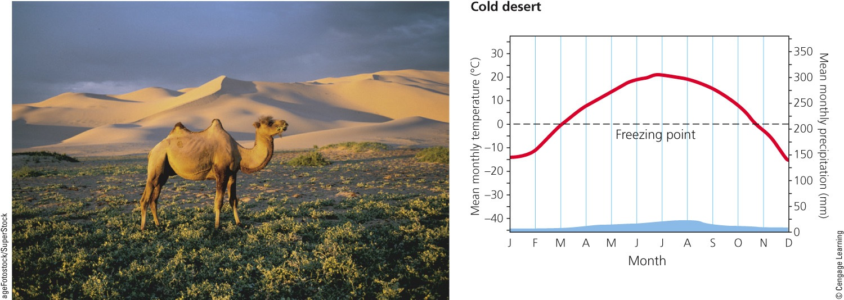
There Are Three Major Types of Deserts (cont’d.)
Fig. 7-10c, p. 150
Notes:
Figure 7.10 These climate graphs track the typical variations in annual temperature (red) and precipitation (blue) in tropical, temperate, and cold deserts. Top photo: a tropical desert in Morocco. Center photo: a temperate desert in southeastern California, with saguaro cactus, a prominent species in this ecosystem. Bottom photo: a cold desert, Mongolia’s Gobi Desert, where Bactrian camels live. Question: Which month of the year has the highest temperature and which month has the lowest rainfall for each of the three types of deserts?

Slide 24
There Are Three Major Types of Grasslands
Grasslands occur in:
Interior continents too moist for deserts and too dry for forests
Three main types:
Tropical
Temperate
Cold (arctic tundra)

Slide 25
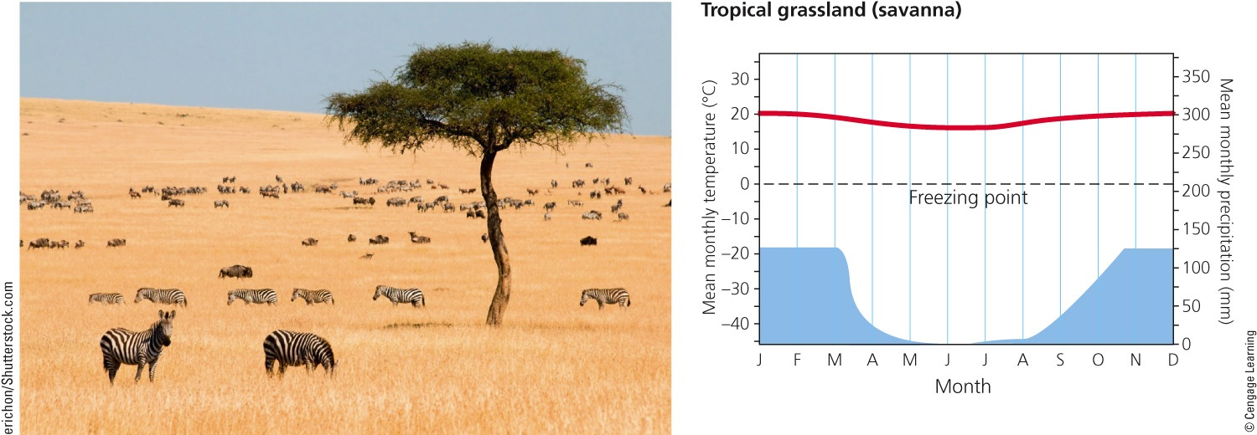
There Are Three Major Types of Deserts (cont’d.)
Fig. 7-11a, p. 153
Notes:
Figure 7.11 These climate graphs track the typical variations in annual temperature (red) and precipitation (blue) in tropical, temperate, and cold (arctic tundra) grasslands. Top photo: savanna (tropical grassland) in Kenya, Africa, with zebras grazing. Center photo: prairie (temperate grassland) in the U.S. state of Illinois, with wildflowers in bloom. Bottom photo: arctic tundra (cold grassland) in Alaska’s Arctic National Wildlife Refuge in summer. Question: Which month of the year has the highest temperature and which month has the lowest rainfall for each of the three types of grasslands?

Slide 26
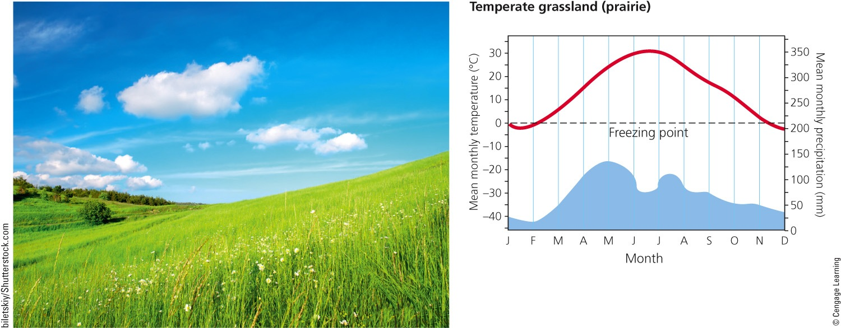
There Are Three Major Types of Deserts (cont’d.)
Fig. 7-11b, p. 153
Notes:
Figure 7.11 These climate graphs track the typical variations in annual temperature (red) and precipitation (blue) in tropical, temperate, and cold (arctic tundra) grasslands. Top photo: savanna (tropical grassland) in Kenya, Africa, with zebras grazing. Center photo: prairie (temperate grassland) in the U.S. state of Illinois, with wildflowers in bloom. Bottom photo: arctic tundra (cold grassland) in Alaska’s Arctic National Wildlife Refuge in summer. Question: Which month of the year has the highest temperature and which month has the lowest rainfall for each of the three types of grasslands?

Slide 27
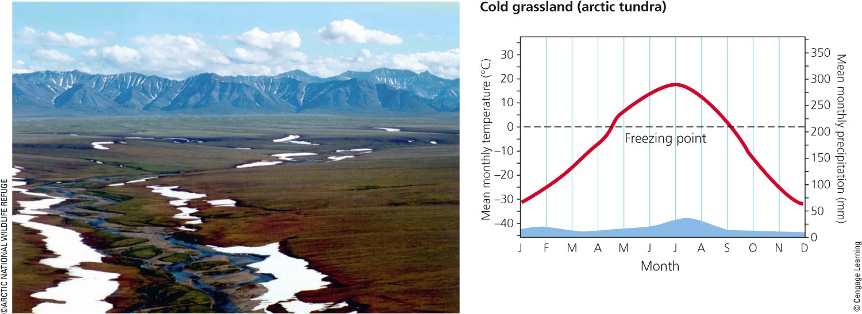
There Are Three Major Types of Deserts (cont’d.)
Fig. 7-11c, p. 153
Notes:
Figure 7.11 These climate graphs track the typical variations in annual temperature (red) and precipitation (blue) in tropical, temperate, and cold (arctic tundra) grasslands. Top photo: savanna (tropical grassland) in Kenya, Africa, with zebras grazing. Center photo: prairie (temperate grassland) in the U.S. state of Illinois, with wildflowers in bloom. Bottom photo: arctic tundra (cold grassland) in Alaska’s Arctic National Wildlife Refuge in summer. Question: Which month of the year has the highest temperature and which month has the lowest rainfall for each of the three types of grasslands?

Slide 28
There Are Three Major Types of Grasslands (cont’d.)
Tropical
Savanna
Grazing animals
Browsing animals
Temperate
Cold winters and hot and dry summers
Tall-grass prairies
Short-grass prairies
Often converted to farmland

Slide 29
There Are Three Major Types of Grasslands (cont’d.)
Fig. 7-12, p. 154
Notes:
Figure 7-12: Natural capital degradation: This intensively cultivated cropland is an example of the replacement of biologically diverse temperate grasslands (such as in the center photo of Figure 7-11) with a monoculture crop.

Slide 30
There Are Three Major Types of Grasslands (cont’d.)
Arctic tundra
Plants close to ground to conserve heat
Most growth in short summer
Animals have thick fur
Permafrost
Underground soil that stays frozen
Alpine tundra
Above tree line in mountains

Slide 31
There Are Three Major Types of Forests
Forests – lands dominated by trees
Tropical
Temperate
Cold
Northern coniferous and boreal

Slide 32
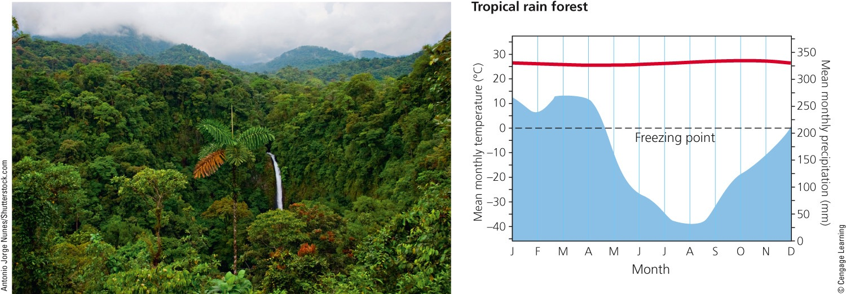
There Are Three Major Types of Forests (cont’d.)
Fig. 7-13a, p. 156
Notes:
Figure 7.13 These climate graphs track the typical variations in annual temperature (red) and precipitation (blue) in tropical, temperate, and cold (northern coniferous, or boreal) forests. Top photo: the closed canopy of a tropical rain forest in Costa Rica. Middle photo: a temperate deciduous forest in the autumn near Hamburg, Germany (see also Figure 7.1, left). Bottom photo: a northern coniferous forest in Canada’s Jasper National Park. Question: Which month of the year has the highest temperature and which month has the lowest rainfall for each of the three types of forests?

Slide 33
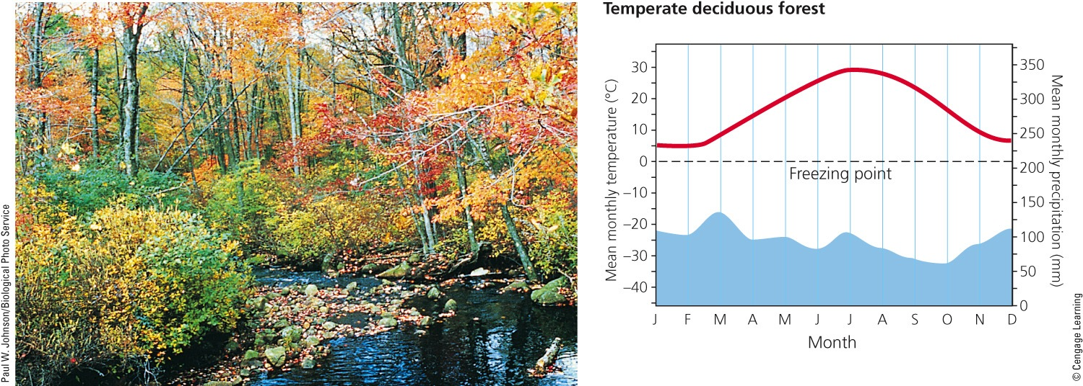
There Are Three Major Types of Forests (cont’d.)
Fig. 7-13b, p. 156
Notes:
Figure 7.13 These climate graphs track the typical variations in annual temperature (red) and precipitation (blue) in tropical, temperate, and cold (northern coniferous, or boreal) forests. Top photo: the closed canopy of a tropical rain forest in Costa Rica. Middle photo: a temperate deciduous forest in the autumn near Hamburg, Germany (see also Figure 7.1, left). Bottom photo: a northern coniferous forest in Canada’s Jasper National Park. Question: Which month of the year has the highest temperature and which month has the lowest rainfall for each of the three types of forests?

Slide 34
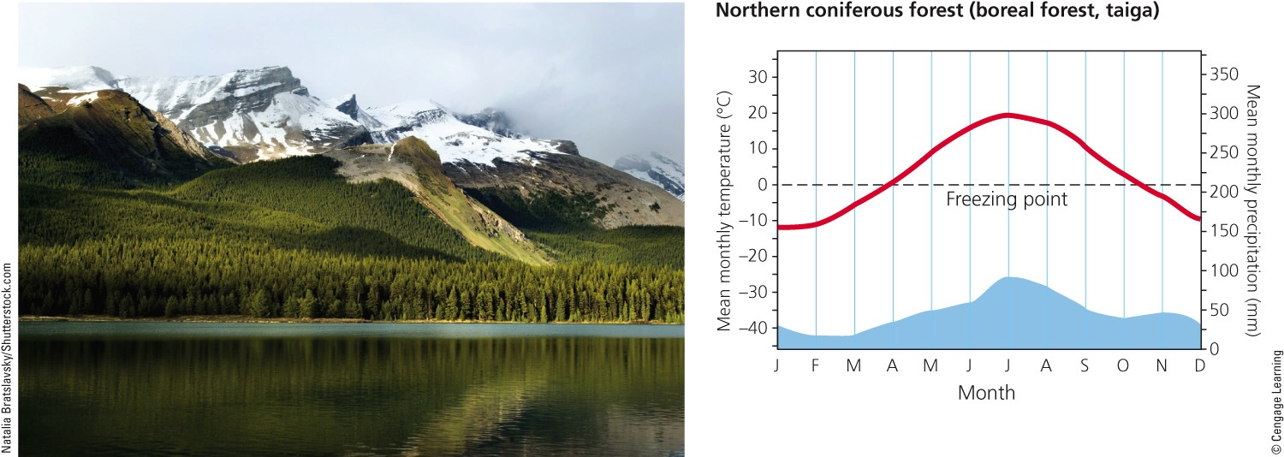
There Are Three Major Types of Forests (cont’d.)
Fig. 7-13c, p. 156
Notes:
Figure 7.13 These climate graphs track the typical variations in annual temperature (red) and precipitation (blue) in tropical, temperate, and cold (northern coniferous, or boreal) forests. Top photo: the closed canopy of a tropical rain forest in Costa Rica. Middle photo: a temperate deciduous forest in the autumn near Hamburg, Germany (see also Figure 7.1, left). Bottom photo: a northern coniferous forest in Canada’s Jasper National Park. Question: Which month of the year has the highest temperature and which month has the lowest rainfall for each of the three types of forests?

Slide 35
There Are Three Major Types of Forests (cont’d.)
Tropical rain forests
Hot and high moisture
Stratification of specialized plant and animal niches
Rapid recycling of scarce soil nutrients
What is the impact of human activities in the rain forest?

Slide 36
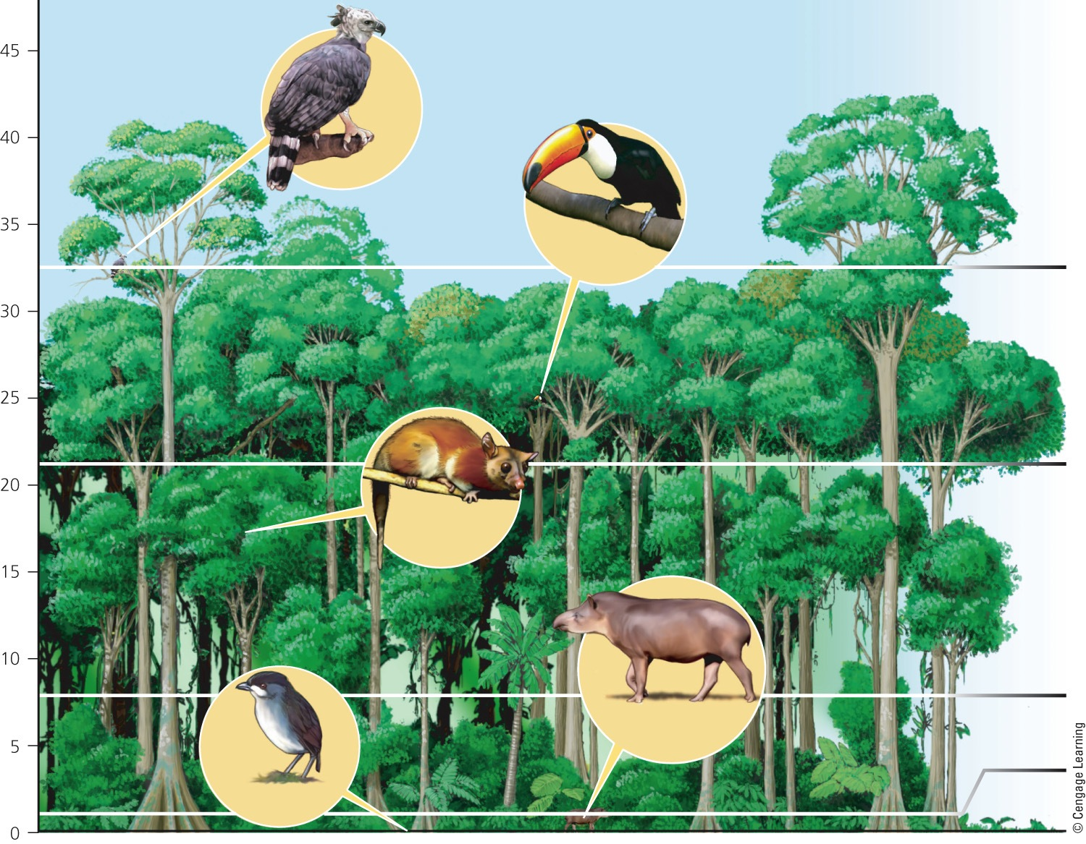
There Are Three Major Types of Forests (cont’d.)
Emergent layer
Harpy eagle
Toco toucan
Canopy
Height (meters)
Wooly opossum
Understory
Brazilian tapir
Shrub layer
Black.crowned antpitta
Ground layer
Fig. 7-14, p. 157
Notes:
Figure 7.14 Specialized plant and animal niches are stratified, or arranged roughly in layers, in a tropical rain forest. Filling such specialized niches enables species to avoid or minimize competition for resources and results in the coexistence of a great variety of species.

Slide 37
There Are Three Major Types of Forests (cont’d.)
Temperate deciduous forests
Cooler temperature and less moisture
Broad-leaf deciduous trees
Slow rate of decomposition
What is the impact of human activities on temperate forests?

Slide 38
There Are Three Major Types of Forests (cont’d.)
Evergreen coniferous forests: boreal and taigas
Cold winters
Few species of cone-bearing trees
Slow decomposition
Coastal coniferous forest, temperate rain forests
Found in scattered coastal regions

Slide 39
Mountains Play Important Ecological Roles
Mountains – steep high elevation lands
Majority of the world’s forests
Islands of biodiversity
Habitats for endemic species
Help regulate the earth’s climate
Major storehouses of water
Role in hydrologic cycle

Slide 40
Mountains Play Important Ecological Roles (cont’d.)
Mount Rainier National Park in Washington State
Fig. 7-16, p. 159
Notes:
Figure 7-16: Mountains, such as this one in Aspen, Colorado, play important ecological roles.

Slide 41
7-3 How Have Human Activities Affected the Word’s Terrestrial Ecosystems?
Human activities are disrupting ecosystem and economic services provided by many of earth’s deserts, grasslands, forests, and mountains

Slide 42
Humans Have Disturbed Much of the Earth’s Land
About 60% of the world’s major terrestrial ecosystems are being degraded
The human ecological footprint is spreading across the globe

Slide 43
Natural Capital Degradation
Major Human Impacts on Terrestrial Ecosystems
Deserts
Grasslands
Forests
Mountains
Large desert cities
Conversion to cropland
Clearing for agriculture, livestock grazing, timber, and urban development
Agriculture
Destruction of soil and underground habitat
by off-road vehicles
Release of CO₂ to atmosphere from burning grassland
Timber and mineral extraction
Conversion of diverse forests to tree plantations
Hydroelectric dams and reservoirs
Depletion of groundwater
Overgrazing by livestock
Damage from off-road vehicles
Air pollution blowing in from urban areas and power plants
Land disturbance and pollution from mineral extraction
Oil production and off-road vehicles in arctic tundra
Pollution of forest streams
Soil damage from off-road vehicles
Fig. 7-17, p. 160
Notes:
Figure 7.17 Human activities have had major impacts on the world’s deserts, grasslands, forests, and mountains (Concept 7-3), as summarized here. Question: For each of these biomes, which two of the impacts listed do you think are the most harmful?

Slide 44
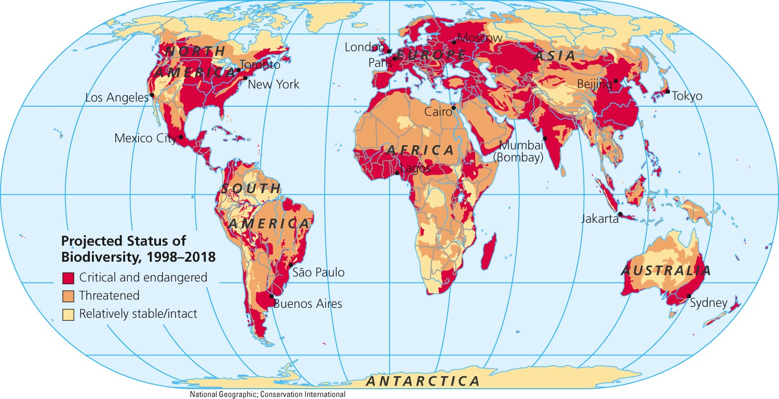
Fig. 7-18, p. 160
Notes:
Figure 7-18: Natural capital degradation: Projected status of biodiversity in 2018, resulting from ongoing threats of habitat loss and fragmentation, invasions of nonnative species, pollution, climate change, and unsustainable exploitation.

Slide 45
Size and Locations of Biomes Can Change
Biomes are not fixed
They change as the climate changes
Human activities are likely to affect biome placement in the future

Slide 46
Size and Locations of Biomes Can Change (cont’d.)
Fig. 7-19, p. 162
Notes:
Figure 7-19: As temperatures rose during the last 18,000 years, huge quantities of ice melted and the global climate changed. This led to shifts in the sizes and locations of several major biomes in eastern North America. Question: Based on these maps, how might you expect the sizes and locations of these biomes to change if the earth’s average atmospheric temperature rises by about 2–5 Cº (4–9 Fº) during this century.

Slide 47
Three Big Ideas
Differences in climate:
Based on long-term differences in average temperature and precipitation
Largely determine the types and locations of the earth’s deserts, grasslands, and forests
The earth’s terrestrial systems provide important ecological and economic services

Slide 48
Three Big Ideas (cont’d.)
Human activities are degrading and disrupting many of the ecological and economic services provided by the earth’s terrestrial ecosystems

Slide 49
Tying It All Together: A Temperate Deciduous Forest and Sustainability
Climate plays a key role in determining the nature of terrestrial ecosystems
The earth’s dynamic climate system helps distribute heat from solar energy and recycle the earth’s nutrients
In nature, everything is connected

