Slide 1
Lesson 1
Mendelian Genetics

Slide 2
Focus Question
What is the significance of Mendel's experiments to the study of genetics?

Slide 3
New Vocabulary
genetics
genotype
allele
phenotype
dominant
law of segregation
recessive
hybrid
homozygous
law of independent assortment
heterozygous

Slide 4
Review Vocabulary
segregation: the separation of allelic genes that typically occurs during meiosis

Slide 5
How Genetics Began
The passing of traits to the next generation is called inheritance, or heredity.
Gregor Mendel published his findings on the method of inheritance in garden pea plants.
He cross-pollinated pea plants, which normally self-fertilize.
He rigorously followed various traits in the pea plants he bred.
Mendel began the study of genetics, the science of heredity.

Slide 6
The Inheritance of Traits
One trait Mendel noticed was seed color.
Some plants always produced green seeds; others always produced yellow seeds.
Mendel cross-bred the green and yellow seed plants.
Mendel called the green-seed and yellow-seed plants the parent, or P, generation.

Slide 7
The Inheritance of Traits
F₁ and F₂ Generations
The offspring of this P cross are called the first filial (F₁) generation.
The second filial (F₂) generation is the offspring from the F₁ cross.
In Mendel’s peas, the green-seed trait disappeared in the F₁ generation, but reappeared in the F₂ generation.
The F₂ generation showed a 3:1 ratio of yellow: green seeds.

Slide 8
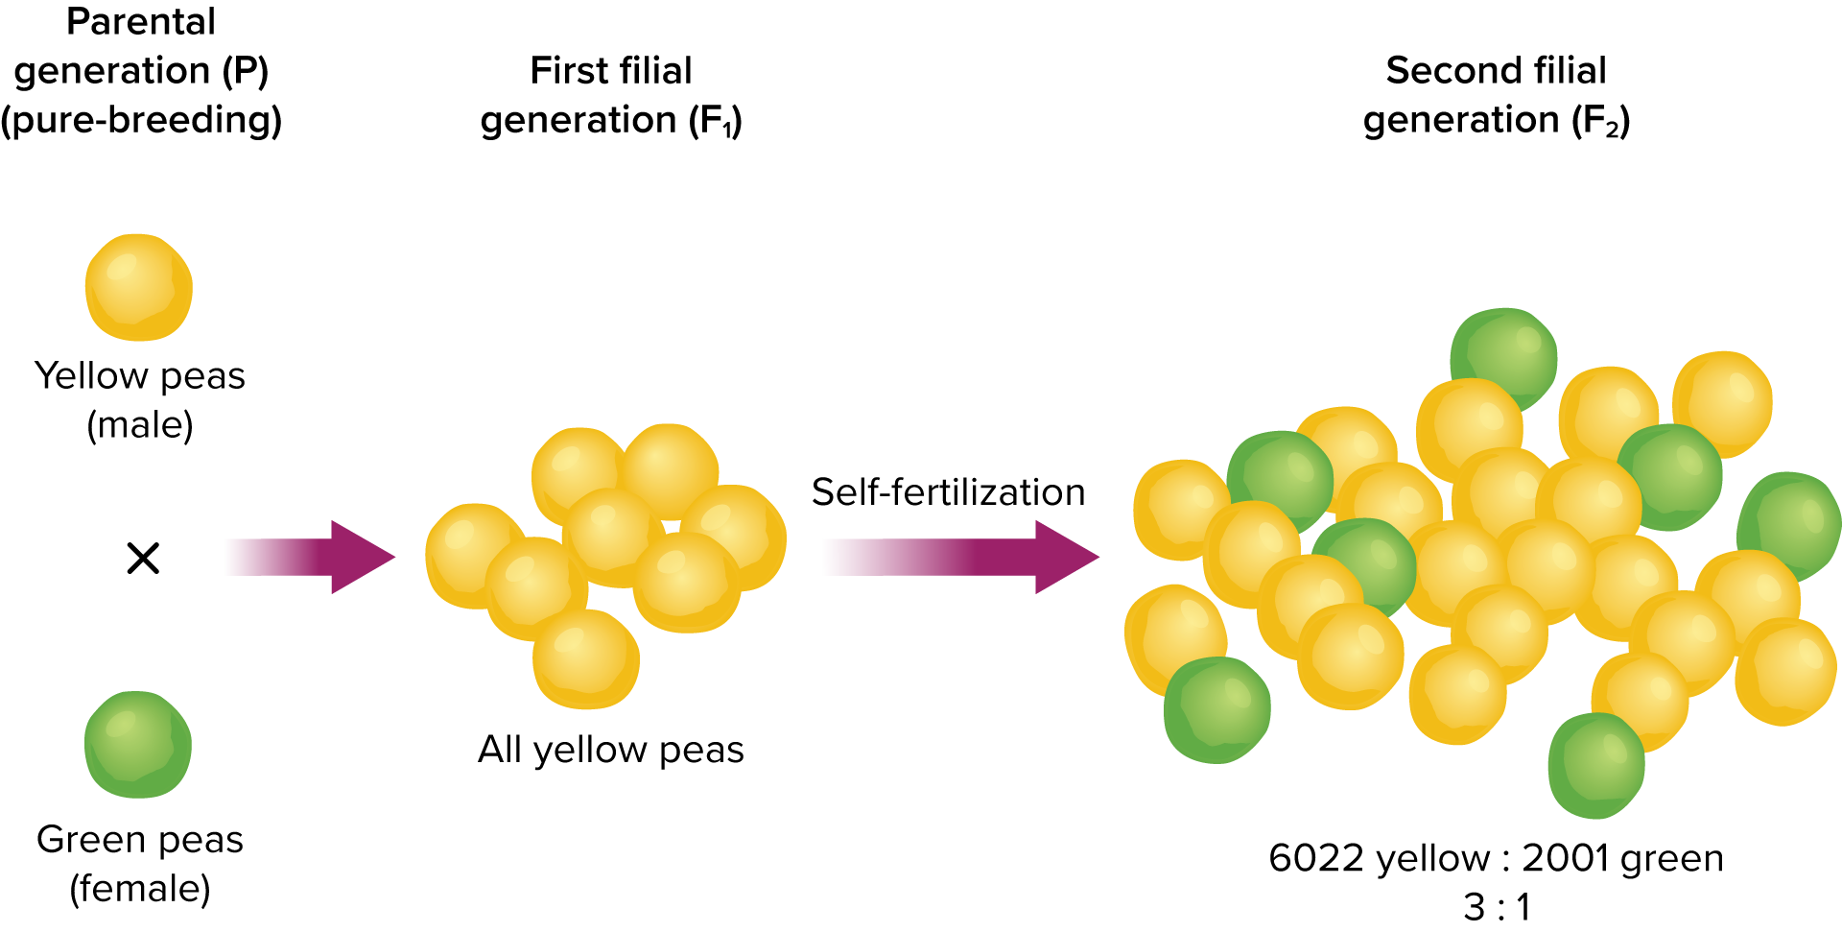
The Inheritance of Traits

Slide 9
The Inheritance of Traits
Genes in Pairs
Mendel concluded that there must be two forms of the seed trait in the pea plants, and that each was controlled by a factor.
An allele is an alternative form of a single gene.
The gene for yellow seeds and the gene for green seeds are different alleles for the same gene.

Slide 10
The Inheritance of Traits
Dominant alleles controlled the traits that appeared in the F₁ generation.
Recessive alleles were masked in the F₁ generation.
In Mendel’s cross, yellow seeds were dominant to green seeds.

Slide 11
The Inheritance of Traits
Dominance
When modeling inheritance, the dominant allele is represented by a capital letter (Y), and a recessive allele is represented with a lower case letter (y).
An organism with two of the same alleles for a particular trait is homozygous for that trait (YY or yy).

Slide 12
The Inheritance of Traits
An organism with two different alleles for a particular trait is heterozygous for that trait (Yy).
In heterozygous individuals, the dominant trait will be observed, and the recessive trait will be masked.

Slide 13
The Inheritance of Traits
Genotype and Phenotype
The appearance of an organism does not always indicate which pair of alleles it possesses.
An organism’s allele pairs are called its genotype.
The observable characteristic or outward expression of an allele pair is called the phenotype.
The genotype of yellow-seed plants could be YY or Yy.
The genotype of green-seed plants is yy.

Slide 14
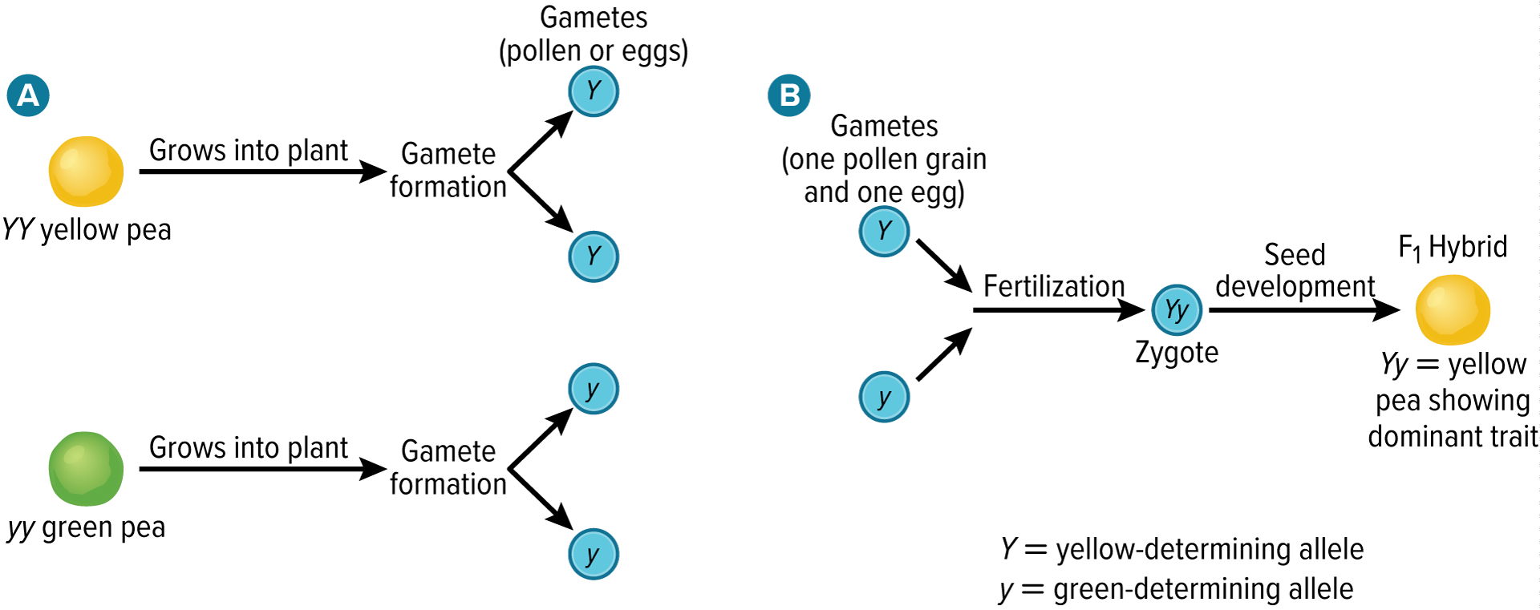
The Inheritance of Traits
Mendel’s Law of Segregation
The law of segregation states that the two alleles for each trait separate during meiosis. During fertilization, two alleles for that trait unite.
Heterozygous organisms are called hybrids.

Slide 15
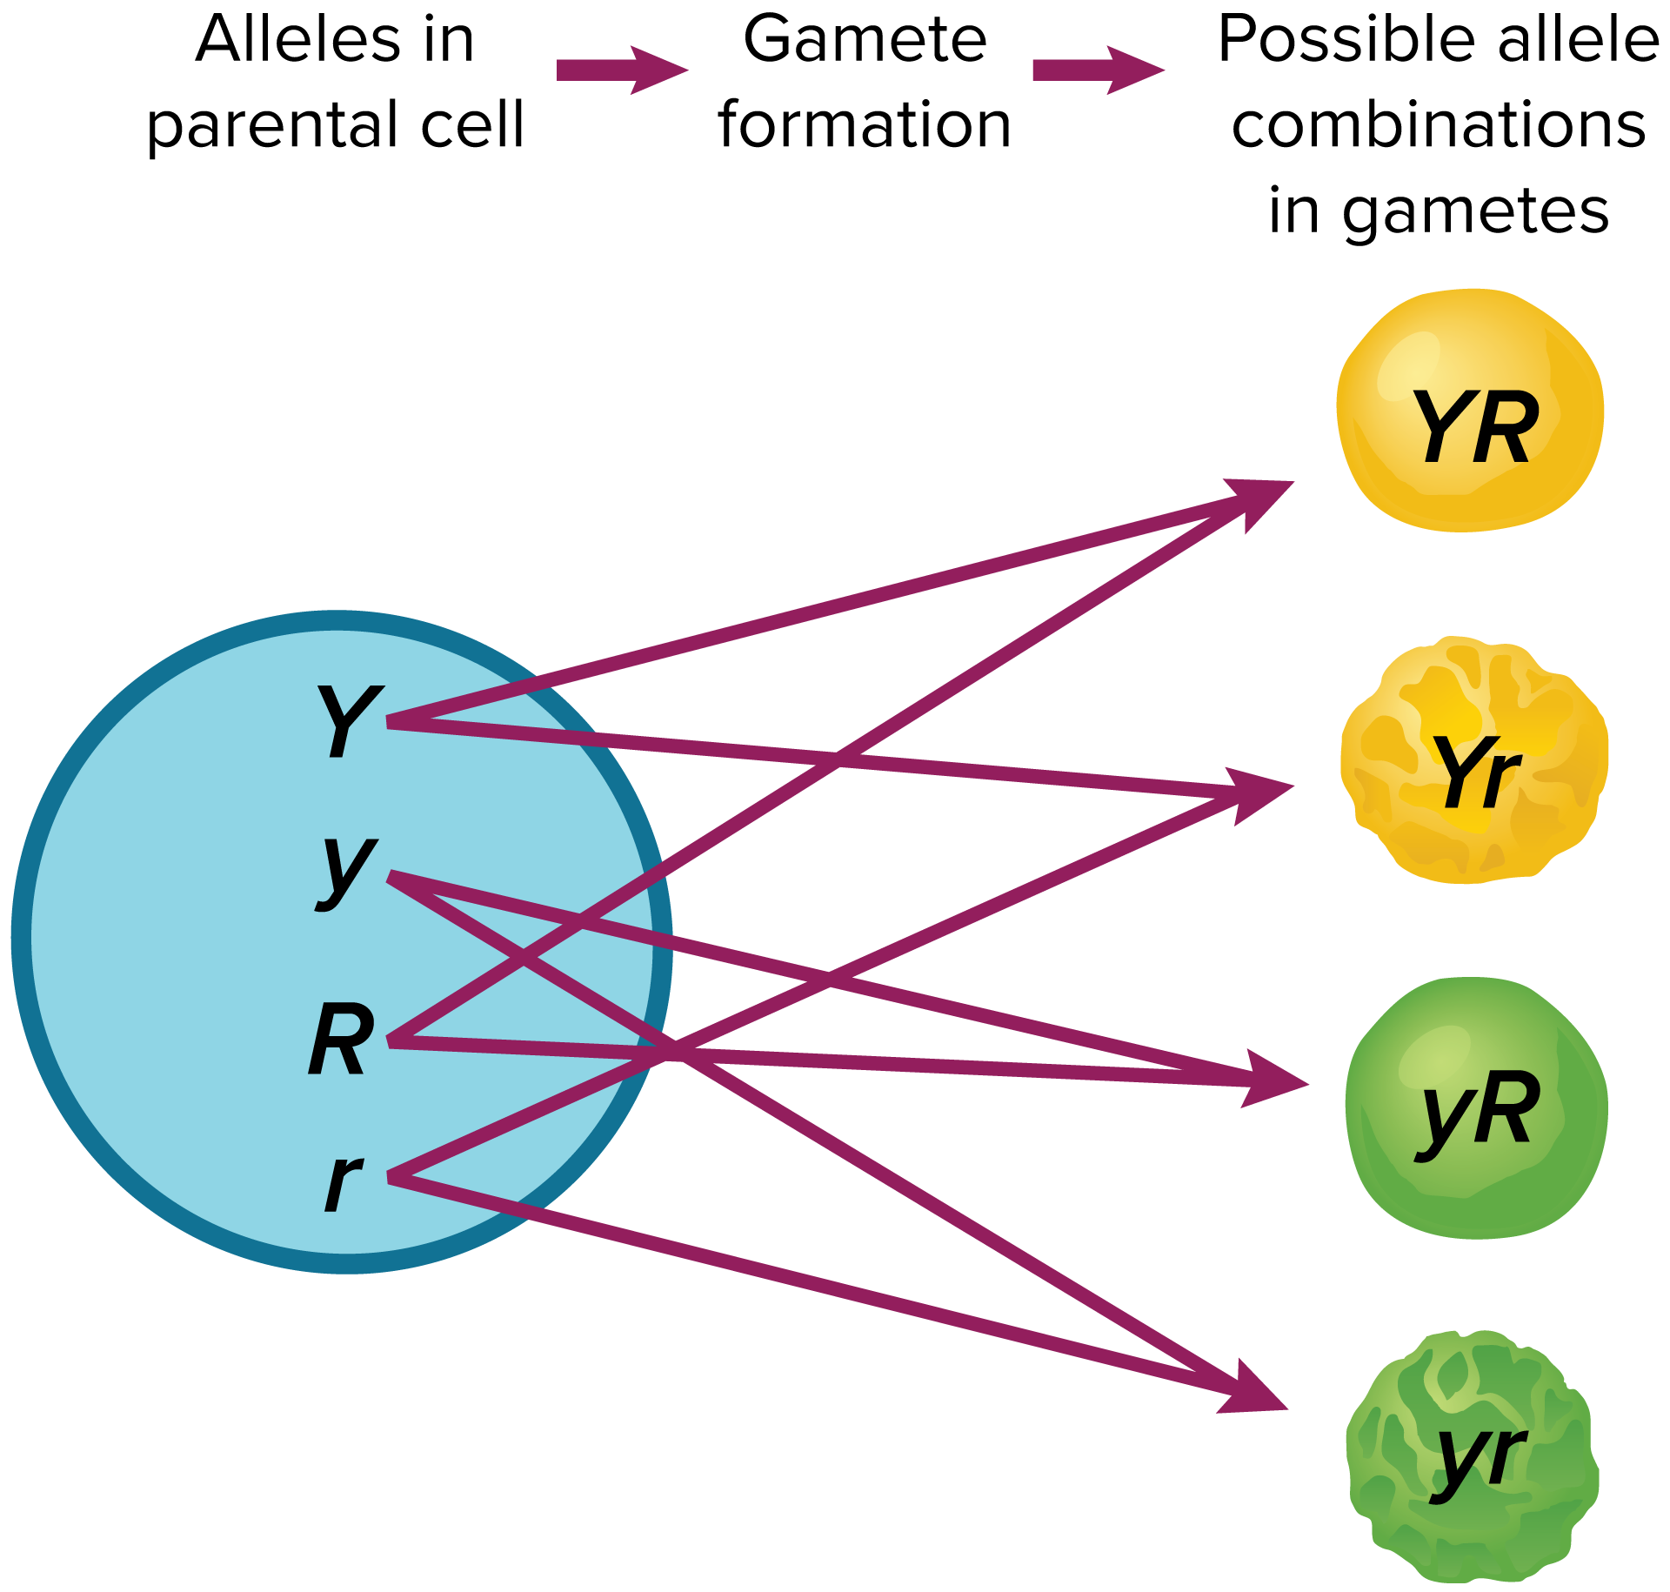
The Inheritance of Traits
Mendel’s Law of Independent Assortment
The law of independent assortment states that random distribution of alleles occurs during gamete formation.
Genes on separate chromosomes sort independently during meiosis.
Each allele combination is equally likely to occur.

Slide 16
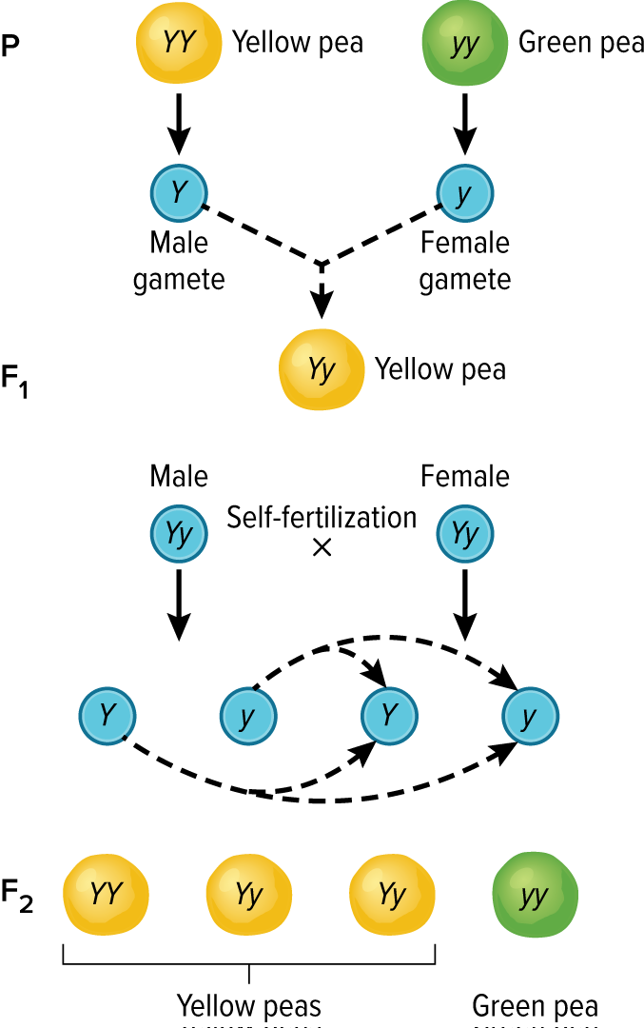
Punnett Squares
Monohybrid Cross
Punnett Squares help keep track of the possible genotypes involved in a cross.
A cross that involves hybrids for a single trait is called a monohybrid cross.

Slide 17
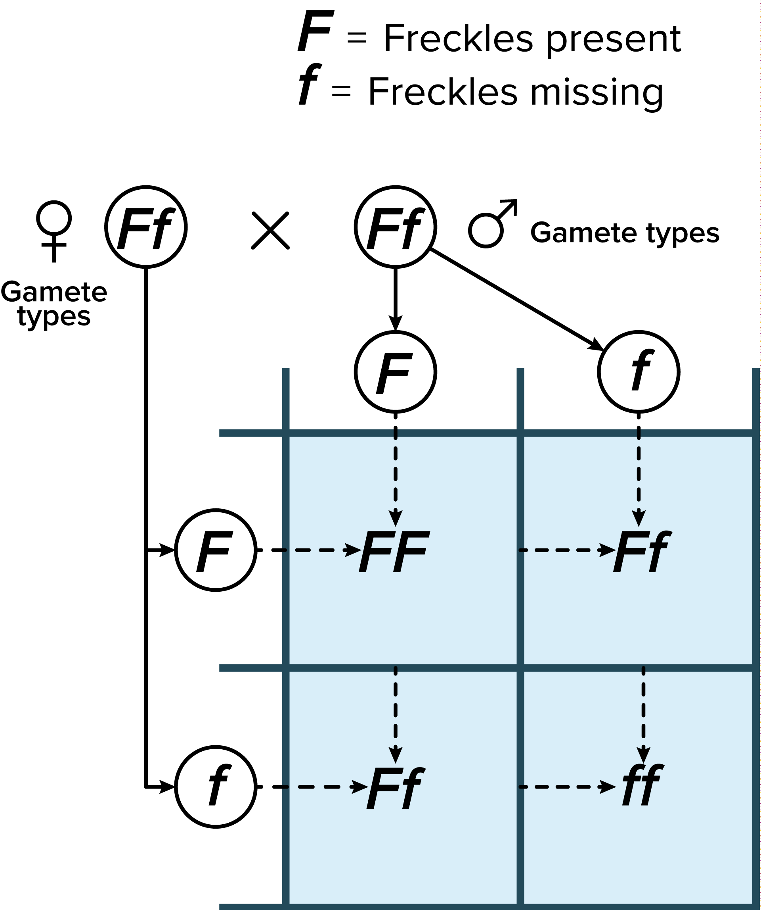
Punnett Squares
Monohybrid Cross
The number of squares is determined by the number of different types of alleles (F or f) produced by each parent.
In this cross, the genotypic ratio is 1:2:1 (FF:Ff:ff).
The phenotypic ratio is 3:1 (freckles: freckles missing).

Slide 18
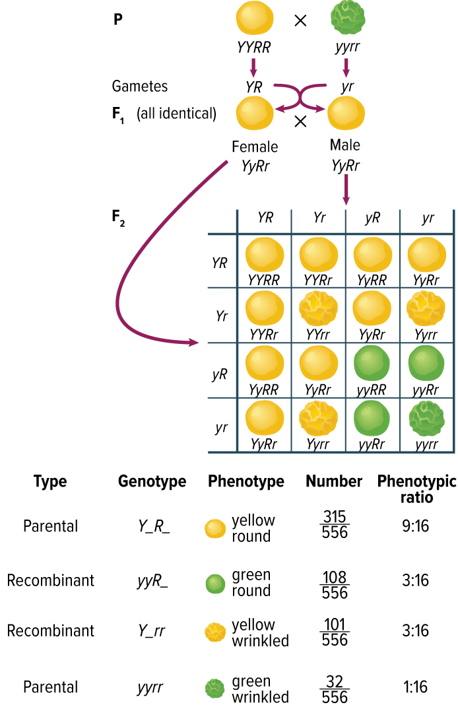
Punnett Squares
Dihybrid Cross
The simultaneous inheritance of two or more traits in the same plant is a dihybrid cross.
Four types of alleles from the male gametes and four types of alleles from the female gametes can be produced.
The resulting phenotypic ratio is 9:3:3:1.

Slide 19
Probability
Dihybrid cross
The inheritance of genes can be compared to the probability of flipping a coin.
Actual data might not perfectly match the predicted ratios.
Mendel’s results were not exactly a 9:3:3:1 ratio, but the larger the number of offspring involved, the more likely it will match the results predicted by Punnett squares.

