Slide 1
Lesson 2
Genetic Recombination and Gene Linkage

Slide 2
Focus Question
How do genetic recombination and gene linkage compare?

Slide 3
New Vocabulary
genetic recombination
polyploidy

Slide 4
Review Vocabulary
protein: large, complex polymer essential to all life that provides structure for tissues and organs

Slide 5
Genetic Recombination
The new combination of genes produced by crossing over and independent assortment is called genetic recombination.
Combinations of genes due to independent assortment can be calculated using the formula 2^{n}, where n is the number of chromosome pairs.
Any possible male gamete can fertilize any possible female gamete, so the possible combinations after fertilization are 2^{n} X 2^{n}.
Genetic recombination increases variation.

Slide 6
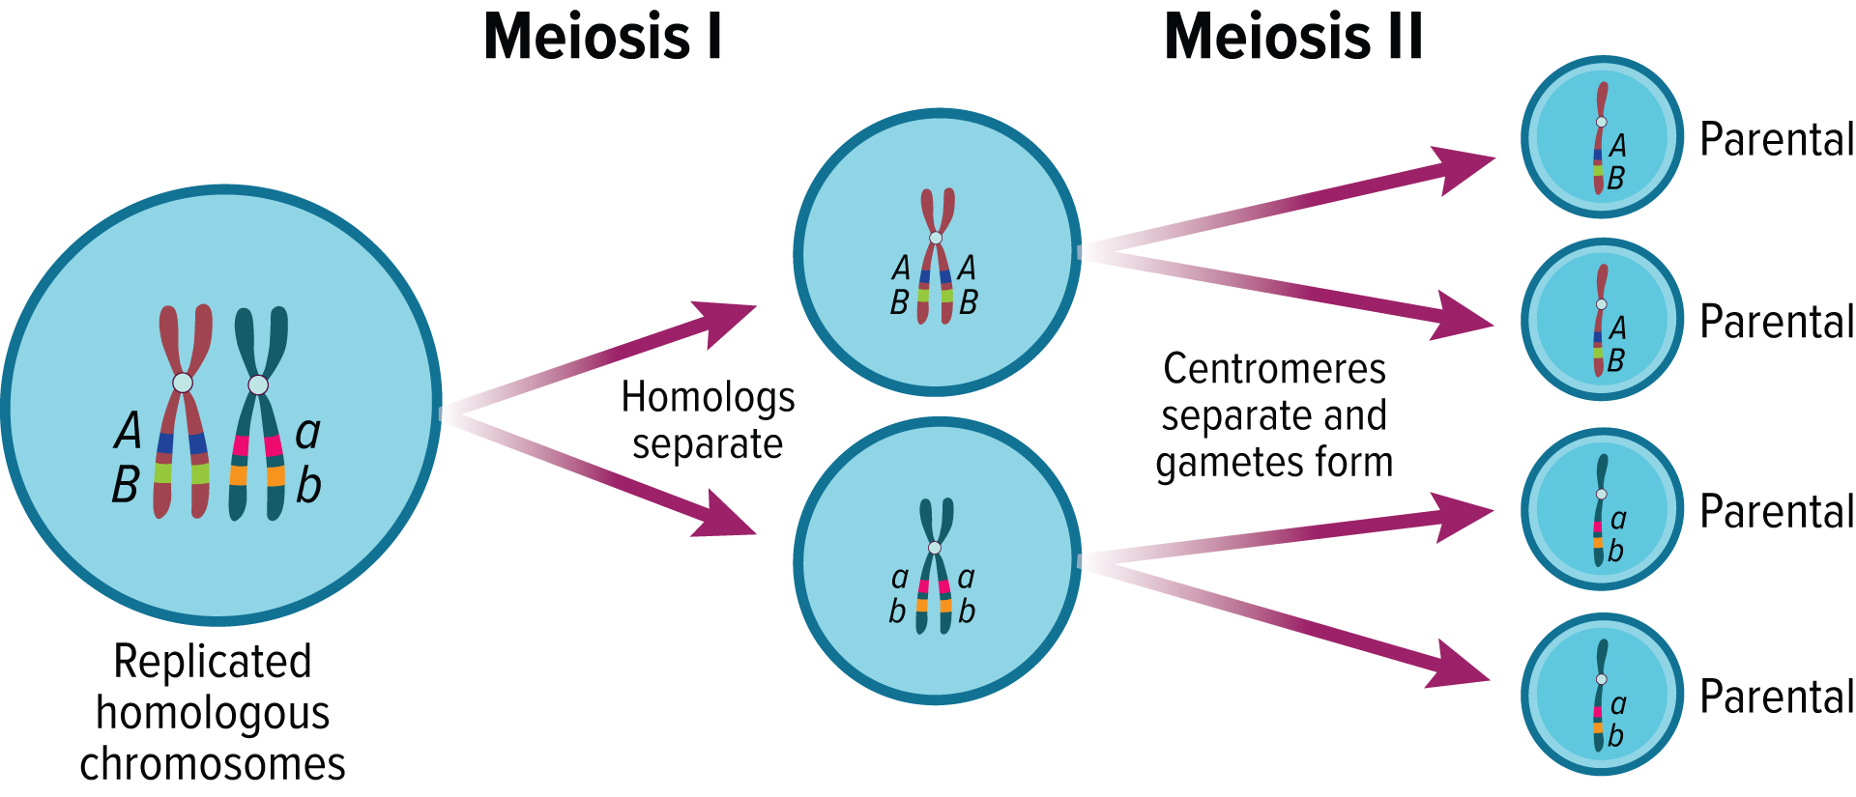
Gene Linkage
Genes located close to each other on the same chromosome are said to be linked.
They usually travel together during gamete formation.
Gene linkage results in an exception to Mendel’s law of independent assortment.

Slide 7
Gene Linkage
Chromosome Maps
Crossing over occurs more frequently between genes that are farther apart.
Cross-over data can be used to create chromosome maps, depictions of how genes are arranged on a chromosome.

Slide 8
Polyploidy
Polyploidy is the occurrence of one or more extra sets of all chromosomes in an organism.
A triploid organism is designated 3n, which means that it has three complete sets of chromosomes.
Many agricultural crops are polyploid.
Example: wheat (6n), oats (6n), and sugar cane (8n)
Polyploid plants often have increased vigor and size.

