Slide 1
Lesson 3
Applied Genetics

Slide 2
Focus Question
What are examples of selective breeding?

Slide 3
New Vocabulary
selective breeding
test cross
inbreeding

Slide 4
Review Vocabulary
hybrid: organism that is heterozygous for a particular trait

Slide 5
Selective Breeding
For thousands of years, humans have bred plants and animals for specific desired traits.
The process by which desired traits of certain plants and animals are selected and passed on to their future generations is called selective breeding.
Methods for selective breeding include hybridization and inbreeding.

Slide 6
Selective Breeding
Hybridization
A hybrid occurs by crossing parent organisms with different forms of a trait to produce offspring with specific traits.
The process of creating hybrids is called hybridization.
Disadvantages of hybridization include expense and length of time needed.
Advantages of hybridization include adaptability and increased numbers of offspring.

Slide 7
Selective Breeding
Inbreeding
Inbreeding is the process in which two closely related organisms are bred to have the desired traits and to eliminate the undesired ones in future generations.
Inbreeding is used to create pure breeds in horses, dogs, and other animals.
A disadvantage of inbreeding is that harmful recessive traits also can be passed on to future generations.

Slide 8
Test Cross
Breeders can determine the genotype of the hybrid by using a test cross.
A test cross involves breeding an organism that has the unknown genotype with one that is homozygous recessive for the desired trait.
If the parent’s genotype is homozygous dominant, all the offspring will have the dominant phenotype.
If the parent’s genotype is heterozygous, the offspring will show a 1:1 phenotypic ratio.

Slide 9
Test Cross
Performing a Test Cross
In grapefruit trees, white fruit color is dominant (W).
Red fruit color is recessive (w).
Red grapefruit must be homozygous recessive (ww).
White can be either homozygous dominant (WW) or heterozygous (Ww).
In a test cross, a tree with white fruit color of unknown genotype is crossed with a tree with red fruit color of ww genotype.

Slide 10
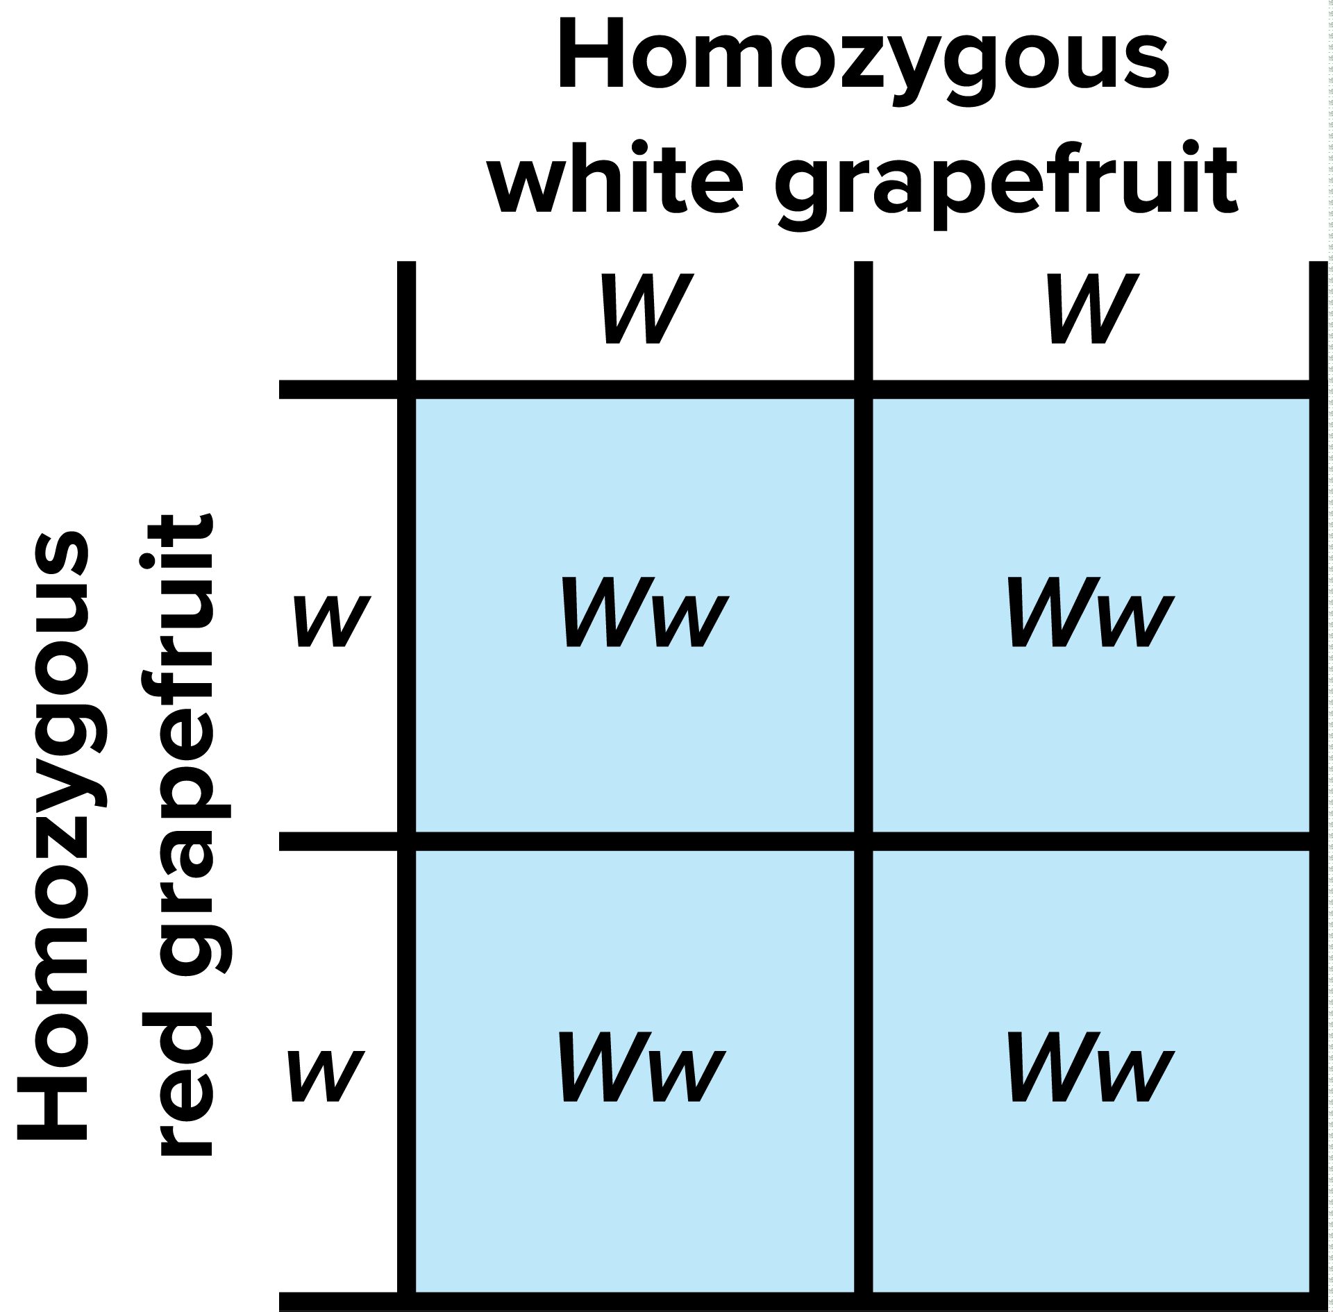
Test Cross
Performing a Test Cross
If the white grapefruit tree’s genotype is WW, the fruit on all of the resulting trees will be white (Ww).

Slide 11
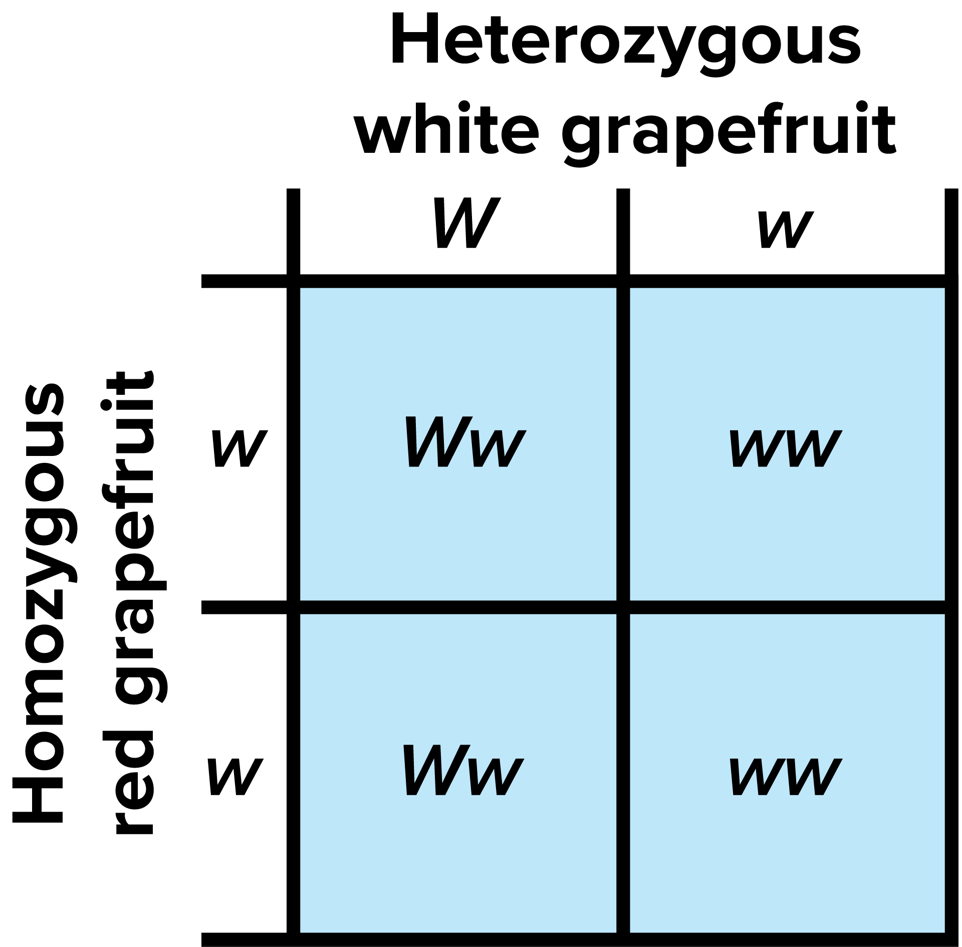
Test Cross
Performing a Test Cross
If the white grapefruit tree’s genotype is Ww, the fruit on half of the resulting trees will be white (Ww), and half will be red (ww).

