Slide 1
Lesson 4
Basic Patterns
of Human Inheritance

Slide 2
Focus Question
Why is a pedigree helpful in analyzing the inheritance of traits through several generations?

Slide 3
New Vocabulary
carrier
pedigree

Slide 4
Review Vocabulary
genes: segments of DNA that control the production of proteins

Slide 5
Pedigrees
Recessive traits are expressed only when the individual is homozygous recessive for a trait.
An individual who is heterozygous for a recessive disorder is called a carrier.
Inheritance of disorders in humans can be achieved by the use of a pedigree, a diagram that traces the inheritance of a particular trait through several generations.

Slide 6
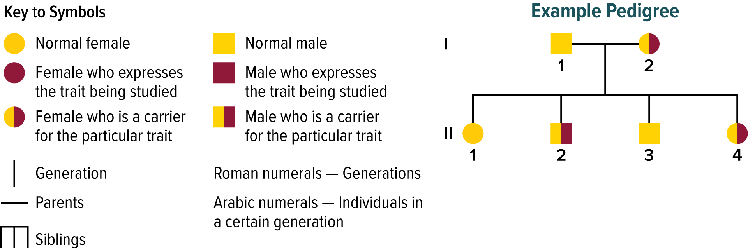
Pedigrees
A pedigree uses symbols to illustrate inheritance of a trait.

Slide 7
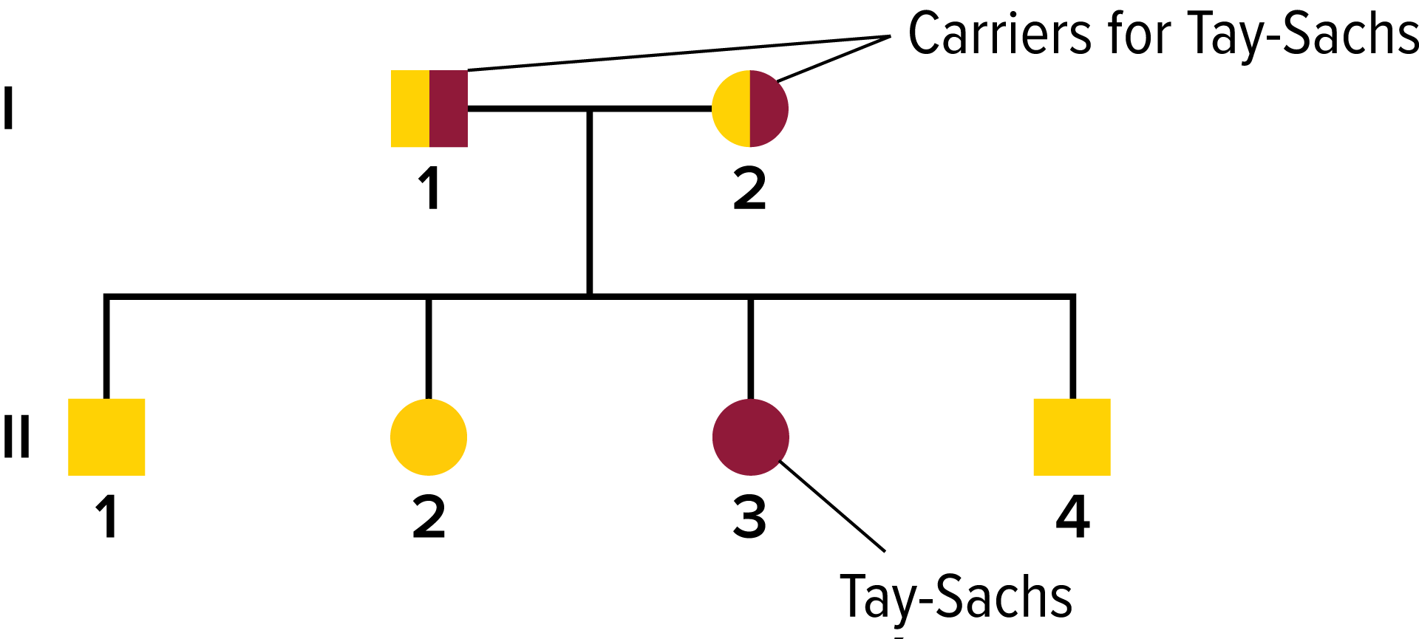
Pedigrees
Recessive Genetic Disorders
This pedigree shows an example of a recessive genetic disorder, Tay-Sachs.
Two unaffected parents have an affected child.
This indicates that both parents are heterozygous and carriers for the trait. The half-filled square and circle show that both parents are carriers.

Slide 8
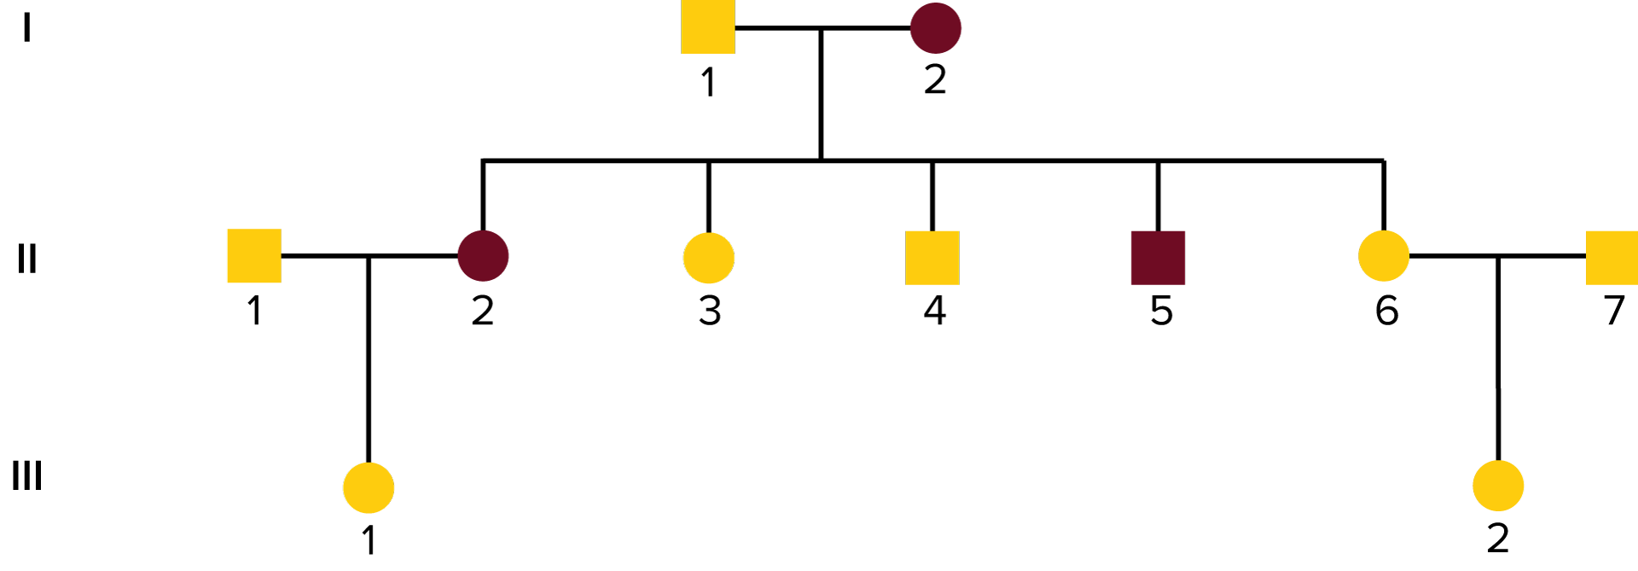
Pedigrees
Dominant Genetic Disorders
This pedigree shows an example of a dominant genetic disorder, polydactyly.
Affected parents can pass the gene to their children.
Unaffected parents cannot have an affected child.

Slide 9
Pedigrees
Inferring Genotypes
Pedigrees can be used to infer genotypes from the observations of phenotypes.
Knowing physical traits can determine what genes an individual is most likely to have.

Slide 10
Pedigrees
Predicting Disorders
Using pedigrees can help predict the possibility of disorders occurring in future offspring.
This is more accurate if several individuals within the family are evaluated.
Record keeping helps scientists use pedigree analysis to study inheritance patterns, determine phenotypes, and ascertain genotypes.

Slide 11
Types of Recessive Genetic Disorders
Albinism
Cause: The body does not produce normal amounts of the pigment melanin.
Effects:
No color in the skin, eyes, and hair
Skin susceptible to UV damage
Vision problems
Cure/Treatment:
No cure
Protect skin from the Sun and other environmental factors.
Visual rehabilitation

Slide 12
Types of Recessive Genetic Disorders
Cystic Fibrosis
Cause: The gene that codes for a membrane protein is defective.
Effects:
Excessive mucus production
Digestive and respiratory failure
Cure/Treatment:
No cure
Daily cleaning of mucus from the lungs
Mucus-thinning drugs
Pancreatic enzyme supplements

Slide 13
Types of Recessive Genetic Disorders
Galactosemia
Cause: Absence of the gene that codes for the enzyme that breaks down galactose
Effects:
Mental disabilities
Enlarged liver
Kidney failure
Cure/Treatment:
No cure
Restriction of lactose/galactose in the diet

Slide 14
Types of Recessive Genetic Disorders
Tay-Sachs Disease
Cause: Absence of a necessary enzyme that breaks down fatty substances
Effects:
Buildup of fatty deposits in the brain
Mental disabilities
Cure/Treatment:
No cure or treatment
Death by age 5

Slide 15
Types of Dominant Genetic Disorders
Huntingdon’s Disease
Cause: A gene affecting neurological function is defective.
Effects:
Decline of mental and neurological functions
Ability to move deteriorates
Cure/Treatment:
No cure or treatment

Slide 16
Types of Dominant Genetic Disorders
Achondroplasia
Cause: A gene that affects bone growth is abnormal.
Effects:
Short arms and legs
Large head
Cure/Treatment:
No cure or treatment

