Slide 1
Lesson 5
Complex Patterns
of Inheritance

Slide 2
Focus Question
What are examples of complex inheritance?

Slide 3
New Vocabulary
incomplete dominance
codominance
multiple alleles
epistasis
sex-linked trait
polygenic trait

Slide 4
Review Vocabulary
gamete: a mature sex cell (sperm or egg) with a haploid number of chromosomes

Slide 5
Incomplete Dominance
In some organisms, heterozygous individuals will display the dominant phenotype.
With incomplete dominance, the heterozygous phenotype is an intermediate phenotype between the two homozygous phenotypes.
Yields a 1:2:1 ratio

Slide 6
Codominance
In codominance, both the dominant and recessive alleles are expressed in heterozygous individuals.
Sickle-Cell Disease
Changes in hemoglobin cause red blood cells to become sickle shaped.
People who are heterozygous for the trait have both normal and sickle-shaped cells.

Slide 7
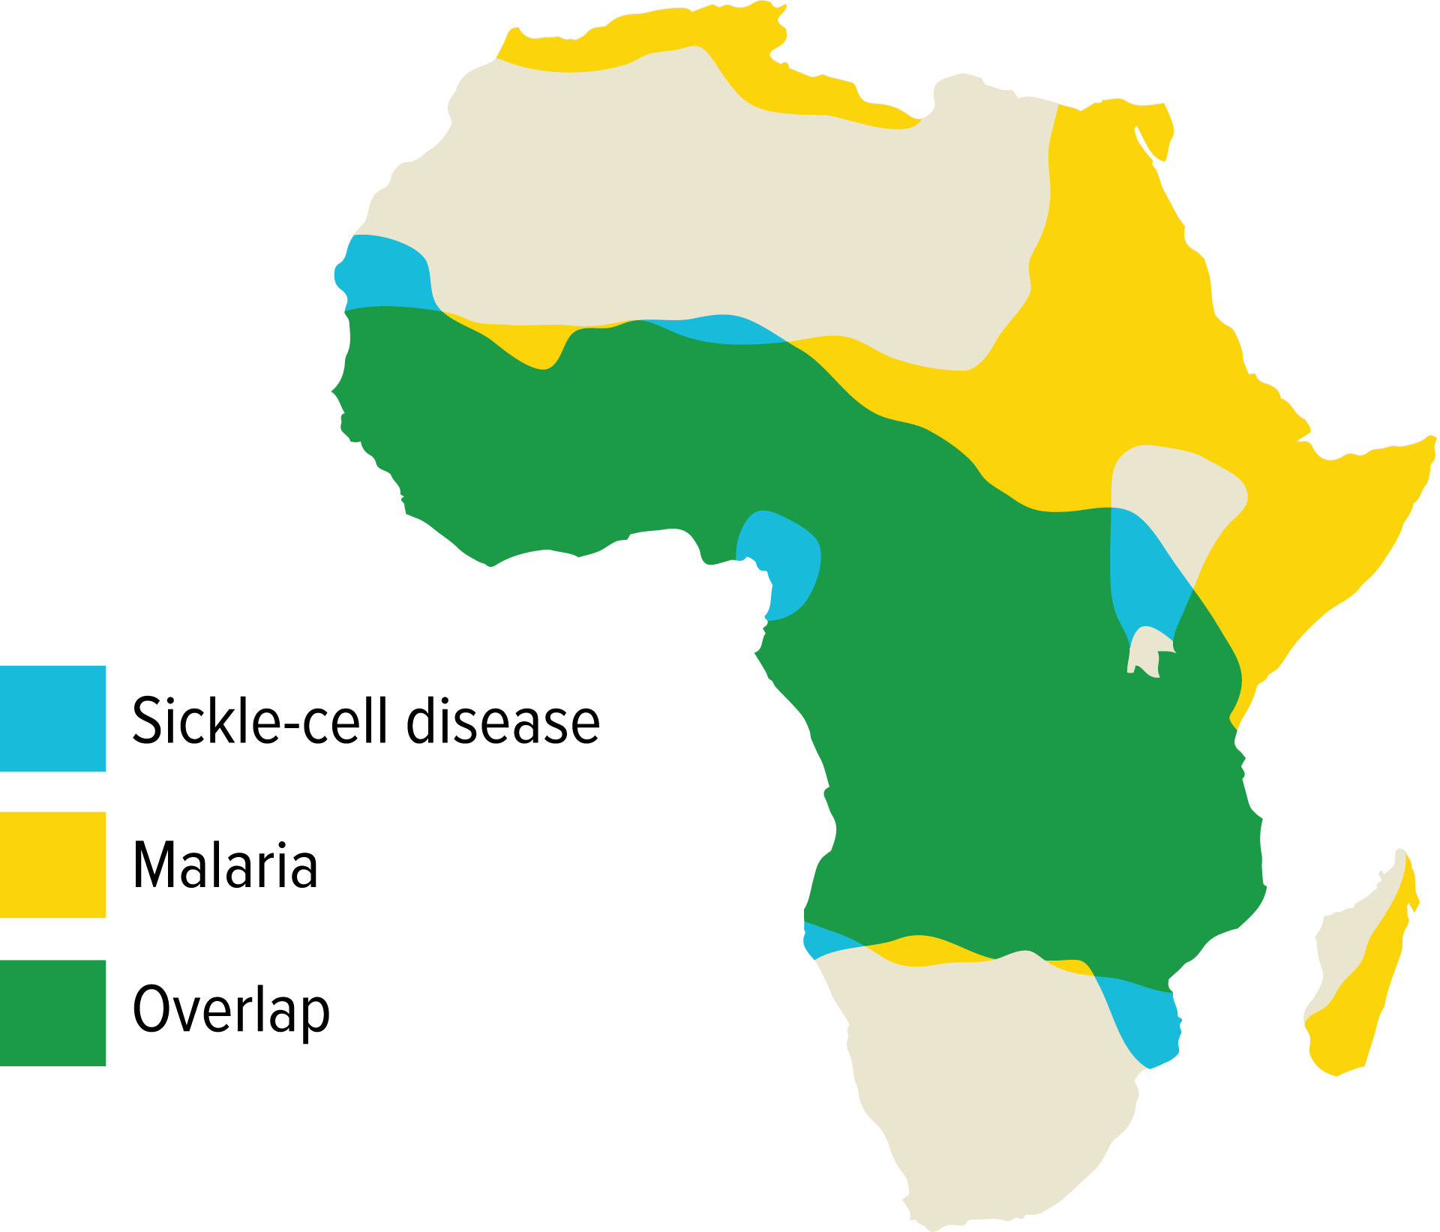
Codominance
Sickle-Cell Disease and Malaria
Those who are heterozygous for the sickle-cell trait also have a higher resistance to malaria.
The death rate due to malaria is lower where sickle-cell trait is higher, meaning more people live to pass it on to their offspring.

Slide 8
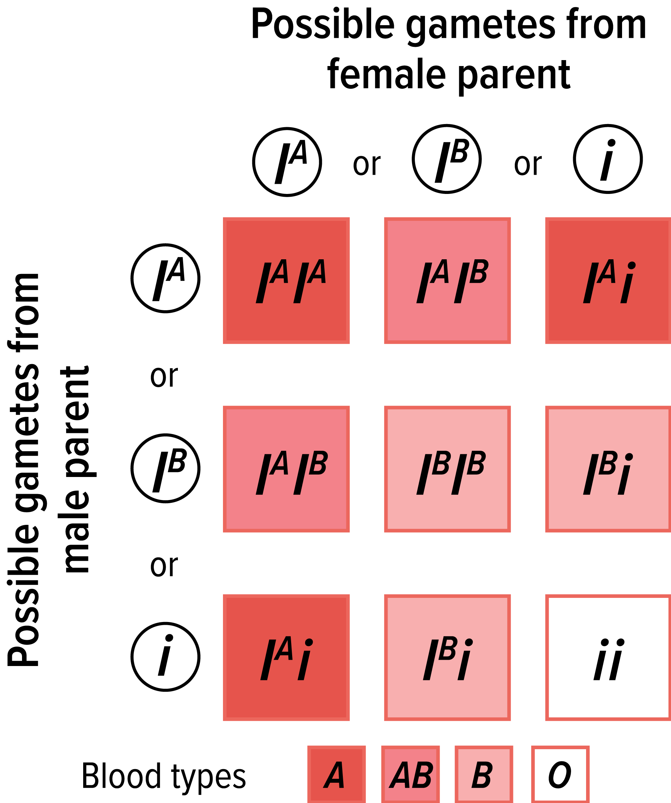
Multiple Alleles
Blood Groups in Humans
Some forms of inheritance are determined by more than two alleles, referred to as multiple alleles.
The ABO blood group has three forms of alleles, sometimes called AB markers.

Slide 9
Multiple Alleles
Coat Color in Rabbits
Multiple alleles can demonstrate a hierarchy of dominance.
In rabbits, four alleles code for coat color: C, c^{ch}, c^{h}, and c.
The hierarchy of dominance is C > c^{ch} > c^{h} >c.
The presence of multiple alleles increases the possible number of genotypes and phenotypes.

Slide 10
Epistasis
Epistasis is an interaction in which one allele hides the effects of another allele.
It is seen in the coat color of Labrador retrievers.
The dominant allele E determines whether the coat will have dark pigment.
Allele B determines how dark the coat will be.
When a dog has recessive ee alleles, the coat will be yellow, because the e allele masks the effects of the B allele.

Slide 11
Dosage Compensation
The X chromosome carries a variety of genes that are necessary for the development of both females and males.
The Y chromosome mainly has genes that relate to the development of male characteristics.
In female, one X chromosome is inactivated in each cell.
Called dosage compensation or x-inactivation
Which X stops working in each cell is random.
Occurs in all mammals

Slide 12
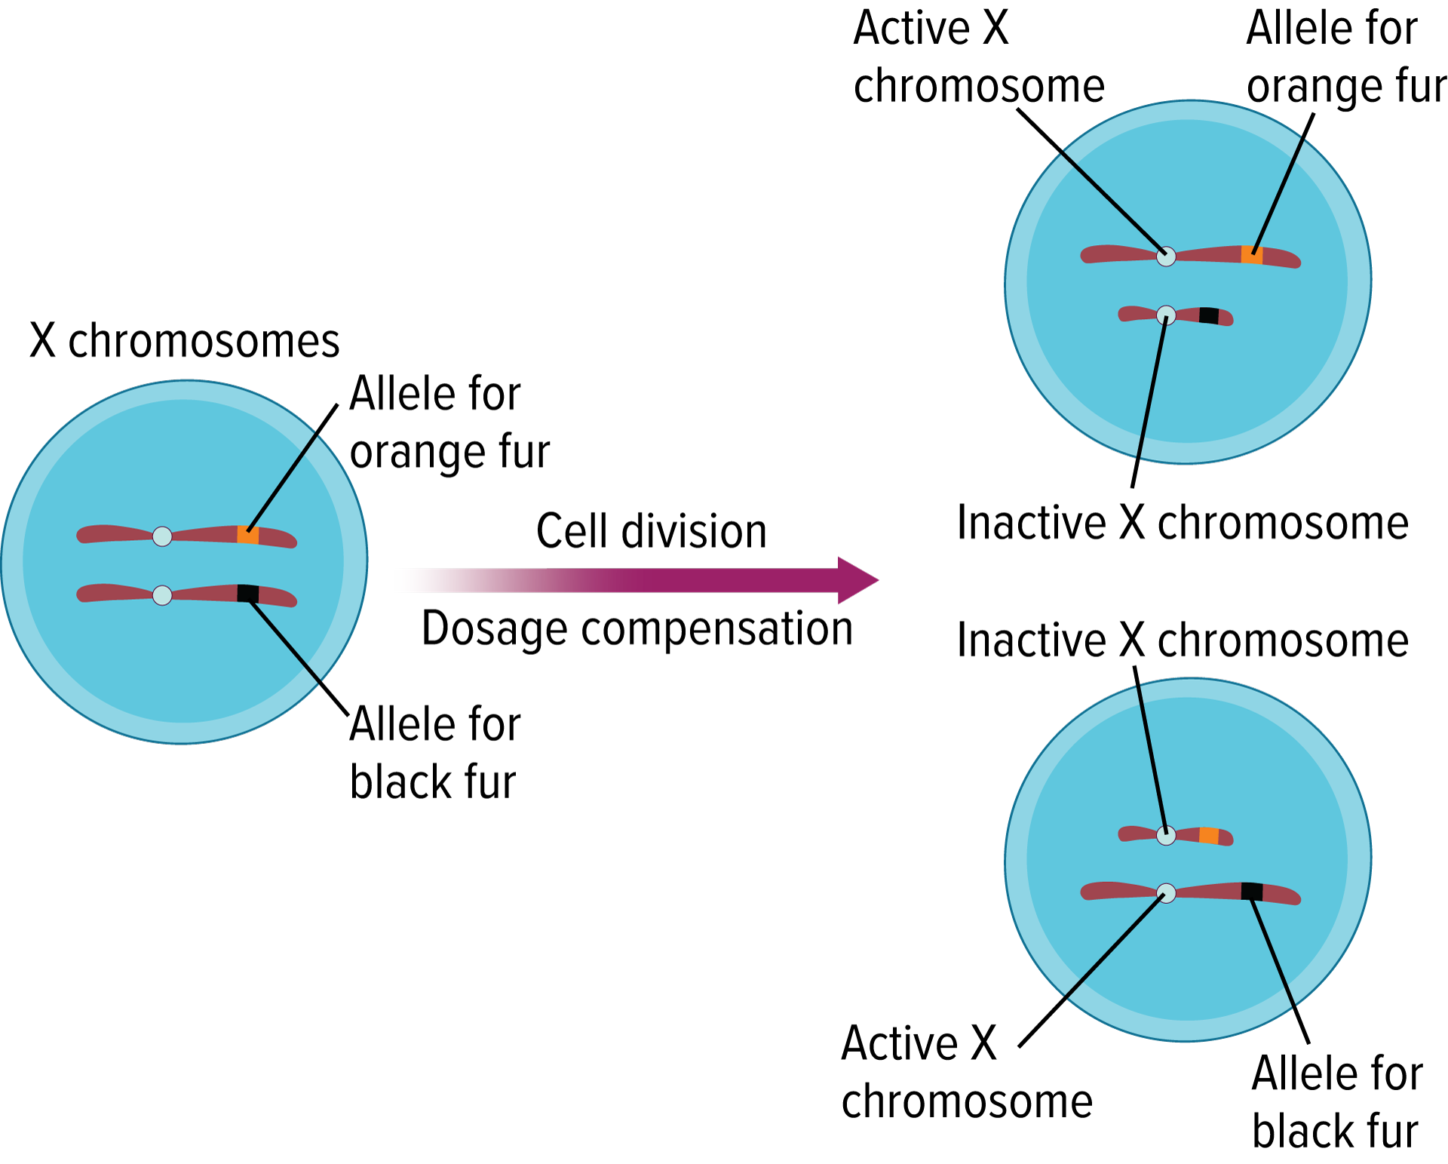
Dosage Compensation
Chromosome Inactivation
Coat colors in calico cats are caused by the random inactivation of a particular X chromosome.
The colors that result depend on the X chromosome that is activated.
Example: orange patches: inactivation of X chromosome that carries allele for black fur

Slide 13
Dosage Compensation
Barr Bodies
The inactivated X chromosome can be observed in cells.
Darkly stained, inactivated X chromosomes are called Barr bodies.

Slide 14
Sex-Linked Traits
Predicting Disorders
Traits controlled by genes located on the X chromosome are sex-linked traits. They are also called (X-linked) traits.
Because males have only one copy of the X chromosome, they are more affected by recessive X-linked traits.
Some traits that are located on autosomes may appear to be sex-linked, even though they are not.

Slide 15
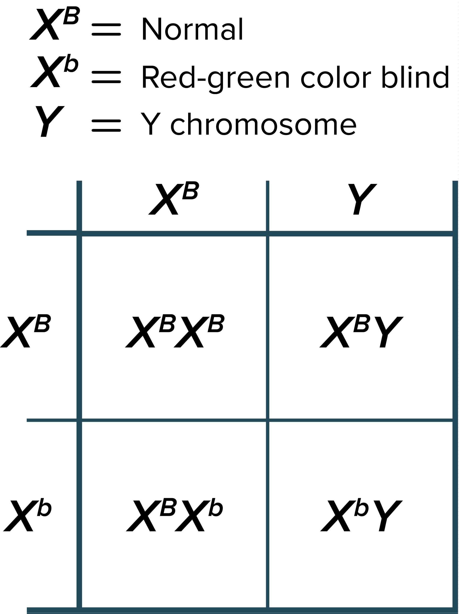
Sex-Linked Traits
Red-Green Colorblindness
Recessive, X-linked trait
Mothers are carriers.
Females can be colorblind, but only if they inherit the recessive allele from both parents.

Slide 16
Sex-Linked Traits
Red-Green Colorblindness
Hemophilia
Recessive, X-linked trait that causes delayed clotting of blood
Famous pedigree involves the family of Queen Victoria of England

Slide 17
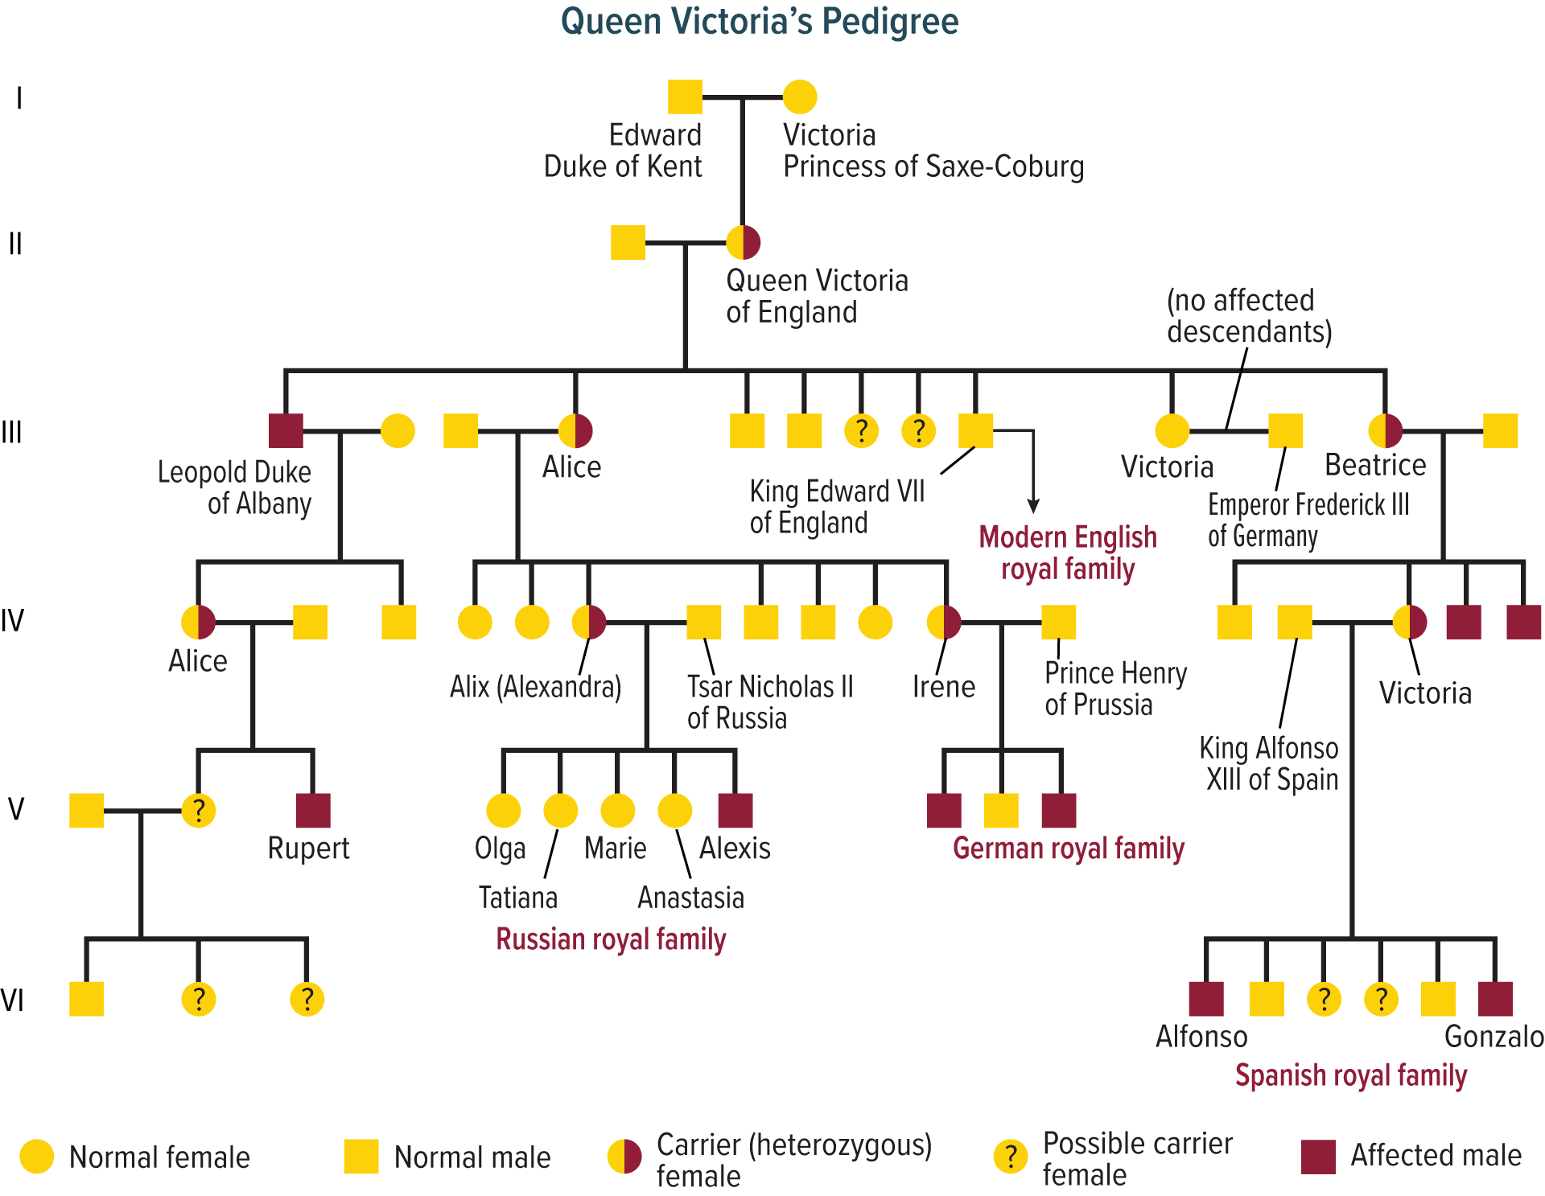
Sex-Linked Traits

Slide 18
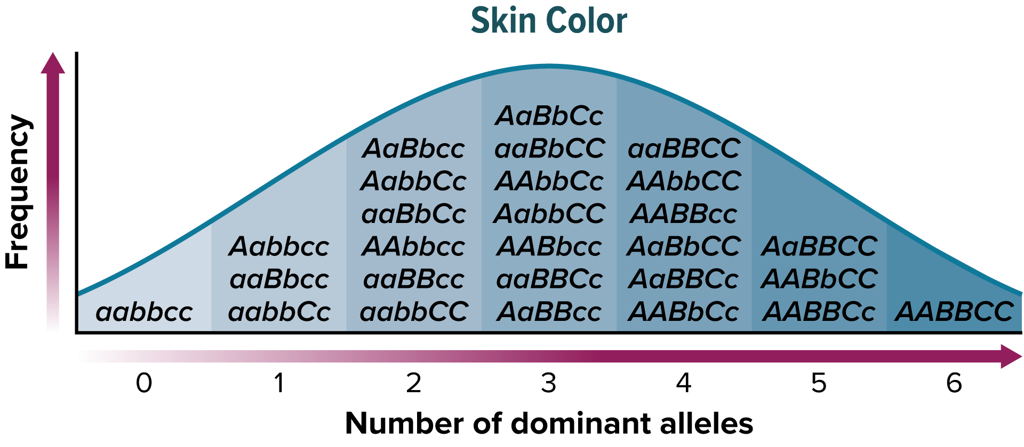
Polygenic Traits
Polygenic traits arise from the interaction of multiple pairs of genes.
Include such traits as skin color, height, and eye color

Slide 19
Environmental Influences
The variation and distribution of traits in a population also depends on environmental factors.
Because environmental factors affect the expression of some traits, they affect the probability of those traits appearing in a population.

Slide 20
Environmental Influences
Sunlight and Water
Without enough sunlight, most plants will not produce flowers.
Insufficient water causes plants to drop their leaves.
Temperature
Most organisms experience phenotypic changes with extreme heat.

Slide 21
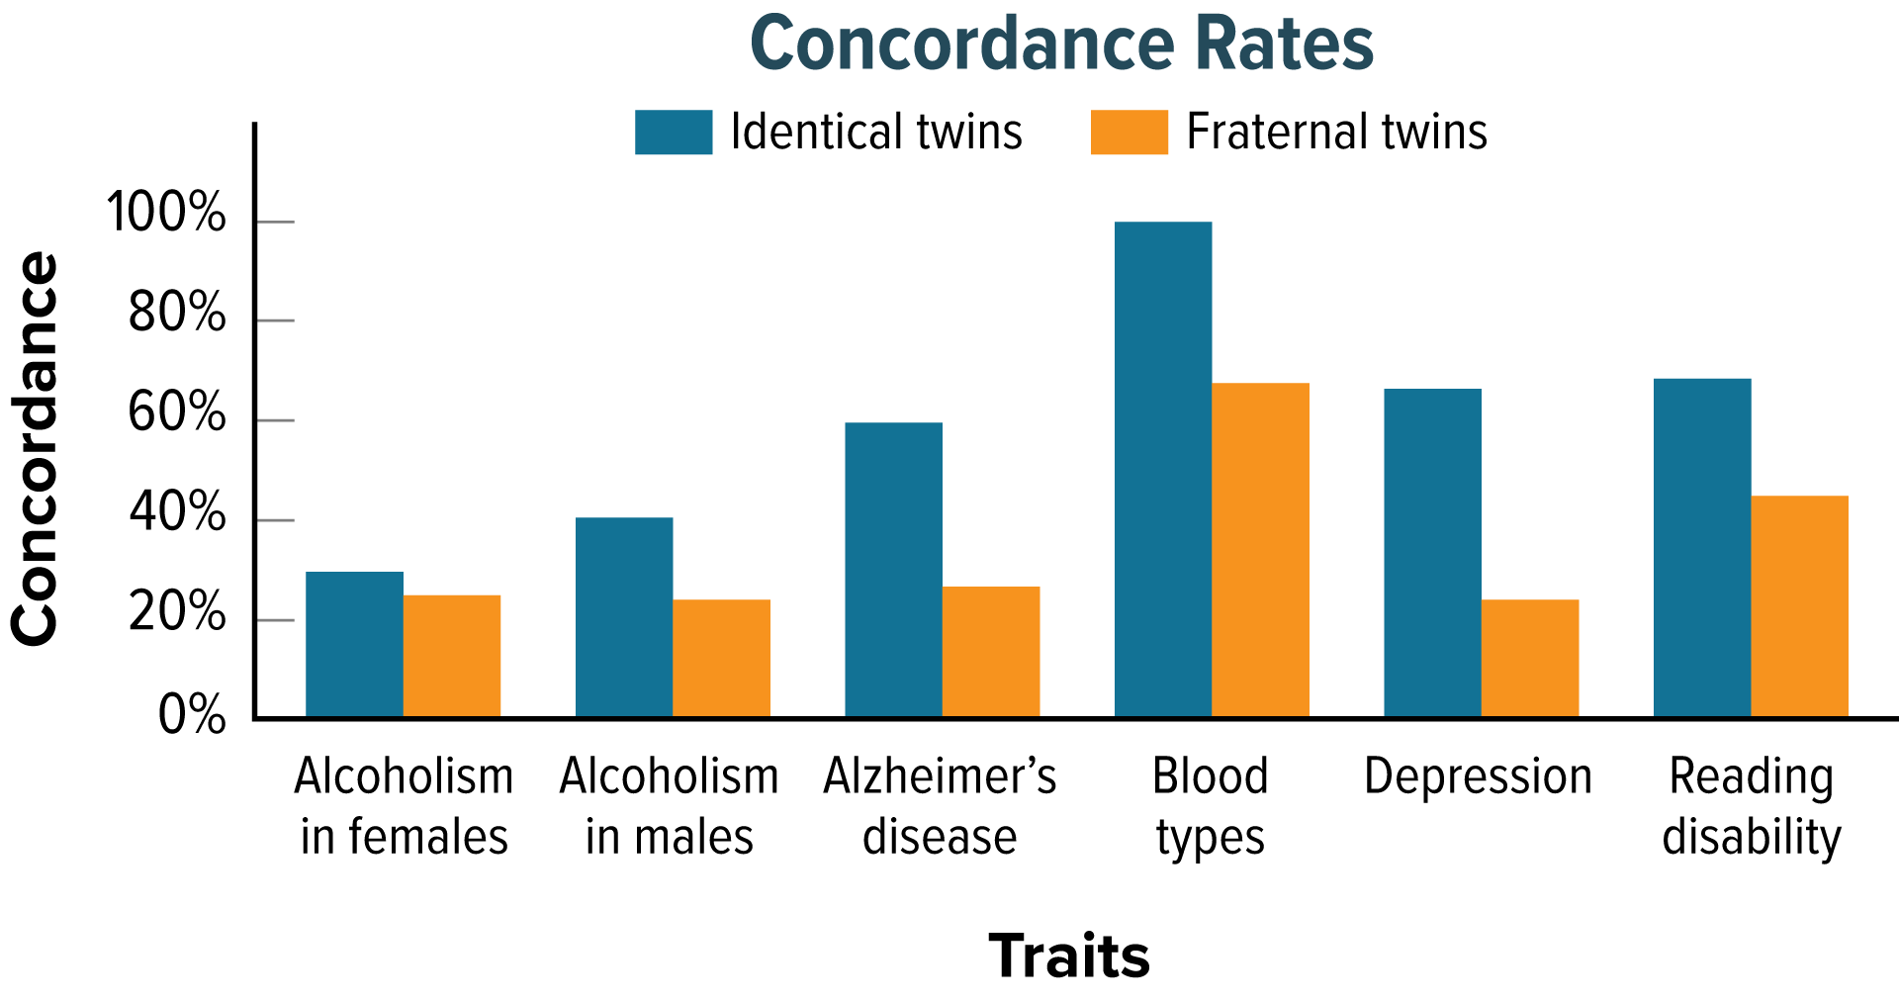
Twin Studies
Help scientists separate genetic contributions from environmental contributions
Traits that appear frequently in identical twins are at least partially controlled by heredity.
Traits expressed differently in identical twins are strongly influenced by environment.

