Slide 1
Lesson 1
DNA: The Genetic Material

Slide 2
Focus Question
Which experiments led to the discovery of DNA, and which led to the structure of DNA?

Slide 3
New Vocabulary
double helix

Slide 4
Review Vocabulary
nucleic acid: complex biomolecule that stores cellular information in the form of a code

Slide 5
Discovery of DNA
Frederick Griffith
He carried out experiments that led to the conclusion that a substance can transform bacteria.
These experiments set the stage for the search to identify the transforming factor.

Slide 6
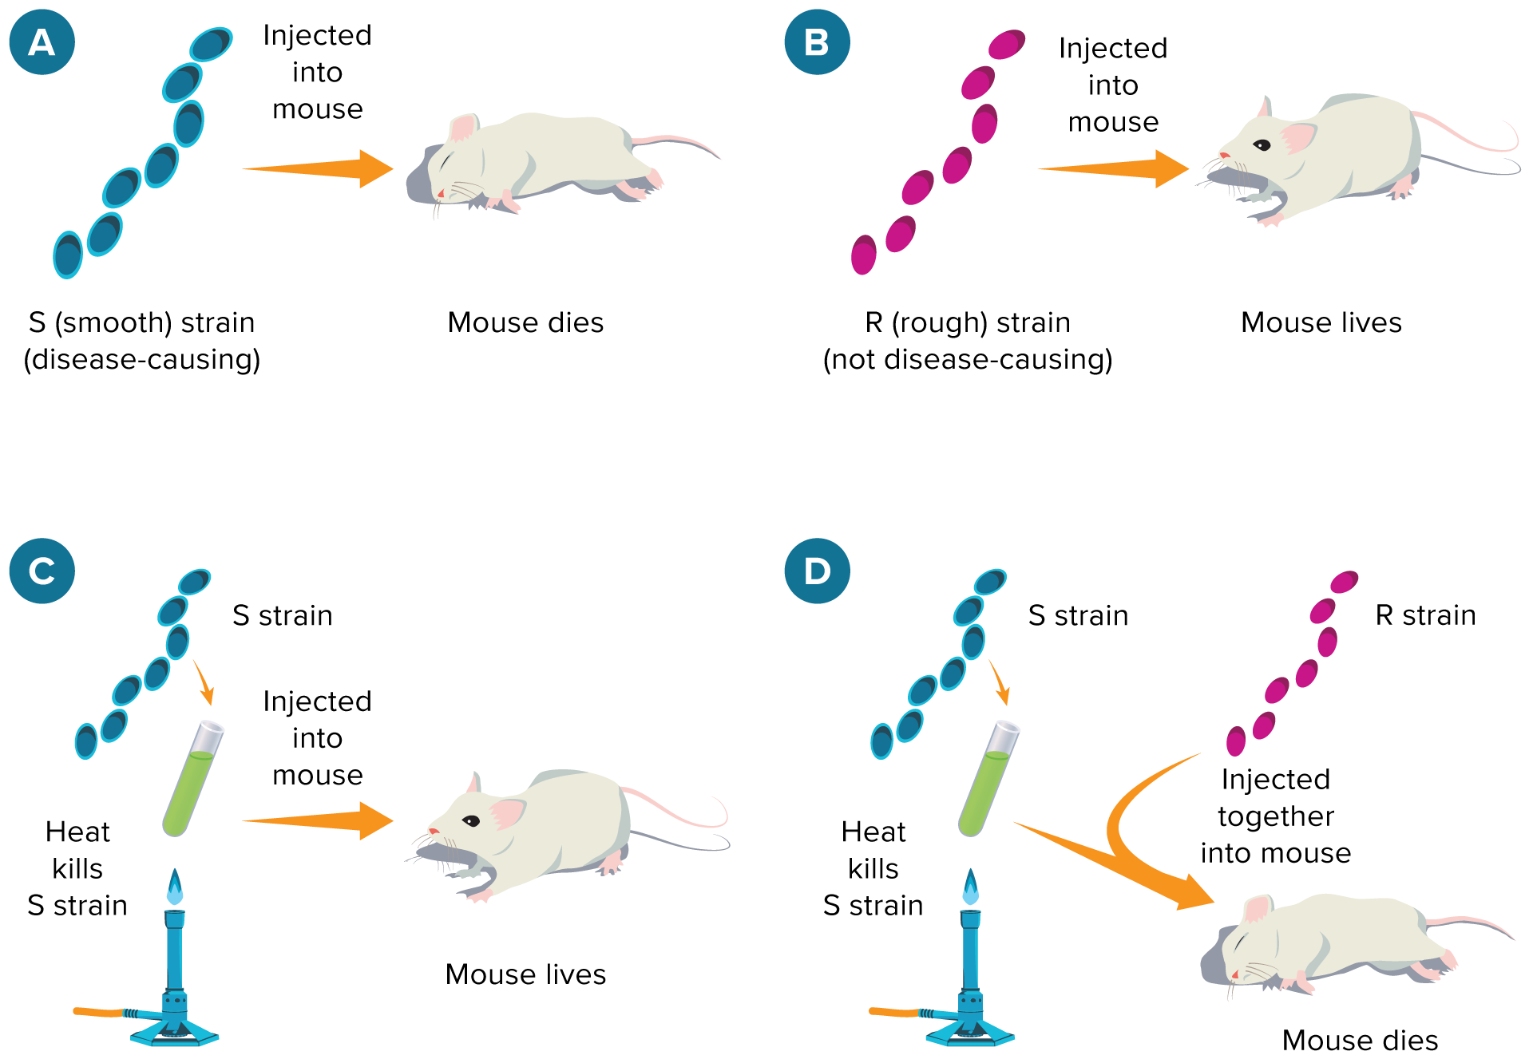
Discovery of DNA
Griffith’s transformation experiment demonstrated the change of rough bacteria into smooth bacteria.

Slide 7
Discovery of DNA
Oswald Avery
He identified the molecule that transformed the R strain of S. pneumoniae into the S strain.
Avery concluded that when the S cells were killed, DNA was released.
R bacteria incorporated this DNA into their cells and changed into S cells.

Slide 8
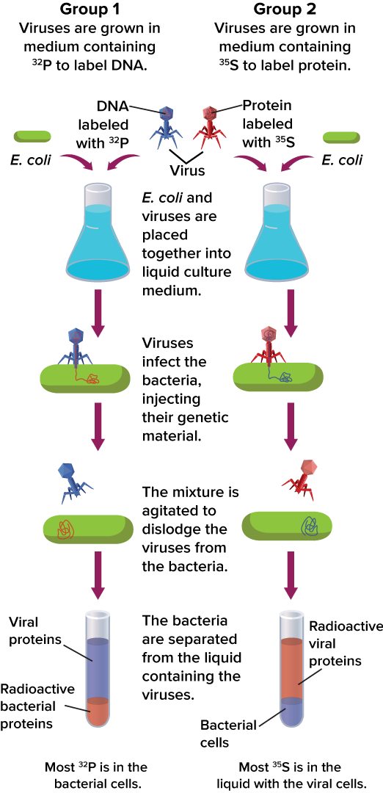
Discovery of DNA
Alfred Hershey and Martha Chase
They used radioactive labeling to trace bacteriophage DNA and protein.
They concluded that the bacteriophage DNA was injected into the cell and provided the genetic information needed to produce new viruses.

Slide 9
Discovery of DNA
Summary of Hershey-Chase Results
Group 1 (Viruses labeled with ³²P) |  | Group 2 (Viruses labeled with ³⁵S)
Infected Bacteria | Liquid with Viruses | Infected Bacteria | Liquid with Viruses
Labeled viral DNA (³²P) found in the bacteria Viral replication occurred New viruses contained ³²P | No labeled DNA No viral replication | No labeled viral proteins (³⁵S) Viral replication occurred New viruses did not have a label | Labeled proteins found No viral replication

Slide 10
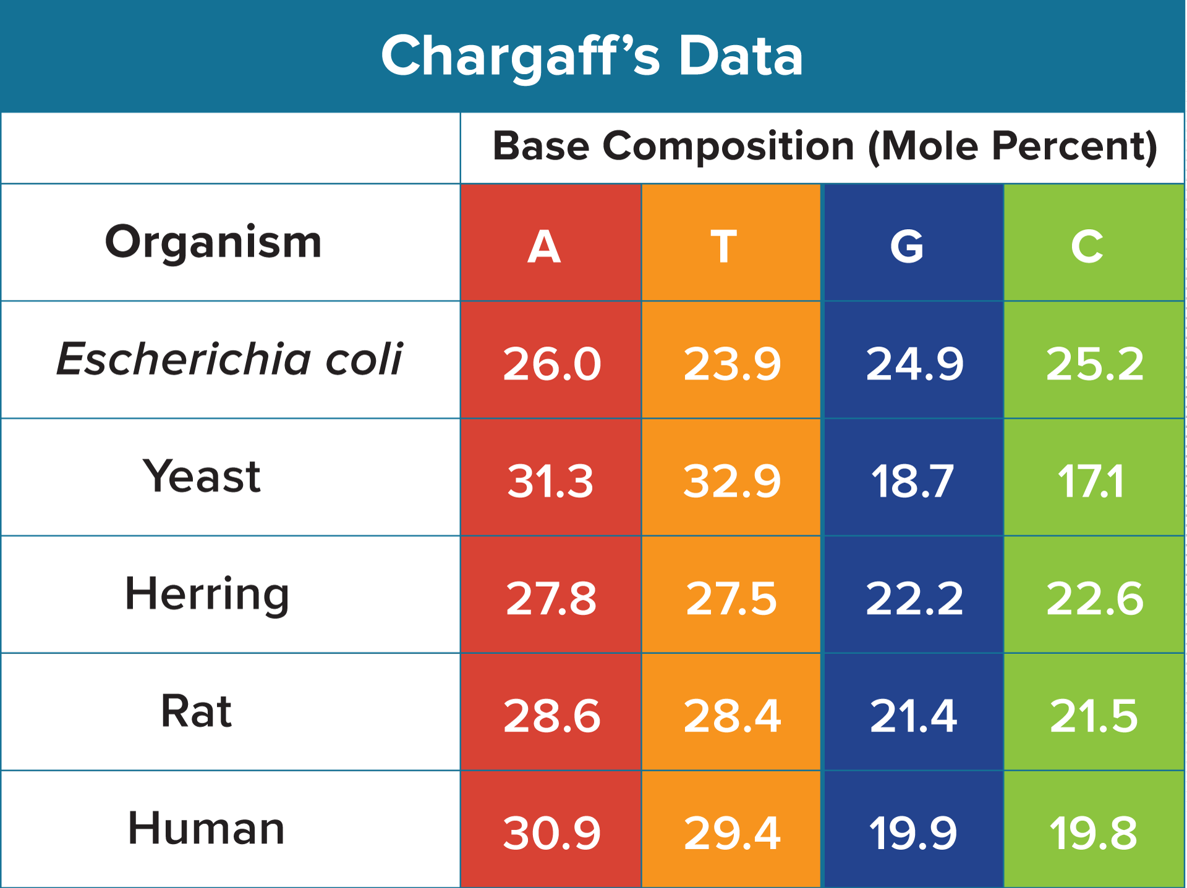
Discovery of DNA Structure
Erwin Chargaff
He analyzed the amount of A, G, T, and C in the DNA of various species.
Chargaff’s rule: C = G and T = A

Slide 11
Discovery of DNA Structure
Rosalind Franklin and Maurice Wilkins
X-ray diffraction techniques indicated that DNA was a double helix, or twisted ladder shape.
The double helix shape was formed by two strands of nucleotides twisted around each other.

Slide 12
Discovery of DNA Structure
James Watson and Francis Crick
Using Franklin’s and Chargaff’s data, Watson and Crick measured the width of the helix and the spacing of the bases.
They built a model that conformed Franklin’s and Chargaff’s data.

Slide 13
Discovery of DNA Structure
Important features of the model constructed by Watson and Crick include:
Two outside strands consist of alternating deoxyribose and phosphate.
Cytosine and guanine bases pair to each other by three hydrogen bonds.
Thymine and adenine bases pair to each other by two hydrogen bonds.

Slide 14
Discovery of DNA Structure
Nucleotides
Nucleotides are the subunits of nucleic acids. They consist of:
5-carbon sugar
Phosphate group
Nitrogenous base

Slide 15
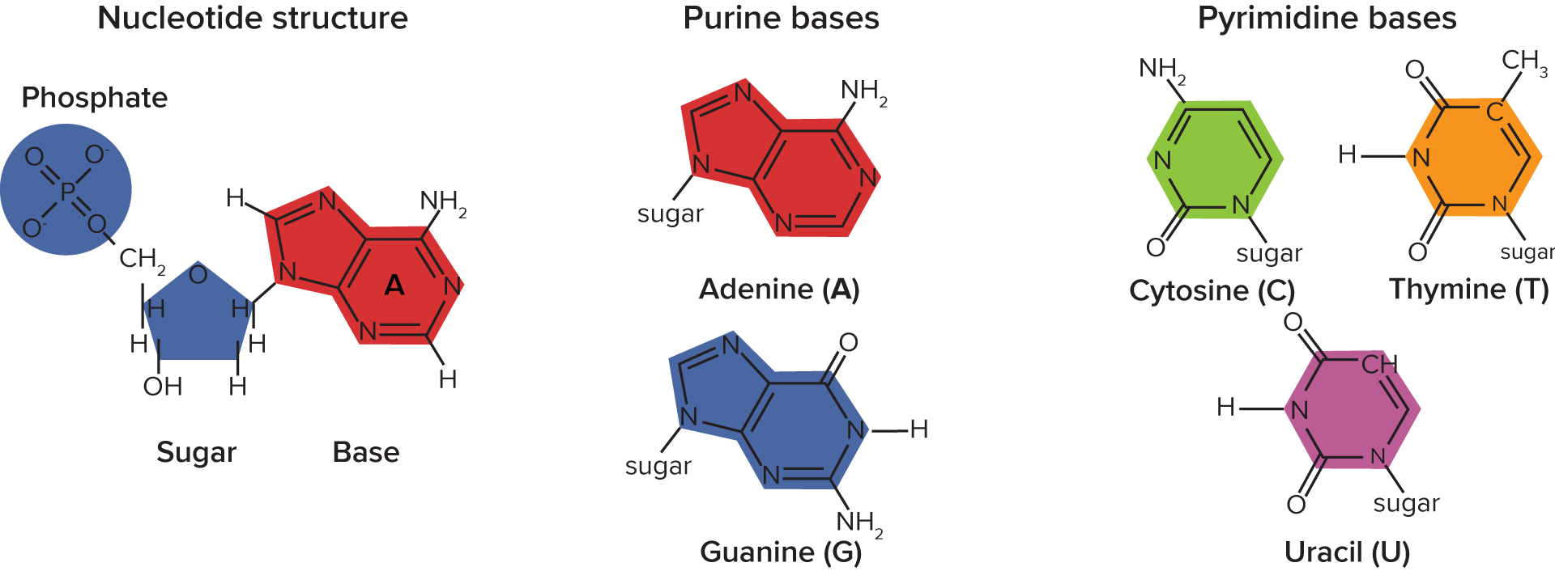
Discovery of DNA Structure
Nucleotides

Slide 16
Discovery of DNA Structure
DNA Structure
DNA often is compared to a twisted ladder.
Rails of the ladder are represented by the alternating deoxyribose and phosphate.
The pairs of bases (cytosine-guanine or thymine-adenine) form the steps.
Purine base always binds to a pyrimidine base.

Slide 17
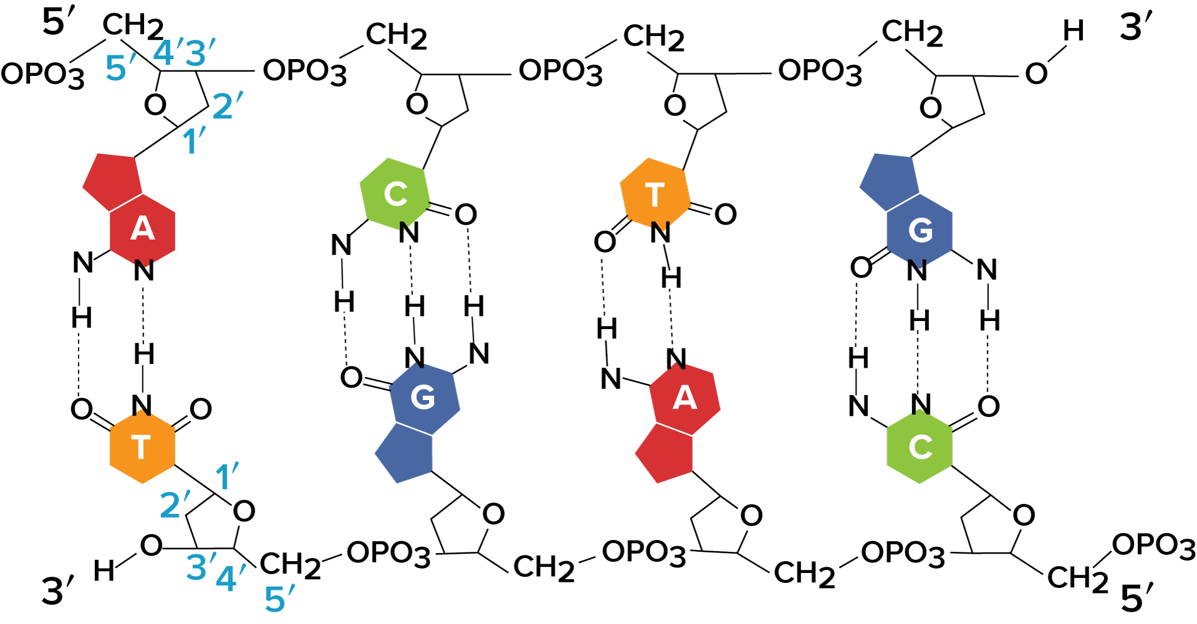
Discovery of DNA Structure
Orientation
DNA molecules have specific orientations of the two strands:
The top strand is said to be oriented 5’ to 3’.
The bottom strand is oriented 3’ to 5’.

