Slide 1
Lesson 2
Replication of DNA

Slide 2
Focus Question
How does DNA replicate?

Slide 3
New Vocabulary
semiconservative replication
DNA polymerase
Okazaki fragment

Slide 4
Review Vocabulary
template: a molecule of DNA that is a pattern for synthesis of a new DNA molecule

Slide 5
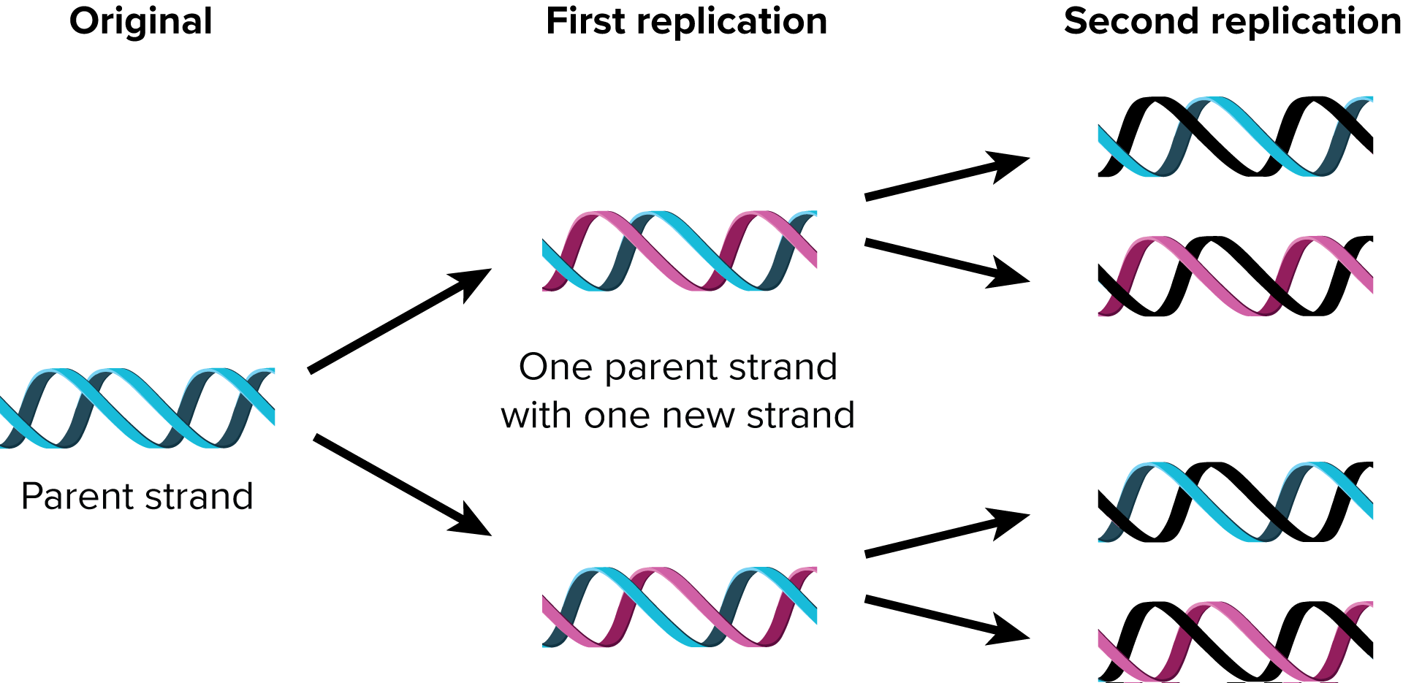
Semiconservative Replication
During semiconservative replication, parental strands of DNA separate, serve as templates, and produce DNA molecules that have one strand of parental DNA and one strand of new DNA.

Slide 6
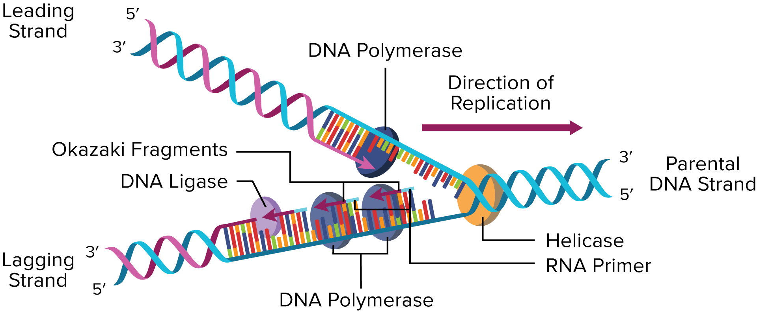
Semiconservative Replication
Semiconservative replication has three main stages: unwinding, base pairing, and joining.

Slide 7
Semiconservative Replication
Unwinding
DNA helicase, an enzyme, unwinds the helix, breaking the hydrogen bonds between bases.
Single-stranded binding proteins keep the DNA strands separate during replication.
RNA primase adds a short segment of RNA, called an RNA primer, on each DNA strand.

Slide 8
Semiconservative Replication
Base pairing
The enzyme DNA polymerase adds appropriate nucleotides to the new DNA strand from the 3’ end.
The leading strand is built continuously, and the lagging strand is built discontinuously in small segments called Okazaki fragments.

Slide 9
Semiconservative Replication
Joining
DNA polymerase removes the RNA primer and fills in the place with DNA nucleotides.
When the primer has been replaced, DNA ligase links the two sections.

Slide 10
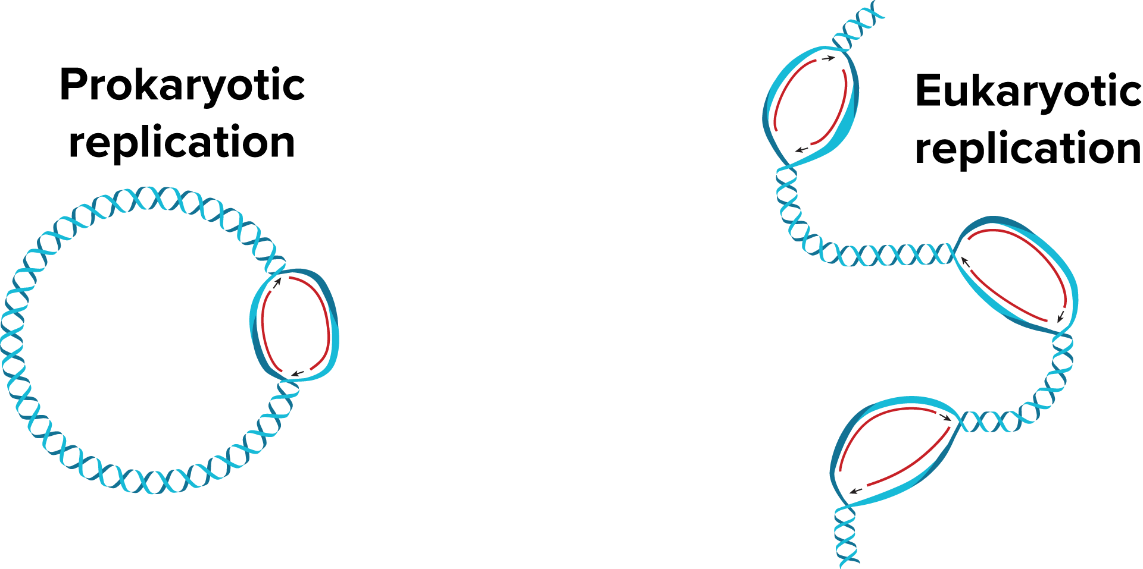
Comparing DNA Replication in Eukaryotes and Prokaryotes
Eukaryotic DNA unwinds in multiple areas as DNA is replicated.
In prokaryotes, the circular DNA strand is opened at one origin of replication.

