Slide 1
Lesson 3
DNA, RNA, and Protein

Slide 2
Focus Question
How is DNA and RNA involved in transcription and translation?

Slide 3
New Vocabulary
RNA
RNA polymerase
messenger RNA
intron
ribosomal RNA
exon
transfer RNA
codon
transcription
translation
anticodon

Slide 4
Review Vocabulary
synthesis: the composition or combination of parts to form a whole

Slide 5
Central Dogma
Geneticists accept that the basic mechanism for reading and expressing genes is from DNA to RNA to protein.
This is referred to as the central dogma of biology: DNA codes for RNA, which guides the synthesis of proteins.

Slide 6
Central Dogma
Types of RNA
RNA is a nucleic acid similar to DNA, but with the sugar ribose, and with uracil instead of thymine.
There are three major types of RNA (see next slide for descriptions):
Messenger RNA (mRNA)
Ribosomal RNA (rRNA)
Transfer RNA (tRNA)

Slide 7
Central Dogma
Comparison of Three Types of RNA
Name | mRNA | rRNA | tRNA
Function | Carries genetic information from DNA in the nucleus to direct protein synthesis in the cytoplasm | Associates with protein to form the ribosome | Transports amino acids to the ribosome
Example

Slide 8
Central Dogma
Transcription
The first step of the central dogma involves the synthesis of mRNA from DNA in a process called transcription.
The enzyme RNA polymerase regulates RNA synthesis.
RNA polymerase moves along the DNA strand in a 3’ to 5’ direction, synthesizing mRNA.

Slide 9
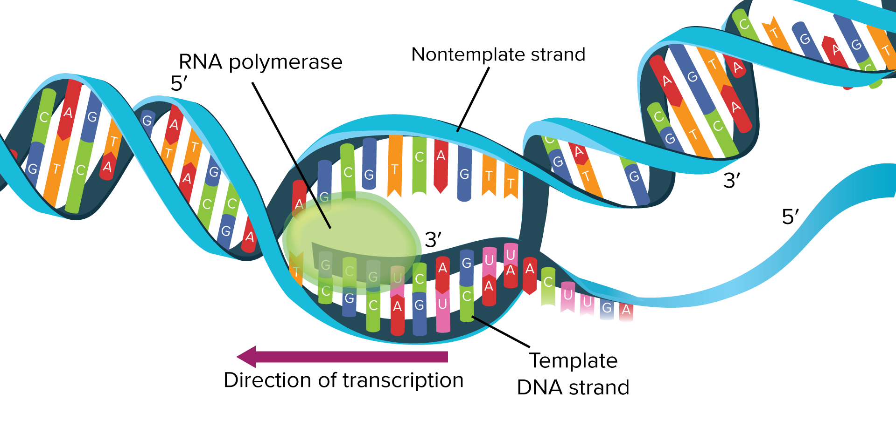
Central Dogma
RNA is transcribed in the 5’ to 3’ direction.

Slide 10
Central Dogma
RNA Processing
In comparing DNA code with its transcribed mRNA code, scientists found that the mRNA code was much shorter.
DNA sequences not found in mRNA are called introns.
DNA sequences that remain in the final mRNA are called exons.

Slide 11
The Code
Scientists hypothesized that the instructions from protein synthesis were encoded in DNA.
Experiments during the 1960s demonstrated that the DNA code was a three-base code.
The three-base code in DNA or mRNA is called a codon.

Slide 12
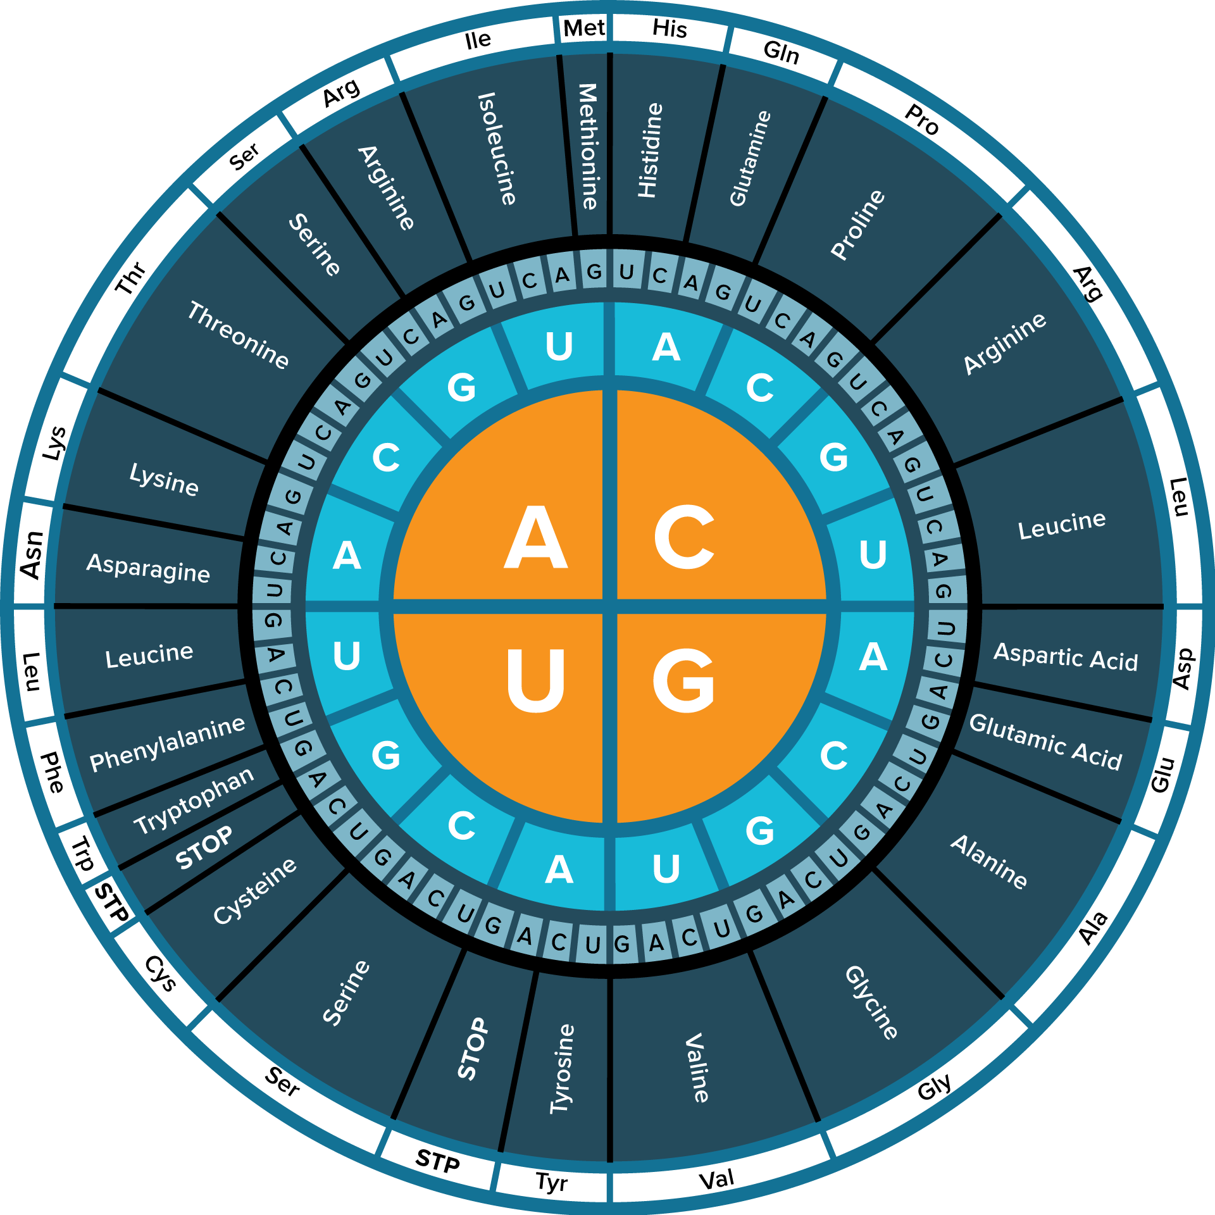
The Code
The figure shows a “dictionary” of the genetic code.
Notice that all but three codons are specific for an amino acid; these three are stop codons.

Slide 13
The Code
Translation
After synthesis, mRNA moves from the nucleus into the cytoplasm, where it connects at the 5’ end to a ribosome.
The mRNA code is read and translated into a protein through a process called translation.

Slide 14
The Code
Translation
tRNA molecules act as the interpreters of the mRNA codon sequence.
The tRNA is activated by an enzyme that attaches a specific amino acid to the 3’ end.
The middle of the folded tRNA contains an anticodon, a complementary sequence to the mRNA codon.

Slide 15
The Code
The Role of the Ribosome
Ribosomes provide a site for protein synthesis.
When mRNA leaves the nucleus, the two ribosomal subunits come together to hold the mRNA in place for translation.
The ribosome structure has grooves that serve as tRNA sites for amino acid attachment.

Slide 16
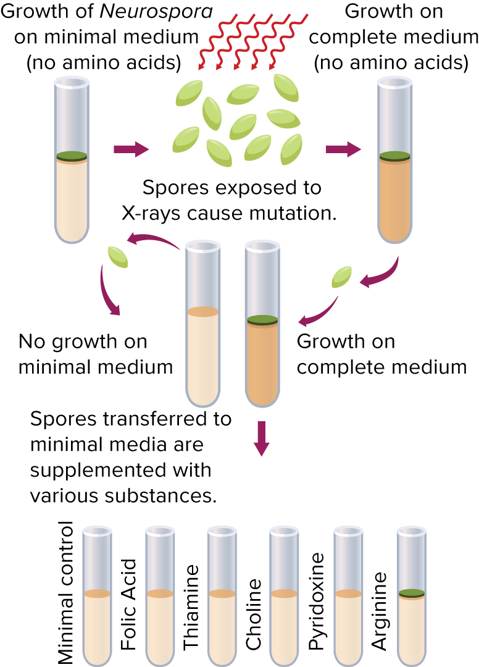
One Gene – One Enzyme
The Beadle and Tatum experiment showed that one gene codes for one enzyme.
We now know that one gene codes for one polypeptide.

