Slide 1
Lesson 4
Gene Regulation
and Mutation

Slide 2
Focus Question
How do prokaryotes and eukaryotes regulate their genes?

Slide 3
New Vocabulary
gene regulation
operon
mutation
mutagen

Slide 4
Review Vocabulary
prokaryote: organism that does not have membrane-bound organelles and DNA that is organized in chromosomes

Slide 5
Prokaryote Gene Regulation
Gene regulation is the ability of an organism to control which genes are transcribed in response to the environment.
An operon is a section of DNA that contains the genes for the proteins needed for a specific metabolic pathway.
An operon contains:
Operator – on/off switch
Promoter – where RNA polymerase binds
Regulatory gene
Genes coding for proteins

Slide 6
Prokaryote Gene Regulation
The trp Operon
Tryptophan synthesis occurs in five steps controlled by the trp operon.
The trp operon is a repressible operon, because it is usually repressed or turned off.

Slide 7
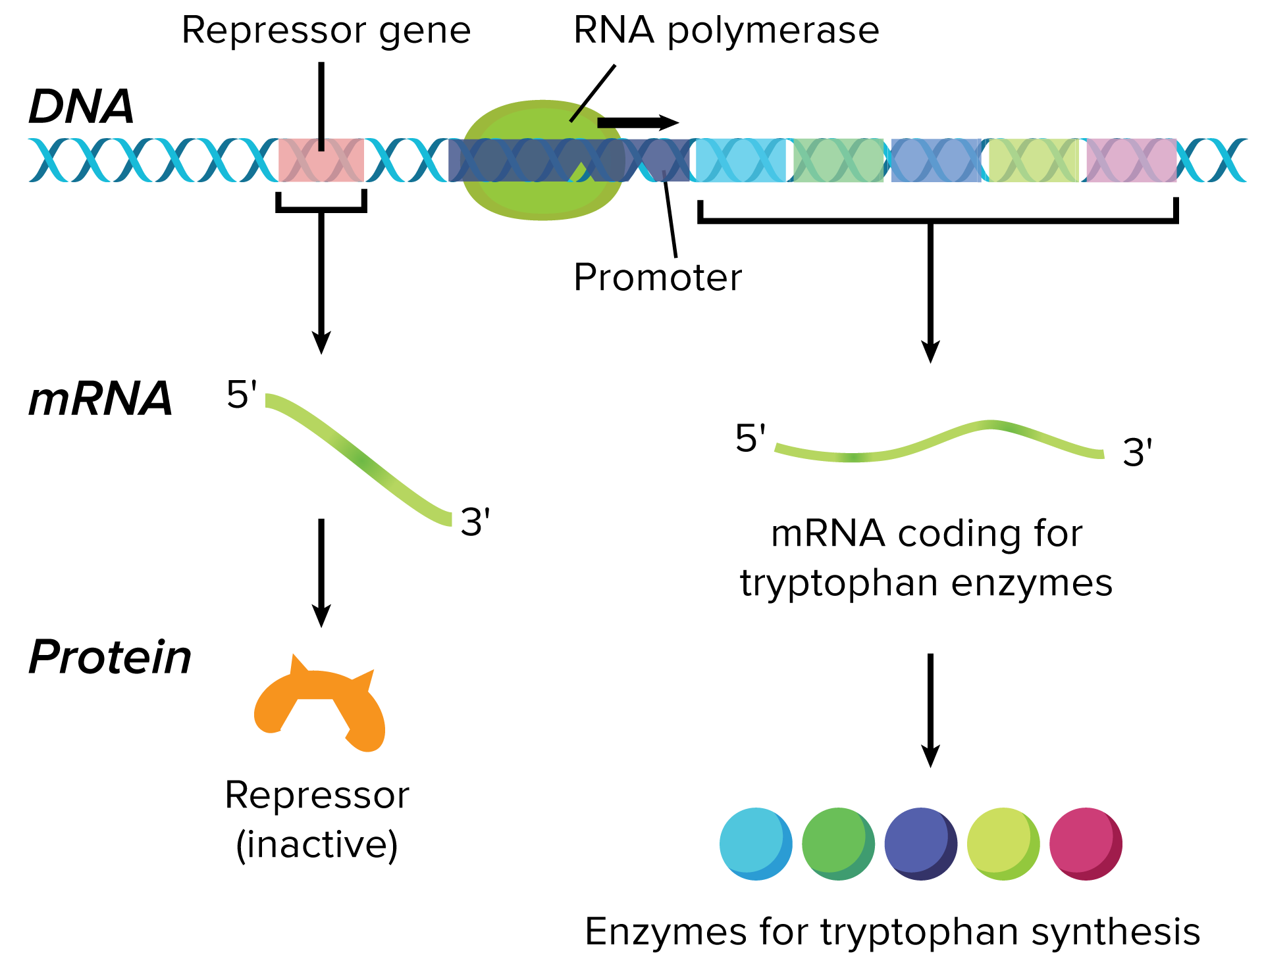
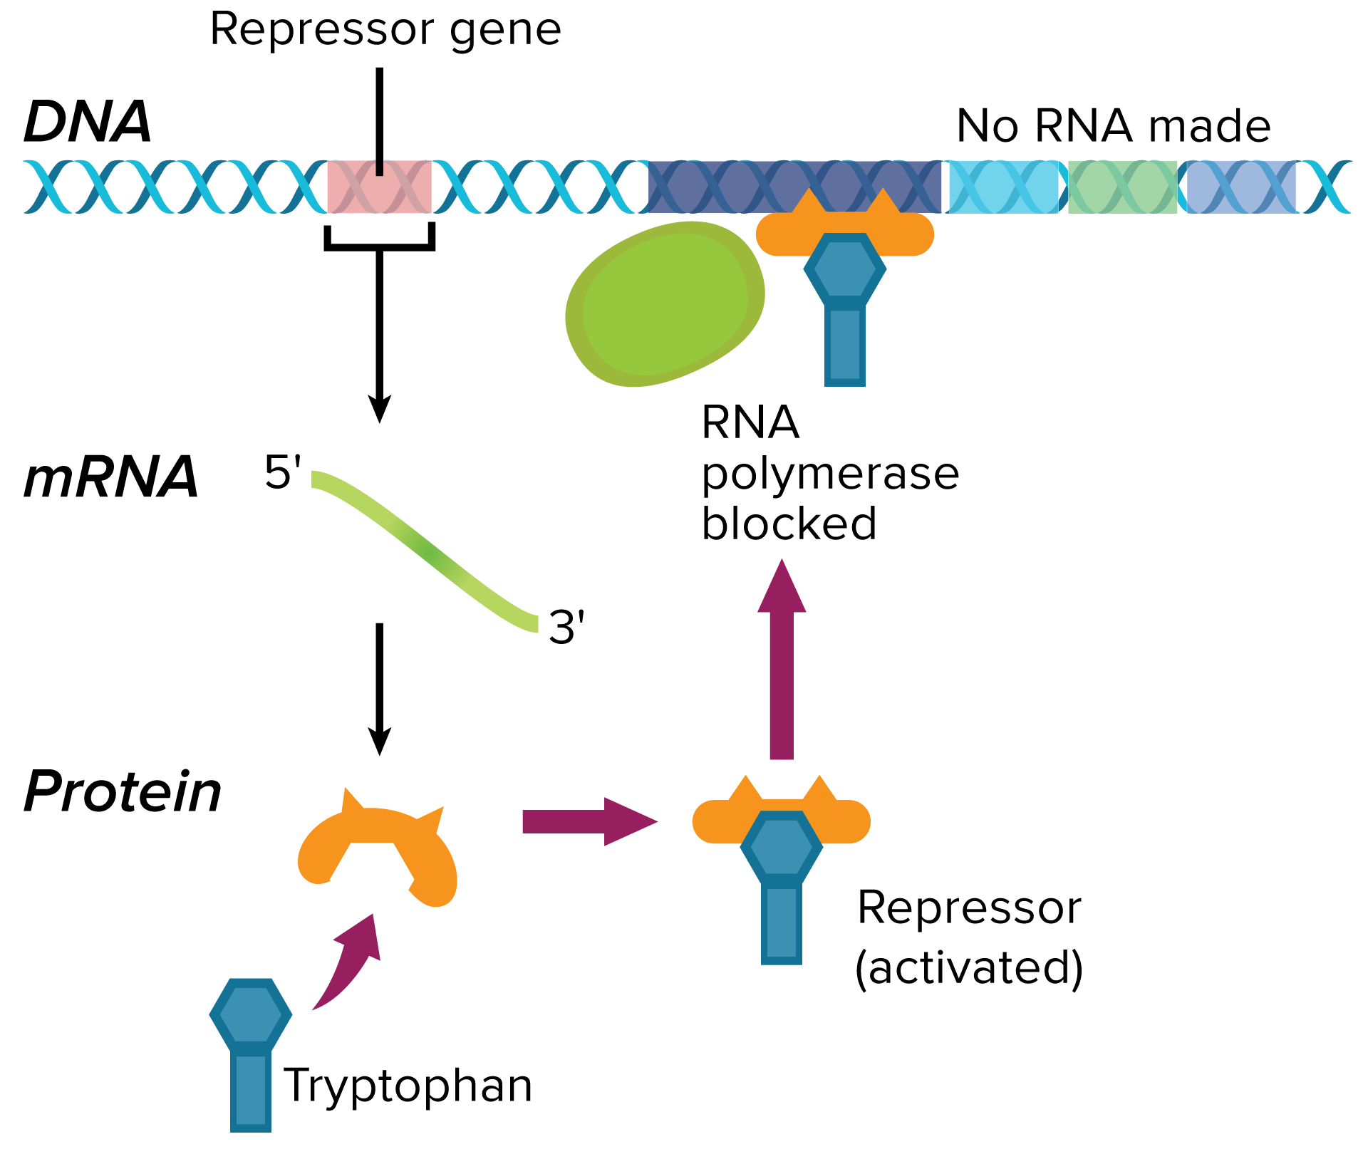
Prokaryote Gene Regulation
The trp operon
Trp operon “on” | Trp operon “off”

Slide 8
Prokaryote Gene Regulation
The lac Operon
When lactose is present, E. coli can synthesize an enzyme to use it as an energy source.
The lac operon is an inducible operon, because an inducer binds to the repressor and inactivates it, allowing transcription to be turned on.

Slide 9
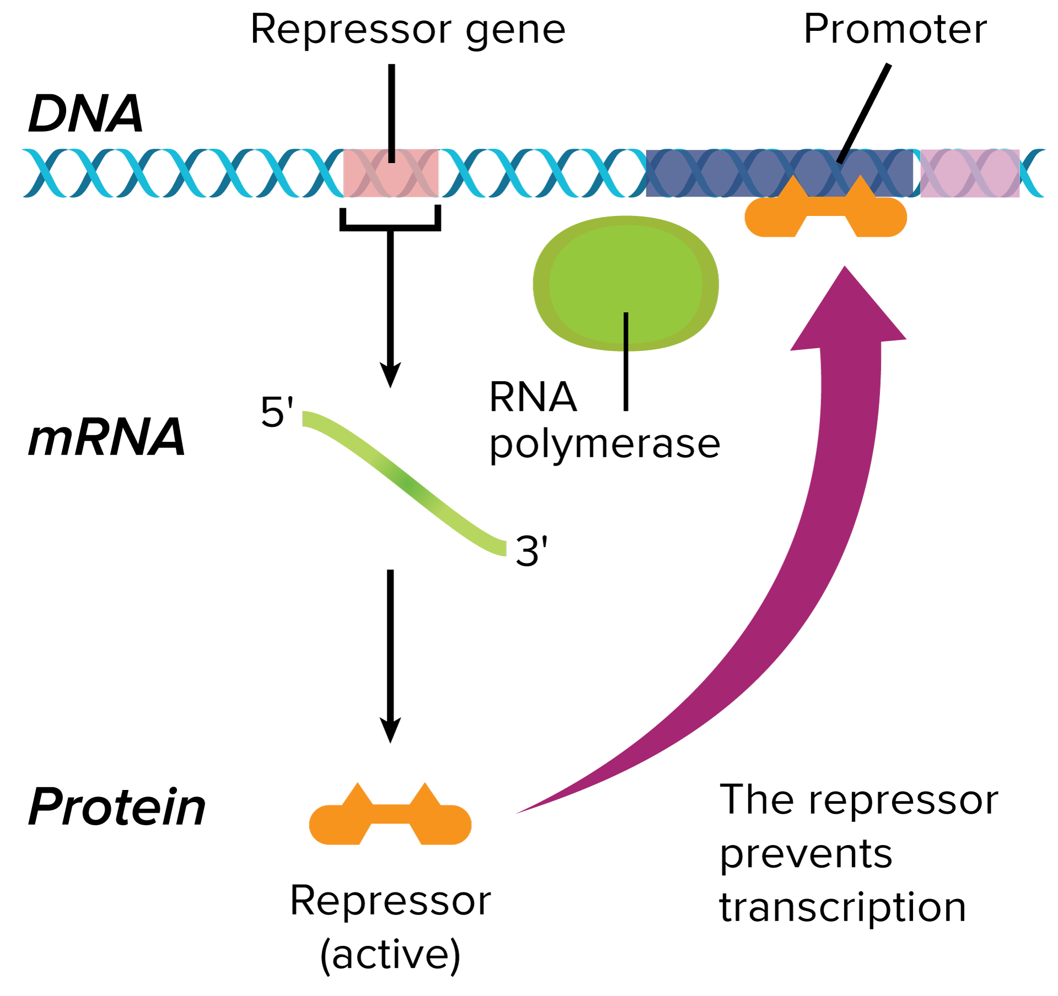
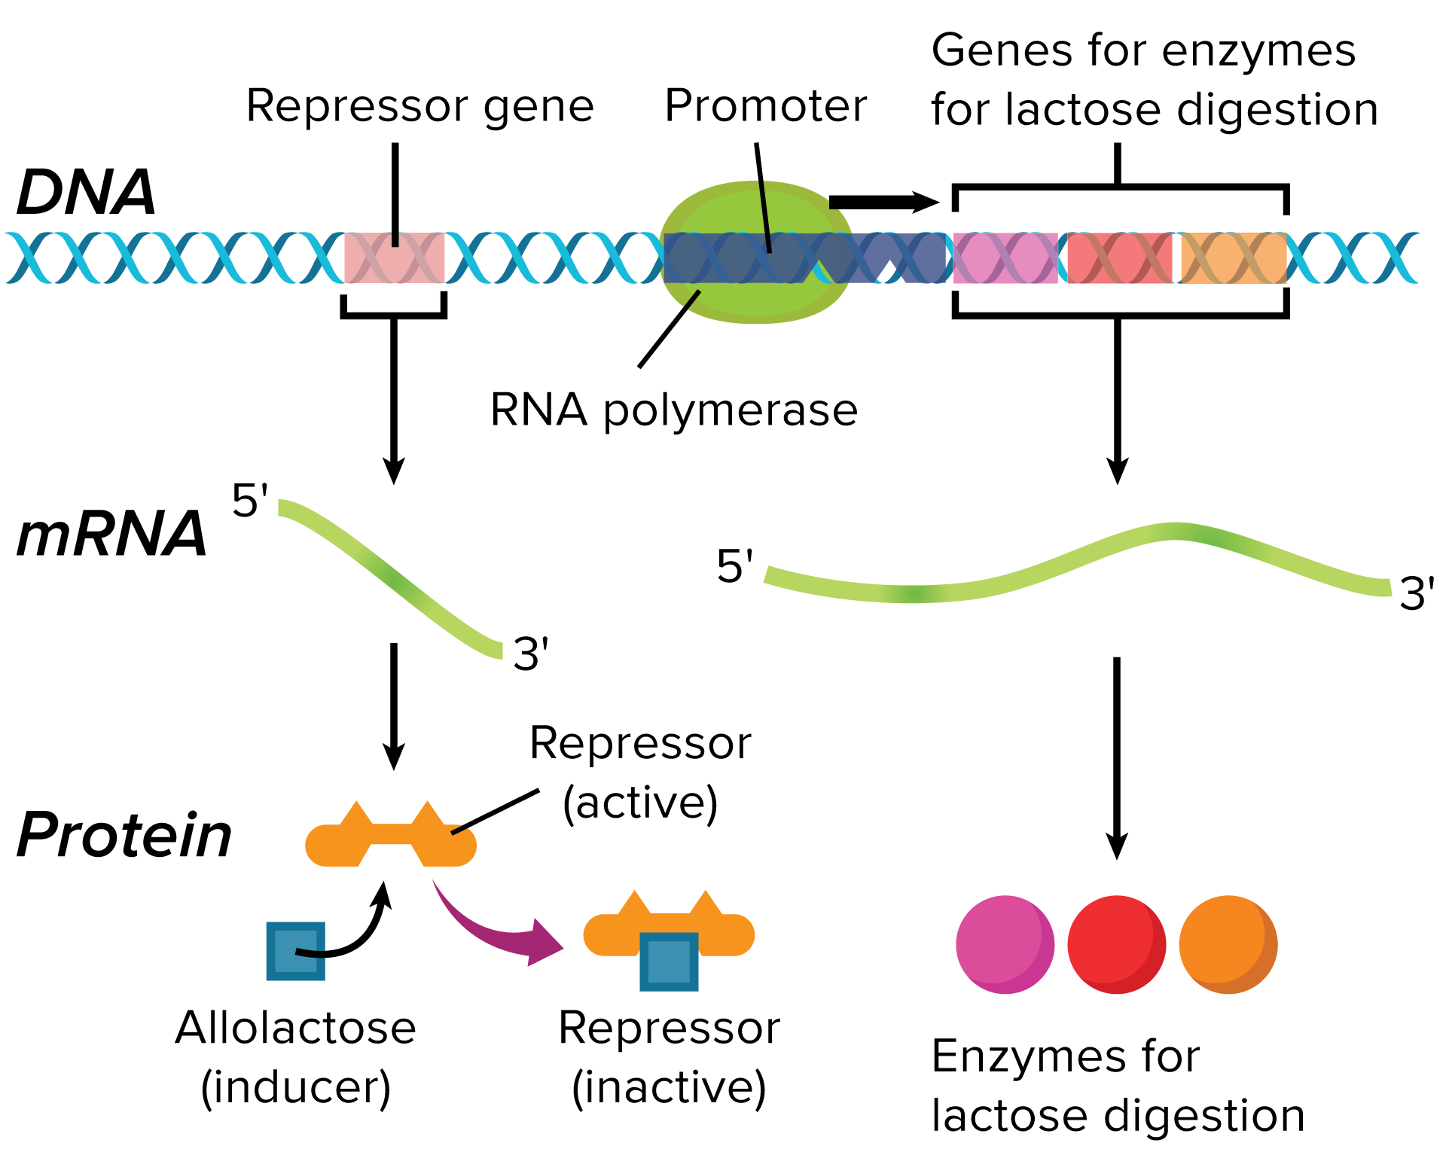
Prokaryote Gene Regulation
The lac operon
Lac operon “on” | Lac operon “off”

Slide 10
Eukaryotic Gene Regulation
Controlling Transcription
Transcription factors ensure that a gene is used at the right time and that proteins are made in the right amounts.
There are two types of transcription factors:
Complexes that guide the binding of the RNA polymerase to a promoter
Regulatory proteins that help control the rate of transcription
The complex structure of eukaryotic DNA also regulates transcription.

Slide 11
Eukaryotic Gene Regulation
Hox Genes
Gene regulation is crucial during development and cell differentiation.
One group of genes that control cell differentiation is the homeobox (Hox) gene group.
Hox genes are transcribed at specific times in specific places on the genome.
Hox genes control which body part will develop at a given body location.

Slide 12
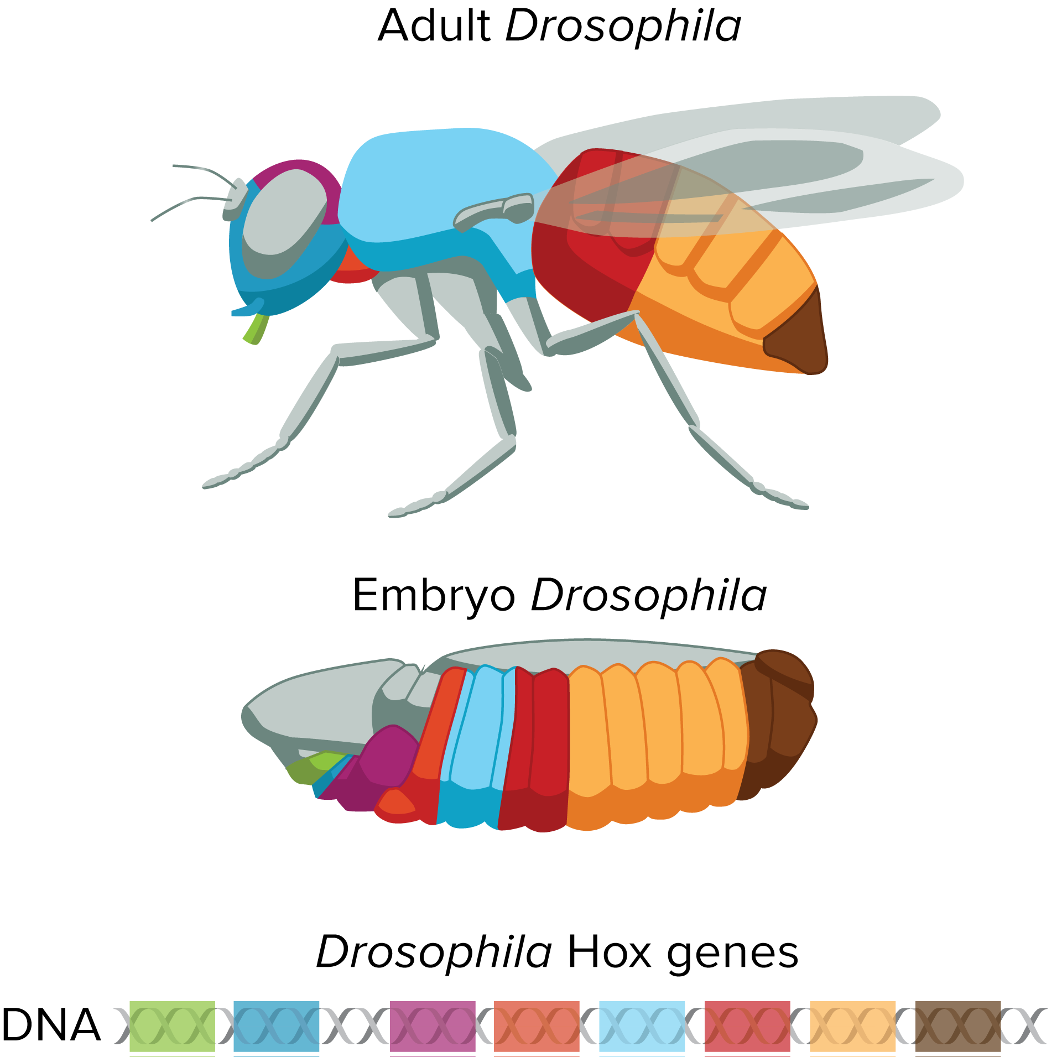
Eukaryotic Gene Regulation
Hox Genes
Hox genes are responsible for the general body pattern of most animals. Notice that the order of the genes is the same as the order of the body sections the genes control.

Slide 13
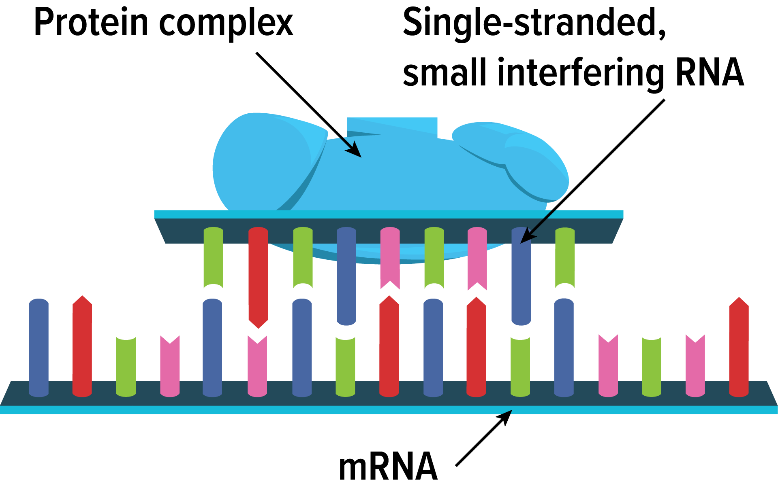
Eukaryotic Gene Regulation
RNA Interference
RNA interference (RNAi) can stop the mRNA from translating its message.
Single-stranded small interfering RNA and protein complexes bind to mRNA and stop translation.

Slide 14
Mutations
A permanent change that occurs in a cell’s DNA is called a mutation.
A point mutation involves change to just one base.
Missense substitution: DNA codes for the wrong amino acid.
Nonsense mutation: The codon for amino acid becomes a stop codon.
Insertion/deletion: There is an addition or loss of a nucleotide in the DNA sequence.
These cause “frameshifts.”

Slide 15
Mutations
Mutations
Mutation Type | Analogy Sentence | Example of Associated Disease
Normal | THE BIG FAT CAT ATE THE WET RAT
Missense | THE BIZ FAT CAT ATE THE WET RAT | Achondroplasia
Nonsense | THE BIG RAT | Muscular dystrophy
Deletion | THB IGF ATC ATA TET HEW ETR AT | Cystic fibrosis
Insertion | THE BIG ZFA TCA TAT ETH EWE TRA | Crohn’s disease
Duplication | THE BIG FAT FAT CAT ATE THE WET RAT | Charcot-Marie-Tooth disease
Expanding mutation | THE BIG FAT CAT CAT CAT ATE THE WET RAT THE BIG FAT CAT CAT CAT CAT CAT CAT ATE THE WET RAT | Huntington’s disease

Slide 16
Mutations
Protein Folding and Stability
Even small changes in the DNA code can cause genetic disorders.
A change in one amino acid can change the sequence of the protein enough to affect both the folding and stability of the protein.
Sickle-cell disease is an example of a disorder caused by a single-point mutation.

Slide 17
Mutations
Causes of Mutation
Mutations can occur spontaneously; DNA polymerase can attach the wrong nucleotide, but this is rare and is usually corrected.
Certain chemicals and radiation called mutagens can damage DNA.
Chemicals can cause mispairing of base pairs, or themselves substitute for base pairs.
High-energy radiation can eject electrons from atoms within the DNA molecule, leaving behind unstable free radicals.

Slide 18
Mutations
Body-Cell v. Sex-Cell Mutation
Somatic cell mutations are not passed on to the next generation.
Mutations that occur in sex cells are passed on to the organism’s offspring and will be present in every cell of the offspring.

