Slide 1
Lesson 1
Fossil Evidence of Change

Slide 2
Focus Question
How can fossils provide evidence of past life?

Slide 3
New Vocabulary
fossil
epoch
paleontologist
period
relative dating
era
law of superposition
eon
radiometric dating
Cambrian explosion
half-life
K-T boundary
geologic time scale
plate tectonics

Slide 4
Review Vocabulary
extinction: the death of all individuals of a species

Slide 5
Earth’s Early History
Earth formed about 4.6 billion years ago.
Gravity pulled the densest elements to the center of the planet.
After about 500 million years, a solid crust formed on the surface.

Slide 6
Earth’s Early History
The gases that likely made up the atmosphere are those that were expelled by volcanoes:
Water vapor (H₂O)
Carbon dioxide (CO₂)
Sulfur dioxide (SO₂)
Carbon monoxide (CO)
Nitrogen (N₂)
Hydrogen (H₂)
Minerals in the oldest known rocks suggest that the early atmosphere had little to no free oxygen.

Slide 7
Clues in Rocks
A fossil is any preserved evidence of an organism.
99% of the species that have ever lived are now extinct, but only a small percentage remain as fossils.
Most organisms decompose before they have a chance to become fossilized.

Slide 8
Clues in Rocks
Nearly all fossils are formed in sedimentary rock.
The sediments build up until they cover the organism’s remains.
Minerals replace the organic matter or fill the empty pore spaces of the organism, or the organism decomposes and leaves behind an impression of its body.

Slide 9
Clues in Rocks
Scientists who study fossils are called paleontologists.
Relative dating is a method used to determine the age of rocks by comparing them with those in other layers.

Slide 10
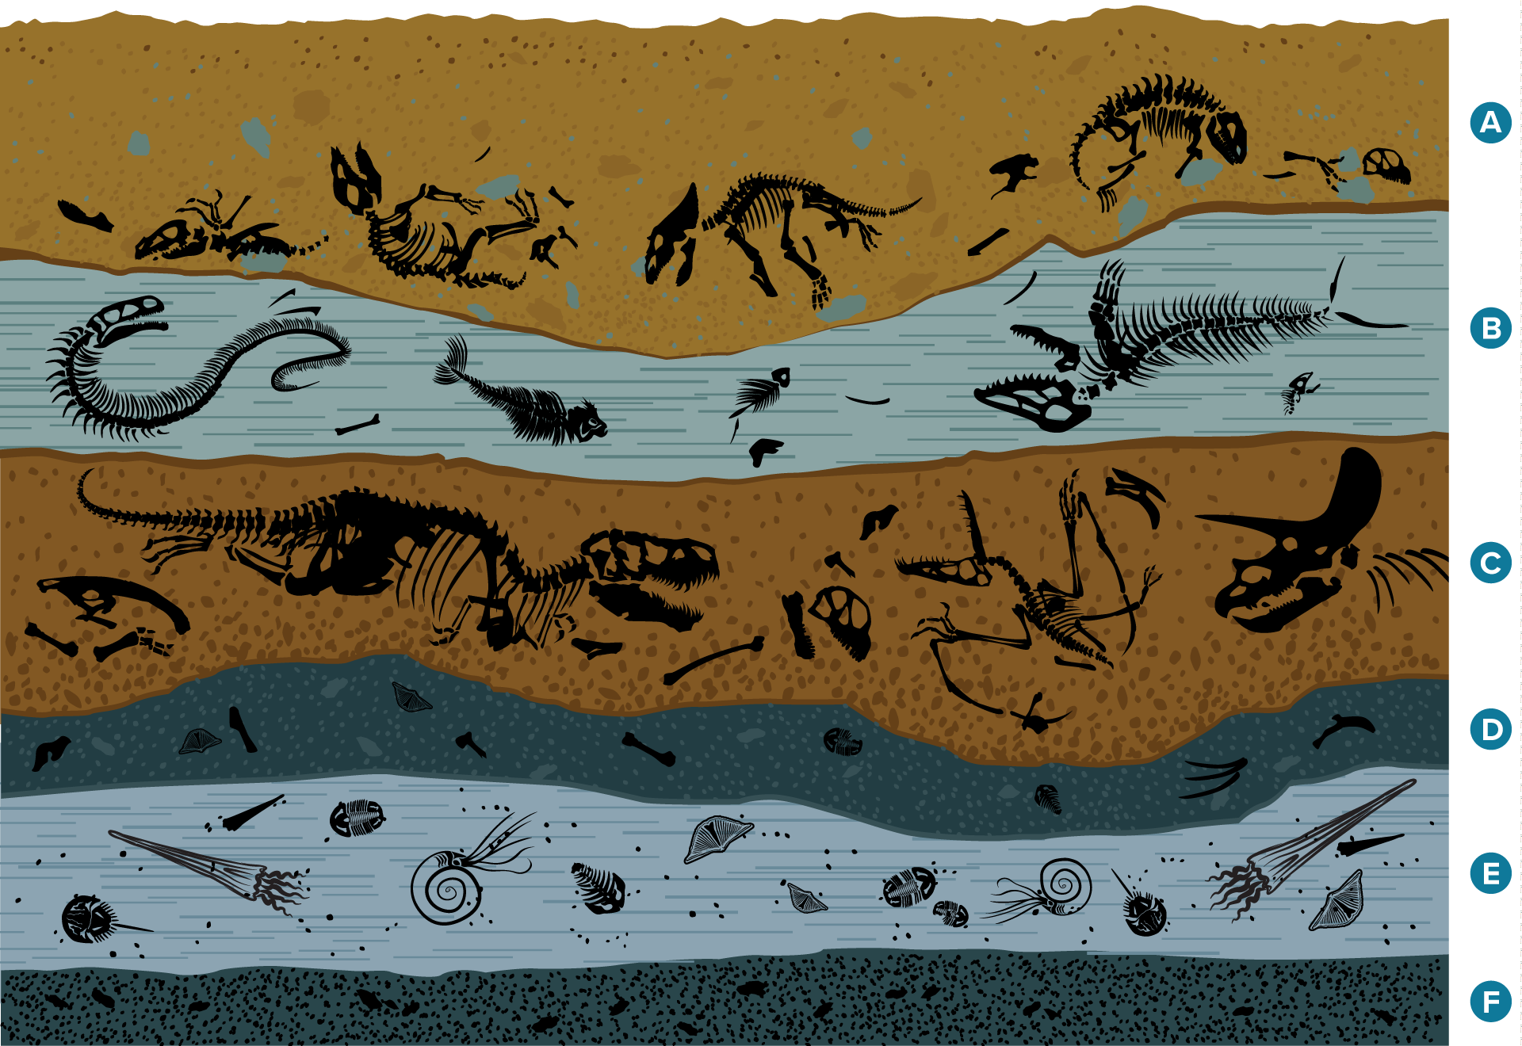
Clues in Rocks
Relative dating is based on the law of superposition, which states that younger layers of rock are deposited on top of older layers.

Slide 11
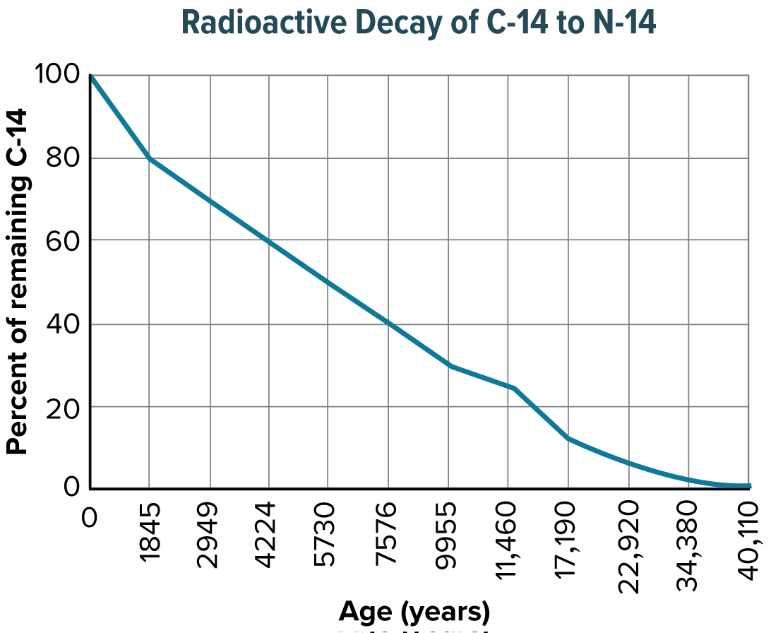
Clues in Rocks
Radiometric dating uses the decay of radioactive isotopes to measure the age of a rock.
Radiometric dating depends on knowing the half-life – the time it takes for half of the original isotope to decay – of the isotope in question.

Slide 12
The Geologic Time Scale
The geologic time scale is a model that expresses the major geological and biological events in Earth’s history.
Epochs are the smallest units of geologic time(>1m years).
Periods are composed of two or more epochs (10m years).
Eras consist of two or more periods (100m years).
An eon, the longest unit of time in the geologic time scale, can include billions of years.

Slide 13
The Geologic Time Scale
Geologic time is divided into two segments:
Precambrian Era
Phanerozoic Era
The Precambrian Era
This era is comprised of the first 4 billion years (90 percent) of Earth’s history.
Life first appeared during the Precambrian era.
Autotrophic prokaryotes enriched the atmosphere with oxygen.
Eukaryotes emerged; the first animals appeared.
Food chains were generally short and simple

Slide 14
The Geologic Time Scale
The Paleozoic Era
During this era, the ancestors of most major animal groups diversified in what scientists call the Cambrian explosion.
The first life on land emerged during this era.
A mass extinction ended the Paleozoic Era, with 90% of marine organisms going extinct.

Slide 15
The Geologic Time Scale
The Mesozoic Era
Dinosaurs, birds, and mammals evolved.
The K-T boundary is a layer of material that has unusually high levels of iridium. The K-T boundary is found between the rocks of the Cretaceous period and the rocks of the Paleogene period.
Iridium is rare on Earth, but it is common in meteorites, suggesting a massive meteorite struck the Earth about 65 million years ago.
This meteorite impact changed the climate on Earth, wiping out the dinosaurs, many marine invertebrates, and many plant species.

Slide 16
The Geologic Time Scale
Geologic changes during the Mesozoic Era shaped the course of evolution.
Plate tectonics describes the movement of several large plates that make up the surface of the Earth.
These plates move atop a partially molten layer of rock underneath them.

Slide 17
The Geologic Time Scale
The Cenozoic Era
During this era, mammals became the dominant land animals.
After the mass extinction at the end of the Mesozoic era, mammals of all kinds began to diversify.
Humans appeared very recently, during the current Neogene Period.

