Slide 1
Lesson 2
The Origin of Life

Slide 2
Focus Question
How does the theory of biogenesis relate to modern ideas of cellular life?

Slide 3
New Vocabulary
spontaneous generation
theory of biogenesis
endosymbiotic theory

Slide 4
Review Vocabulary
amino acid: building blocks for proteins

Slide 5
Origins: Early Ideas
Spontaneous generation, one of the earliest ideas about how life is produced, suggested that life arises from nonlife.
People believed that worms, insects, and fish arose from mud.

Slide 6
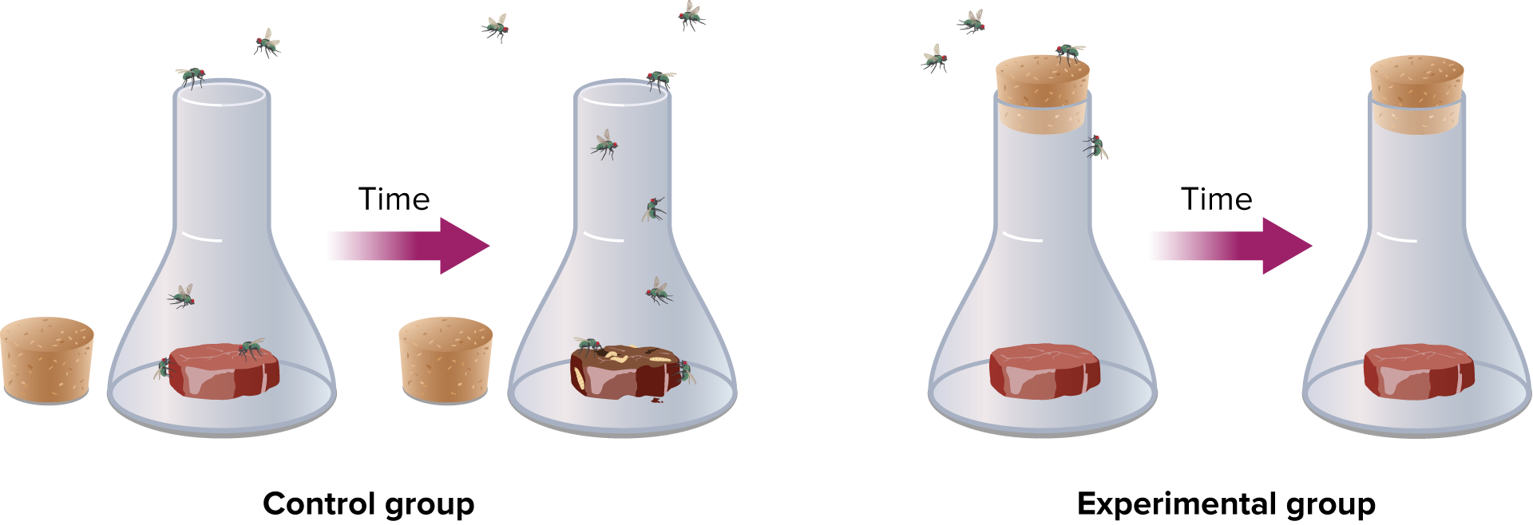
Origins: Early Ideas
Francesco Redi tested the idea that flies arose from rotting meat in 1668. He hypothesized that other flies, not meat, produced flies.

Slide 7
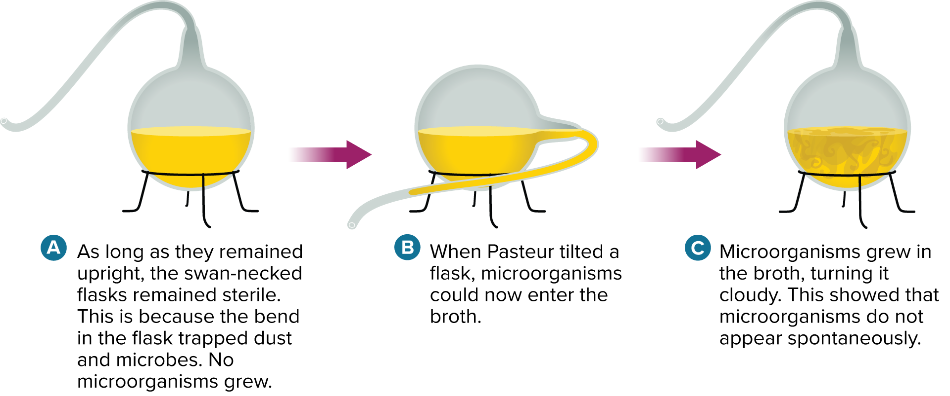
Origins: Early Ideas
The theory of biogenesis says that only living organisms can produce other living organisms. Louis Pasteur designed an experiment to show that biogenesis was true even for microorganisms.

Slide 8
Origins: Modern Ideas
Most biologists agree that life originated through a series of chemical events in Earth’s early history.
The primordial soup hypothesis suggested that if the Earth’s atmosphere had a mix of certain gases, organic molecules could have been synthesized.
UV light from the Sun could serve as the energy source for these organic molecules, which would eventually be the precursors to life.

Slide 9
Origins: Modern Ideas
Stanley Miller and Harold Urey were the first to show that inorganic compounds could produce simple organic molecules, including amino acids.
Scientists later found precursors to nucleotide bases could be formed from even simpler molecules in simulated environments.

Slide 10
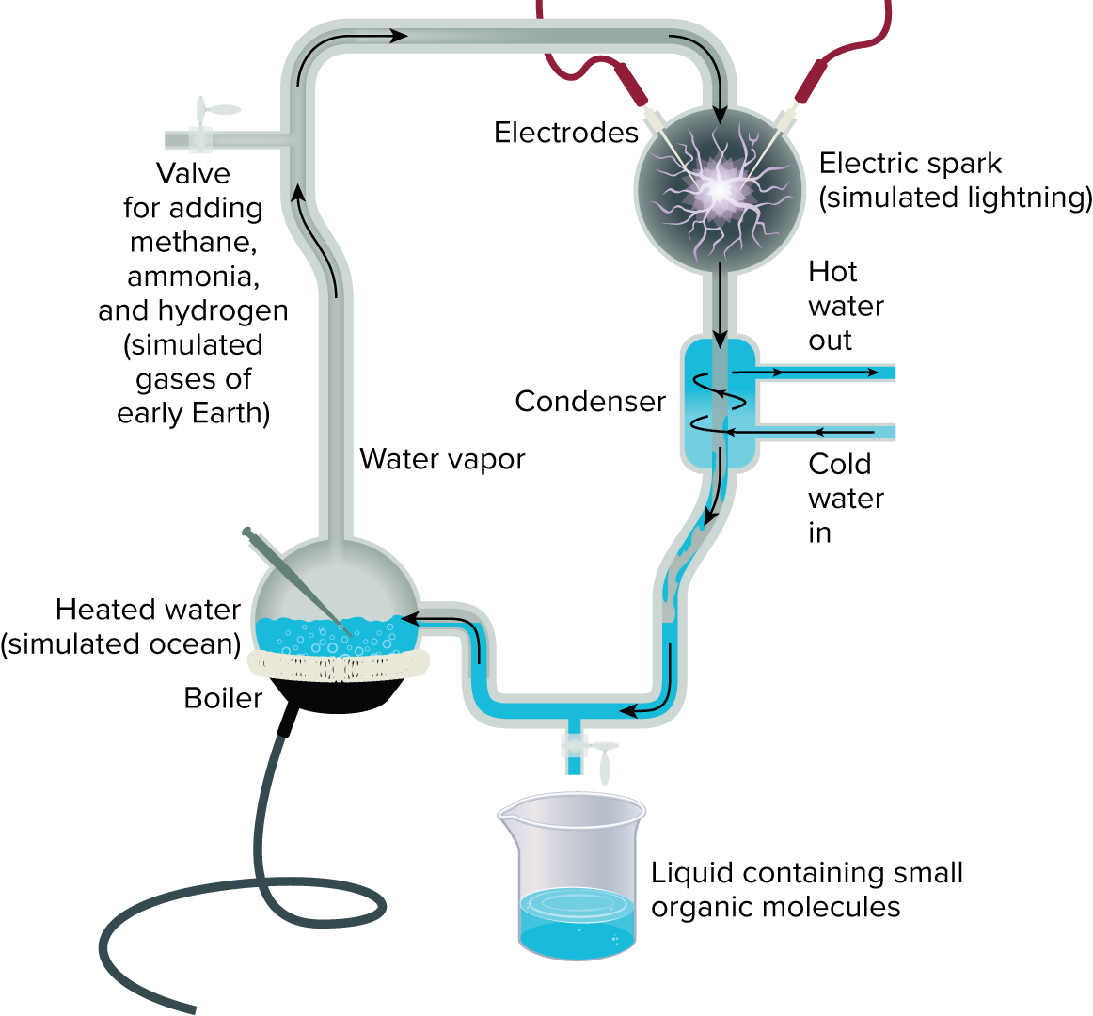
Origins: Modern Ideas

Slide 11
Origins: Modern Ideas
Making Proteins
Life requires proteins, not just amino acids.
One possible mechanism for the formation of proteins would be if amino acids were bound to a clay particle, a common sediment in early oceans.

Slide 12
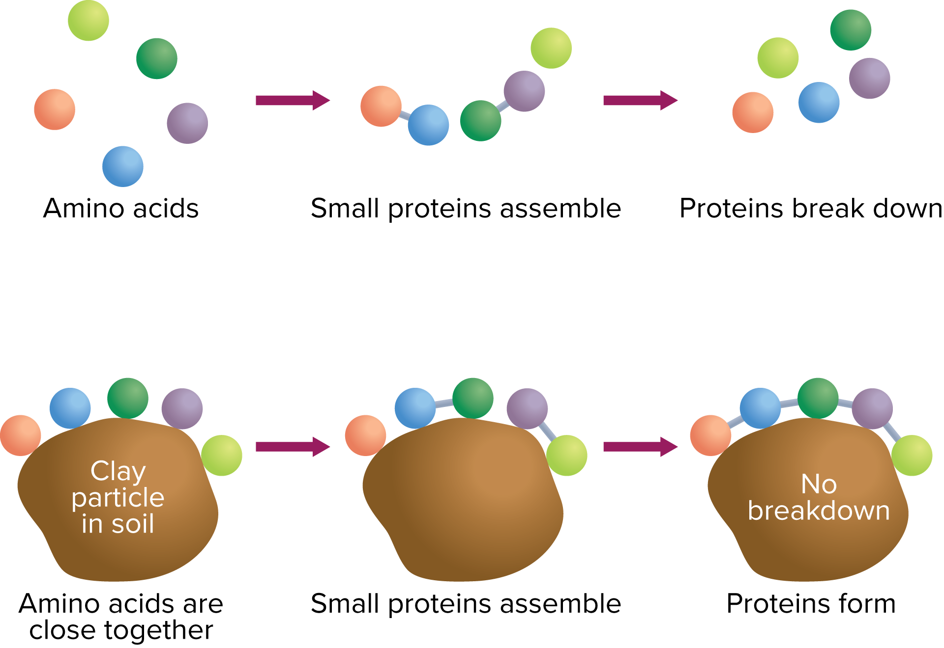
Origins: Modern Ideas

Slide 13
Origins: Modern Ideas
Genetic Code
Many biologists consider RNA to have been life’s first coding system.
RNA can act like enzymes called ribozymes; it may have carried out early life processes.
Other researchers have proposed that clay crystals could have provided an initial template for RNA replication.

Slide 14
Origins: Modern Ideas
Molecules to Cells
Formation of membranes was an important step in the evolution of life.
Researchers have investigated ways of enclosing molecules in membranes, but the connection between various chemical events and the overall path to cells is unresolved.

Slide 15
Cellular Evolution
Scientists hypothesize that the first cells were prokaryotes.
Prokaryotes are smaller and simpler than eukaryotic cells.
Prokaryotes are most similar to modern-day archaea.
Modern archaea are found in extreme environments that are similar to early Earth.

Slide 16
Cellular Evolution
Photosynthesizing Prokaryotes
Early earth lacked free oxygen until about 1.8 billion years ago.
Evidence that iron oxide was formed by oxygen is found in banded iron formations in sedimentary rocks.
Fossil evidence of photosynthesizing prokaryotes called cyanobacteria has been found in rocks as old as 3.5 billion years.
Cyanobacteria eventually produced enough oxygen to support the formation of the ozone layer.

Slide 17
The Endosymbiont Theory
Lynn Margulis proposed the endosymbiont theory, which proposed that ancestral eukaryotic cells absorbed prokaryotic cells, which evolved into organelles.
Prokaryotes entered eukaryotic cells as undigested food or parasites.
Their relationship became mutually beneficial.
The theory explains the double membranes around mitochondria and chloroplasts.

Slide 18
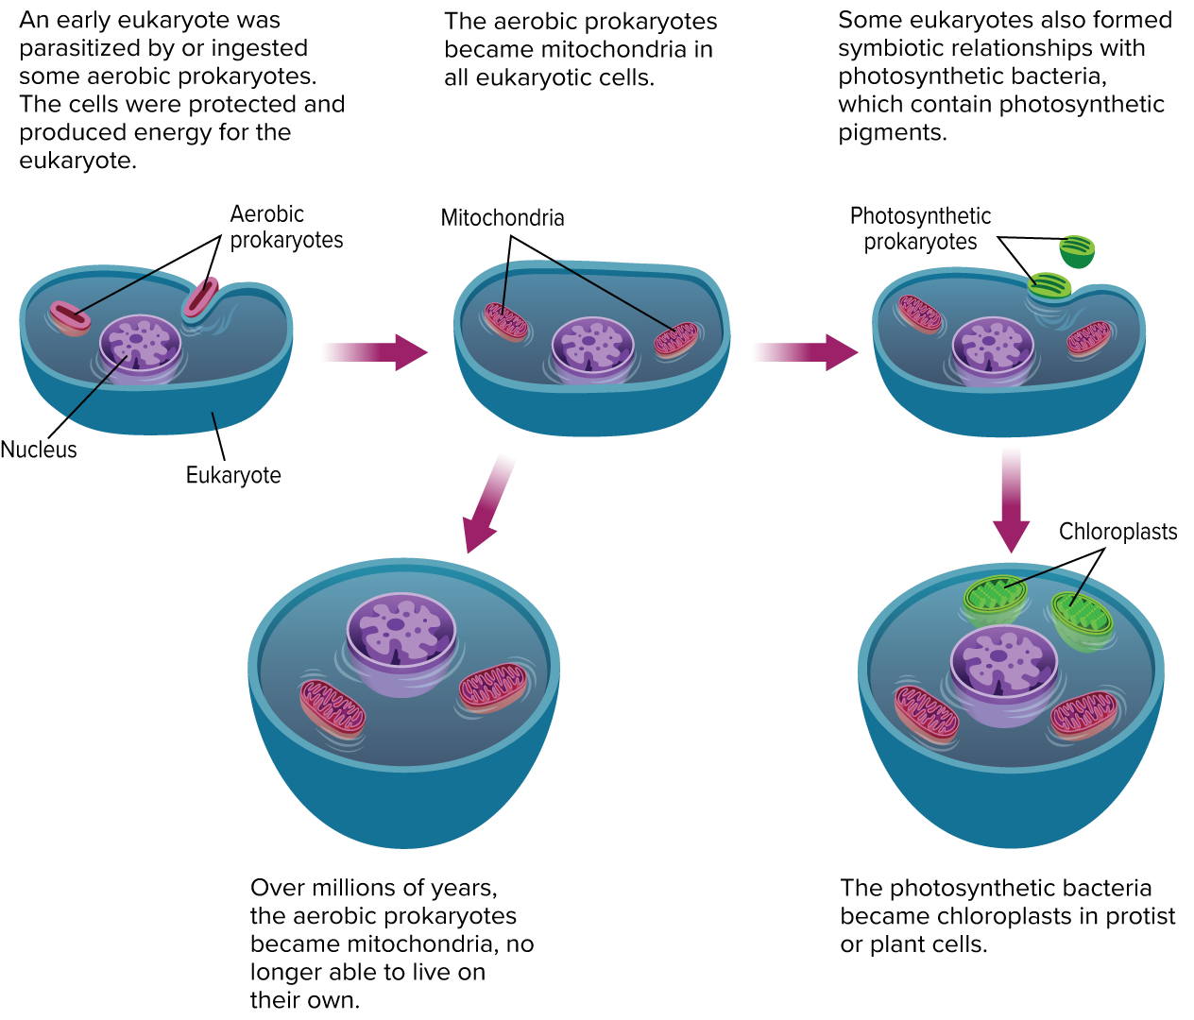
The Endosymbiont Theory

