Slide 1
Lesson 2
Evidence of Evolution

Slide 2
Focus Question
How does the fossil record, morphology, biochemistry, and adaptation provide evidence of evolution?

Slide 3
New Vocabulary
derived trait
embryo
ancestral trait
biogeography
homologous structure
fitness
vestigial structure
camouflage
analogous structure
mimicry

Slide 4
Review Vocabulary
fossil: remains of an organism or its activities

Slide 5
Support for Evolution
The theory of evolution states that all organisms on Earth have descended from a single ancestor.
Recall that theories provide explanations for natural phenomena based on observation.
Darwin’s On the Origin of Species demonstrated how evolution might happen, and provided evidence of its occurrence.

Slide 6
Support for Evolution
Evidence for evolution comes from:
The fossil record
Comparative anatomy
Vestigial structures
Comparative embryology
Comparative molecular biology
Geographic distribution

Slide 7
Support for Evolution
The Fossil Record
Fossils show modern species resemble ancient species.
They also reveal that some species have changed very little.
The fossil record is an important source of information for determining the ancestry of organisms and the patterns of evolution.

Slide 8
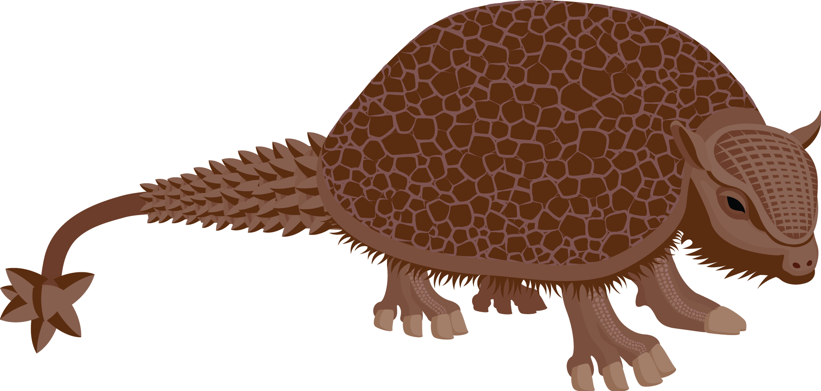
Support for Evolution
The Fossil Record
The giant armadillo-like glyptodont, Glyptodon, is an extinct animal that Darwin thought must have been related to living armadillos.

Slide 9
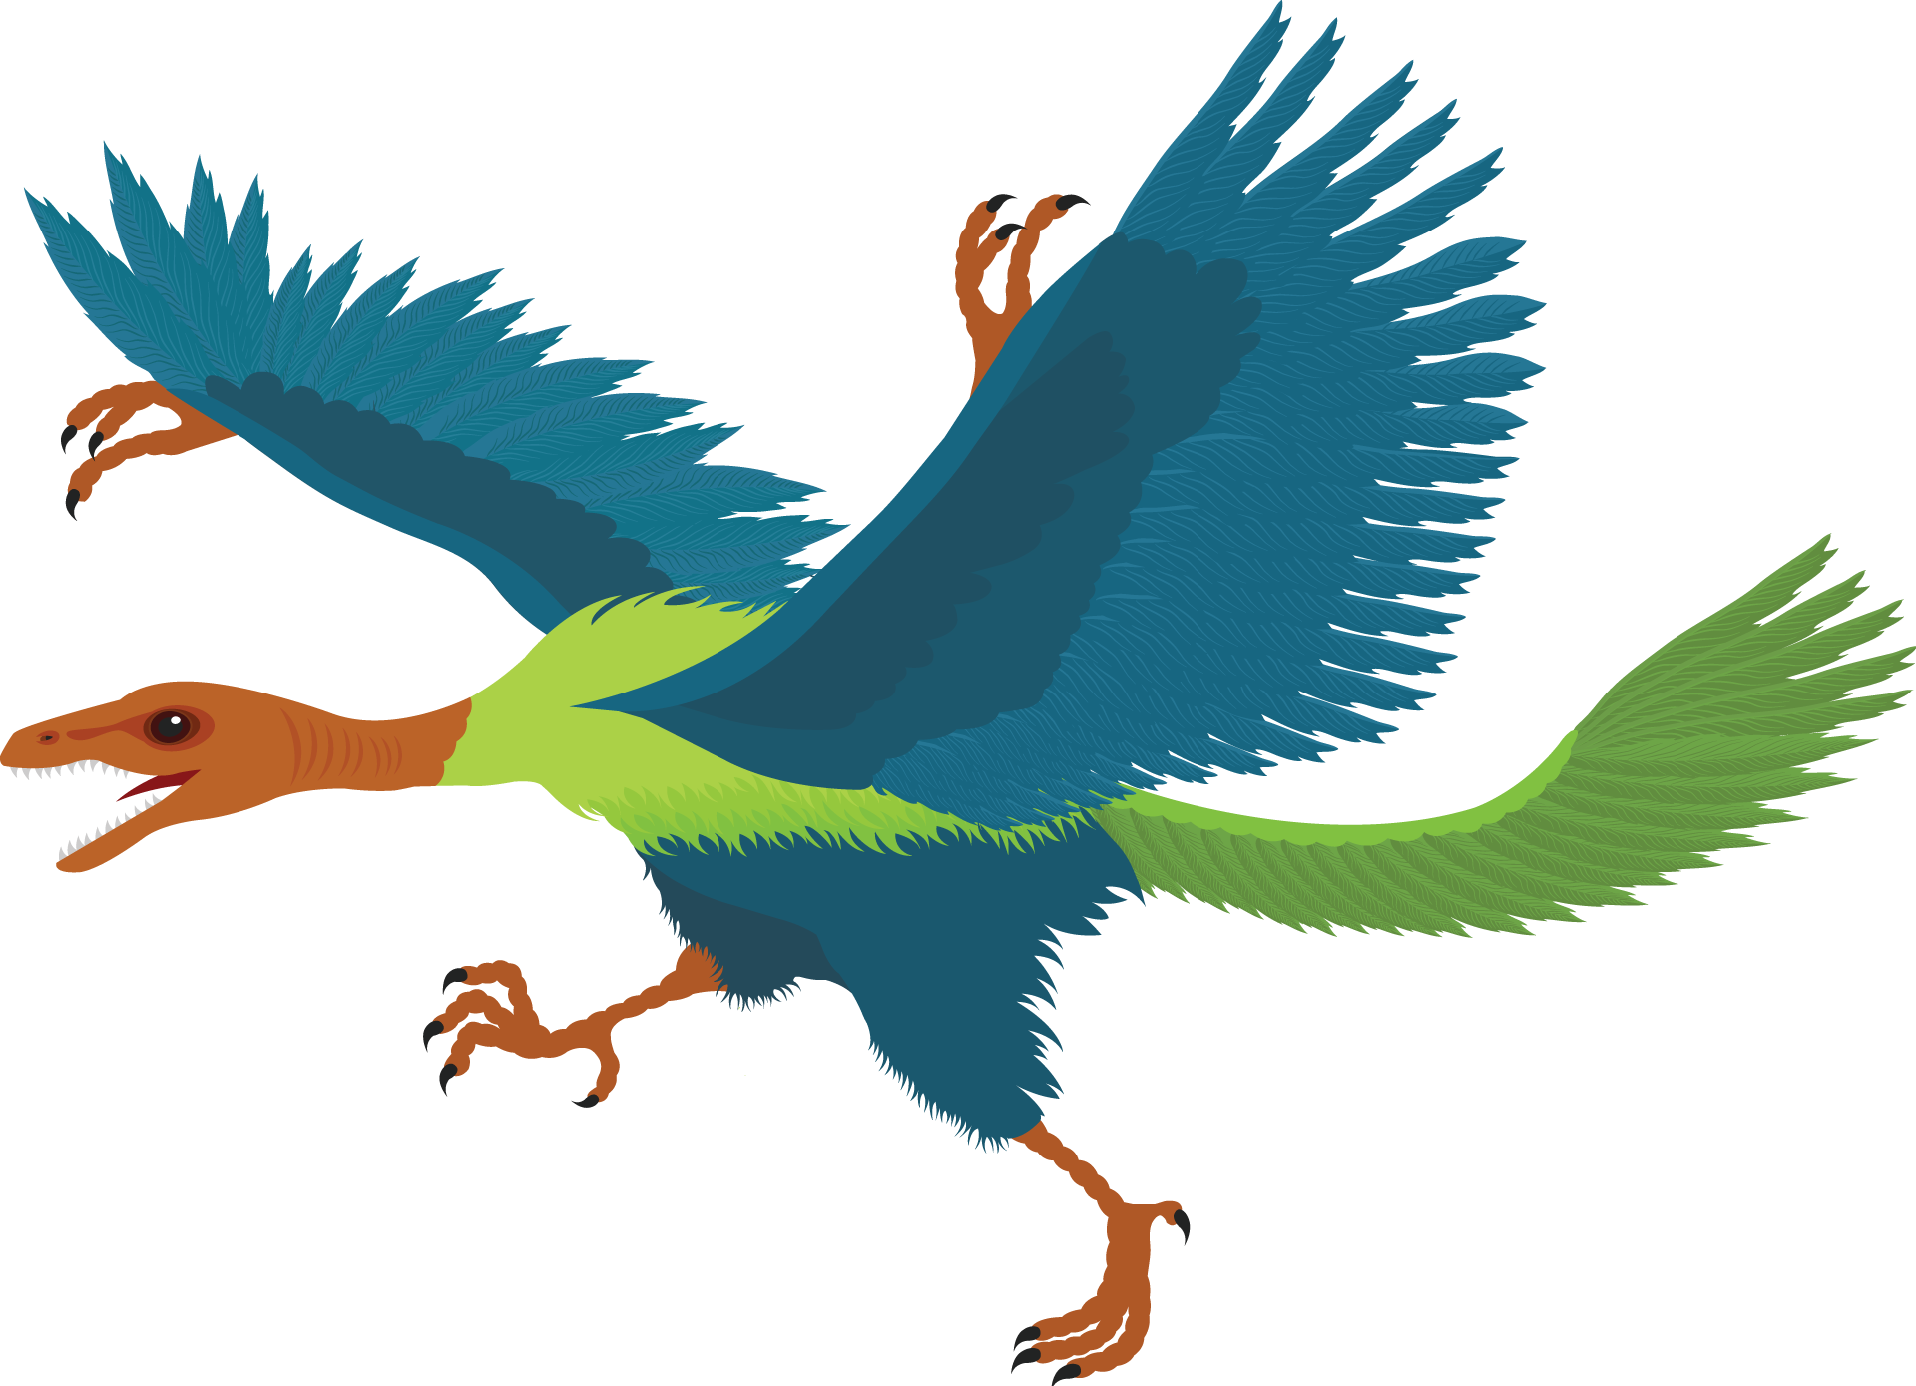
Support for Evolution
The Fossil Record
Darwin predicted the existence of fossils intermediate in form between species, such as Archaeopteryx.

Slide 10
Support for Evolution
The Fossil Record
Researchers consider two major classes of traits when studying transitional fossils:
Derived traits are newly evolved features, such as feathers, that do not appear in the fossils of common ancestors.
Ancestral traits are more primitive features, such as teeth and tails, that do appear in ancestral forms.

Slide 11
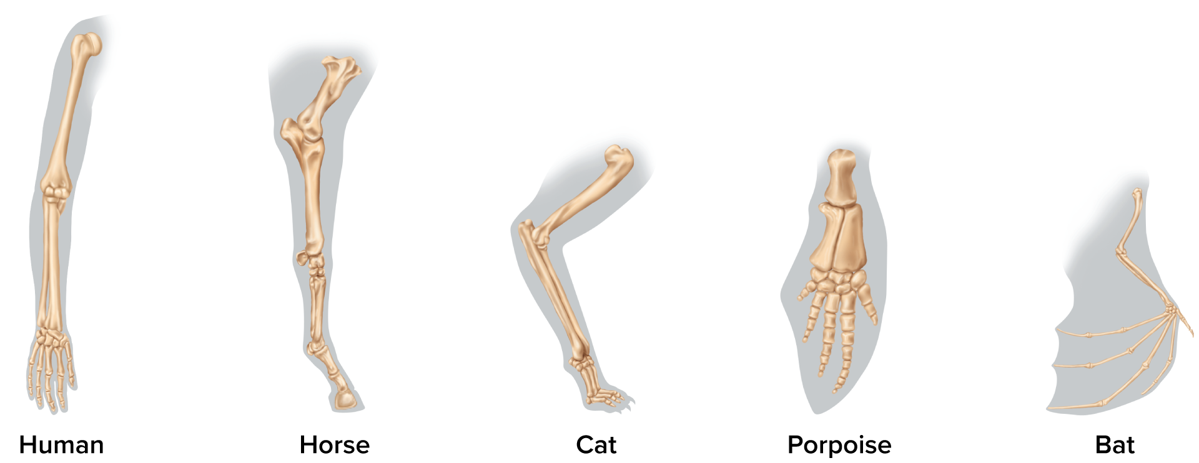
Support for Evolution
Comparative Anatomy
Anatomically similar structures inherited from a common ancestor are called homologous structures.
Evolution predicts that an organism’s body parts are more likely to be modifications of ancestral body parts than entirely new structures.

Slide 12
Support for Evolution
Vestigial Structures
Vestigial structures are structures that are the reduced forms of functional structures in other organisms.
Evolutionary theory predicts that features of ancestors that no longer have a function for that species will become smaller over time until they are lost.
Examples of vestigial structures include human wisdom teeth, the wings of Emus, and the human tailbone.

Slide 13
Support for Evolution
Vestigial Structures
Analogous structures can be used for the same purpose and be superficially similar in construction, but they are not inherited from a common ancestor.
Analogous structures show that functionally similar features can evolve independently under similar conditions.

Slide 14
Support for Evolution
Comparative Embryology
An embryo is an early, pre-birth stage of an organism’s development.
Vertebrate embryos exhibit homologous structures during phases of development that become totally different structures in the adult forms.

Slide 15
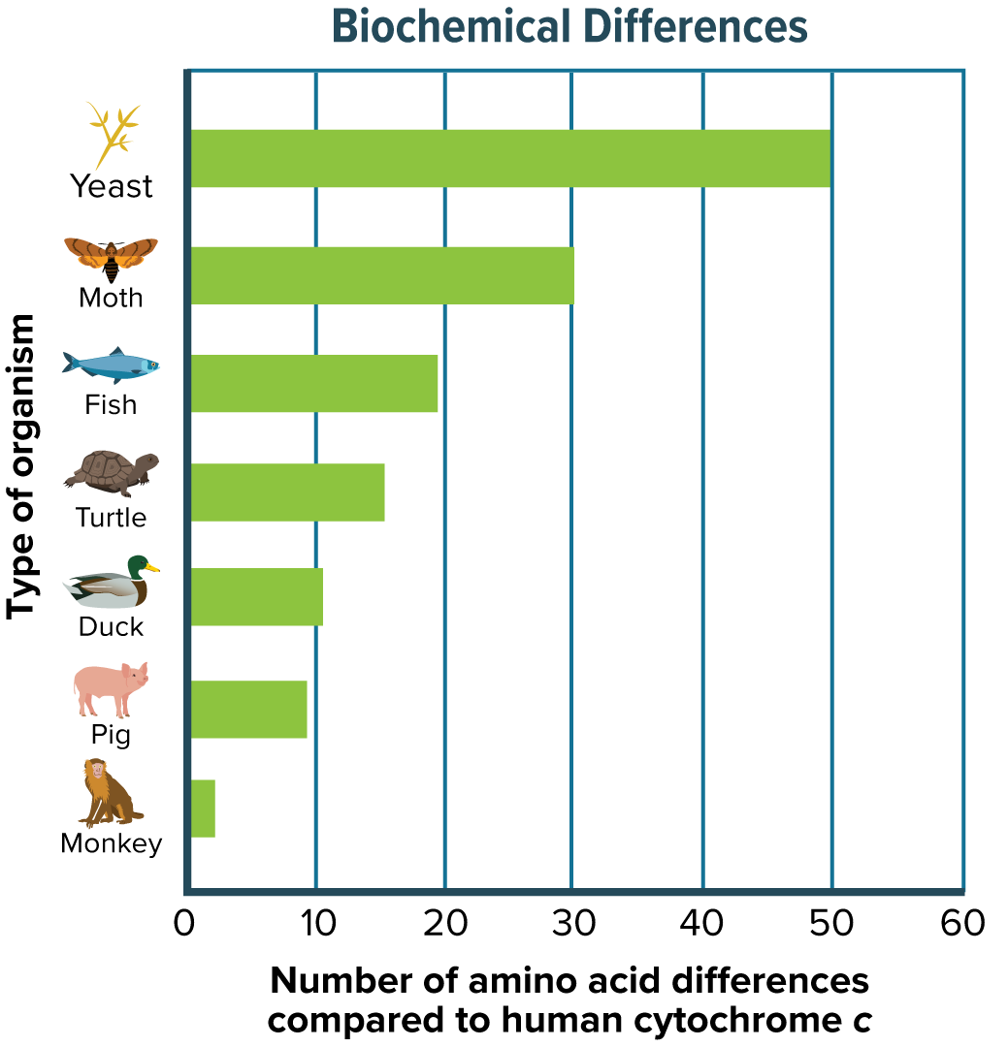
Support for Evolution
Comparative Molecular Biology
Common ancestry can be seen in the complex metabolic molecules that many different organisms share.
The more closely related species are to each other, the greater the biochemical similarity.

Slide 16
Support for Evolution
Geographic Distribution
The distribution of plants and animals were what first suggested evolution to Darwin.
The distribution of plants and animals around the world is studied in the field of biogeography.
Evolution is linked to migration patterns, climate, and geological forces such as plate tectonics.

Slide 17
Adaptation
Types of Adaptations
An adaptation is a trait shaped by natural selection that increases an organism’s reproductive success.
Fitness is a measure of the relative contribution an individual trait makes to the next generation.
The better an organism is adapted to its environment, the greater its chances of survival and reproductive success.

Slide 18
Adaptation
Types of Adaptations
Camouflage is a suite of morphological adaptations that allow an organism to blend into its environment.
Mimicry is a type of morphological adaptation where a species evolves to resemble another species.
Species of bacteria that originally were killed by penicillin and other antibiotics have developed drug resistance.

Slide 19
Adaptation
Consequences of Adaptations
Not all features of an organism are necessarily adaptive.
Some features are consequences of other evolved characteristics.
Helplessness of human babies: Humans give birth at a much earlier developmental stage than other primates.
May be a consequence of larger brain size and upright posture

