Slide 1
Lesson 3
Shaping Evolutionary Theory

Slide 2
Focus Question
What patterns can be observed in evolution?

Slide 3
New Vocabulary
Hardy-Weinberg principle
prezygotic isolating mechanism
genetic drift
postzygotic isolating mechanism
founder effect
bottleneck
allopatric speciation
stabilizing selection
sympatric speciation
directional selection
adaptive radiation
disruptive selection
gradualism
sexual selection
punctuated equilibrium

Slide 4
Review Vocabulary
allele: alternate forms of a character trait that can be inherited

Slide 5
Mechanisms of Evolution
Natural selection is not the only mechanism of evolution.
Evolution occurs at the population level, with genes as the raw material.

Slide 6
Mechanisms of Evolution
Population Genetics
Hardy and Weinberg showed that evolution will not occur in a population unless allelic frequencies are acted upon by forces that cause change.
The Hardy-Weinberg principle states that when allelic frequencies remain constant, a population is in genetic equilibrium.

Slide 7
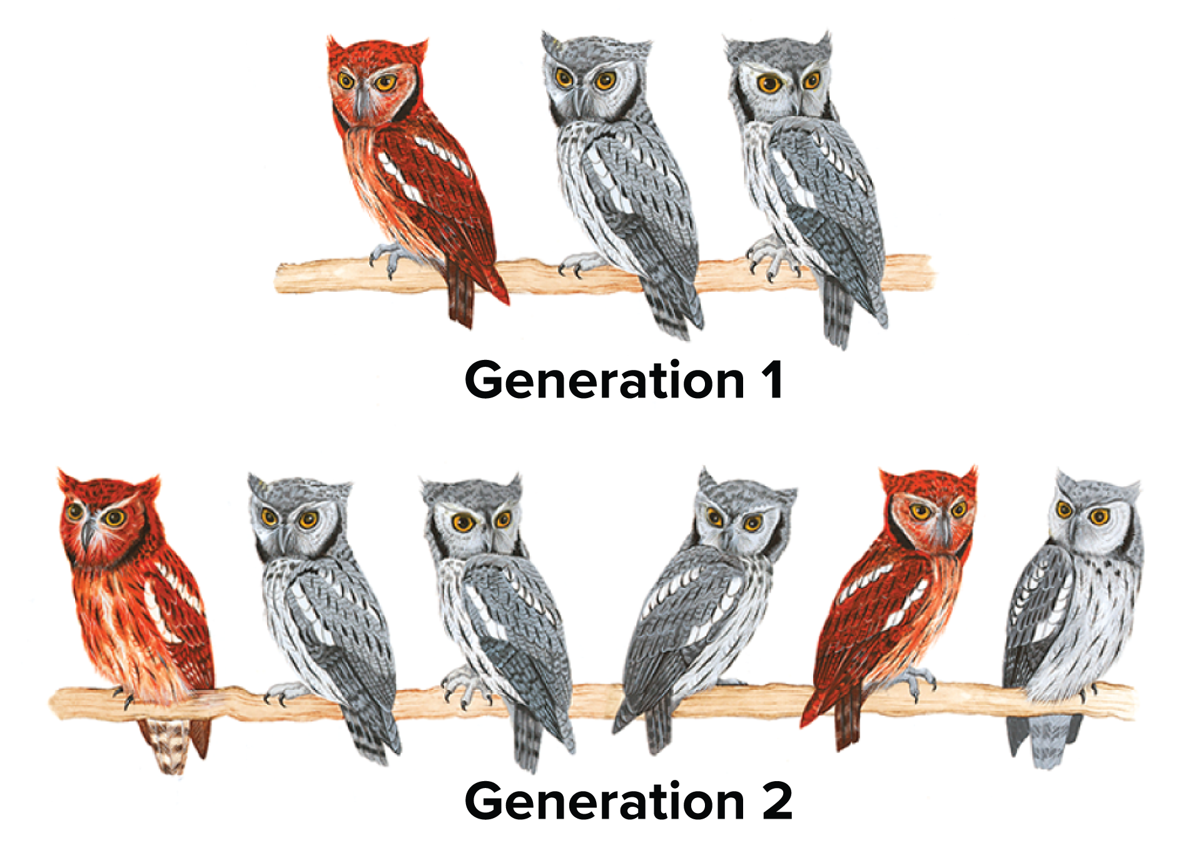
Mechanisms of Evolution
Population Genetics
According to the Hardy-Weinberg principle, if the number of owls in a population doubles, the ratio of gray to red owls will remain the same.

Slide 8
Mechanisms of Evolution
Population Genetics
The Hardy-Weinberg principle can be numerically represented as:
p² is the proportion of homozygous
dominant.
2pq is the proportion of heterozygous.
q² is the proportion of homozygous
recessive.

Slide 9
Mechanisms of Evolution
Population Genetics
According to the Hardy-Weinberg principle, for a population to be in genetic equilibrium, it must meet five conditions:
No genetic drift
No gene flow
No mutation
Mating must be random
No natural selection
These five conditions are the mechanisms of evolutionary change.

Slide 10
Mechanisms of Evolution
Genetic Drift
Any change in the allelic frequencies in a population that results from chance is called genetic drift.
In smaller populations, the effects of genetic drift become more pronounced, and the chance of losing an allele becomes greater.

Slide 11
Mechanisms of Evolution
Genetic Drift
The founder effect can occur when a small sample of a population settles in a location separated from the rest of the population.
Alleles that were uncommon in the original
population may be common in the new
population.
The founder effect can result in large genetic
variations in the separated population.

Slide 12
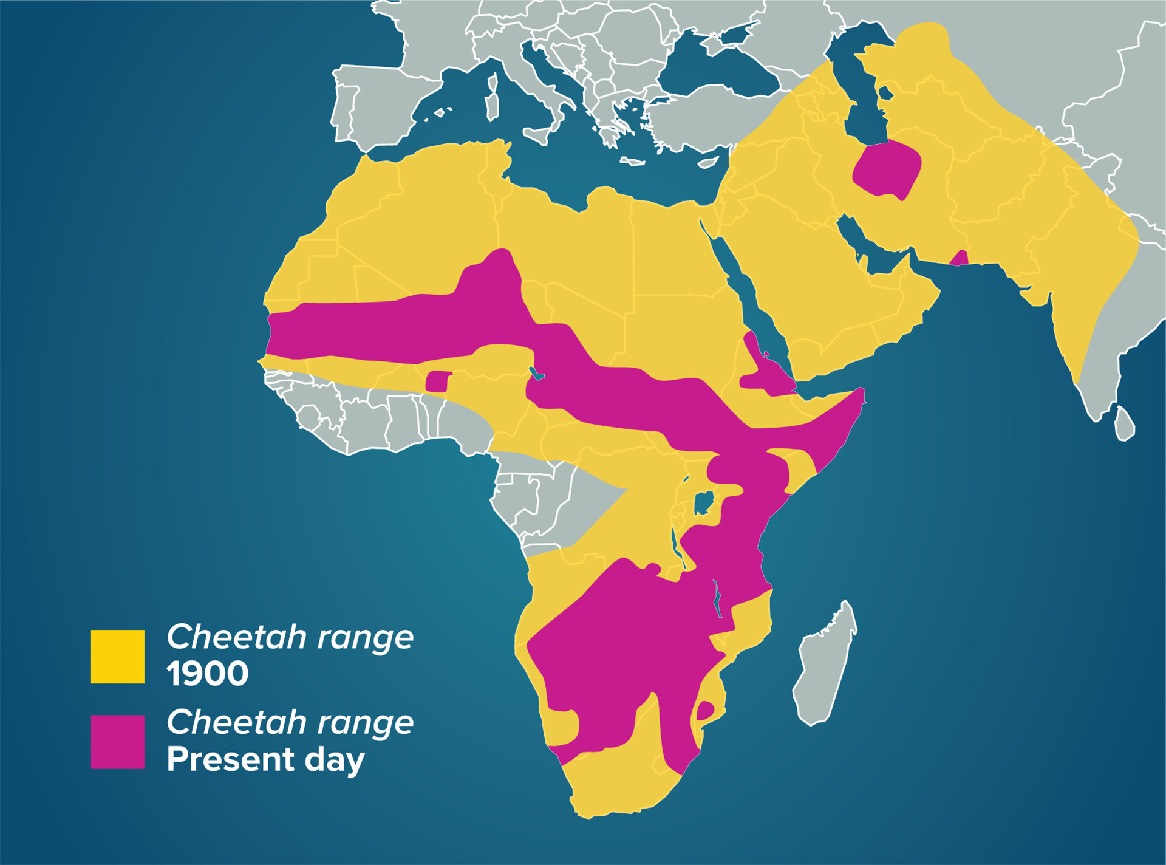
Mechanisms of Evolution
Genetic Drift
A bottleneck results when a population declines to a very low level and then rebounds.
The gene pool of the rebound population is similar to the low-level population, which may have reduced diversity.

Slide 13
Mechanisms of Evolution
Gene Flow
A population in genetic equilibrium experiences no gene flow. It is a closed system.
Gene flow is uncommon in natural populations. Organisms migrate/move between populations.
Random movement increases genetic variation within a population and decreases the genetic variation between populations.

Slide 14
Mechanisms of Evolution
Nonrandom Mating
A population in genetic equilibrium must exhibit random mating.
This rarely occurs in populations; instead, mating occurs between individuals in close proximity.
Promotes inbreeding
Changes allelic frequencies, favoring
individuals that are homozygous

Slide 15
Mechanisms of Evolution
Mutation
A mutation is a random change in genetic material. The cumulative effect of mutations in a population might shift allelic frequencies.
Most mutations are harmful, but some may be beneficial and become more common.

Slide 16
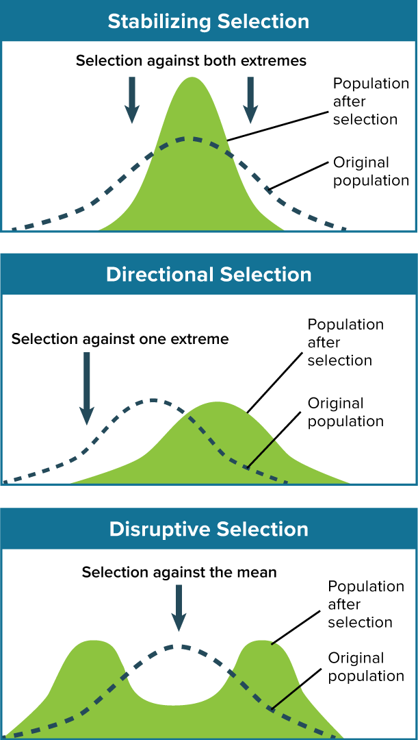
Mechanisms of Evolution
Natural Selection
Natural selection acts to select the individuals that are best adapted for survival and reproduction.
There are three types of natural selection:
Stabilizing
Directional
Disruptive

Slide 17
Mechanisms of Evolution
Directional Selection
Directional selection increases the expression of an extreme version of a trait and increases fitness.
Disruptive selection removes individuals with average traits, but retains individuals expressing extreme traits.
Sexual selection drives change in the frequency of a trait based on the ability to attract a mate.

Slide 18
Reproductive Isolation
Most scientists define speciation as the process whereby some members of a sexually reproducing population change so much that they can no longer produce fertile offspring with members of the original population.
Two types of reproductive isolation mechanisms prevent gene flow:
Prezygotic
Postzygotic

Slide 19
Reproductive Isolation
Prezygotic Isolation
Prezygotic isolating mechanisms operate before fertilization occurs.
They prevent reproduction by making fertilization unlikely.
They often occur through geographic, ecological, or behavioral isolation, or other differences.

Slide 20
Reproductive Isolation
Postzygotic Isolation
Postzygotic isolating mechanisms operate after fertilization and ensure that the resulting hybrid remains infertile.
Hybrid offspring either cannot develop or cannot reproduce.

Slide 21
Speciation
For speciation to occur, populations must diverge and become reproductively isolated.
There are two types of speciation:
Allopatric
Sympatric

Slide 22
Speciation
Allopatric Speciation
Allopatric speciation occurs when populations are divided by a physical barrier.
Most scientists think allopatric speciation is the most common type of speciation.

Slide 23
Speciation
Sympatric Speciation
Sympatric speciation occurs without a physical barrier
Populations remain in close proximity.
Sympatric speciation is common in plants due to polyploidy.

Slide 24
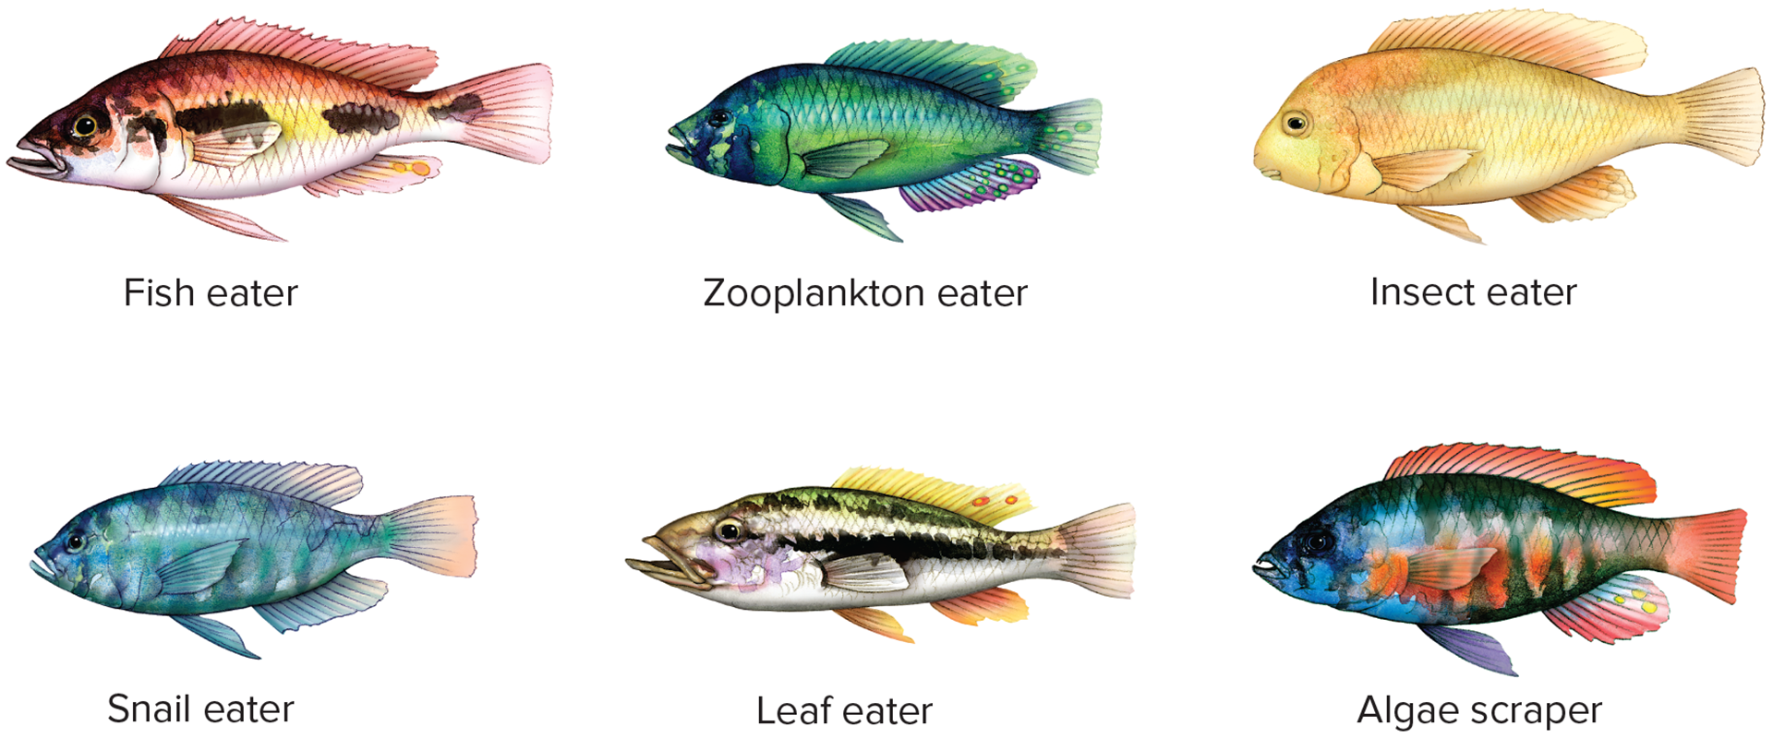
Patterns of Evolution
Adaptive Radiation
Adaptive radiation can occur when one species gives rise to many species in response to the creation of a new habitat or another ecological opportunity.
Adaptive radiation often follows large-scale extinction events or the creation of new habitat.

Slide 25
Patterns of Evolution
Coevolution
Coevolution occurs when relationships between species are so close that they influence each other’s evolution.
Mutualism: both species benefit
Coevolutionary arms race: parasitic or
predatory relationship

Slide 26
Patterns of Evolution
Convergent Evolution
Unrelated species evolve similar traits, even though they live in different parts of the world.
Convergent evolution occurs in environments that are geographically distinct but ecologically similar.

Slide 27
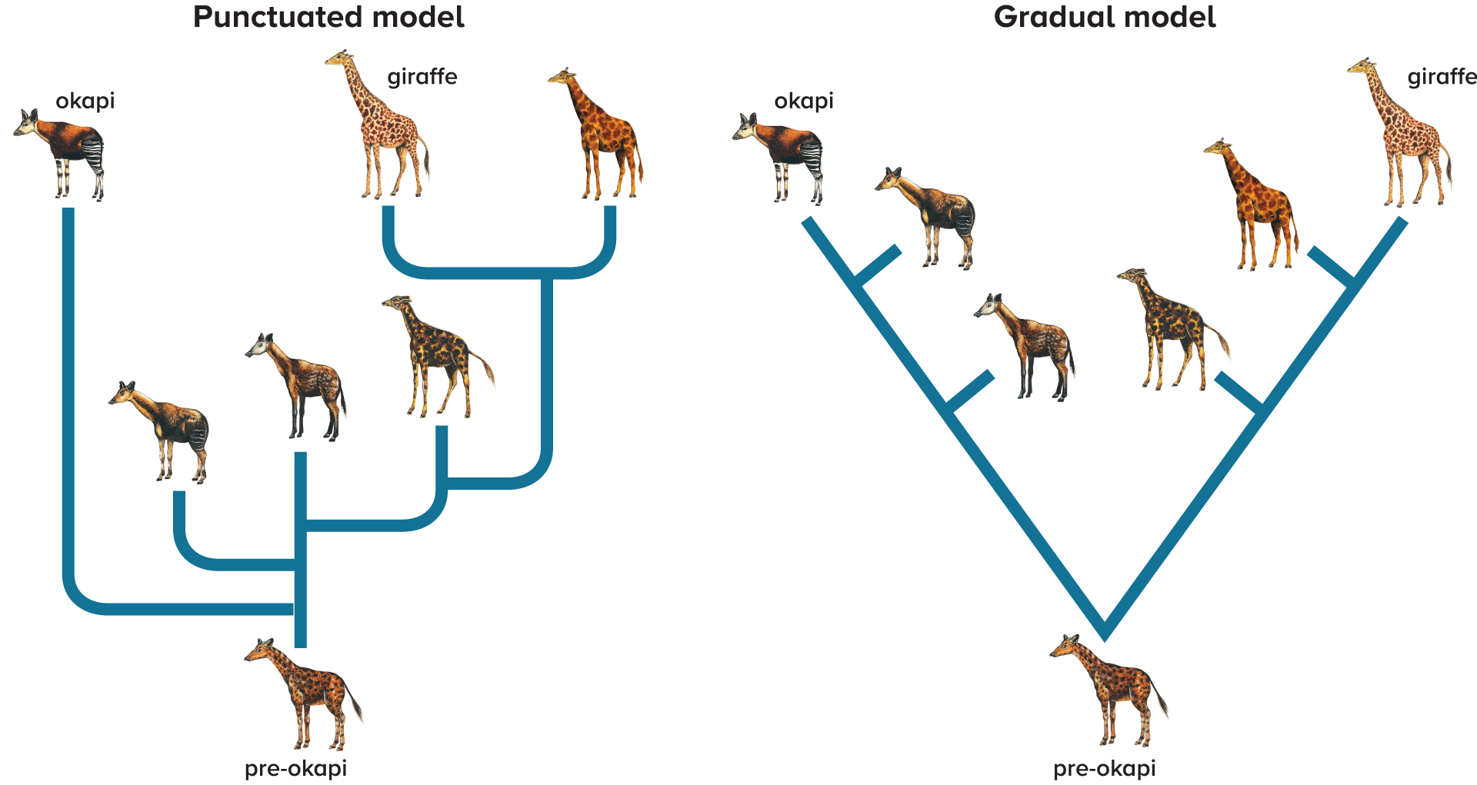
Patterns of Evolution
Rate of Speciation
Evolution proceeds in small, gradual steps, according to a theory called gradualism.
Punctuated equilibrium states rapid spurts of genetic change causing rapid speciation punctuate long periods of little change.

