Slide 1
Lesson 3
Animal Behavior

Slide 2
Focus Question
What are the different types of animal behavior and what are examples of each?

Slide 3
New Vocabulary
behavior
cognitive behavior
innate behavior
agonistic behavior
fixed action pattern
dominance hierarchy
learned behavior
territorial behavior
habituation
foraging behavior
classical conditioning
migratory behavior
operant conditioning
circadian rhythm
imprinting
language

Slide 4
New Vocabulary
courting behavior
nurturing behavior
altruistic behavior

Slide 5
Review Vocabulary
colony: a group of unicellular or multicellular organisms that live together in a close association

Slide 6
Behavior
Innate Behavior
A behavior is the way in which an animal responds to an external or internal stimulus.
Behaviors that are genetically based and not linked to past experiences are called innate behaviors.
Behaviors are referred to as innate when the same behavior is observed in a large number of individuals, even if the environments are different.
When an animal carries out a specific set of actions in sequence, in response to a stimulus, it is called a fixed action pattern.

Slide 7
Behavior
Learned Behavior
Learned behaviors result from an interaction between innate behaviors and past experiences within a particular environment.
Types of learned behavior include habituation, conditioning, imprinting, and cognitive behavior.

Slide 8
Behavior
Habituation
Habituation is a decrease in an animal’s response after repeatedly being exposed to a stimulus that has no positive or negative effects.
Habituation can be thought of as learning not to respond to a stimulus.
Habituation allows an animal to ignore unimportant stimuli and focus on important stimuli, such as the presence of food, a mate, or a predator.

Slide 9
Behavior
Classical Conditioning
Classical conditioning occurs when an association is made between two different kinds of stimuli.
Ivan Pavlov was a Russian scientist who investigated animal behavior. His work led to an understanding of classical conditioning, as shown on the next screen.

Slide 10
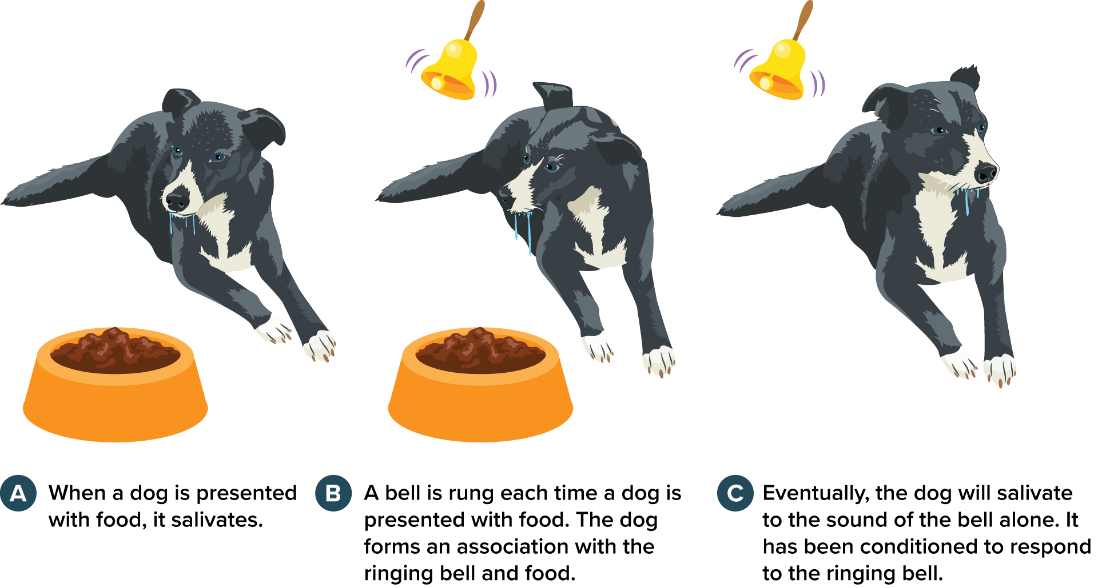
Behavior
Classical conditioning

Slide 11
Behavior
Operant Conditioning
In operant conditioning, an animal learns to associate its response to a stimulus with a reward or a punishment.

Slide 12
Behavior
Imprinting
Learning that can only occur within a specific time period in an animal’s life and is permanent is called imprinting.
Some animals form a social attachment to the first object they see after birth.
Other animals imprint on the chemical composition of the water in which they are hatched.

Slide 13
Behavior
Cognitive Behavior
Thinking, reasoning, and processing information to understand complex concepts and solve problems are cognitive behaviors.
Humans exhibit cognitive behaviors when they solve problems, make decisions, and plan for the future.

Slide 14
Ecological Behavior
Competitive Behaviors
Competition for food, space, mates, and other resources occurs between individuals within a population.
Animals that are successful at competitive behaviors are more likely to get resources needed for survival and reproduction.

Slide 15
Ecological Behavior
Competitive Behaviors
Agnostic behavior: Threatening or combative interaction between two individuals of the same species
Dominance hierarchies: Group of animals in which the top-ranked animal has access to resources without conflict from others in the group
Territorial behaviors: Attempts to adopt and control a physical area against other animals of the same species

Slide 16
Ecological Behavior
Foraging Behaviors
Foraging behaviors are related to finding and eating food.
Foraging successfully means obtaining needed nutrients while avoiding predators and poisonous foods.

Slide 17
Ecological Behavior
Migratory Behaviors
Some animals engage in migratory behaviors. They move long distances seasonally to new locations, thereby increasing their chances of survival.
Migratory behaviors are driven by a search for food or climates that can support food resources.
Many animals migrate in groups.

Slide 18
Ecological Behavior
Biological Rhythms
Many animals, including humans, repeat behaviors in a rhythmic cycle.
A circadian rhythm is a cycle, such as sleeping and waking, that occurs daily.

Slide 19
Ecological Behavior
Communication Behaviors
Some animals communicate by spreading highly specific chemicals called pheromones.
Language is a form of auditory communication in which animals use vocal organs to produce groups of sounds that have shared meanings.

Slide 20
Ecological Behavior
Courting and Nurturing Behaviors
An animal engages in courting behaviors in order to attract a mate.
When parents provide care to their offspring in the early stages of development, they are engaging in nurturing behaviors.
Animal species that spend time nurturing young often produce fewer offspring than animals that do not nurture.

Slide 21
Ecological Behavior
Cooperative Behaviors
In altruistic behavior, an animal will perform an action that benefits another individual at a cost to itself.
Kin selection: Altruistic behavior evolves because it increases the number of copies of a gene that is common to a population.
Organisms work to make sure genes similar to their own are passed on.

Slide 22
Ecological Behavior
Behavior, Survival, and Reproduction
Many behaviors have benefits and disadvantages related to survival and reproductive success.
Group behaviors have evolved because membership can increase the chances of survival for individuals and their genetic relatives.

