Slide 1
Lesson 1
Matter

Slide 2
Focus Question
What makes up everything around us?

Slide 3
New Vocabulary
atom
isotope
nucleus
compound
proton
ion
neutron
ionic bond
electron
covalent bond
element
molecule

Slide 4
Review Vocabulary
substance: the form of matter that has a uniform and unchanging composition

Slide 5
Atoms
Matter is anything that has mass and takes up space.
Atoms are the building blocks of matter.

Slide 6
Atoms
The Structure of an Atom
Atoms are made up of smaller particles called neutrons, protons, and electrons.
Neutron and protons are located at the center of the atom, called the nucleus.
Protons are positively charged particles (p⁺).
Neutrons are particles that have no charge (n⁰).

Slide 7
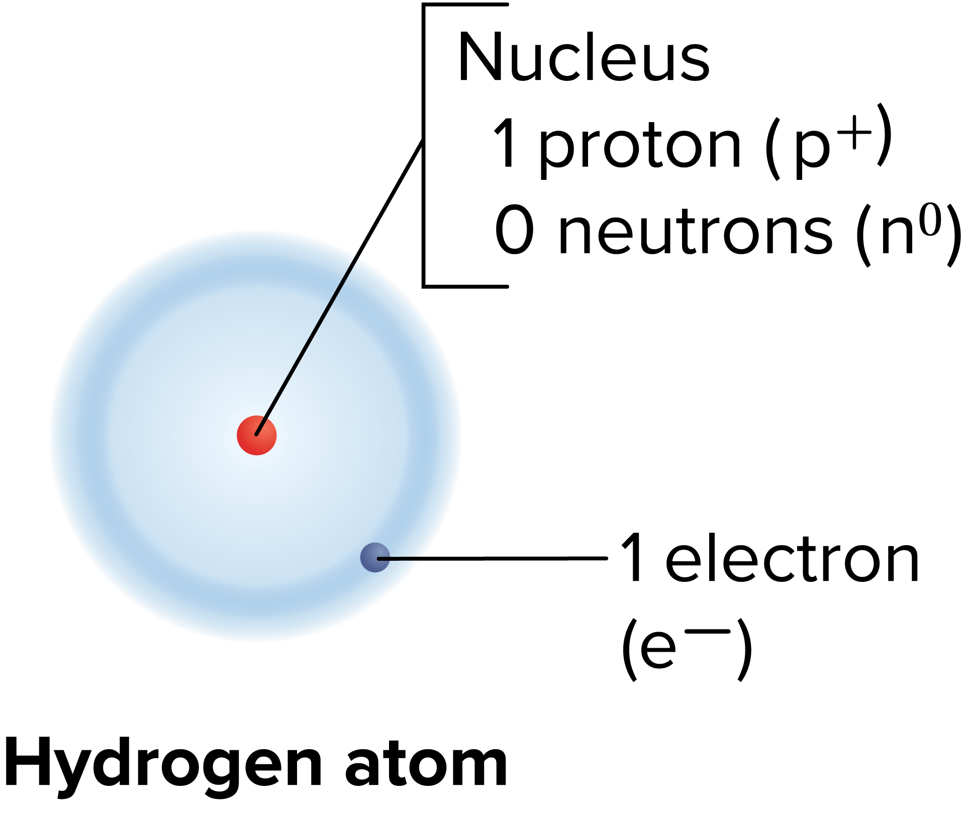
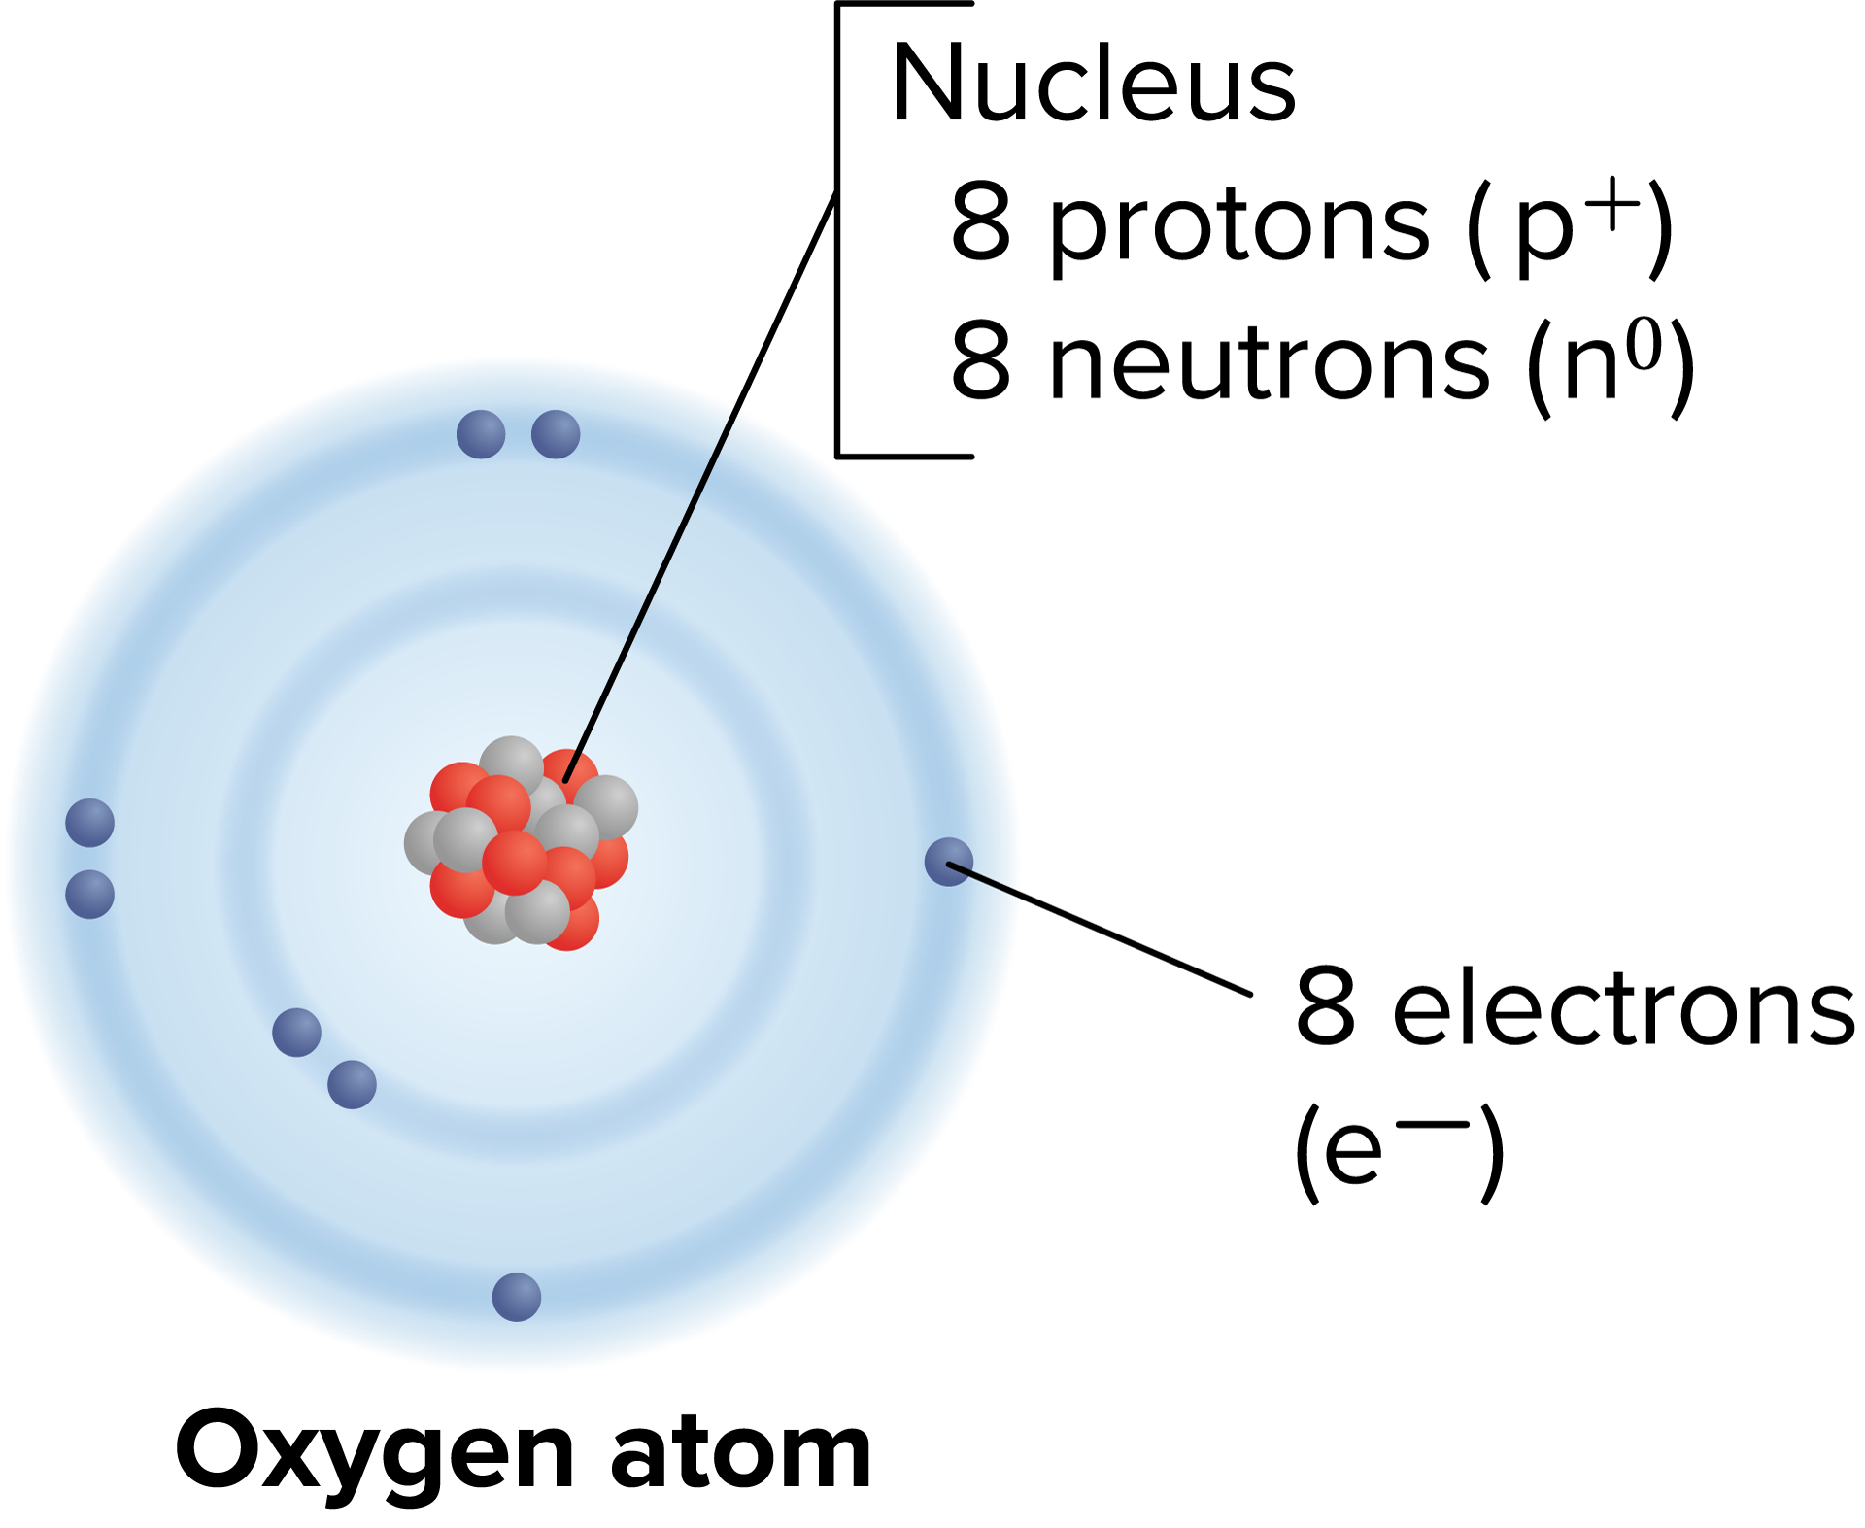
Atoms
The Structure of an Atom
Electrons are negatively charged particles (e⁻).
Electrons constantly move around an atom’s nucleus.

Slide 8
Elements
An element is a pure substance that cannot be broken down into other substances by physical or chemical means.
Elements are made of only one type of atom.
There are over 100 known elements, 92 of which occur naturally.
Each element has a unique name and symbol.

Slide 9
Elements
The Periodic Table of the Elements
Horizontal rows are called periods.
Vertical columns are called groups.
Elements in the same group have similar chemical and physical properties.

Slide 10
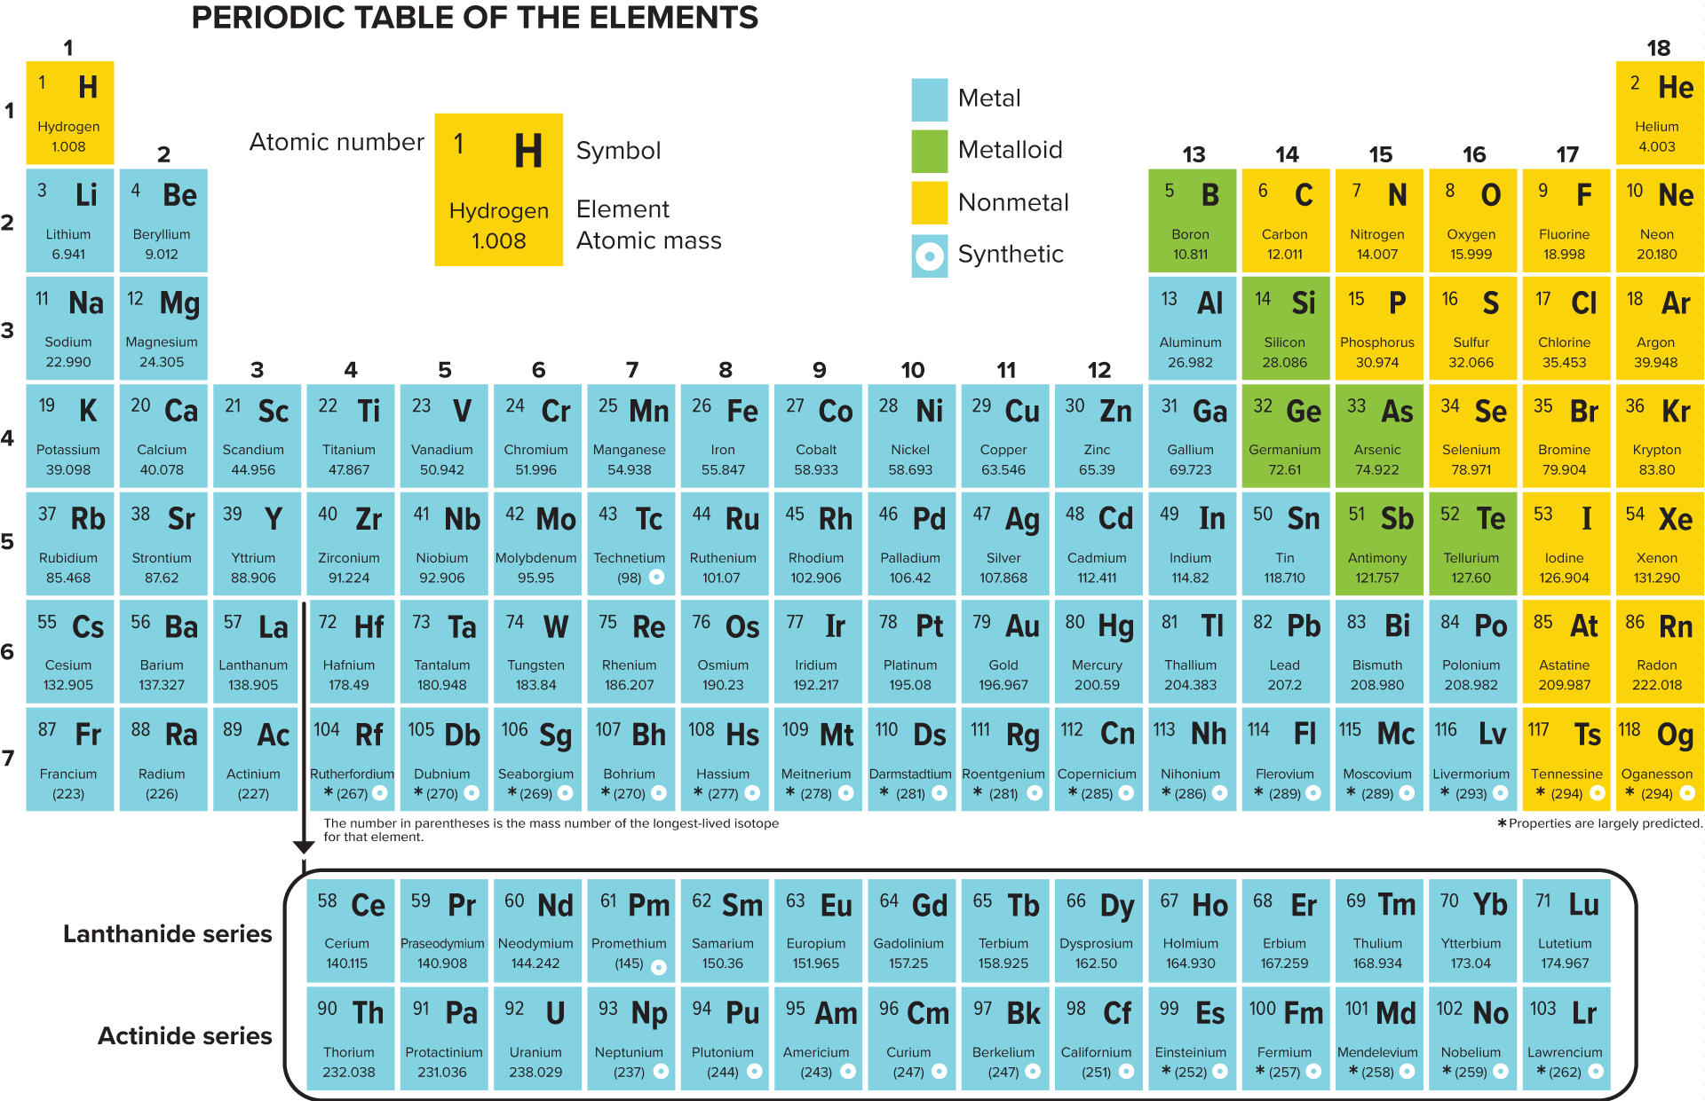
Elements

Slide 11
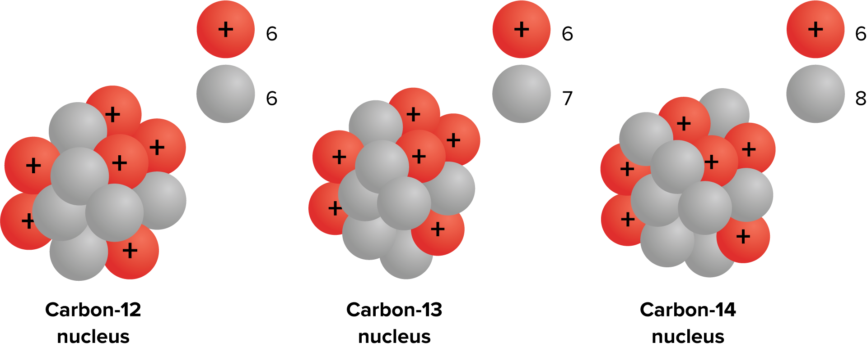
Elements
Isotopes
Atoms of the same element that have the same number of protons and electrons but that have a different number of neutrons are called isotopes.

Slide 12
Elements
Radioactive Isotopes
Changing the number of neutrons in an atom does not affect the charge, but it does affect the stability.
When a nucleus breaks apart, it gives off radiation that can be detected and used for many applications.
Isotopes that give off radiation are called radioactive isotopes.

Slide 13
Compounds
A compound is a pure substance formed when two or more different elements combine.
Compounds are always formed from a specific combination of elements in a fixed ratio.
Compounds cannot be broken down into simpler compounds or elements by physical means, but they can be broken down by chemical means.

Slide 14
Chemical Bonds
Compounds such as water are formed when two or more substances combine.
The force that holds the substances together is called a chemical bond.
Electrons travel around the nucleus of an atom in areas called energy levels.
Atoms become more stable by losing electrons or attracting electrons from other atoms.

Slide 15
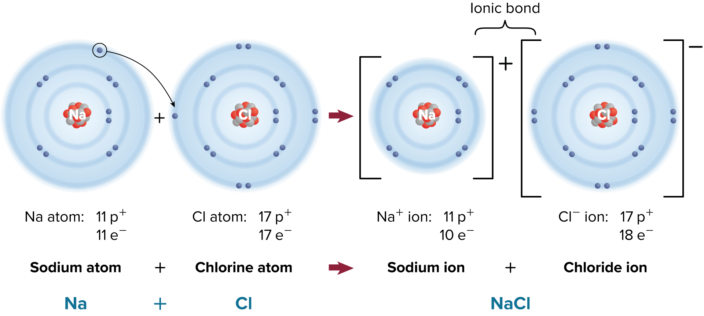
Chemical Bonds
An atom that has lost or gained one or more electrons is an ion.
Ions carry an electric charge.
An ionic bond is an electrical attraction between two oppositely charged atoms.

Slide 16
Chemical Bonds
The chemical bond that forms when electrons are shared is called a covalent bond.
A molecule is a compound in which the atoms are held together by covalent bonds.

