Slide 1
Lesson 2
Chemical Reactions

Slide 2
Focus Question
How do enzymes facilitate life?

Slide 3
New Vocabulary
chemical reaction
catalyst
reactant
enzyme
product
substrate
activation energy
active site

Slide 4
Review Vocabulary
process: a series of steps or actions that produce an end product

Slide 5
Reactants and Products
A chemical reaction is the process by which atoms or groups of atoms in substances are reorganized into different substances.
Chemical bonds are broken or formed during a chemical reaction.
Clues that a chemical reaction has taken place:
production of heat or light
formation of a new gas, liquid, or solid
Substances can also undergo physical changes, which change the appearance, but not the composition.

Slide 6
Reactants and Products
Chemical Equations
Chemical equations describe the substances in a reaction:
$Reactants→Products$
Reactants are the starting substances, on the left side of the arrow.
Products are the substances formed during the reaction, on the right side of the arrow.
The arrow indicates the process of change. It can be read as “yields” or “react to form.”

Slide 7
Reactants and Products
Chemical Equations
Balanced equations
In chemical reactions, matter cannot be created or destroyed.
All chemical equations must show this balance of mass.
The number of atoms of each element on the reactant side must equal the number of atoms of the same element on the product side.
$$\text{C}\text{6}\text{H}\text{12}\text{O}\text{6}\text{ + 6}\text{O}\text{2} \text{→ 6}\text{CO}\text{2}\text{ + 6}\text{H}\text{2}\text{O}$$

Slide 8
Energy of Reactions
Activation Energy
The minimum amount of energy needed for reactants to form products is called activation energy.
Some reactions rarely happen due to the high activation energy required.

Slide 9
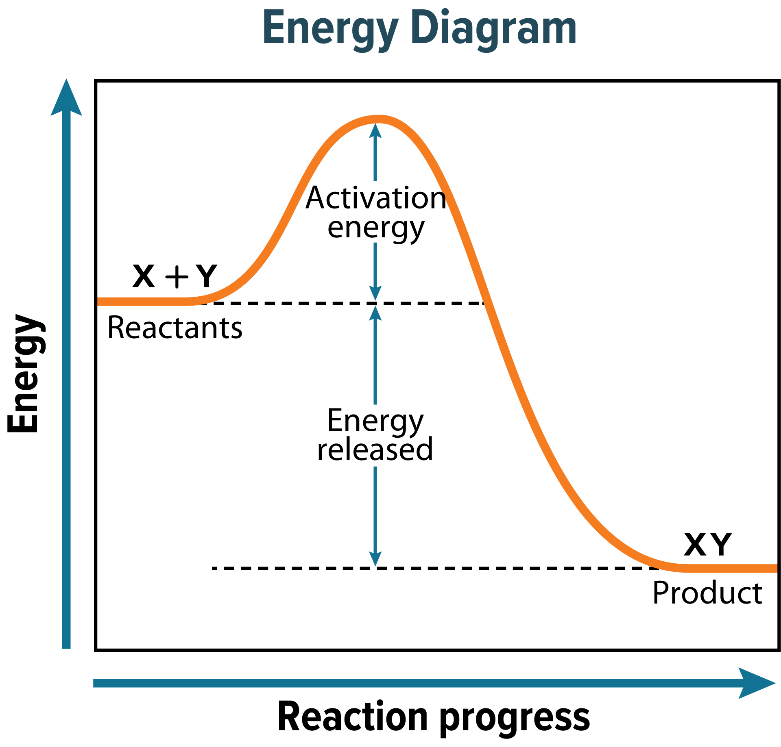
Energy of Reactions

Slide 10
Energy of Reactions
Energy Change in Chemical Reactions
Reactions that release energy in the form of heat are exothermic. An exothermic reaction is shown on the left side of the next slide.
Reactions that absorb energy in the form of heat are endothermic. An endothermic reaction is shown on the right side of the next slide.

Slide 11
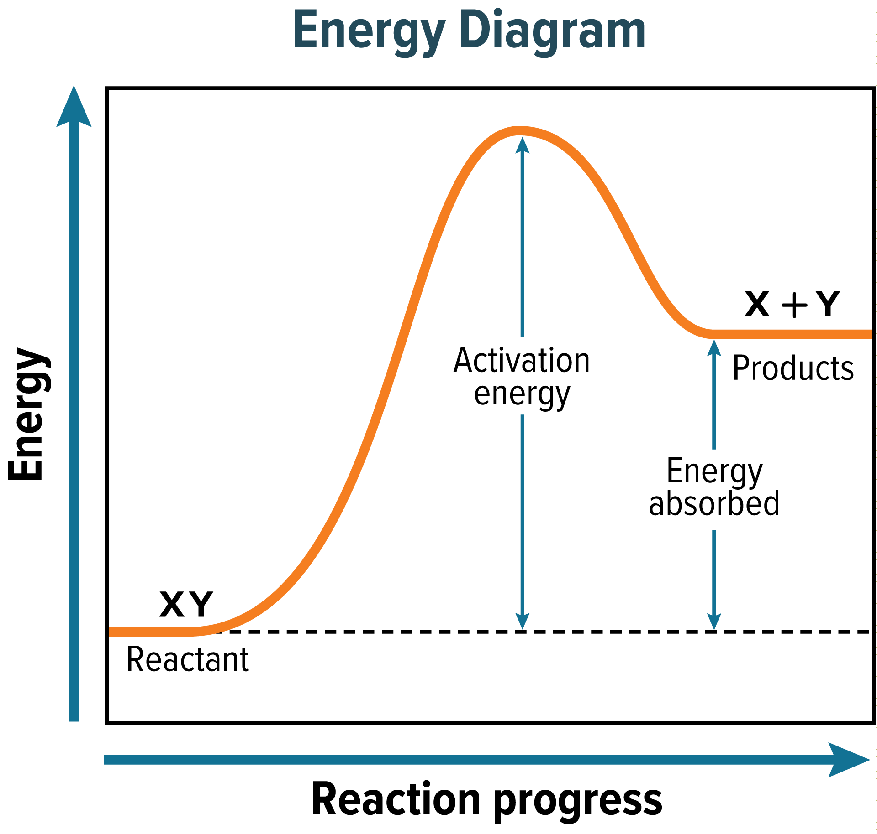
Energy of Reactions

Slide 12
Enzymes
All living things are driven by chemical reactions.
Additional substances are needed to reduce activation energy and reaction time in living organisms.
A catalyst is a substance that lowers the activation energy needed to start a chemical reaction.
Catalysts do not change the amount of product produced, nor are they used up during the reaction.

Slide 13
Enzymes
Special proteins called enzymes are the biological catalysts that speed up the rate of chemical reactions in biological processes.
Most enzymes are specific to one reaction.

Slide 14
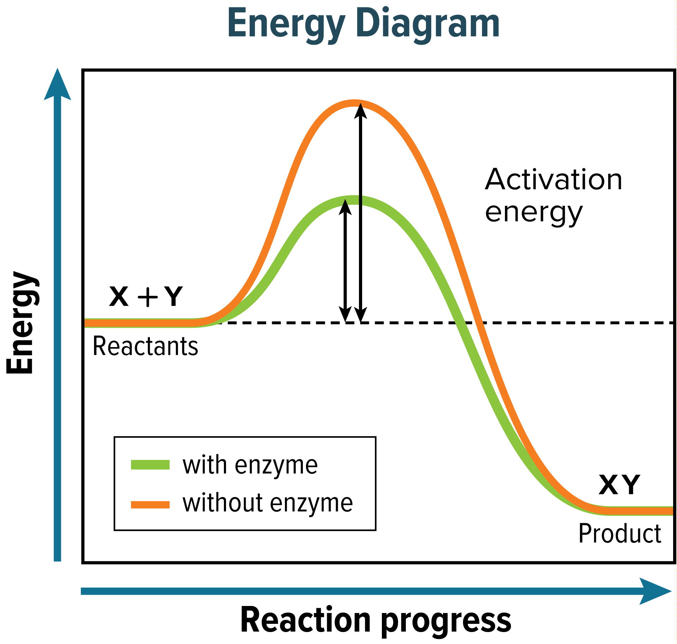
Enzymes

Slide 15
Enzymes
The reactants that bind to an enzyme are called substrates.
The specific location where a substrate binds on an enzyme is called the active site.
Factors such as pH, temperature, and other substances affect enzyme activity.

Slide 16
Enzymes
Factors that Affect Enzyme Activity
Each enzyme has a range of conditions in which it is most active.
Factors that affect enzyme activity include pH and temperature.
Substances called inhibitors can bind to an enzyme’s active site, preventing the substrate from binding to the enzyme, and slowing the rate of reaction.

