Slide 1
Lesson 3
Water and Its Solutions

Slide 2
Focus Question
Why do things dissolve in water?

Slide 3
New Vocabulary
polar molecule
solute
van der Waals forces
acid
hydrogen bond
base
mixture
pH
solution
buffer
solvent

Slide 4
Review Vocabulary
physical property: characteristic of matter, such as color or melting point, that can be observed or measured without changing the composition of the substance

Slide 5
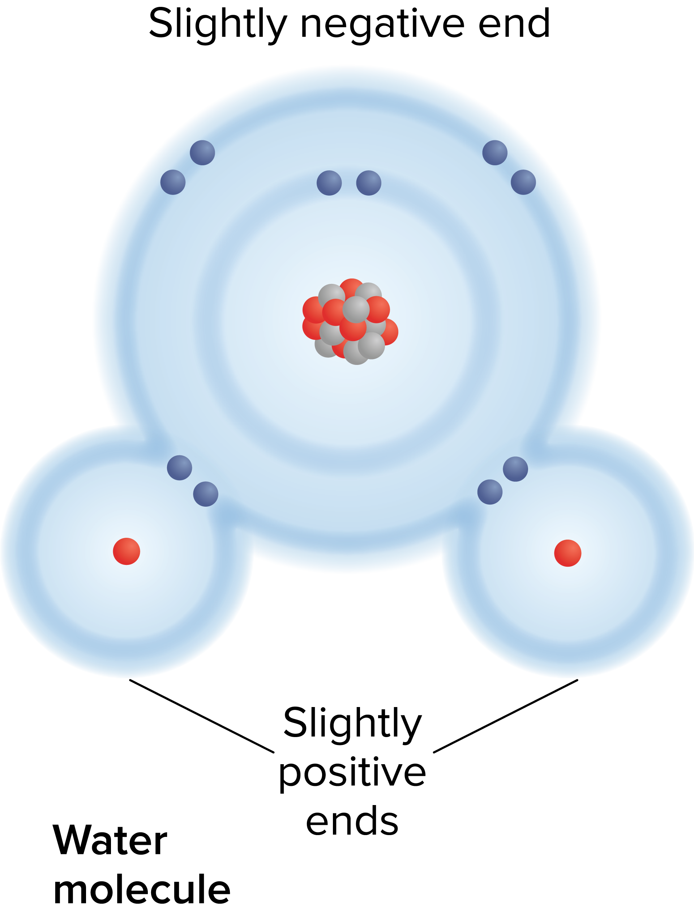
Intermolecular Forces
Polarity is the property of having two opposite poles, or ends.
Molecules that have an unequal distribution of charges are called polar molecules, meaning that they have oppositely charged regions.
Water has a slightly negative end and two slightly positive ends. Therefore, it is a polar molecule.

Slide 6
Intermolecular Forces
Van der Waals Forces
Regions of opposite charge cause weak electrostatic attractions between molecules called van der Waals forces.
These attractions cause intermolecular forces.
Intermolecular forces determine physical characteristics like boiling and melting point.

Slide 7
Intermolecular Forces
Van der Waals Forces in Water
The attraction of the areas of slight positive and negative charges around the water molecules hold the molecules together.
This gives water many of the properties that enable life on Earth.

Slide 8
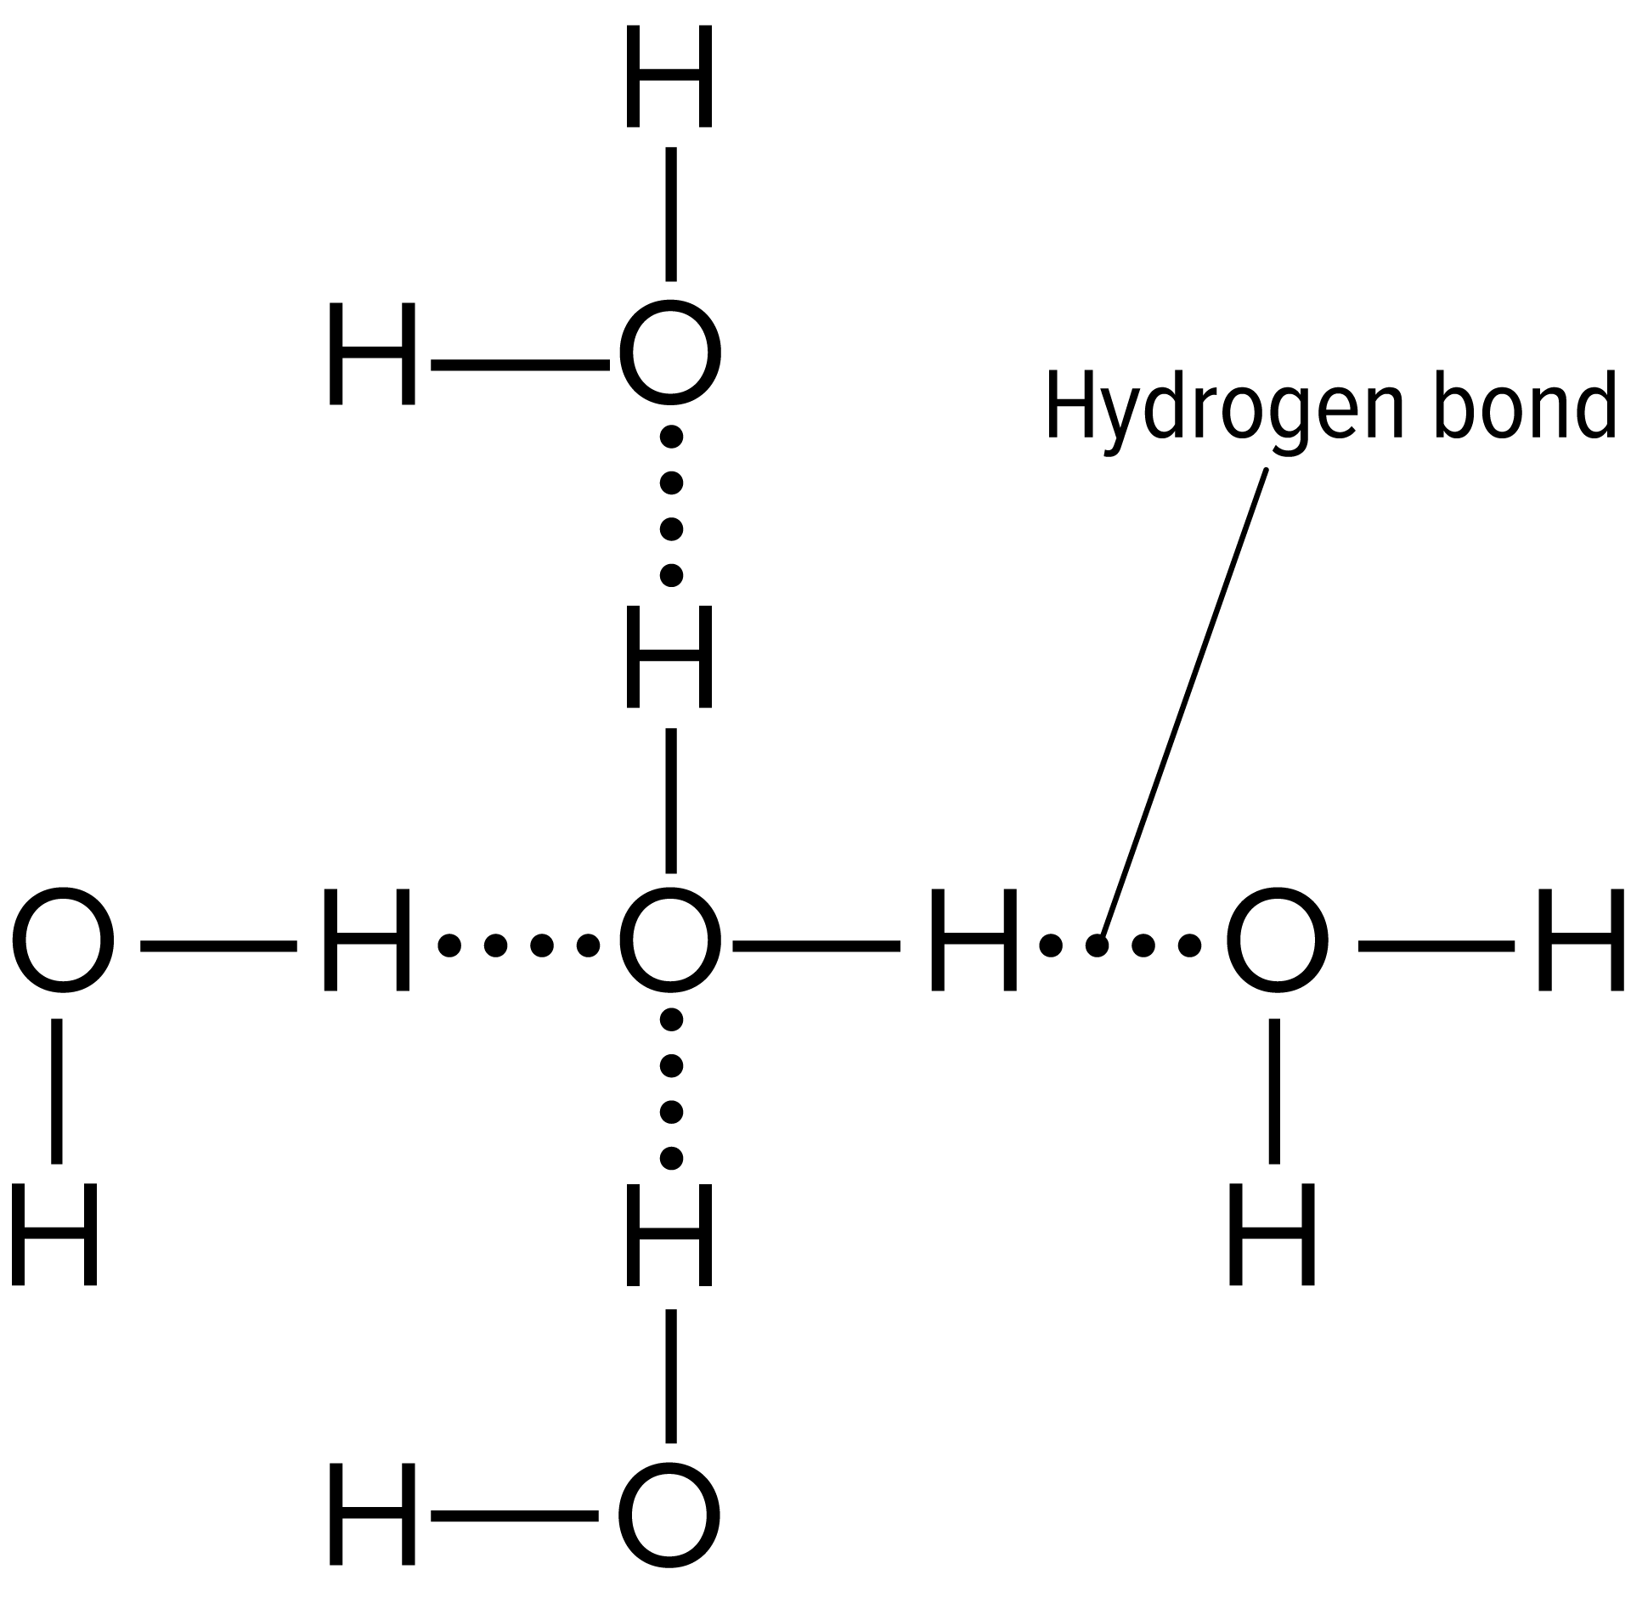
Intermolecular Forces
Hydrogen Bonds
When a charged region of a polar molecule comes close to the oppositely charged region of another polar molecule, a weak attraction forms.
A hydrogen bond is a weak interaction involving a hydrogen atom and a fluorine, oxygen, or nitrogen atom.
A hydrogen bond is a strong type of van der Waals force.

Slide 9
Mixtures with Water
A mixture is a combination of two or more substances in which each substance retains its individual characteristics and properties.
Mixtures are either homogeneous or heterogeneous.

Slide 10
Mixtures with Water
Homogeneous Mixtures
When a mixture has a uniform composition throughout, it is called homogenous.
A solution is another name for a homogeneous mixture.
In a solution, there are two components:
A solvent is a substance in which another substance is dissolved.
A solute is the substance that is dissolved in the solvent.

Slide 11
Mixtures with Water
Heterogeneous Mixtures
When the components in a mixture remain distinct, it is a heterogeneous mixture.
A suspension is a type of heterogeneous mixture in which the particles settle out over time
A colloid is a heterogeneous mixture in which the particles do not settle out.

Slide 12
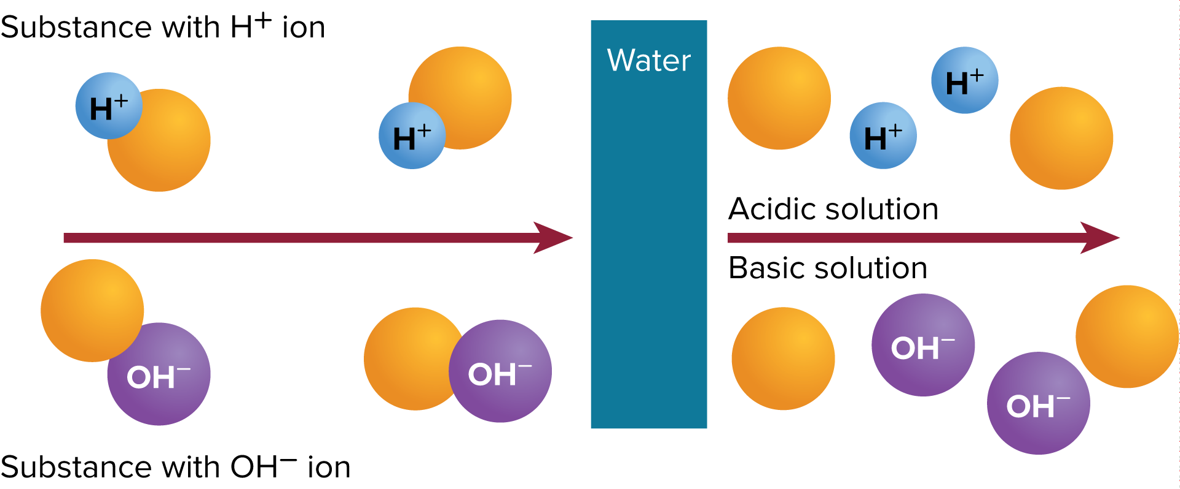
Mixtures with Water
Acids and Bases
Many solutes readily dissolve in water because of water’s polarity.
Substances that release H⁺ when they are dissolved in water are called acids.
Substances that release hydroxide ions (OH⁻) when they are dissolved in water are called bases.

Slide 13
Mixtures with Water
pH and Buffers
The amount of hydrogen or hydroxide ions in a solution determines the strength of an acid or base.
The measure of concentration of H⁺ in a solution is called pH.
Acids have pH values < 7.
Bases have pH values > 7.
Buffers are mixtures that can react with acids or bases to keep the pH within a particular range.

Slide 14
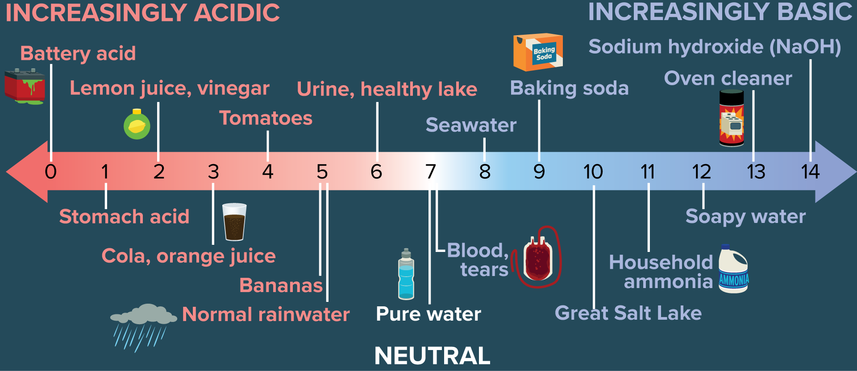
Mixtures with Water

