Slide 1
Lesson 4
The Building Blocks of Life

Slide 2
Focus Question
Why is carbon essential to life?

Slide 3
New Vocabulary
macromolecule
protein
polymer
amino acid
carbohydrate
nucleic acid
lipid
nucleotide

Slide 4
Review Vocabulary
organic compound: a carbon-based substance that is the basis of living matter

Slide 5
Organic Chemistry
Organic chemistry is the study of organic compounds, or compounds that contain carbon.
Carbon is a component of almost all biological molecules.
Carbon atoms bond together to form a variety of important organic compounds.

Slide 6
Macromolecules
Macromolecules are large molecules formed by joining smaller organic molecules together.
Polymers are molecules made from repeating units of identical or nearly identical compounds called monomers.
Macromolecules are organized into four major categories:
Carbohydrates
Lipids
Proteins
Nucleic acids

Slide 7
Macromolecules
Carbohydrates
Compounds composed of a ratio of 1 carbon to 2 hydrogen to 1 oxygen are called carbohydrates.
Carbohydrates have a general formula of (CH₂O)_{n} where n indicates the number of CH₂O units in the chain.
Carbohydrates are a central energy source for organisms.
Carbohydrates also function as cellular support in plants, fungi, and animals.

Slide 8
Macromolecules
Carbohydrates
Carbohydrates that have values of n ranging from three to seven are called monosaccharides.
Two monosaccharides joined together form a disaccharide.
Longer carbohydrate molecules are called polysaccharides.

Slide 9
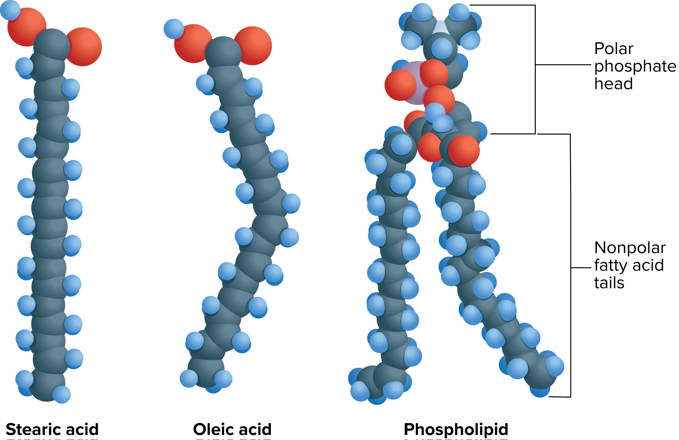
Macromolecules
Lipids
Lipids are molecules made mostly of carbon and hydrogen.
Lipids make up the fats, oils, and waxes.
Lipids’ primary function is to store energy.
They also prevent water loss in plants and form the honeycomb in beehives.

Slide 10
Macromolecules
Proteins
Proteins are compounds made of smaller carbon compounds called amino acids.
All amino acids are made of carbon, nitrogen, oxygen, hydrogen, and sometimes sulfur.
All amino acids share the same general structure.

Slide 11
Macromolecules
Amino Acid Structure
Amino acids have a carbon bonded to a hydrogen atom, an amino group, a hydroxyl group, and a variable side chain.
Amino acids form covalent bonds with one another. These bonds are called peptide bonds.

Slide 12
Macromolecules
Protein Function
There are 20 different amino acids.
Proteins are composed of various combinations of amino acids.
Proteins are responsible for:
structural support in cells
transporting substances within and between cells
signaling within and between cells
speeding up chemical reactions
controlling cell growth

Slide 13
Macromolecules
Three-Dimensional Protein Structure
The variable side chains of amino acids interact to create up to four levels of structure in proteins.
Primary structure: amino acid chain
Secondary structure: helix or pleated sheet
Tertiary structure: mostly globular
Quaternary structure: combining of proteins

Slide 14
Macromolecules
Nucleic Acids
Nucleic acids are macromolecules that transmit and store genetic information.
Nucleic acids are composed of repeating subunits composed of carbon, nitrogen, oxygen, phosphorus, and hydrogen called nucleotides.
There are two types of nucleic acids:
Deoxyribonucleic acid (DNA)
Ribonucleic acid (RNA)

