Slide 1
Lesson 2
The Plasma Membrane

Slide 2
Focus Question
Why is the plasma membrane an important structure of the cell?

Slide 3
New Vocabulary
phospholipid bilayer
transport protein
fluid mosaic model
selective permeability

Slide 4
Review Vocabulary
ion: an atom or group of atoms with a positive or negative electric charge

Slide 5
Structure of the Plasma Membrane
The plasma membrane is composed of a phospholipid bilayer – two layers of phospholipids arranged to allow the membrane to exist in a watery environment.
Polar heads face outside the cell.
Nonpolar tails face inside the cell.
This arrangement allows the membrane to keep the internal and external environments separate.

Slide 6
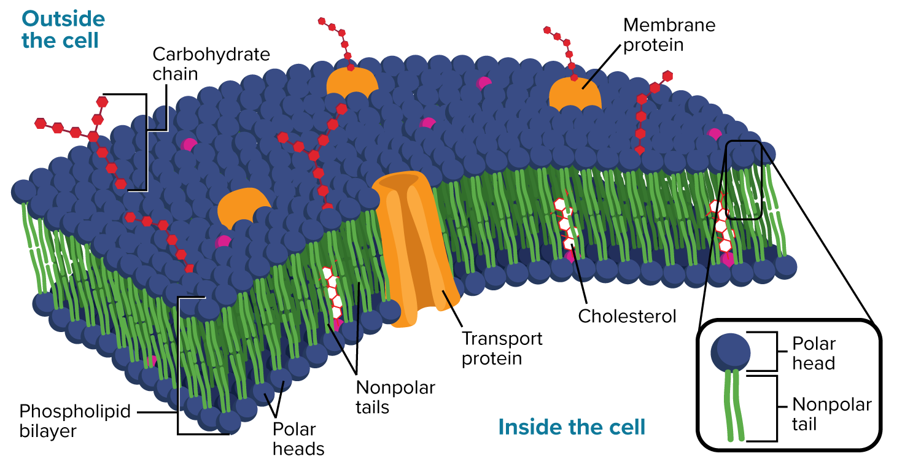
Structure of the Plasma Membrane

Slide 7
Structure of the Plasma Membrane
The plasma membrane also contains cholesterol, proteins, and carbohydrates.
Some proteins called receptors transmit signals to the inside of the cell.
Some proteins serve as support structures for the membrane.
Transport proteins move substances and wastes through the membrane.

Slide 8
Structure of the Plasma Membrane
Cholesterol prevents the fatty acid tails of the phospholipid bilayer from sticking together.
Cholesterol contributes to the fluidity of the membrane.
Carbohydrates define the cell’s characteristics and help cells identify chemical signals.

Slide 9
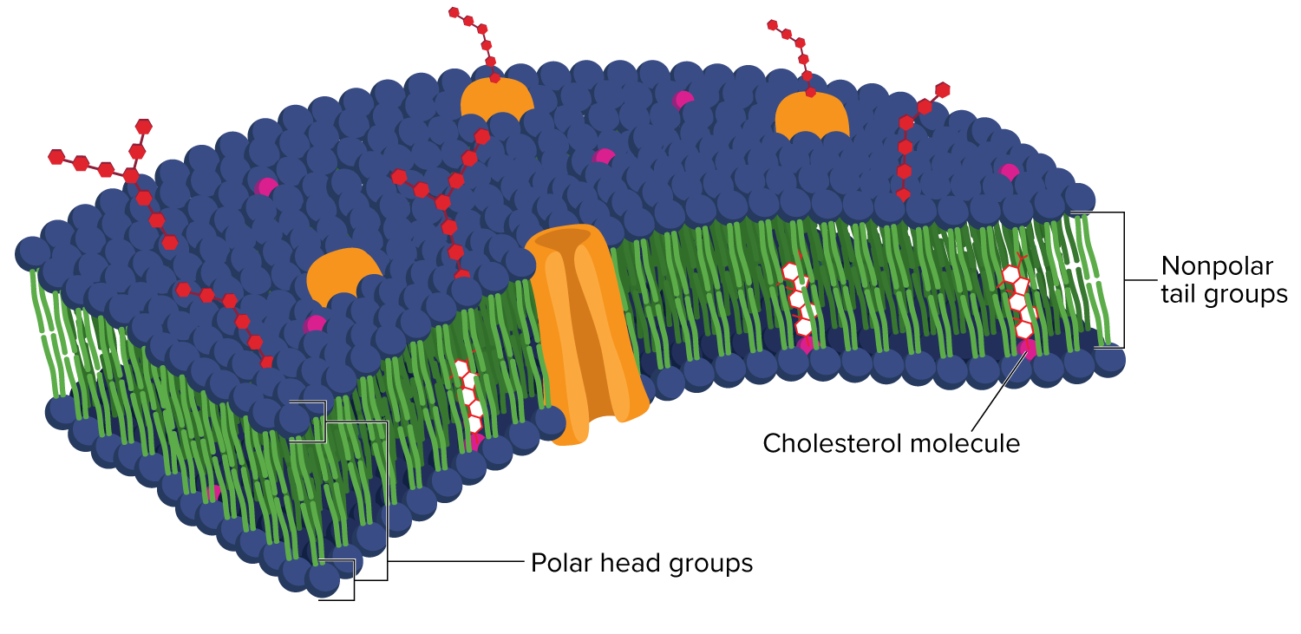
Structure of the Plasma Membrane
The fluid mosaic model describes the phospholipids in the bilayer as a “sea” in which other components move around, forming a pattern or mosaic on the cell surface.

Slide 10
Function of the Plasma Membrane
The process of maintaining balance in an organism’s internal environment is called homeostasis.
One of the structures responsible for homeostasis is the plasma membrane.
The plasma membrane forms a thin, flexible boundary between a cell and its environment.

Slide 11
Function of the Plasma Membrane
Plasma membranes have selective permeability, which means that they allow some substances to pass through while keeping others out.
Control of how, when, and how much of various substances enter and leave a cell depends on the structure of the plasma membrane.

