Slide 1
Lesson 3
Cellular Transport

Slide 2
Focus Question
What processes enable substances to move into or out of a cell?

Slide 3
New Vocabulary
diffusion
hypotonic solution
dynamic equilibrium
hypertonic solution
facilitated diffusion
active transport
osmosis
endocytosis
isotonic solution
exocytosis

Slide 4
Review Vocabulary
homeostasis: the regulation of the internal environment of a cell or organism to maintain conditions suitable for life

Slide 5
Diffusion
Particles in solids, liquids, and gasses are in constant random motion.
Diffusion is the net movement of particles from an area of high concentration to an area of lower concentration.
Additional energy is not required for diffusion because the particles are already in motion.

Slide 6
Diffusion
When diffusion occurs over a long enough time, concentrations will become uniform, and the solution will reach dynamic equilibrium.
In dynamic equilibrium, molecules continue to move, but the concentration remains the same.

Slide 7
Diffusion
Diffusion causes the inks to move from high-ink concentration to low-ink concentration, until the color becomes evenly blended in the water.

Slide 8
Diffusion
Diffusion Across the Plasma Membrane
Water can diffuse across the plasma membrane, but most other substances cannot.
Facilitated diffusion uses transport proteins to move ions and small molecules across the plasma membrane.
Diffusion and facilitated diffusion are types of passive transport; they require no additional energy.

Slide 9
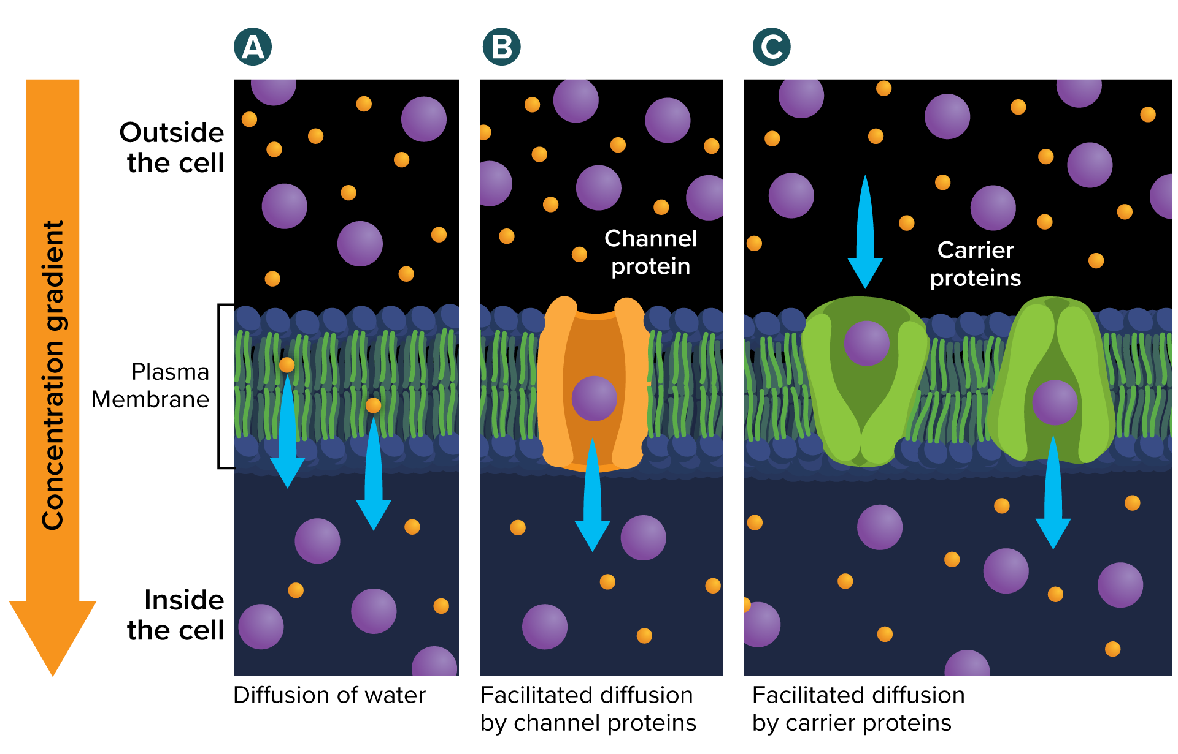
Facilitated Diffusion
Water moves freely through the plasma membrane (A), but other substances cannot pass through on their own. Channel proteins (B) and carrier proteins (C) help ions and small molecules move across the membrane.

Slide 10
Osmosis: Diffusion of Water
Osmosis is the diffusion of water across a selectively permeable membrane.
Water is the solvent in a cell and its environment.
Water will move across a membrane until the concentration of solute is the same on both sides.

Slide 11
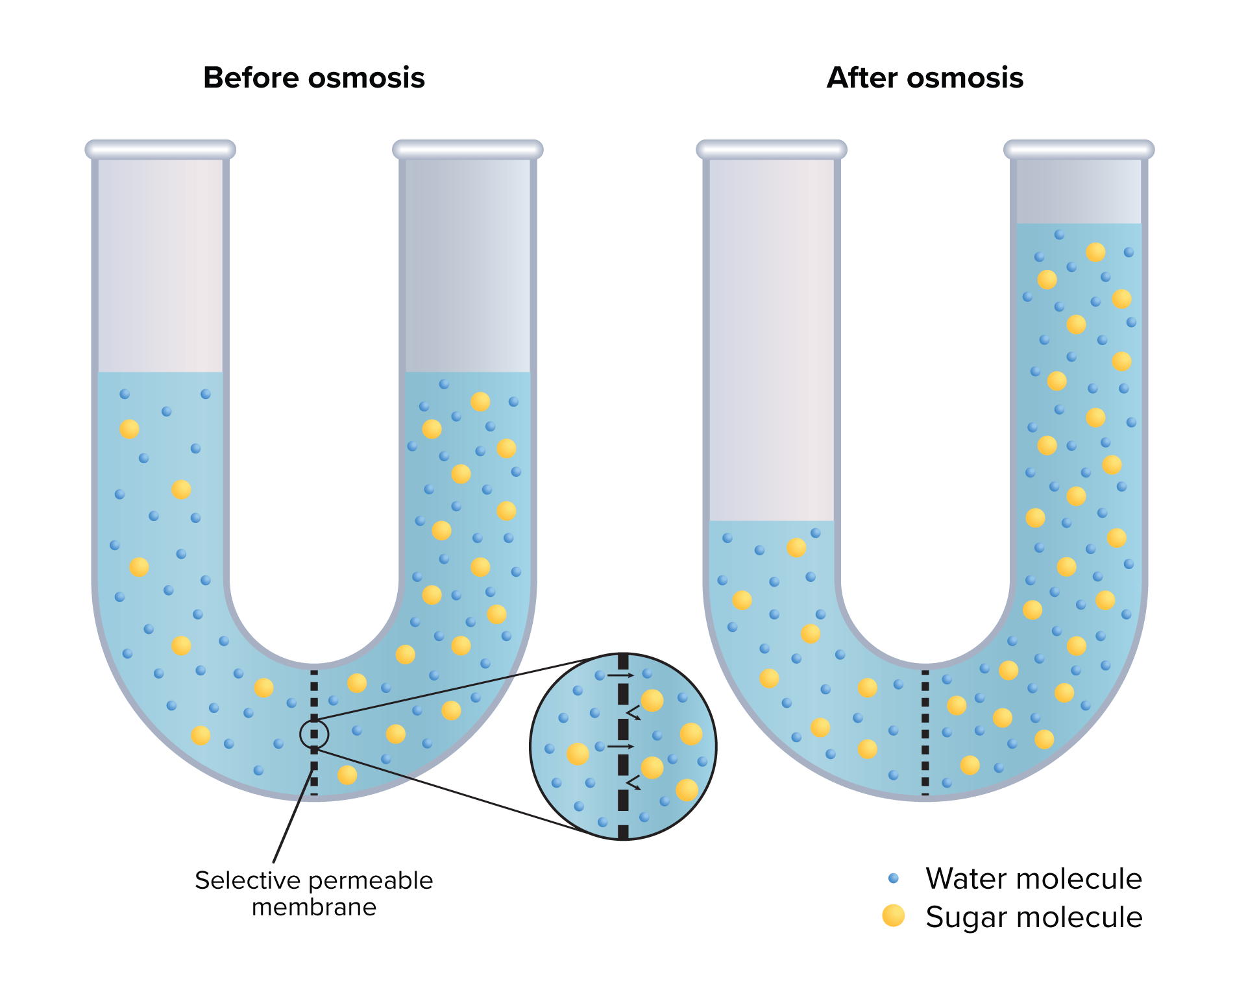
Osmosis: Diffusion of Water
Before osmosis, the sugar concentration is greater on the right side. After osmosis, the concentrations are the
same on both sides. Water molecules continue to move across the membrane.

Slide 12
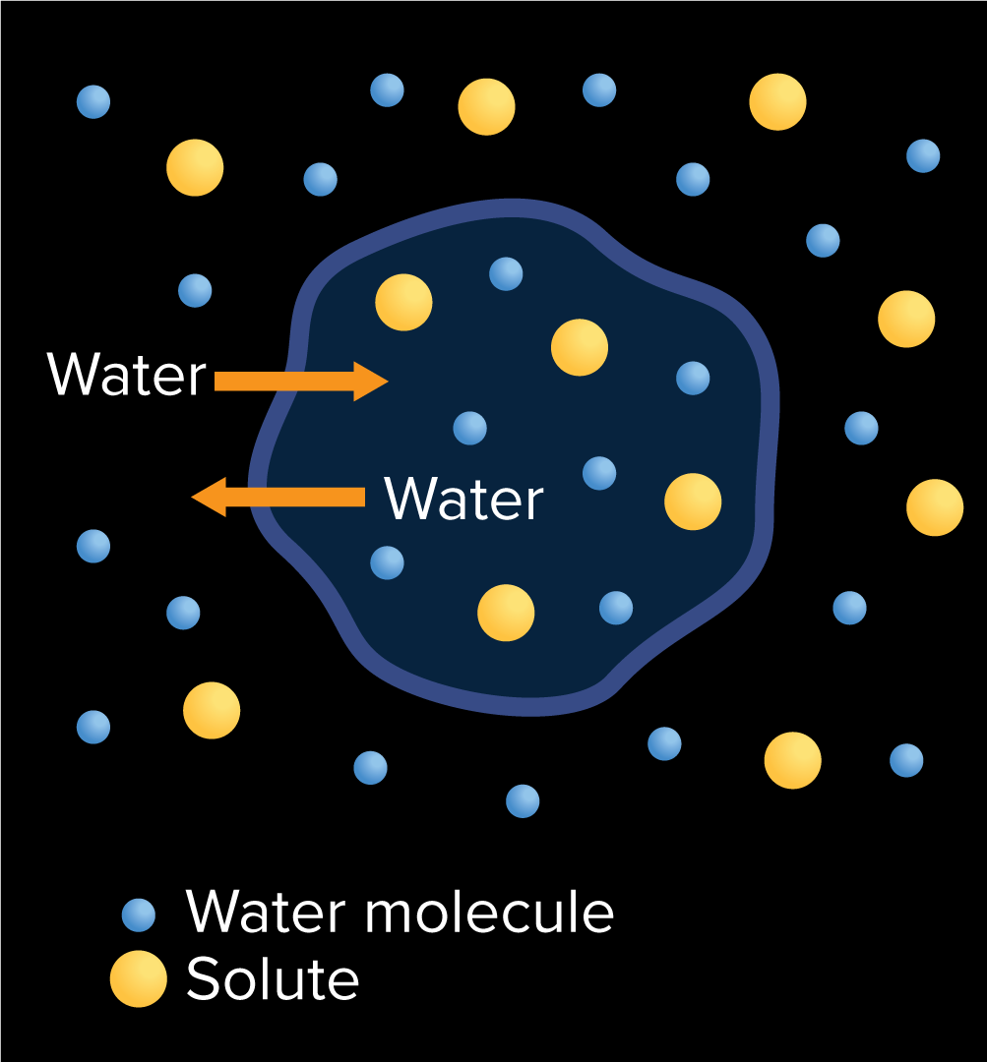
Osmosis: Diffusion of Water
An isotonic solution has the same concentration of water and solutes as the cytoplasm of the cell.
Water still moves through the membrane, but it enters and leaves at the same rate.

Slide 13
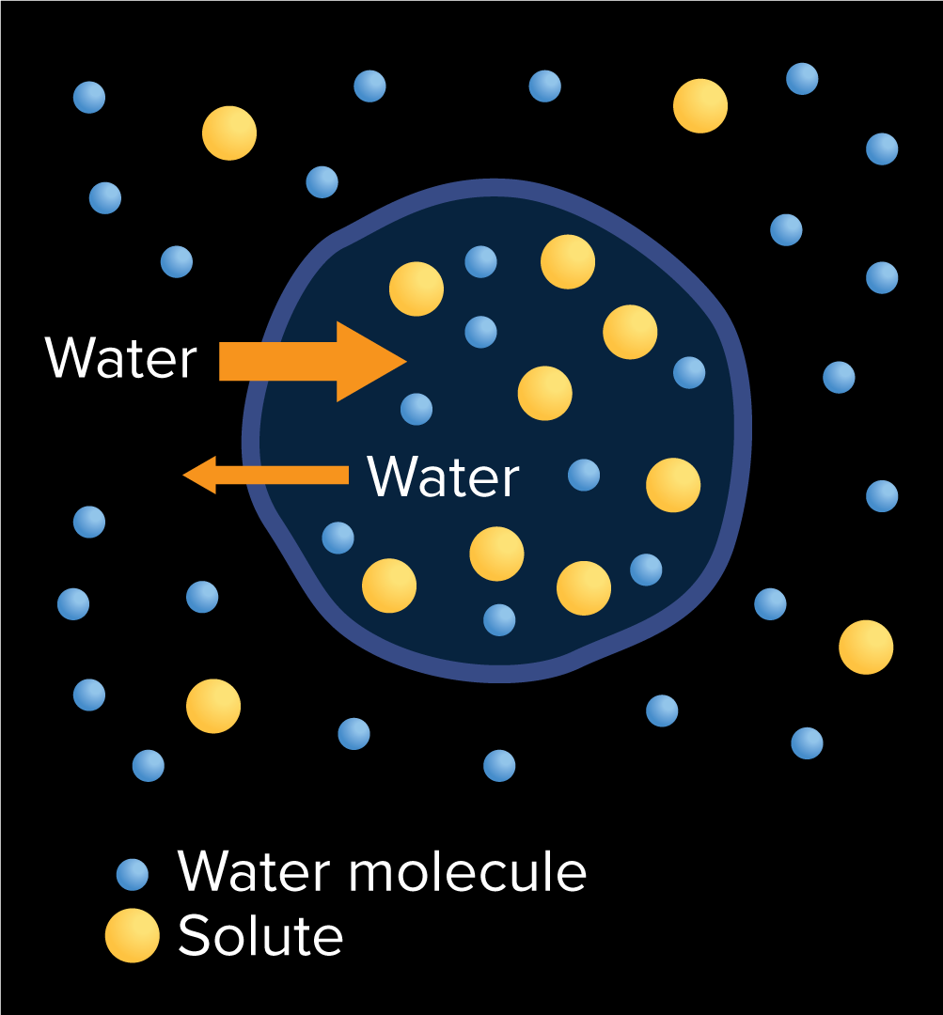
Osmosis: Diffusion of Water
A hypotonic solution has a lower concentration of solutes than the cytoplasm of the cell.
The net movement of water is into the cell.
As water moves into the cell, pressure increases.
Animal cells can burst when placed in extremely hypotonic solutions.

Slide 14
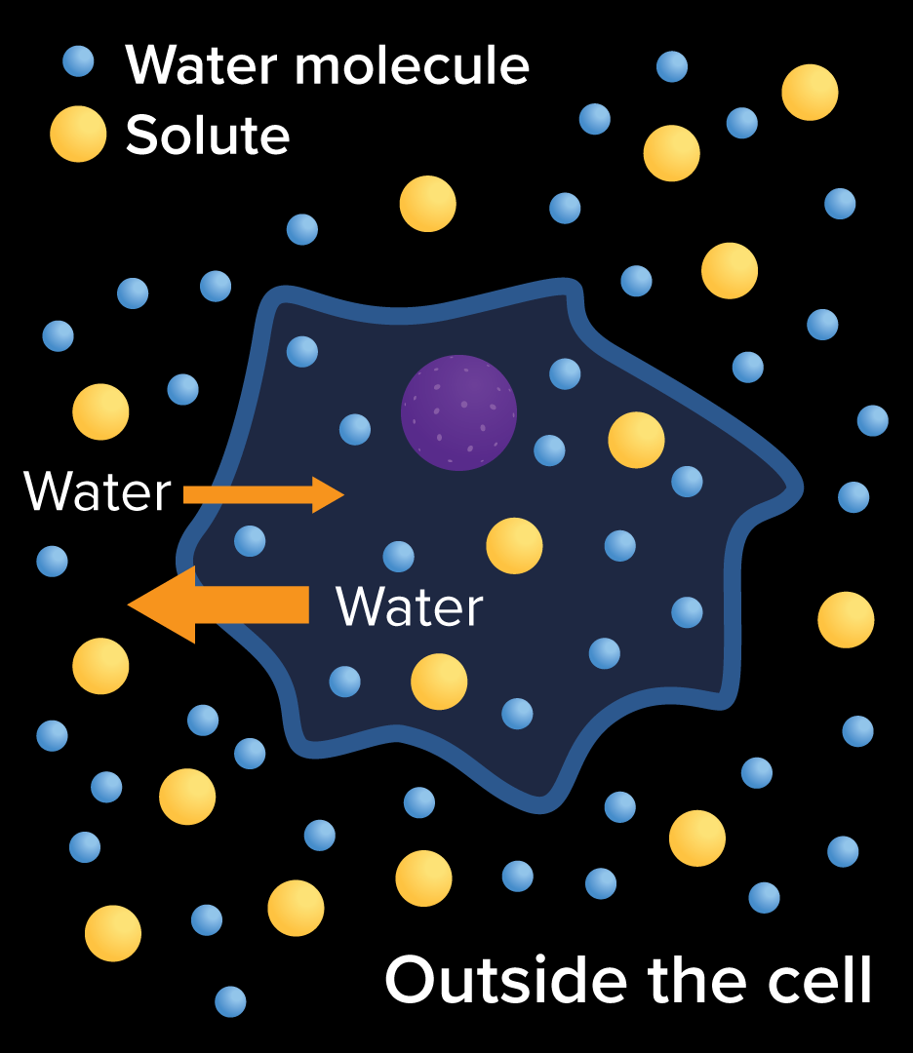
Osmosis: Diffusion of Water
An hypertonic solution has a higher concentration of solutes than the cytoplasm of the cell.
The net movement of water is out the cell.
As water moves out of the cell, pressure decreases.
Hypertonic solutions cause wilting in plants.

Slide 15
Active Transport
Sometimes substances must move from an area of lower concentration to an area of higher concentration.
Movement of particles across the cell membrane, against the concentration gradient, requires energy and is called active transport.
Active transport occurs with the aid of carrier proteins, which are often called pumps.

Slide 16
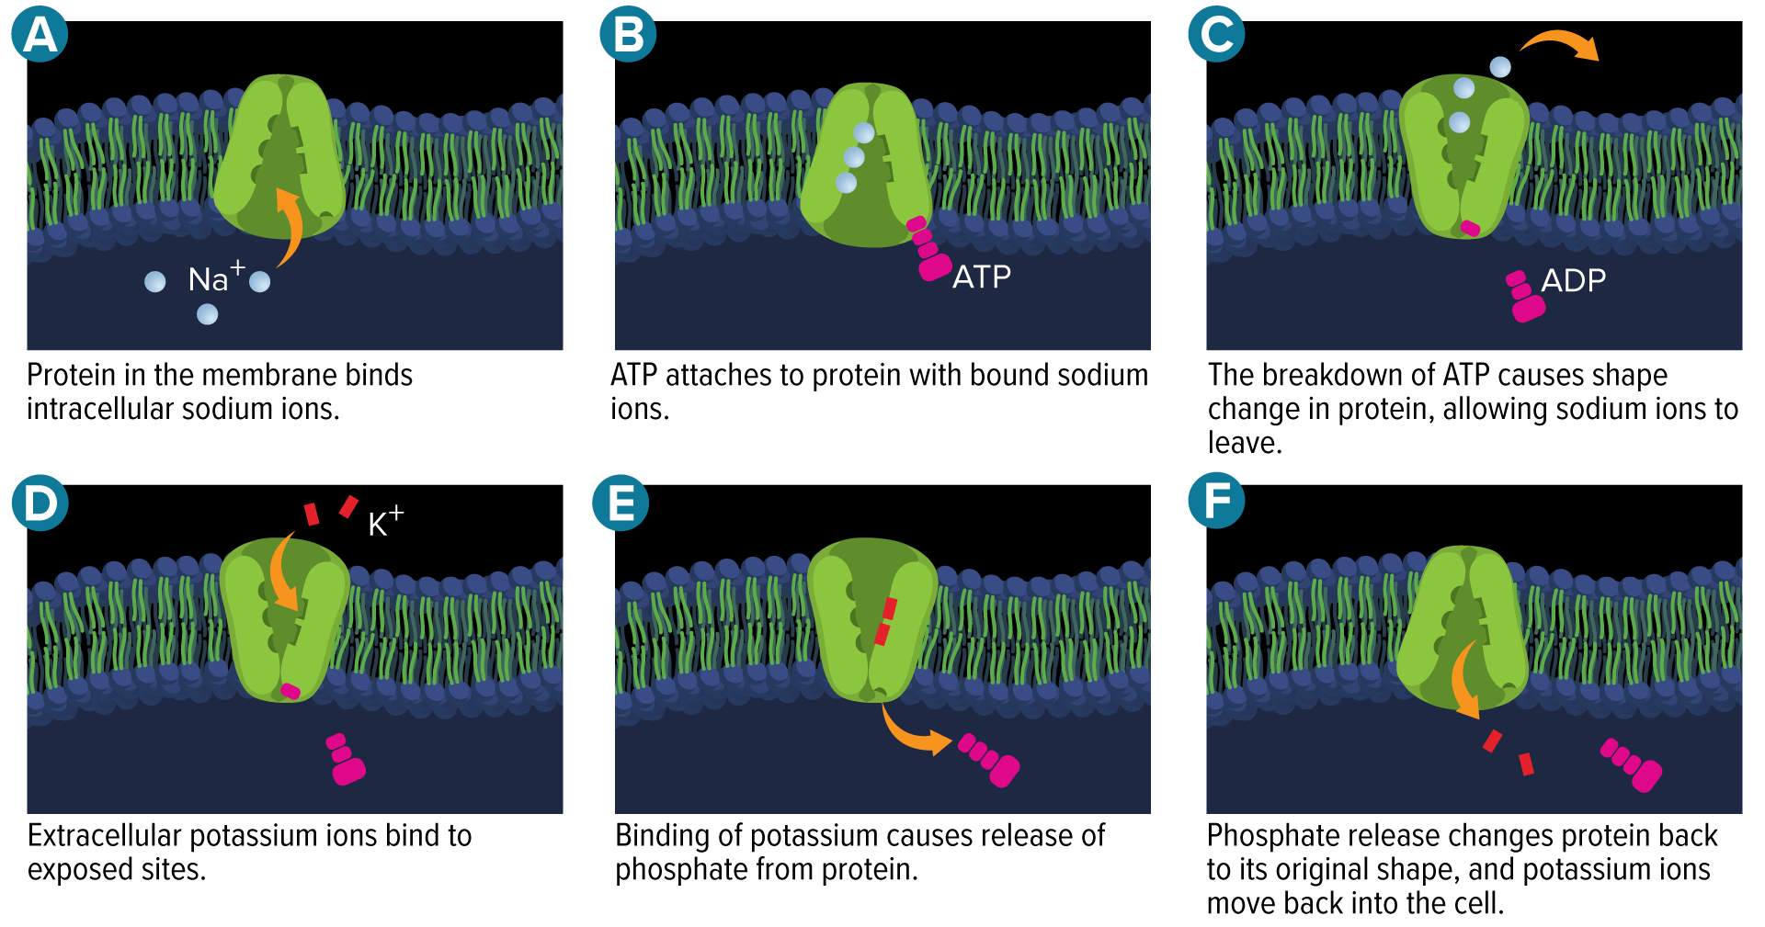
Active Transport
Na⁺/K⁺ ATPase Pumps
These pumps are found in the plasma membrane of animal cells.
They maintain levels of sodium (Na⁺) and potassium (K⁺) inside and outside the cell.

Slide 17
Active Transport
Large molecules, such as sugar, need to move against a concentration gradient into the cell.
In a process called coupled transport, sugars can pair with Na⁺ ions and enter the cell through a membrane protein called a coupled channel.
Coupled transport allows sugars to enter through facilitated diffusion, which saves energy.

Slide 18
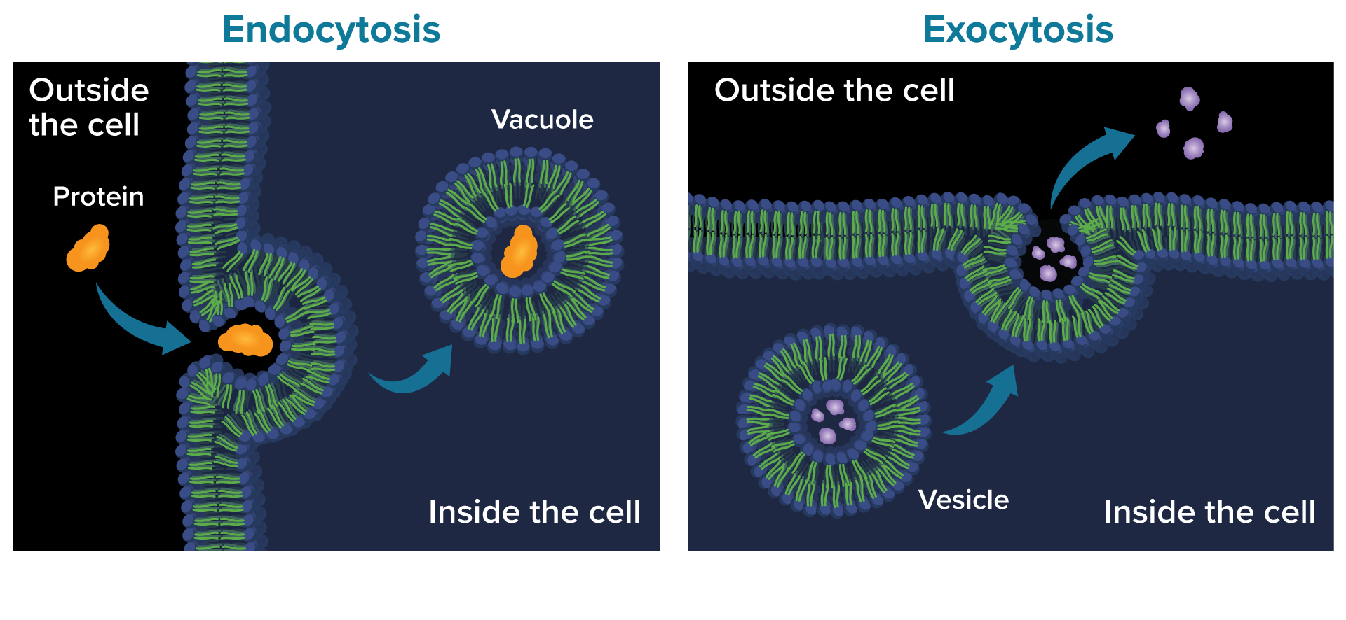
Transport of Large Particles
Endocytosis is the process by which a cell surrounds an object in the outside environment in a portion of the plasma membrane.
Exocytosis is the excretion of materials at the plasma membrane.

