Slide 1
Lesson 4
Structures and Organelles

Slide 2
Focus Question
What are the structures and their functions in prokaryotic and eukaryotic cells?

Slide 3
New Vocabulary
cytoplasm
chloroplast
cytoskeleton
ribosome
centriole
nucleolus
cilium
endoplasmic reticulum
flagellum
Golgi apparatus
cell wall
vacuole
mitochondrion
lysosome

Slide 4
Review Vocabulary
enzyme: a protein that speeds up the rate of a chemical reaction

Slide 5
Cell Structures
The environment enclosed by the plasma membrane is a semifluid material called cytoplasm.
In prokaryotes, all the chemical processes of the cell take place directly in the cytoplasm.
In eukaryotes, these processes take place within organelles in the cytoplasm.

Slide 6
Cell Structures
The cytoskeleton is a supporting network of long, thin protein fibers that form a framework for the cell.
Microtubules are long, hollow protein cylinders that form a rigid skeleton for the cell and help move substances within the cell.
Microfilaments are thin protein threads that help give the cell shape and enable it to move.
Centrioles, which are made of microtubules, function during cell division.

Slide 7
Cell Structures
Cilia and flagella are made of microtubules.
Cilia are short, numerous projections that look like hair and that move in tandem, like oars in a rowboat.
Flagella are longer and less numerous than cilia. They move with a whip-like motion.

Slide 8
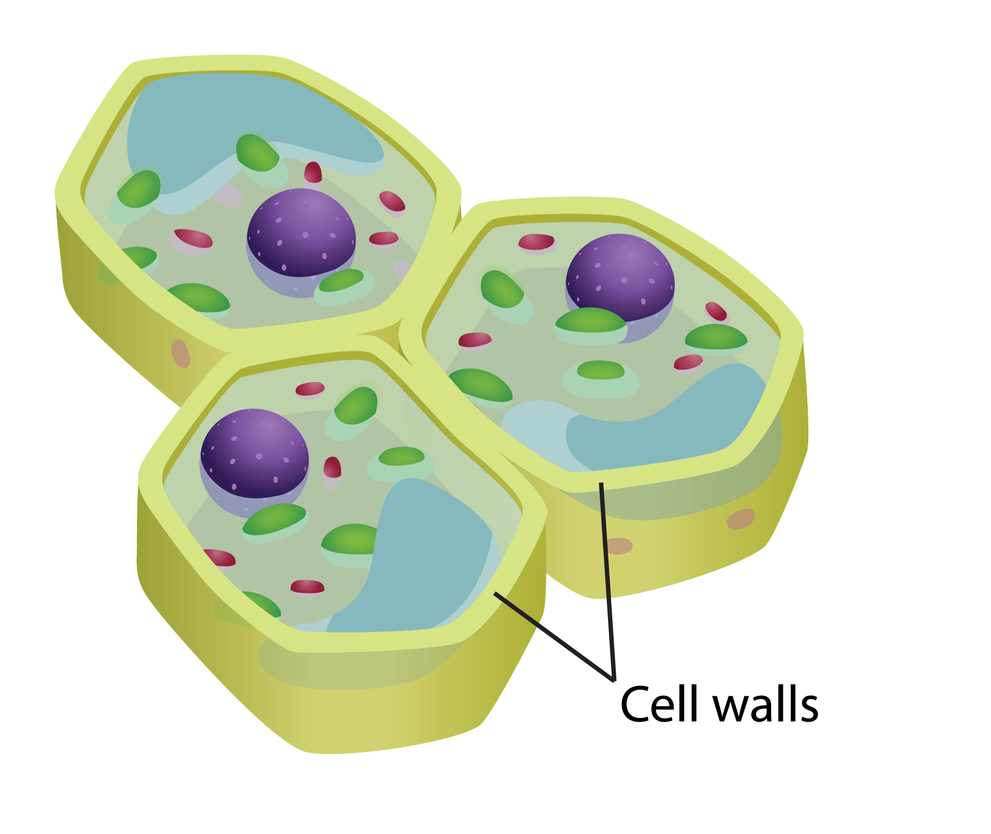
Cell Structures
The cell wall of a plant is a thick, rigid mesh of fibers that surrounds the outside of the plasma membrane. The cell wall:
Protects the cell and gives it structure
Is made from a carbohydrate called cellulose

Slide 9
Cell Structures
The cell wall of a prokaryote functions similarly to a plant cell wall. The prokaryote cell wall:
Protects the cell and gives it structure
Is made from peptidoglycan

Slide 10
Controlling Cell Activities
The nucleus of a cell contains most of the cell’s DNA, which stores information used to make proteins that determine a cell’s growth, function, and reproduction.
The nucleus is surrounded by a double membrane called a nuclear envelope.

Slide 11
Processing Energy
Mitochondria (singular: mitochondrion) convert fuel particles into usable energy.
They have an outer membrane and a highly folded inner membrane that provides surface area for breaking the bonds in sugar molecules.

Slide 12
Processing Energy
Plant cells and some other eukaryotes also contain chloroplasts, which capture light and convert it into chemical energy in a process called photosynthesis.
Chloroplasts are composed of multiple small disks called thylakoids, which contain the light-capturing pigment called chlorophyll.

Slide 13
Manufacturing Proteins
Ribosomes are organelles that manufacture proteins.
Unlike other organelles, ribosomes are not membrane-bound.
Ribosomes are produced inside the nucleus in the nucleolus.

Slide 14
Manufacturing Proteins
The endoplasmic reticulum (ER) is a membrane system of folded sacs and interconnected channels that serves as the site for protein and lipid synthesis.
There are two types of endoplasmic reticulum:
rough
smooth

Slide 15
Processing, Transporting, and Storing Molecules
The Golgi apparatus is a flattened stack of membranes that modifies, sorts, and packages proteins.
Proteins are packaged into sacs called vesicles, which can fuse to the plasma membrane and release the proteins to the environment.

Slide 16
Processing, Transporting, and Storing Molecules
A vacuole is a membrane-bound sac used for temporary storage.
Vacuoles store food, enzymes, or waste.
Vacuoles are found only in plant cells.

Slide 17
Processing, Transporting, and Storing Molecules
Lysosomes are vesicles that contain substances that digest excess or worn-out organelles and food particles.
They also digest bacteria or viruses that invade the cell.

Slide 18
Comparing Cells
Plant cells have:
Chloroplasts/chlorophyll
Vacuoles
Cell walls
Animal cells generally do not have these features.

Slide 19
Organelles at Work
Knowledge of organelles allows for an increased understanding of cellular processes.
Protein synthesis begins in the nucleus with DNA.
RNA and ribosomes leave the nucleus and produce a protein on the endoplasmic reticulum.
Proteins produced in the ER are sent to Golgi apparatus for packaging.
Packaged proteins are delivered to other organelles, where they serve a variety of functions.

