Slide 1
Lesson 1
How Organisms Obtain Energy

Slide 2
Focus Question
Lettuce plants can't eat, so how do they obtain energy?

Slide 3
New Vocabulary
energy
thermodynamics
metabolism
photosynthesis
cellular respiration
adenosine triphosphate (ATP)

Slide 4
Review Vocabulary
trophic level: each step in a food chain or a food web

Slide 5
Transformation of Energy
Cellular processes require energy – the ability to do work.
Thermodynamics is the study of the flow and transformation of energy in the universe.

Slide 6
Transformation of Energy
Laws of Thermodynamics
First Law—The Law of Conservation of Energy: Energy can be converted from one form to another, but it cannot be created or destroyed.
Second Law: Energy cannot be converted without the loss of usable energy; that is, entropy—disorder or unusable energy—increases.

Slide 7
Transformation of Energy
Autotrophs and Heterotrophs
Directly or indirectly, nearly all the energy for life comes from the Sun.
Autotrophs make their own food, either with energy from the Sun or from inorganic substances.
Heterotrophs ingest food to obtain energy.

Slide 8
Metabolism
All of the chemical reactions in a cell are referred to as the cell’s metabolism.
A series of chemical reactions in which the product of one is the substrate for the next is called a metabolic pathway.
Catabolic pathways release energy by breaking down larger molecules.
Anabolic pathways use energy to build larger molecules.

Slide 9
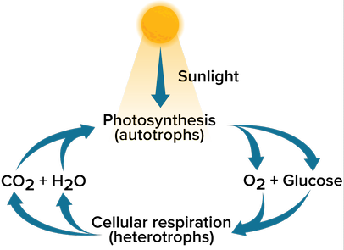
Metabolism
Photosynthesis: anabolic pathway in which light energy from the Sun is converted to stored chemical energy for use by the cell
Cellular respiration: catabolic pathway in which organic molecules are broken down to release energy for use by the cell

Slide 10
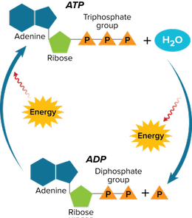
ATP: The Unit of Cellular Energy
Adenosine triphosphate (ATP) is the most important biological molecule that provides chemical energy.

Slide 11
ATP: The Unit of Cellular Energy
ATP Structure
ATP is a nucleotide made of an adenine base, a ribose sugar, and three phosphate groups.
ATP Function
ATP releases energy when the bond between the second and third phosphate groups is broken.

