Slide 1
Lesson 2
Photosynthesis

Slide 2
Focus Question
What do lettuce plants need to survive?

Slide 3
New Vocabulary
thylakoid
granum
stroma
pigment
NADP⁺
Calvin cycle
rubisco

Slide 4
Review Vocabulary
carbohydrate: an organic compound containing only carbon, hydrogen, and oxygen, usually in a 1:2:1 ratio

Slide 5
Overview of Photosynthesis
Most autotrophs make organic compounds using photosynthesis.
Photosynthesis converts light energy into chemical energy.
The products and reactants of photosynthesis are identified in the overall chemical reaction for photosynthesis:
6CO₂ + 6H₂O C₆H₁₂O₆ + 6O₂
light

Slide 6
Overview of Photosynthesis
Photosynthesis occurs in two phases:
In the light-dependent phase, light energy is captured and converted into chemical energy.
In the light-independent phase, molecules formed during the light-dependent phase are used to make glucose.

Slide 7
Phase One: Light Reactions
The absorption of light is the first step in photosynthesis.
Once light energy is captured, two energy storage molecules, ATP and NAPDH, are produced.

Slide 8
Phase One: Light Reactions
Chloroplasts are organelles that capture light energy. They contain two main compartments:
Thylakoids: flattened saclike membranes
Stacks of thylakoids are called grana (singular: granum).
Stroma: fluid-filled space outside the grana

Slide 9
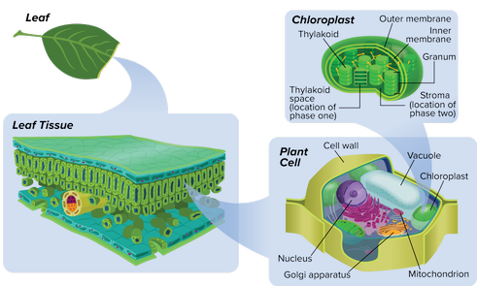
Phase One: Light Reactions
Chloroplasts
Photosynthesis occurs inside pigmented organelles called chloroplasts.

Slide 10
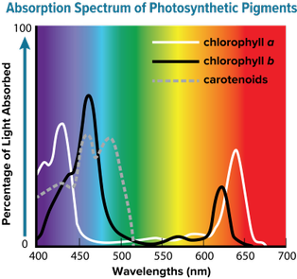
Phase One: Light Reactions
Pigments
Light-absorbing colored molecules called pigments are found in the thylakoid membranes.
Different pigments absorb specific wavelengths of light.

Slide 11
Phase One: Light Reactions
Electron Transport
The thylakoid membrane has a large surface area, providing space for a large number of electron transporting molecules and two types of protein complexes called photosystems.
Photosystems contain the light-capturing pigments and proteins that play important roles in the light reactions.

Slide 12
Phase One: Light Reactions
Electron Transport (continued)
Light energy excites electrons in photosystem II and causes a water molecule to split.
Next, the excited electrons move from photosystem II to an electron acceptor molecule.

Slide 13
Phase One: Light Reactions
Electron Transport (continued)
Next, the electron-acceptor molecule transfers the electrons along a series of electron-carriers to photosystem I.
Photosystem I transfers the electrons to a protein called ferredoxin.
Finally, ferredoxin transfers the electrons to the electron carrier NADP⁺, forming the energy-storage molecule NADPH.

Slide 14
Phase One: Light Reactions
Chemiosmosis
Chemiosmosis is the mechanism by which ATP is produced as a result of the flow of electrons down a concentration gradient.
The breakdown of water is essential to this process.

Slide 15
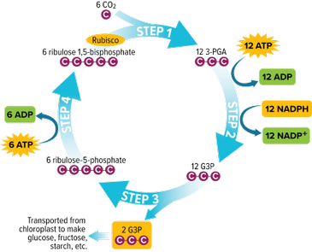
Phase Two: The Calvin Cycle
In the second phase of photosynthesis, called the Calvin cycle, energy is stored in organic molecules such as glucose.

Slide 16
Phase Two: The Calvin Cycle
The first step of the Calvin cycle is called carbon fixation. CO₂ molecules combine with 5-carbon molecules to form 3-phosphoglycerate (3-PGA).
In the second step, chemical energy stored in ATP and NADPH is transferred to the 3-PGA to form glyceraldehyde 3-phospate (G3P).

Slide 17
Phase Two: The Calvin Cycle
In the third step, some G3P molecules leave the cycle to be used for the production of glucose and other organic compounds.
In the fourth and final step, an enzyme called rubisco converts the remaining G3P molecules into 5-carbon molecules called ribulose 1,5-bisphospates (RuBP). These molecules combine with new CO₂ and continue the cycle.

Slide 18
Alternative Pathways
C₄ Plants
The C₄ pathway allows plants to maintain photosynthesis while reducing water loss.
C₄ plants have significant structural modification in the arrangement of cells within the leaves.

Slide 19
Alternative Pathways
CAM Plants
Crassulacean acid metabolism (CAM) is found in desert plants.
These plants collect CO₂ at night and store it in organic compounds.
During the day, the plants release CO₂ from organic compounds for the light-dependent cycle of photosynthesis.

