Slide 1
Lesson 3
Cellular Respiration

Slide 2
Focus Question
How does your body get energy from eating lettuce?

Slide 3
New Vocabulary
anaerobic process
glycolysis
aerobic respiration
Krebs cycle
aerobic process
fermentation

Slide 4
Review Vocabulary
cyanobacterium: the type of bacterium that is a photosynthetic autotroph

Slide 5
Overview of Cellular Respiration
Organisms obtain energy in a process called cellular respiration.
The equation for cellular respiration is the opposite of the equation for photosynthesis:
C₆H₁₂O₆ + 6O₂ 6CO₂ + 6H₂O + Energy

Slide 6
Overview of Cellular Respiration
Cellular respiration occurs in two main parts: glycolysis and aerobic respiration.
Glycolysis is an anaerobic process, meaning it does not require oxygen.
Aerobic respiration involves the Krebs cycle and electron transport. Aerobic processes require oxygen.

Slide 7
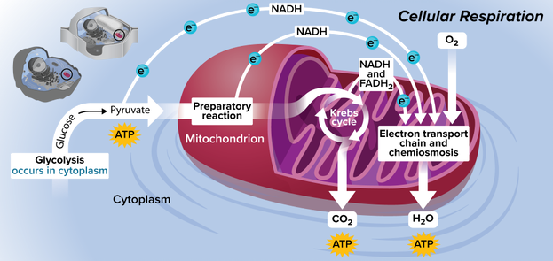
Overview of Cellular Respiration
Cellular respiration occurs in mitochondria.

Slide 8
Glycolysis
Glucose is broken down in the cytoplasm through the process of glycolysis.
Two molecules of ATP and two molecules of NADH are formed for each molecule of glucose that is broken down.

Slide 9
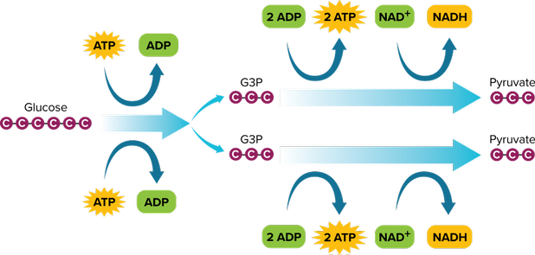
Glycolysis
Glucose is broken down during glycolysis inside the cytoplasm of cells.

Slide 10
Krebs Cycle
Glycolysis has a net result of two ATP and two pyruvate. Most of the energy from the glucose is still contained in the pyruvate.
The series of reactions in which pyruvate is broken down into carbon dioxide is called the Krebs cycle, which is also known as the tricarboxylic acid (TCA) cycle.

Slide 11
Krebs Cycle
Preparatory Reaction
Pyruvate reacts with coenzyme A (CoA) to form acetyl CoA and carbon dioxide. NAD⁺ is converted to NADH.
Acetyl CoA moves into the mitochondrial matrix.

Slide 12
Krebs Cycle
Steps of the Krebs Cycle
Acetyl CoA combines with a 4-carbon compound to form citric acid.
Citric acid is broken down, releasing two molecules of carbon dioxide and generating one ATP, three NADH, and one FADH₂.
Finally, acetyl CoA and citric acid are generated, and the cycle continues.

Slide 13
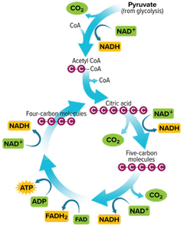
Krebs Cycle
The net yield from the Krebs cycle is six carbon dioxide molecules, two ATP, eight NADH, and two FADH₂.

Slide 14
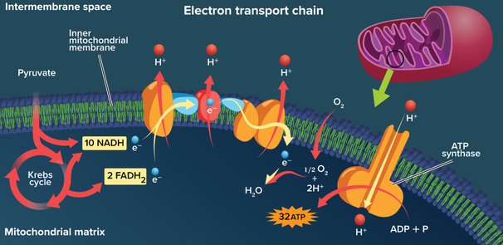
Krebs Cycle
Electron Transport
Electron transport occurs along the mitochondrial matrix.

Slide 15
Krebs Cycle
Prokaryotic Cellular Respiration
Some prokaryotes undergo aerobic respiration.
They do not have mitochondria, so they use the cellular membrane as the location of electron transport.

Slide 16
Anaerobic Respiration
When oxygen is unavailable, cells cannot follow glycolysis with the aerobic respiration (Krebs cycle and electron transport).
The anaerobic process that follows glycolysis is anaerobic respiration, or fermentation.
Fermentation, which occurs in the cytoplasm of the cell, produces NAD⁺ and ATP.

Slide 17
Anaerobic Respiration
Lactic Acid Fermentation
Enzymes convert the pyruvate made during glycolysis into lactic acid.
Skeletal muscles produce lactic acid when the body cannot supply enough oxygen, such as during periods of strenuous exercise.
Alcohol Fermentation
This process occurs in yeast and some bacteria.
It converts pyruvate into ethyl alcohol and carbon dioxide.

Slide 18
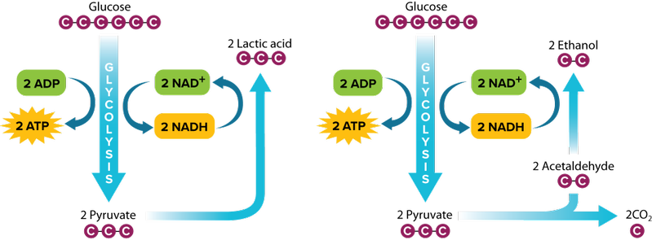
Anaerobic Respiration
When oxygen is absent or in limited supply, fermentation can occur.
Lactic Acid Fermentation Alcohol Fermentation

Slide 19
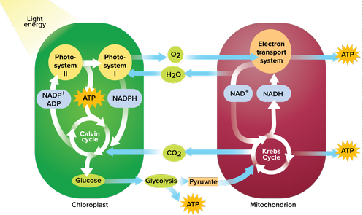
Photosynthesis and Cellular Respiration
Photosynthesis and cellular respiration are interrelated. Together, they provide most of the energy for life processes.

