Slide 1
Lesson 1
Cellular Reproduction

Slide 2
Focus Question
What are the primary stages of the cell cycle?

Slide 3
New Vocabulary
chromatin
spindle apparatus
chromosome
metaphase
nucleosome
anaphase
cell cycle
telophase
interphase
cytokinesis
mitosis
cyclin
prophase
cyclin-dependent kinase
sister chromatid
apoptosis
centromere
cancer
carcinogen

Slide 4
Review Vocabulary
life cycle: the sequence of growth and development stages that an organism goes through during its life

Slide 5
Cell Size Limitations
Ratio of Surface Area to Volume
Several factors influence cell size.
Surface area is the area covered by the plasma membrane.
The plasma membrane is the structure through which all the nutrients and waste products must pass.
Volume is the space taken up by the inner contents of the cell.

Slide 6
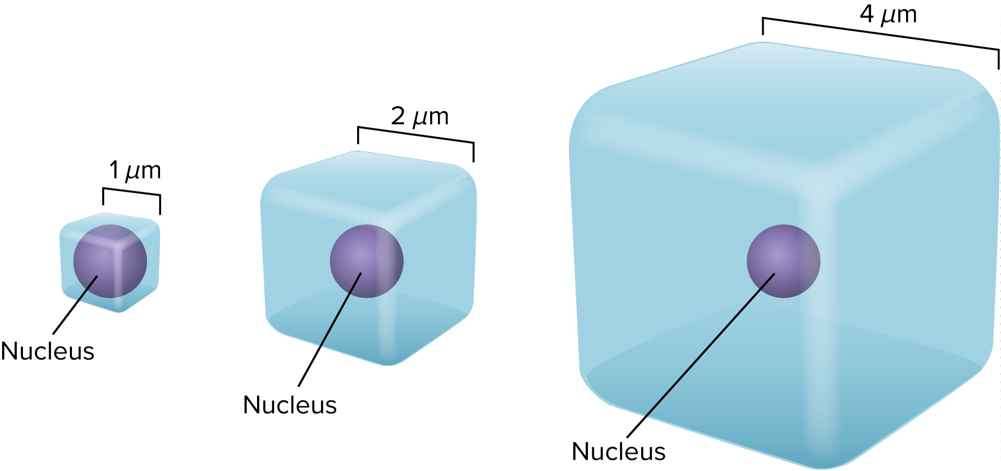
Cell Size Limitations
The ratio of surface area to volume decreases as a cell gets bigger.
Cells with a higher ratio of surface area to volume can sustain themselves more easily.

Slide 7
Cell Size Limitations
Transport of Substances
Smaller cells can transport substances more easily.
Diffusion is inefficient over longer distances.
The cytoskeleton transportation network becomes less efficient for a cell if the distance to travel becomes too large.
Cellular Communication
Cellular communication is more efficient in smaller cells.

Slide 8
Chromosomes
Chromatin and Chromosomes
Chromatin is the relaxed form of DNA.
Chromosomes are condensed structures that contain the DNA that are visible during mitosis.
They are passed from generation to generation.
Eukaryotic DNA is organized into chromosomes.
The phosphate groups in DNA create a negative charge, which attracts the DNA to the positively charged histone proteins and form a nucleosome.
The nucleosomes group together into chromatin fibers, which supercoil to make up the chromosome.

Slide 9
The Cell Cycle
Cells reproduce by a cycle of growing and dividing called the cell cycle.
Interphase
Interphase is the stage during which the cell grows, develops into a mature, functional cell, duplicates the DNA in its nucleus, and prepares for division.
Interphase is divided into three stages: Gap 1(G₁), synthesis (S), and Gap 2 (G₂).

Slide 10
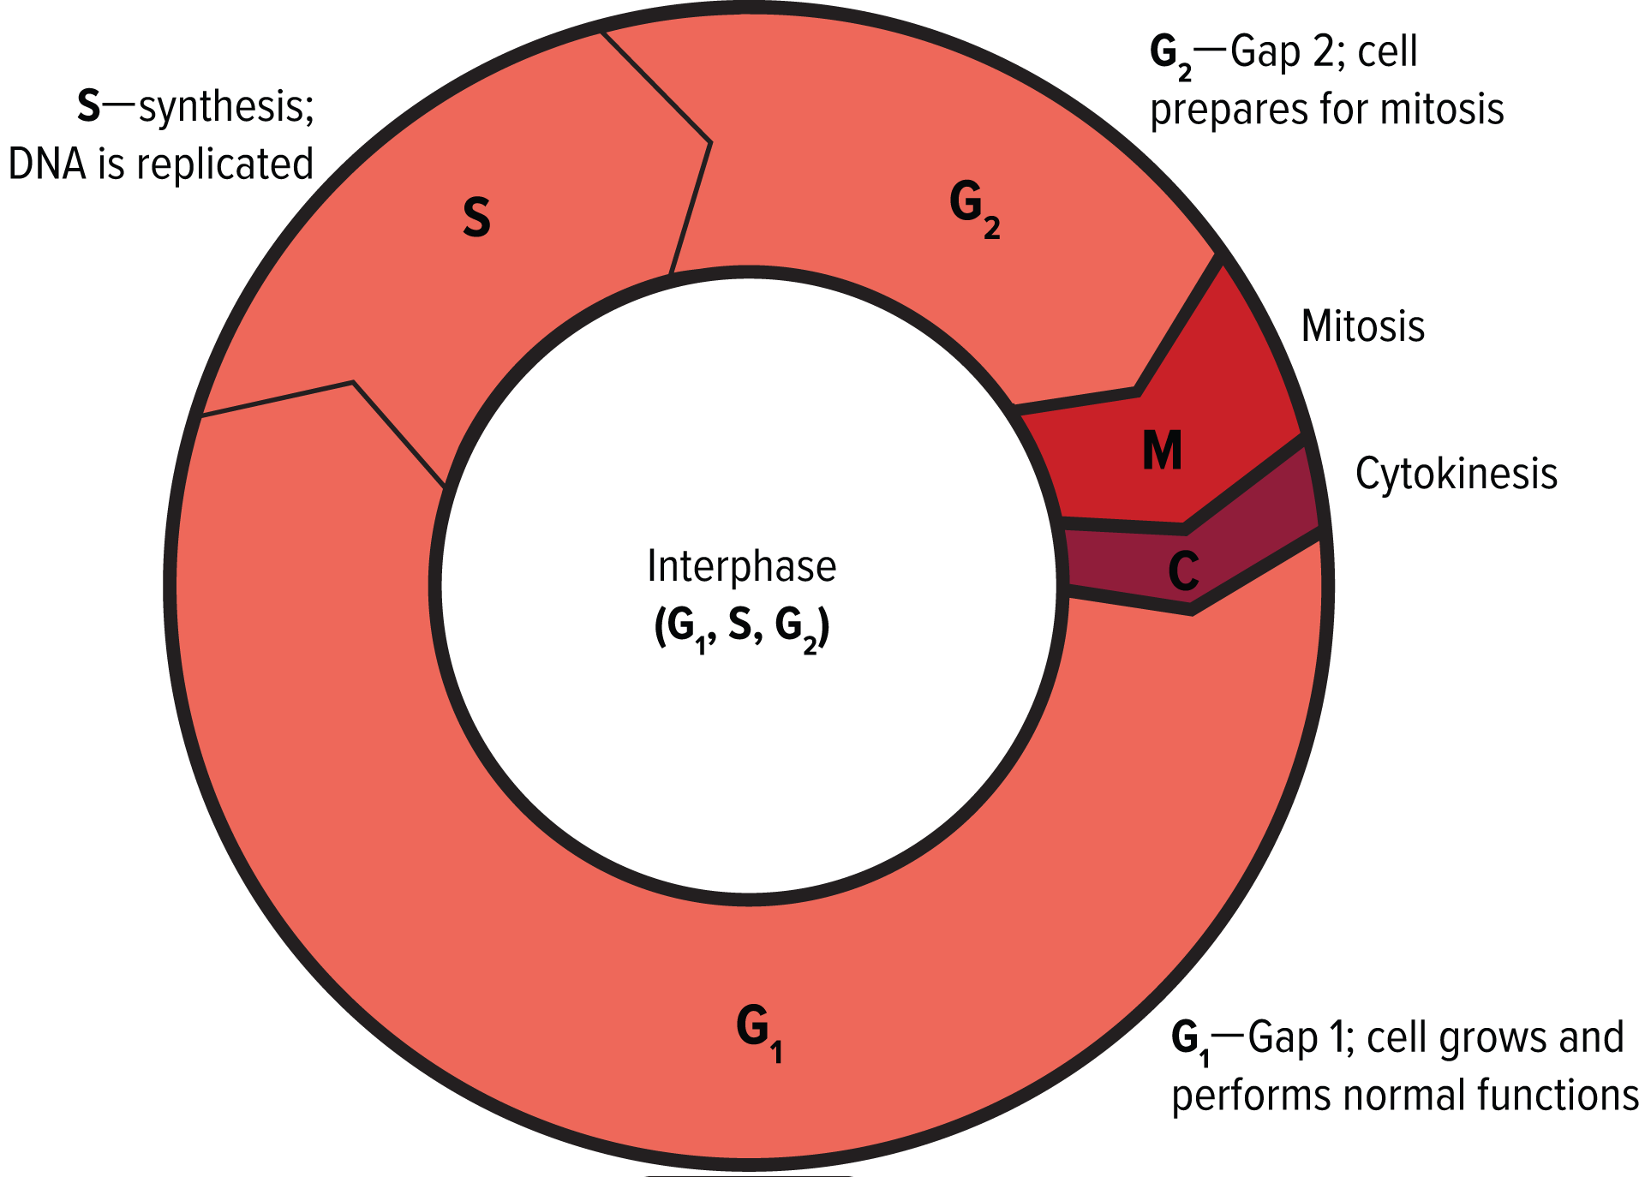
The Cell Cycle
Gap 1(G₁): growing, carrying out normal cellular functions, and preparing to replicate DNA
Synthesis (S): copying DNA to prepare for division
Gap 2 (G₂): preparing for the division of nucleus

Slide 11
The Cell Cycle
Mitosis
The stage of the cell cycle during which the cell’s nucleus and nuclear material divide is called mitosis.
The cell’s replicated genetic material separates and the cell prepares to split into two.
In multicellular organisms, mitosis increases the number of cells in young, growing organisms.
Organisms also use mitosis to replace damaged cells.
Mitosis also helps maintain chromosome number in organisms that undergo asexual reproduction.

Slide 12
The Cell Cycle
The Stages of Mitosis
Prophase: the first and longest stage of mitosis
Chromatin condenses into chromosomes.
Sister chromatids are structures that contain identical copies of DNA. They are attached at the centromere.
As prophase continues, spindle fibers, centrioles, and aster fibers form a spindle apparatus, as shown in the next slide.
The apparatus attaches to each of the sister chromatids before cell division.

Slide 13
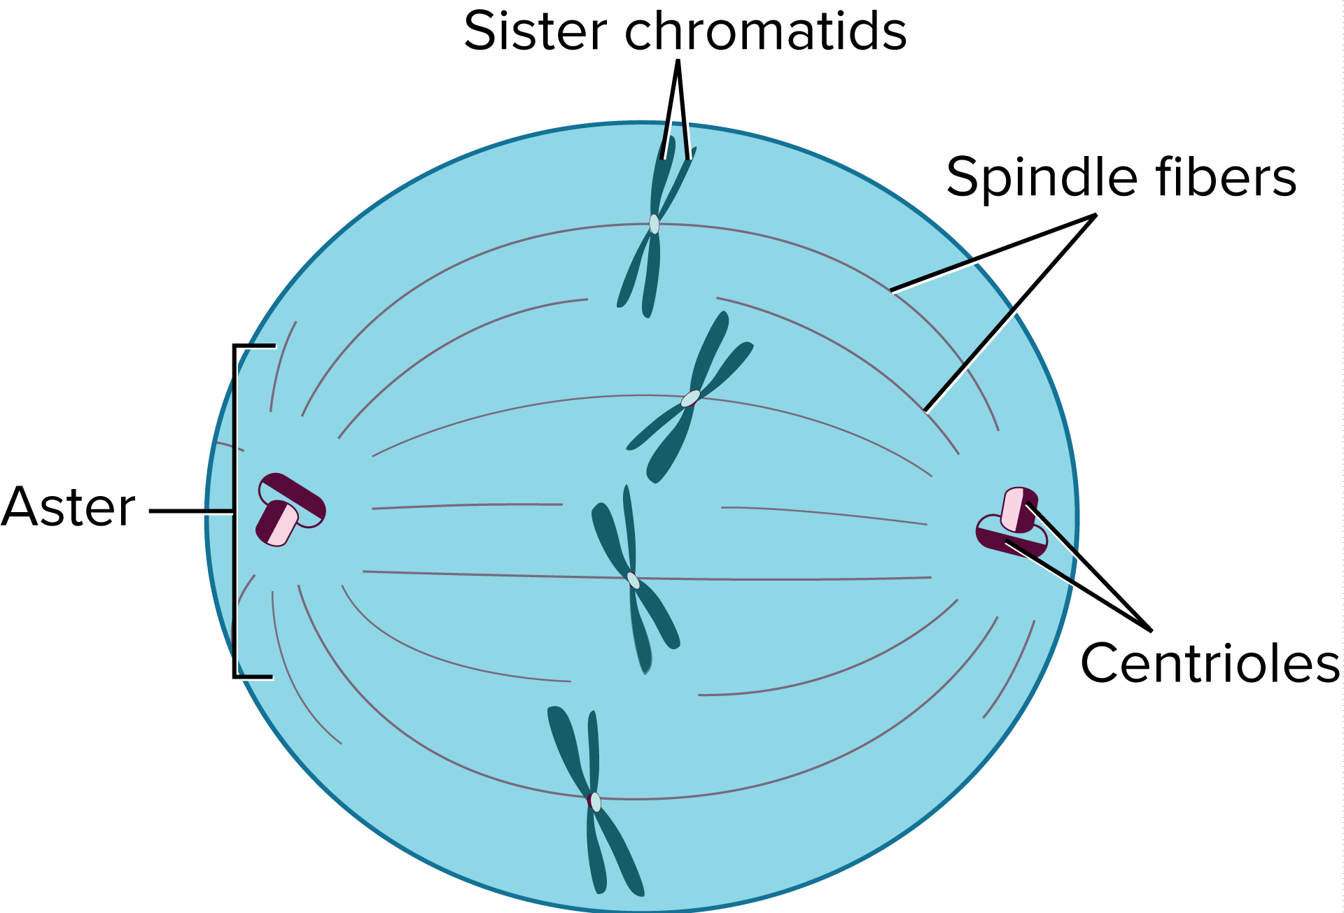
The Cell Cycle

Slide 14
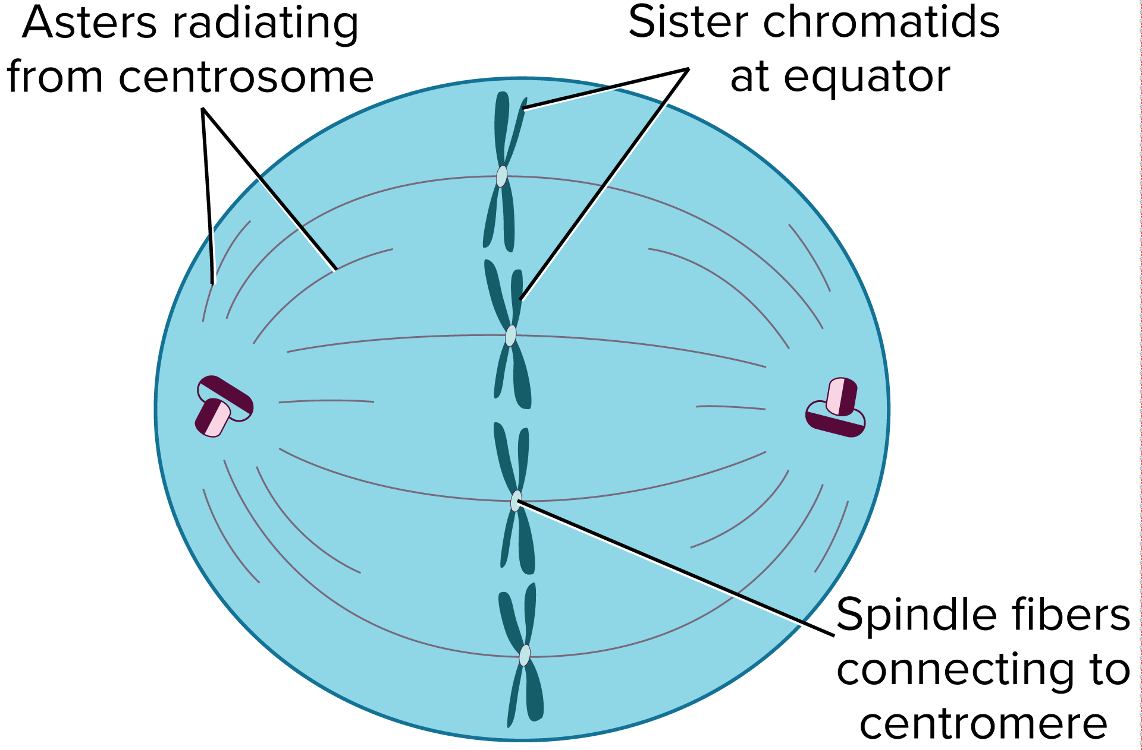
The Cell Cycle
Metaphase: the second stage of mitosis
Sister chromatids are pulled along the spindle apparatus toward the center of the cell and line up.

Slide 15
The Cell Cycle
Anaphase: the third stage of mitosis
Chromatids pull apart.
Microtubules of the spindle apparatus begin to shorten.
Sister chromatids separate.
Chromosomes move toward the poles of the cell.

Slide 16
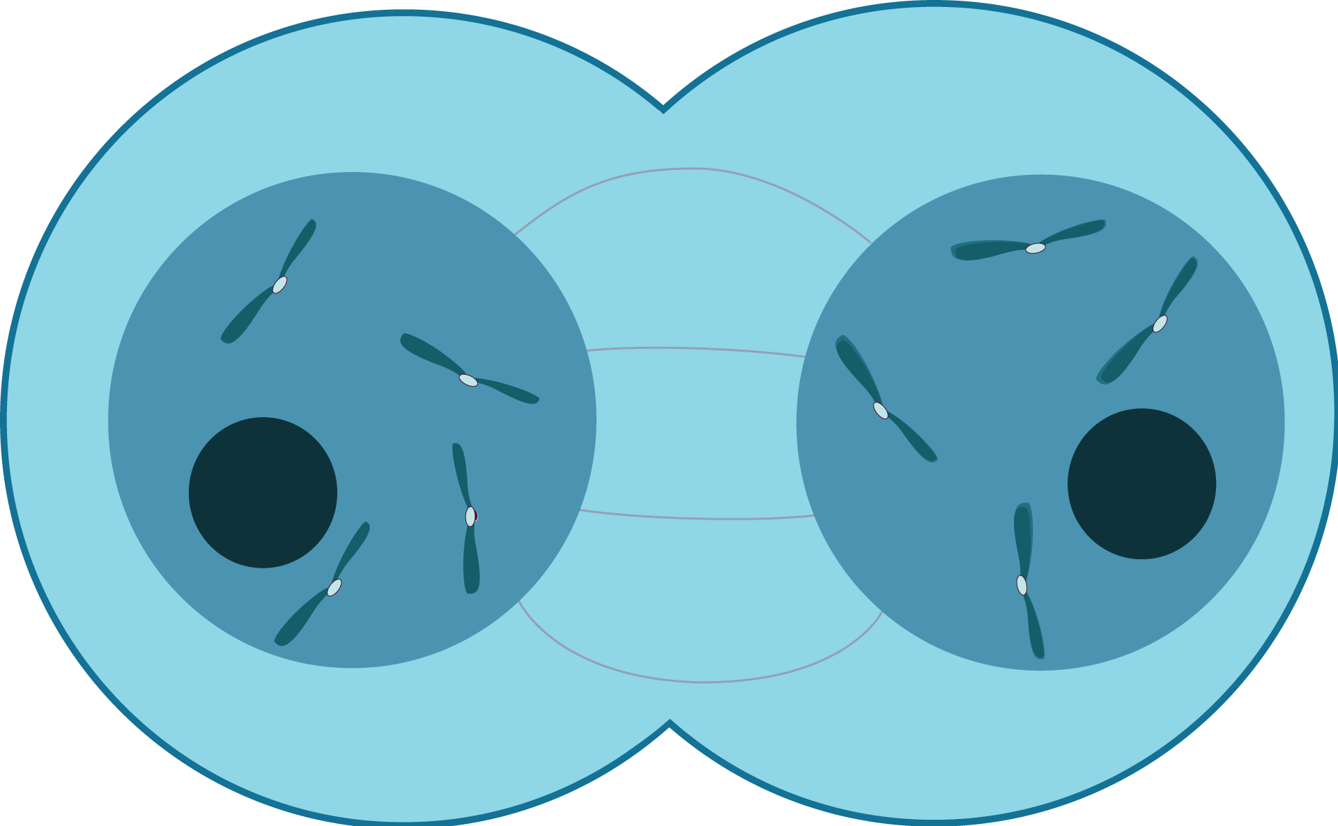
The Cell Cycle
Telophase: the last stage of mitosis.
Chromosomes arrive at poles and begin to relax.
Two new nuclear membranes begin to form and the nucleoli reappear.

Slide 17
The Cell Cycle
Cytokinesis
Towards the end of mitosis, the cell begins cytokinesis by which a cell’s cytoplasm divides, resulting in two cells with identical nuclei.
During cytokinesis in animal cells, microfilaments constrict/pinch off to form two cells.
In plant cells, instead of pinching in half, a new structure called the cell plate forms between the two daughter nuclei.

Slide 18
Cell Cycle Regulation
Cells have specific instructions for carrying out and completing the cell cycle.
The complex system sometimes fails.
The Role of Cyclins
The cell cycle in eukaryotic cells is driven by a combination of two substances.
Proteins called cyclins bind to enzymes called cyclin-dependent kinases (CDKs).
Different cyclin/CDK combinations control different activities during different stages of the cell cycle.

Slide 19
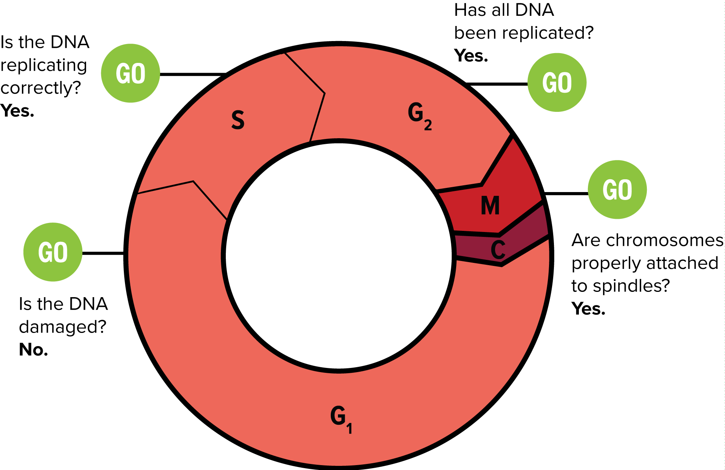
Cell Cycle Regulation
Quality control checkpoints
Built-in checkpoints monitor the cycle and can stop it if something goes wrong.

Slide 20
Cell Cycle Regulation
Apoptosis
Not every cell is destined to survive. Some cells go through apoptosis, or programmed cell death.
These cells shrink or shrivel in a controlled process.
An example of apoptosis occurs in the development of the human hand and foot. Cells in spaces between fingers and toes undergo apoptosis.
An example in plants is the localized death of cells that results in leaves falling from trees during autumn.

Slide 21
Cell Cycle Regulation
Abnormal Cell Cycle: Cancer
Cancer is the uncontrolled growth and division of cells. Cancer results when cells stop responding to the controls of the cell cycle.
Cancer cells can kill an organism by crowding out normal cells, resulting in loss of tissue function.

Slide 22
Cell Cycle Regulation
Causes of Cancer
Mutations cause cancer cell growth and division.
Environmental factors can affect the occurrence of cancer cells.
Carcinogens are substances or agents known to cause cancer.
Not all cancers can be prevented, but avoiding known carcinogens can help reduce the risk.
Cancer Genetics
More than one change in DNA is required to change an abnormal cell into a cancer cell.
This might explain why risk increases with age.

