Slide 1
Lesson 2
Meiosis and Sexual Reproduction

Slide 2
Focus Question
What are the stages of meiosis, and how does meiosis provide genetic variation?

Slide 3
New Vocabulary
gene
meiosis
homologous chromosome
crossing over
gamete
telomere
haploid
karyotype
fertilization
nondisjunction
diploid
cell differentiation
sex chromosome
stem cell
autosome

Slide 4
Review Vocabulary
chromosome: cellular structure that contains DNA

Slide 5
Chromosome Numbers
All cells contain genetic information in the form of DNA molecules.
The instructions for traits (for example, hair color) are located on chromosomes.
The DNA on chromosomes is arranged in regions called genes that code for the formation of proteins, which carry out most of the work of cells.
Each chromosome consists of hundreds of genes, each playing a role in determining characteristics and functions of the cell.

Slide 6
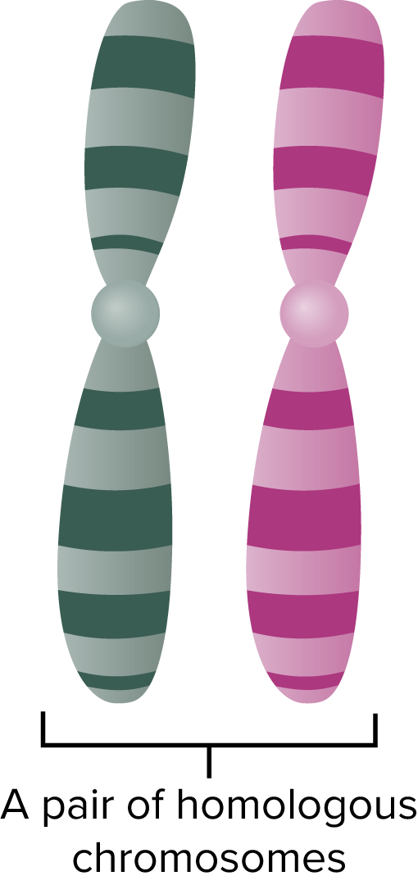
Chromosome Numbers
Homologous Chromosomes
Human body cells have 46 chromosomes. Each parent contributes 23, resulting in 23 pairs of chromosomes.
Chromosomes that make up a pair, one from each parent, are called homologous chromosomes.
Homologous chromosomes have the same length and centromere position. They carry genes that control the same traits.

Slide 7
Chromosome Numbers
Haploid and Diploid Cells
Gametes are sex cells that have half the number of chromosomes. The symbol n is used to represent the number of chromosome. In humans, n is 23.
A cell with n number of chromosomes is called haploid.
Fertilization is the process by which one haploid gamete combines with another haploid gamete.
A cell that contains 2n number of chromosomes is called a diploid cell.

Slide 8
Chromosome Numbers
Sex Determination
Each cell in your body, except for gametes, contain 23 pairs of chromosomes.
One of these pairs, the sex chromosomes, determine an individual’s gender.
The other 22 pairs of chromosomes are called autosomes.
There are two types of sex chromosomes—X and Y. Individuals with two X chromosomes are female. Individuals with X and Y are male.

Slide 9
Meiosis I
Gametes form during meiosis, a type of cell division that reduces the number of chromosomes.
Meiosis occurs in the reproductive structures of organisms that reproduce sexually, forming haploid gametes or spores.
It reduces the chromosome number by half through the separation of homologous chromosomes.
As shown on the next slide, a cell with 2n chromosomes will have gametes with n chromosomes after meiosis.

Slide 10
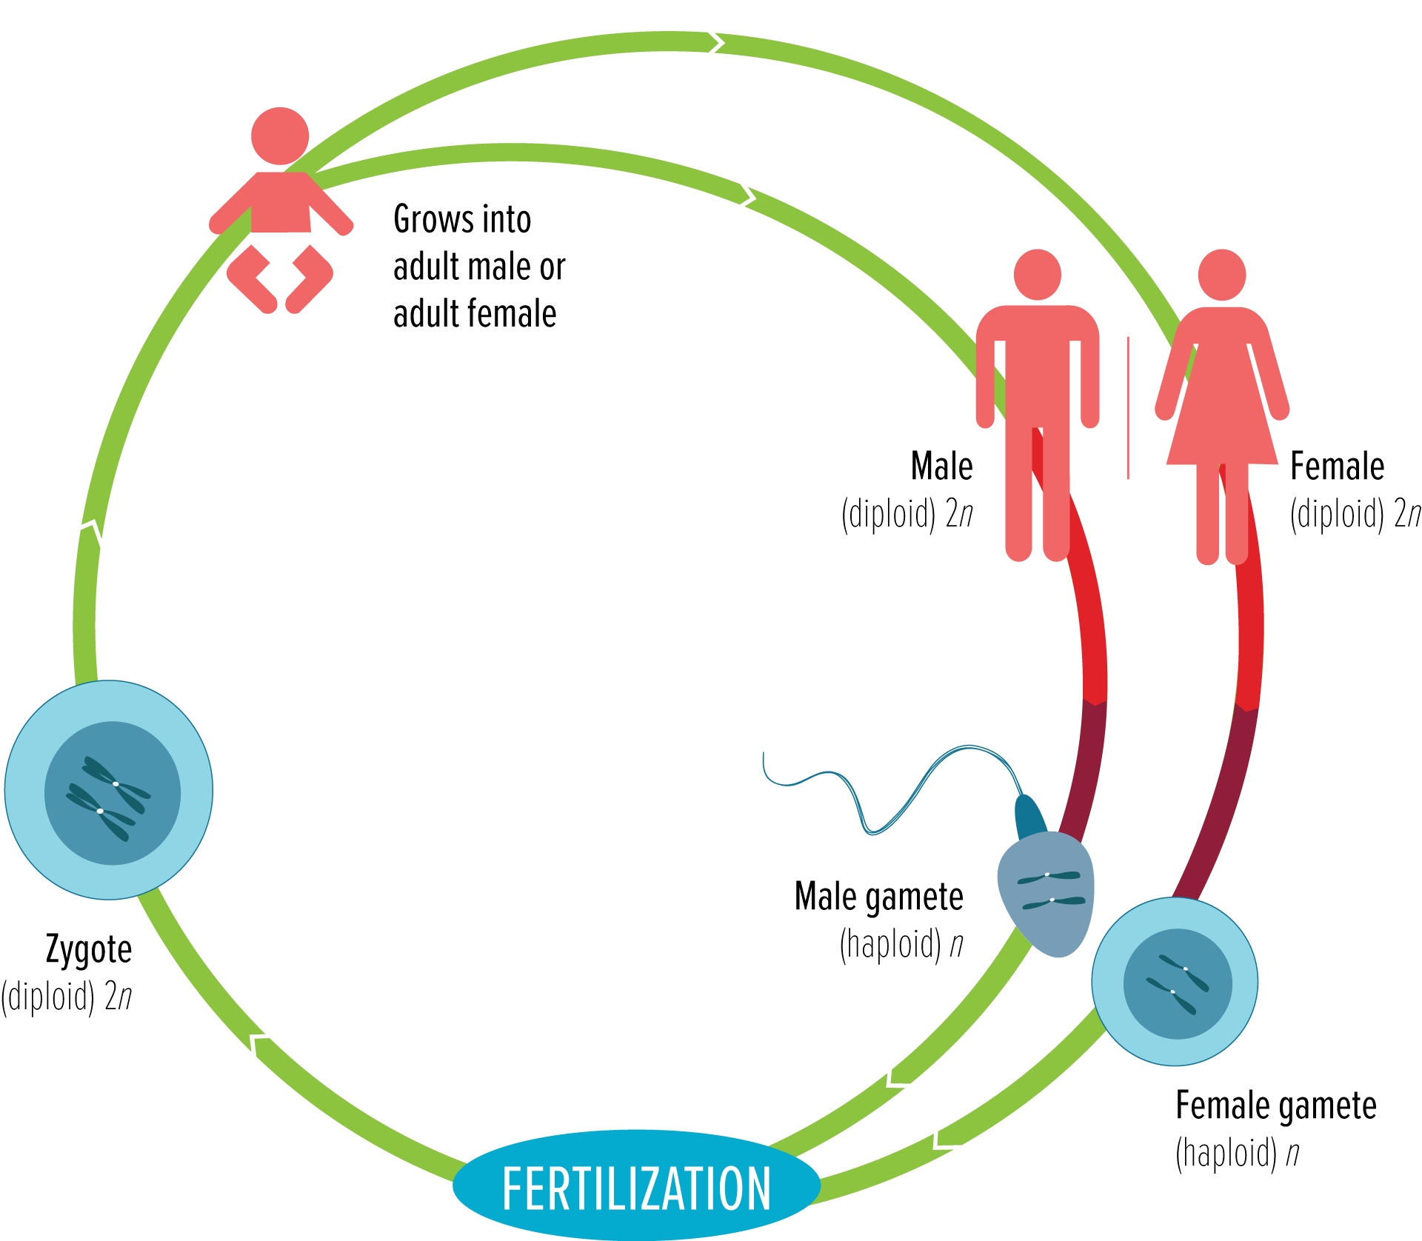
Meiosis I

Slide 11
Meiosis I
Interphase
Chromosomes replicate.
Chromatin condenses.
Prophase I
Homologous chromosomes pair. Each chromosome consists of two chromatids.
Crossing over produces the exchange of genetic information. The next slide illustrates the process.
The nuclear envelope breaks down.
Spindles form.

Slide 12
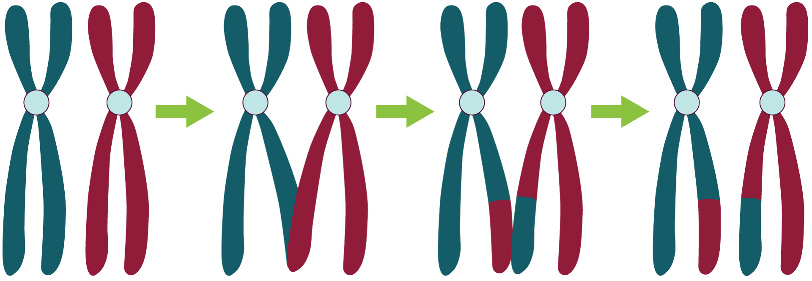
Meiosis I
Crossing over is a process during which chromosomal segments are exchanged between a pair of homologous chromosomes.

Slide 13
Meiosis I
Metaphase I
Chromosome centromeres attach to spindles.
Homologous chromosomes line up at equator.
Anaphase I
Homologous chromosomes separate and move to opposite poles of the cell.
Telophase I
Spindles break down.
Chromosomes uncoil to form two nuclei.
The cell divides.

Slide 14
Meiosis II
Prophase II
Chromosomes condense.
Spindles form in each new cell.
Spindle fibers attach to chromosomes.
Metaphase II
Centromeres of chromosomes line up randomly at the equator of each cell.
Anaphase II
Centromeres split.
Sister chromatids separate and move to opposite poles.

Slide 15
Meiosis II
Telophase II
Four nuclei form around chromosomes.
Spindles break down.
Cells divide.
Products
Four cells have formed.
Each nucleus contains a haploid number of chromosomes.

Slide 16
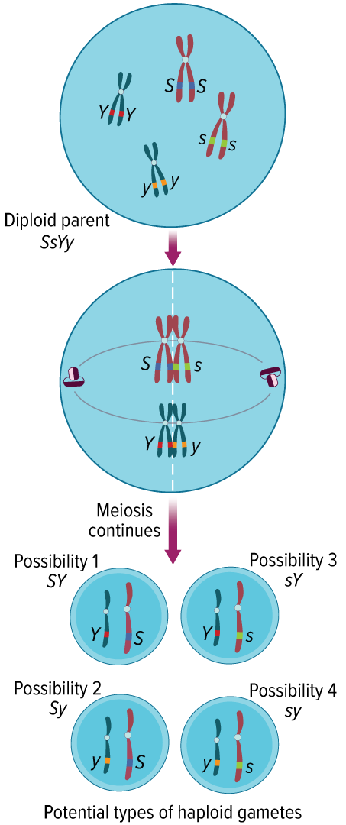
The Importance of Meiosis
Meiosis Provides Variation
Depending on how chromosomes line up at the equator, four gametes with four different combinations of chromosomes can result.
This independent assortment of alleles during gamete formation is a source of genetic variation.

Slide 17
Sexual Reproduction v. Asexual Reproduction
During asexual reproduction, chromosome number is maintained by mitosis.
The organism inherits all of its chromosomes from a single parent.
The new individual is genetically identical to its parent.
Bacteria reproduce asexually, whereas most protists reproduce both asexually and sexually, depending on environmental conditions.
Most plants and many of the more simple animals can reproduce both asexually and sexually.

Slide 18
Telomeres
Telomeres are chromosomes that end in protective caps that consist of DNA associated with proteins.
The cap serves a protective function for the structure of the chromosome.
Telomeres might be involved in aging and cancer.

Slide 19
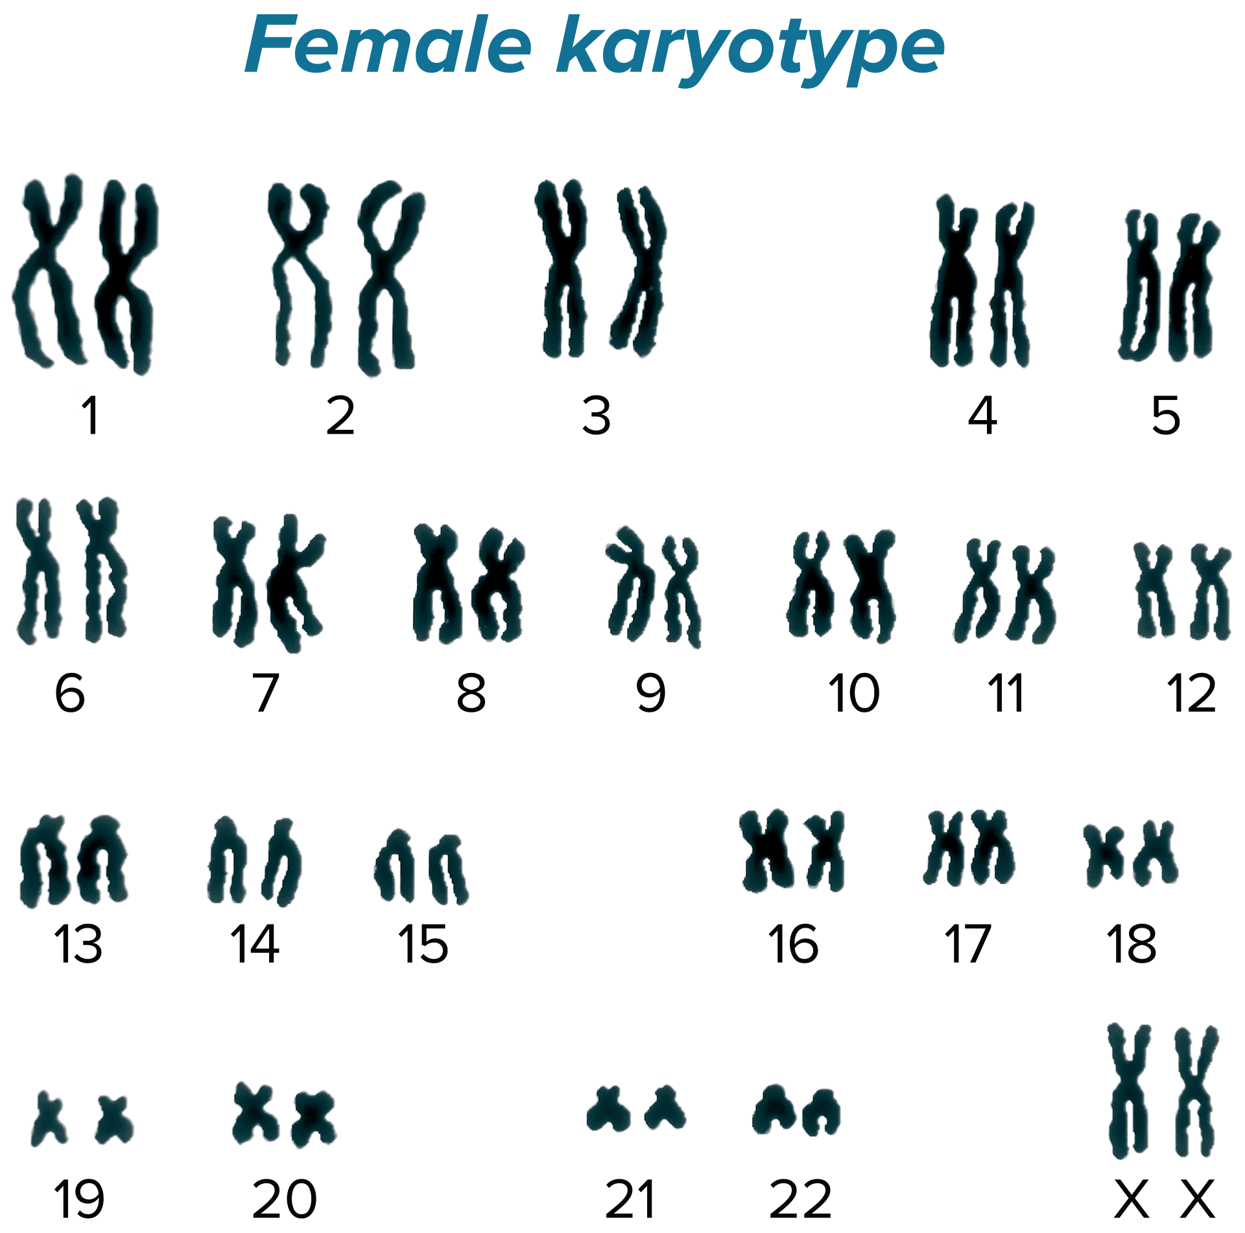
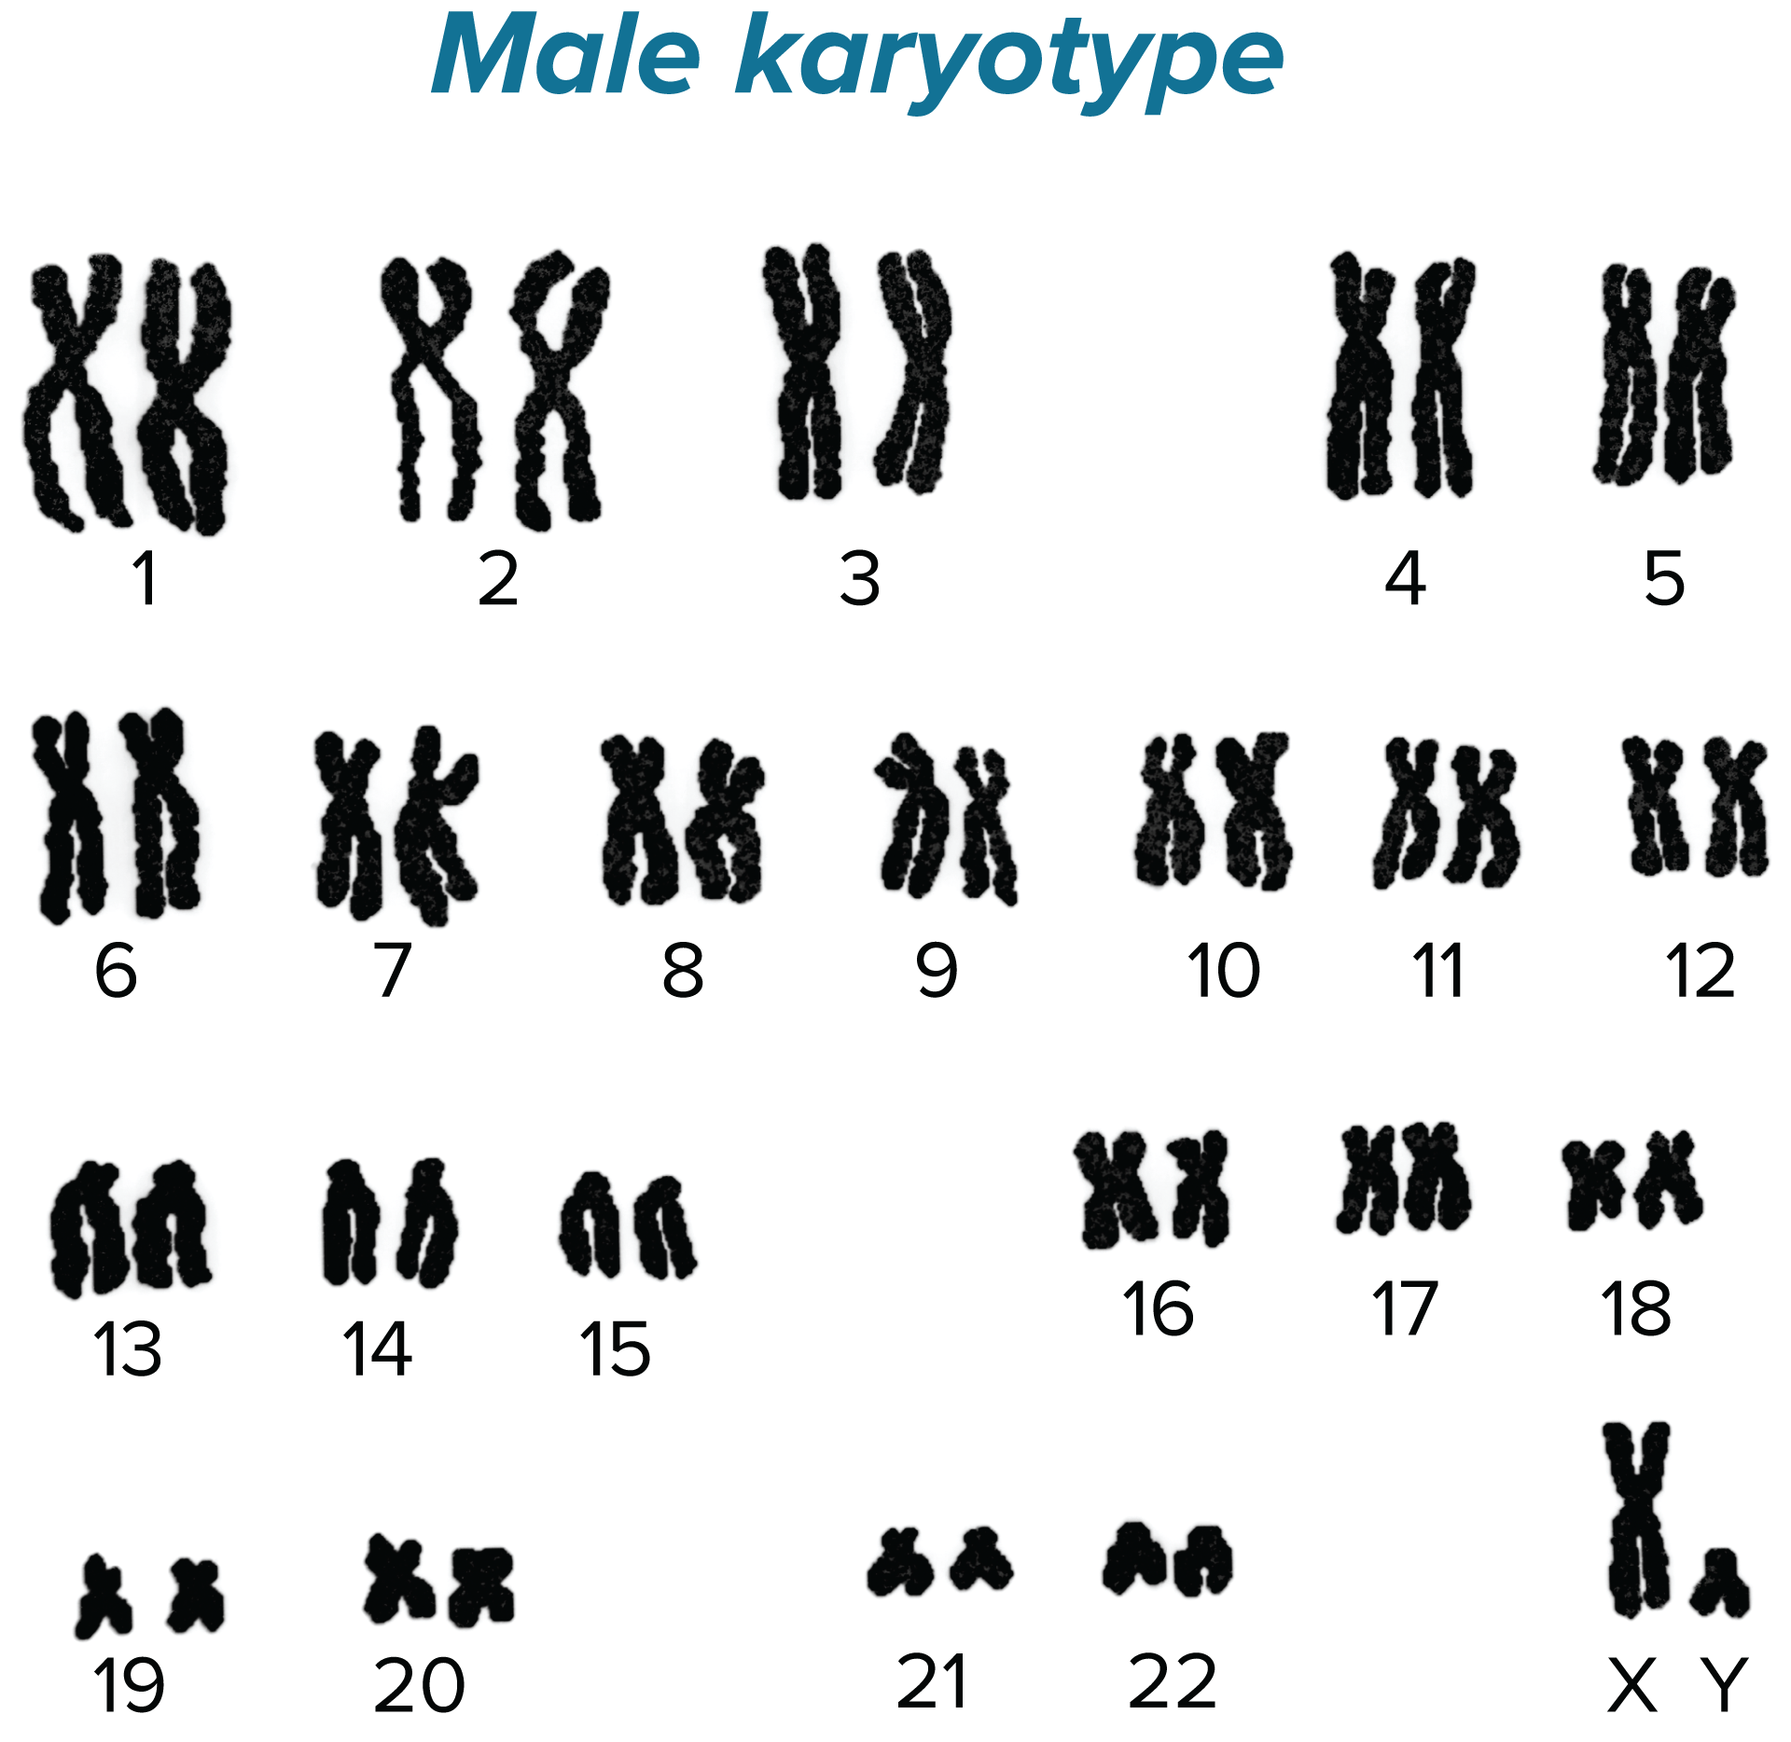
Karyotypes and Nondisjunction
Karyotypes
A karyotype is a type of micrograph in which the pairs of homologous chromosomes are arranged in decreasing size.

Slide 20
Karyotypes and Nondisjunction
Nondisjunction
Cell division during which sister chromatids fail to separate properly (which happens occasionally) is called nondisjunction.
Nondisjunction can result in extra copies of certain chromosomes or only one copy of a particular chromosome in offspring.
In humans, alterations of chromosome numbers are associated with serious disorders, which are often fatal.

Slide 21
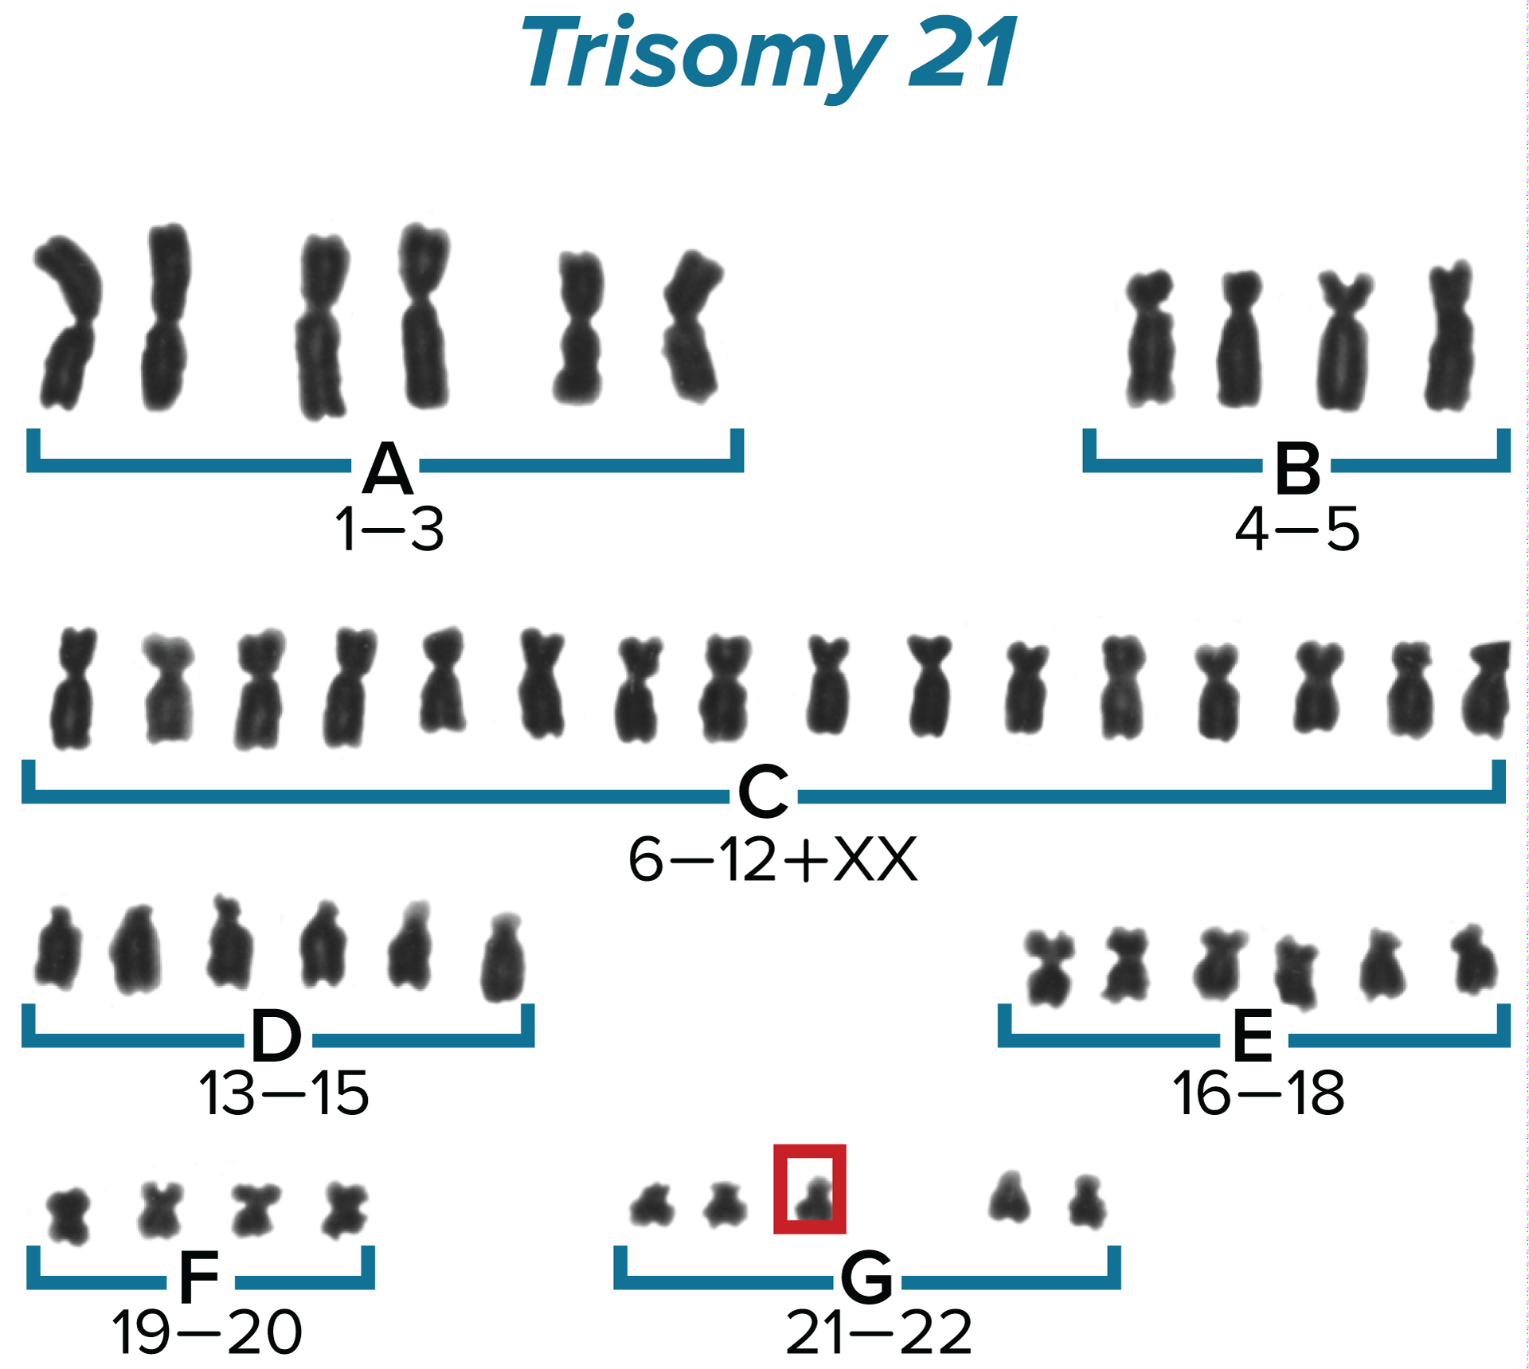
Karyotypes and Nondisjunction
Autosomes
Autosomes are chromosomes that are not sex chromosomes.
Humans typically have 22 pairs of autosomes.
Down syndrome is the result of an extra chromosome 21 and is often called trisomy 21.

Slide 22
Karyotypes and Nondisjunction
Sex Chromosomes
Nondisjunction occurs in both autosomes and sex chromosomes.
An individual with Turner’s syndrome has only one sex chromosome. The condition results from fertilization with a gamete that had no sex chromosome.
An individual with Klinefelter’s syndrome has three sex chromosomes. This condition results from fertilization with a gamete that had two sex chromosomes.

Slide 23
Cellular Differentiation and Stem Cells
Cellular differentiation is the process by which an unspecialized cell develops into a specialized cell with a defined structure and function.
Stem cells are a type of cell that can be directed to become a specialized cell.
Embryonic Stem Cells
These are unspecialized cells that result after a sperm fertilizes an egg.
Each embryonic stem cell has all the DNA needed to develop into a wide variety of specialized cells.
Embryonic stem cell research is controversial.

Slide 24
Cellular Differentiation and Stem Cells
Adult Stem Cells
As adults, animals have stem cells that can differentiate into the specific types of cells they are surrounded by.
Stem cells are found in various tissues in the body and might be used to maintain and repair tissue.
Adult stem cell research is less controversial.

Slide 25
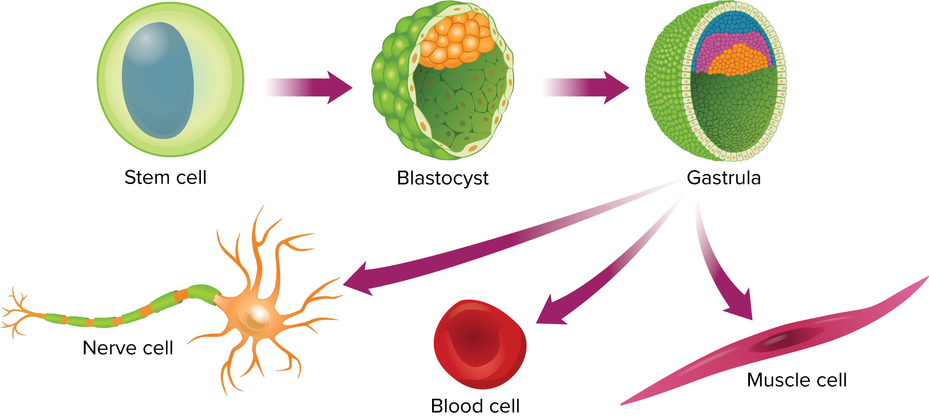
Cellular Differentiation and Stem Cells
Embryonic Stem Cells

Slide 26
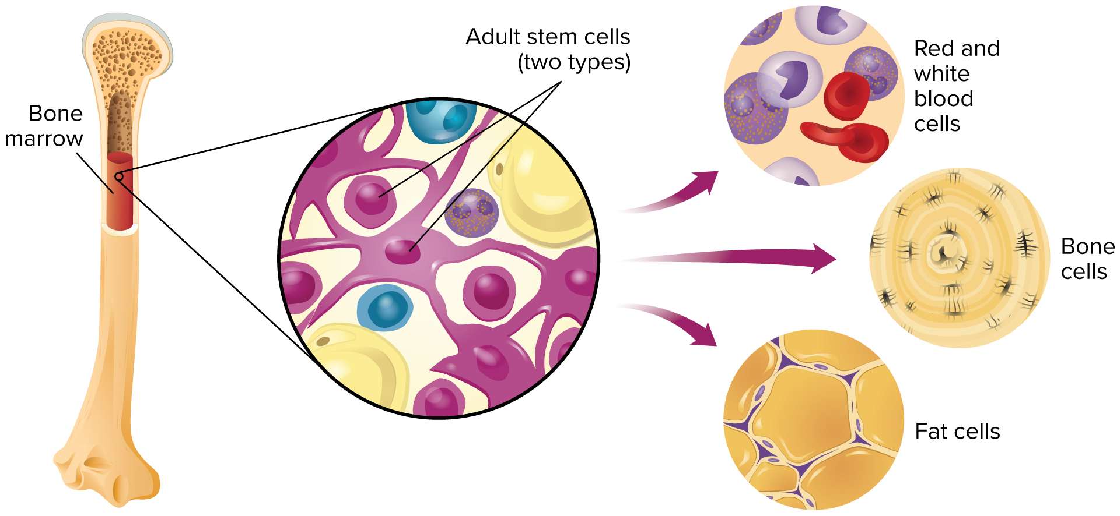
Cellular Differentiation and Stem Cells
Adult Stem Cells

